Slide 1



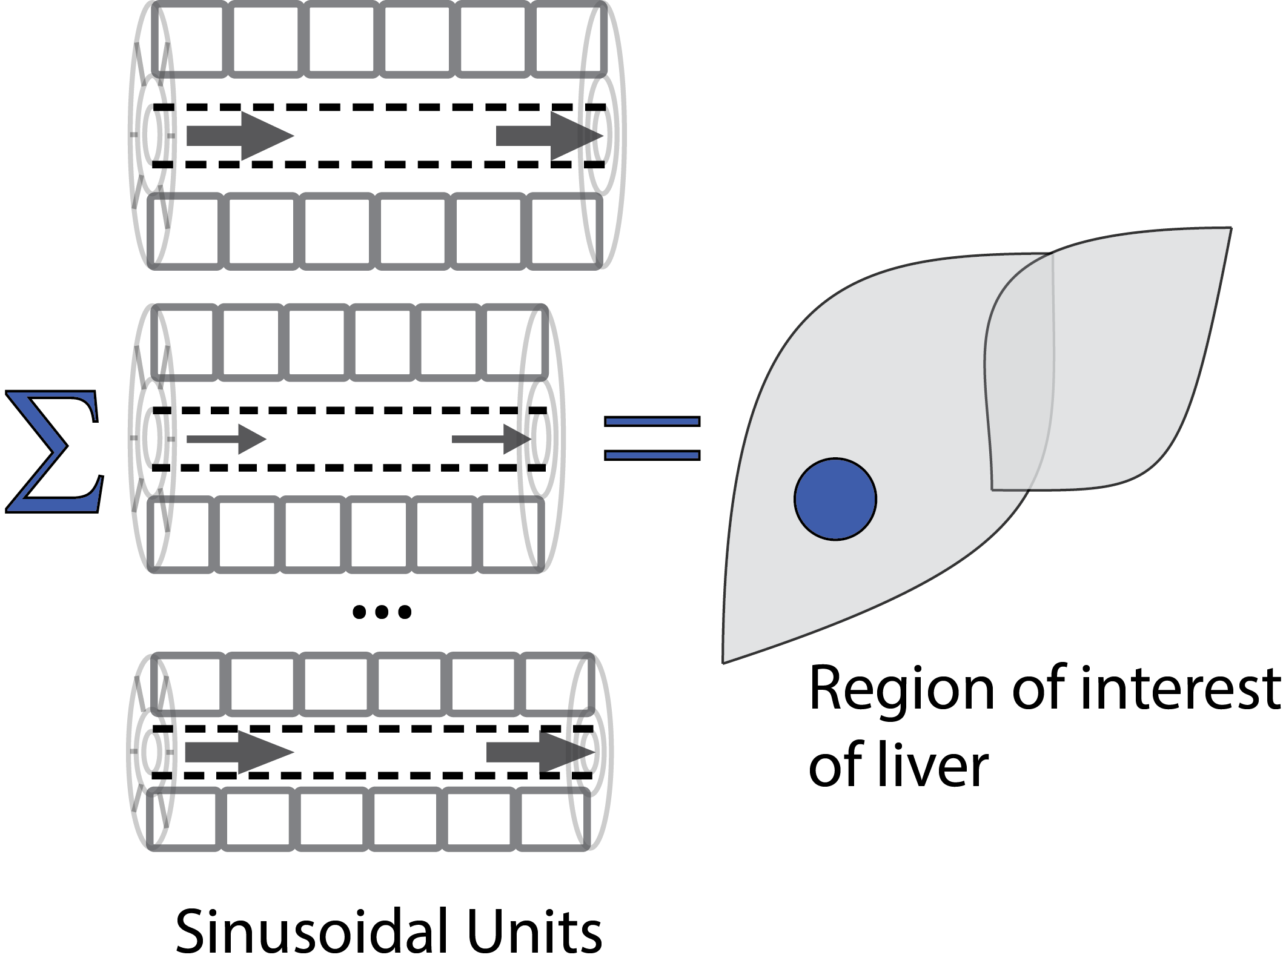
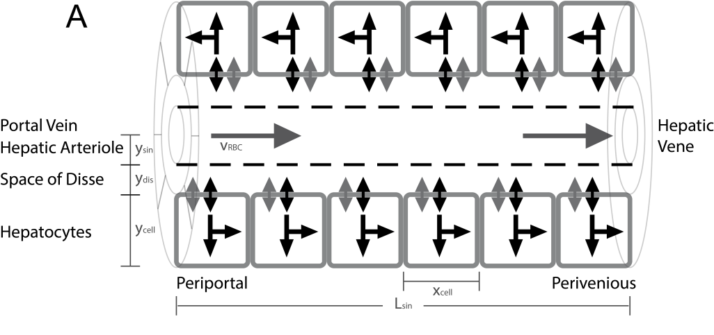
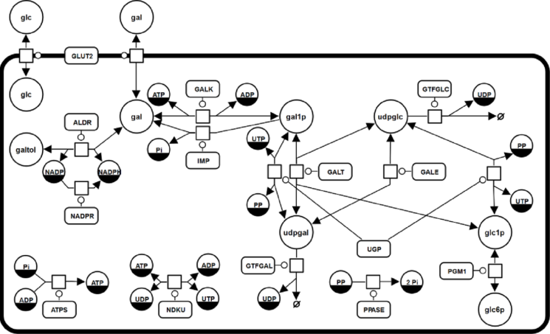
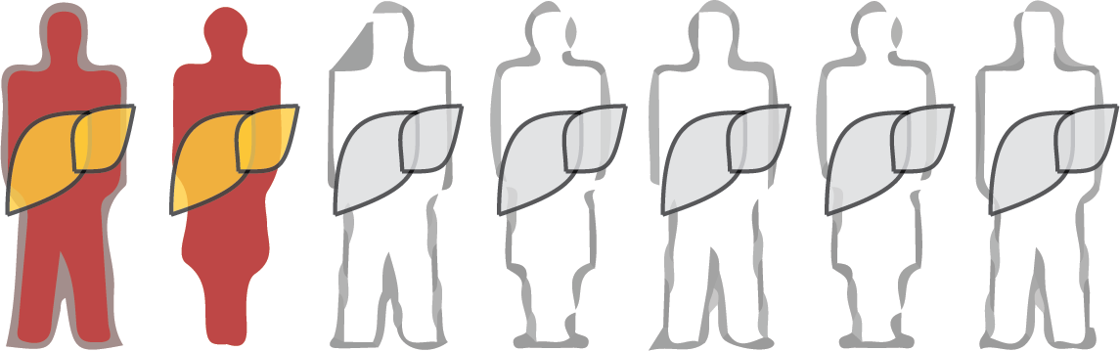
Population Variability in Liver Function
König M. & Holzhütter HG.
Sinusoidal Unit
Lobulus
Hepatocyte
Individuals / Population

Slide 2
Importance of prediction variability &

Slide 3
Variability & Sensitivity

Slide 4
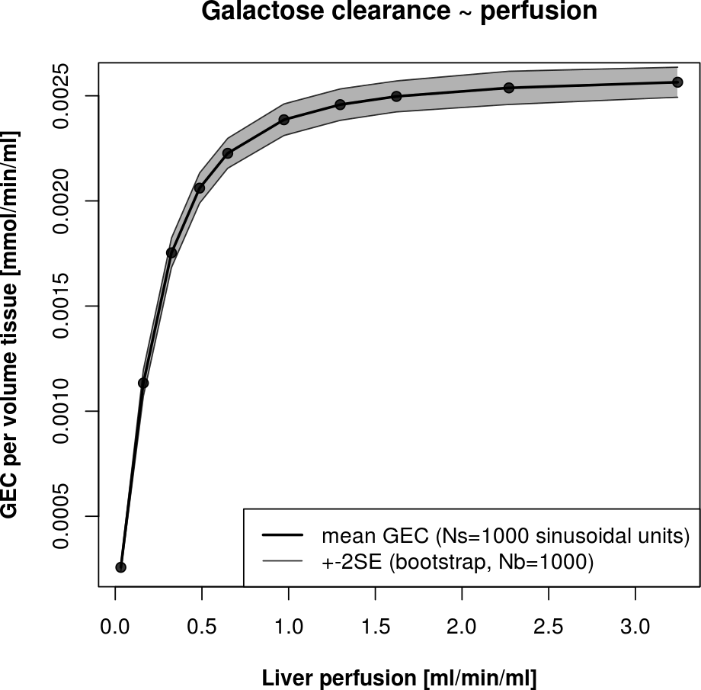
Scaling to the liver
Calculation of galactose clearance per tissue volume for given perfusion in the region
Scaling to individuals via personalized calculation of liver volume and perfusion

Slide 5
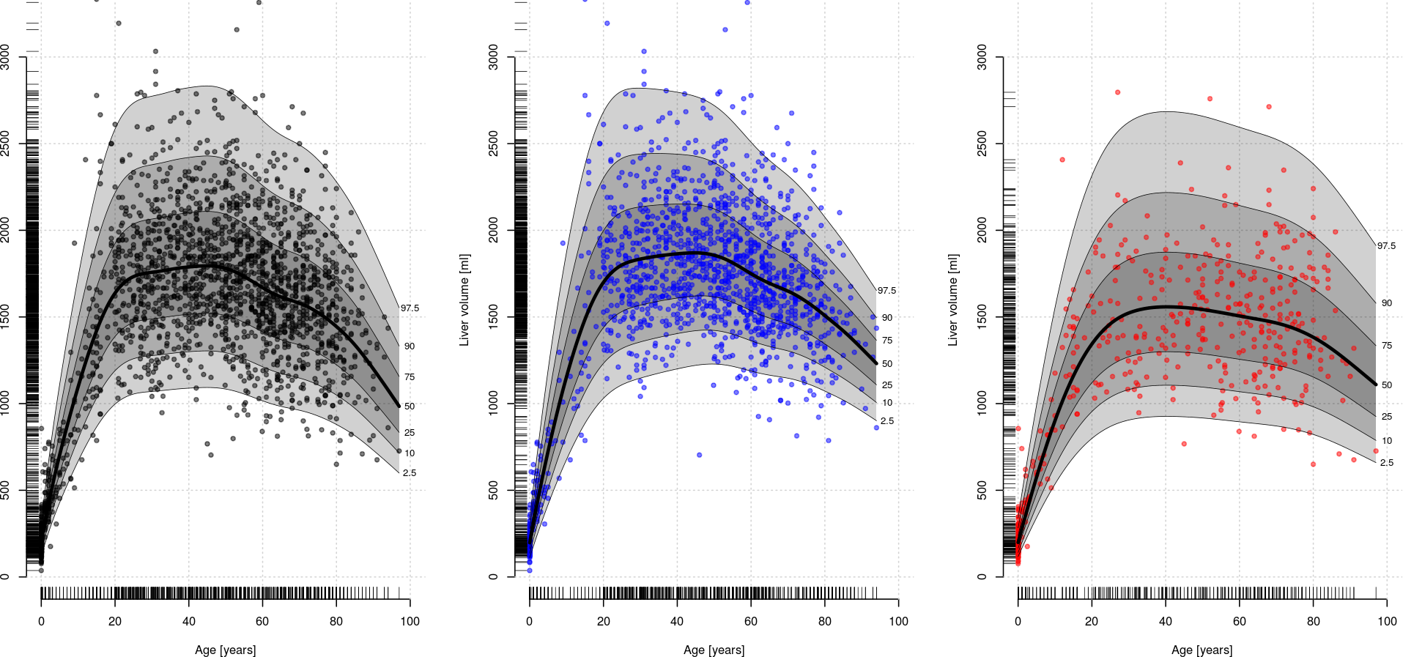
Age & gender dependence
Density calculation via generalized additive models combined with centile estimation
Analog curves for volLiver ~ bodyweight, volLiver~height, volLiver~BSA, ...
all
male
female
Liver volume [ml]
age [years]

Slide 6
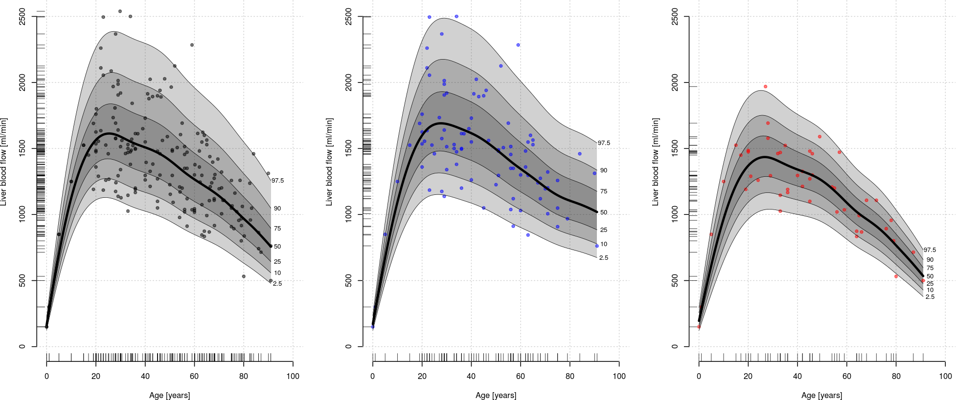
Age & gender dependence blood flow
Analog for bloodflow with additional flowLiver~volLiver correlation
Combined dataset from many sources & experimental methods
Results: probability densities for flowLiver & volLiver
all
male
female
Liver bloodflow [ml/min]
age [years]

Slide 7
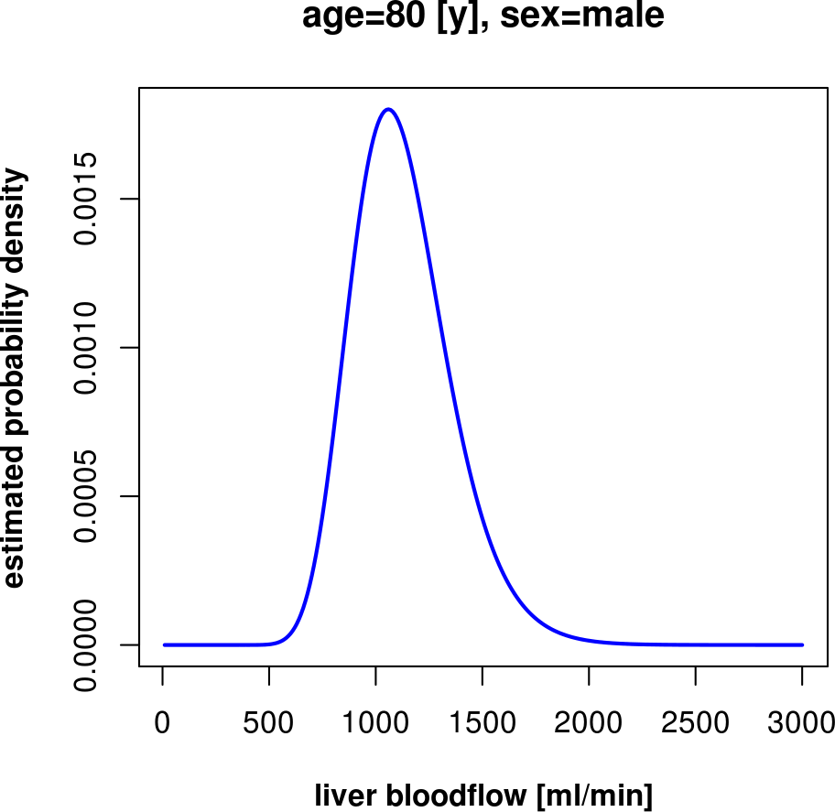
Age & gender dependence blood flow
Analog for bloodflow with additional flowLiver~volLiver correlation
Combined dataset from many sources & experimental methods
Results: probability densities for flowLiver & volLiver
all
male
female
Liver bloodflow [ml/min]
age [years]

Slide 8
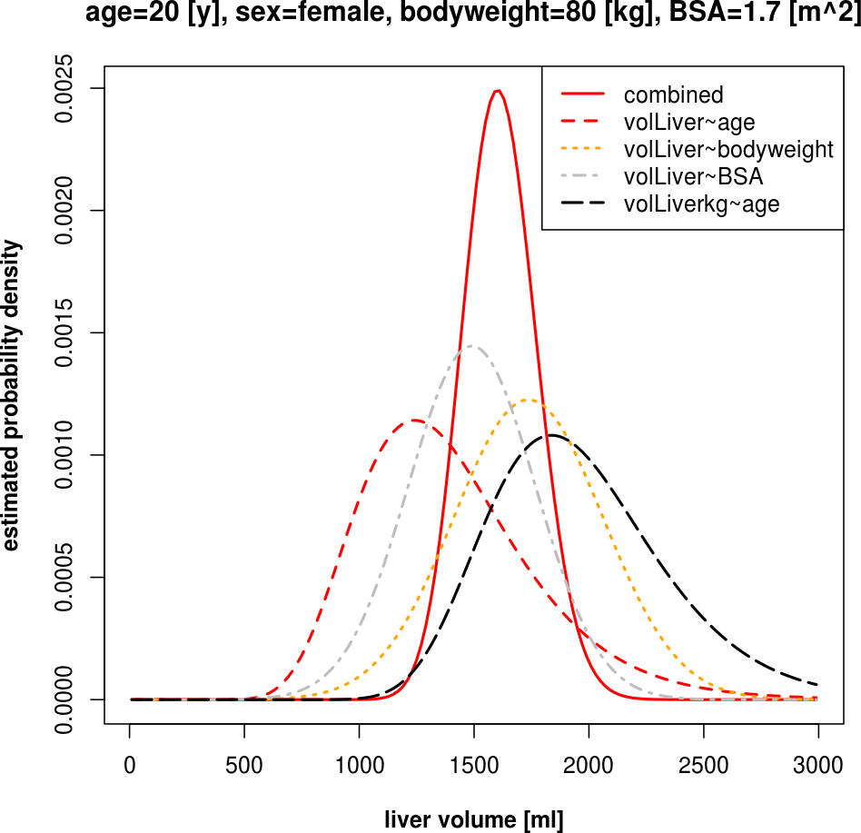
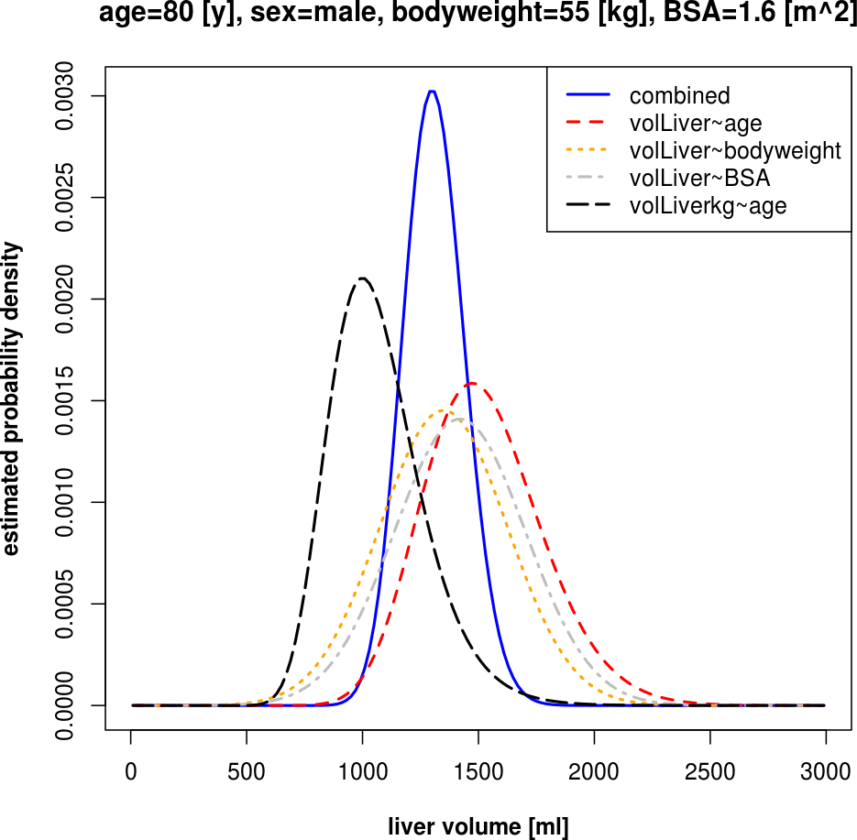
Combining the information from multiple datasets & correlations
Combining the information from multiple correlations to get best prediction for liver volumes & blood flows

Slide 9
Predicting age & gender dependence of liver function
NHANES GEC curves (vs. data)
Predicted experimental datasets

Slide 10
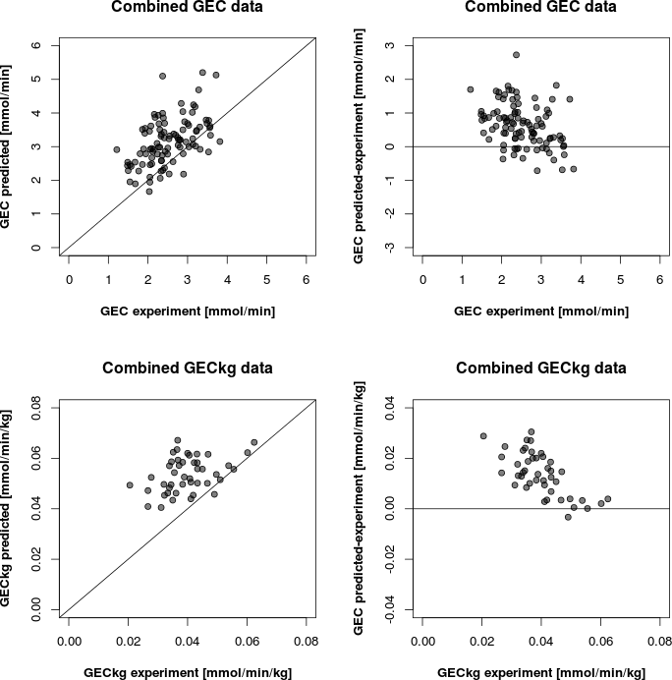

Slide 11


Acknowledgements
Concept & Modeling
  Prof. Holzhütter
Experimental Partners
  Prof. Vilstrup, Prof. Marchesini
  Prof. Wang, Dr. Wynne, Dr. Heinemann
SBML & SED-ML
  Frank Bergmann, Lucian Smith, Mike Hucka, Sarah Keating
SABIO-RK & data management
  Martin Golibiewski
  Wolfgang Müller
  Renate Wittig
Funding
  Charité
  Virtual Liver Network

Slide 12
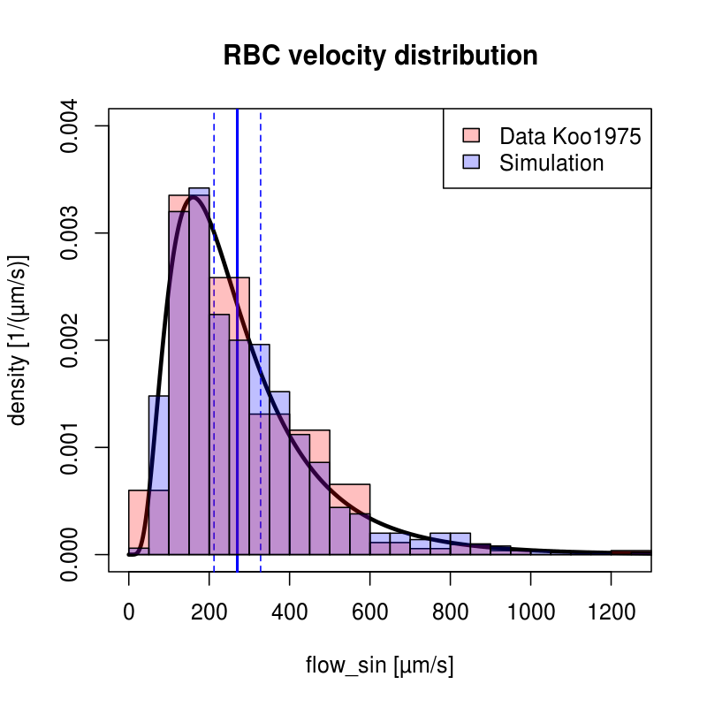
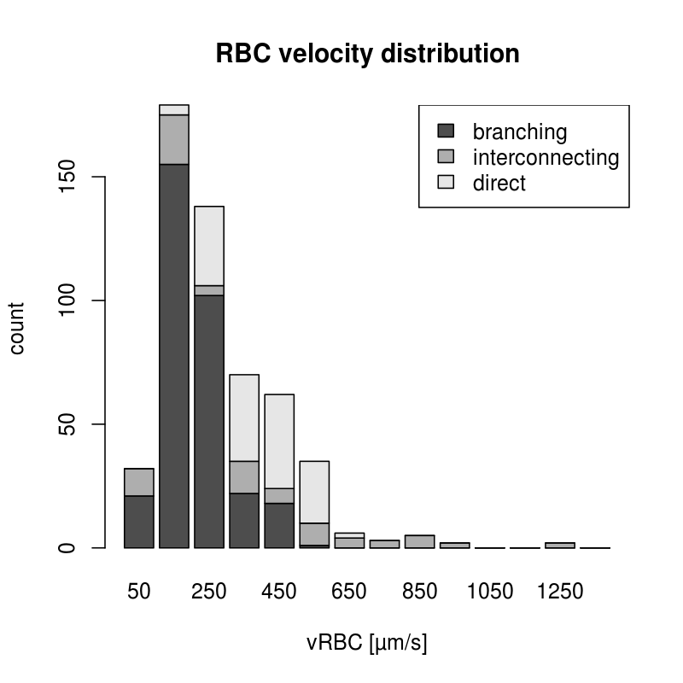
Fitting Distributions
maximum-likelihood method for univariate distributions (log-normal)

Slide 13
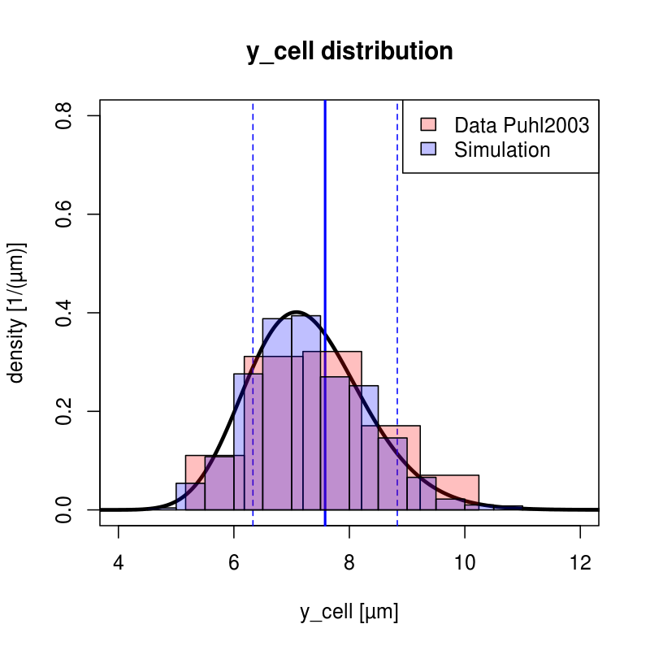
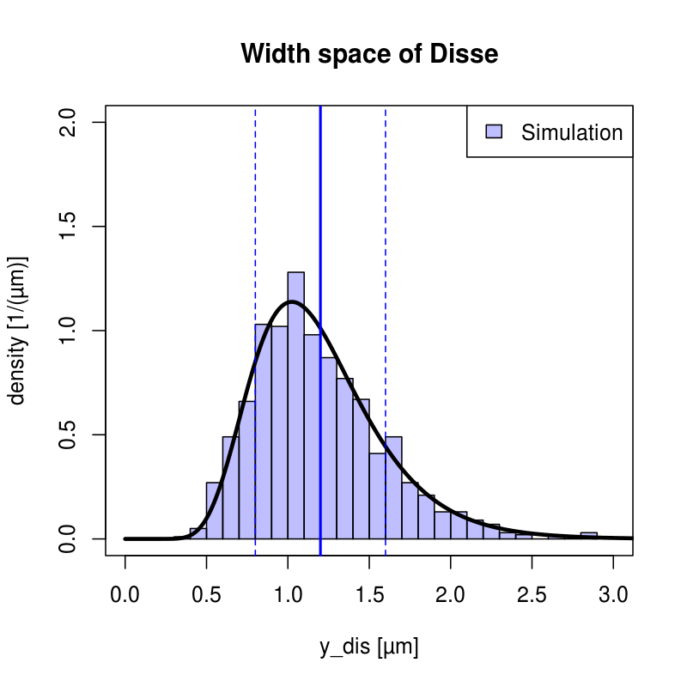
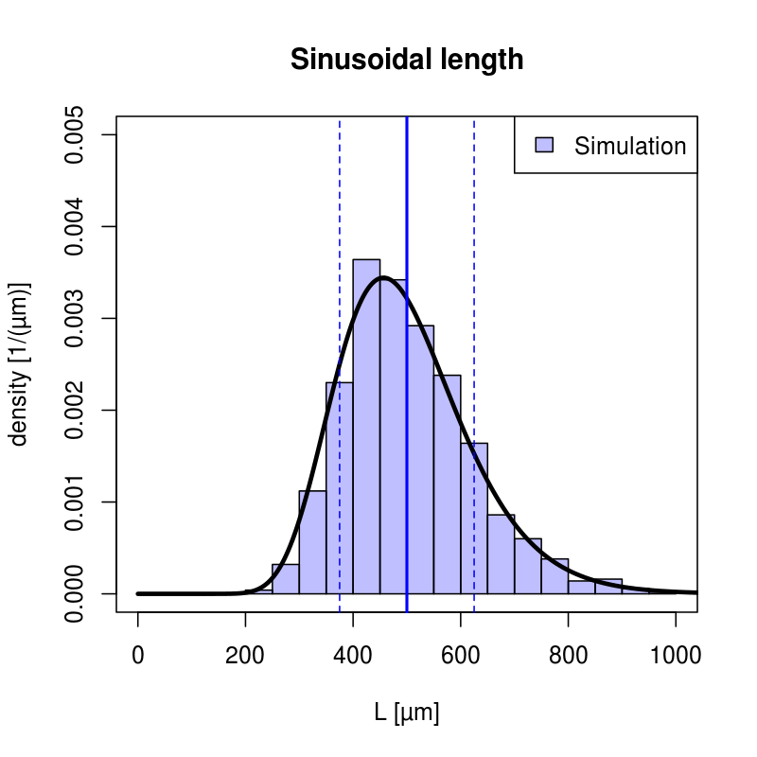
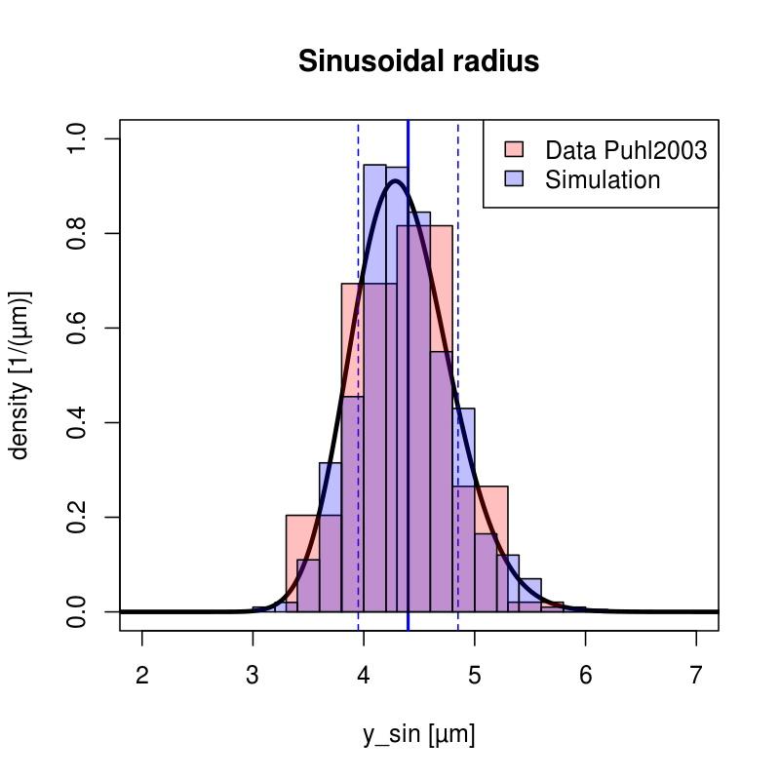
Tissue-scale Sinusoidal Unit

