Slide 1
Hepatic glucose metabolism
Liver plays central role in glucose homeostasis due to its ability to switch between glucose production & consumption & storage of glucose as glycogen
Kinetic modeling of core processes integrated with the hormonal regulation via insulin and glucagon
Analysis of glucose homeostasis under normal conditions and in impairment (diabetes type 2)

Slide 2
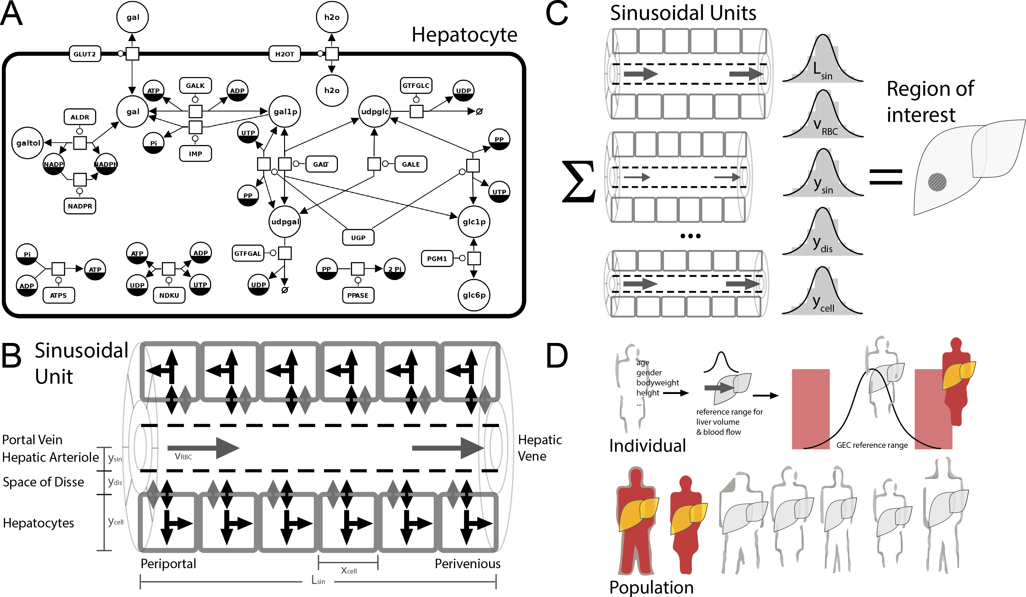
Multi-scale liver models
Liver function complex interplay between structure, perfusion & metabolism on multiple scales
Modeling provides insights into these interactions
Predictions of individual metabolic function (galactose clearance) based on tissue models combined with anthropomorphic information

