Slide 1



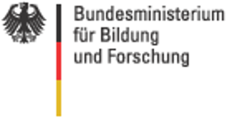
Metabolic modelling in liver:
glucose & galactose
Matthias König

Slide 2
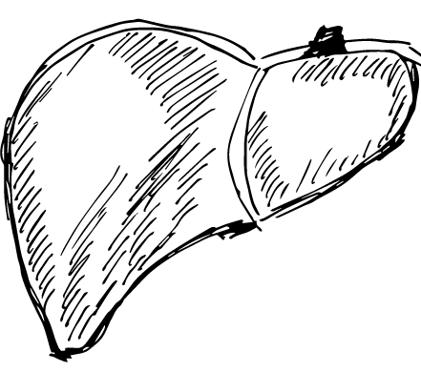
Why liver?
metabolism
Central organ of metabolism
Metabolic homeostasis
(glucose, amino acids, …)
detoxification & clearance
disease
~5 million affected by liver disease in Germany
Fatty liver (NAFLD/NASH), cirrhosis, hepatitis, alcoholic damage, cancer, …
Central role in metabolic diseases like diabetes & metabolic syndrom, NAFDL
Enormous cost for the health system
Causes of diseases often remain unknown, despite enormous progress in treatment
system
Liver function is complex interplay of physiology, morphology, perfusion & metabolism on multiple scales

Slide 3
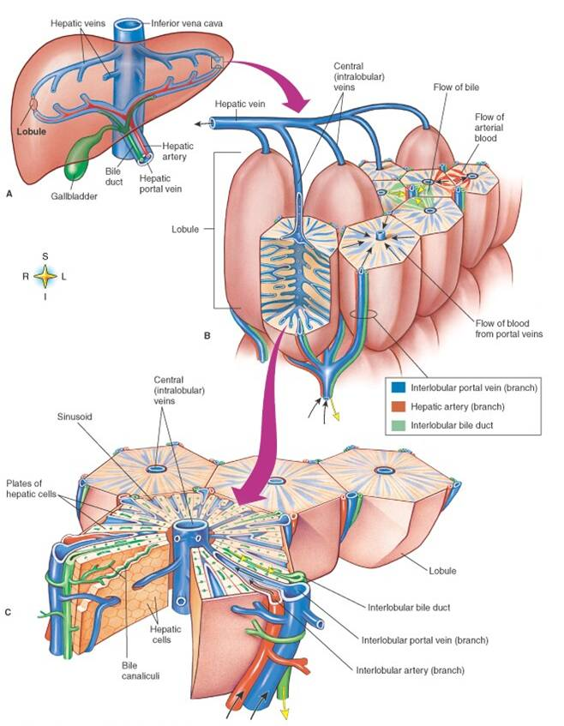
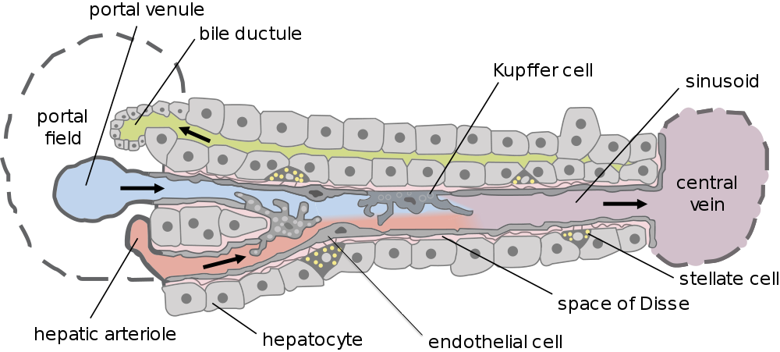
Liver in a nutshell
Liver
Hierarchical architecture
  Parallel circuit of hexagonal subunits (lobulus)
  Lobulus consists of network of sinusoids
  Hepatocytes main cell type
Dual blood supply
  Portal vein (80%)
  Hepatic artery (20%)
Lobulus
Sinusoidal unit
Hepatocyt

Slide 4

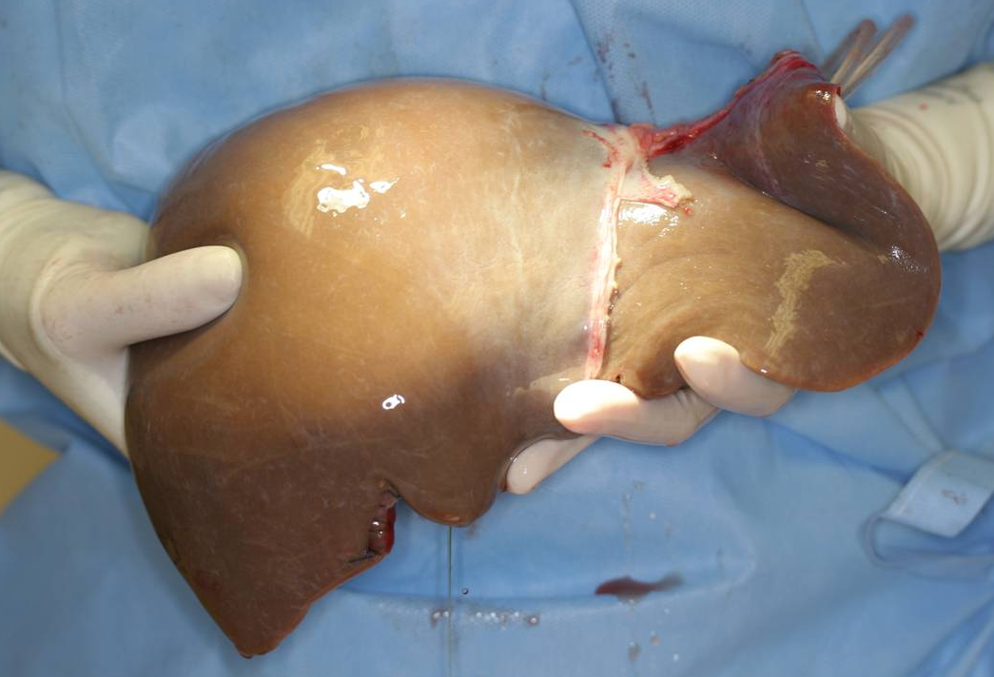
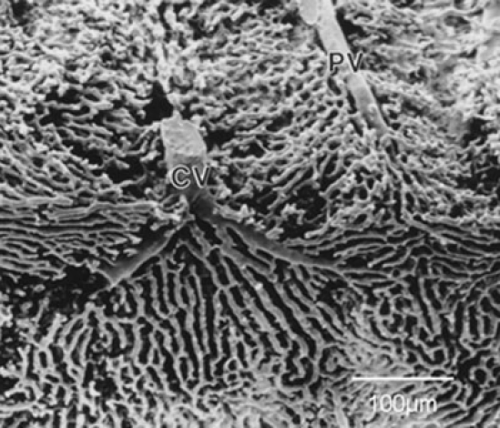
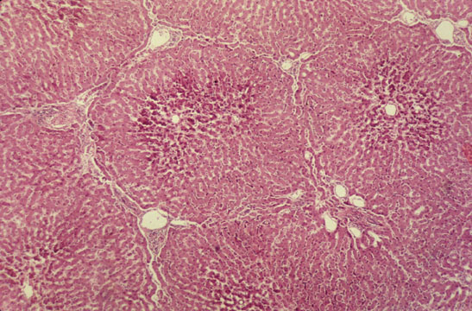
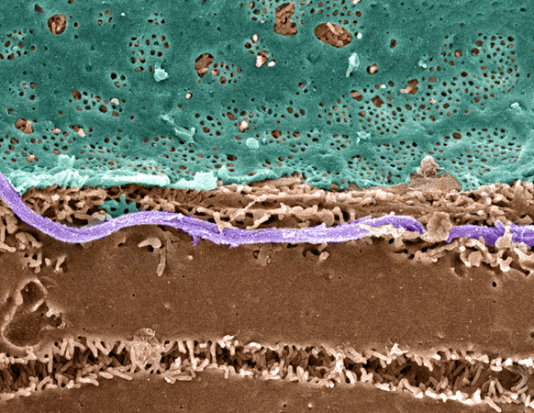
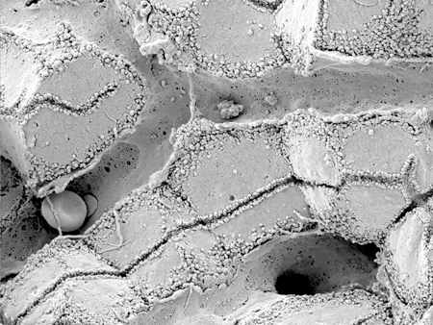
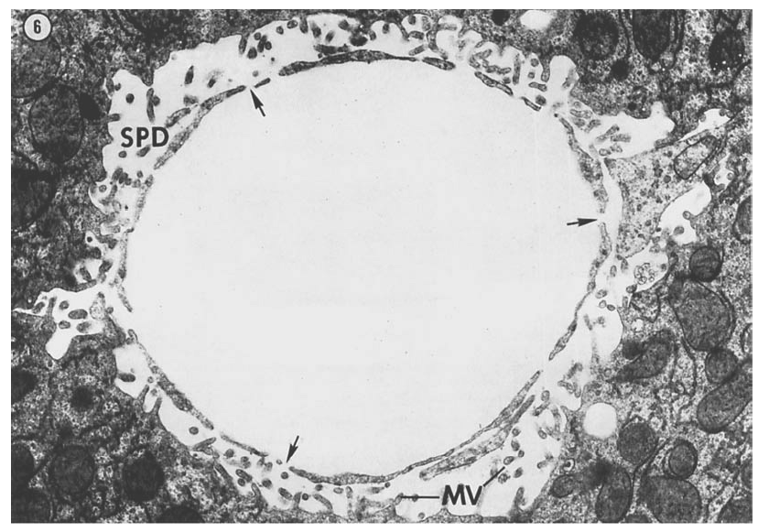

Slide 5
Glucose metabolism
König M. and Holzhütter HG.
Kinetic Modeling of Human Hepatic Glucose Metabolism in T2DM Predicts Higher Risk of Hypoglycemic Events in Rigorous Insulin Therapy
J Biol Chem. 2012
König M., Bulik S. and Holzhütter HG.
Quantifying the Contribution of the Liver to the Homeostasis of Plasma Glucose: A Detailed Kinetic Model of Hepatic Glucose Metabolism Integrated with the Hormonal Control by Insulin, Glucagon and Epinephrine
PLoS Comput Biol. 2012 Jun;8(6):e1002577. Epub 2012 Jun 21.
König M. and Holzhütter HG.
Homeostasis of blood glucose – Computer simulations of central liver functions
systembiologie.de 2014; 8:p.53-57
Ricken T. Werner D., Holzhütter HG., König M., Dahmen U., Dirsch O.
Modeling function-perfusion behavior in liver lobules including tissue, blood, glucose, lactate and glycogen by use of a coupled two-scale PDE-ODE approach.
Biomech Model Mechanobiol. 2014 Sep 19.

Slide 6
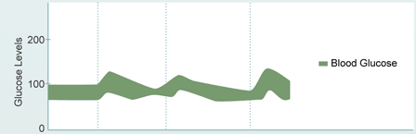

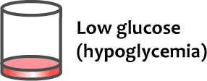
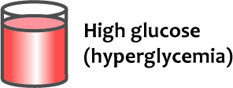
Glucose level tightly controlled
Plasma glucose almost constant despite large changes in
  glucose supply (meals)
  glucose usage (muscle activity)
~ 5mM (= 80mg/dl)
  min > 3mM: prolonged fasting, intensive muscle activity
  max < 9mM: postprandial
  3mM 5mM 6mM 9mM
Glucose supply
for all organs (brain)
Glucose toxicity
protein modifications

Slide 7
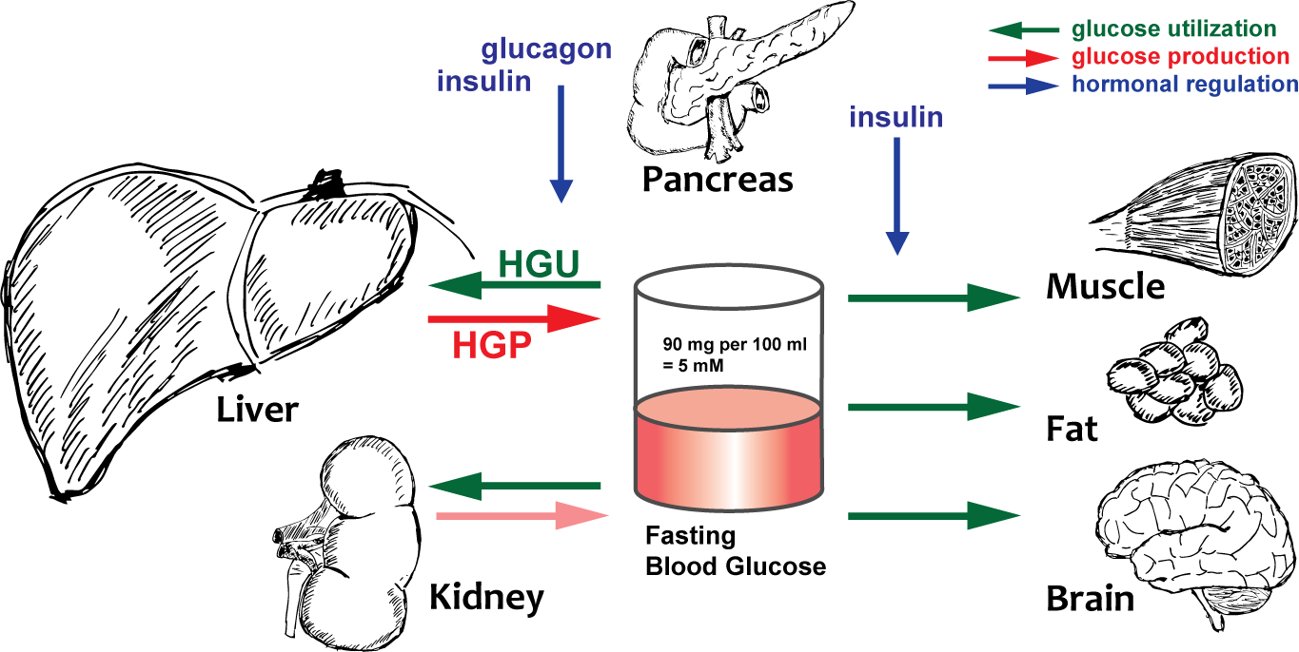
Whole body effects

Slide 8
Dual liver role
  3mM 5mM 6mM 9mM
Controlled by Hormones
glucagon & epinephrine
HGP HGU
insulin
HGP HGU

Slide 9
Hepatic glucose metabolism in a nutshell

Slide 10
Kinetic Model
Glycolysis, gluconeogenesis & glycogen metabolism
Detailed ODE model of human glucose metabolism
  kinetics for all reactions and transporters
  hormonal regulation
  allosteric regulation

Slide 11
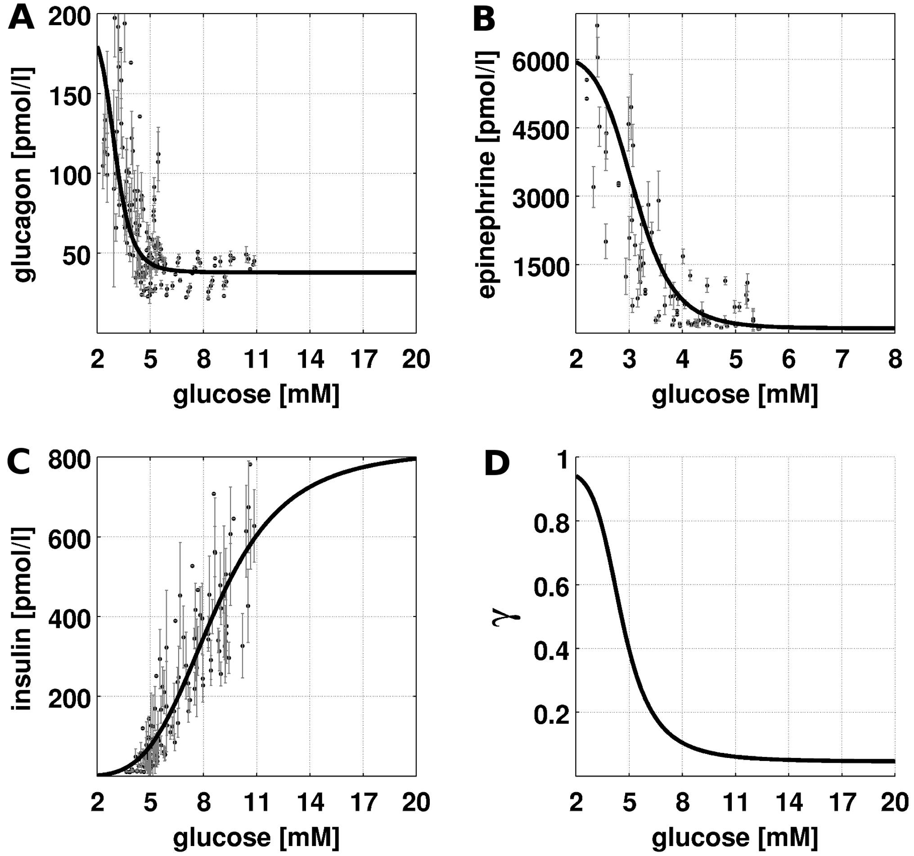
Hormonal regulation
Insulin, glucagon and epinephrine main hormones of glucose homeostasis
change with blood glucose in a dose response manner
hormones activate signal cascades which change phosphorylation state γ of key interconvertible enzymes of glucose metabolism
enzyme kinetics depend on phosphorylation state
depending on glucose level metabolism is shifted in direction of HGP or HGU

Slide 12
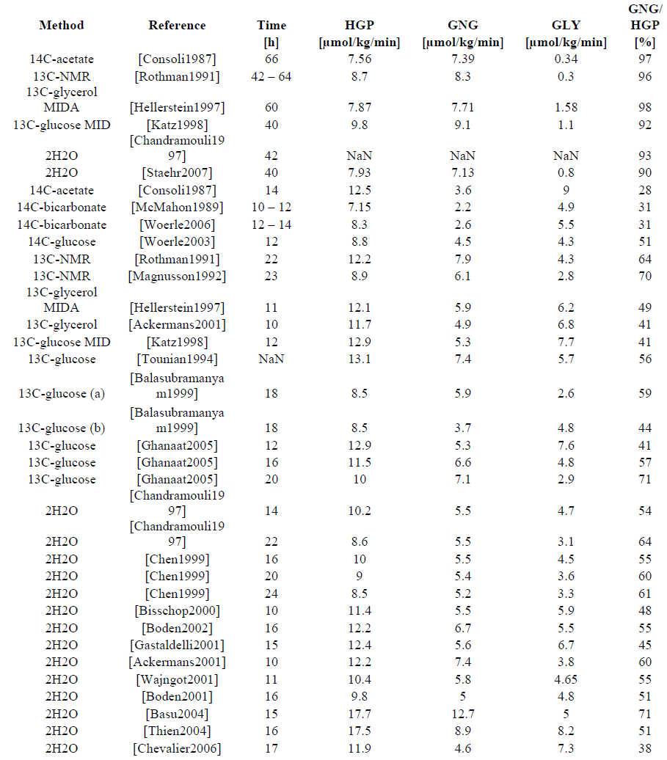
Quantifying HGP Contributions
tracer methods to measure HGP and contributions by gluconeogenesis (GNG) and glycogenolysis (GLY)
multitude of different studies with different methods

Slide 13
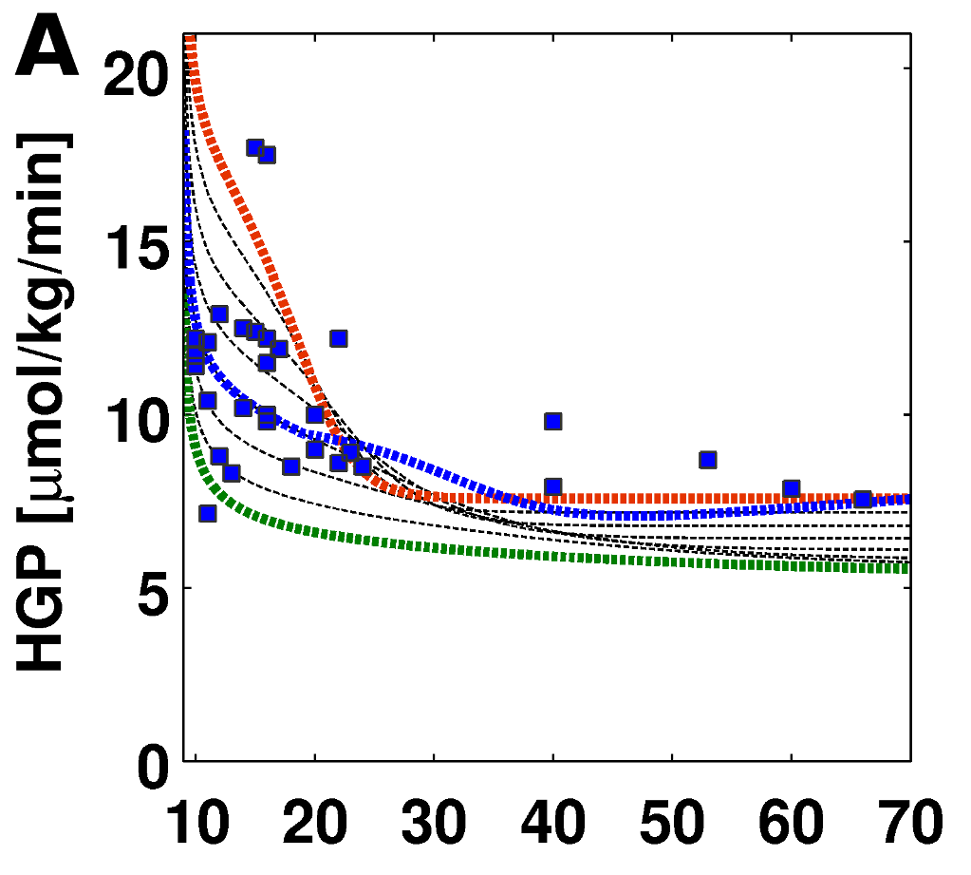

HGP in Short Term Fasting
HGP decreases over time to basal rates of
~7-8 µmol/min/kg in ~30h fasting
Decrease depends on glucose concentration between 5mM and 3.6mM
Taking decreasing plasma glucose into account (blue)

Slide 14
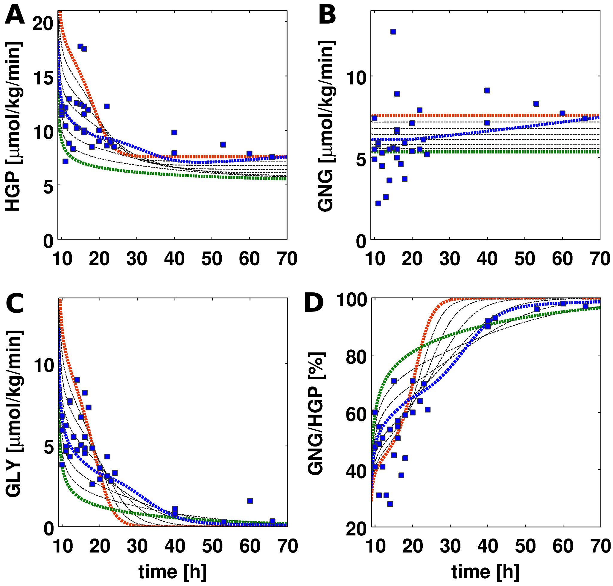
Contributions to HGP in Fasting
Hepatic glucose production (HGP) is combination of gluconeogenesis (GNG) and glycogenolysis (GLY)
glucose- and time- depending changes in contributions
very good agreement with exp. data

Slide 15
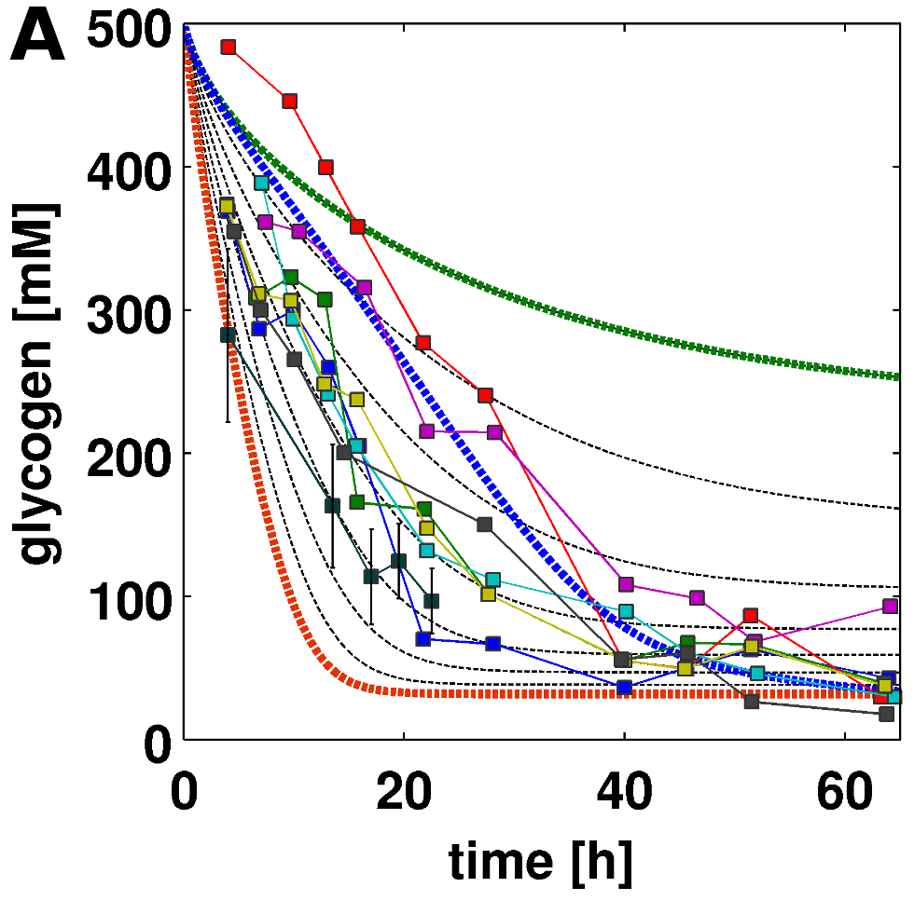
Hepatic Glycogen Decrease
decrease in glycogen in fasting
depending on glucose concentration between 5mM and 3.6mM, or taking the decrease in plasma glucose into account (blue)
very good agreement with experimental data (13C-NMR [Magnusson1992, Rothman1991])

Slide 16
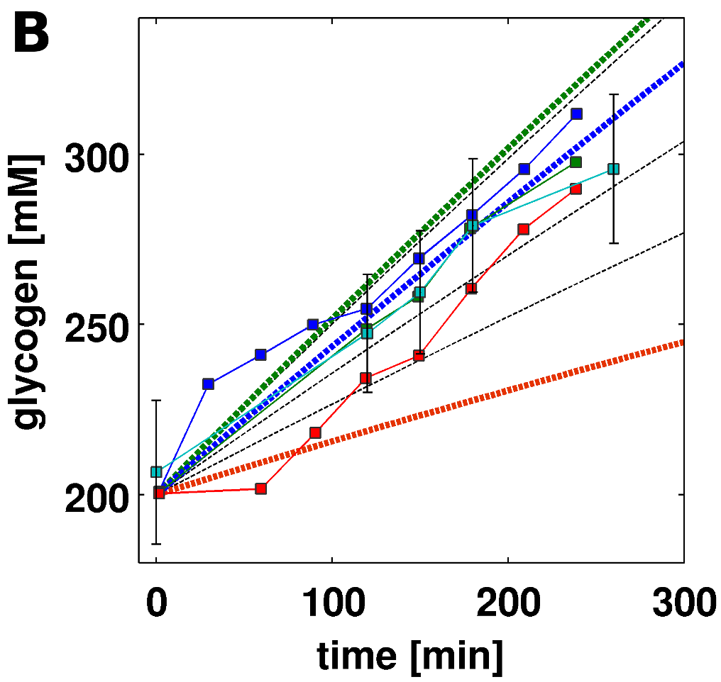
Hepatic Glycogen Synthesis
increase in glycogen postprandial
depending on glucose concentration between 5mM and 8mM (7mM)
very good agreement with experimental data ([Radziuk2001, Taylor1996, Ferrannini1985])

Slide 17
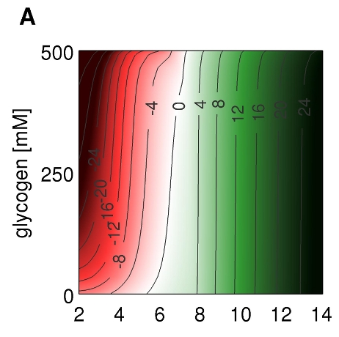

Simulate glucose metabolism
HGP/HGU (GLUT2)
[µmol/min/kg]
switch between HGP and HGU depending on blood glucose
correct set point of ~6mM
HGP/HGU fluxes like reported under various conditions
  postprandial
  overnight fasting
  shortterm fasting

Slide 18
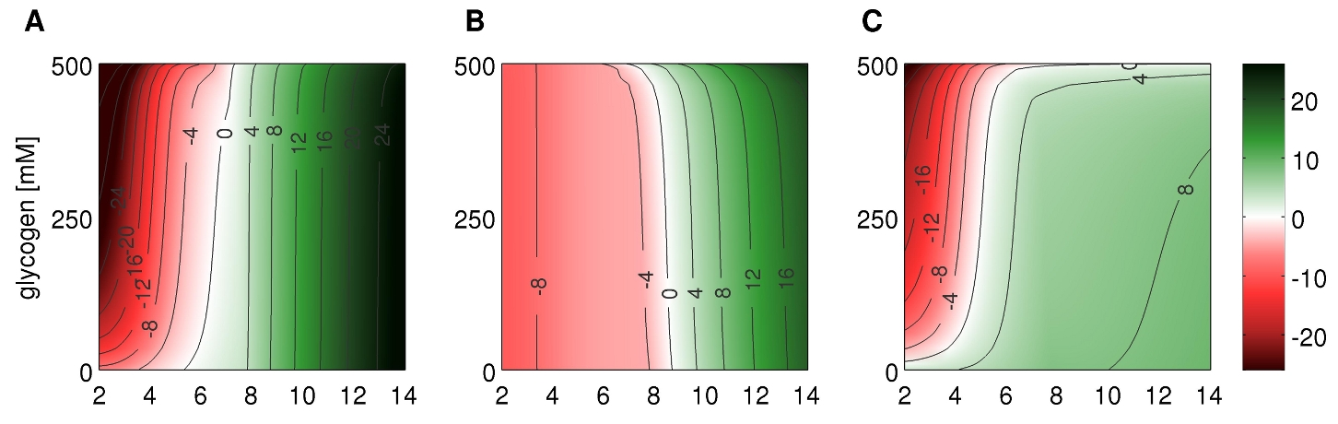
Contributions to HGP/HGU
HGP/HGU (GLUT2)
[µmol/min/kg]
GNG/GLY (GPI)
[µmol/min/kg]
GLYL/GLYS (G1PI)
[µmol/min/kg]
correct set points
correct absolute and relative contributions to HGP and HGU under various conditions
  postprandial, overnight fast, short-term fasting

Slide 19
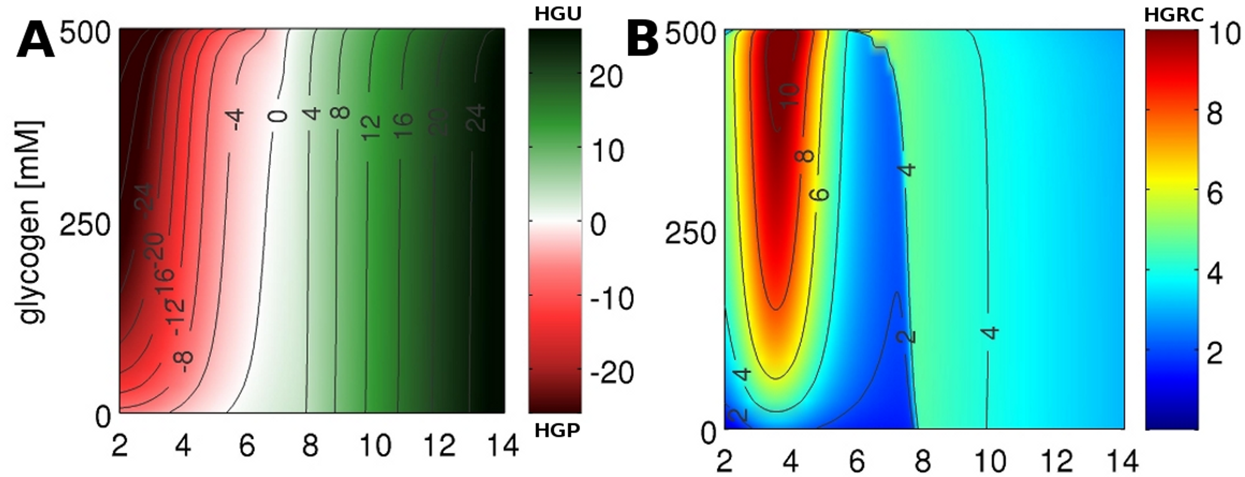
Liver - A Glucose Homeostate
ideal regulatory properties to respond to typical physiological challenges to blood glucose homeostasis:
  hypoglycemia in fasting and muscle activity
  postprandial hyperglycemia

Slide 20
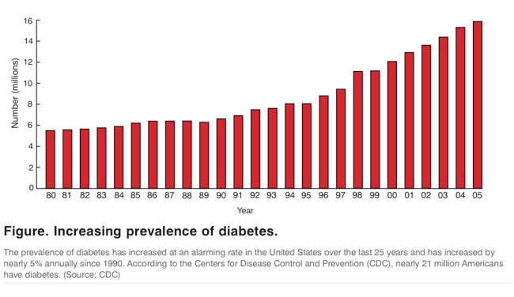
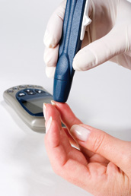
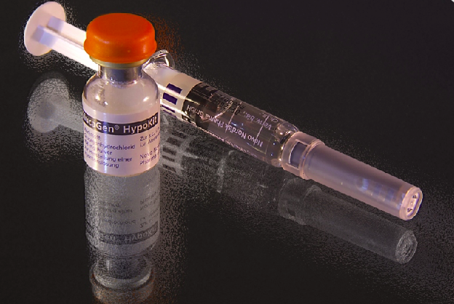
T2DM (diabetes)
metabolic disorder characterized by high blood glucose in the context of insulin resistance and relative insulin deficiency.
hallmarks are
  alterations in blood glucose homeostasis
  increased blood glucose levels
  increased HGP mainly due to increased gluconeogenesis
insulin treatment standard therapy
  but associated with hypoglycemic events

Slide 21
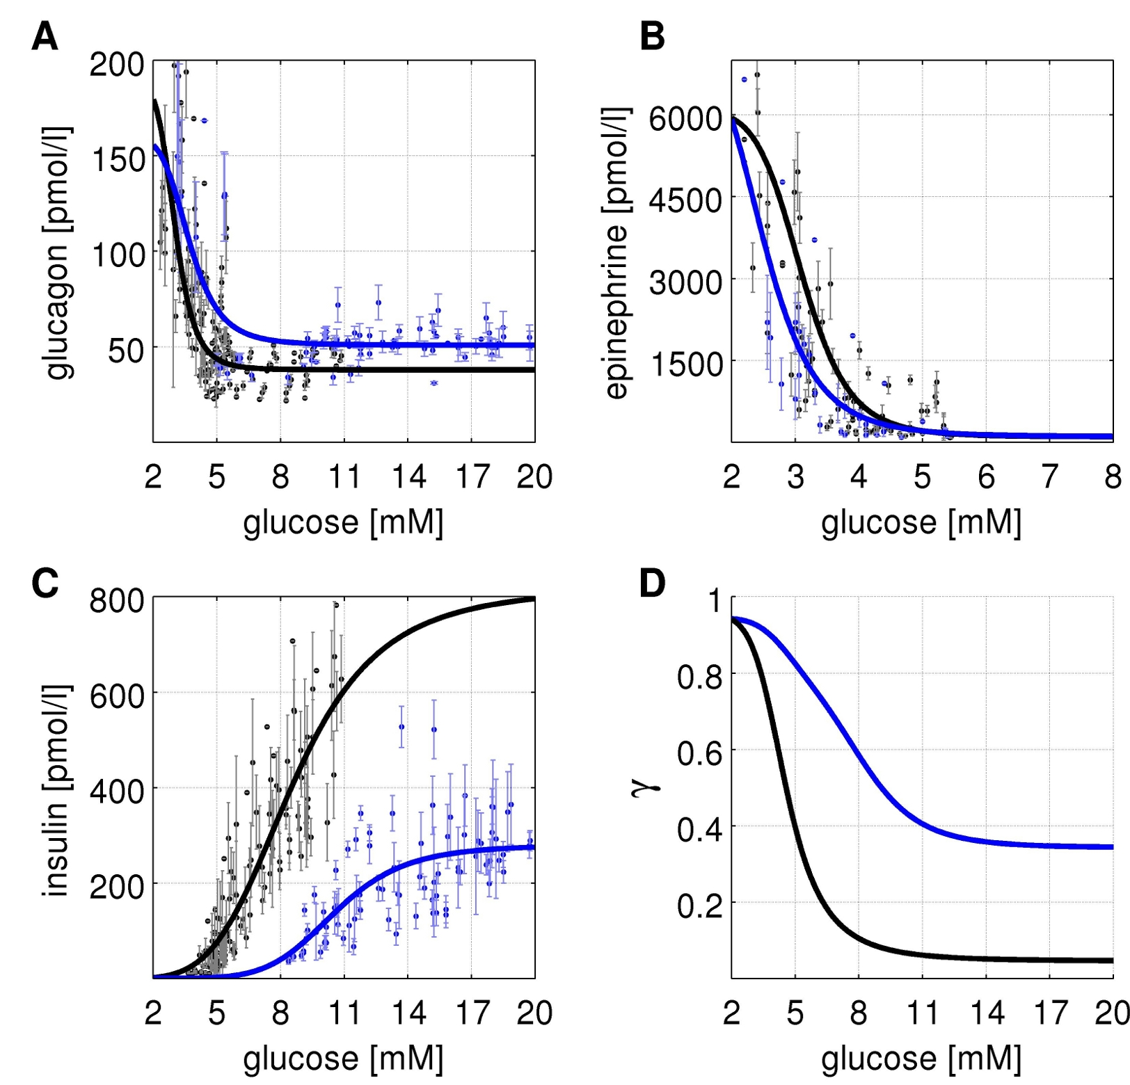
Hormonal responses (T2DM)
altered hormonal responses in insulin glucagon and epinephrine
  insulin deficiency
  increased basal glucagon
phosphorylation state γ is markly altered
consequently glucose metabolism shifted towards a glucose producing phenotype

Slide 22
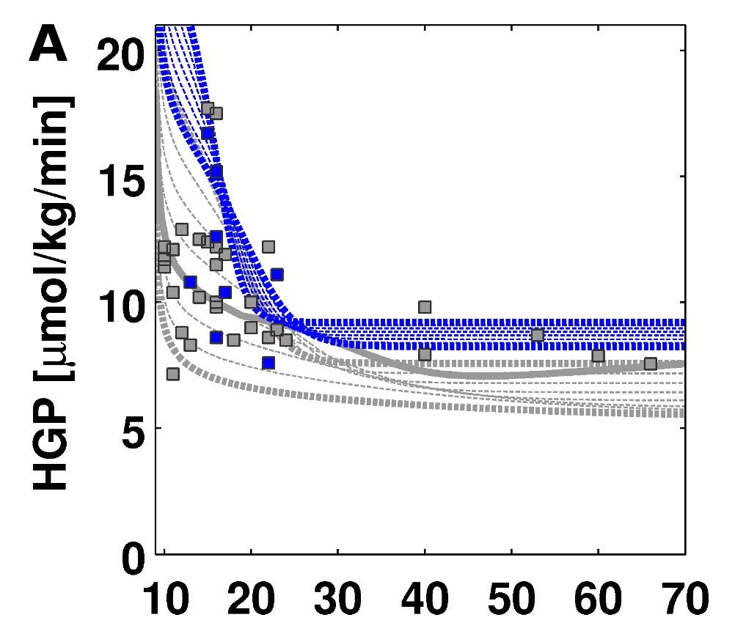

T2DM : HGP in Fasting
increased HGP in T2DM
good prediction of experimental data from a multitude of studies
no T2DM data used for model fitting !
model of normal subjects with impaired hormonal responses

Slide 23
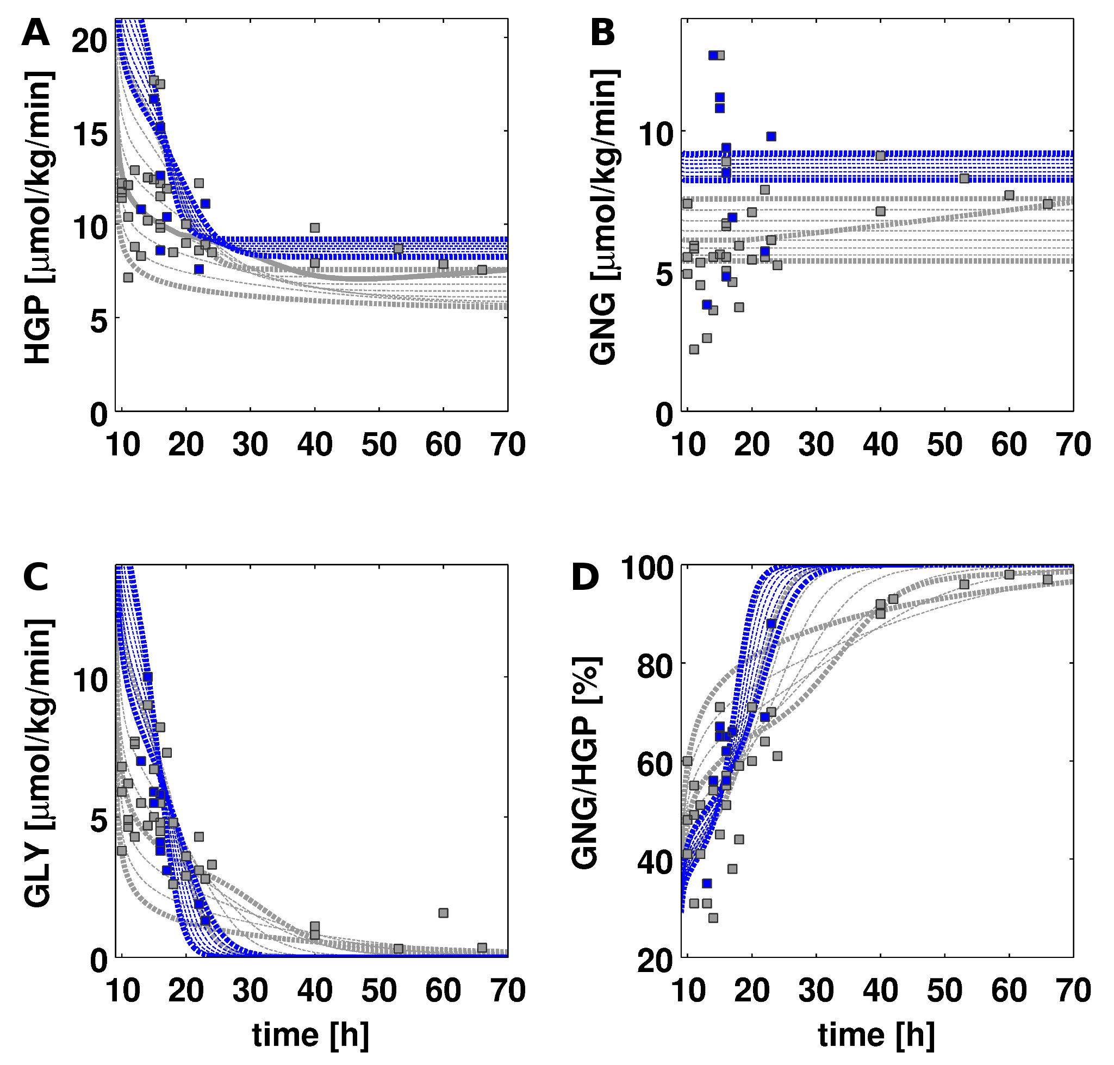
T2DM: Contributions to HGP
increased HGP predicted to be mainly due to increased gluconeogenesis
glycogenolysis altered in T2DM
higher rate and faster decrease in glycogenolysis (~25h instead of 40h)
very good predictions of T2DM phenotype

Slide 24
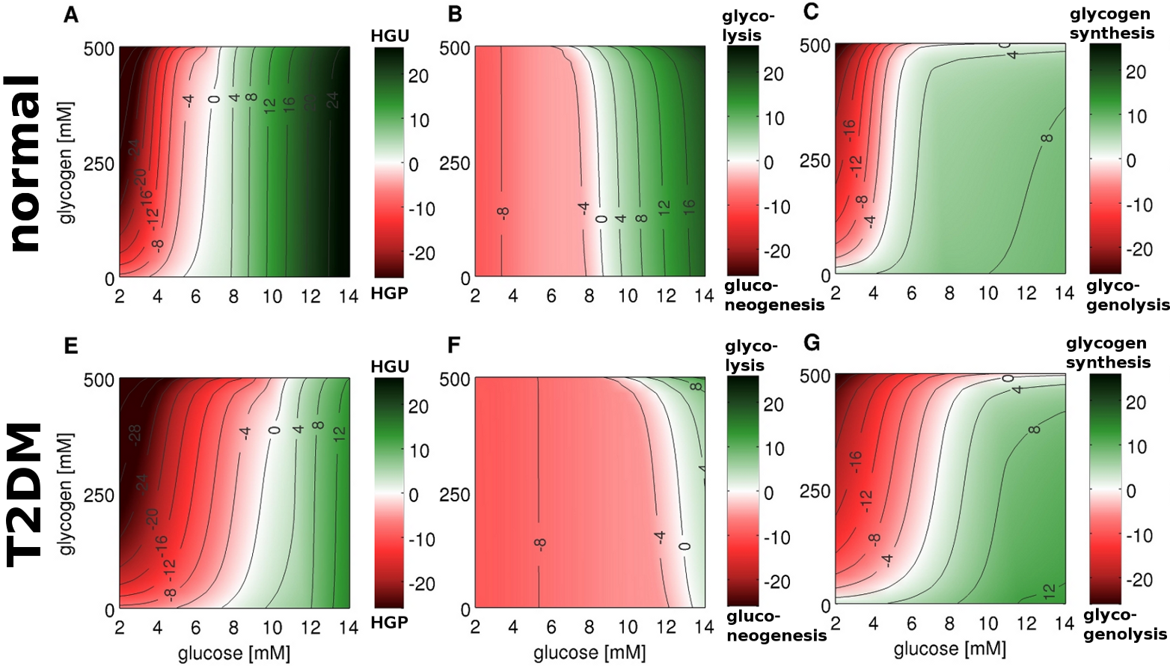
T2DM: Shifted metabolism

Slide 25
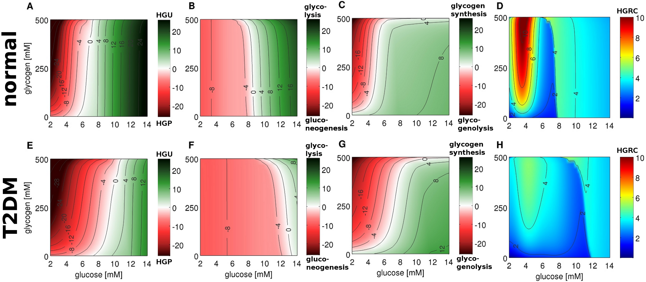
Impaired hepatic response

Slide 26
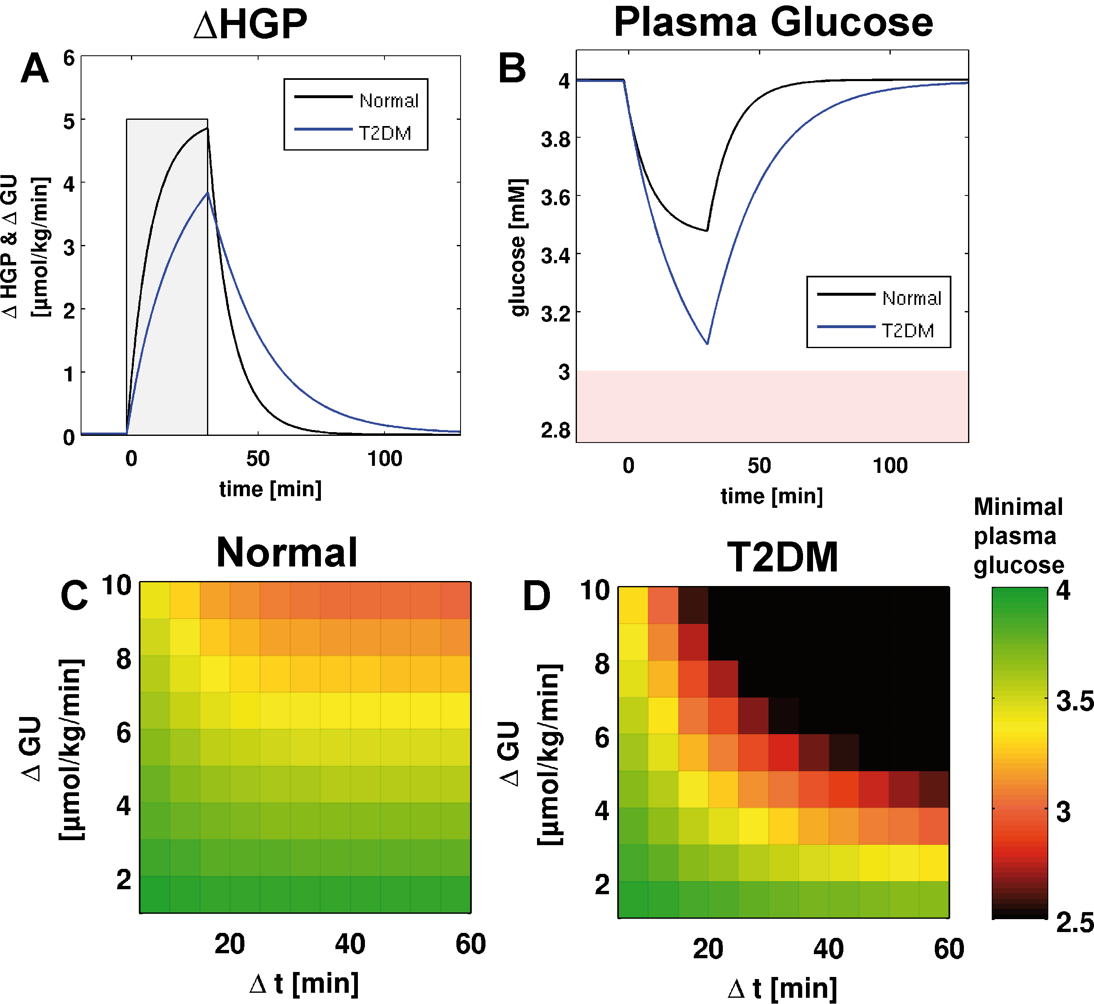
Impaired counter-regulation in T2DM
hepatic glucose metabolism impaired in T2DM
reduced capacity for counter-regulation to increase in glucose utilization in T2DM
increased risk of hypoglycemic events

Slide 27
Galactose metabolism & Liver function tests
König M., Holzhütter HG., Berndt N.
Metabolic Gradients as Key Regulators in Zonation of Tumor Energy Metabolism: A Tissue-scale Model Based Study.
Biotechnol J. 2013 Apr 16.
König M., Marchesini G., Vilstrup H., and Holzhütter HG.
A Multiscale Computational Model Predicts Human Liver Function From Single-Cell Metabolism
2015, [in submission]

Slide 28
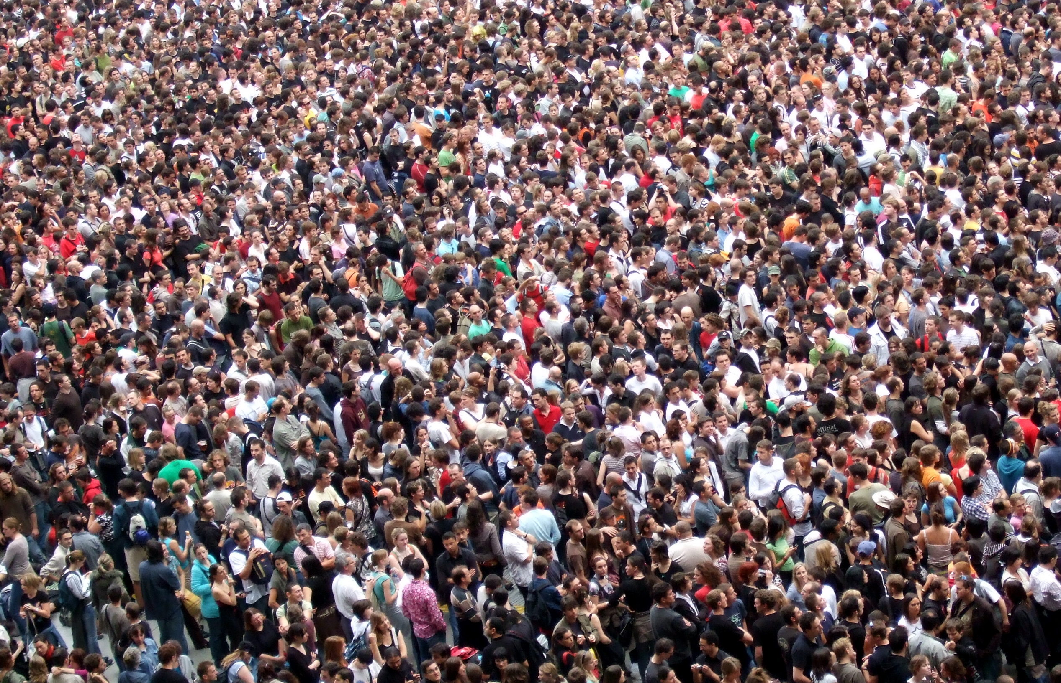
We are all different ...
… so why no individualized function tests?

Slide 29
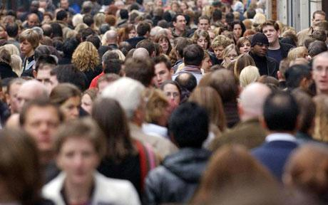


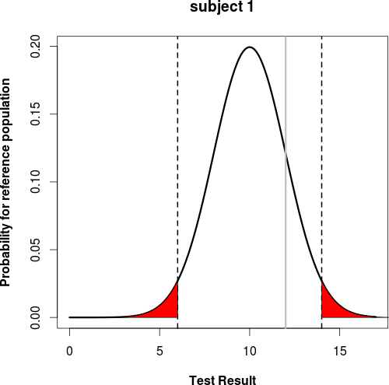
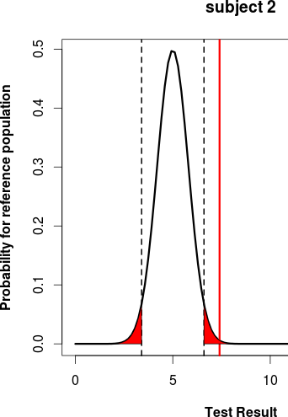
Liver Function Tests
Liver is central organ for whole-body metabolism & clearance of galactose
Galactose elimination capacity (GEC) is established clinical test of liver function
  Analysis via simple cutoff
  But: large population variability in liver volume & hepatic blood flow
  (Age, gender, bodyweight, height, ethnicity, …)
Idea: Improved evaluation of liver function based on antropomorphic data & multiscale modelling
  Individualized liver function test
  Reference range based on comparable individuals
  Values outside range → further investigation & treatment
  Analysis of perfusion, morphological & metabolic effects on liver function

Slide 30
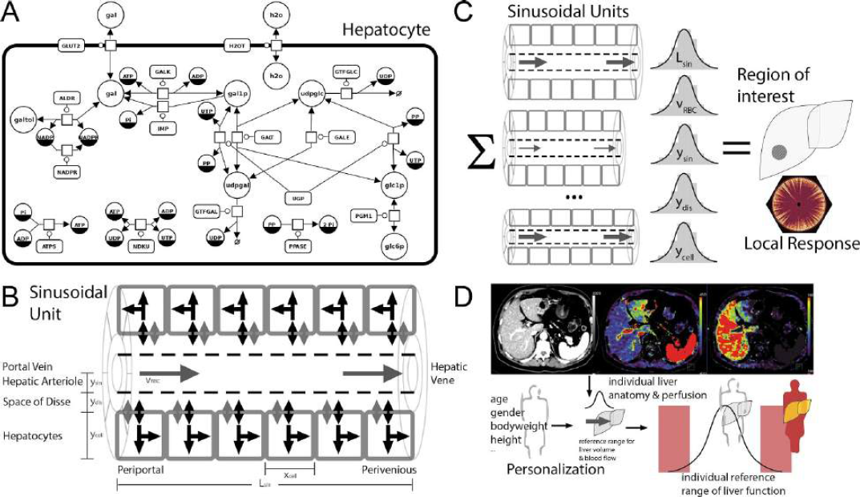

Slide 31
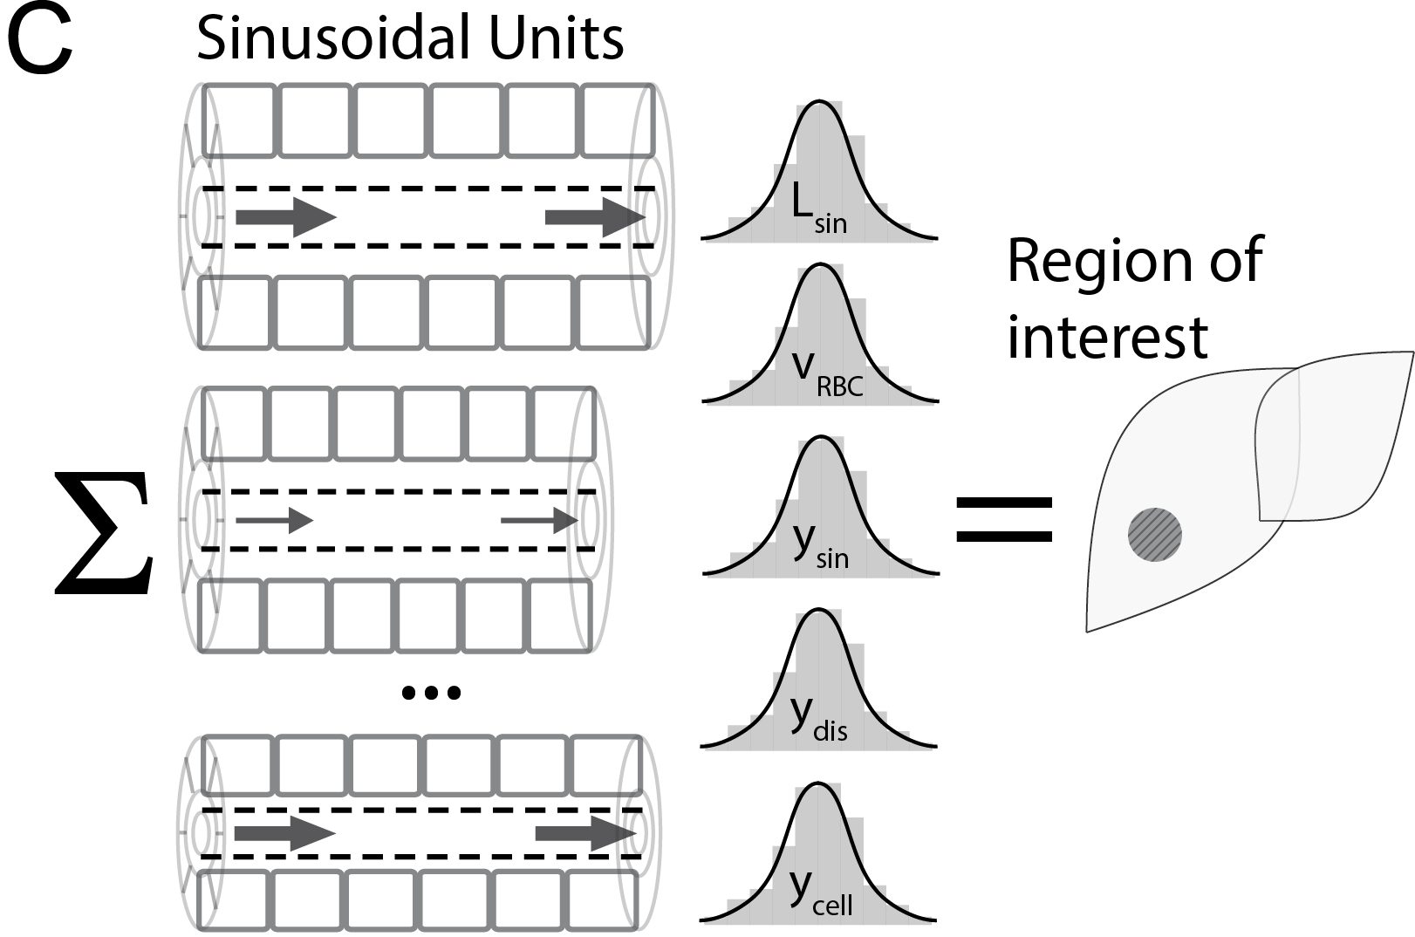
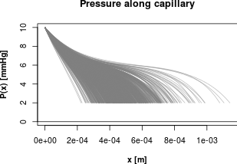
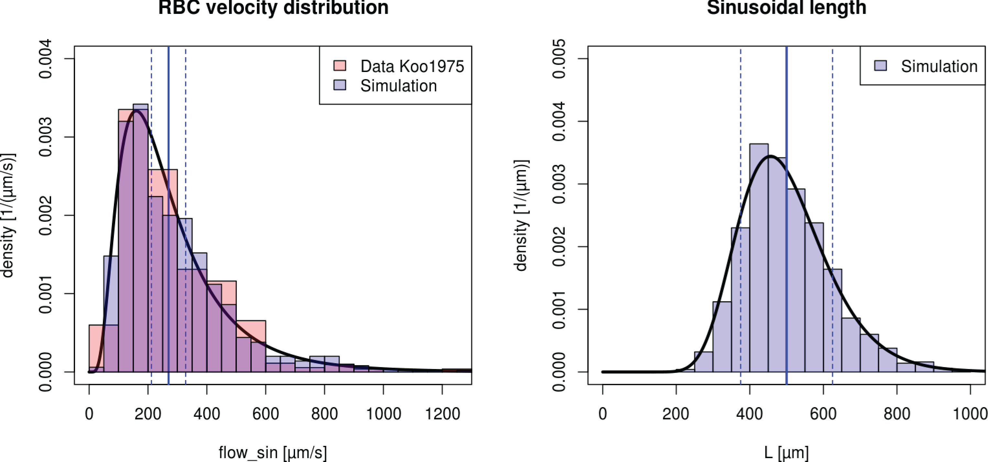
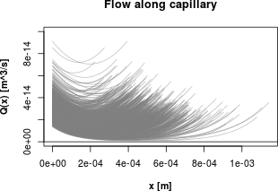
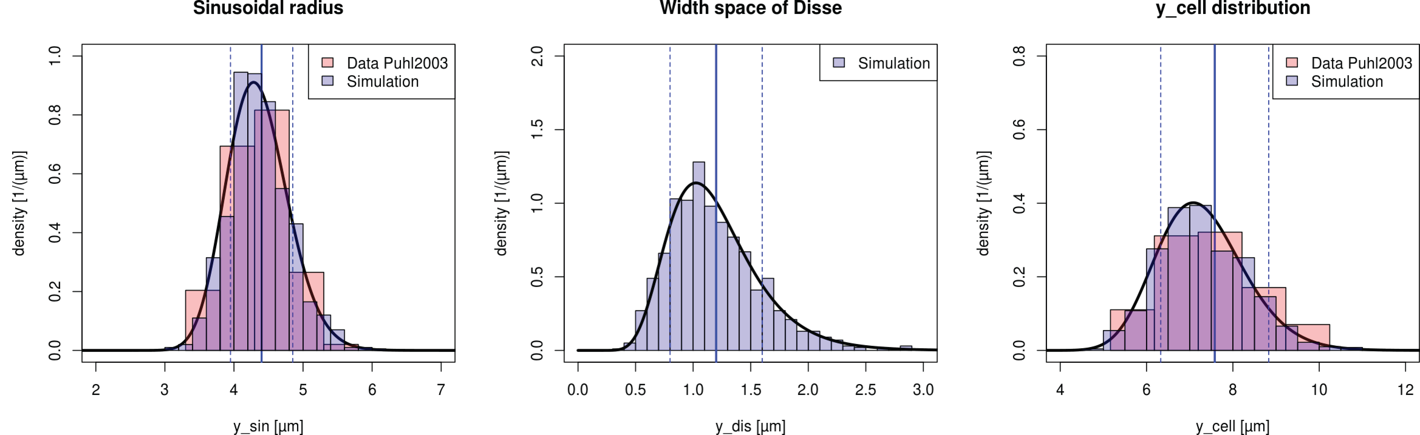
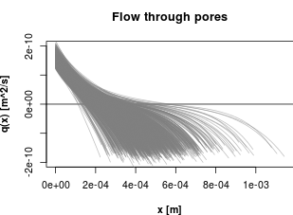
Region of interest

Slide 32



Multiple Indicator Dilution Curves

Slide 33


Galactose elimination, extraction ratio & clearance

Slide 34
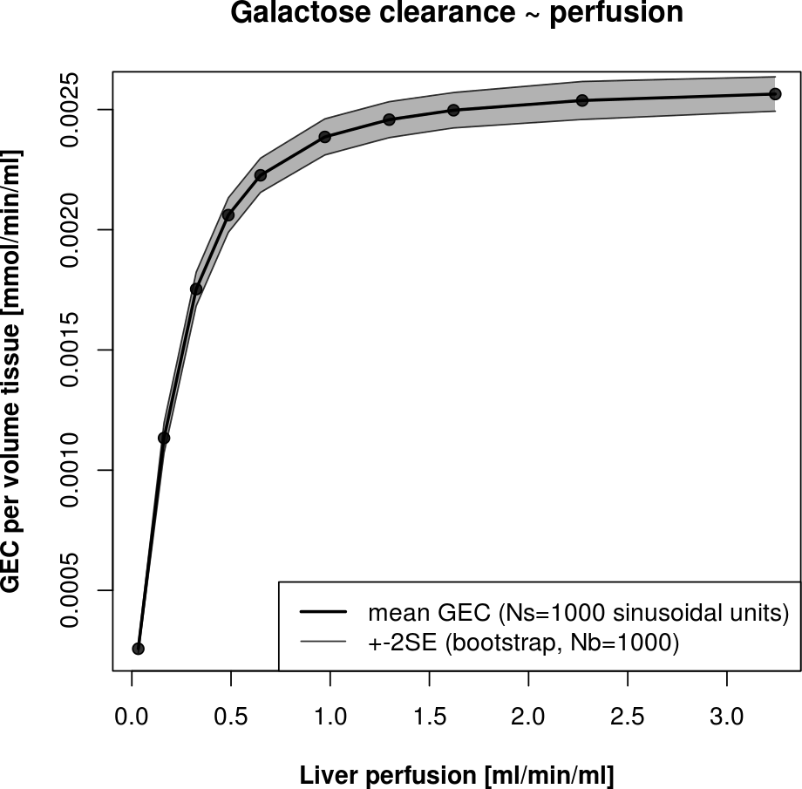
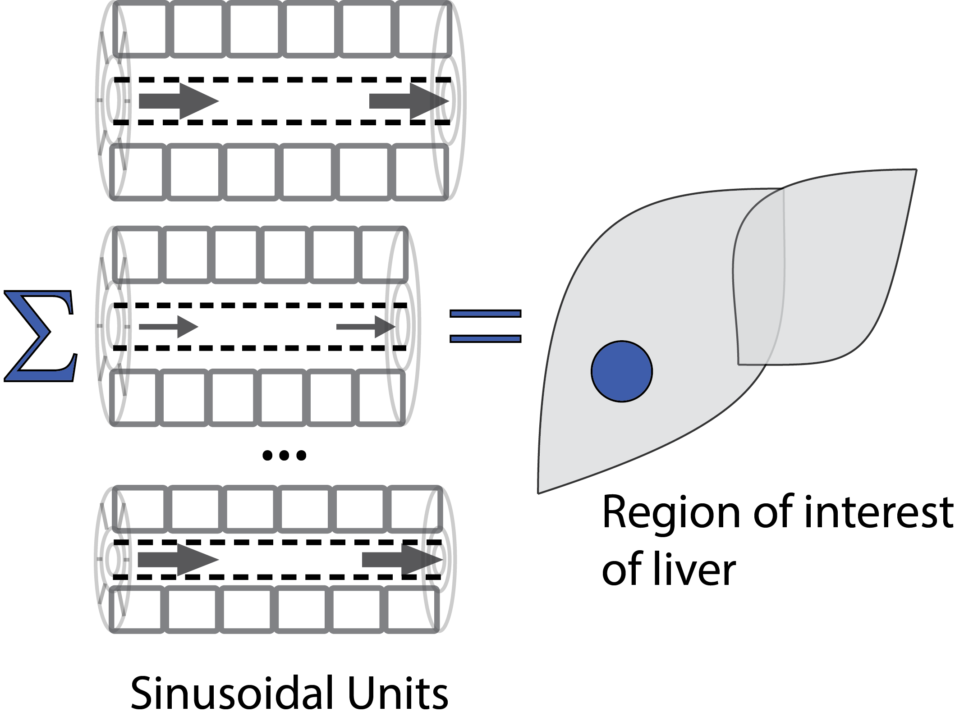
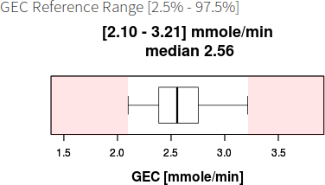
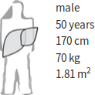
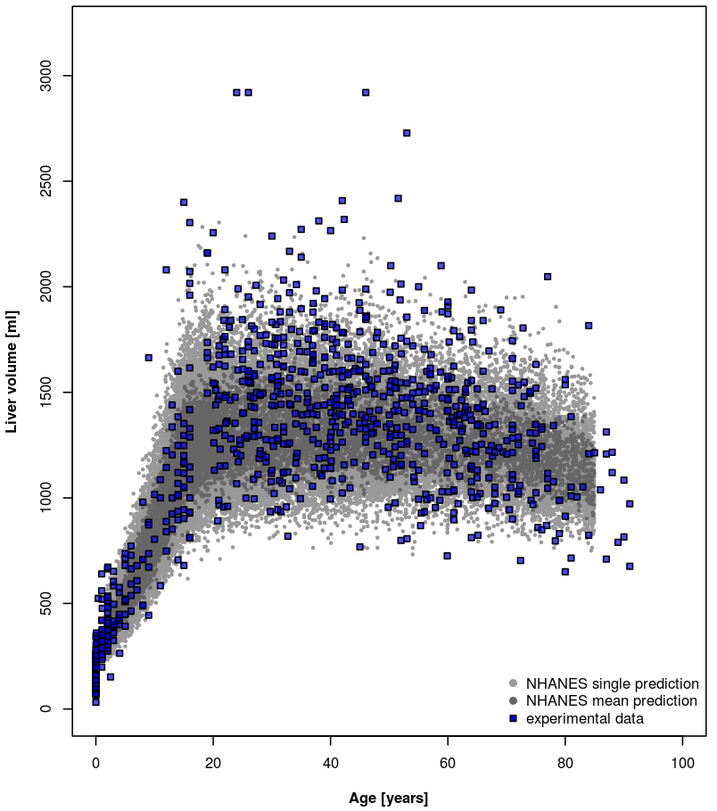
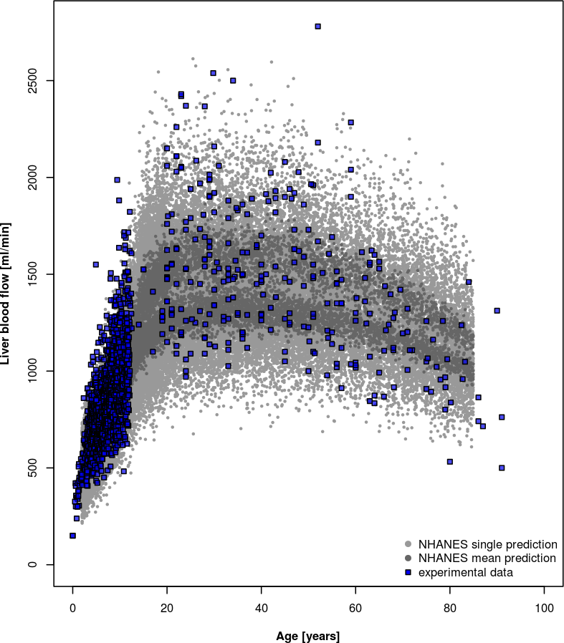

Individualized Liver Function
Tissue-Model predicts galactose clearance per tissue volume for given perfusion (regional GEC)
Scale with predicted individual distributions of liver volume and perfusion (total GEC)
Liver volume [ml]
Liver blood flow [ml/min]
GEC [mmol/min]
GEC App
Age [years]

Slide 35

Personalized prediction
https://www.livermetabolism.com/gec_app/

Slide 36


Ultrastructure in aging
Pseudocapillarization
  Endothelial cells are thickened and defenestrated with old age
Cogger2003, Warren2005

Slide 37

Alterations in Aging
Reduced Clearance & Extraction ratio under low concentrations (local effect)
In combination with reduced liver volume & perfusion in age can have drastic effects on drug/compound clearance

Slide 38
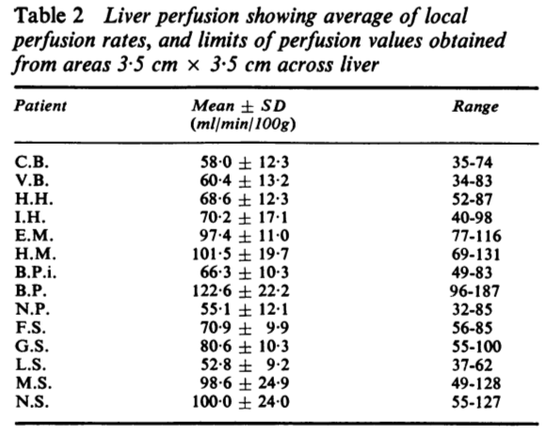

Perfusion heterogeneity (Individuals & liver regions)
Sheriff1977

Slide 39


Local galactose elimination
ALP (arterial liver
perfusion)
PVP (portal-venous
perfusion)
HPI (hepatic perfusion
index)
GE [µmol/min/ml(tissue)]
Galactose elimination (8mM galactose)
Galactose elimination depending on local liver perfusion
THP = ALP + PVP
(total hepatic perfusion)
Wang2013

Slide 40


GE [µmol/min/ml(tissue)]
Galactose elimination depending on galactose

Slide 41
Thank you for your attention

Slide 43
LiSyM – Junior group

Slide 44


Slide 45



Slide 46
Bioinformatics software
König M. and Holzhütter HG.
FluxViz - Cytoscape Plug-in for Vizualisation of Flux Distributions in Networks
Genome Informatics 2010, Vol.24, p.96-103
König M., Dräger A. and Holzhütter HG.
CySBML: a Cytoscape plugin for SBML
Bioinformatics. 2012 Jul 5.
Somogyi ET., Bouteiller JM., Glazier JA., König M., Medley JK., Swat MH and Sauro HM.
LibRoadRunner: a high performance SBML simulation and analysis library.
Bioinformatics. 2015 Jun 17. pii: btv363.

Slide 47

Galactose Metabolism
Kinetic ODE model for single cells
Main enzymatic steps
  Galactokinase (GALK) phosphorylation of galactose (gal) to galactose 1-phosphate (gal1p) catalysed
  Galactose-1-phosphate uridyl transferase (GALT)
  conversion of gal1p to UDP-galactose (udpgal)
  UDP-galactose 4´-epimerase (GALE)
  interconversion of udpgal and UDP-glucose (udpglc)

Slide 48

Sinusoidal gradients

Slide 49
Predicted liver volumes, blood flow & GEC
Liver volume [ml]
Liver blood flow [ml/min]
GEC [mmol/min]
Age [years]
Predictions (grey) uses anthropomorphic dataset from NHANES cohort (N>10000). Statistical models (GAMLSS) based on anthropomorphic trainings sets.
http://www.cdc.gov/nchs/nhanes/about_nhanes.htm
Experimental data (blue) from multiple studies measuring liver volumes & blood flow
All data points are single indiviuums.

Slide 50






Pressure dependent
Fluid transport
Kozlova2000
Model of pressure and flow dependency in the sinusoidal unit based on analytical solutions for filtration and reabsorption in capillaries depending on ultrastructural parameter
  W: specific hydraulic resistance of the capillary with R radius of sinusoid
  ω: hydraulic resistance of all pores (fenestrae) at capillary surface with r radius of pore, l capillary thickness, n pore density
  P(x) : pressure along sinusoid
  Q(x): flow along sinusoid
  q(x): pore flow

Slide 51




Transport & Metabolism
Diffusion & convection are modeled via discretized one-dimensional equations based on local flow Q(x), q(x) and concentrations c(x)
Diffusion through sinusoidal fenestraetion is described via pore theory (sterical hindrance depending on molecule sizes)
Metabolic models (ODE) based on detailed kinetic equations for the enzymes in galactose pathway in all hepatocyte along the sinusoid
Renkin1954, Pappenheimer1953

Slide 52


Perfusion CT
Kanda2011

Slide 53


Heterogeneity in galactose elimination due to ultrastructure

Slide 54


Perfusion Heterogeneity
Distribution of perfusion heterogeneity in liver similar with 133Xe & CT measurements
The local distribution of perfusion results in distributions of galactose elimination
Width and shape of perfusion distribution is transformed depending on actual galactose concentration
Analog the GE can be calculated locally in perfusion-CT

