Slide 1



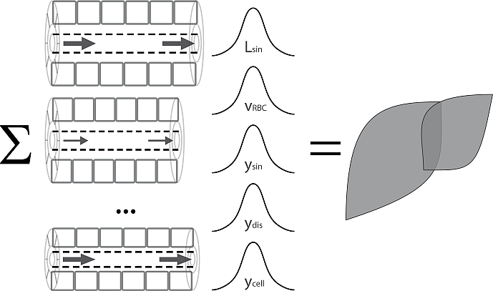
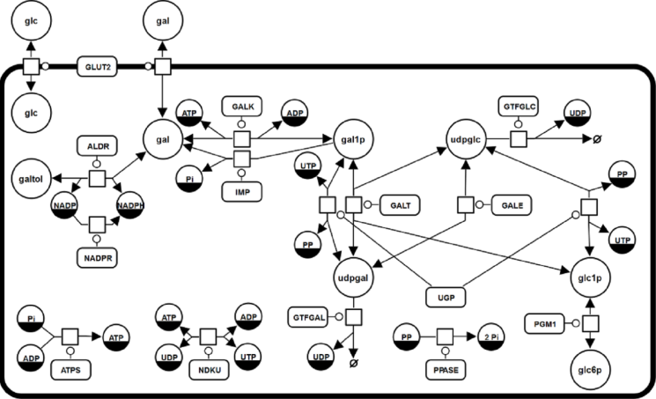
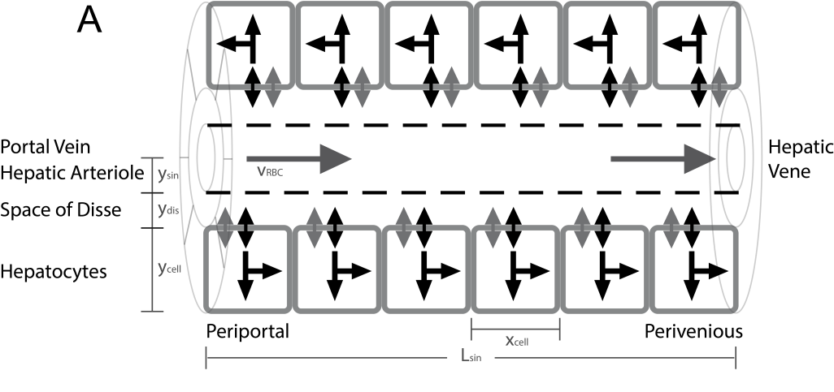
From Hepatocytes to Whole Liver Function:
A Multi-scale Model of Human Galactose Metabolism
König M. & Holzhütter HG.

Slide 2

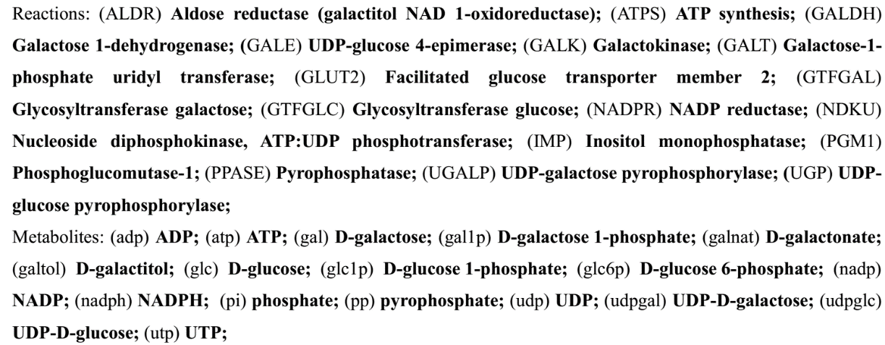
Galactose Metabolism
liver most important organ for whole-body metabolism and clearance of galactose
Main enzymatic steps
  Galactokinase (GALK) phosphorylation of galactose (gal) to galactose 1-phosphate (gal1p) catalysed
  Galactose-1-phosphate uridyl transferase (GALT)
  conversion of gal1p to UDP-galactose (udpgal)
  UDP-galactose 4´-epimerase (GALE)
  interconversion of udpgal and UDP-glucose (udpglc)
  Galactose can enter glycolysis as glucose-1 phosphate (glc1p)
  Galactose can be incorporated in glycoproteins and glycolipids as udpgal

Slide 3

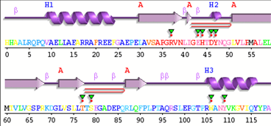
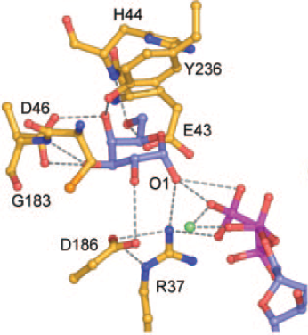

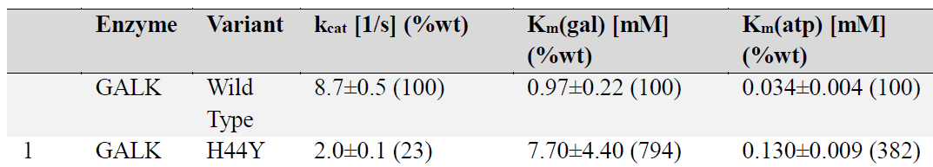


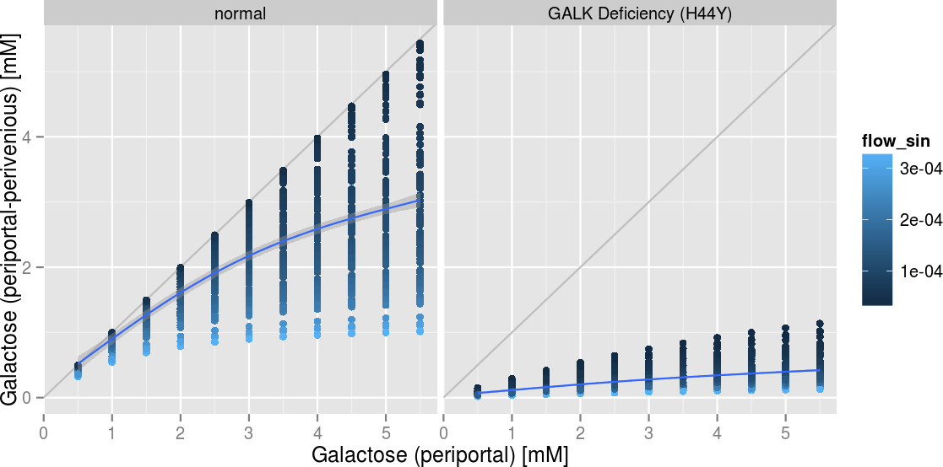
Mutation in conserved region of galactokinase (GALK)
Sequencing
His44 involved in galactose binding
Patient with
Galactosemia
H44Y
Conservation coloring
Mutation leads to altered kinetic properties
Prediction of galactose elimination
Metabolic modelling
[m/s]

Slide 4
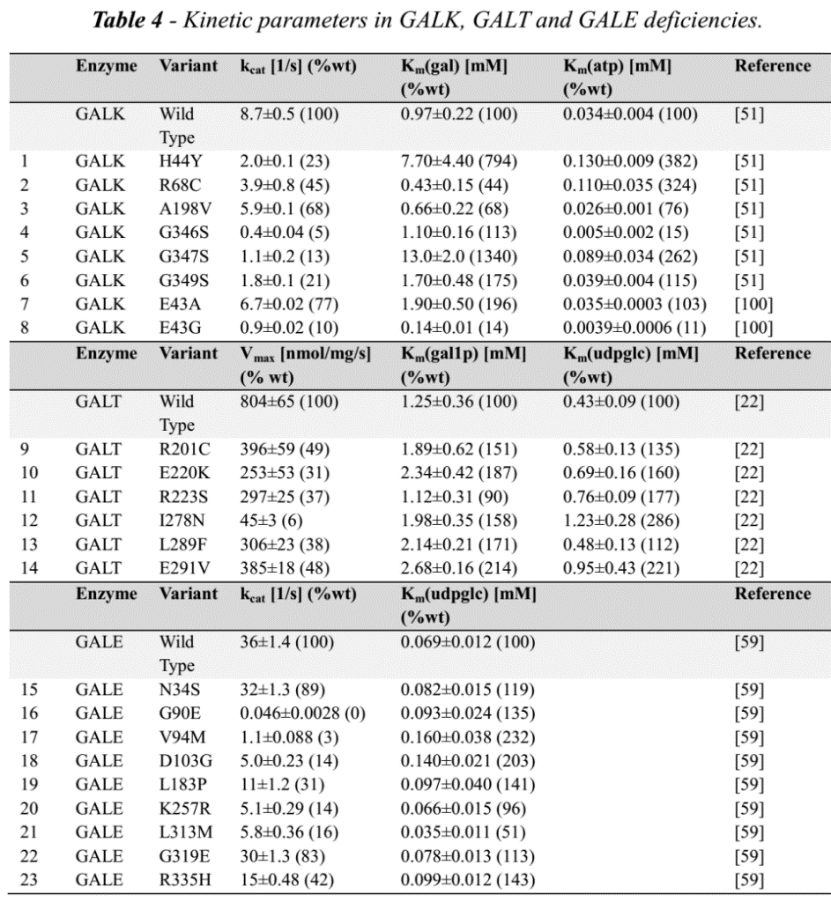
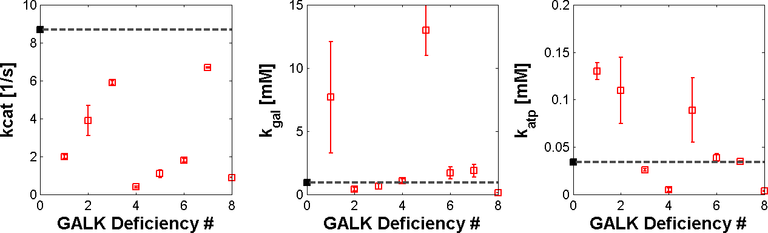
Galactosemias
Deficiencies in GALK, GALT or GALE
Modelled by using alterations in kinetic properties in galactosemias
untreated as well as treated patients have accumulation and/or depletion of specific metabolites, and often abnormalities of glycosylation
implementation
via measured alterations in kinetic properties in human protein mutations
GALK

Slide 5
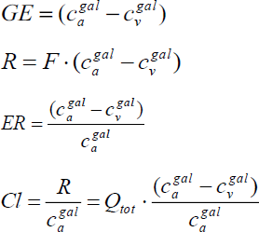
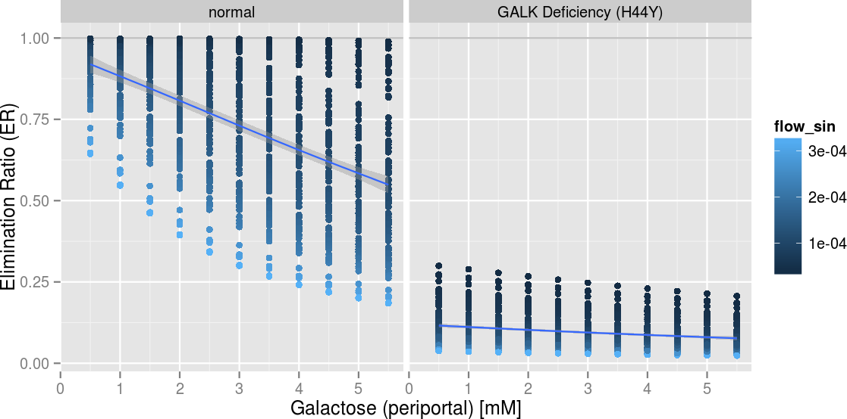
H44Y

Slide 6
GALK (Galactokinase)
  UniProt: P51570 http://www.uniprot.org/uniprot/P51570
  MIM230200
  http://www.omim.org/entry/230200
  Structure: 1wuu (exp)
GALT
  UniProt: P07902
  http://www.uniprot.org/uniprot/P07902
  MIM230400
  http://www.omim.org/entry/230400
  Structure: 1R3A (model)
  Mutation database
  http://arup.utah.edu/database/GALT/GALT_display.php
GALE
  UniProt:Q14376
  http://www.uniprot.org/uniprot/Q14376
  MIM2300350
  http://www.omim.org/entry/230350
  Structures: 1EK6, 1HZJ, 1I3K, 1I3L, 1I3M
Structures
1wuu
J Biol Chem. 2005 Mar 11;280(10):9662-70. Epub 2004 Dec 7.
Molecular structure of human galactokinase: implications for type II galactosemia.
Thoden JB1, Timson DJ, Reece RJ, Holden HM.
http://www.ncbi.nlm.nih.gov/pubmed/15590630
1R3A (model)
J Med Chem. 2005 Feb 10;48(3):773-9.
Homology modeling studies on human galactose-1-phosphate uridylyltransferase and on its galactosemia-related mutant Q188R provide an explanation of molecular effects of the mutation on homo- and heterodimers.
Marabotti A1, Facchiano AM.
http://www.ncbi.nlm.nih.gov/pubmed/15689161
1EK6
Biochemistry. 2000 May 16;39(19):5691-701.
Crystallographic evidence for Tyr 157 functioning as the active site base in human UDP-galactose 4-epimerase.
Thoden JB1, Wohlers TM, Fridovich-Keil JL, Holden HM.
www.ncbi.nlm.nih.gov/pubmed/10801319
1HZJ
J Biol Chem. 2001 May 4;276(18):15131-6. Epub 2001 Jan 26.
Human UDP-galactose 4-epimerase. Accommodation of UDP-N-acetylglucosamine within the active site.
Thoden JB1, Wohlers TM, Fridovich-Keil JL, Holden HM.
http://www.ncbi.nlm.nih.gov/pubmed/11279032
1I3K, 1I3L, 1I3M
J Biol Chem. 2001 Jun 8;276(23):20617-23. Epub 2001 Mar 7.
Molecular basis for severe epimerase deficiency galactosemia. X-ray structure of the human V94m-substituted UDP-galactose 4-epimerase.
Thoden JB1, Wohlers TM, Fridovich-Keil JL, Holden HM.
http://www.ncbi.nlm.nih.gov/pubmed/11279193

