Slide 1



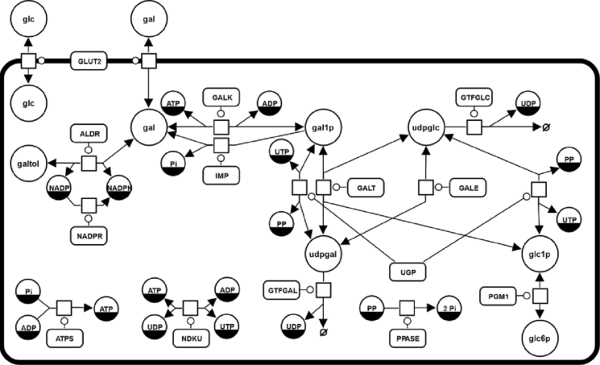
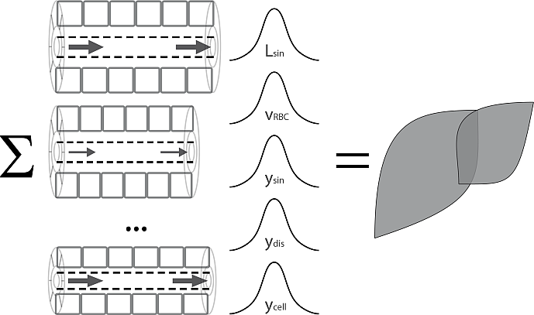
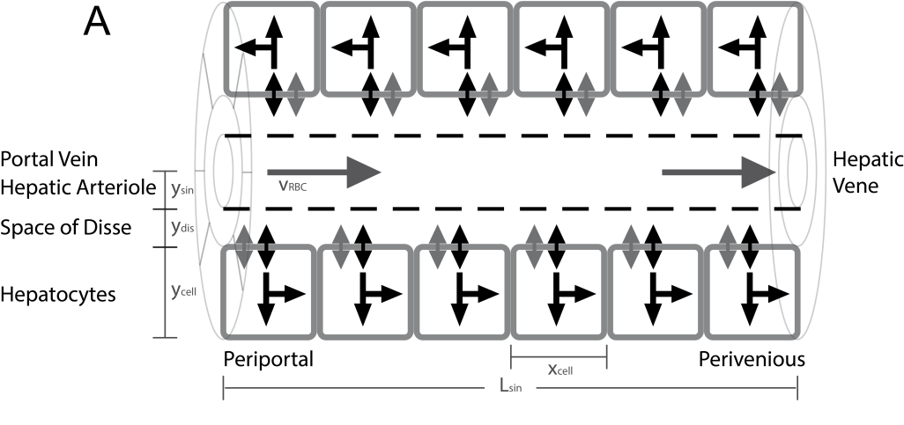
From Hepatocytes to Whole Liver Function: A Multi-scale Model of Human Galactose Metabolism König M. & Holzhütter HG.

Slide 2
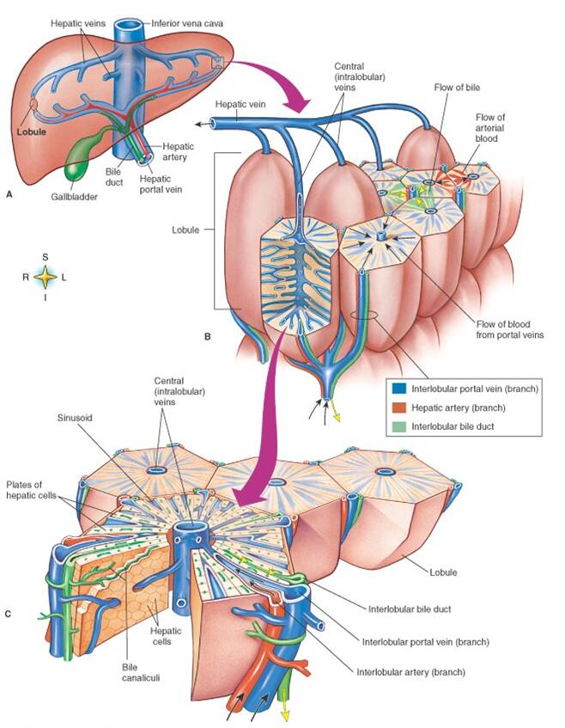
Liver Architecture
Liver
liver structured in parallel subunits (liver lobulus)
liver lobulus consists of network of sinusoids
Sinusoidal Unit central sinusoid surrounded by hepatocyes
Lobulus
Sinusoidal Unit
Hepatocytes

Slide 3
Cellular Scale - Hepatocytes

Slide 4

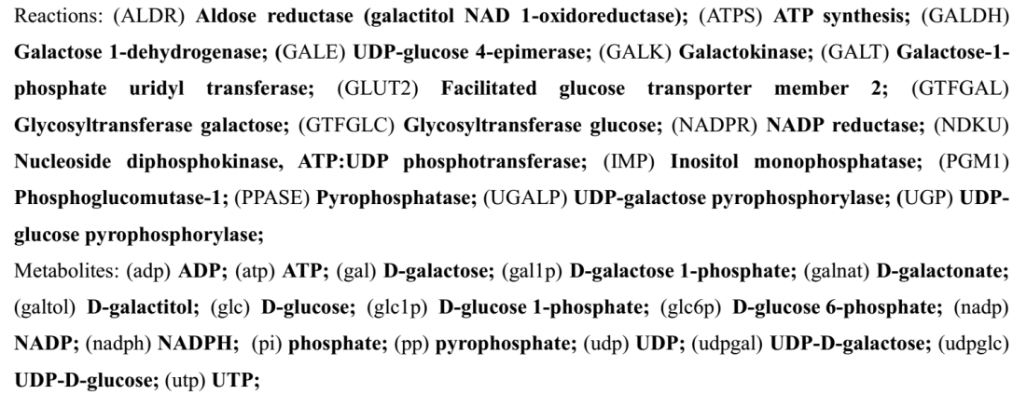
Galactose Metabolism
Liver most important organ for whole-body galactose metabolism
Galactose Clearance Capacity (GEC) used in liver function test
Independent of other pathways
Galactokinase (GALK) phosphorylation of galactose (gal) to galactose 1-phosphate (gal1p) catalysed
Galactose-1-phosphate uridyl transferase (GALT) conversion of gal1p to UDP-galactose (udpgal)
UDP-galactose 4´-epimerase (GALE) interconversion of udpgal and UDP-glucose (udpglc)
Galactose can enter glycolysis as glucose-1 phosphate (glc1p)
Galactose can be incorporated in glycoproteins and glycolipids as udpgal

Slide 5
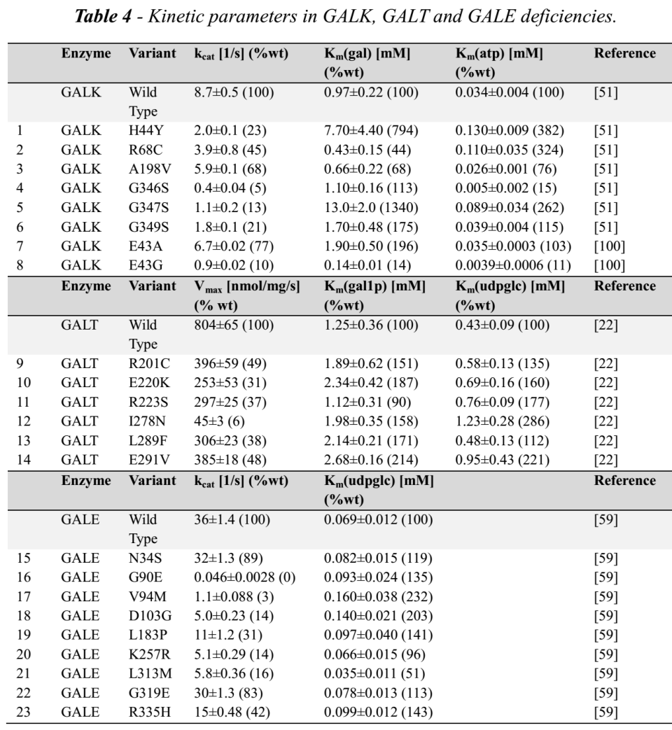
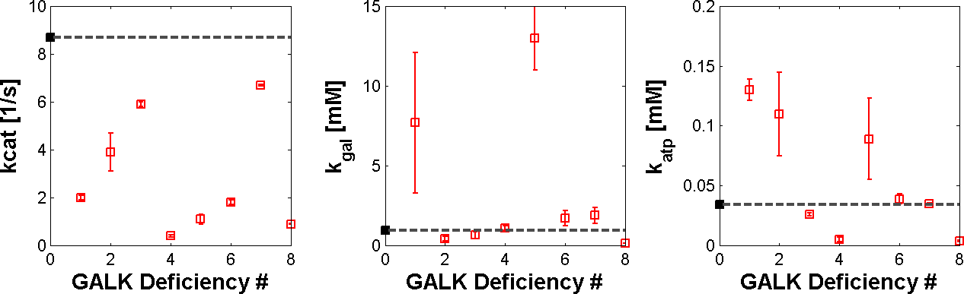
Galactosemias
Deficiencies in GALK, GALT or GALE
Modelled by using alterations in kinetic properties in galactosemias
untreated as well as treated patients have accumulation and/or depletion of specific metabolites, and often abnormalities of glycosylation

Slide 6
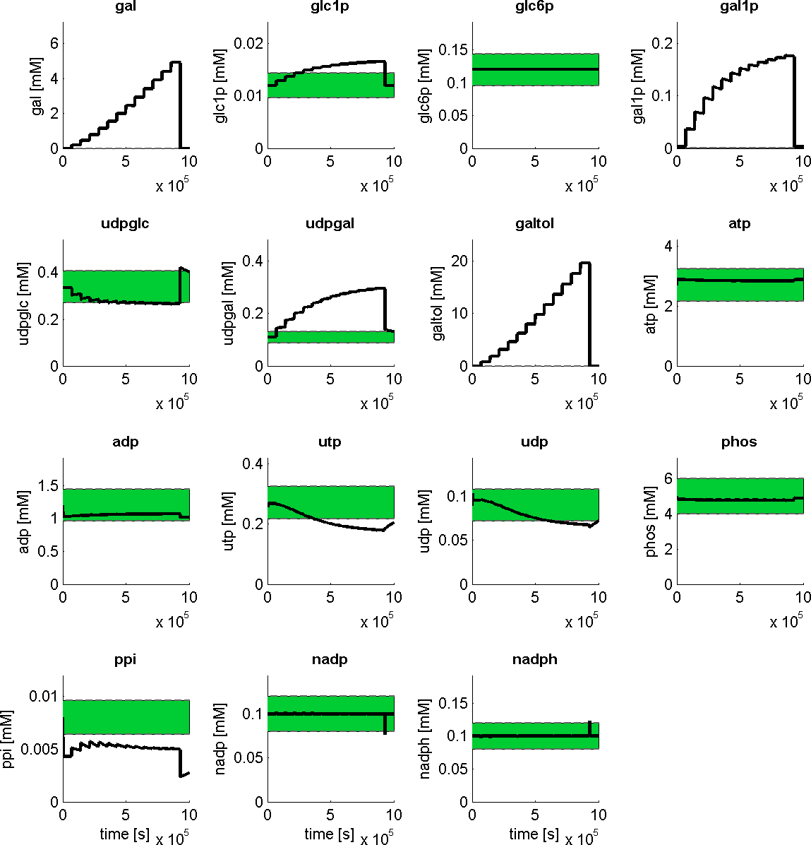
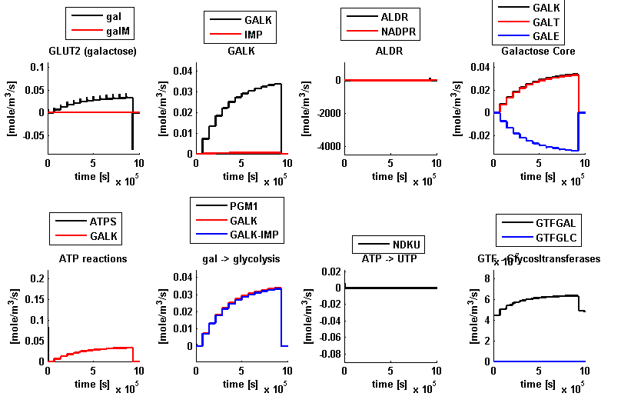
Galactose Challenge
Reproduces
normal metabolic concentrations
altered metabolite levels during galactose challenge
observed saturation of clearance capacity
concentrations
fluxes
time
time

Slide 7
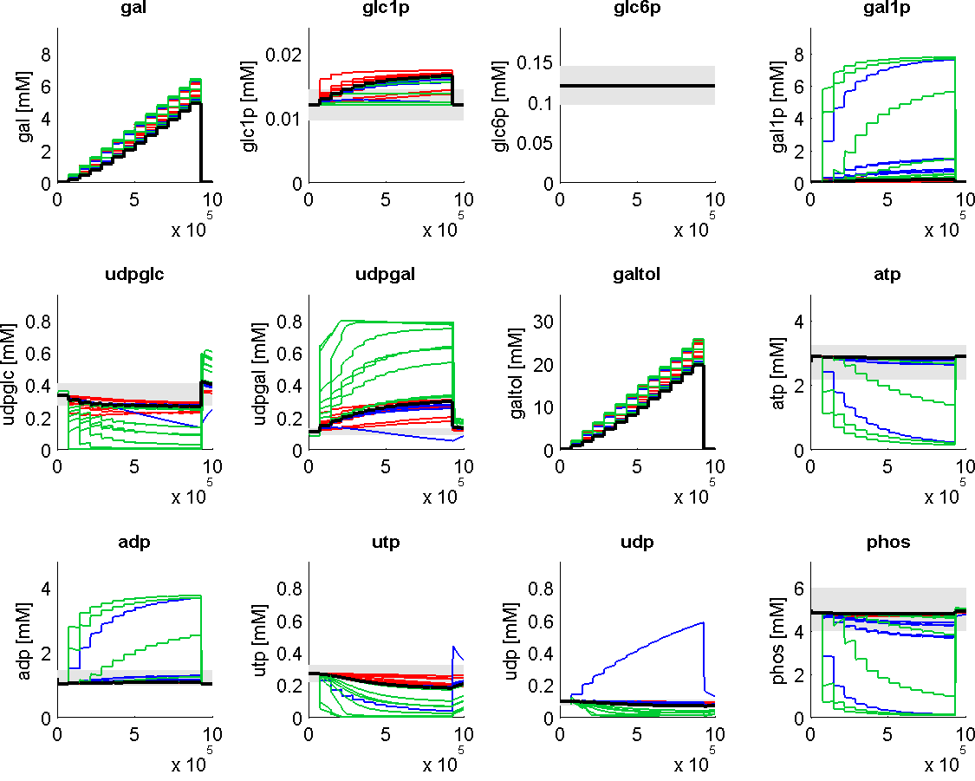
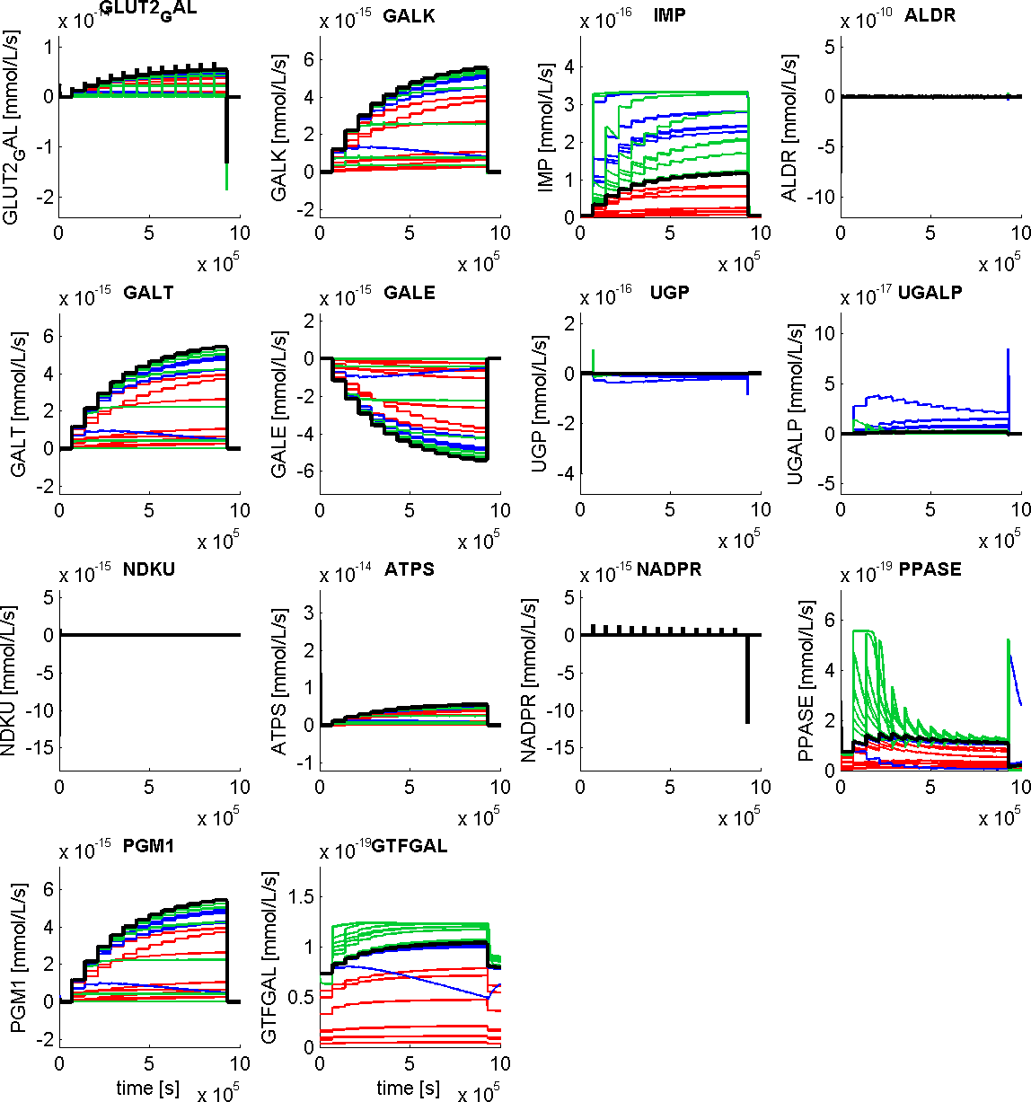
Galactosemia (GALK, GALT, GALE)
marked alterations in metabolite levels & fluxes
reduced galactose clearance
galactitol accumulation
shift of udpglc/udpgal level
reduced galactose clearance
energetically challenged
concentrations
fluxes
time
time
time

Slide 8

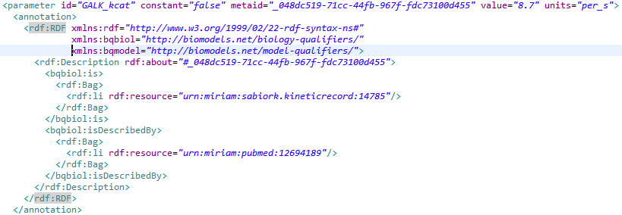

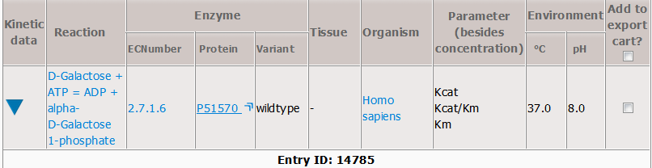
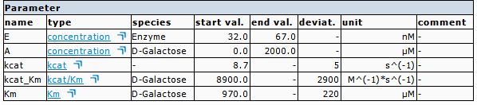
Data Management
Galactokinase
SBML Model
http://seek.virtuelle-leber.de/models/138
Annotations
CHEBI, UniProt, KEGG, RHEA
kinetic parameters linked to SABIO-RK

Slide 9
Tissue-scale – Sinusoidal Unit

Slide 10
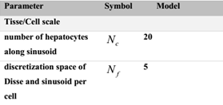
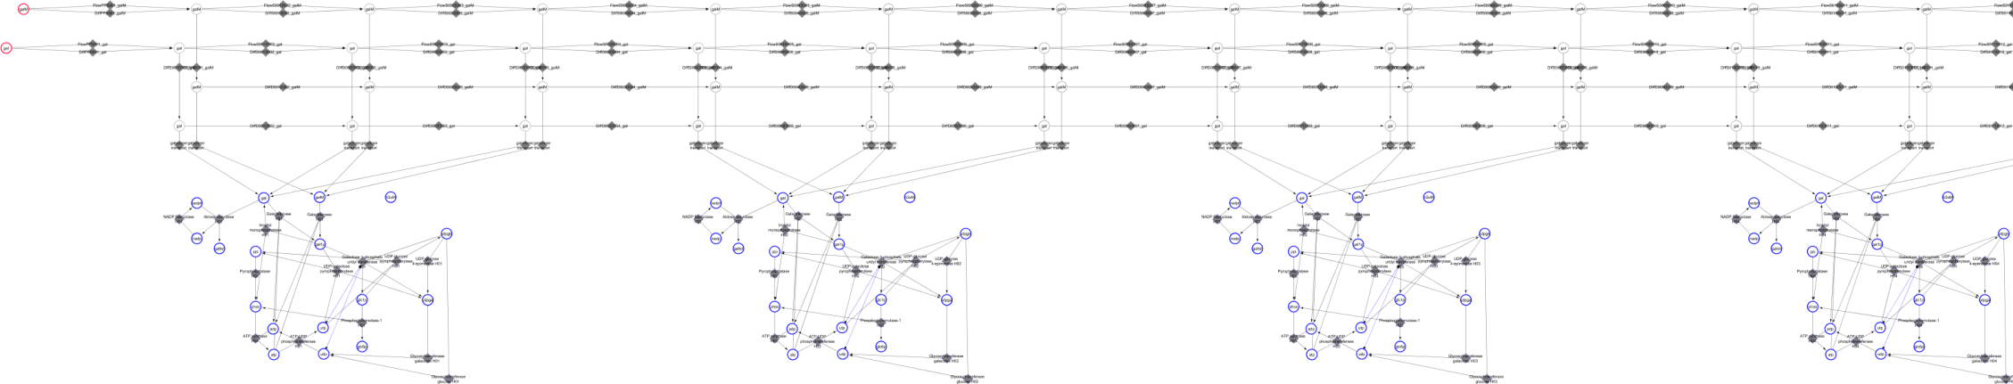
Tissue-Scale: Sinusoidal Unit
Hepatocyte 1
Hepatocyte 2
H1
H20

Slide 11
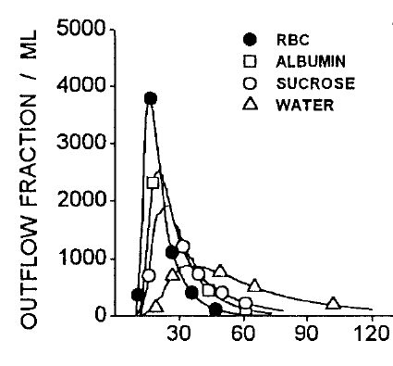
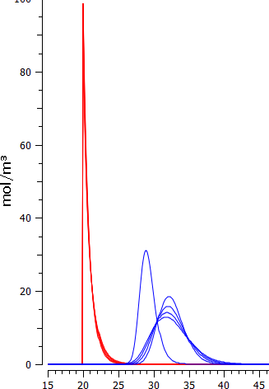
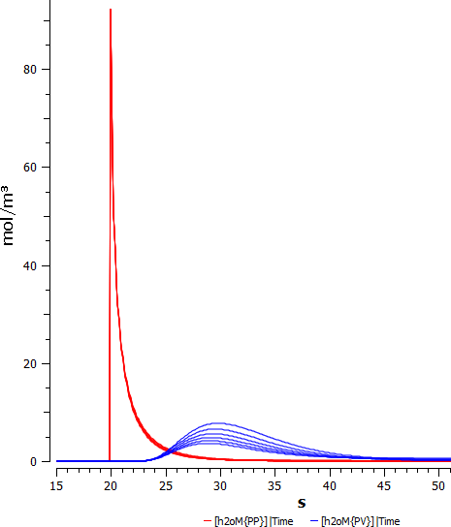
Multiple-Indicator Dilution Curves
WATER: varying exchange
rates with hepatocytes
periportal
perivenous
RBC
periportal
perivenous
ALBUMIN
time [s]
time [s]

Slide 12
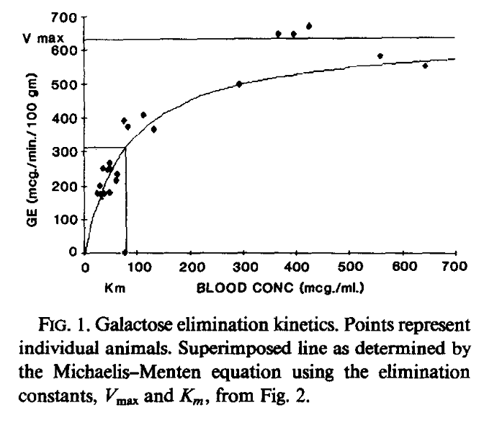
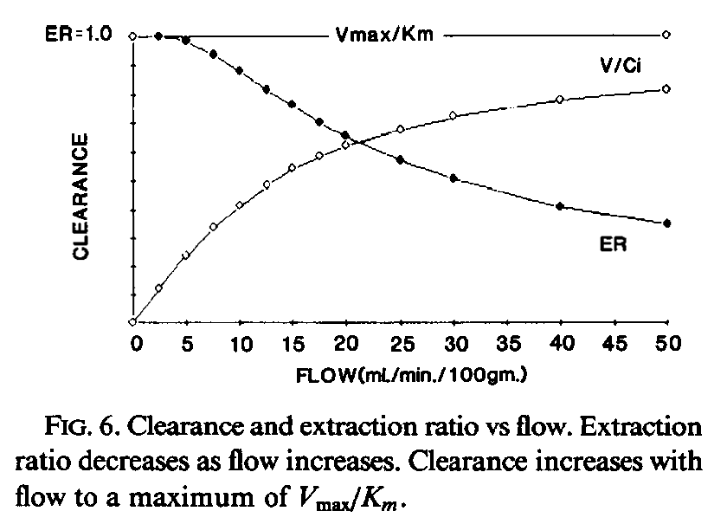
Galactose Clearance & Extraction Ratios
Work in progress: dependencies of galactose & blood flow

Slide 13
Organ-scale – Whole Liver Metabolism

Slide 14
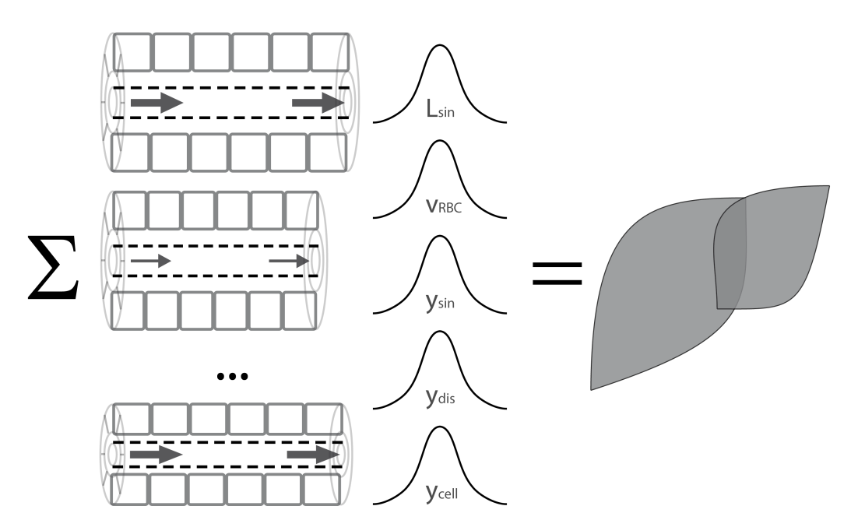
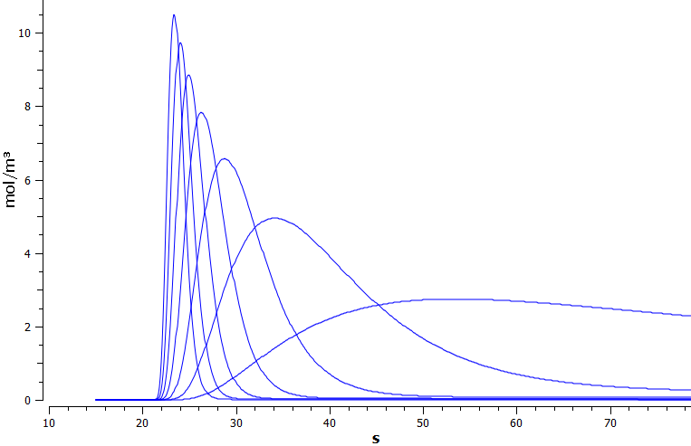
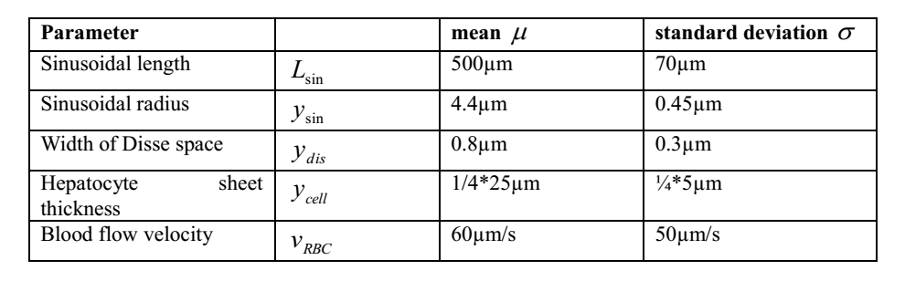
Organ-Scale
whole liver model
integrating heterogeneous contributions of sinusoidal units differing in blood-flow and tissue-architecture
Dilution profiles under
variation of perfusion
time [s]

Slide 15
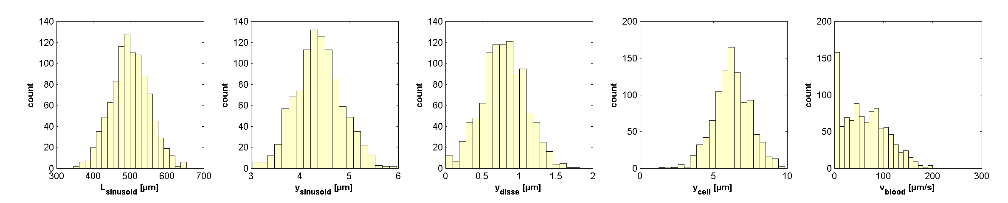
Current Work
Calculate distributions of sinusoidal units
optimized C++ integration routines
parallelization & integration
Simulations
Galactosemias (tissue & organ changes)
homogeneous alterations
changes in GEC dring CCL4 intoxication
changes in GEC in cirrhosis
heterogeneous alterations
local perfusion inhomogenities

