Slide 1



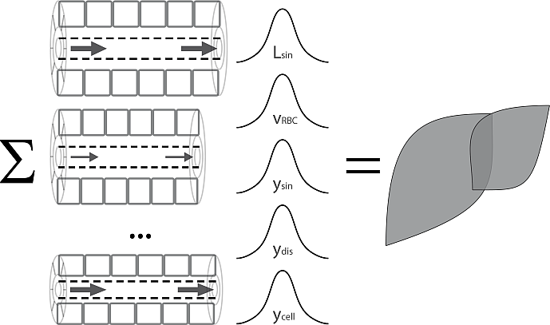
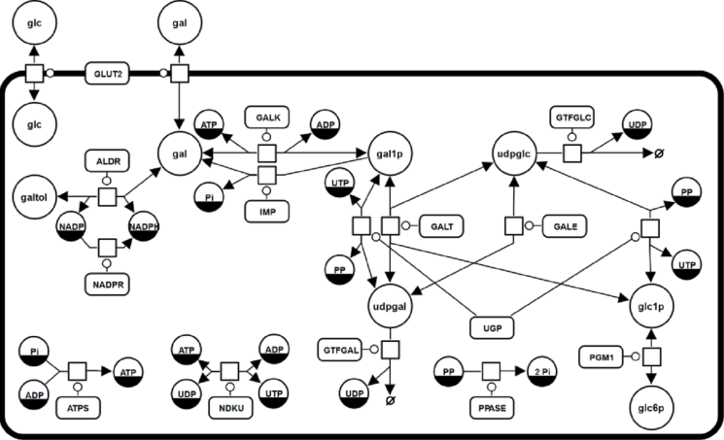
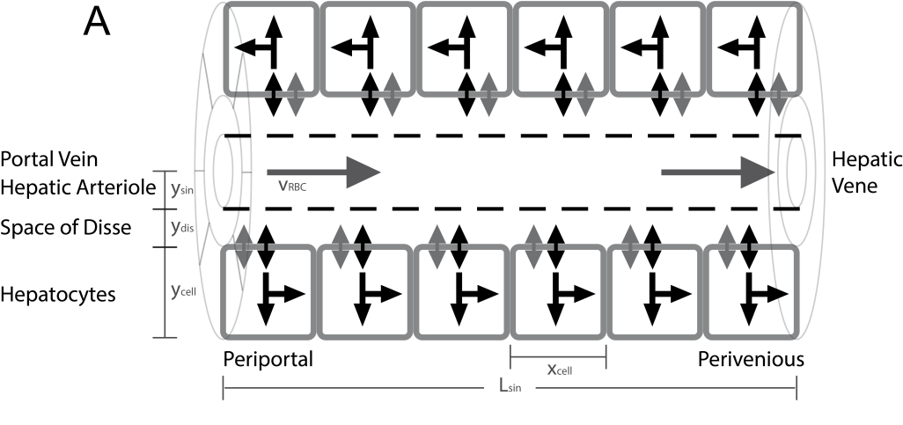
From Hepatocytes to Whole Liver Function: A Multi-scale Model of Human Galactose Metabolism König M. & Holzhütter HG.

Slide 2

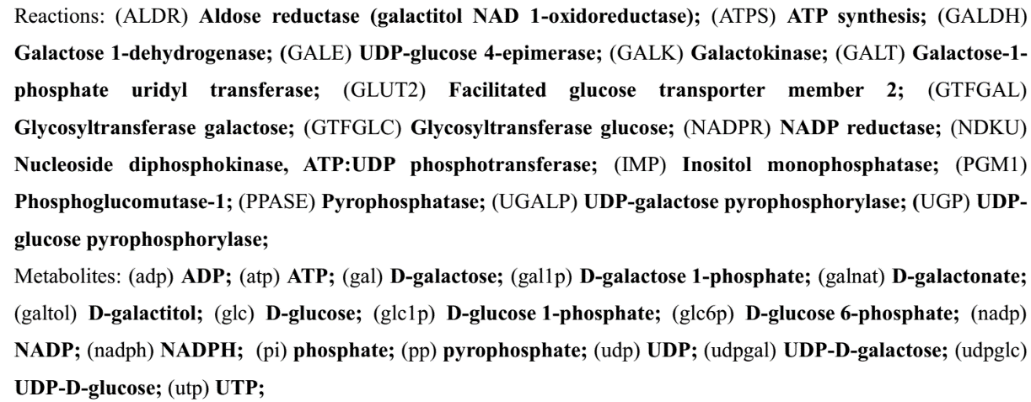
Galactose Metabolism
liver most important organ for whole-body metabolism and clearance of galactose
Main enzymatic steps
Galactokinase (GALK) phosphorylation of galactose (gal) to galactose 1-phosphate (gal1p) catalysed
Galactose-1-phosphate uridyl transferase (GALT) conversion of gal1p to UDP-galactose (udpgal)
UDP-galactose 4´-epimerase (GALE) interconversion of udpgal and UDP-glucose (udpglc)
Galactose can enter glycolysis as glucose-1 phosphate (glc1p)
Galactose can be incorporated in glycoproteins and glycolipids as udpgal

Slide 3
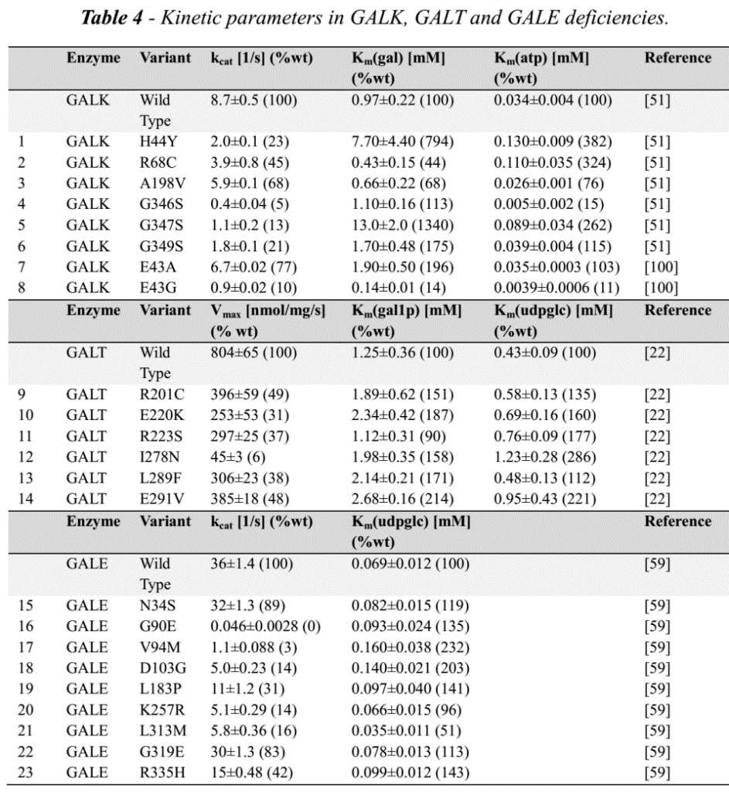
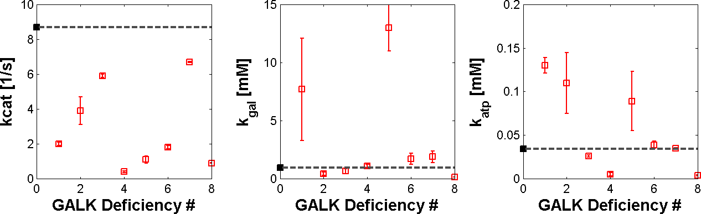
Galactosemias
Deficiencies in GALK, GALT or GALE
Modelled by using alterations in kinetic properties in galactosemias
untreated as well as treated patients have accumulation and/or depletion of specific metabolites, and often abnormalities of glycosylation
implementation
via measured alterations in kinetic properties in human protein mutations
GALK

Slide 4

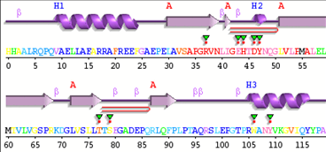
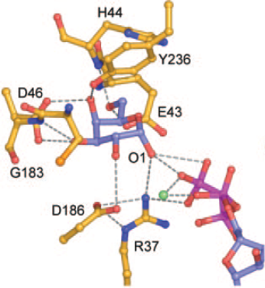



Mutation in conserved region of galactokinase (GALK)
Sequencing
His44 involved in galactose binding
Patient with
Galactosemia
H44Y
Conservation coloring
Mutation results in altered kinetic properties
Metabolic model predicts alteration in hepatic metabolism & galactose clearance

Slide 5
GALK (Galactokinase)
UniProt: P51570
http://www.uniprot.org/uniprot/P51570
MIM230200
Structures: 1wuu
GALT
UniProt: P07902
Omim: 230400
http://arup.utah.edu/database/GALT/GALT_display.php (266 variants)
GALE
Q14376
Omim2300350
J Biol Chem. 2005 Mar 11;280(10):9662-70. Epub 2004 Dec 7.
Molecular structure of human galactokinase: implications for type II galactosemia.
Thoden JB1, Timson DJ, Reece RJ, Holden HM.

Slide 6
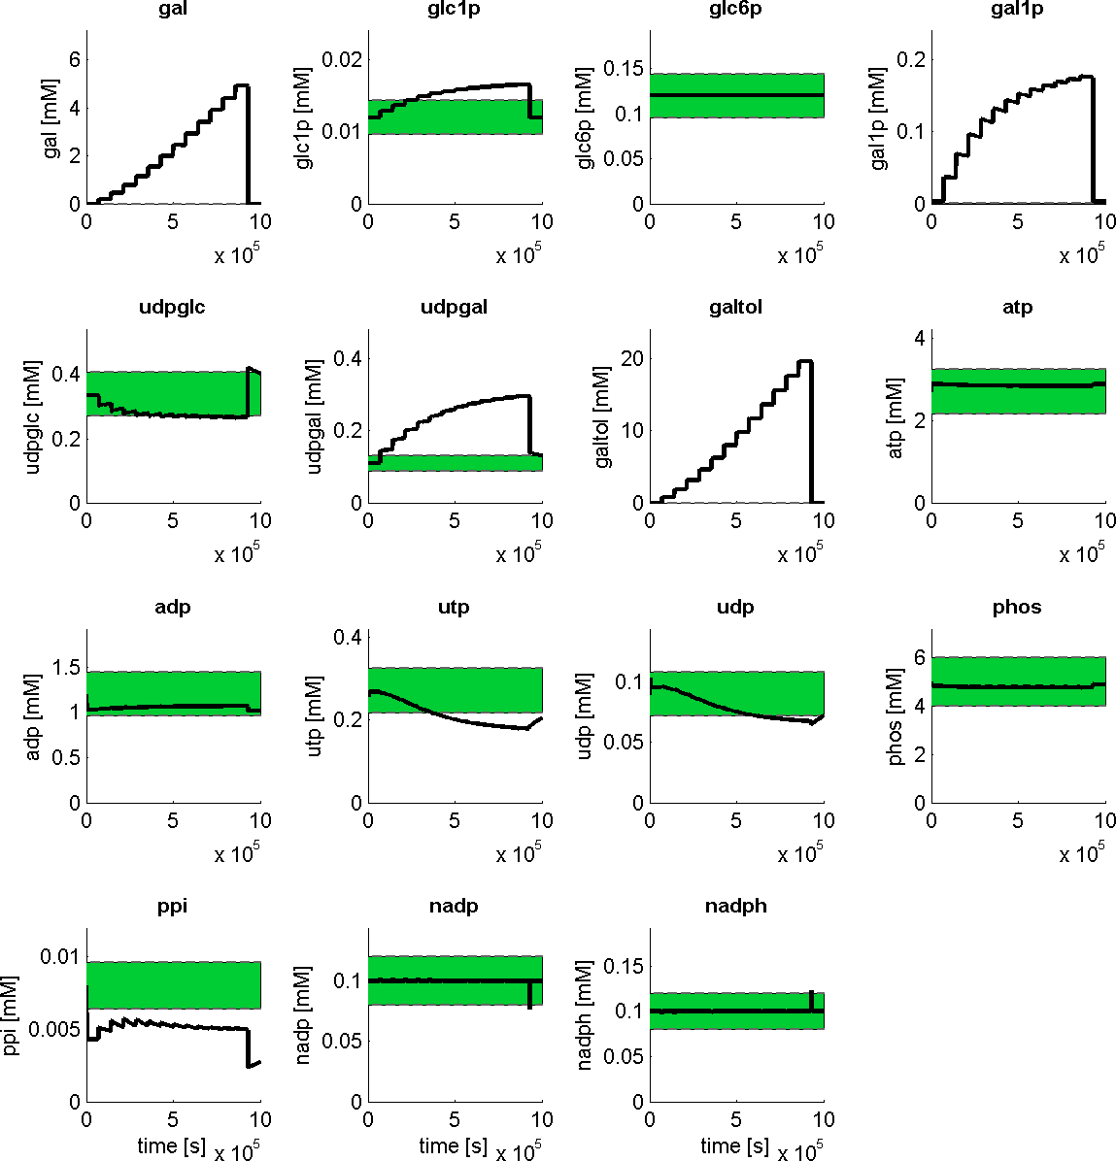
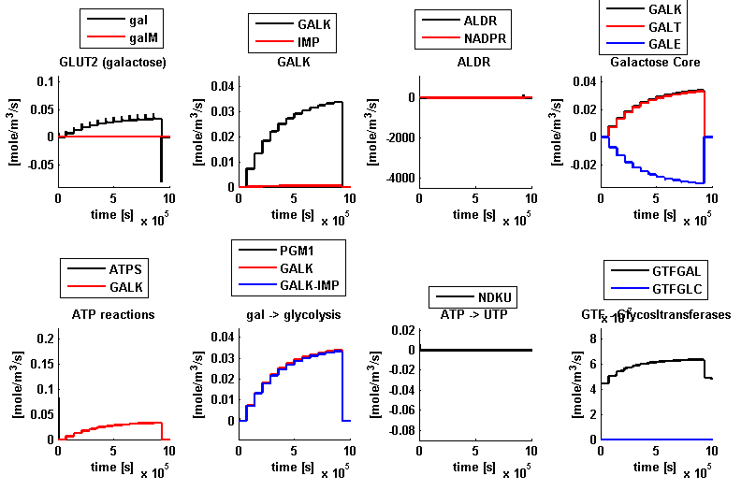
Hepatocyte Model
Reproduces
metabolic concentrations normal state
altered metabolite levels during galactose challenge
saturation of clearance capacity

Slide 7
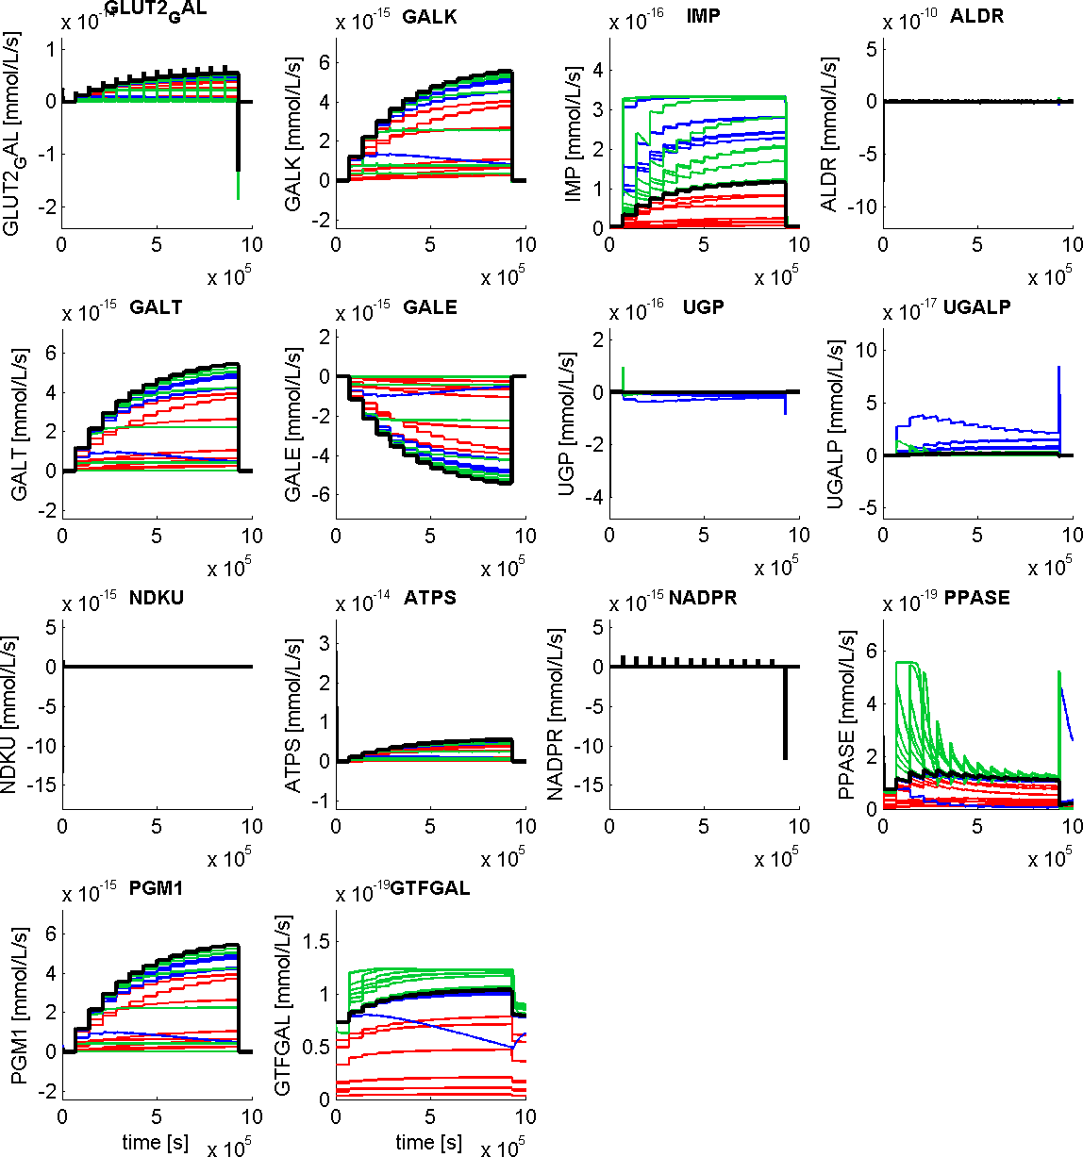
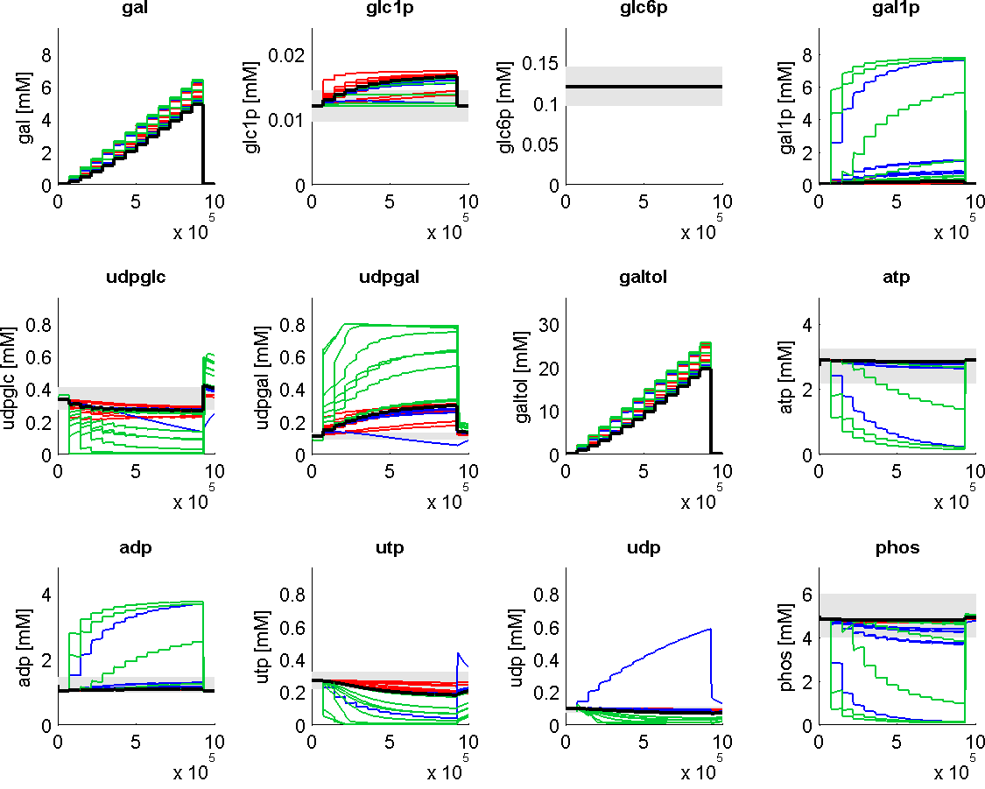
Galactosemia (GALK, GALT, GALE)
marked alterations in metabolite levels
galactitol accumulation
shift of udpglc/udpgal level
reduced galactose clearance
energetically challenged

