Slide 1


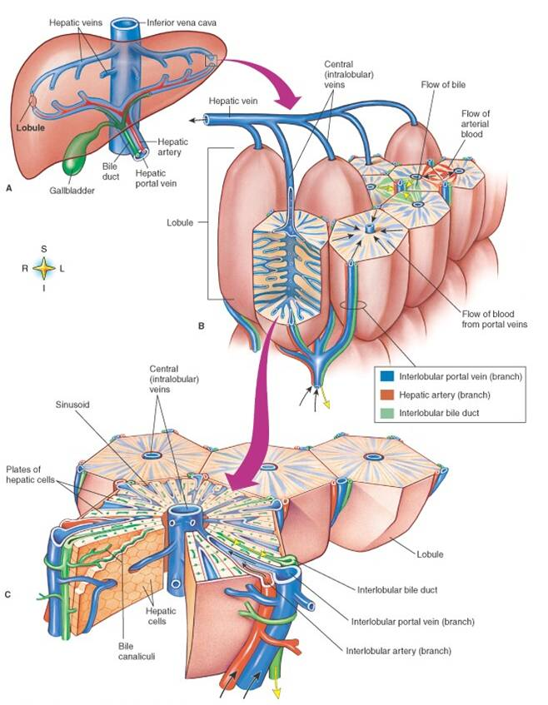
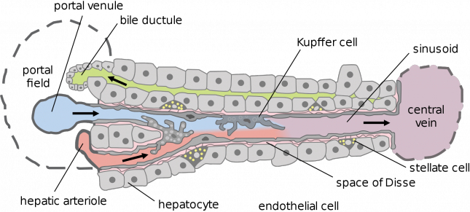
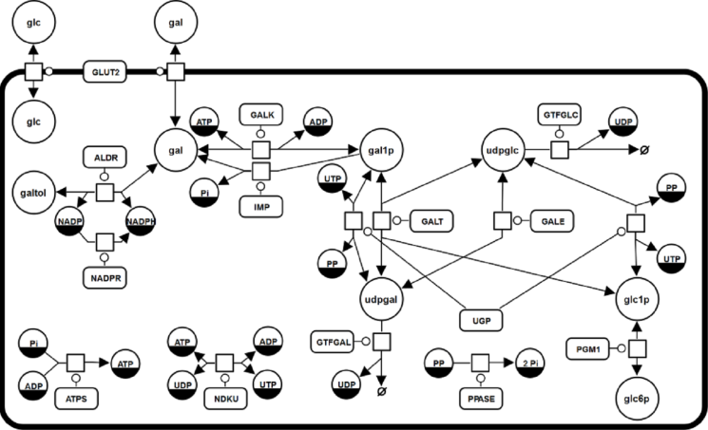
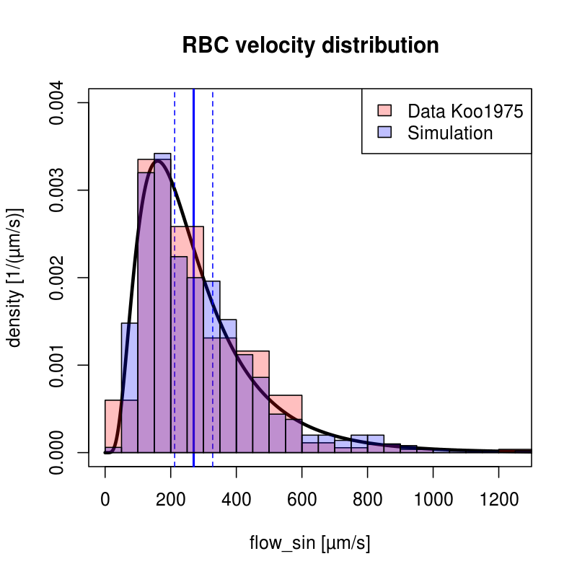
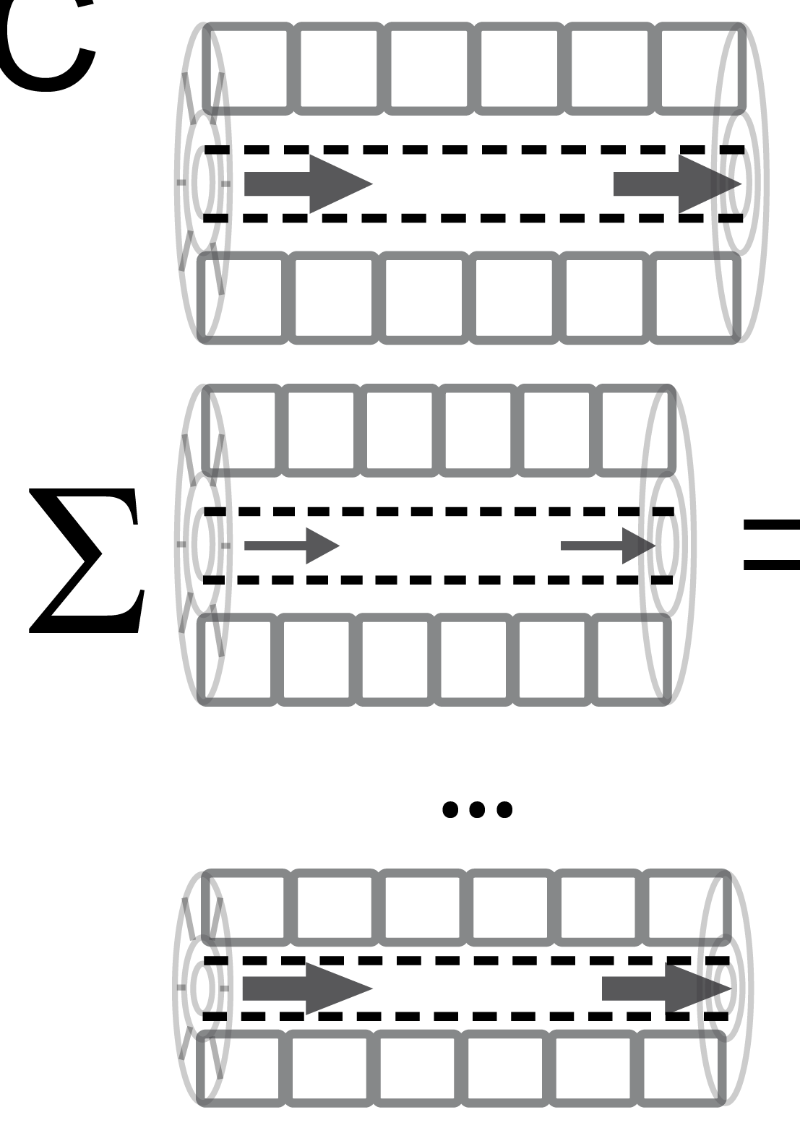
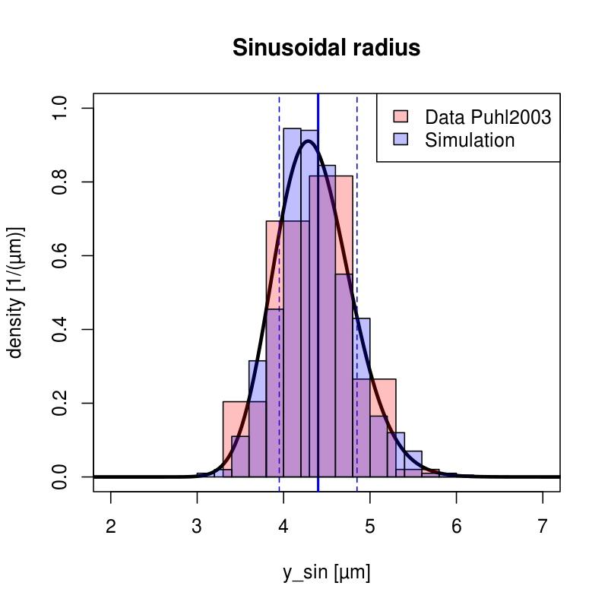
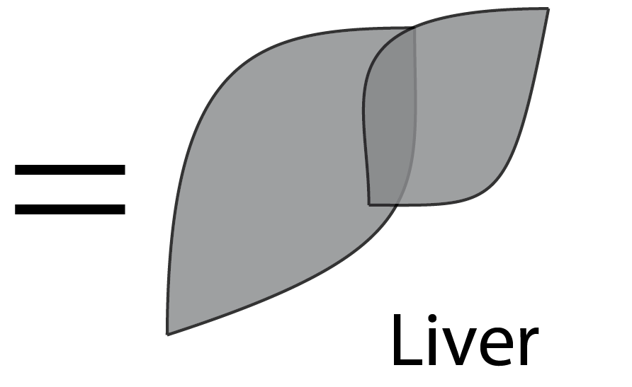
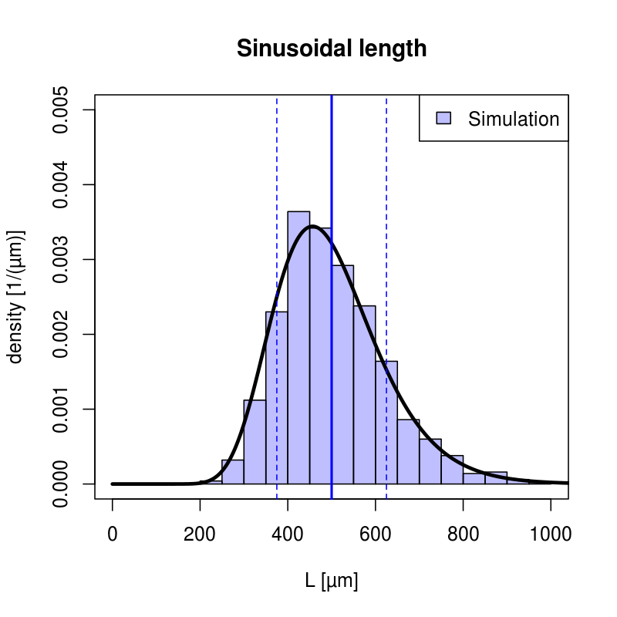
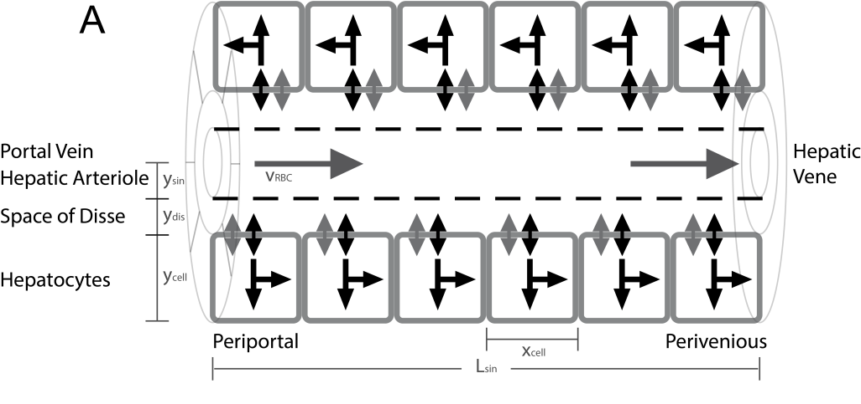
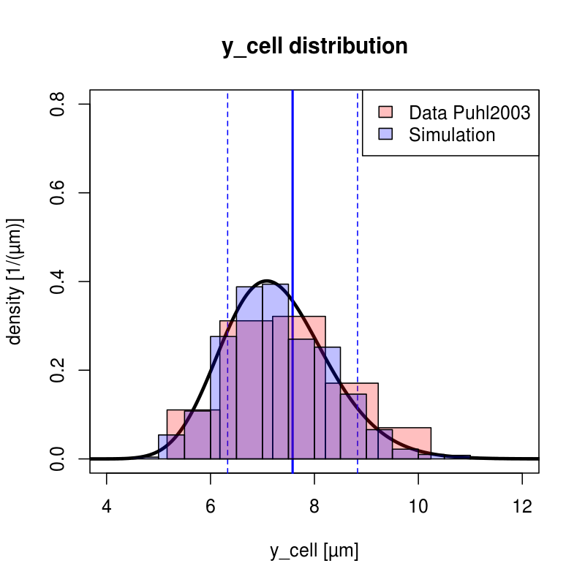
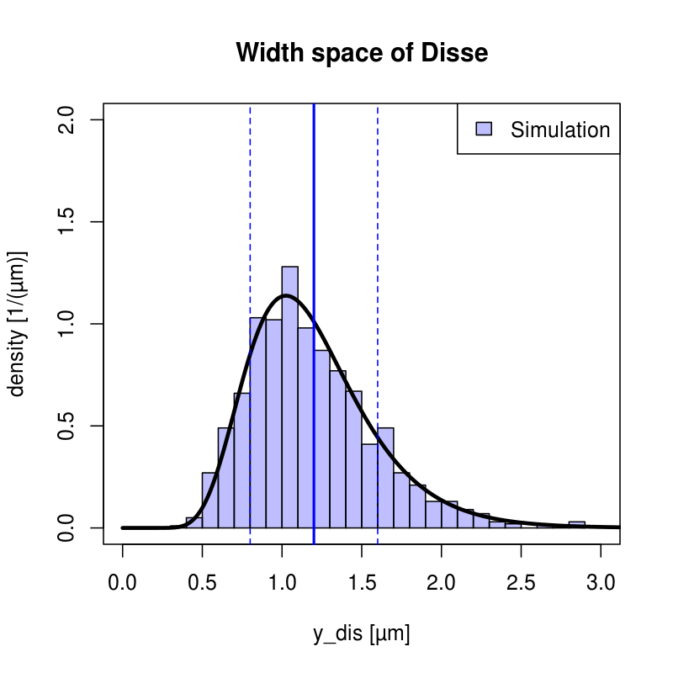

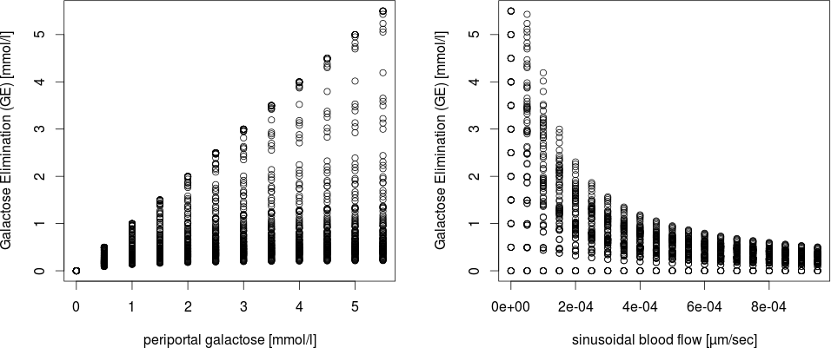
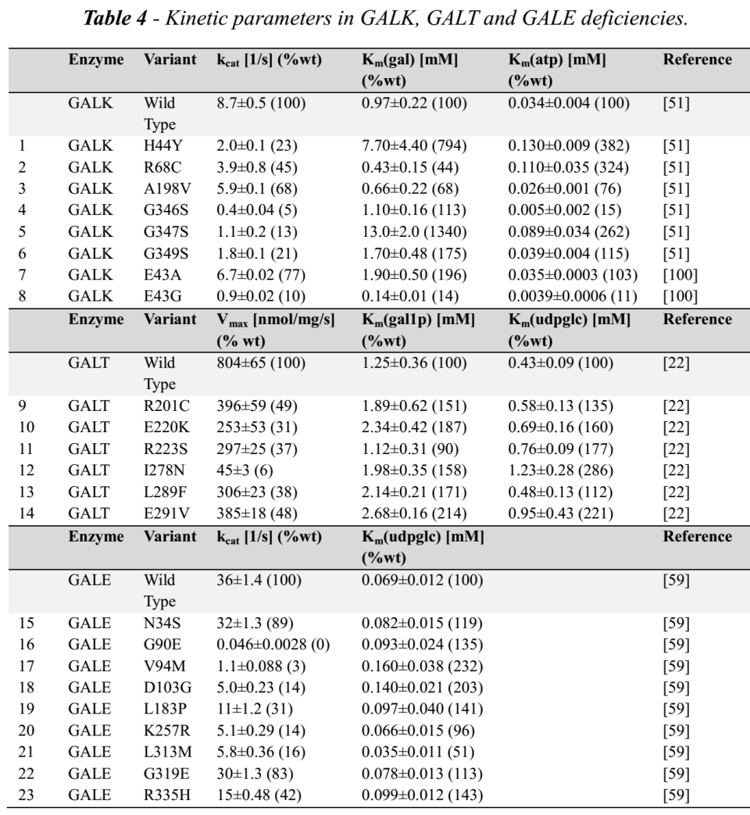
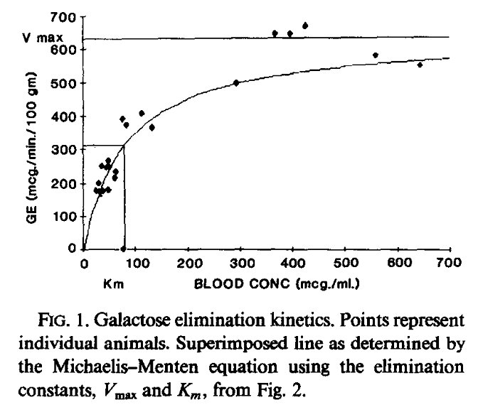
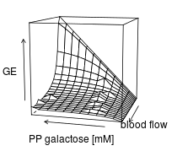
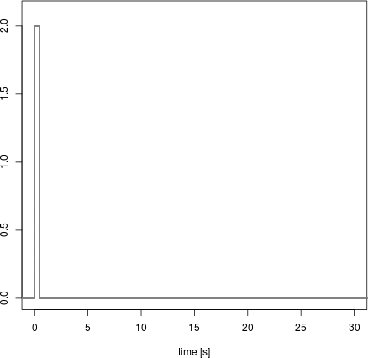

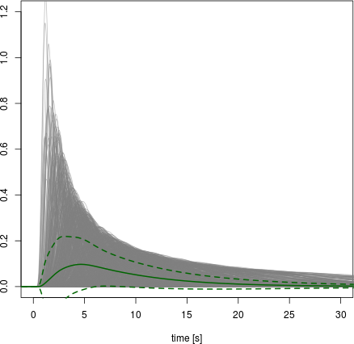
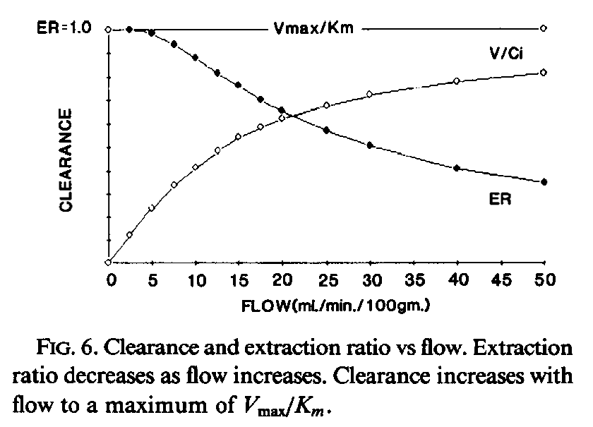
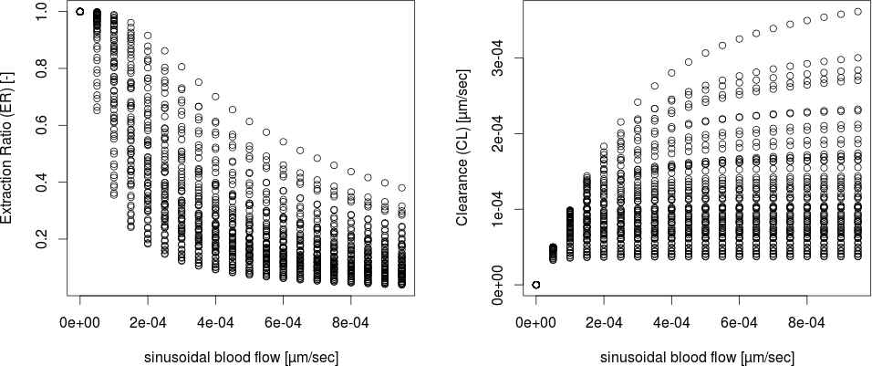
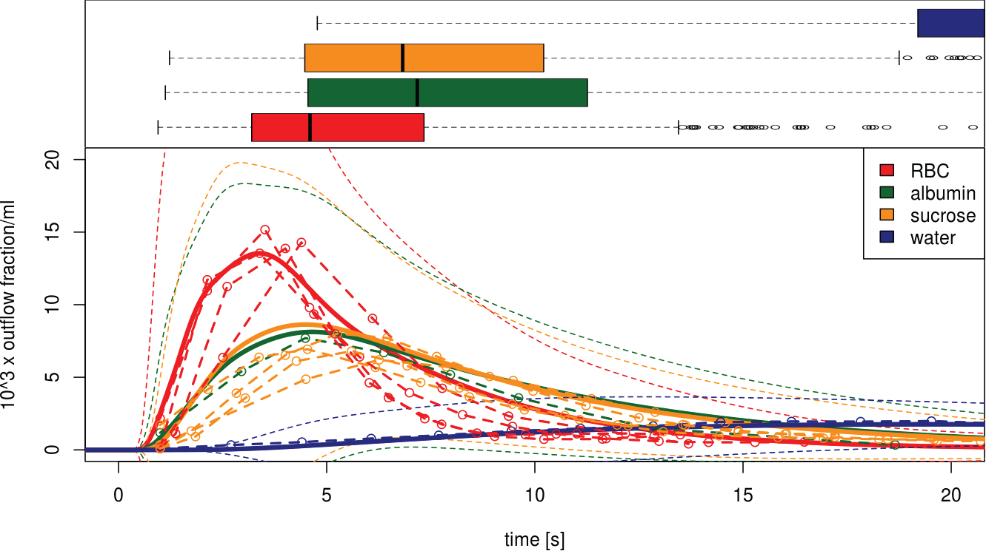
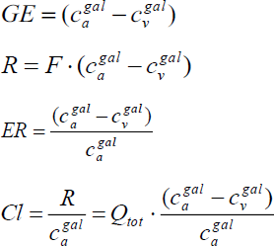
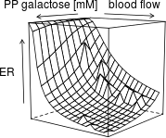
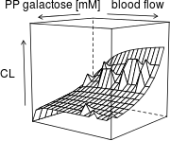
funded by
Liver
From Single Hepatocytes to Whole Liver Function:
A Multi-Scale Model of Human Galactose Metabolism
König M.¹ & Holzhütter HG.¹
¹ Institute of Biochemistry, Charité Berlin, konigmatt@googlemail.com
MODEL
Lobulus
Within a single lobulus a network of capillaries, the so-called liver sinusoids, which are surrounded by hepatocytes, form the smallest functional units.
Model Overview
We present a multi-scale model of liver galactose metabolism bridging the scales from single-cell metabolism over the tissue level to the whole-organ. The model combines a detailed kinetic model of the cellular galactose metabolism with a tissue-scale perfusion model of the sinusoid. The metabolic capacity of the whole liver is modelled by integrating the heterogeneous contribution of sinusoids differing in blood-flow rates and tissue-architecture and metabolism.
Introduction
The liver plays a central role in maintaining the homeostasis of numerous plasma metabolites, clearance of substances and detoxification of xenobiotics. For galactose, the liver is the most important organ for the whole-body metabolism and clearance.
The liver architecture is unique within the body in that hepatic functionality is parallelized across a multitude of structural similar hexagonal subunits, the lobuli.
Sinusoidal Unit
Hepatocyte
[<] Fig.1A Schema of the metabolic network in system in Systems Biology Graphical Notation (SBGN). The kinetic model of hepatic galactose metabolism is implemented in SBML.
[˅] Fig.1B Schema of the tissue-scale model of hepatic metabolism consisting of diffusion and convection based transport of substances in the blood, diffusion-based transport of substances in the space of Disse and detailed kinetic models of metabolism on the cellular level. Galactose metabolism was included in the sinusoid-scale model with exchangeable metabolites between the cells and the space of Disse.
[>] Fig.1C Modeling the liver via integration of heterogenous tissue-models. A multitude of sinusoidal units is sampled from the distribution of tissue parameters and integration over the whole liver volume is performed.
Reactions: (ALDR) Aldose reductase (galactitol NAD 1-oxidoreductase); (ATPS) ATP synthesis; (GALDH) Galactose 1-dehydrogenase; (GALE) UDP-glucose 4-epimerase; (GALK) Galactokinase; (GALT) Galactose-1-phosphate uridyl transferase; (GLUT2) Facilitated glucose transporter member 2; (GTFGAL) Glycosyltransferase galactose; (GTFGLC) Glycosyltransferase glucose; (NADPR) NADP reductase; (NDKU) Nucleoside diphosphokinase, ATP:UDP phosphotransferase; (IMP) Inositol monophosphatase; (PGM1) Phosphoglucomutase-1; (PPASE) Pyrophosphatase; (UGALP) UDP-galactose pyrophosphorylase; (UGP) UDP-glucose pyrophosphorylase;
Metabolites: (adp) ADP; (atp) ATP; (gal) D-galactose; (gal1p) D-galactose 1-phosphate; (galnat) D-galactonate; (galtol) D-galactitol; (glc) D-glucose; (glc1p) D-glucose 1-phosphate; (glc6p) D-glucose 6-phosphate; (nadp) NADP; (nadph) NADPH; (pi) phosphate; (pp) pyrophosphate; (udp) UDP; (udpgal) UDP-D-galactose; (udpglc) UDP-D-glucose; (utp) UTP;
Sinusoidal Unit
Liver
Liver
RESULTS
Galactose Elimination
Galactosemias
The model was validated with data from multiple scales and the effects of local & global metabolic & structural parameters were analysed
Simulations
Multiple Indicator Dilution Curves
Galactose elimination capacity (GEC) and galactose clearance
Effect of metabolic deficiencies (galactosemias)
Work in progress
Effect of alterations in global liver volume and blood flow (aging)
Effect of structural alterations of the liver (cirrhosis)
Multiple Indicator Dilution Curves
Perivenious
dilution
Periportal
tracer
Galactose Clearance & Extraction
time [s]
time [s]
Boxplot
maximum times
Dilution curves
with experiments
time [s]

