Slide 1




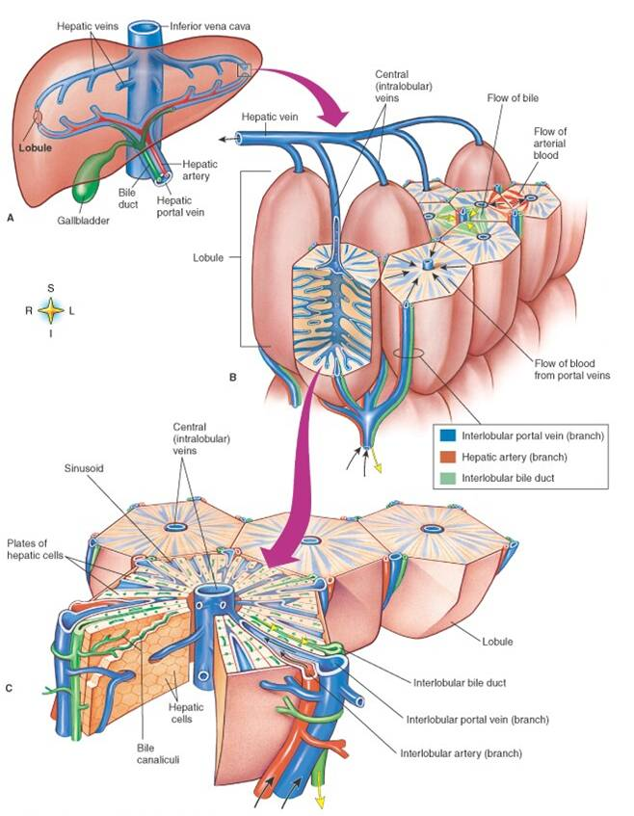
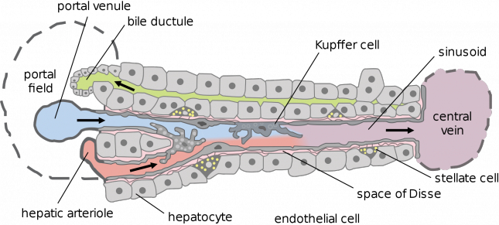
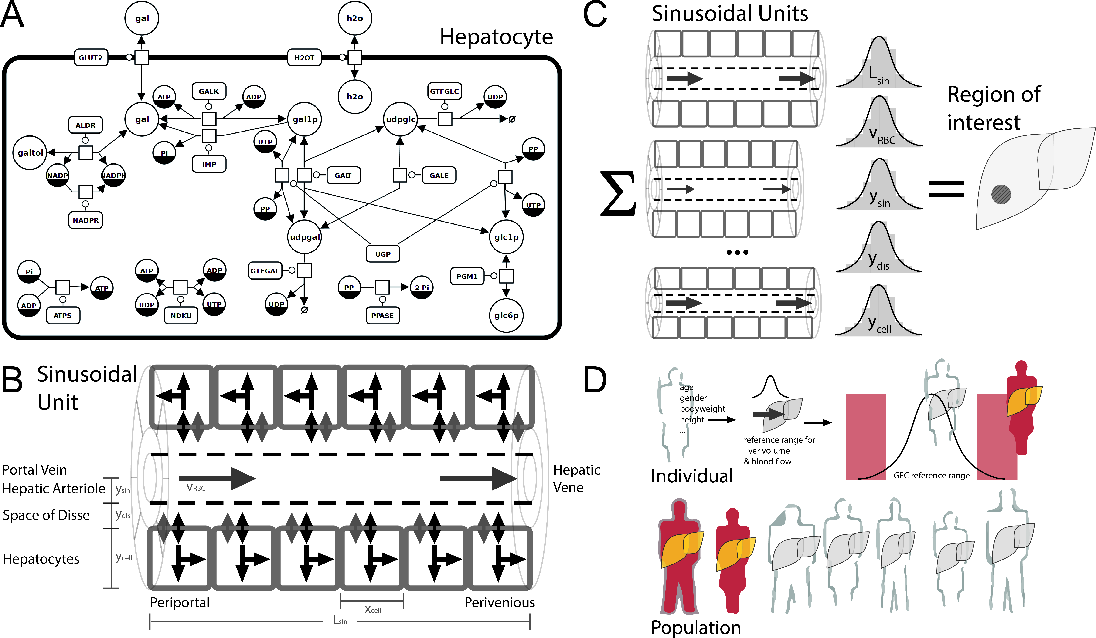
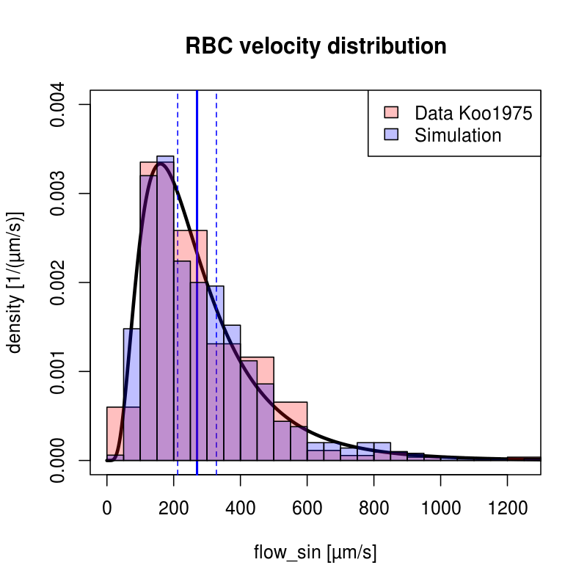
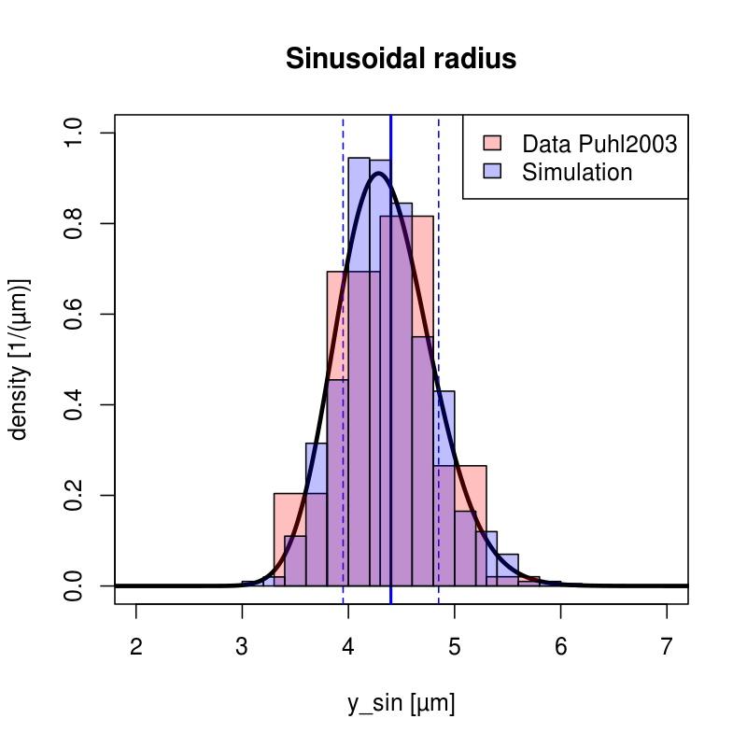
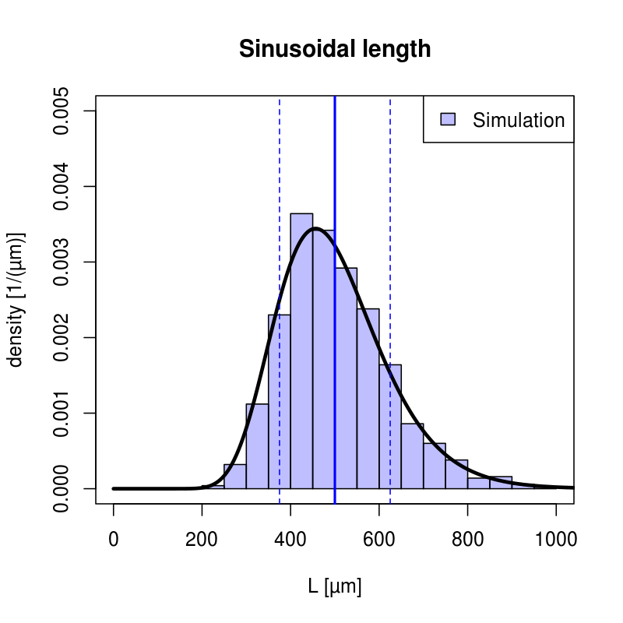
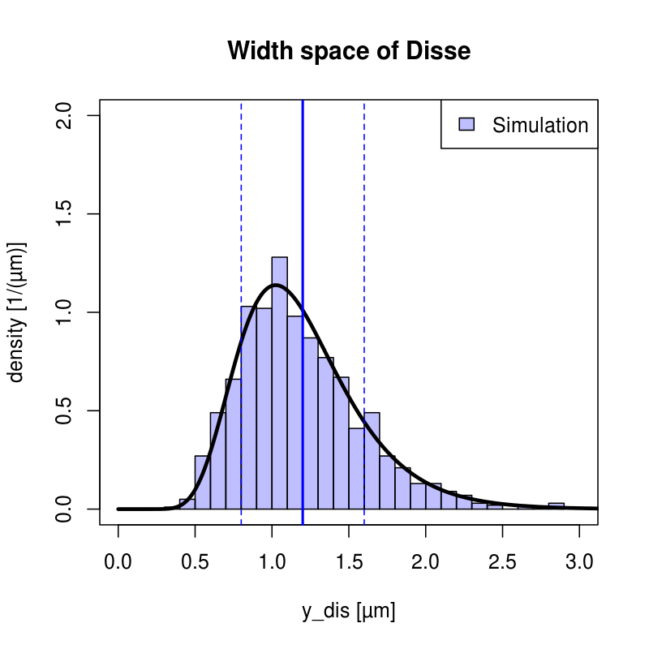
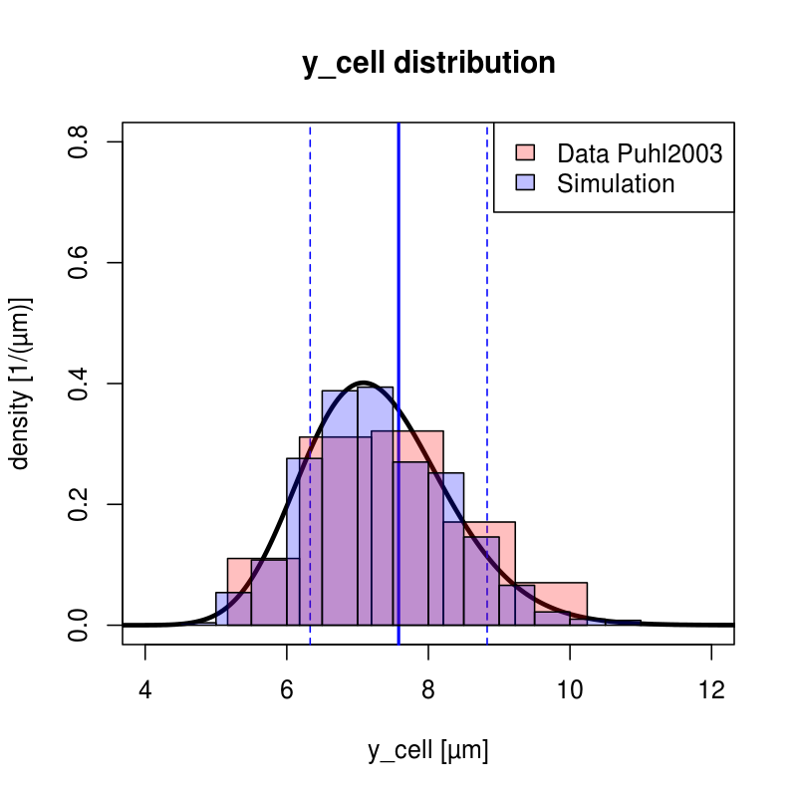
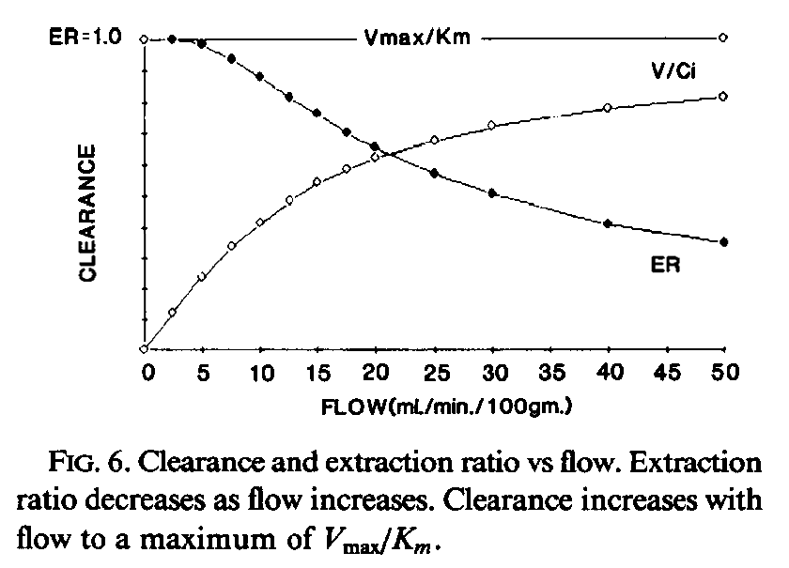
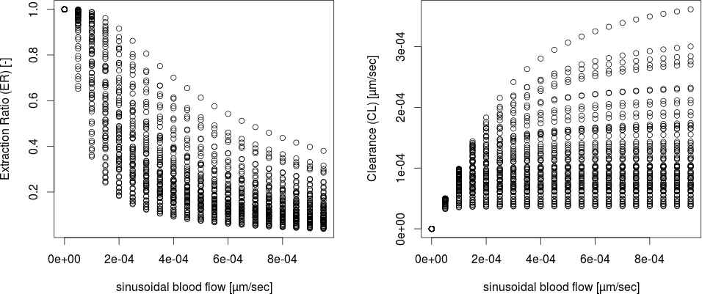
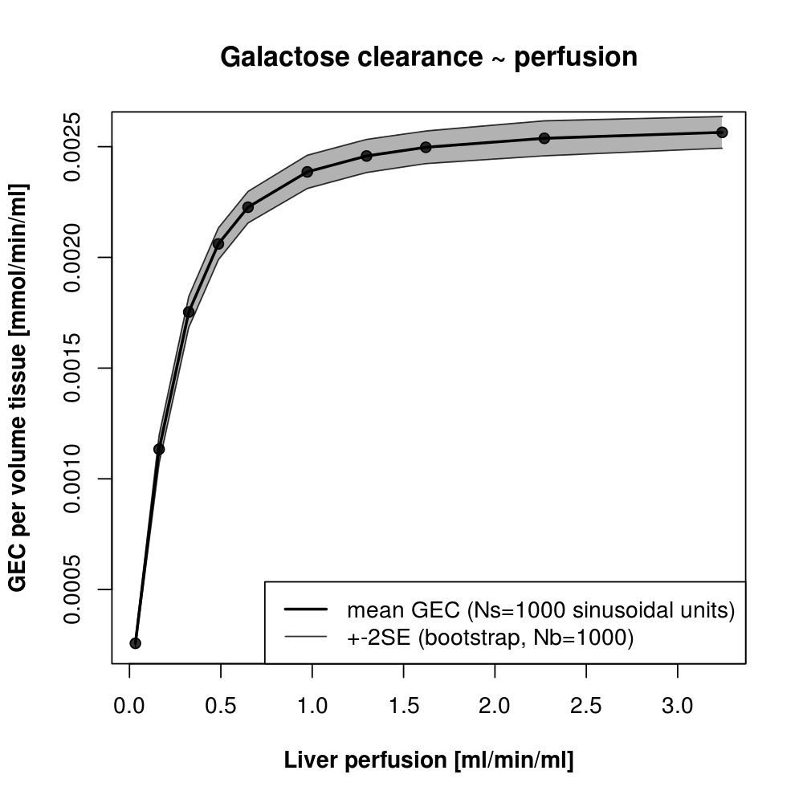
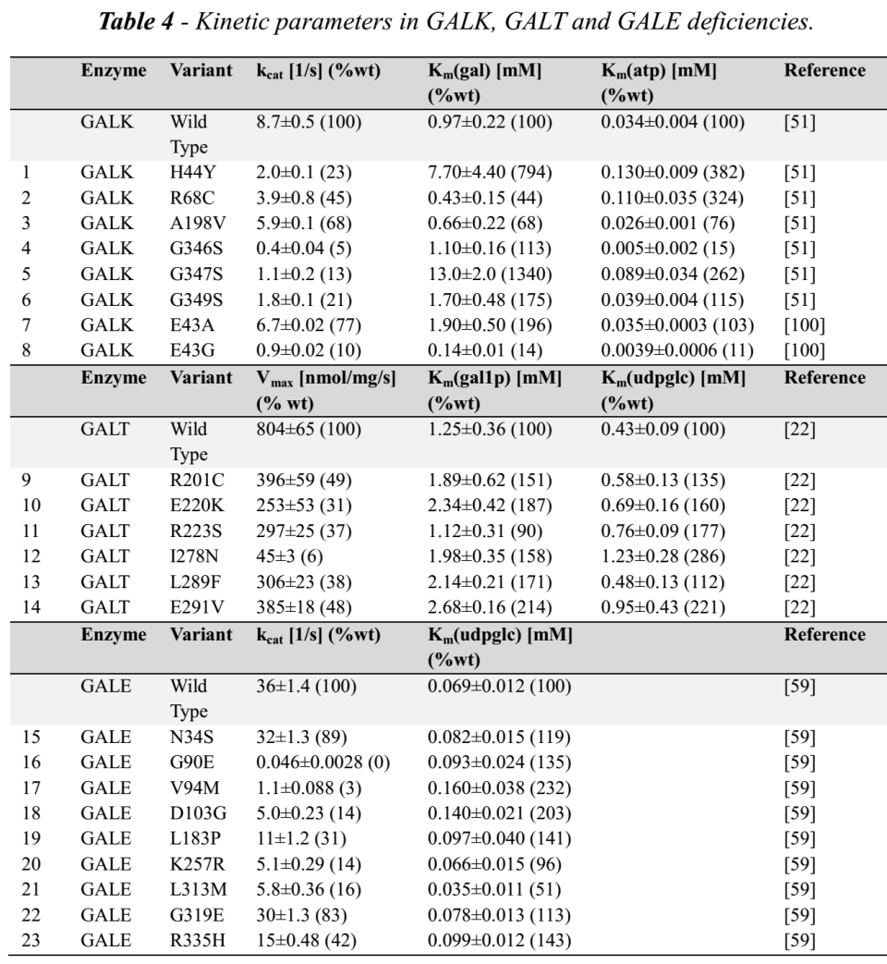
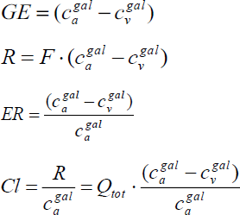
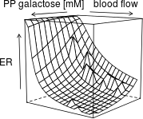
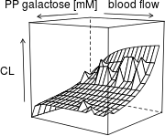
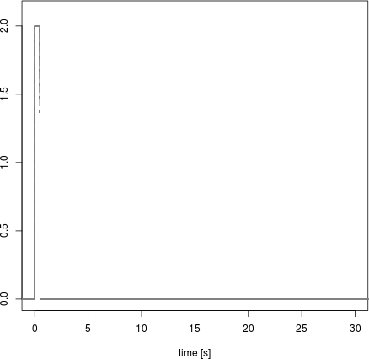

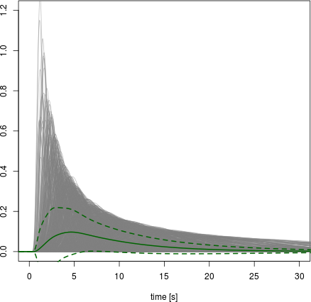
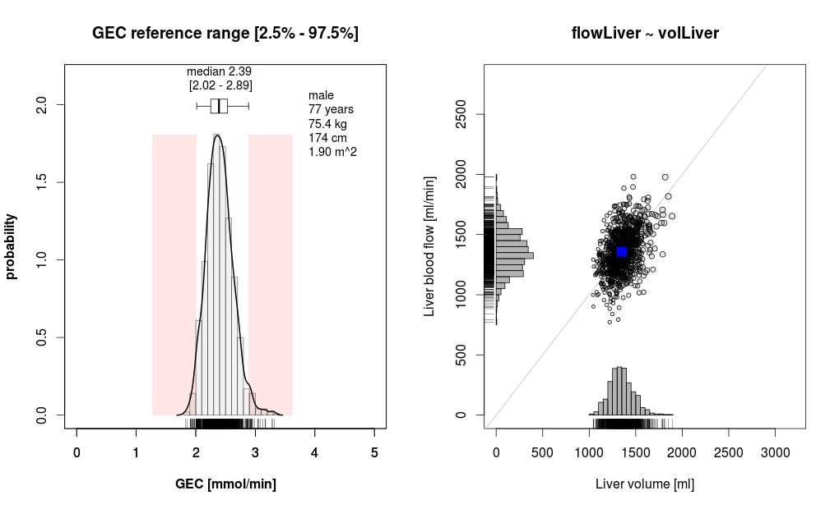
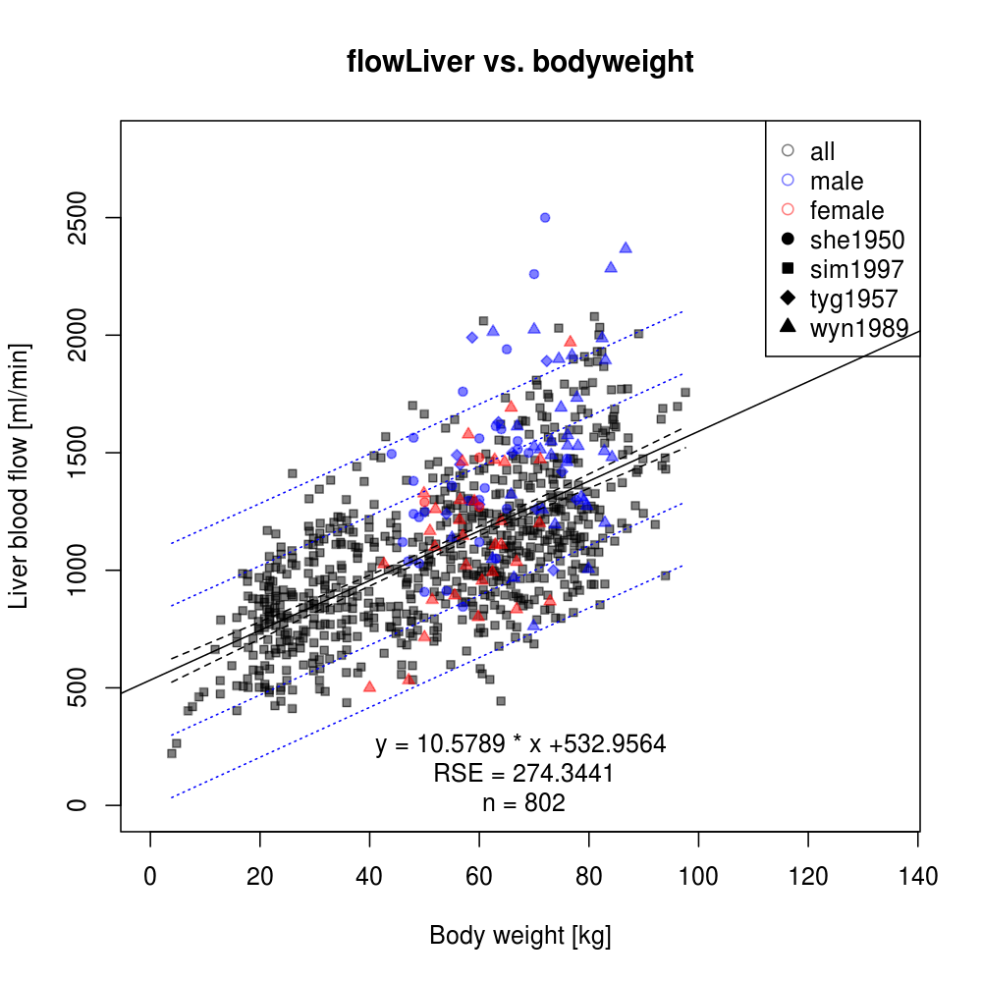
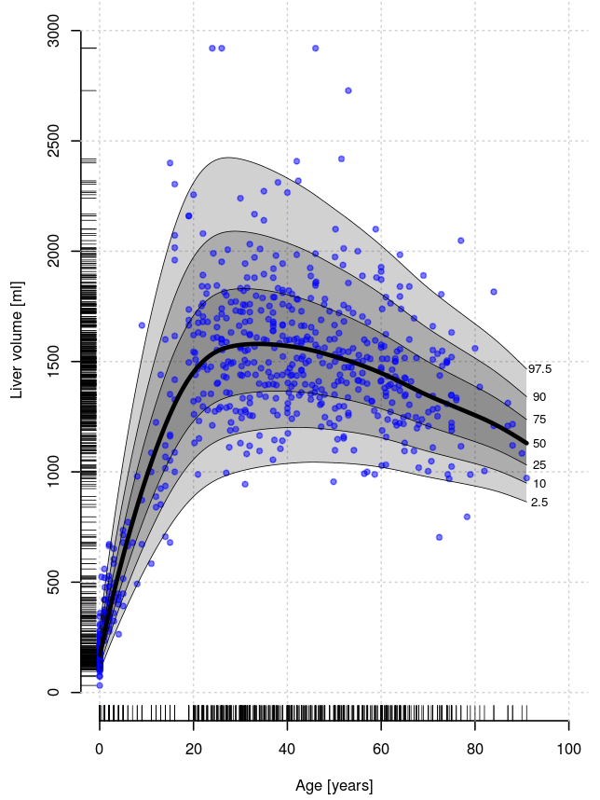
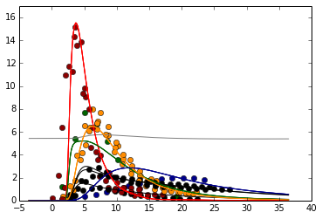
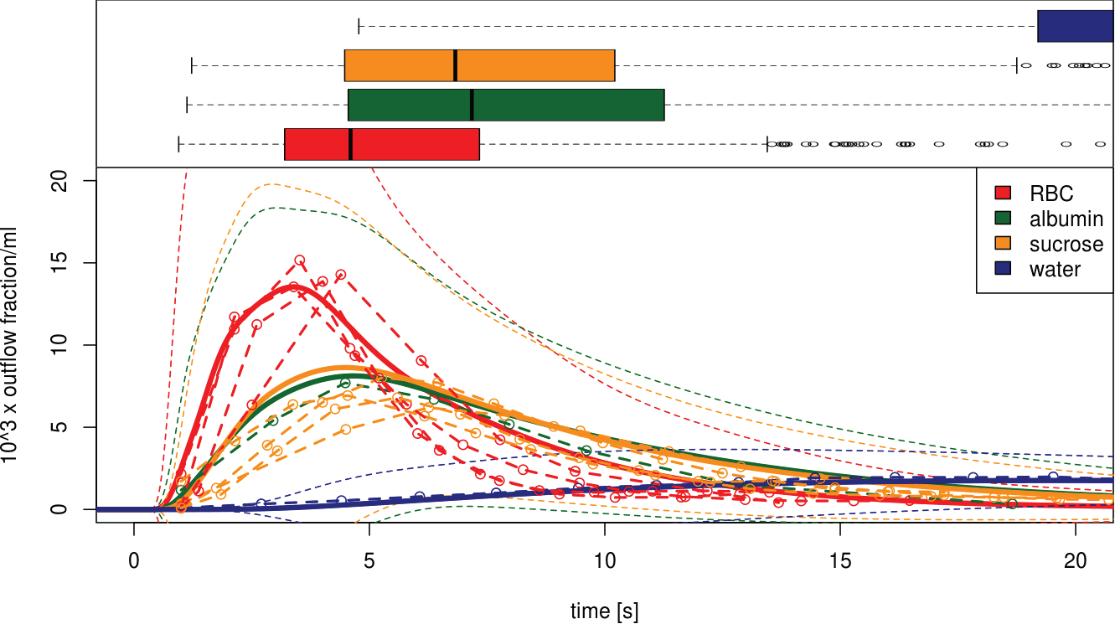
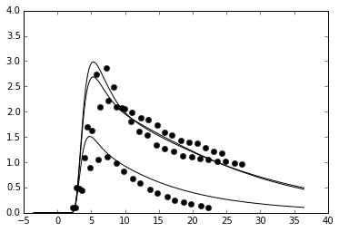
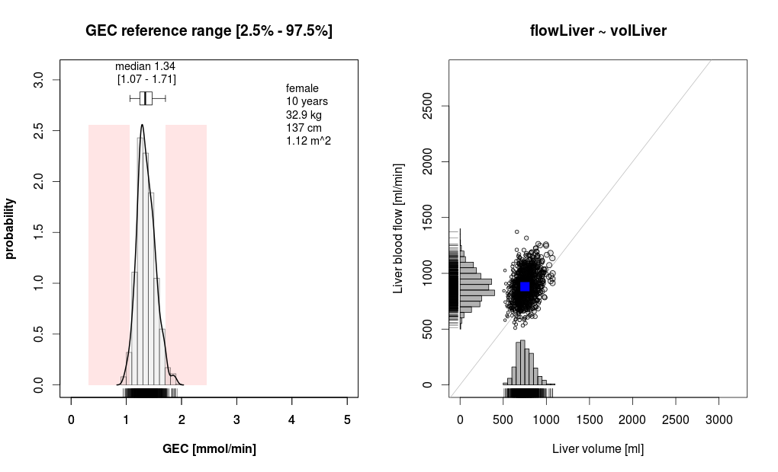
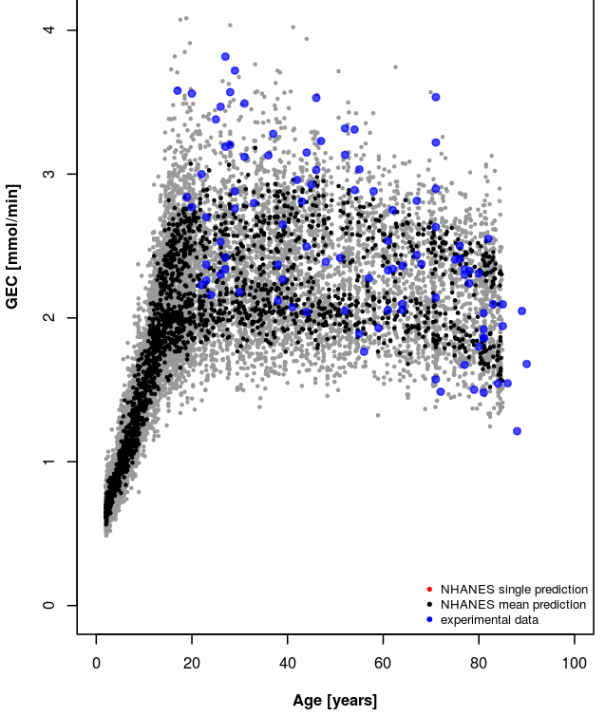
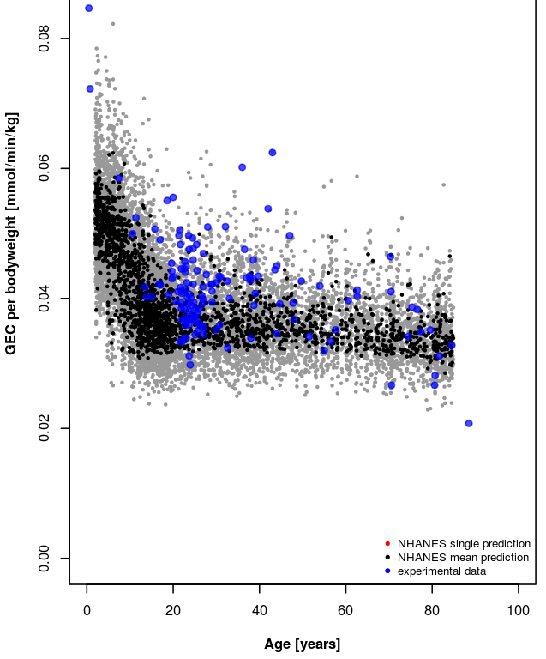

Liver
From Hepatocytes to Personalized Liver Function:
Multi-Scale Model of Hepatic Galactose Metabolism
König M.¹, Marchesini G.², Vilstrup H.³, Somogyi A.⁴ & Holzhütter HG.¹
¹Institute of Biochemistry, Charité Berlin, Germany, matthias.koenig@charite.de; ²Department of Internal Medicine, University Bologna, Italy; ³Department of Hepatology & Gastroenterology, Aarhus University Hospital, Denmark; ⁴Biocomplexity Institute, Indiana University, USA
Lobulus
Introduction
The liver plays a central role in maintaining the homeostasis of numerous plasma metabolites, clearance of substances and detoxification of xenobiotics. For galactose, the liver is the most important organ for clearance and whole-body metabolism.
The liver architecture is unique within the body in that hepatic functionality is parallelized across a multitude of structural similar hexagonal subunits, the lobuli. Within a single lobulus a network of capillaries, the so-called liver sinusoids, which are surrounded by hepatocytes, form the smallest functional units. Hepatic function is the consequence of a complex interplay between organ/tissue structure, perfusion/micro-circulation, metabolism and the individual liver volume and perfusion. Systems-level multi-scale computational approaches are required to elucidate and understand the underlying principles.
Model
We present a multi-scale model of liver galactose metabolism bridging the scales from single-cell metabolism over the tissue level to the whole-organ. The model combines a detailed kinetic model of the cellular galactose metabolism with a tissue-scale perfusion model of the sinusoid. The metabolic capacity of the whole liver is modelled by integrating the heterogeneous contribution of sinusoids differing in blood-flow rates and tissue-architecture. The combination of predictive models for liver volumes and blood flow based on population data with individual anthropomorphic information allows the prediction of personalized galactose clearance ranges. Application to population data allows prediction of population variability and changes in ageing.
Methods
kinetic models of single cell metabolism
models of convection, diffusion and metabolism of sinusoidal units on tissue scale(ODE)
representation in SBML & Integration with high performance integrator (libRoadRunner SBML just in time JIT engine to generate intermediate code representation which is compiled in memory to native machine code)
Monte Carlo simulations of sinusoidal units based on parameter distributions for ultra-structure and microcirculation to calculate local variability & for
integration over region of interests based on sampling
perfusion dependent response curves for local tissue function are scaled to whole organ output via individual liver perfusion and liver volume
individualized predictions based on anthropomorphic data in combination with generalized additive models of location shape and scale (GAMLSS)
Multiple Indicator Dilution Curves
Overview
A Schema of the metabolic single hepatocyte model in Systems Biology Graphical Notation (SBGN). Main enzymatic steps of galactose clearance are the uptake of galactose by facilitated transport via GLUT2, the phosphorylation of galactose to galactose-1p via galactokinase (GALK), the subsequent transformation to UDP-galactose via galactose transferase and the epimerization between UDP-galactose and UDP-glucose.
B Schema of the tissue-scale model of the sinusoidal unit comprising diffusion and convection based transport of substances in the blood, diffusion-based transport of substances in the space of Disse and detailed kinetic models of metabolism on the cellular level.
C Modeling regions of the liver via integration of heterogenous tissue-models based on underlying parameter distributions for parameters of microcirculation and ultrastructure.
D Calculation of individual galactose clearance ranges (GEC) and population variability based on individual antropomorphic data and distributions of liver volume and blood flow in the population.
Sinusoidal Unit
Parameter Distributions
Galactose Clearance & Extraction
GEC
Galactosemias
Periportal
tracer
Perivenious
dilution
Individual Predictions
Population Variability
time [s]
time [s]
time [s]
time [s]

