Slide 1


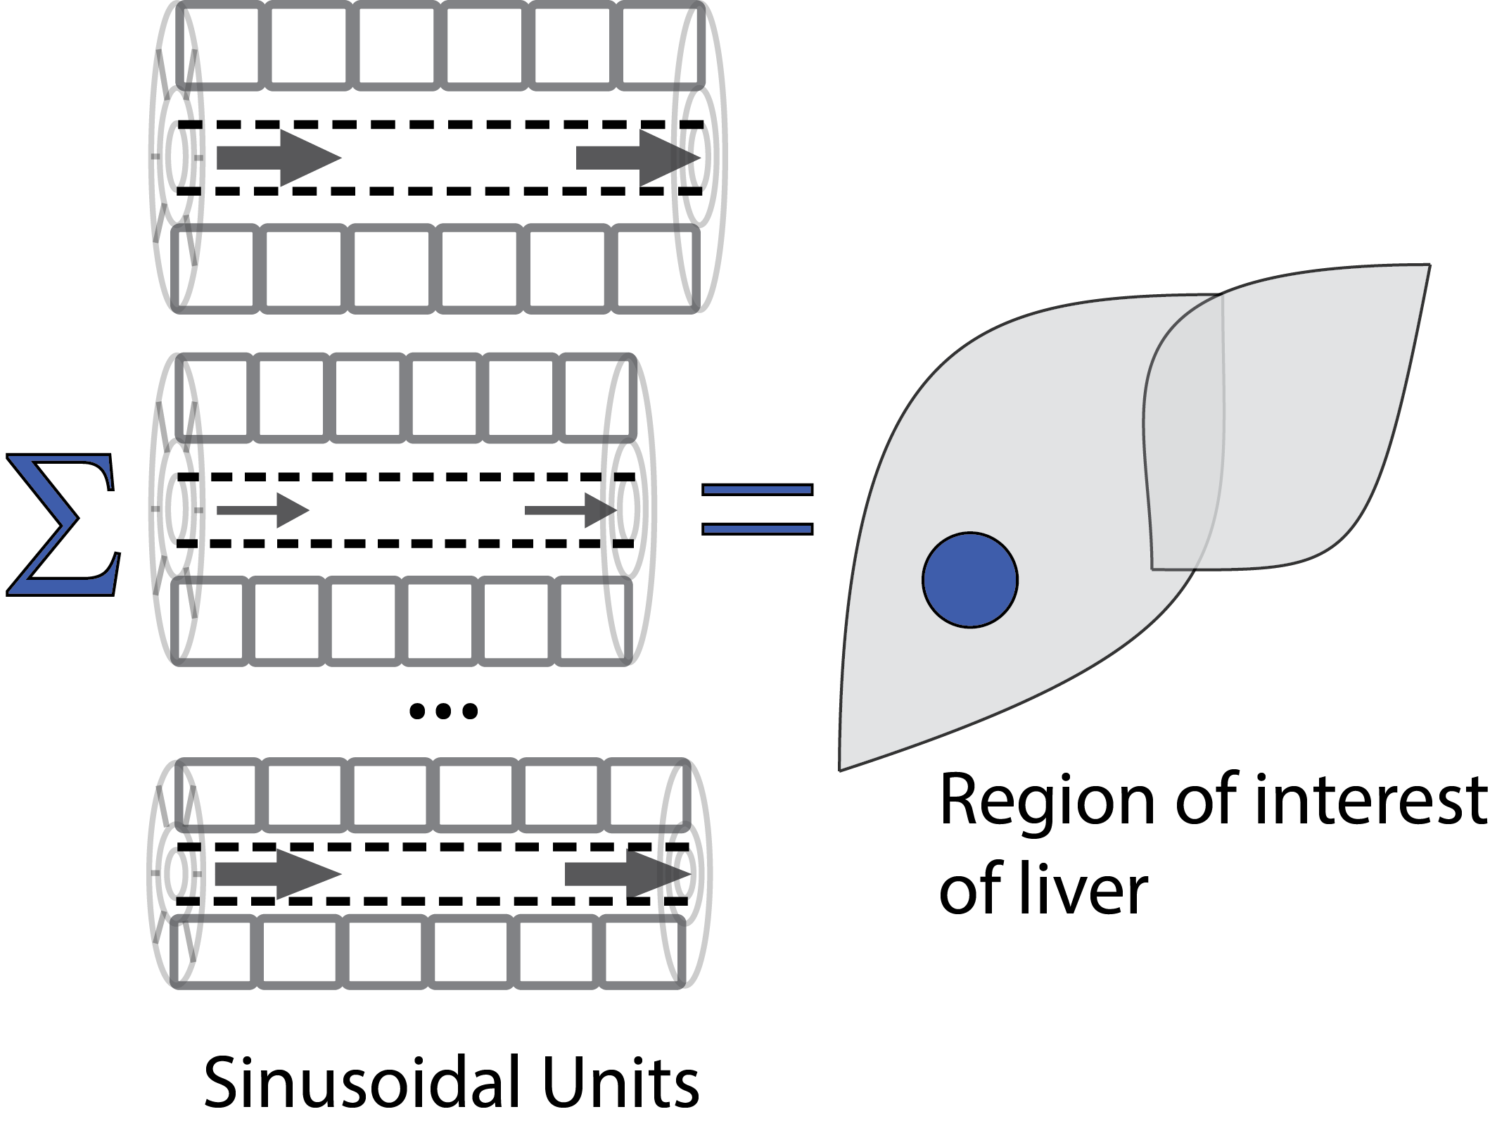
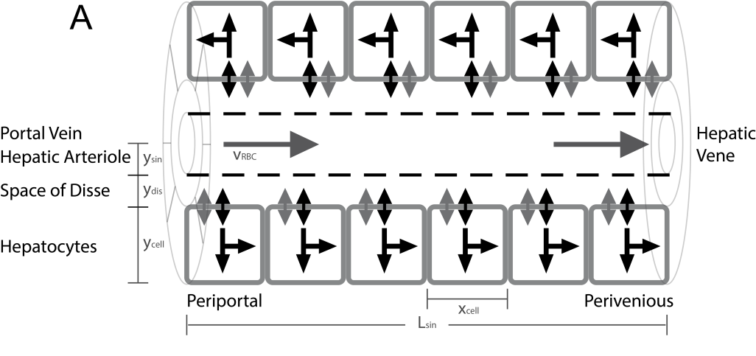
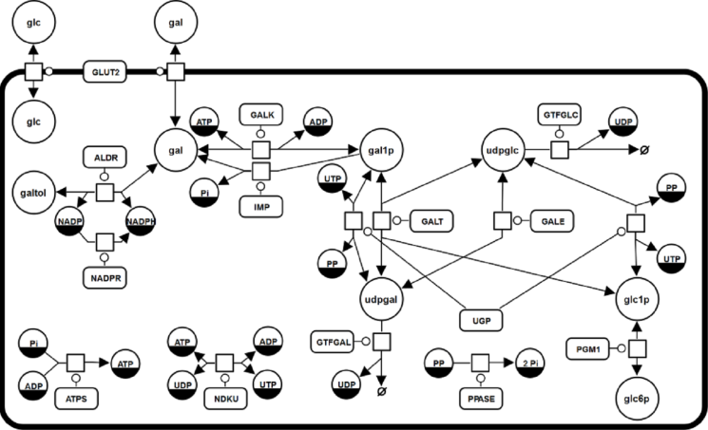
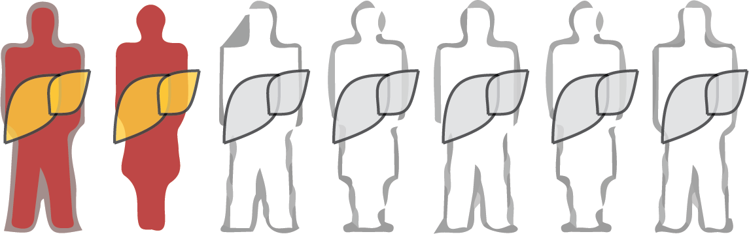
Population Variability of Liver Function
König M. & Holzhütter HG.
Sinusoidal Unit
Lobulus
Hepatocyte
Individuals / Population

Slide 2
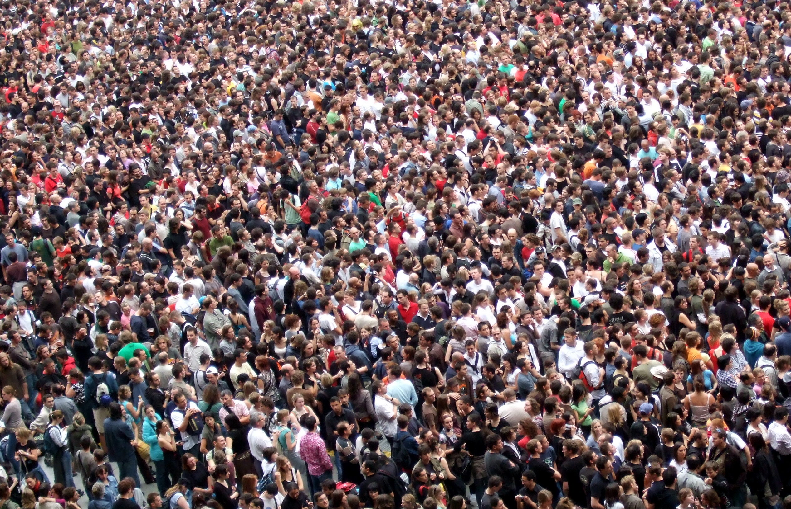
We are all different ...
… so why no individualized predictions?

Slide 3
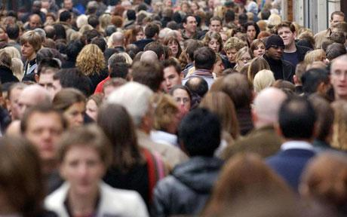


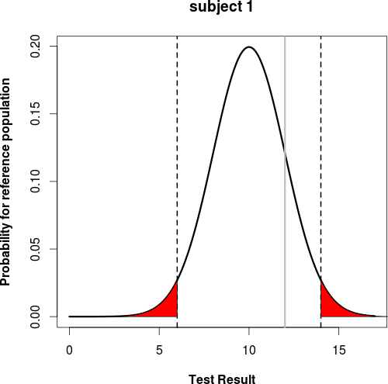
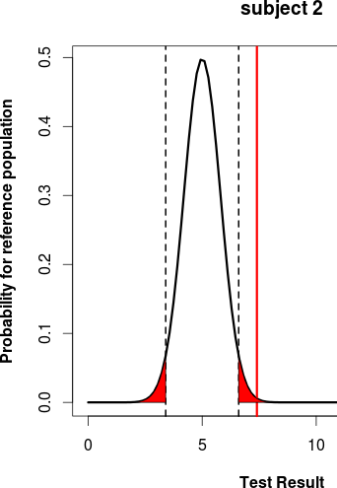
Individualized Liver Function Tests
Large population variability in liver volume & hepatic blood flow
  Age, gender, bodyweight, height, ethnicity, …
What are the effects of this variability on model prediction?
Improved evaluation of liver function based on antropomorphic data
  Individualized liver function test
  Reference range based on comparable individuals
  Values outside range → further investigation & treatment

Slide 4
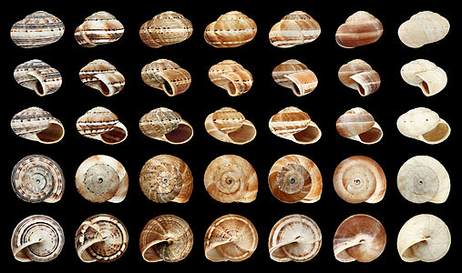
Variability & Sensitivity of Parameters
Variability
  The focus of variability analysis is to evaluate the range of values that a parameter expected to be present in individuals may have in a population and the impact of that variability on the simulation prediction.
Sensitivity
  Sensitivity analysis provides a quantitative evaluation of how parameters influence the simulation prediction.

Slide 5
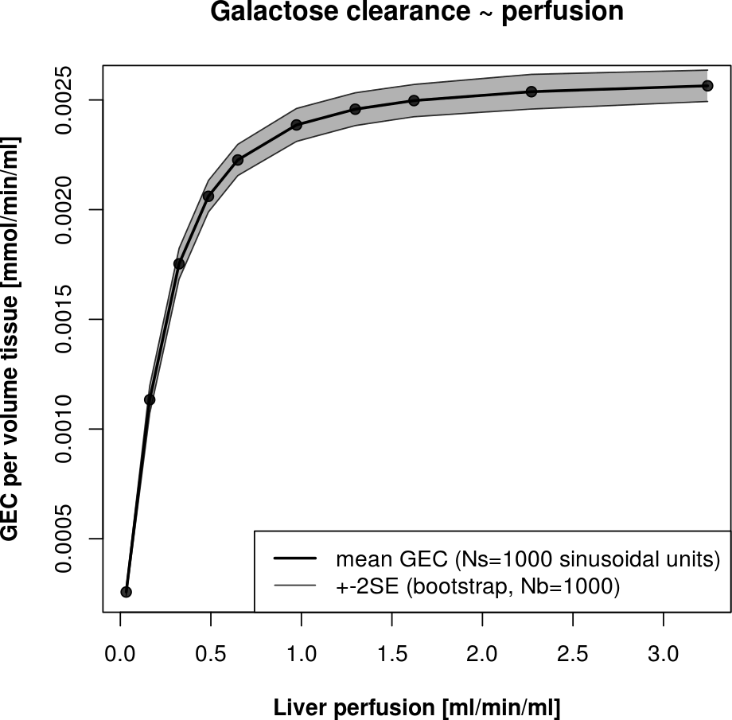
Liver Function Test - GEC
Evaluation of liver function via galactose elimination capacity (GEC)
Tissue-Model predicts the galactose clearance per tissue volume for given perfusion in the region (regional GEC)
Scale with individual liver volume and perfusion (total GEC)
Evaluation of individual & population variability in GEC

Slide 6
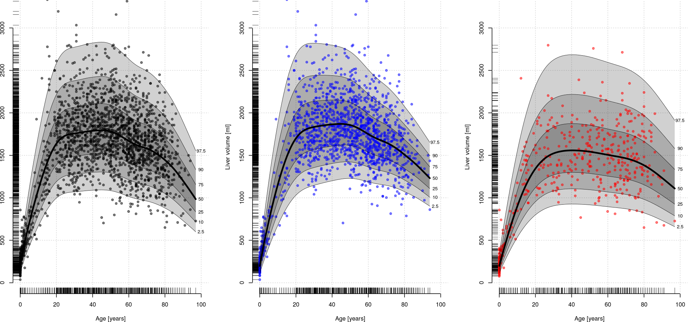
Liver volume = f(age, gender, ...)
Density estimation of liver volume ~ age via generalized additive models (GAM) combined with centile estimation
Analog: volLiver ~ bodyweight, volLiver~height, volLiver~BSA, …
Combined dataset from multiple sources & experimental methods
Normal-weight, caucasian
all
male
female
Liver volume [ml]
age [years]

Slide 7
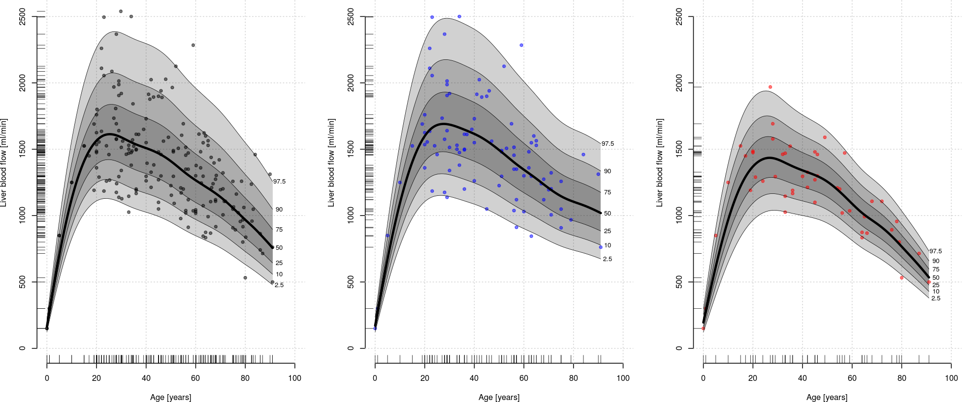
Age & gender dependence blood flow
Analog for bloodflow with additional flowLiver~volLiver correlation
Results of model fitting:
probability densities for liver volume & liver bloodflow
Normal-weight, caucasian
all
male
female
Liver bloodflow [ml/min]
age [years]

Slide 8
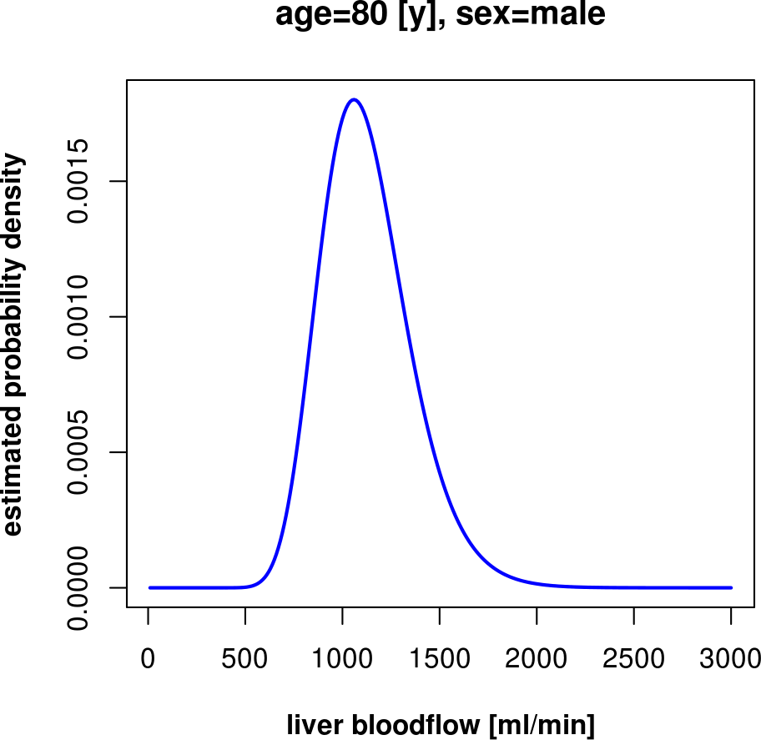
Models can be used for prediction of individual
parameter distributions.
Probability distribution of liver blood flow
- normal-weight (BMI<24.9)
- caucasian
- male
- 80 years old
all
male
female
Liver bloodflow [ml/min]
age [years]

Slide 9
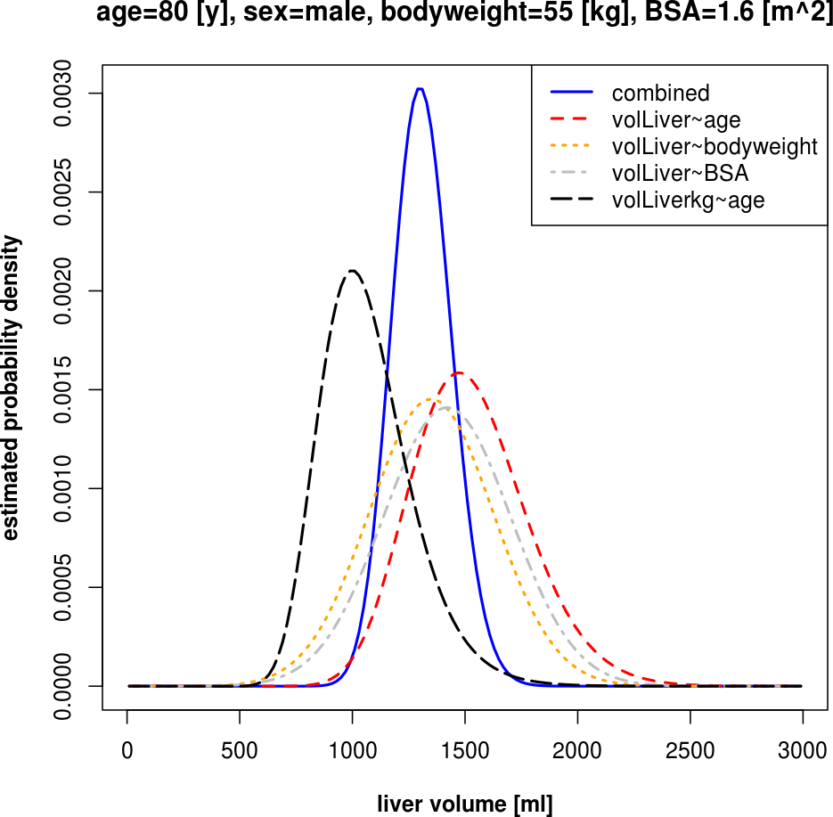
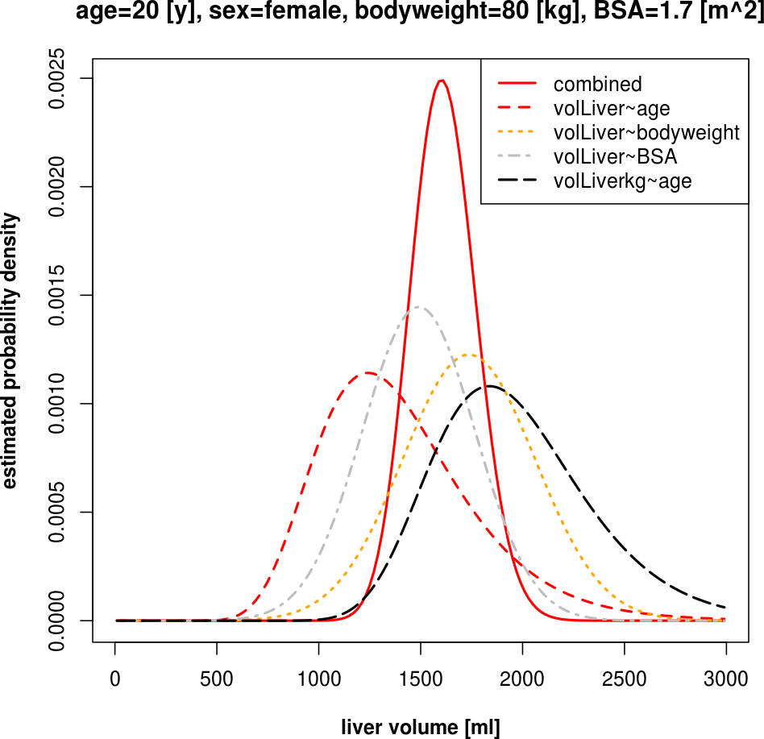
Combining the information
Set of probabilty distributions for pair-wise correlations
Important to represent the correlation structure between different pairs
Solution: Combination of individual probability distributions for best estimate
(use all the available knowledge)
Result: individual probability distributions for liver volume and bloodflow based on normal reference population

Slide 10
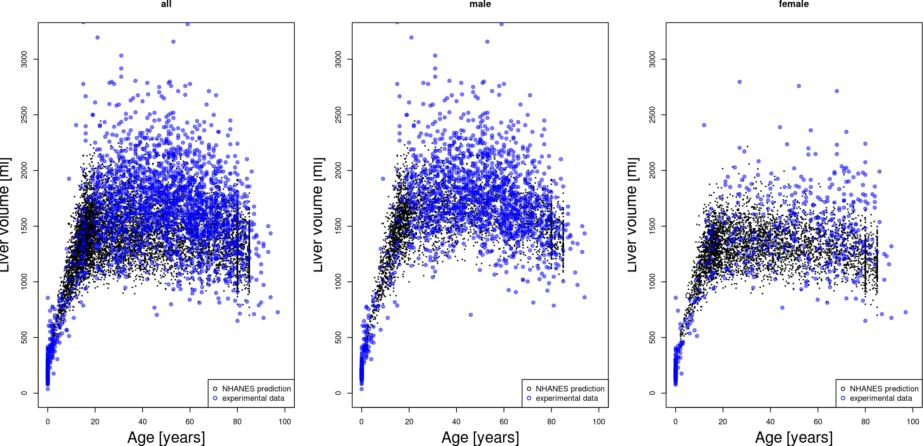
Prediction of population variability
NHANES prediction (~8000 normal-weight, caucasian)
  Correlation structure of sex, age, bodyweight, height of US population
Liver volume ~ age

Slide 11
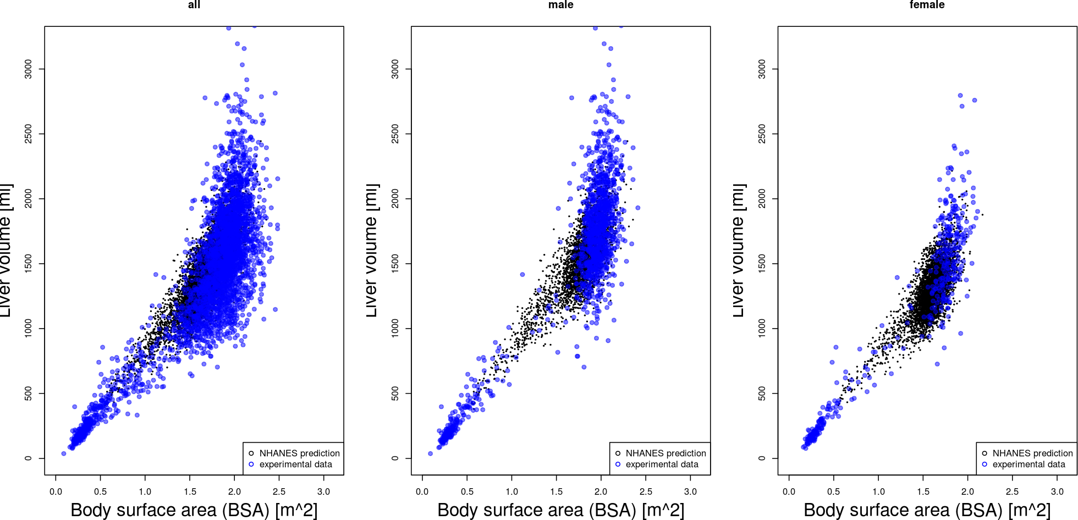
Prediction: Liver volume ~ BSA
(body surface area)

Slide 12
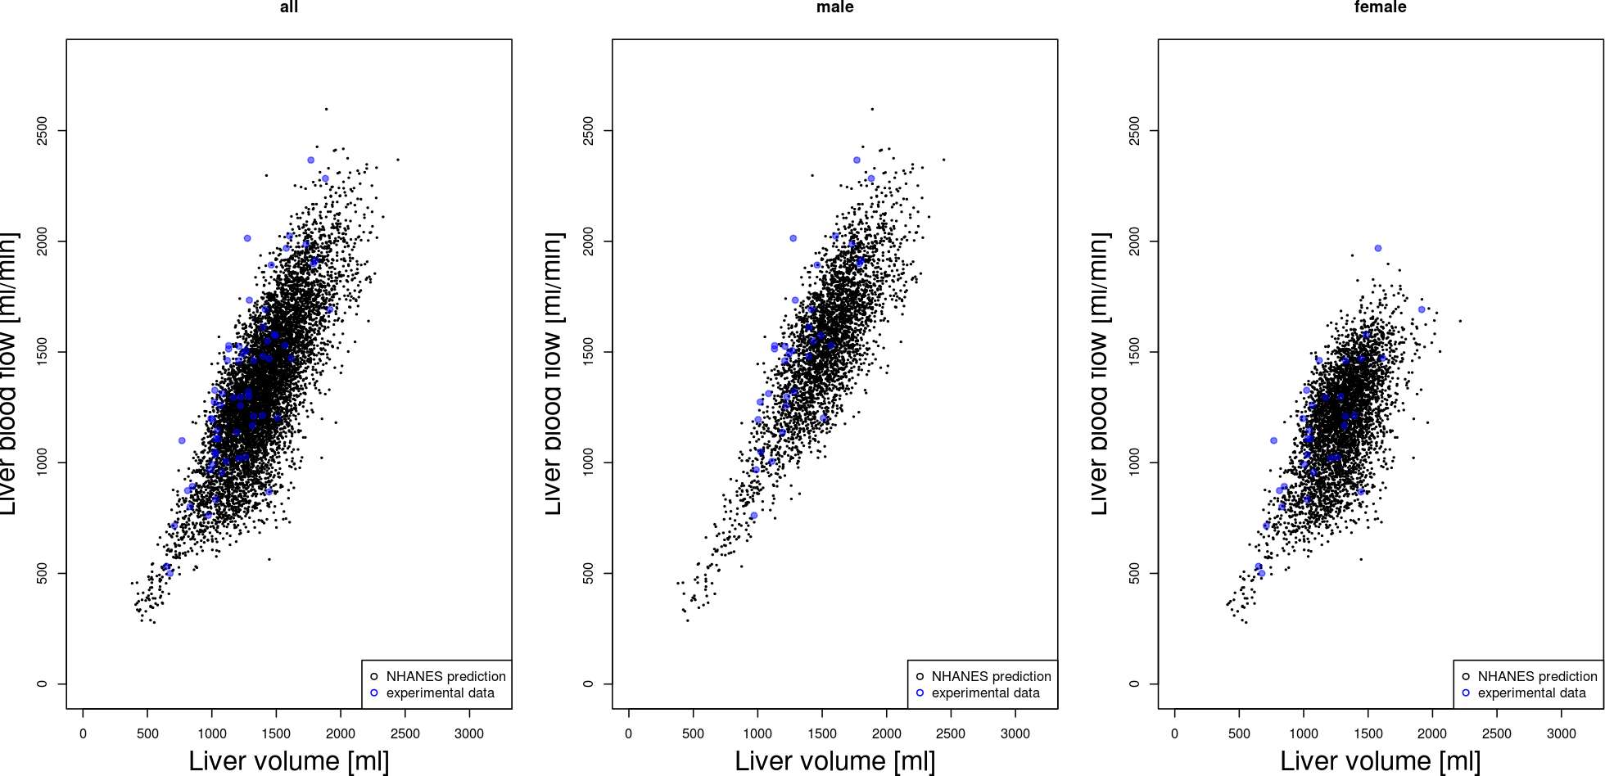
Prediction: liver blood flow ~ liver volume

Slide 13
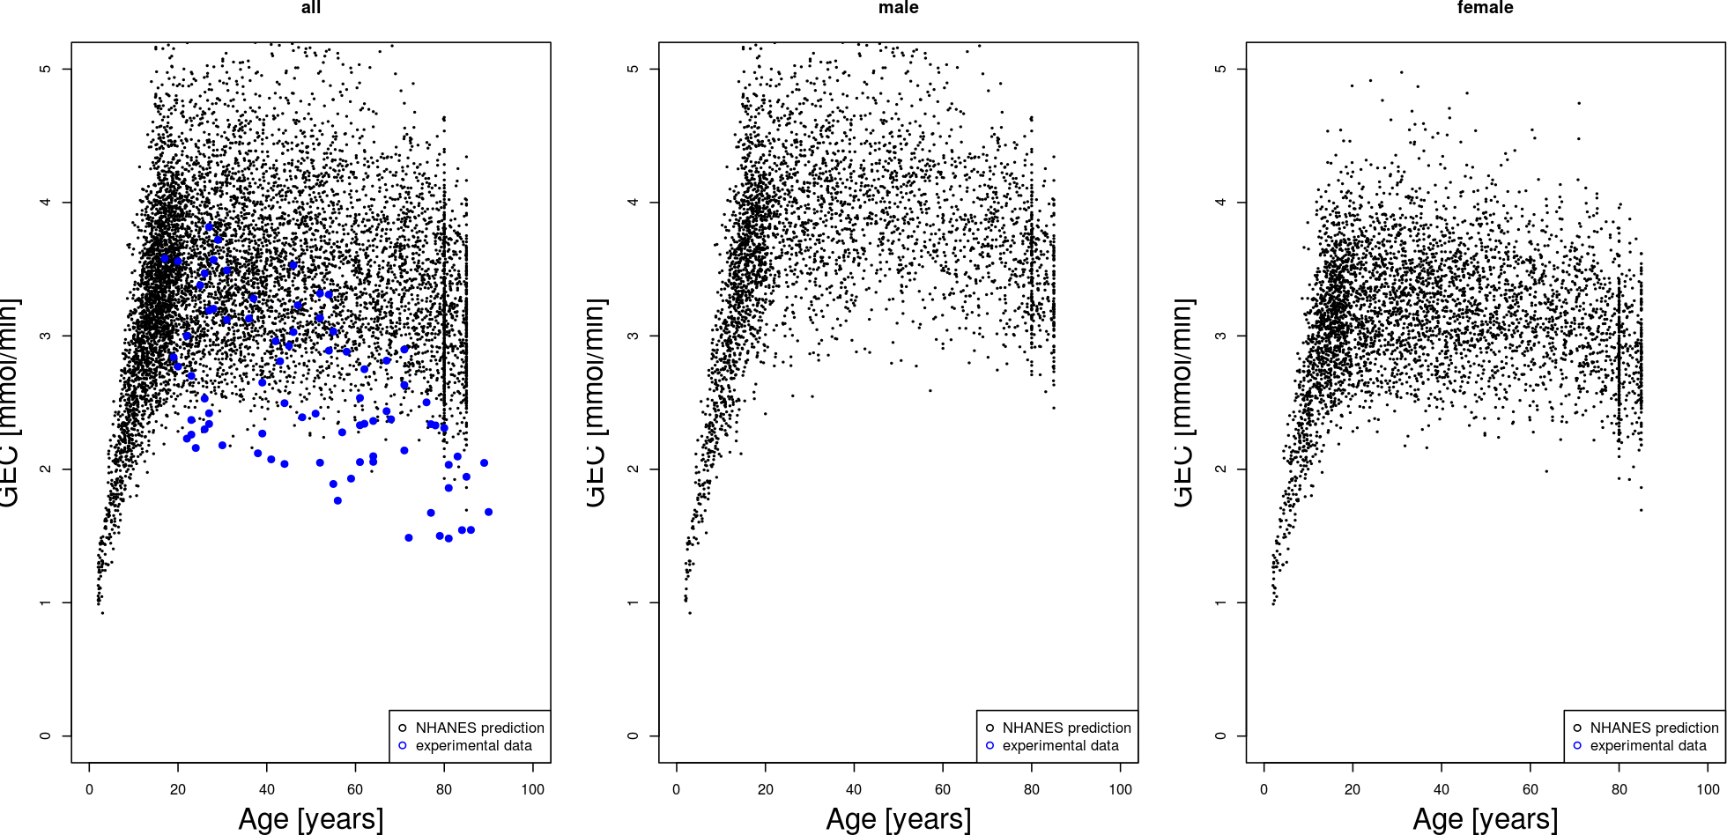
Prediction of GEC
(galactose clearance capacity)

Slide 14
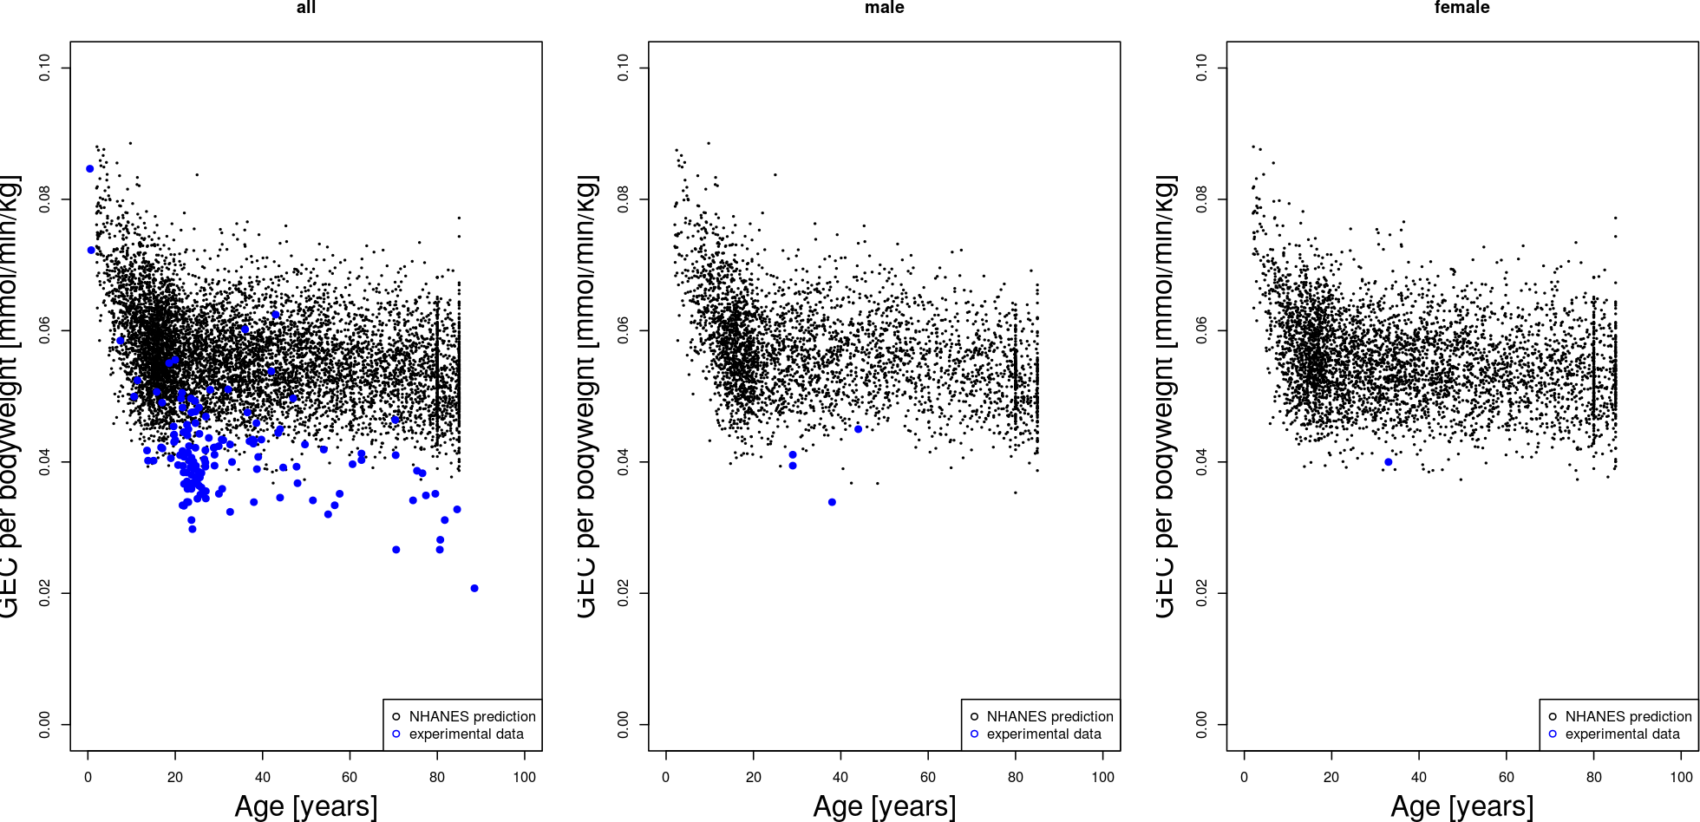
Prediction of GEC per bodyweight

Slide 15
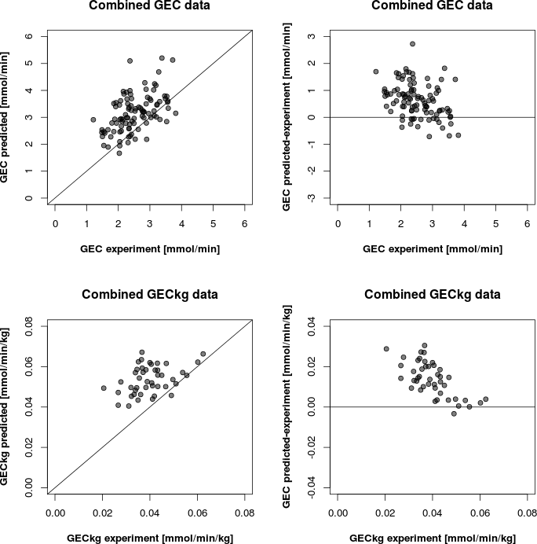
Individualized GEC prediction
First draft predictions, no adaption of metabolic capacity
No correction for large vessels

Slide 16
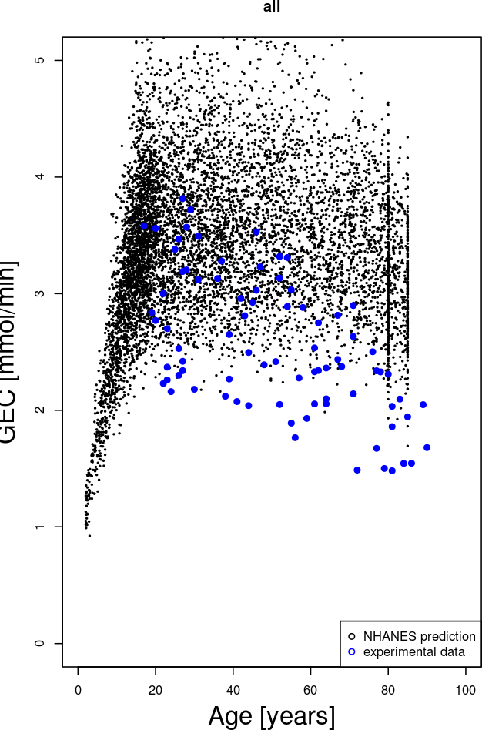
GEC variability
  Large part of GEC variability is explained by the population variability
    Additional variability in metabolic (Vmax) & morphological components in population
    (→ sensitivity analysis)
    For instance age changes in structure (pseudo-capillarization) & decrease in metabolic capacity (?)
  Next steps
    Adaption of galactose clearance on cellular level
    Prediction of additional GEC datasets

Slide 17

Acknowledgements
Concept & Modeling
  Prof. Holzhütter
Experimental Partners
  Prof. Vilstrup, Prof. Marchesini, Dr. Wynne, Dr. Heinemann, Dr. Wang
SBML & SED-ML
  Frank Bergmann, Lucian Smith, Mike Hucka, Sarah Keating
SABIO-RK & data management
  Martin Golibiewski, Wolfgang Müller, Renate Wittig
Funding
  Charité
  Virtual Liver Network

Slide 18
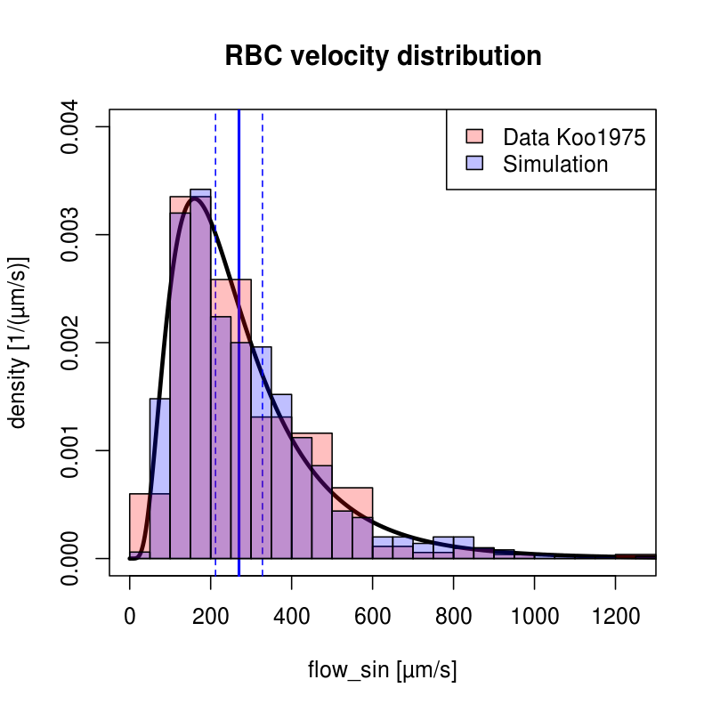
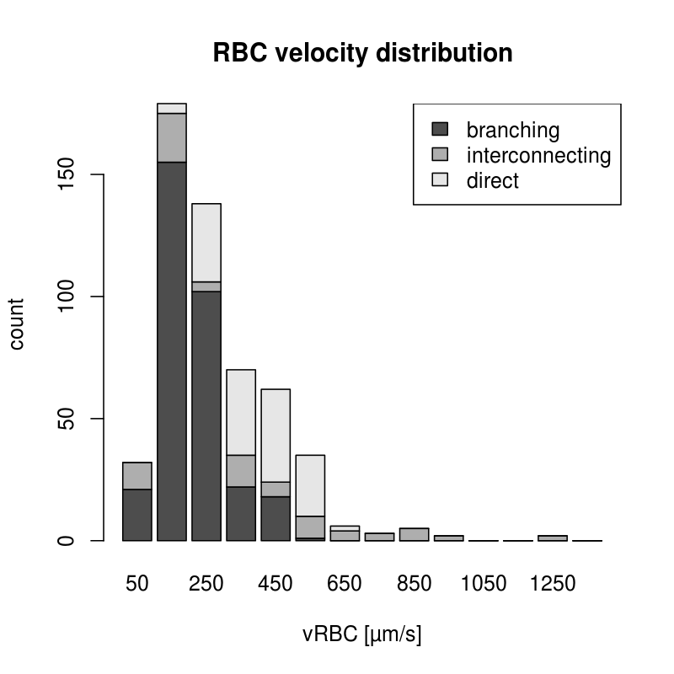
Fitting Distributions
maximum-likelihood method for univariate distributions (log-normal)

Slide 19
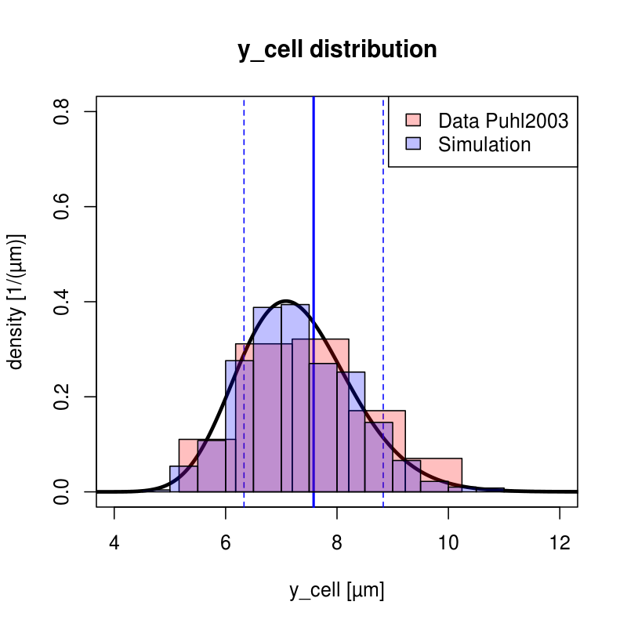
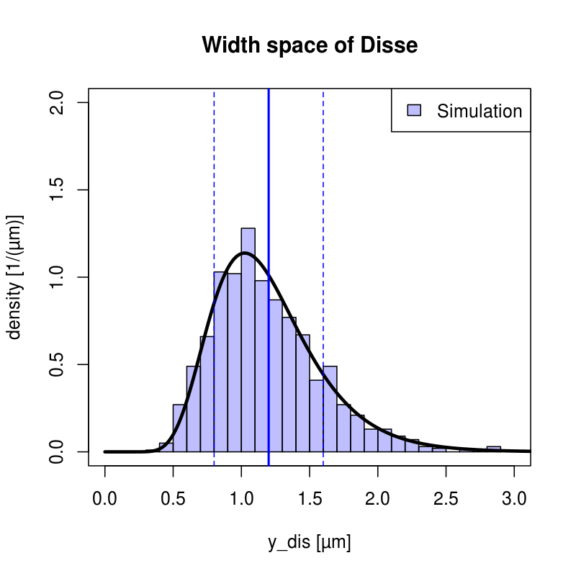
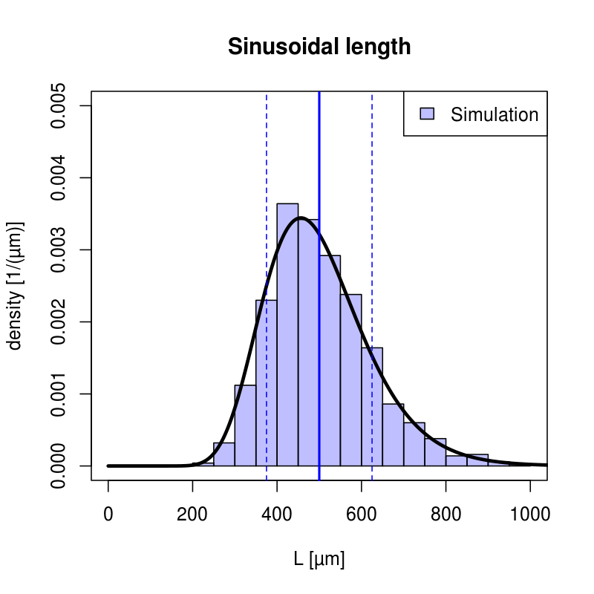
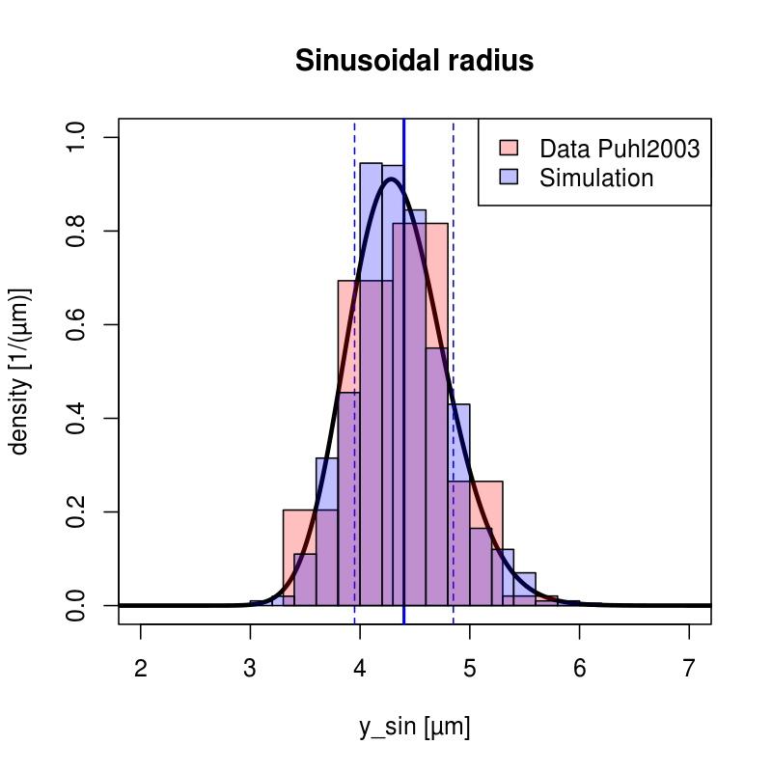
Tissue-scale Sinusoidal Unit

