Slide 1
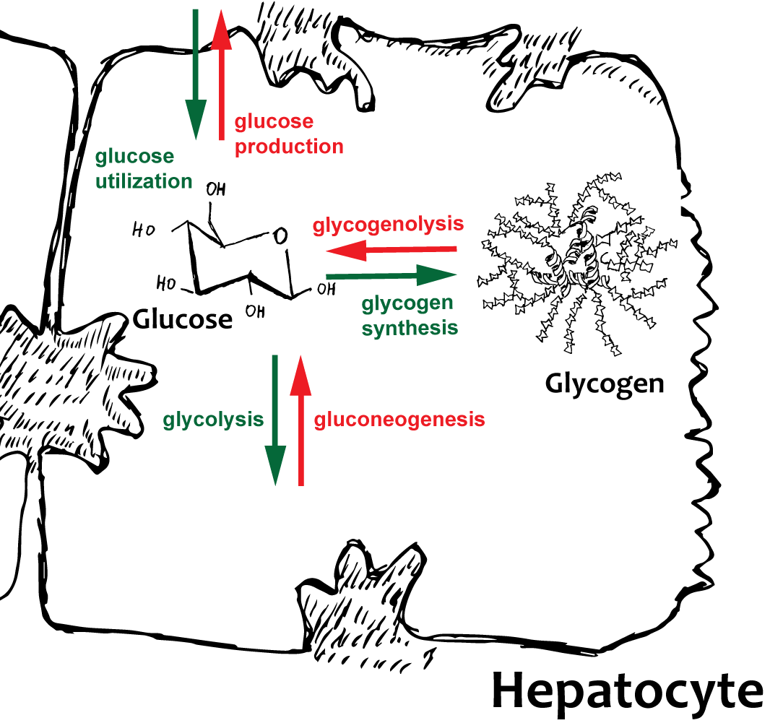
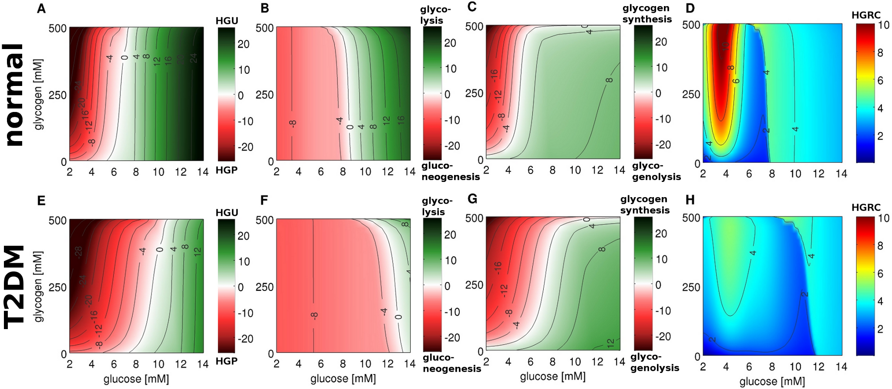
Hepatic glucose metabolism
Liver plays central role in glucose homeostasis due to its ability to switch between glucose production & consumption and the storage of glucose as glycogen
Kinetic model of glucose metabolism integrated with the hormonal regulation via insulin and glucagon
Analysis of glucose homeostasis under normal conditions and in impairment (diabetes type 2 - T2DM)
Glucose production/
consumption
Gluconeogenesis/
glycolysis
Glycogen synthesis/
glycogenolyis
Ability to counteract changes
In blood glucose

Slide 2
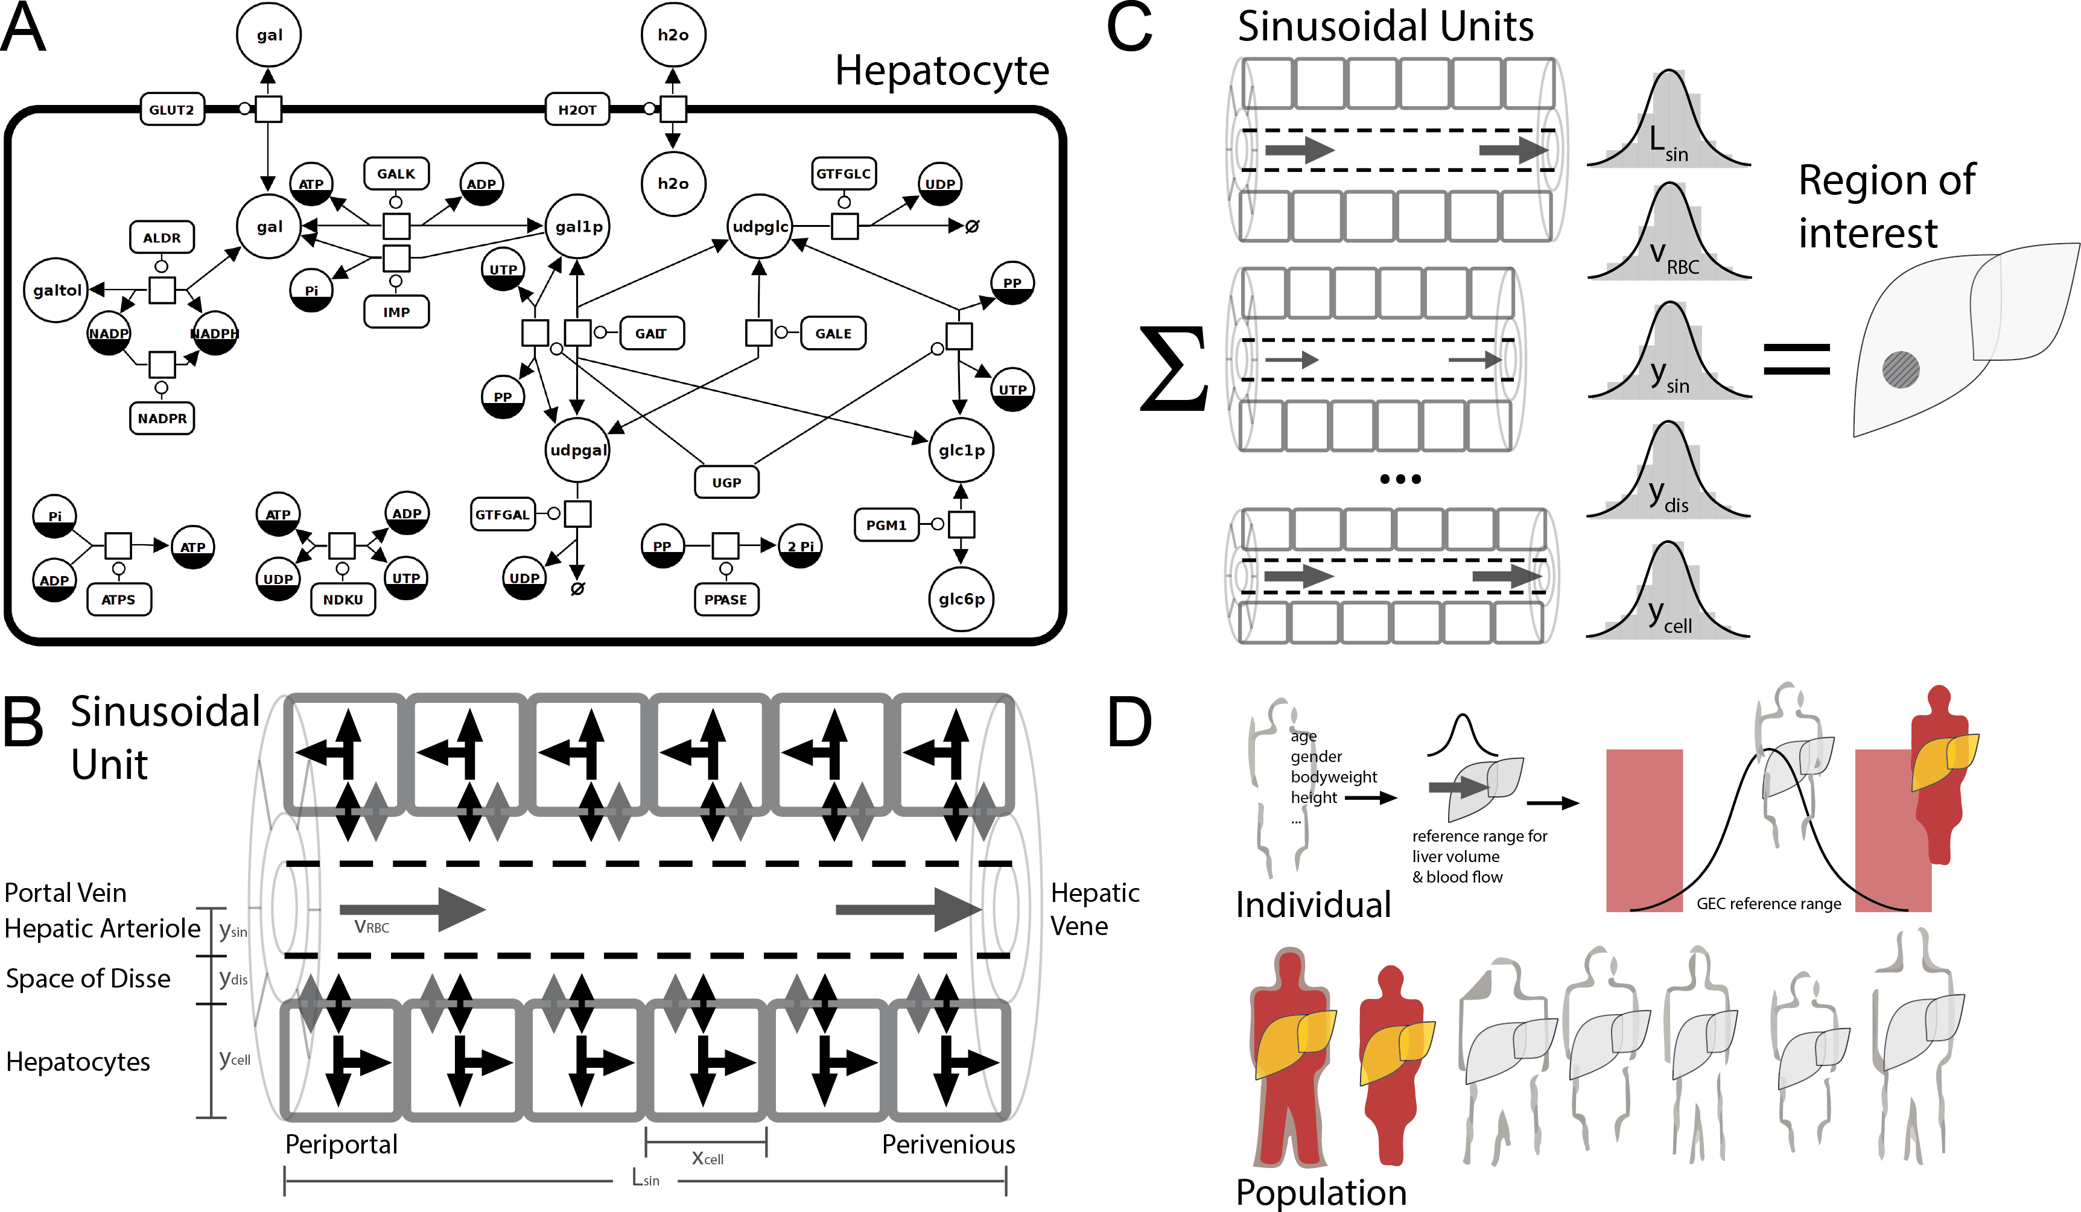
Multi-scale liver models
Liver function complex interplay between structure, perfusion & metabolism on multiple scales
Modeling provides insights into these interactions
Predictions of individual metabolic function (galactose clearance) based on tissue models combined with anthropomorphic information

