Slide 1
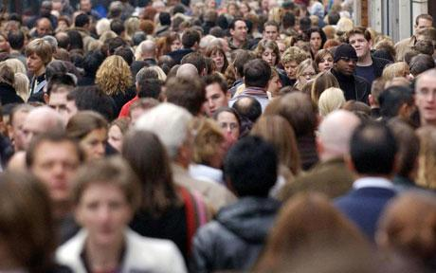


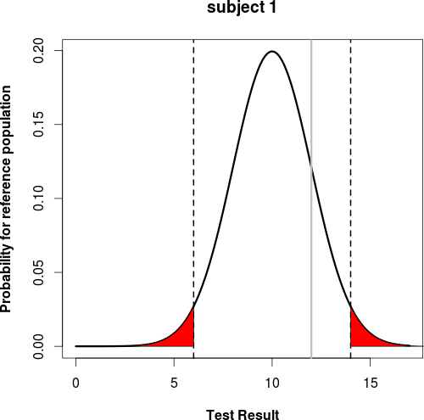
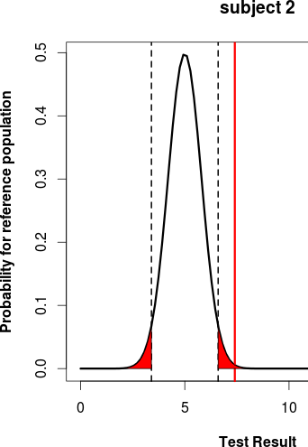
Individualized Liver Function
Large population variability in liver volume & hepatic blood flow
  Age, gender, bodyweight, height, ethnicity, …
Improved evaluation of liver function based on anthropomorphic data
  Individualized liver function test
  Reference range based on comparable individuals
  Values outside range → further investigation & treatment
Implementation
  Trainings data: correlation between liver features and anthropomorhic data
  Prediction: generalized additive models (nonlinear regression models)

Slide 2
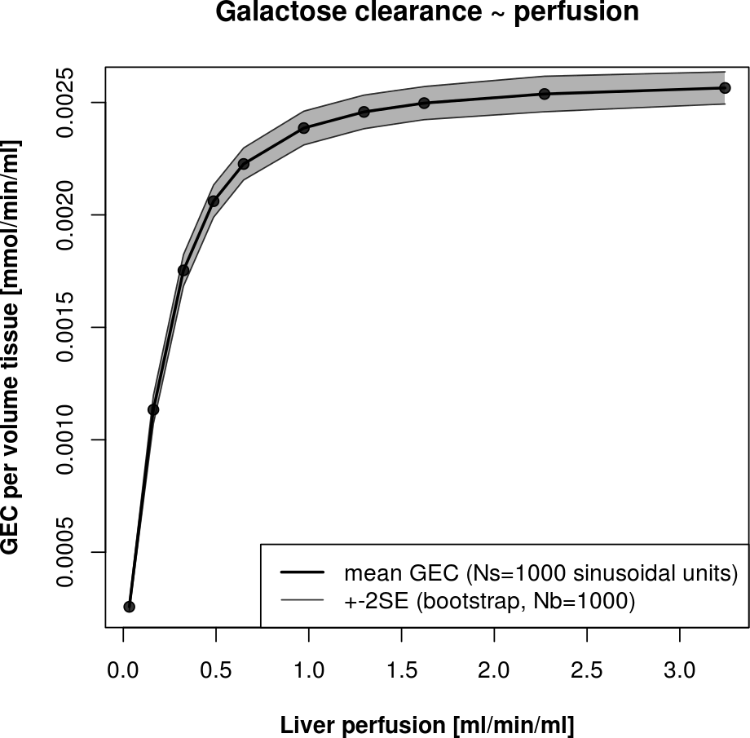
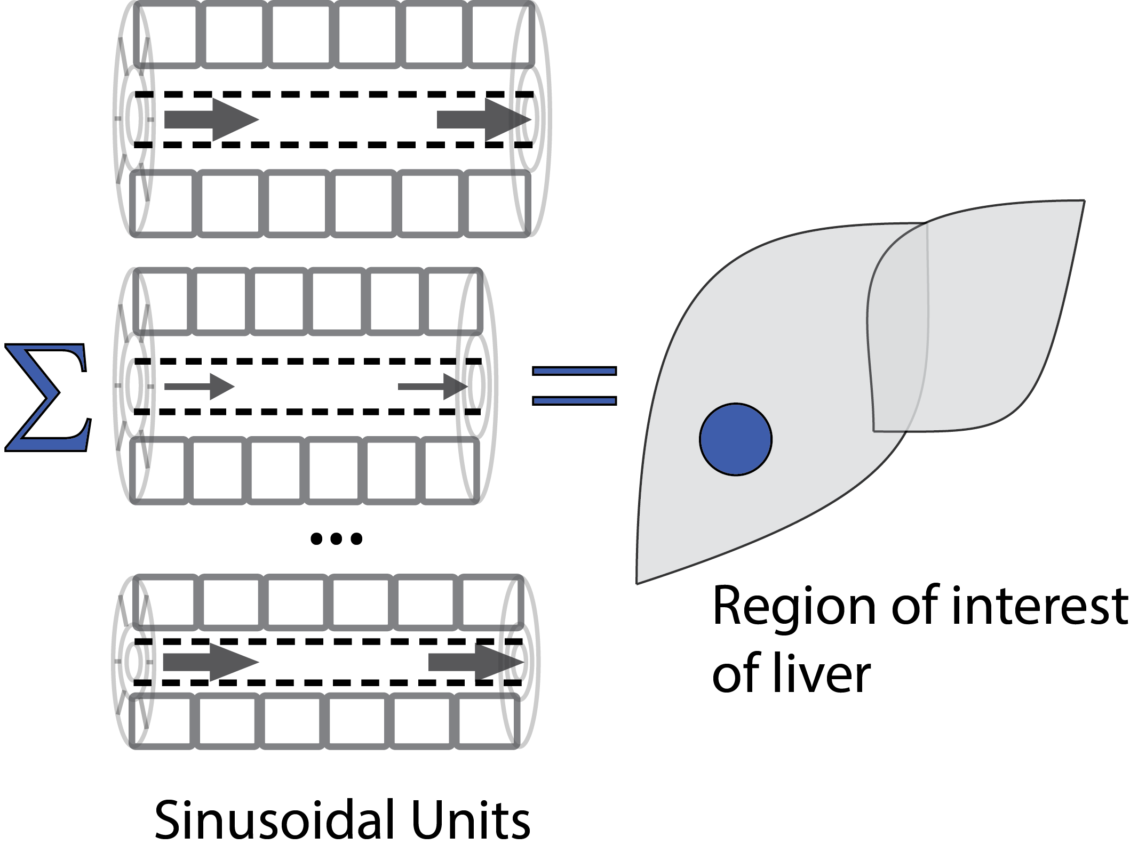
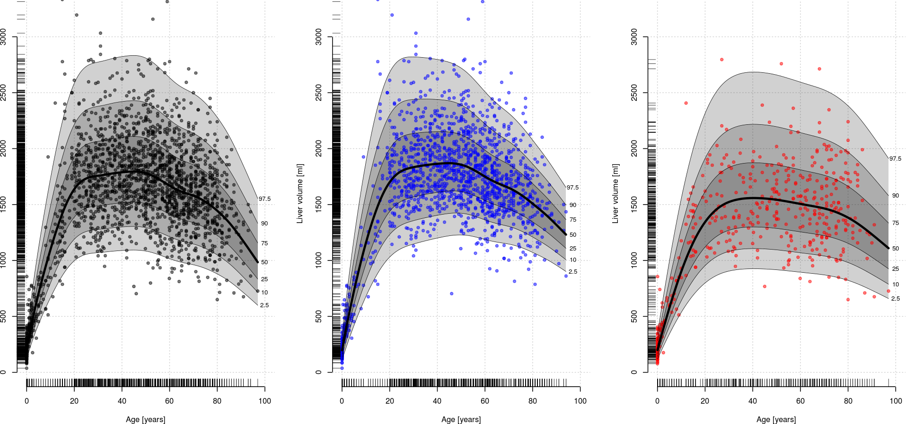
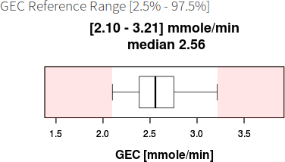
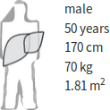
Individualized Liver Function
Galactose elimination capacity (GEC) as proxy for liver function
Tissue-Model predicts galactose clearance per tissue volume for given perfusion (regional GEC)
Scale with predicted individual distributions of liver volume and perfusion (total GEC)
Evaluation of individual & population variability in GEC
all
male
female
Liver volume [ml]
age [years]
GEC App

Slide 3

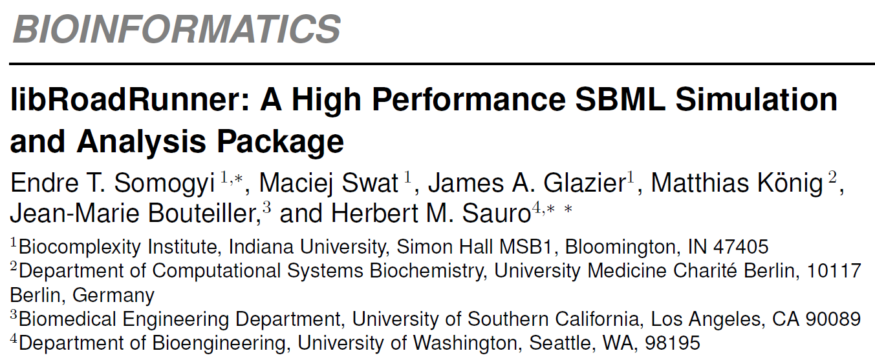
(manuscript in submission)

Slide 4
libRoadRunner
Complex problems in computational biology require highly efficient simulations, analyses or parameter optimizations with thousands of cells and thousands of species and reactions in each cell.
Results
  Highly innovative cross-platform, open-source software library
    easy integration with existing computational code
    highly efficient
    capable of handling very large and complex SBML models
  Uses novel just in time (JIT) compiler to compile SBML based models to optimized native machine code at runtime using LLVM
  Runs on x86 and ARM based processors
  Comprehensive native Python bindings
  Full suite of stoichiometric and metabolic control analysis routines
Availability & Implementation
  Self-contained library with native C, C++ & Python bindings for Linux, Mac Os & Windows
  www.libroadrunner.org

Slide 5
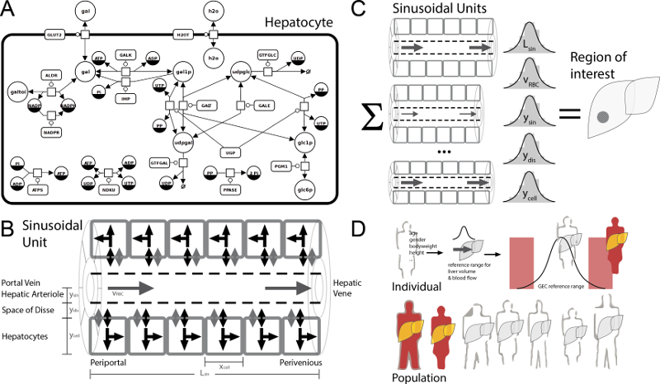
LibRoadRunner Projects
James A. Glazier, Biocomplexity Institute, Indiana University
  Multi-cell simulation of tissue morphogenesis
  CompuCell3D
Jean-Marie Bouteiller, Biomedical Engineering Department, University of Southern California
  Large scale modeling of synaptic, neuronal and neuron network dynamics (MEMORY platform)
Matthias König, Computational Systems Biochemistry
  Multi-scale modeling of liver metabolism in Virtual Liver Network

Slide 7


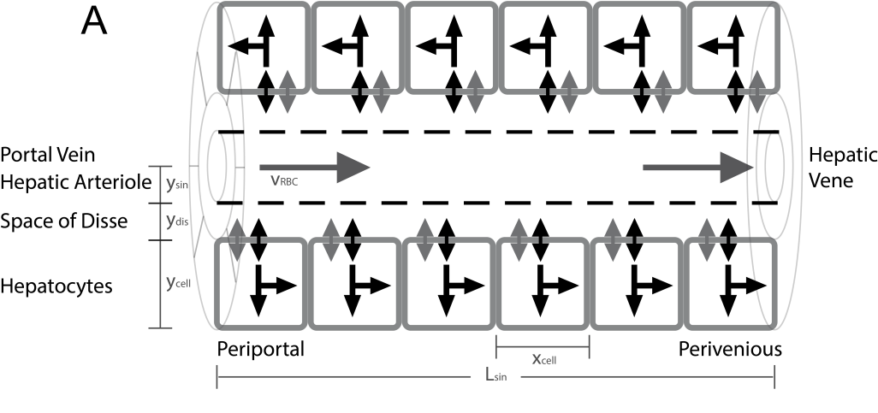
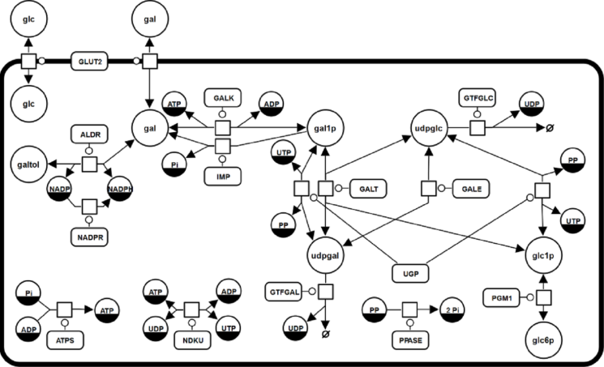
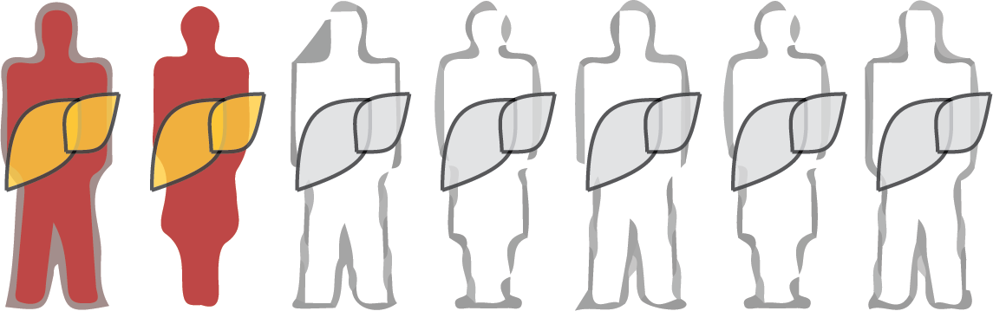
Population Variability of Liver Function
König M. & Holzhütter HG.
Sinusoidal Unit
Lobulus
Hepatocyte
Individuals / Population

