Slide 1

Stroke Volume and Cardiac Output in Normotensive Children and Adults
by Giovanni de Simone, Richard B. Devereux, Stephen R. Daniels, GianFrancesco Mureddu, Mary J. Roman, Thomas R. Kimball, Rosanna Greco, Sandra Witt, and Franco Contaldo
Circulation
Volume 95(7):1837-1843
April 1, 1997
Copyright © American Heart Association, Inc. All rights reserved.

Slide 2
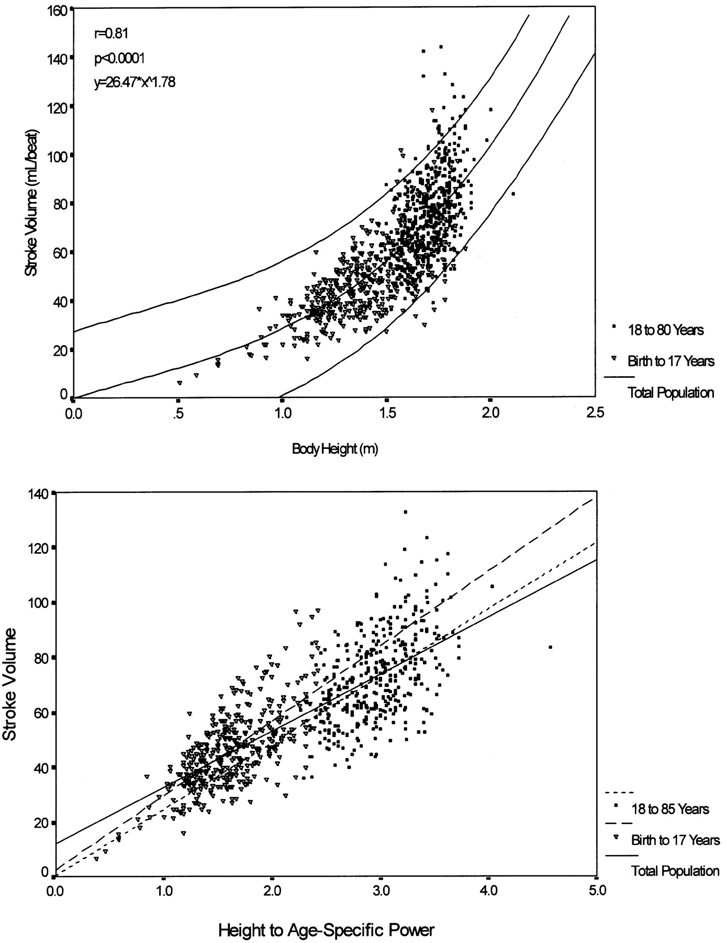
Top, Relation of stroke volume (vertical axis) to height (horizontal axis) in 373 normal-weight children/adolescents (open triangles) and 393 adults (solid squares).
de Simone G et al. Circulation. 1997;95:1837-1843
Copyright © American Heart Association, Inc. All rights reserved.
Notes:
Top, Relation of stroke volume (vertical axis) to height (horizontal axis) in 373 normal-weight children/adolescents (open triangles) and 393 adults (solid squares). Relation is curvilinear and is best represented by an allometric (power) equation. Bottom, Relation of stroke volume (vertical axis) to height^{1.78} (horizontal axis) in 373 children/adolescents (open triangles, dotted line) and 393 adults (solid squares, shaded line). Relations became linear with near-zero intercepts.

Slide 3
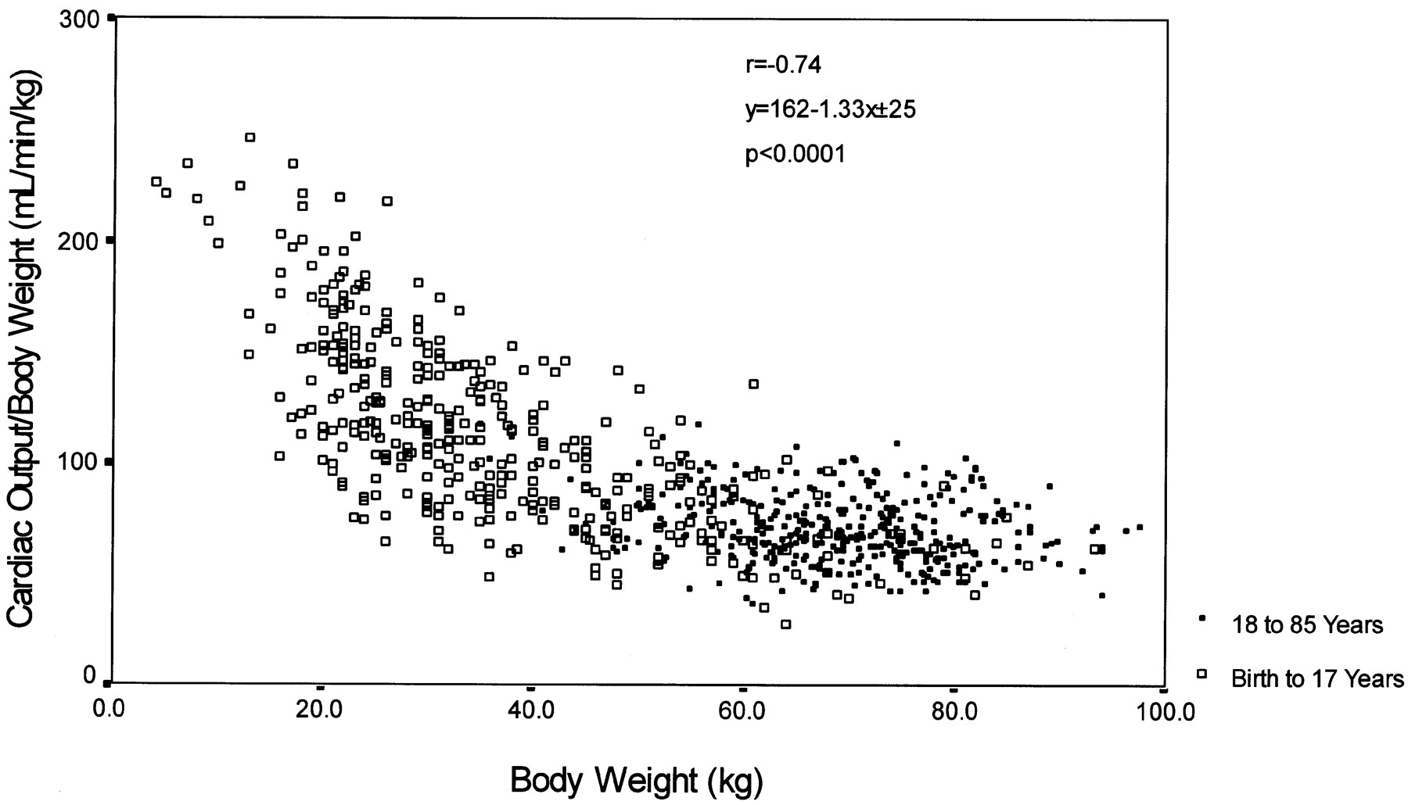
Relation of cardiac output/body weight (vertical axis) to body weight (horizontal axis) in 373 children/adolescents (open squares) and 393 adults (solid squares) showing strong negative relation between indexed value of cardiac output and body weight.
de Simone G et al. Circulation. 1997;95:1837-1843
Copyright © American Heart Association, Inc. All rights reserved.
Notes:
Relation of cardiac output/body weight (vertical axis) to body weight (horizontal axis) in 373 children/adolescents (open squares) and 393 adults (solid squares) showing strong negative relation between indexed value of cardiac output and body weight.

