Slide 1
UFO Shape Prediction Project
Group 94 Chenning Huang, Jingyi Gong, Shangyi Du

Slide 2
Objective
Model and interpret how contextual factors influence the reporting of UFO shapes using NUFORC sighting data from the late 20th century to the present.
NUFORC: National UFO Reporting Center

Slide 3
Value Proposition
Our project allows us to:
- Evaluate whether UFO shape reports are driven by actual observational features
e.g., distance to UFO, duration of UFO
- Detect geographic and temporal trends that may indicate environmental causes to
UFO shapes.
- Identify potential human-driven reporting biases.
e.g., culture, literacy, population density
Ultimately, this work helps clarify whether reported UFO shapes reflect actual aerial anomalies, or if they are shaped more by human interpretation, environment, and culture.

Slide 4
Contents:
Datasets Information
Major learnings from EDA
Modeling results
Implications and insights
Challenges/limitations/potential future work

Slide 5
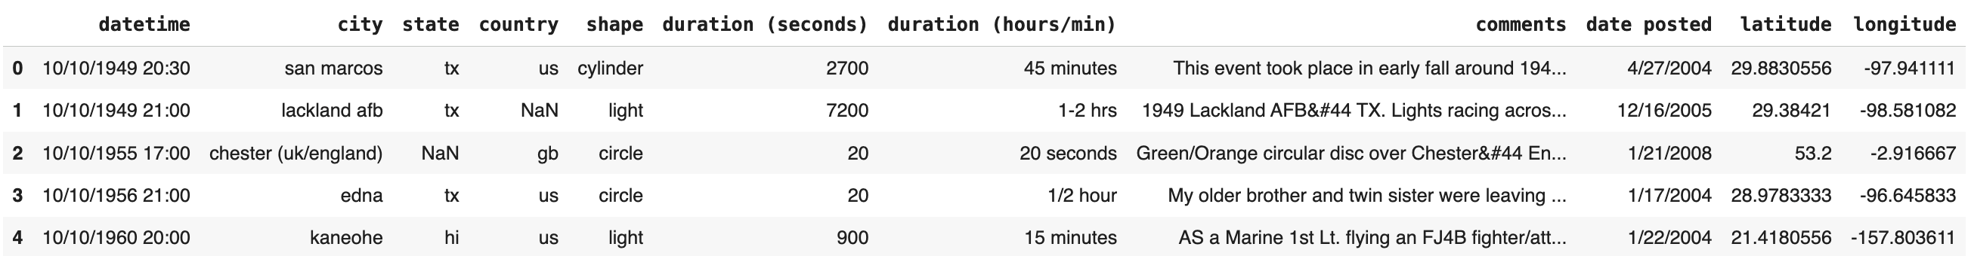
Dataset Used 1st
Main Dataset: NUFORC UFO Sightings (NUFORC, Kaggle)
Reports of UFO sighting events submitted to the National UFO Reporting Center
over 20th century.
Size: 80,000+ reports
→ actual observational features

Slide 6
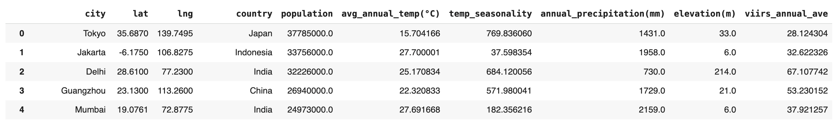
Dataset Used 2nd
City Features Dataset (SimpleMaps, NASA/NOAA VIIRS, WorldClim)
Geographic and environmental characteristics of cities worldwide
Size: 48,000+ cities
→ geographic and temporal features

Slide 7
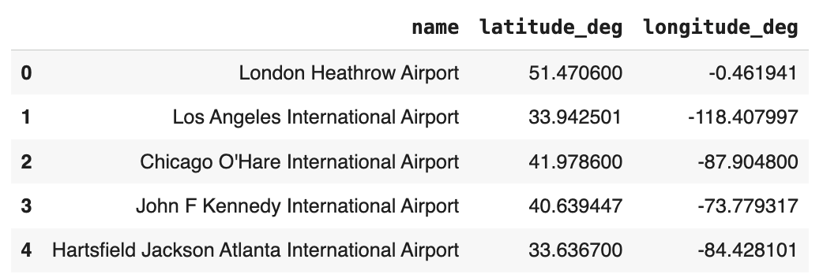
Dataset Used 3rd
Global Airports Dataset (OurAirports)
Up-to-date information on airport locations and aviation infrastructure worldwide.
Size: 84,000+ airports
→ human-driven reporting biases

Slide 8
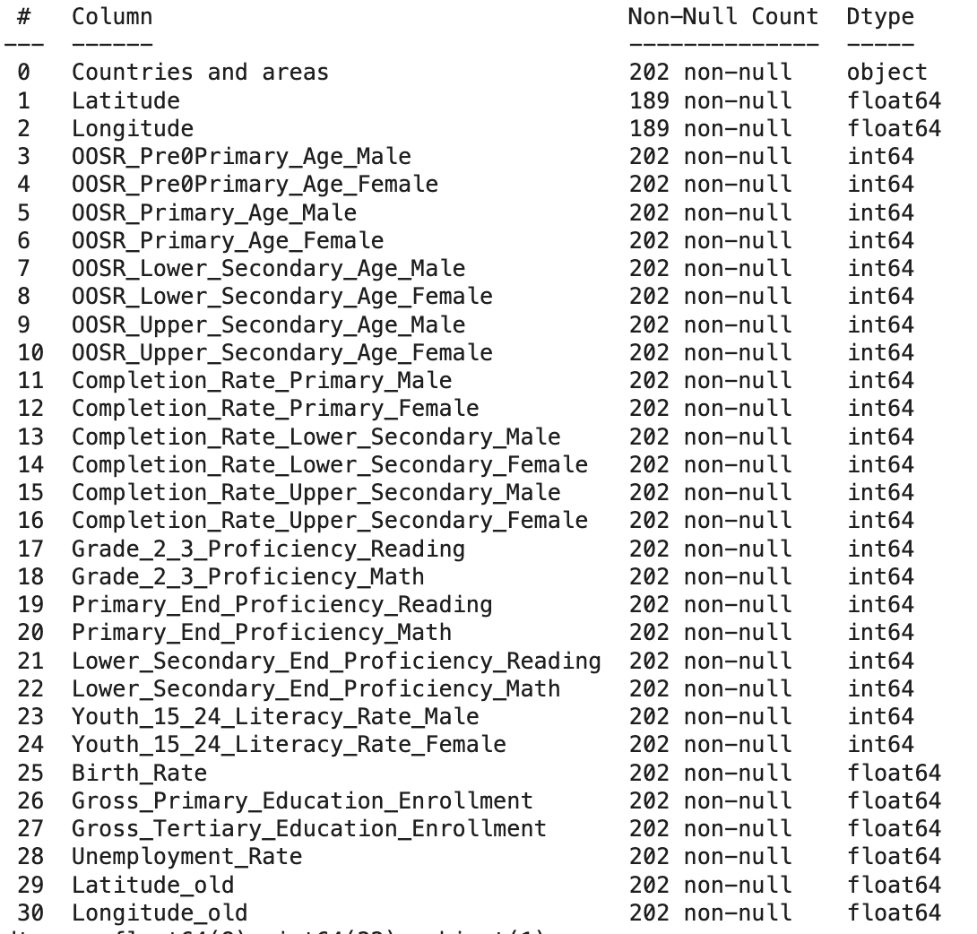
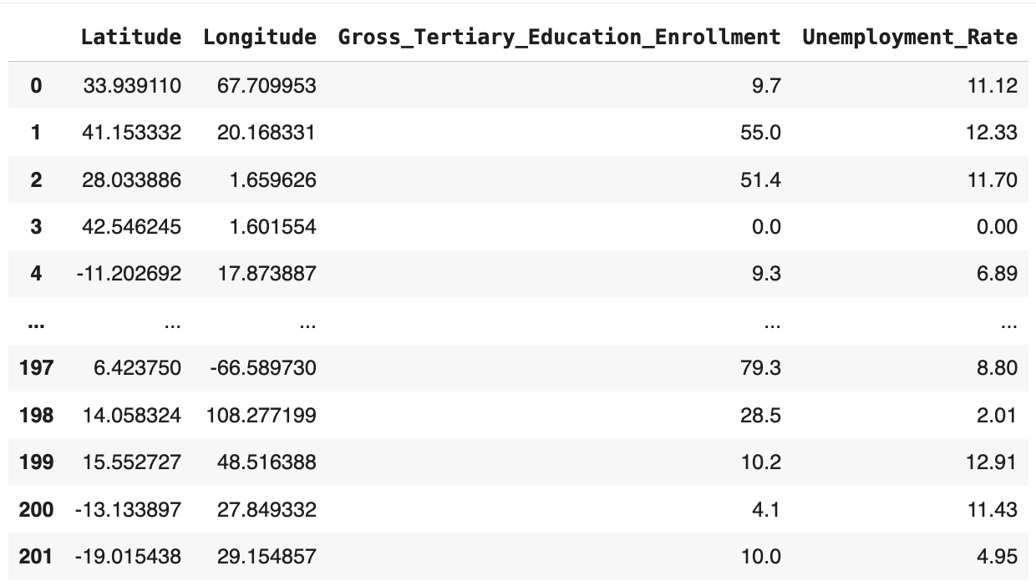
Dataset Used 4th
Country Education Level Dataset (Our World in Data, Kaggle)
National-level indicators reflecting cultural exposure and socioeconomic conditions
Size: 200+ countries
→ human-driven reporting biases

Slide 9
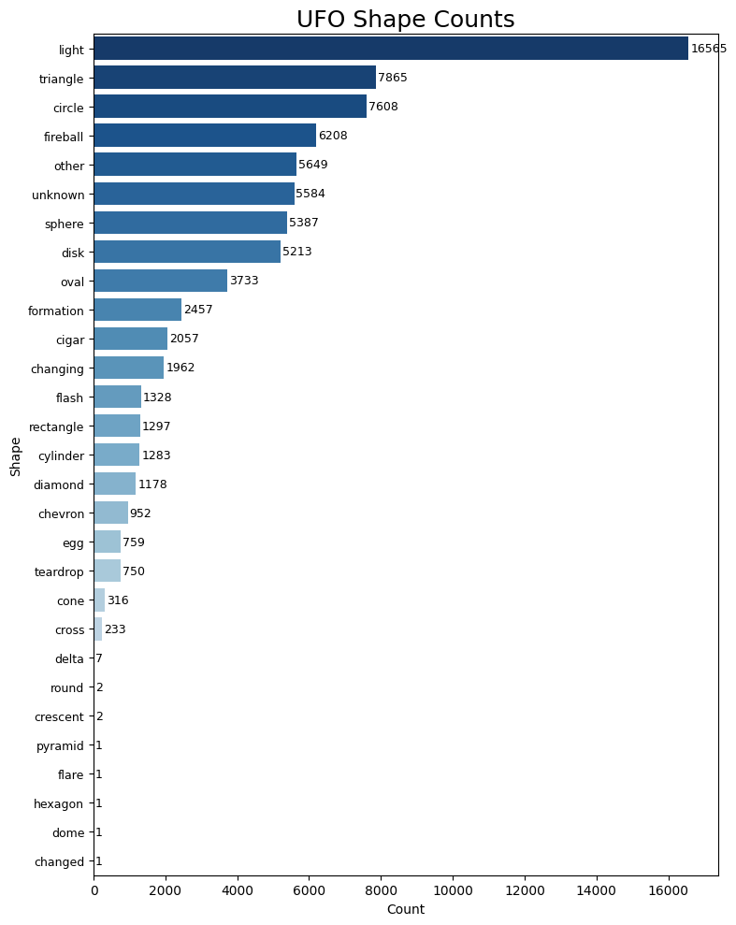
EDA Insights #1
Target Class Distribution (Shape Distribution)
Shows the severe class imbalance
Informed our choice of SMOTE in feature engineering to prepare data for modeling

Slide 10
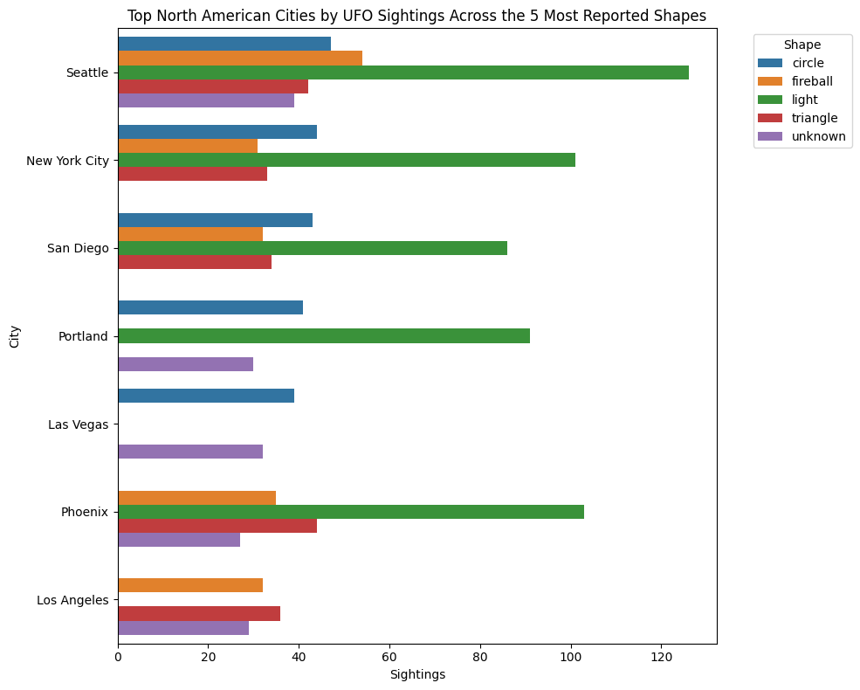
EDA Insights #2
Shape Distribution in Most Reported American Cities
Different shape rankings among cities
Distribution of shapes not tied to a single region

Slide 11
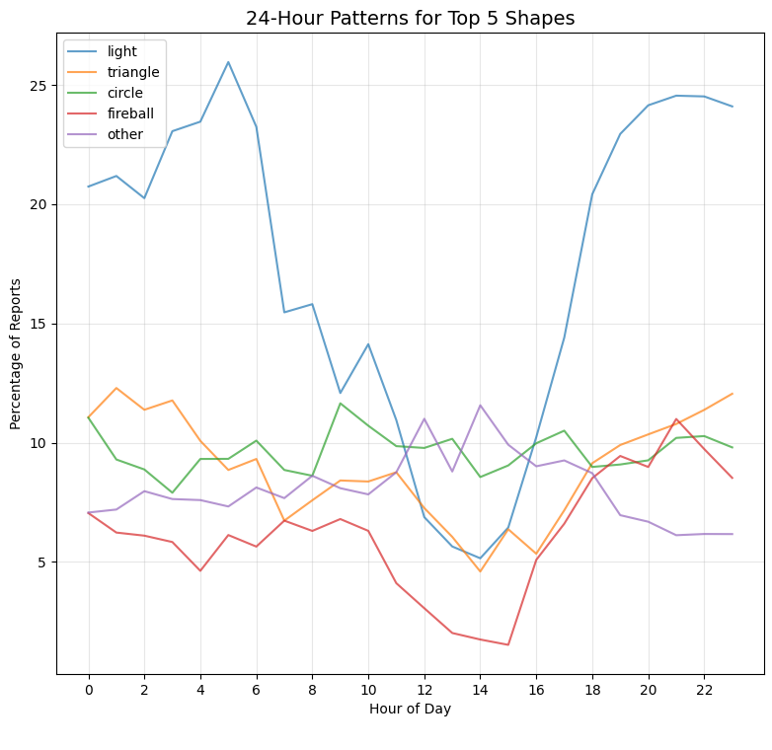
EDA Insights #3
Time vs Shape Analysis
Shows shapes behave differently across hours: ”light" has largest difference between night and afternoon, “circle” remain flat

Slide 12
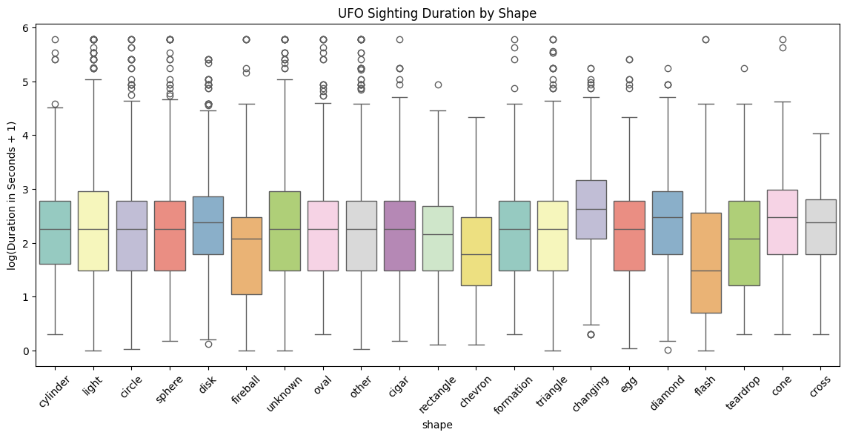
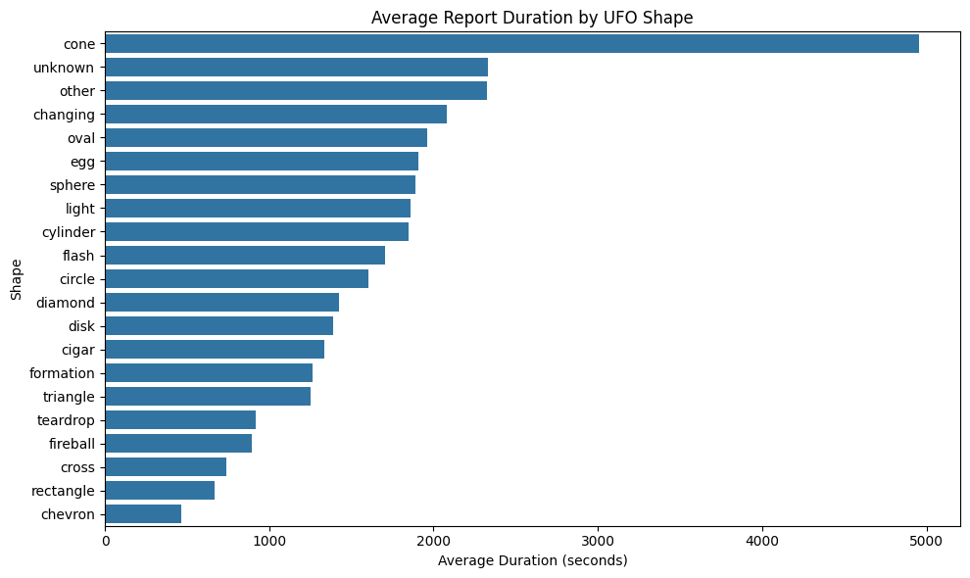
EDA Insights #4
Duration vs Shape Analysis
Boxplot showing median duration per shape; bar chart showing mean duration
Duration (seconds) has predictive signal
Suggesting certain shapes are associated with longer/shorter sightings

Slide 13
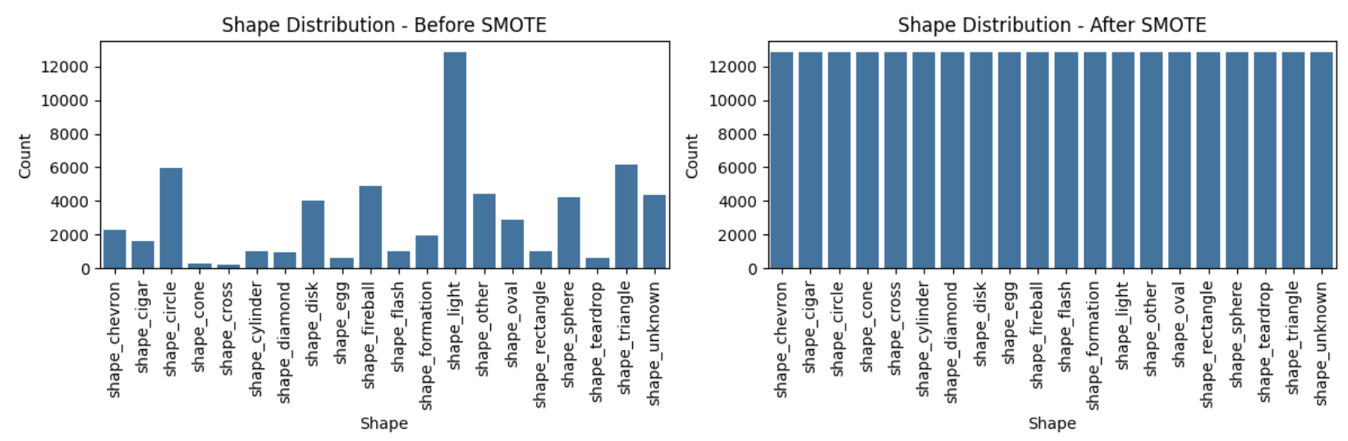
Handling imbalanced classes
Oversampling with SMOTE
Oversample: synthetically generate the minority class to fix class imbalance

Slide 14
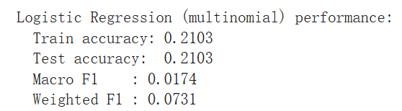
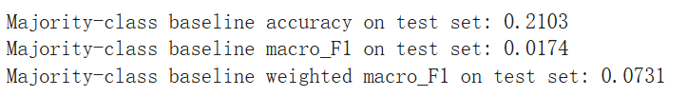
Baseline Models
Two Baseline Models
Baseline 1: Majority-class model
Always predicts the most frequent shape (“light”)
Baseline 2: Multinomial Logistic Regression
Linear classifier on all engineered features

Slide 15
Modeling Pt.2
Nonlinear Models & Imbalance Handling
4 Models evaluated:
Random Forests
AdaBoost
XGBoost
SVM(RBF)
Two imbalance strategies
Original train set + class or sample weights
SMOTE-balanced train set, no weights
Hyperparameter Tuning
RandomizedSearchCV
 | Acc (Orig) | Macro F1 (Orig) | Acc (SMOTE) | Macro F1 (SMOTE)
Majority | / | / | 21.0% | 0.073
LogReg | / | / | 21.0% | 0.073
RF | 12.9% | 0.127 | 12.7% | 0.125
AdaBoost | 12.6% | 0.127 | 11.0% | 0.112
XGBoost | 7.2% | 0.076 | 16.4% | 0.125
SVM | 4.1% | 0.044 | 4.4% | 0.052

Slide 16
Overfitting & Effect of SMOTE
Overfitting
Good Training Result:
RF (SMOTE): 94.7% train accuracy, 0.95 macro F1
AdaBoost (SMOTE): 97.4% train accuracy, 0.97 macro F1
Weak Generalization to Test Set
Only 7–16% accuracy across all models
Imbalance handling
Class / sample weights: improve training metrics, small gains on test
SMOTE: makes training easier, slightly improves XGBoost, but
Still below majority baseline accuracy
Rare shapes remain very hard to predict

Slide 17
Conclusion
Main Takeaways
Linear baselines + current features ≈ majority classifier
Nonlinear ensembles + imbalance tricks
High training F1, but test accuracy < 21% baseline
Rare shapes remain difficult to predict
Main bottleneck: limited signal in current features
Future Works
Incorporating additional datasets covering other relevant factors, but it is challenging because external data often differ in format, coverage, and geographic alignment.
Adding textual descriptions as a new feature and apply NLP techniques, but how to proces noisy and unstructured sighting reports makes it difficult.
Neural networks for richer nonlinear representations, but they require even larger, balanced datasets and careful tuning to avoid overfitting.
If problem still exists, we may conclude that the UFO shapes are impacted by actual aerial anomalies.

