Slide 1
Kubernetes
Qingsong Zhang, Ph. D. October, 2025

Slide 2
What is Kubernetes
Kubernetes is an orchestration framework for Docker containers which helps expose containers as services to the outside world.
For example, you can have two services − One service would contain nginx and mongoDB, and another service would contain nginx and redis.
Each service can have an IP or service point which can be connected by other applications. Kubernetes is then used to manage these services.

Slide 3
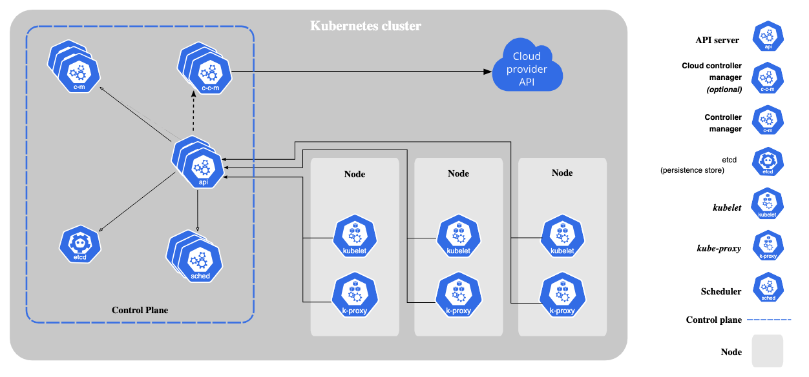
Kubernetes Components

Slide 4
Core Components
Control Plane
Kube-apiserver: the core component server that exposes the Kubernetes HTTP API
Etcd: consistent and highly-available key value store for all API server data
kube-scheduler: Looks for pods not yet bounded to a node, and assigns each Pod to a suitable node.
Kube-controller-manager: Runs controllers to implement Kubernetes API behavior
Cloud-controller-manager (optional): integrates with underlying cloud provide(s)

Slide 5

Core Components
Node Components
kubelet: ensure that Pods are running, including their containers
kube-proxy (optional): maintains network rules on nodes to implement services
container runtime: software responsible for running containers.
Addons
DNS: for cluster-wide DNS resolution
Web UI (dashboard): For cluster management via a web interface
Container Resource Monitoring: For collecting and storing container metrics
Cluser-level Logging: For saving container logs to a central log store

Slide 6
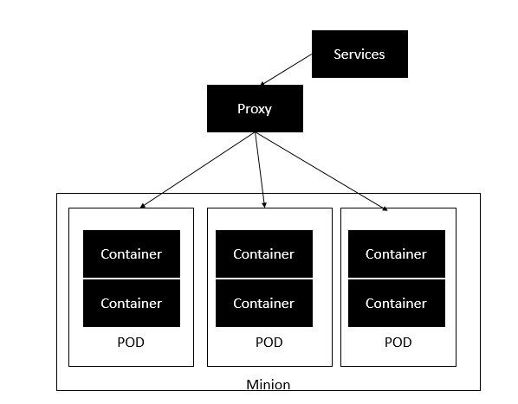
What is Kubernetes
The minion is the node on which all the services run. You can have many minions running at one point in time. Each minion will host one or more POD. Each POD is like hosting a service. Each POD then contains the Docker containers. Each POD can host a different set of Docker containers. The proxy is then used to control the exposing of these services to the outside world.

Slide 7
What is Kubernetes
Pods are the smallest deployable units of computing that you can create and manage in Kubernetes.
A Pod (as in a pod of whales or pea pod) is a group of one or more containers, with shared storage and network resources, and a specification for how to run the containers. A Pod's contents are always co-located and co-scheduled, and run in a shared context. A Pod models an application-specific "logical host": it contains one or more application containers which are relatively tightly coupled. In non-cloud contexts, applications executed on the same physical or virtual machine are analogous to cloud applications executed on the same logical host.

Slide 8
Kubernetes Architecture
etcd − This component is a highly available key-value store that is used for storing shared configuration and service discovery. Here the various applications will be able to connect to the services via the discovery service.
Flannel − This is a backend network which is required for the containers.
kube-apiserver − This is an API which can be used to orchestrate the Docker containers.
kube-controller-manager − This is used to control the Kubernetes services.
kube-scheduler − This is used to schedule the containers on hosts.
Kubelet − This is used to control the launching of containers via manifest files.
kube-proxy − This is used to provide network proxy services to the outside world.

Slide 9
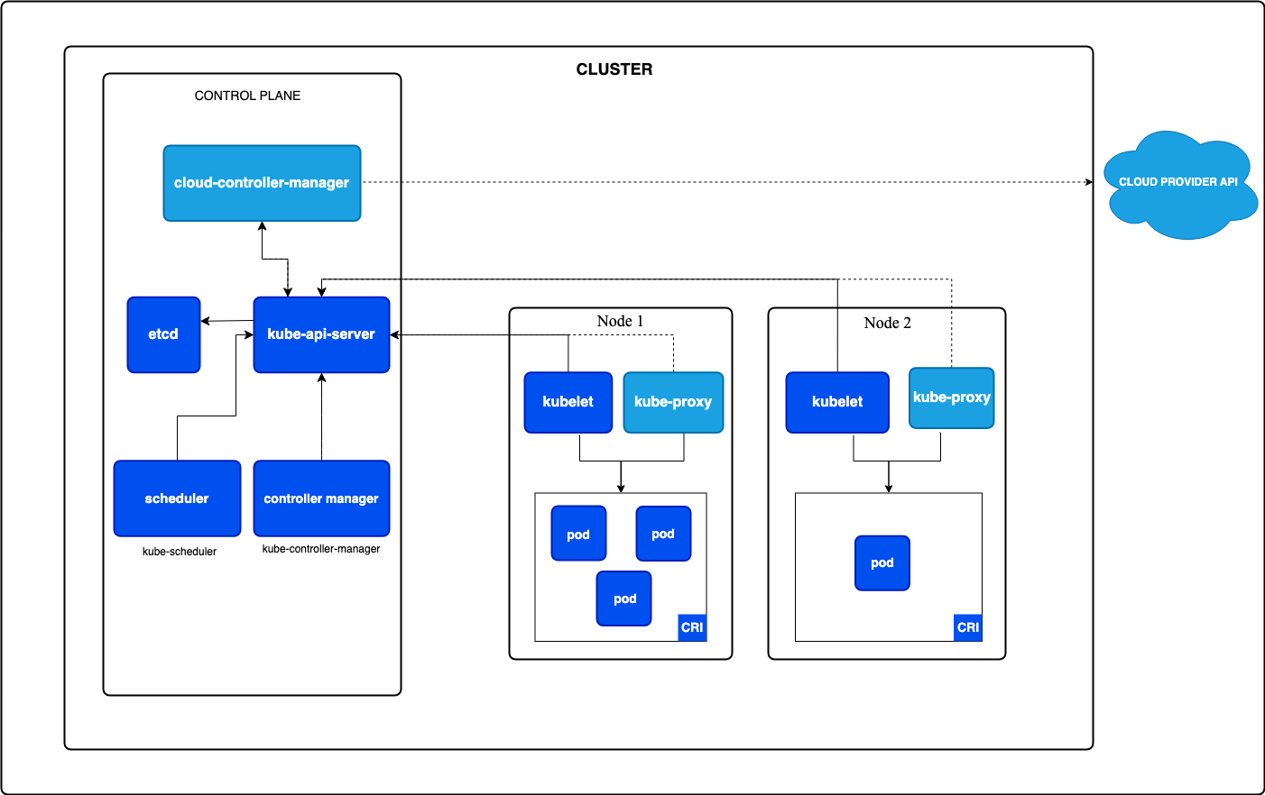
Kubernetes Architecture

Slide 10
Docker and Kubernetes
Kubernetes and Docker work together to simplify application deployment and management. Docker packs an application and its dependencies into a portable container that guarantees the same environment at development, staging, testing, and production. Next, Kubernetes orchestrates all these Docker containers through automation - tasks such as scaling, load balancing, self-healing, and many more.
Kubernetes clusters comprise worker nodes on which the Docker containers run, and a master node managing the state of the cluster. By defining desired states of applications in YAML files, Kubernetes continuously monitors the Deployment while adhering to the specifications, therefore providing high availability and efficient resource utilization.

Slide 11
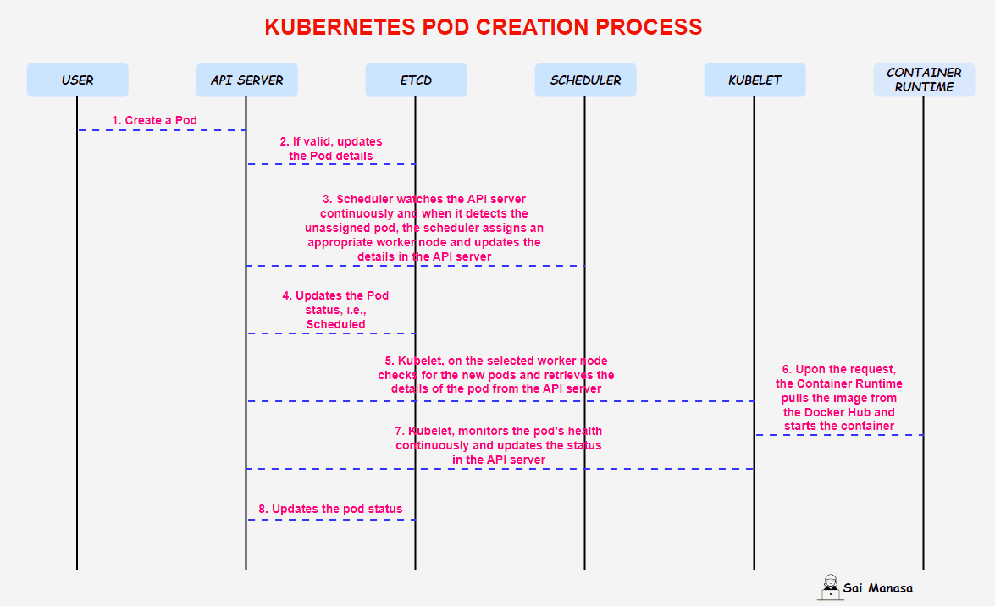
POD Creation

Slide 12
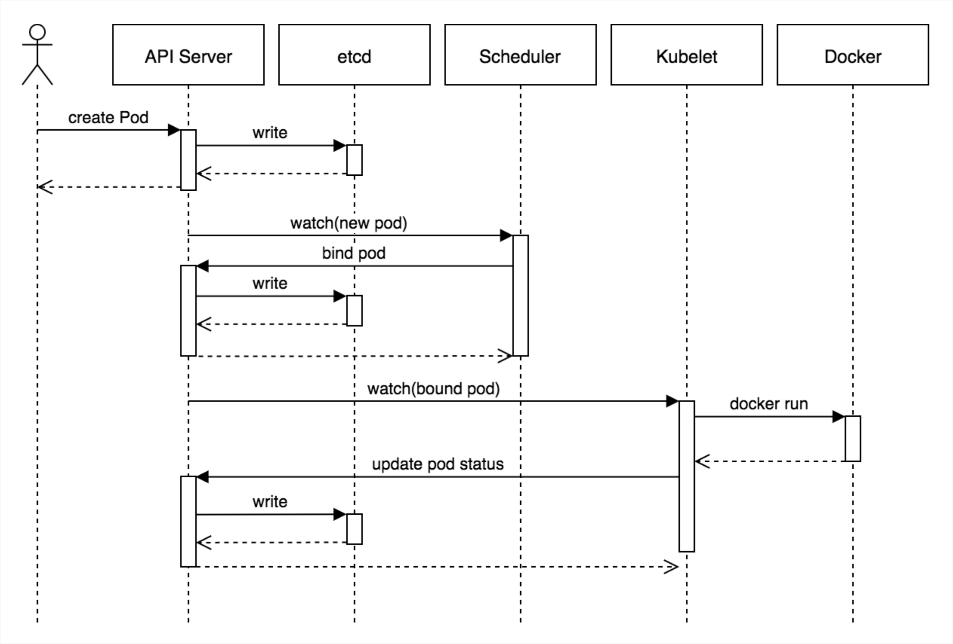
POD Creation

