Slide 1
Predicting Salary through Job Description
A Natural Language Processing Project
By: Justin Zhang

Slide 2
Data Introduction
Goal: Predict salary using content of job description.
Data is obtained from kaggle
https://www.kaggle.com/c/job-salary-prediction/data
Total sample: 244,768
Notable columns ‘FullDescription’, ‘Title’, ‘LocationNormalized’, and ‘Category’

Slide 3
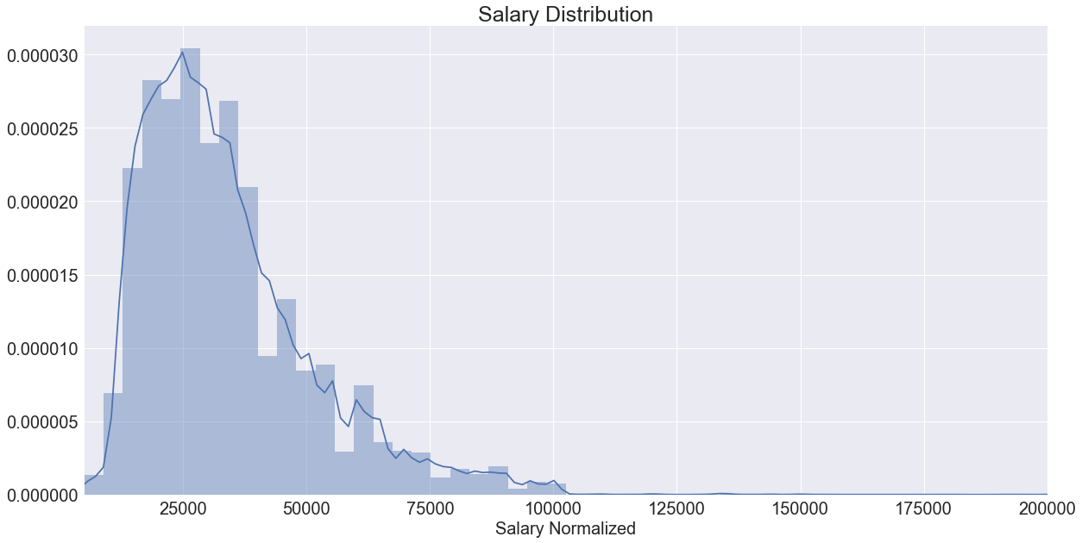
Exploratory Data Analysis
Data is left skewed.
Mean of 30,000 and median of 34,122.
Majority of jobs are paying around 30,000

Slide 4
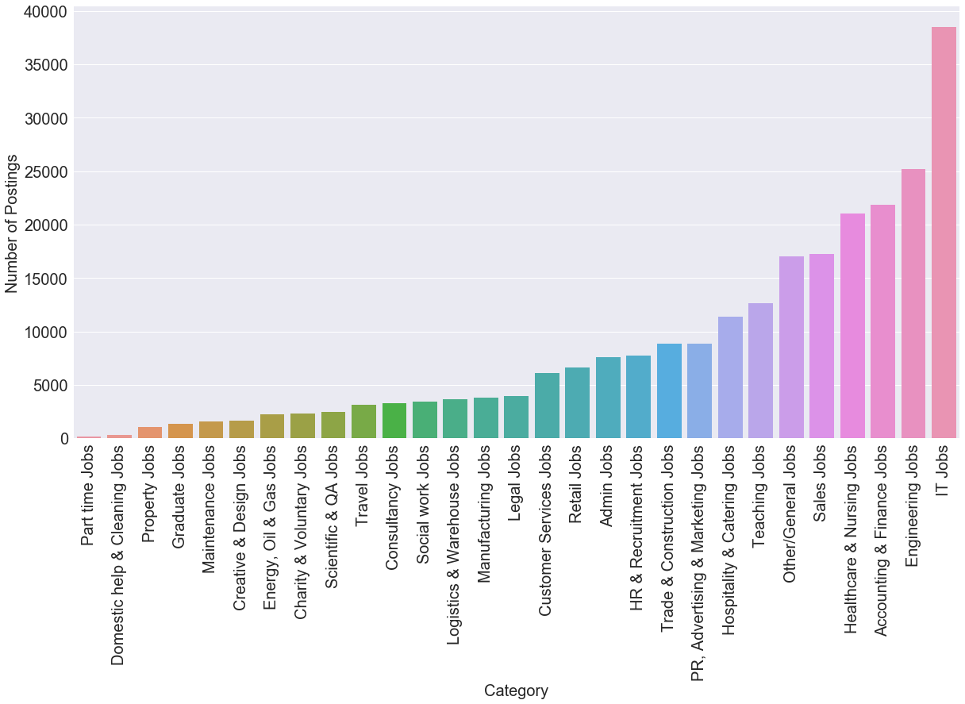
Exploratory Data Analysis
Aggregation by ‘Category’ column.
Large amount of IT and Engineering positions.
Most jobs are full time.
Does demand determine pay rate?

Slide 5
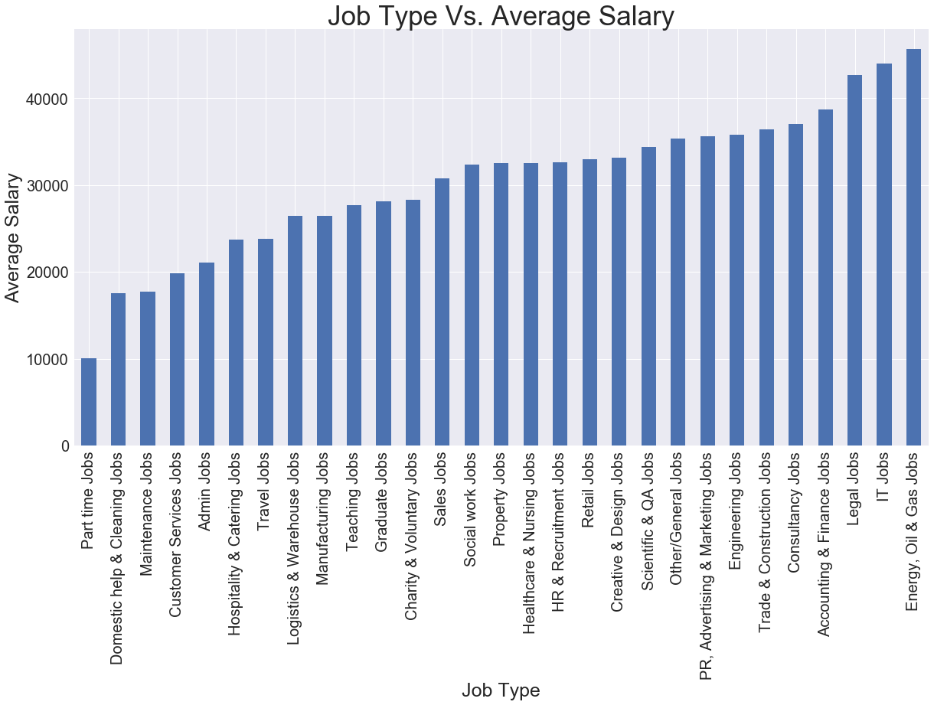
Exploratory Data Analysis
Part time jobs are low paying, due to possible low skill cap requirement.
Salary depends on both demand and skill qualification.
Energy, Oil & Gas is the highest paying due to high education background.
Part time jobs are not posted as frequently on job posting sites.

Slide 6
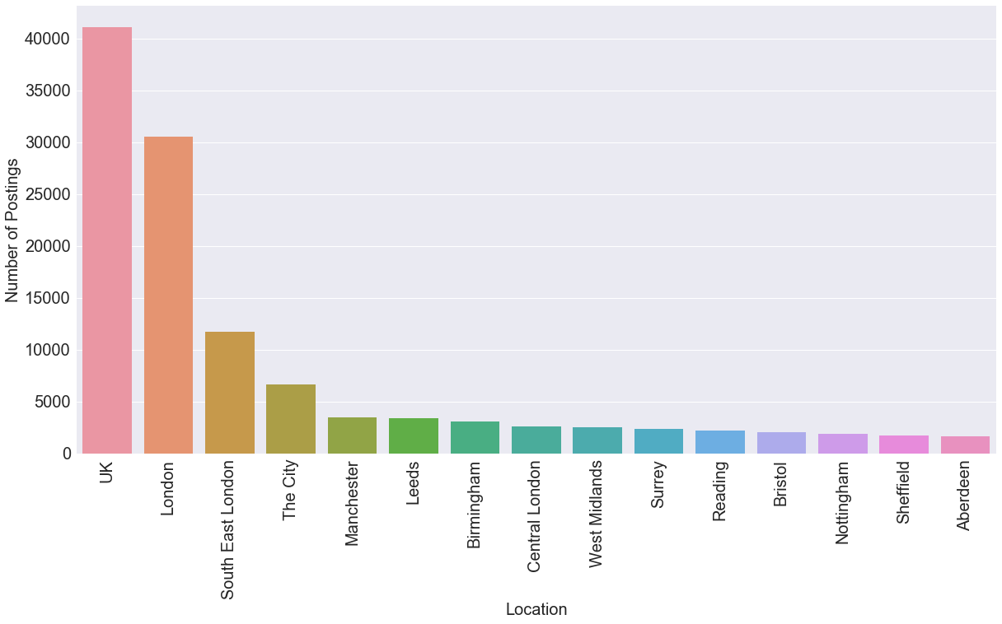
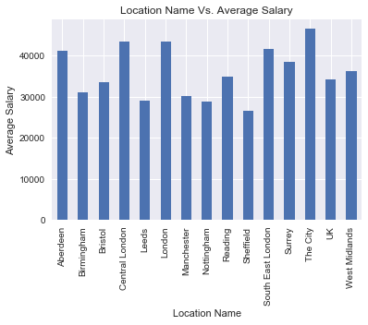
Exploratory Data Analysis
Top 15 location names are too generalized
UK/London/South East London are similar. Information is poor quality because data is not standard.
Average salary fluctuates greatly between the most frequent and least frequent location names.
Weak relationship. Weak predictive variable.

Slide 7
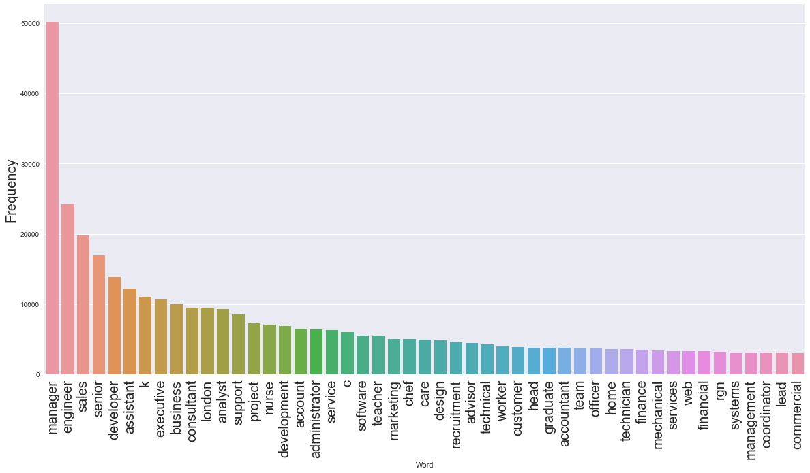
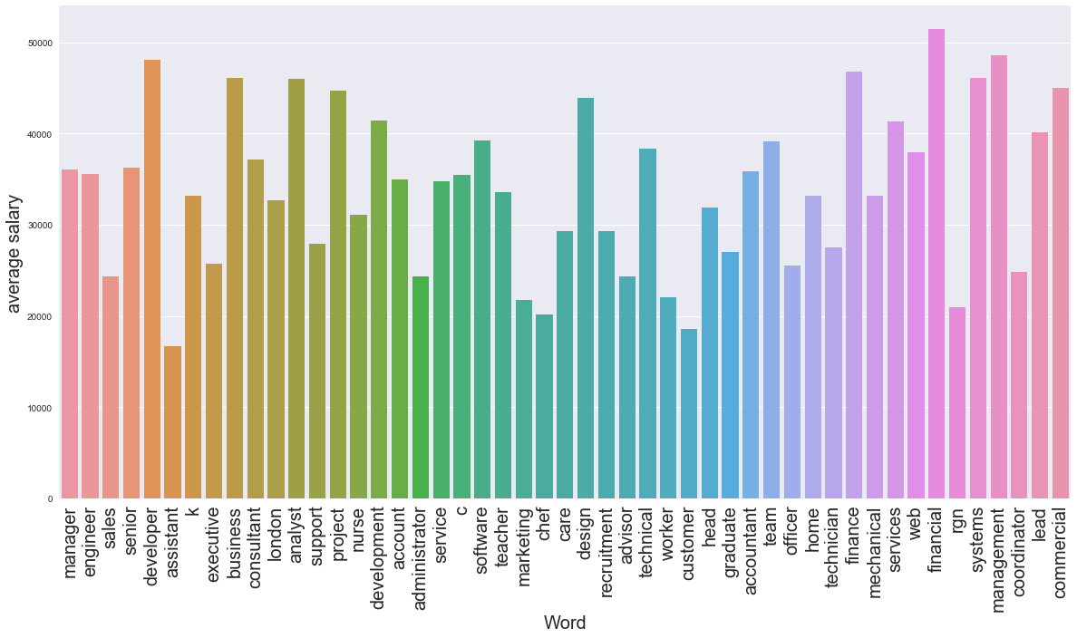
Exploratory Data Analysis
Top 50 words in ‘Title’. Frequency is the word count.
Word vs. Average salary. Relationship is not obvious.
Weak relationship indicates bad predictive power.

Slide 8
Model Building
Multinomial Naive Bayes
  Most common for natural language processing
Random Forest Classifier
  More complicated, low interpret-ability, high predictive power.
LinearSVC (Support Vector Machine)
  High interpret-ability, with high training/prediction speed.

Slide 9
Model Building
TfidfVectorizer used to construct bag of words.
Words appearing in many documents are given less weight.
Corpus is the dictionary made from training set.
Each row is a document, each word is a token.
Testing set can be transformed to return a term-document matrix.

Slide 10
Model Building
Notable parameters for TfidfVectorizer:
  stop_words
  max_df
  ngram_range
stop_words removes filler words and max_df removes words that appear too frequent out of all the documents.
stop_words and max_df had minimal effect on the accuracy score.
ngram_range groups words together by specified number. It construct word phrases, therefore deriving additional meaning from data.
ngram_range parameter significantly increased accuracy score with range (3,4).

Slide 11
Results
 | MultinomialNB | Random Forest | LinearSVC
No parameter training | 80.42% | 99.42% | 92.26%
No parameter testing | 81.27% | 83.55% | 87.63%
No stopwords/ max_df=0.7 training | 81.42% | 99.42% | 92.45%
No stopwords/ max_df=0.7 testing | 80.55% | 84.69% | 87.61
With ngram training | 92.07% | 99.27% | 99.56%
With ngram testing | 86.42% | 84.34% | 91.34%
All parameter + GridSearchCV: C=3 training |  |  | 99.83%
All parameter+ GridSearchCV: C=3 testing |  |  | 91.45%

Slide 12
Conclusion
The project is turned into a binary classification problem for interpret-ability. Score greater than 50% indicates a working model.
Best model for this project is LinearSVC, it is fast, able to handle large sample of data, and have minimum parameters for tuning.
Resulting model could prove useful for sites such as indeed.com, giving job searchers more power in filtering through millions of applications.

