Slide 1
NBA Salary Prediction
A Regression Project
By: Justin Zhang

Slide 2
Introduction
Goal: using advanced and basic game statistics from players’ on court performance to predict player salary.
Salary data is from:
(https://data.world/datadavis/nba-salaries)
Advanced and basic statistics are from:
(https://www.basketball-reference.com/)
Application: provide additional measure for the NBA and NBA players during salary and contract negotiation.

Slide 3
Data Wrangling
Basic stats data shape: 3589 rows X 31 columns.
Advanced stats data shape: 3575 rows X 28 columns.
Merging Statistics Data
  Six years of advanced/basic statistics divided into 12 files.
  Missing values must be filled in before data merge.
    Missing values are caused by 0 in denominator.
    NaNs are filled in with 0.
  Advanced and basic statistics are merged through inner join.
    Merged on columns:
    Year, Player, Rk, Pos, Age, Tm, G, MP

Slide 4
Data Wrangling
Merged stats data shape: 3575 rows X 51 columns
Salary data shape: 2788 rows X 9 columns
Merge stats data with salary data
  Create uniformity between columns to be merged on.
    ‘Player’ column in stats consist of player name and player ID.
      Separating via regular expression then separating the two variables.
    ‘Team’ column in stats comprised of team abbreviation.
      Replace abbreviated team names with full team names.
Salary dataset had no missing values.
Merging salary and stats dataframe
  Left (salary) join on ‘Player, ‘Team’, and ‘Year’ column
Result dataframe shape: 2788 rows X 58 columns

Slide 5
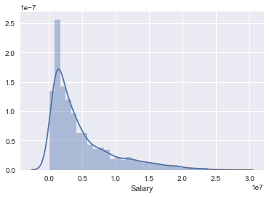
Exploratory Data Analysis
Salary statistics:
  Count: 2378 Mean: 4,416,256
  STD: 4,706,159 Min: 19,914
  Median: 2,677,320 Max: 30,453,800

Slide 6
Exploratory Data Analysis
To pre-screen the predictor variables, it is graphed against the response variable.
  Good relationship is observed when there is a wide spread on x-axis and the best fit line has a strong positive or negative relationship.
  Variables are visually picked out:
    Age, GS, FG, 2P, MP, FTA, TRB, AST, STL, BLK, PTS, OWS, VORP, USG%, PER

Slide 7
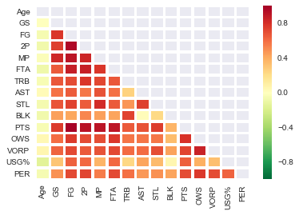
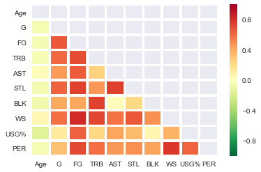
Exploratory Data Analysis
Correlation matrix is constructed to visualize multi-collinearity.
Dark red relationships are removed.
Reducing multi-collinearity should help with prediction accuracy

Slide 8
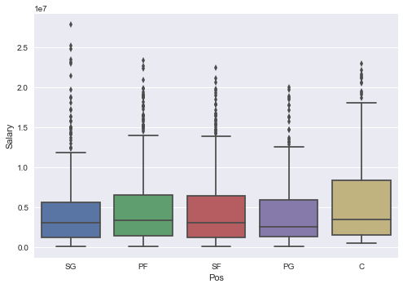
Exploratory Data Analysis
Using hypothesis testing can help decide whether numbers are caused by chance.
  Null hypothesis: salary difference does not exist between PG and SF
  Alternative hypothesis: difference exist between PG and SF salary.
    The player position graph is similar in value.
    To find out if the differences are meaningful, a T-test can be done with alpha=0.05 which is 95% confidence interval.
PG and SF are chosen due to its similar in value.
T-test yields p-value of 0.1578 which is too
high, therefore alternative hypothesis is
rejected.

Slide 9
Model Building
The machine learning algorithms applied:
  Linear Regression
  Ridge Regression
  Random Forest
  Gradient Boosting Regressor
Train-test-split splits training and testing samples into 75% and 25% respectively
Scores are calculated with coefficient of determination which is the proportion of the variance in the dependent variable that is predictable from the independent variable.

Slide 10
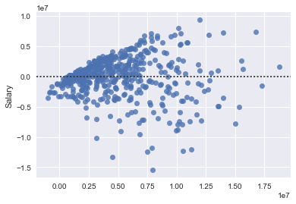
Model Building
Linear Regression
  Fast and easily interpretable.
  Low predictive power
Works best for variables with a normal distribution
Variables can be transformed using log.
Hetoroscedasticity caused by
predictor variables error terms
not having the same variance.

Slide 11
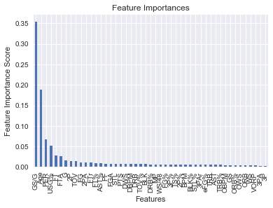
Model Building
Ridge Regression
  Fast and alleviates multi-collinearity amongst regression predictor variables.
  Alpha is the only parameter necessary for tuning
Random Forest
  Slow algorithm, but with high predictive power. Deals with over-fitting quite well.
  Have a method which lists top features of importance.

Slide 12
Model Building
Pick out the top 15 most important features from random forest method.
Gradient Boosting yields the best result
  GBM combines the weak to improve prediction accuracy.
  Slow algorithm with high prediction power.
  Low interpret-ability, often considered as a black-box algorithm.

Slide 13
Results
 | No parameter: training | No parameter: testing | Tuned parameter: training | Tune parameter: testing
Linear (pre-selected X) | 0.5323 | 0.5177
Linear (all X) | 0.5736 | 0.5686
Ridge (pre-selected X)T | 0.5323 | 0.5177 | 0.5323 | 0.5177
Ridge (all X) | 0.5720 | 0.5678 | 0.5661 | 0.5629
Random forest (all X) | 0.9200 | 0.5424 | 0.8875 | 0.6577
Random forest (top 15 X) | 0.9251 | 0.6236 | 0.8971 | 0.6630
GBM (all X) |  |  | 0.7841 | 0.6566
GBM(top 15 X) | 0.7930 | 0.6652 | 0.7476 | 0.6753

Slide 14
Conclusion
It was unnecessary to pre-screen the predictor variables, since some methods have properties that can rank feature importance.
The accuracy increased from 53.23% to 67.53% meaning 67.53% of the testing points can be explained by the model.
Testing score is a generalization of how the model would perform on out of sample data or real world data.
This project can be easily converted to a classification problem for better interpret-ability.
    For example: if it was a binary classification problem, a socre of 50% or higher indicates a working model, since it is better than blind guessing.

