Slide 2
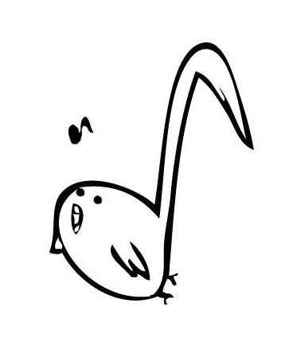
SYNCOPASIAN

