Slide 1

BUS 150
Strengthening Business-to-Business Relationships via Supply Chain and Customer Relationship Management

Slide 2
Supply Chain Group Game
Run Your Own Business (for 5 Weeks)
Today, you are not students. You are managers.
Your goal: Make money. Beat other teams. Survive the market.

Slide 3
Story Setup
Your Business
You own a small online store.
Each week:
Customers come to buy your product
You must decide how many units to order

Slide 4
The Problem
The Reality of Business
You don’t know the “perfect” decision.
If you…
Order too little → customers leave
Order too much → money is wasted
Welcome to supply chain management

Slide 5
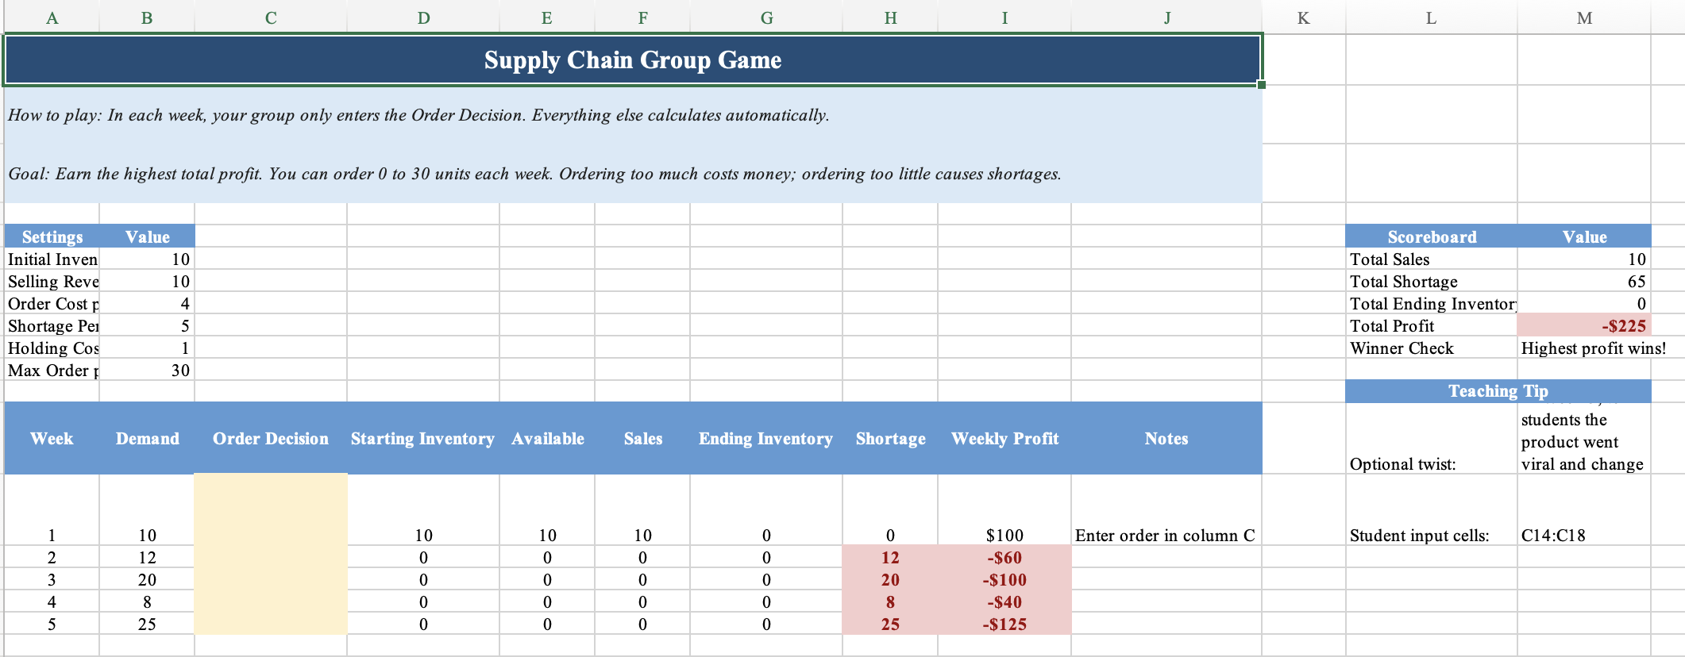
How to Play
Open Excel File: Supply_chain_game_students.xlsx in Week 13

Slide 6
Your ONLY Decision
What You Control
Each week, your group only decides:
Order Decision (Column C)
Everything else is automatic:
Inventory
Sales
Shortage
Profit
You focus on decision-making

Slide 7
How Each Week Works
Weekly Process
Every week:
You decide how much to order
Customers show up (Demand)
You sell what you have
Key rule:
“You can only sell what you have.”

Slide 8
What Happens Next
Two Possible Mistakes
❌ Not enough inventory
→ Lost sales → unhappy customers
❌ Too much inventory
→ Extra cost → wasted money
Both hurt your profit.

Slide 9
How You Make Money
Profit Logic (Simple Version)
You earn money when: You sell products
You lose money when: You order too much You cannot meet demand
Example Scenario
Demand = 10
Order 5 → You lose customers
Order 30 → You waste money

Slide 10
Team Strategy
Work as a Team
Discuss with your group:
Should we be aggressive?
Should we be conservative?
Should we change strategy over time?
This is a Competition
Each week:
You will report your weekly profit
I will display the results for all groups

Slide 11
Important Reminder
Your Profit Depends On:
You earn money when:
You sell products
$10 per unit sold
You lose money when:
You order too much, Order cost: $4 per unit
You have leftover inventory, Holding cost: $1 per unit
You cannot meet demand, Shortage penalty: $5 per unit
Your Goal: Maximize TOTAL profit across 5 weeks

Slide 12
Pause and Reflect
Think about your group’s decisions:
Did your group ever run out of stock?
Did your group ever order too much?
Did your strategy change from Week 1 to Week 5?
What was the hardest part of the game?

Slide 13
What Did You Just Experience?
In the game, your group had to manage:
how much to order
how much inventory to carry
how to avoid shortage
how to earn profit while controlling cost
That is exactly the logic of Supply Chain Management
Supply chain management is about making sure the right products are available:
in the right amount
at the right time
at the right cost

Slide 14
The Real Problem Starts Here
The real problem: Demand is uncertain
In the game, you knew demand.
That made your decision easier.
But in real business:
Companies do NOT know future demand Customers are unpredictable
So firms must ask:
“How much should we order… when we don’t know what will happen?”

Slide 15
So You Have to Decide
You must make a decision before knowing the future
How much should you order?
This is an Inventory Decision
Order too little → shortage
Order too much → leftover inventory
From your game:
Different groups made different decisions → and got very different profits

Slide 16
Why Is It So Hard?
Because of Trade-Offs
There is no perfect decision.
If you order too little:
save cost
risk shortage
If you order too much:
avoid shortage
increase cost
You are choosing which mistake to make

Slide 17
Now Imagine This…
Now imagine you are NOT alone
In real life, supply chains include:
suppliers
manufacturers
warehouses
retailers
Each one makes decisions separately
What could go wrong?
Small changes become big problems, This is called the Bullwhip Effect

Slide 18
So What Is Supply Chain Management?
Supply Chain Management (SCM)
Managing the flow of: products, information, decisions
Goal:
✔ Meet demand ✔ Minimize cost ✔ Avoid chaos
From your game, SCM includes:
forecasting demand
managing inventory
balancing trade-offs
coordinating decisions

Slide 19
SCM → CRM
We focused on products… but what about customers?
In the supply chain game, your goal was:
manage inventory
meet demand
maximize profit
But think about this:
Where does demand come from?
Customers
New question:
“How do we manage customers, not just products?”

Slide 20
The Game: You Are Marketing Managers
Your Role
You are a marketing team in a company.
You have:
A fixed advertising budget: $200
5 customer segments
Different response rates and costs
Your Goal Maximize total profit
Key idea Not all customers are equally valuable.

Slide 21
How to Play
Your Decision
For each segment, choose:
How many customers to target
Important Rules
You are choosing number of customers, NOT money
Each customer has a cost
Your total cost cannot exceed $200
How profit works Revenue = conversions × $20 Conversions = target × response rate Profit = revenue − cost

Slide 22
Game Structure
Round 1 — Try Your Best Make your decision based on intuition Don’t overthink
Round 2 — Improve Now you understand the game Adjust your strategy to do better
Winner Group with the highest total profit wins

Slide 23
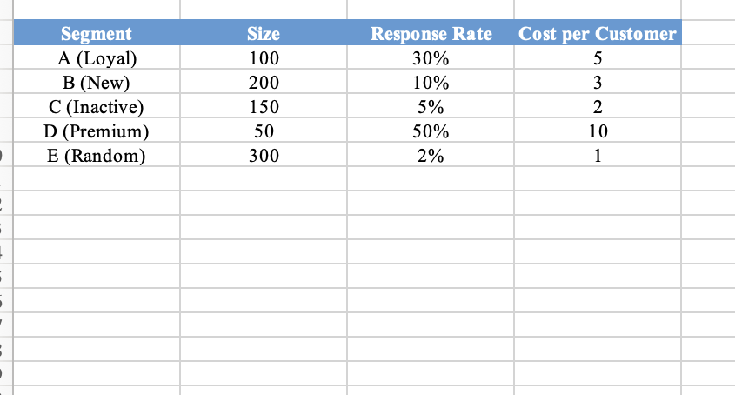

Slide 24
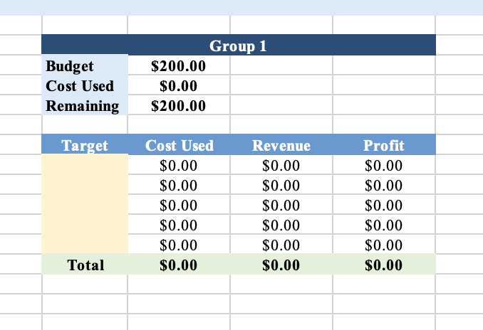

Slide 25
From Supply to Demand
From Supply Chain to Customers
In the previous game, you focused on:
managing inventory
making ordering decisions
balancing shortage and cost
Now we shift the focus: From products → to customers
Key question: Where does demand come from?

Slide 26
What Is CRM?
Customer Relationship Management (CRM)
CRM is the process of managing:
customer interactions
customer data
customer decisions
Goal: Maximize customer value and firm profit

Slide 27
Why CRM Matters
Today’s Customers Are Different
more information
more choices
more power
Implication: Firms must actively manage relationships

Slide 28
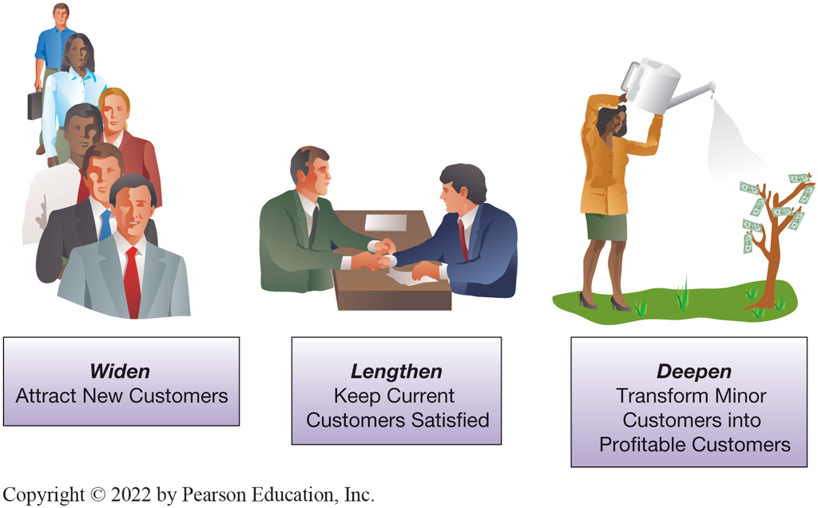
The Goal of CRM
Widen, Lengthen, Deepen
CRM focuses on:
Widen → attract new customers
Lengthen → retain customers
Deepen → increase customer value

Slide 29
What Does CRM Actually Do?
Benefit | Examples
24/7/365 operation | Web-based interfaces provide product information, sales status, support information, issue tracking, and so on
Individualized service | Learn how each customer defines product and service quality so that customized product, pricing, and services can be designed or developed collaboratively
Improved information | Integrate all information for all points of contact with the customers— marketing, sales, and service—so that all who interact with customers have the same view and understand current issues
Improved problem identification/resolution | Improved record keeping and efficient methods of capturing customer complaints help to identify and solve problems faster
Optimized processes | Integrated information removes information handoffs, speeding both sales and support processes
Improved integration | Information from the CRM can be integrated with other systems to streamline business processes and gain business intelligence as well as make other cross-functional systems more efficient and effective
Improved product development | Tracking customer behavior over time helps identify future opportunities for product and service offerings
Improved planning | This provides mechanisms for managing and scheduling sales follow-ups to assess satisfaction, repurchase probabilities, time frames, and frequencies

Slide 30
Types of CRM Systems
Three Types of CRM
Operational CRM
sales, marketing, service
Analytical CRM
data analysis, customer insights
Collaborative CRM
communication across the organization

Slide 31
Connecting to Your Game
What You Did = Analytical CRM
In the game, you:
analyzed response rates
compared customer value
allocated budget
That is: Analytical CRM decision-making

Slide 32
New Update: AI & Ethical Issues
AI in CRM
personalization
recommendation systems
targeted advertising
Ethical Concerns
bias in algorithms
privacy issues
discrimination risks

Slide 33
Final Takeaway
SCM vs CRM
SCM → manage supply
CRM → manage demand
Profit comes from BOTH sides

