Slide 1
<1 cm
>1 cm
macule
patch
<1 cm
>1 cm
t
papule
plaque
wheal
<1 cm
>1 cm
epithelium
vesicle
bulla
pustule
cyst
Corneum
scale
crust
lichenification
ulcer

Slide 2
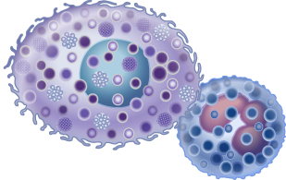
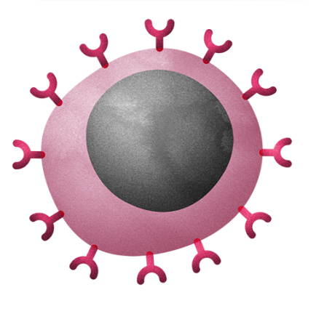
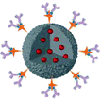
Mast
Enemy Cell
Basophil
IgG
Antigen
IgM
Complement Lysis
IgE
Phagocytosis
Antigen
Type I – atopic / anaphylactic
Type II - cytotoxic
T
PMNs
Type III – Immune complex mediated
Type IV – Cell mediated

Slide 3
Name, Age, Gender Skin condition Vitals

Slide 4
Name, Age, Gender Chronic Health (diabetes) Vitals
timing
Diabetes: type
episode
Symptoms
Drug
Effect
Monitoring
GI: Bowl – freqeuency, description, blood. Muscus, relationship to oral, baseline, distension,
Fever (child): Rash
Fever (adult): Chills, rigor,
PMHx: Pregnancy, birth, medical, surgical, hospital, accident
DHx: allergy, OTC, prescription, immunization
ObGyn: M0 M1 MT
Lifestyle: FES - DAS
Lifestyle (child): Food, Eating, Drinking, Sleeping, Pooping, Crying
Social (child): Daycare,

