Slide 1
Calibration signal
Right atrium
RSR RBBB
Both +ve for normal Axis / Fascicular block
downward P-QRS-T
Midway QRS
Right ventricle
downward QRS - T
lateral left ventricle
downward QRS
M LBBB
downward QRS
Inferior surface
Septum + ant L. ventricle
Ant Lat Left ventricle

Slide 2
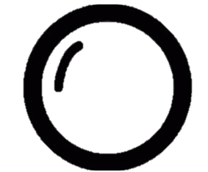
bicarb
PaCO2

