Slide 1
Challenges in Deploying Deep Learning for Chest X-Ray Interpretation to Clinical Practice
Jin Haeng Lee, Ryan Gust, Tiga Choi
Notes:
Hello, welcome to our presentation, Challenges in Deploying Deep learning for chest x-ray interpretation to clinical practice by Jin Haeng Lee, Ryan Gust, Tiga Choi

Slide 2
Table of Contents
Introduction
Problem Formulation
Exploratory Data Analysis: CheXpert
Experimental Setup
Propose Approach
Pre-Processing
Model Description
Training Model
Inference Procedures
Experimental Evaluation
Conclusion
Notes:
Listed here are contents I will be presenting today. Let us dive into introduction first

Slide 3
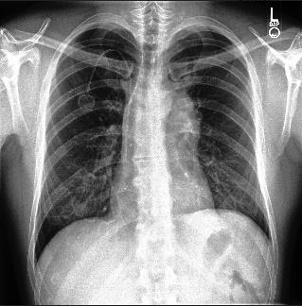
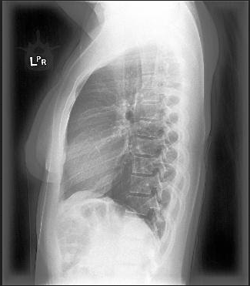
Introduction
Chest X-ray (CXR) is the most common form of medical X-rays.
CXR: b&w 2-D projection of human body
Interpreting medical x-rays is a specialized medical practice: Radiology
Radiologists’ errors in X-ray readings are higher than other medical imaging technology.
Lateral x-ray image
Frontal x-ray image
Notes:
Chext Xray or CXR is the most common form of medical X-rays, and radiology is medical specialization of interpreting the x-ray images.

Slide 4
Problem Formulation
Radiology/CXR interpretation
High interpretation errors
On-going radiologist shortage
Existing Researches
Focused on building higher AUC models
Lack of discussion on actual adoption/deployment
Our project aims to examine and leverage existing researches to construct and evaluate new model(s) with CheXpert dataset and to identify factors that will help its adoption in clinical practice.
Notes:
It is widely known CXR interpretations are prone to high errors. But more importantly, most researches just focus on building higher AUC models. Which brings to our objective, to examine and leverage existing researches to construct and evaluate new models with chexpert dataset and to identify factors that will help its adoption in clinical practice.

Slide 5

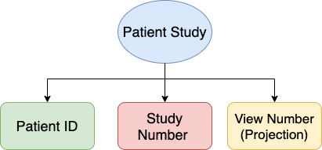
Exploratory Data Analysis: CheXpert
Training Data: 223K CXR images for 64K patients
Validation Data 234 CXR images for 200 patients
Image Resolution
Original: 439 GB
Low-resolution: 11GB
Attributes
Gender, Age, patient id
14 Diagnoses
Image projection
Frontal: 191K (AP vs PA)
Lateral: 32K
Notes:
Chexpert dataset is available in original and low resolution version, which is comprised of attributes such as gender, age, patient id but more importantly 14 diagnostic labels. It is also composed of different image projection such as front to back projection, AP, back to front projection PA and Lateral or side view projection.

Slide 6
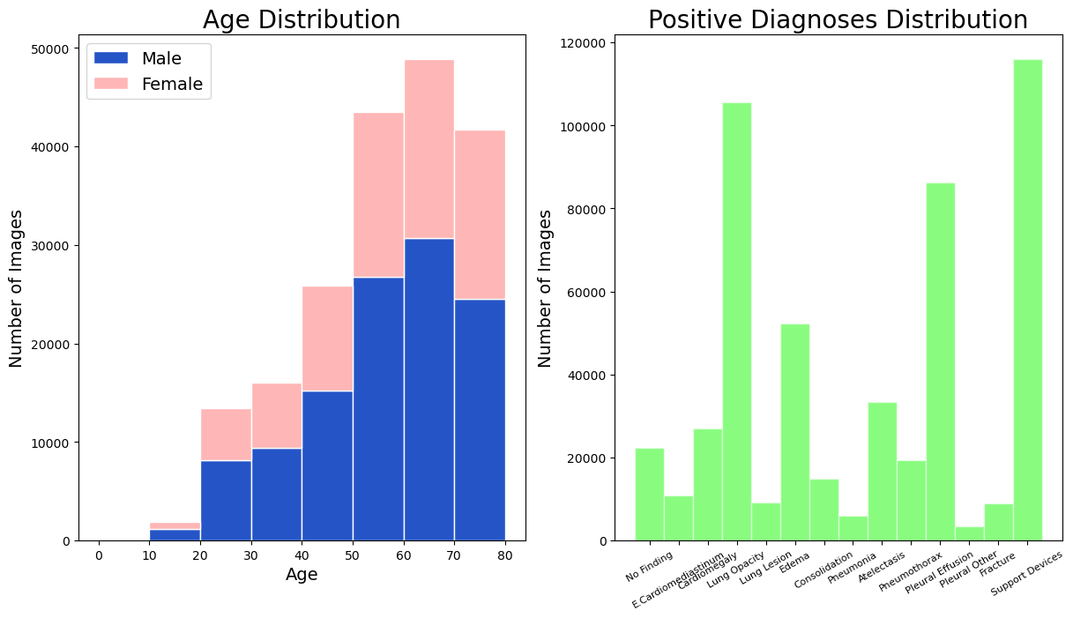
Exploratory Data Analysis: CheXpert
EDA Outcome
Data Quality
Age Distribution
Labeling Coding
Positive Label Distribution
Image Projection Distribution
Binary Classification
Notes:
There are 6 main attributes from chexpert dataset, among them age and positive label distribution plots are exemplified here. It is notable that patients over the age of 60 comprise more than 50% of images, and uneven distribution is observed from positive diagnoses distribution with support devices being the highest, Pleural_other being the lowest.

Slide 7






Experimental Setup
Pre-Processing:
Partitioning
Sampling, filtering
Image Augmentation
Exploratory Data Analysis
Visualizations
Training and Testing:
Model Training (DenseNet121)
Model Testing
Classification metrics
Notes:
For experimental setup, we used spark as big data tool for preprocessing, and pytorch in conjunction with aws for training, testing, validating models.

Slide 8
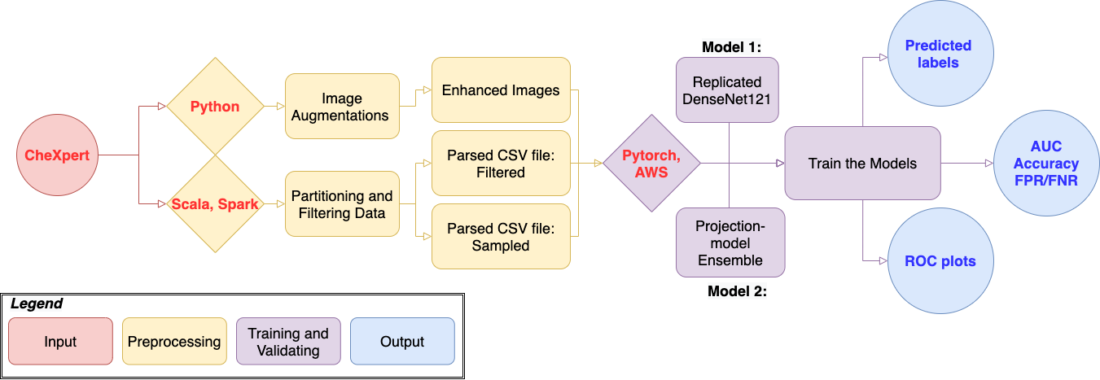
Proposed Approach
Notes:
Flowchart presented here propose our approach. The main idea is chexpert dataset and images are preprocessed to output parsed csv files and enhanced images which are trained by 2 proposed models to finally generate prediction related outputs. More will be elaborated as we proceed further into presentation, starting with pre-processing.

Slide 9
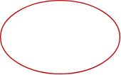
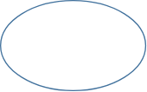

Pre-Processing: Sampling/Partitioning
Sampling (120K patient studies (PS)):
Based upon patient study
Due to small CheXpert validation dataset
Verified representativeness (>70%) of underlying percentage
Partitioning
Based upon image projection
Used to train projection-based model ensemble
120K PS
Training
84K PS
Test
36K PS
Training CXR
AP
PA
LL
Notes:
Preprocessing included sampling patient studies into training and test set. Moreover, partitioning was done on images based on their projection type which are used to train projection-based model ensemble.

Slide 10
Pre-Processing: Image Augmentation
All Images
Applied at p = 0.5
Normalization
Adjust image pixel intensity values
Template Matching / Random Crop + Resize
Selectively rescale image based on template feed.
Transformation
Horizontal Flip
Random rotation: 7°
Shear: 5°
Random Scaling
Resize image by ± 2%
Each image will choose one from two methods
Applied at p = 0.5
Notes:
There are numerous operations performed for image augmentation. All the images are normalized and then went through template matching or random crop with resizing, transformation and random scaling applied at certain probability for generalization purposes

Slide 11

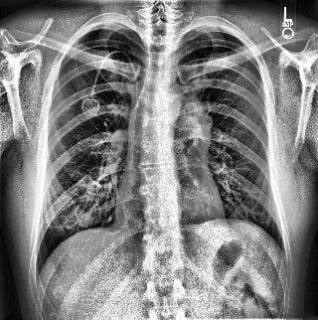
Pre-Processing: Image Augmentation (Continued)
Contrast Limiting Adaptive Histogram Equalization (CLAHE):
CLAHE filter is known to improve deep learning performance [13].
Each image is subdivided into tiles and pixel intensity is equalized in each tile.
Before CLAHE
After CLAHE
Notes:
We want to put emphasis on yet another image augmentation, known as Constrast limiting adaptive histogram equalization or (CLAHE). CLAHE filter is known to improve deep learning performance, and the effectiveness is exemplified in two pictures here.

Slide 12
Model Description
01
Replicated model researched by Pham et al
DenseNet121 as baseline architecture
Pre-trained on ImageNet
5 Epochs on full dataset
CLAHE technique added
DenseNet121 model by Pham et al
02
Images are split based on projection-type: AP, PA, LL
CheXpert: AP (161K), PA (29K), LL (32K)
Compared to PA, AP projection enlarges organ sizes on X-rays
Lateral (LL): side-view
Projection-based model ensemble
Notes:
Our team developed two models: first, replicated densenet 121 model that was researched by Pham et al. and second, projection-based model ensemble where images are split based on projection-type: AP & PA & LL to accentuate distinctive features provided by each type.

Slide 13
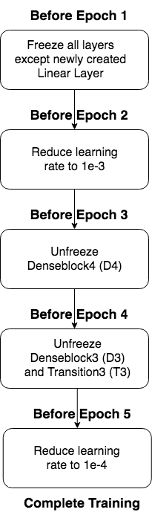
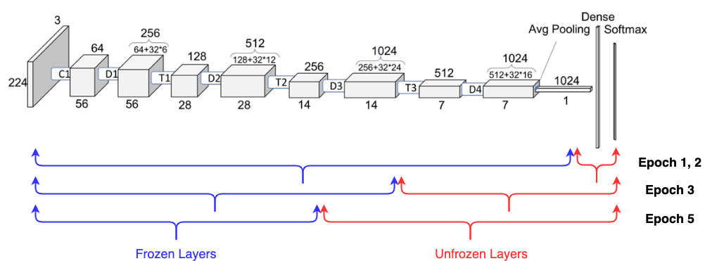
Training Model
Retrieved From: https://towardsdatascience.com/understanding-and-visualizing-densenets-7f688092391a
Projection Ensemble Training
3 separate models, one for each projection-type
Used the exact same architecture/training method for each model
Notes:
Our team used DenseNet121 model that is pre-trained on ImageNet as our baseline classifier. The final fully-connected layer was removed and replaced with a new linear layer with 14 outputs corresponding to the our 14 labels followed by a sigmoid activation function. All other layers were frozen and the final layer weights were exclusively updated for the first training epoch. Using a batch size of 256 images and an Adam optimizer with the initial learning rate set to 0.01, images were fed to the model after passing through our aforementioned augmentation pipeline. As shown in the diagram, learning rate is reduced to 0.001 before epoch 2. Before epoch 3 desneblock d4 will be unfrozen and before epoch 4 denseblock d3 and transition T3 block are unfrozen and before training is completed, learning rate is further reduced to 0.0001 before epoch 5.
Similar procedures are performed for projection esemble training yet there will be 3 separate models for each projection type.

Slide 14
Inference Procedure
Replicated DenseNet121
Load saved model from best validation checkpoint
Predict on validation set 10 times
Due to Test Time Augmentations (TTA) this will produce 10 slightly different predictions
For each image, take the simple average of the 10 generated predictions
Averaged predictions used as final predictions
Projection-based Ensemble
Split training and validation set based on projection-type
For each projection-type, load in the trained model for that projection-type and predict on exclusively those images
Concatenate the predictions generated from each model to form the final prediction set.
Notes:
Inference procedures also differ between the two models. Replicated model load saved model from best validation checkpoint and it predicts on validation set 10 times. Then these predictions are averaged for each image. On the other hand, projection based model split validation set based on the type, then load trained model for each projection-type which then predicts on exclusively those images. Finally the predictions from each model are concatenated to form final prediction set.

Slide 15
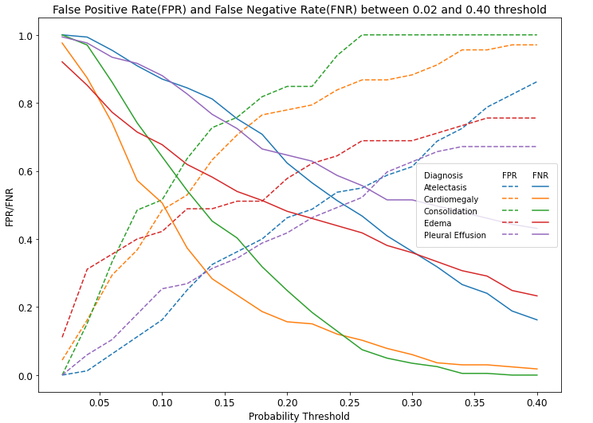
Experimental Evaluation
Outcome
Similar AUC with existing researches
Diagnoses have different FNR/FPR patterns
 | AUC (All 14 Labels)
Population (Epoch= 5) | Replicated DenseNet121 | Projection Ensemble
Training: CheXpert 223K Test: CheXpert 200 | 0.8708 | 0.8588
Training: 70% of sample Test: 30% of sample | 0.8468 | 0.8531
Notes:
As a result, our team managed to generate similar AUC with existing researches with values shown in the table. From observing False negative ratio over false postive ratio with probability threshold, we observed each diagnosis has different pattern, as exhibited in the plot.

Slide 16


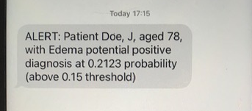
Conclusion
Example Scenario
Efficacy and Speed should NOT prohibit CXR machine learning interpretation.
Machine learning is NOT replacing radiologists
Common labeling scheme (with NIH)
Proposed Implementation
Adjustable threshold for each diagnosis
Probability outcome (along with binary decision)
Future Research
Re-train models with NIH data
Patient | Diagnosis | Probability | Positive
Doe, J | Edema | 0.2123 | Y
Doe, P | Atelectaasis | 0.0321 | N
Smith, D | Cardiomegaly | 0.0045 | N
Summer, M | Edeme | 0.083 | N
Notes:
In conlcusion although deep learning with CXR is effective and fast, it should not replace radiologist but to help.
Hence we propose adjustable threshold for each diagnosis with probability as our outcome. For example, let’s consider a patient Doe, J is diagnosed with Edema potential positive at 0.2123 probability which is above threshold of 0.15, then it can alert radiologist.
In the future, our team hope to retrain models with different Dataset, specifically NIH to provide further evidence on deep learning efficacy in CXR interpretation.

