Slide 1
Team Assignment #1
"House Prices Advanced Regression Techniques"
Jinhang Jiang, Maren Olson, AJ Aviles, Tzu Hsuan Chang
Team 4A

Slide 2
Table of Contents with Who Did What?
Presentation (AJ Aviles)
Business Problem (Maren Olson)
Preprocessing the Data (Jinhang Jiang & Tzu Hsuan Chang)
Individual Predictions (Jinhang Jiang & Tzu Hsuan Chang)
Stacking Ensemble with 3 Models Hypertuning/Cross Validation (Maren Olson, Jinhang Jiang)
Kaggle Results (Jinhang Jiang, Maren Olson, Tzu Hsuan Chang)

Slide 3
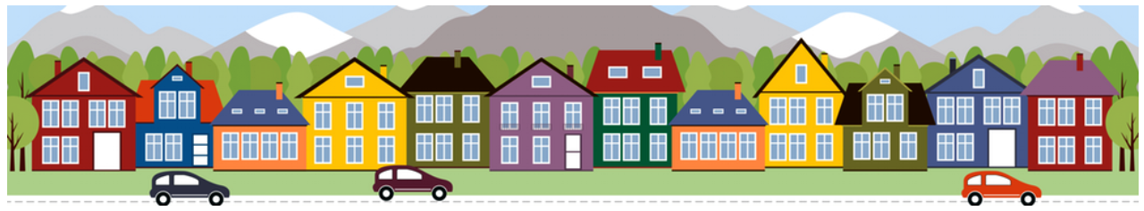
Business Problem
We are trying to predict the sales price for each house sold labeled with unique ID
This data set has 79 explanatory variables to help describe a home's features in Iowa

Slide 4
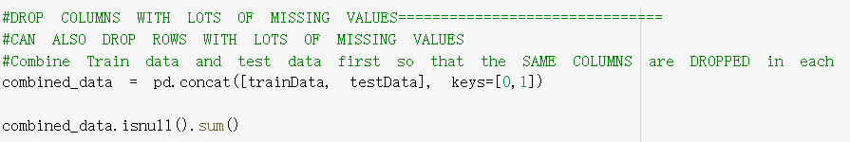
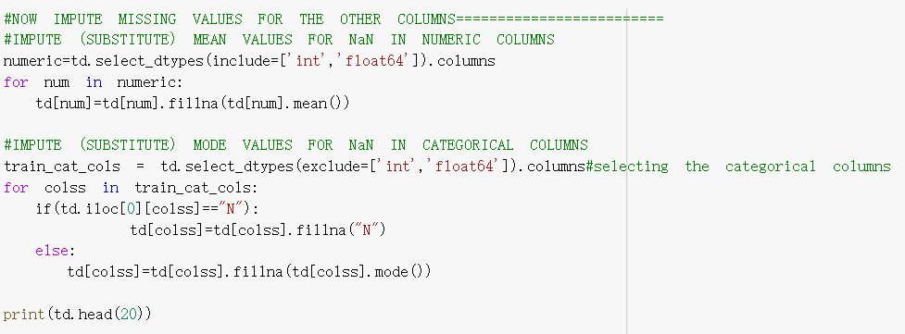
Preprocessing the Data
Missing Values
(1460, 273) (1459, 273)( 1460, 273) (1459, 273(1460, 273) (1459, 273

Slide 5
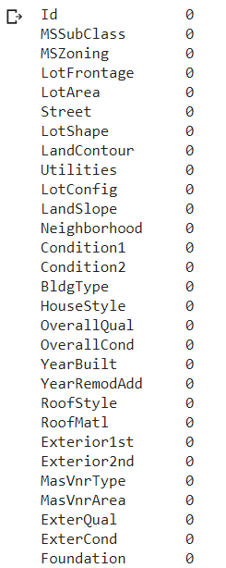
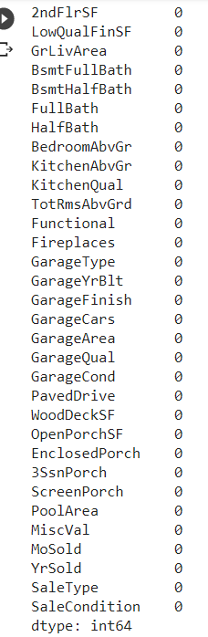
Preprocessing the Data
Missing Values
Shape:
(1460, 273) (1459, 273)( 1460, 273) (1459, 273(1460, 273) (1459, 273

Slide 6
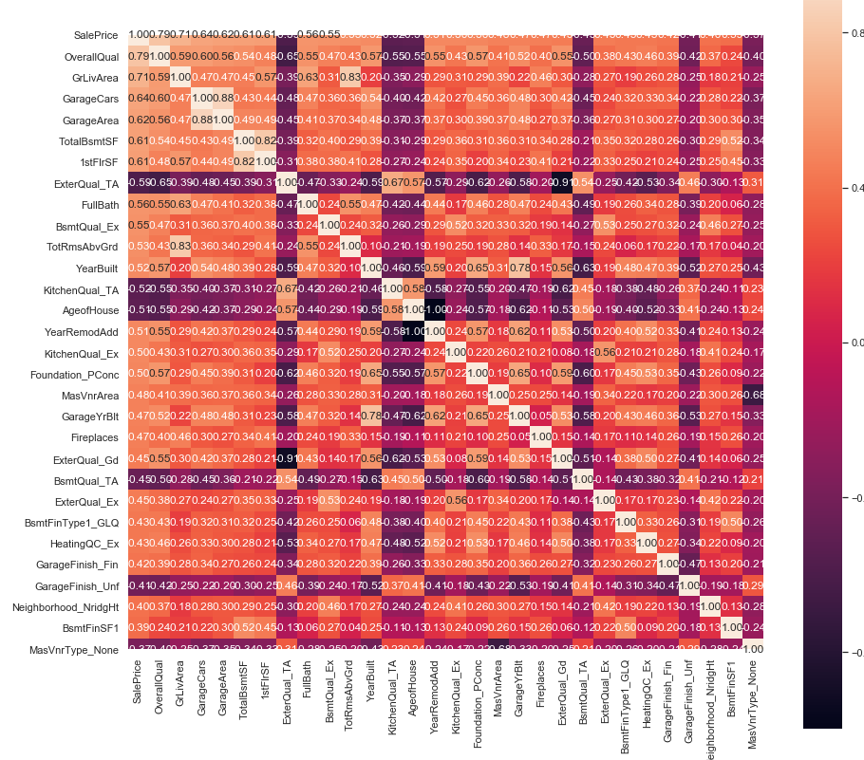
Correlation:
Y ~ all variables
(1460, 273) (1459, 273)( 1460, 273) (1459, 273(1460, 273) (1459, 273

Slide 7
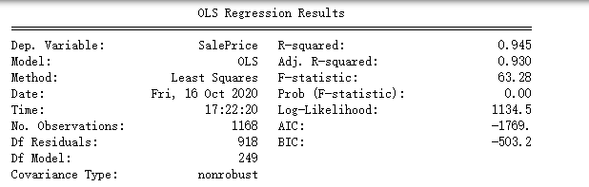
Basic Linear Model Summary
(1460, 273) (1459, 273)( 1460, 273) (1459, 273(1460, 273) (1459, 273

Slide 8
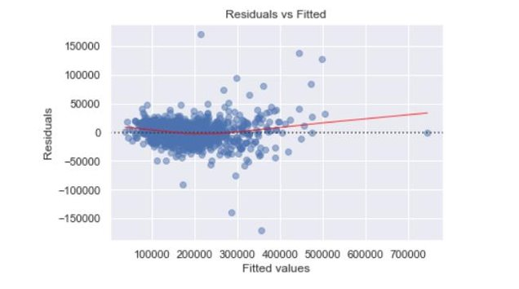
Log Transformation of SalePrice
Before Log Transformation
(1460, 273) (1459, 273)( 1460, 273) (1459, 273(1460, 273) (1459, 273

Slide 9
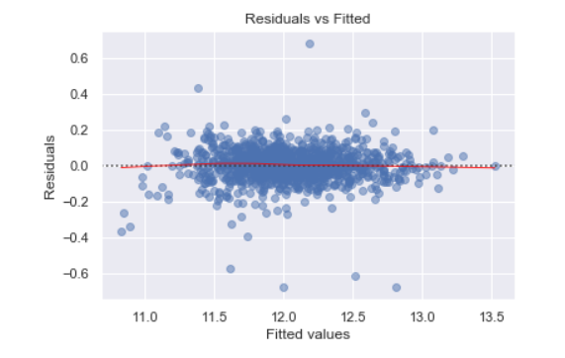
Log Transformation of SalePrice
After Transformation
(1460, 273) (1459, 273)( 1460, 273) (1459, 273(1460, 273) (1459, 273

Slide 10
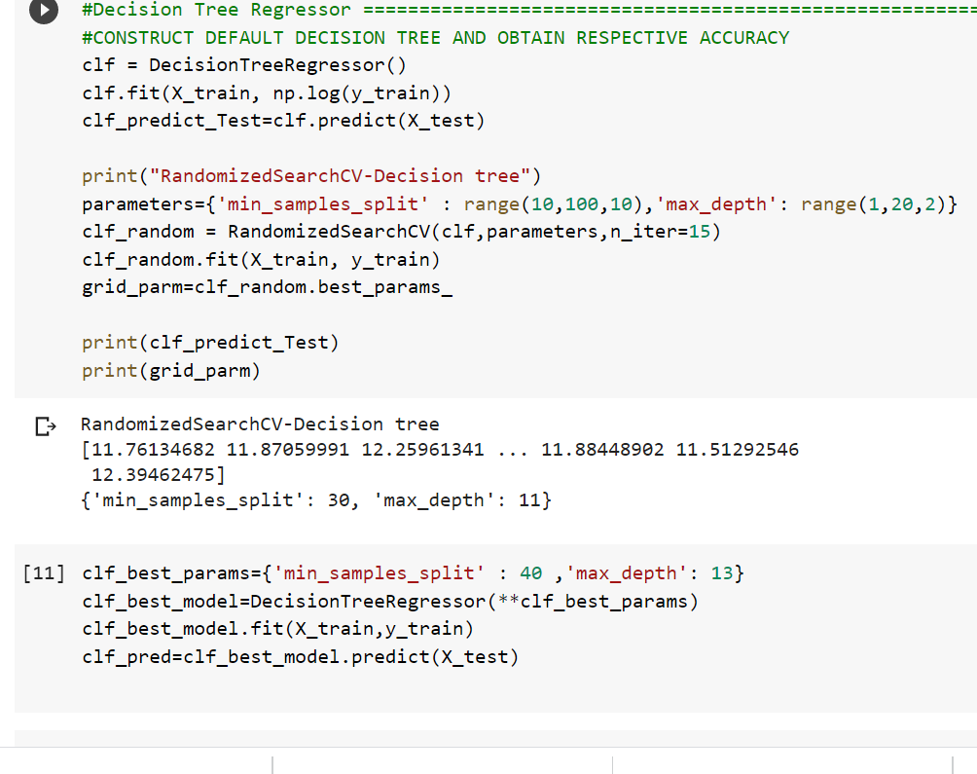
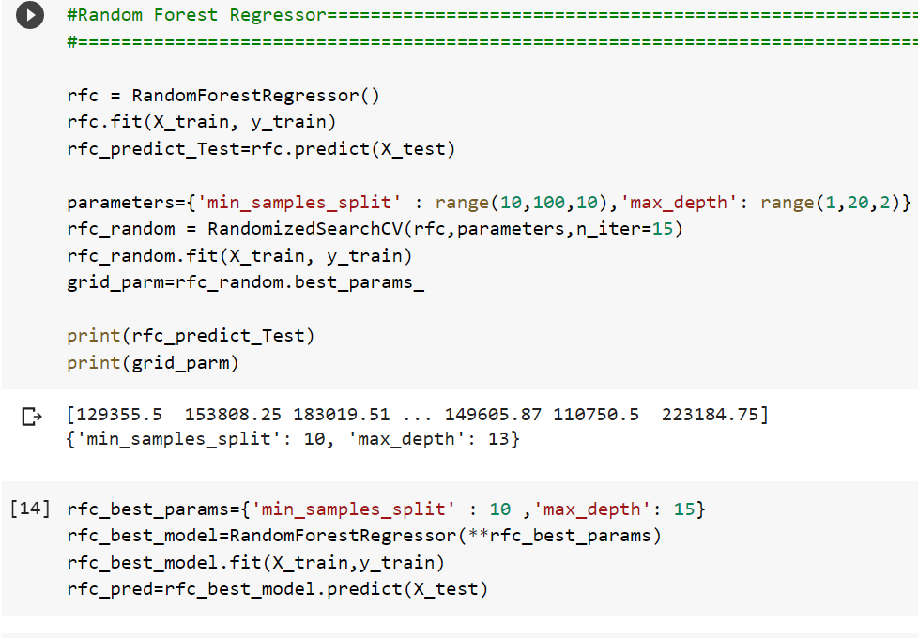
Regression Models
We implemented the following models:
Decision Tree Regressor
Random Forest Regressor
SVM Regressor
XGB Regressor
SGD Regressor
MLP Regressor
Gradient Boosting Regressor

Slide 11
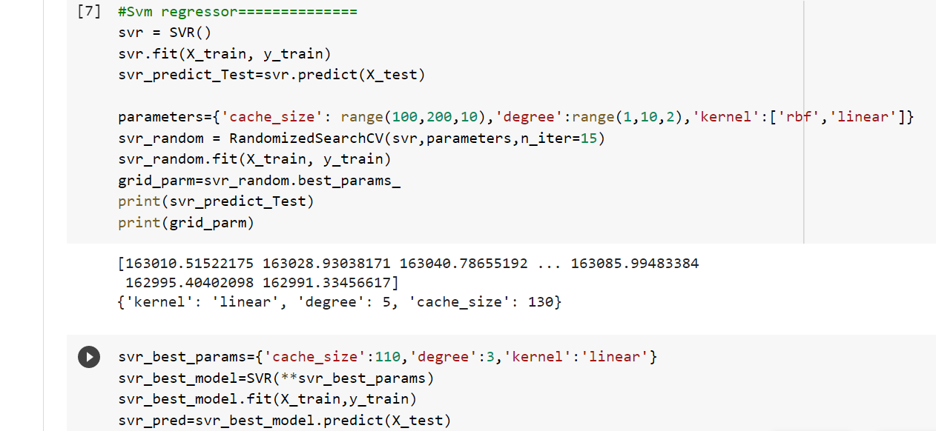
Regression Models: SVM Regressor

Slide 12
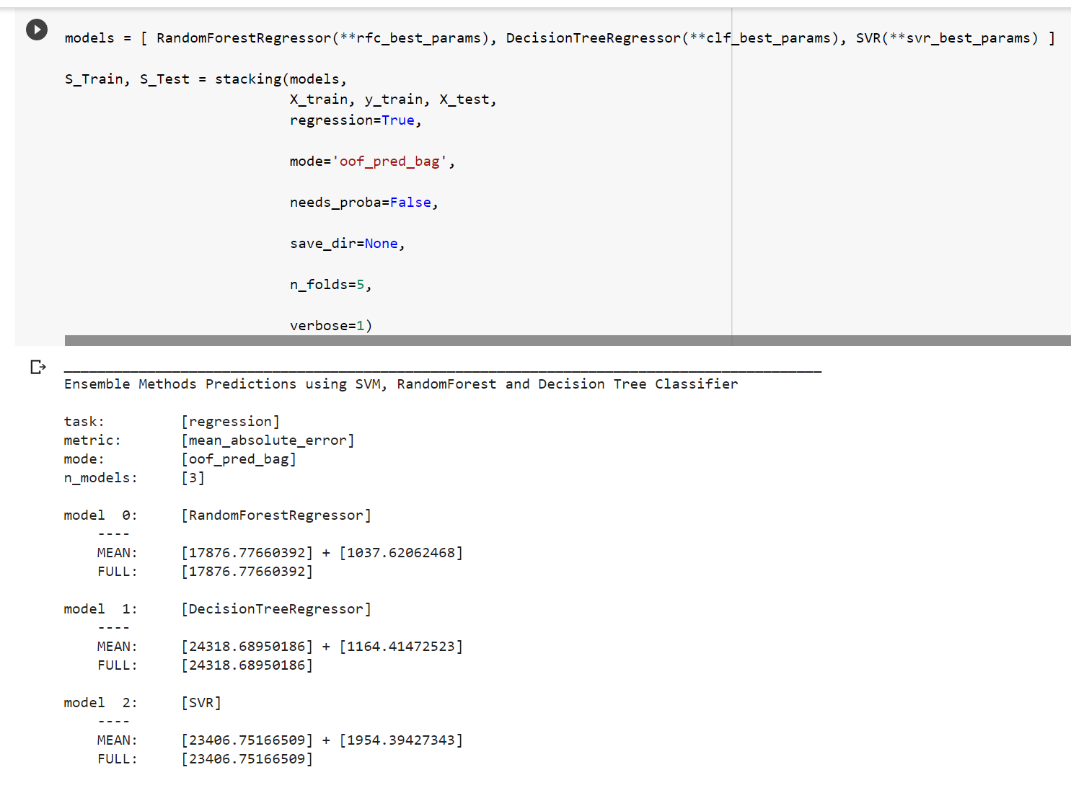
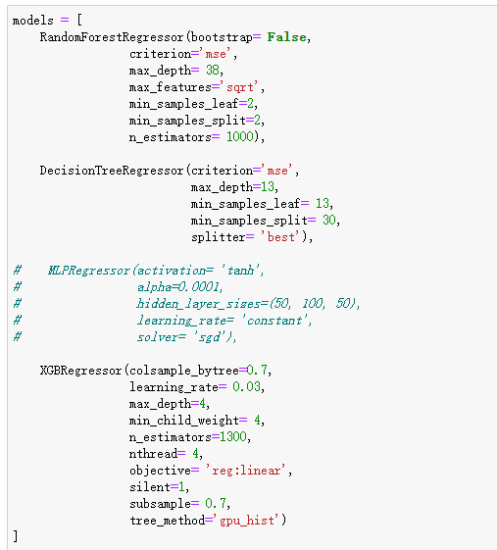
Stacking with Hypertuning & Cross Validation
First Stacking Model
Second Stacking Model

Slide 13
Kaggle Results (Root Mean Squared Log Error)
REGRESSOR MODEL | KAGGLE SCORE
Decision Tree Regressor | .18945
Random Forest Regressor | .14783
SVM Regressor | .41646
XGB Regressor | .12434
SGD Regressor | .69097
MLP Regressor | .28506
STACKED MODEL | KAGGLE SCORE
Decision Tree Regressor, Random Forest Regressor, SVM Regressor | .14097
XGB Regressor, Random Forest Regressor, Decision Tree Regressor | .12543
AVERAGE ENSEMBLE | KAGGLE SCORE
Average (Decision Tree, MLP, Random Forest, XGB) | 0.14565
Weighted Average (0.4*XGB+0.3*Random Forest+ 0.2*Decision Tree+0.1*MLP) | 0.13530
*For our stacked models we used the best parameters for each

Slide 14
Conclusion
Challenges: A lot of missing data in this set.
Kaggle Standing: Our models was ranked as 940 out of 4614 teams.
Think About?
How our model compares with an appraiser in the real world:
- 5% of appraisals are below selling price
- 29% are equal to the selling price.
- 66% are above the selling price.
Source: Erikson et al. 2017. Fannie Mae
https://realestatedecoded.com/the-untold-truth-of-home-appraisals/

