Slide 1
Assignment 4 – Stemming & Feature Selection
Jinhang Jiang

Slide 2
Evaluation Metrics : ROC

Slide 3

Data Overview

Slide 4
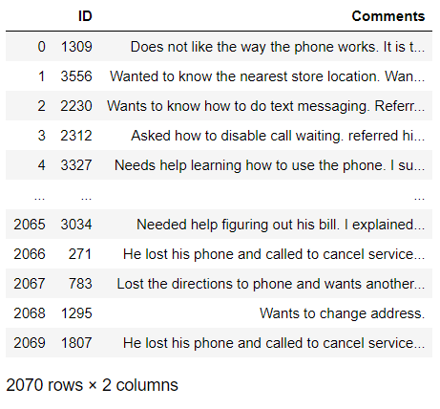

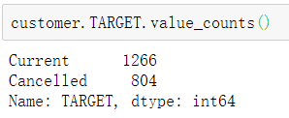
Data Overview

Slide 5
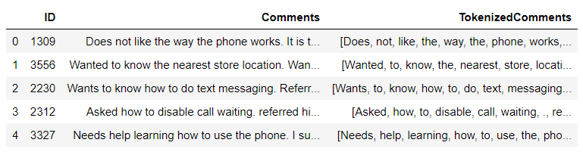
Step 1
1. tokenize the comments

Slide 6
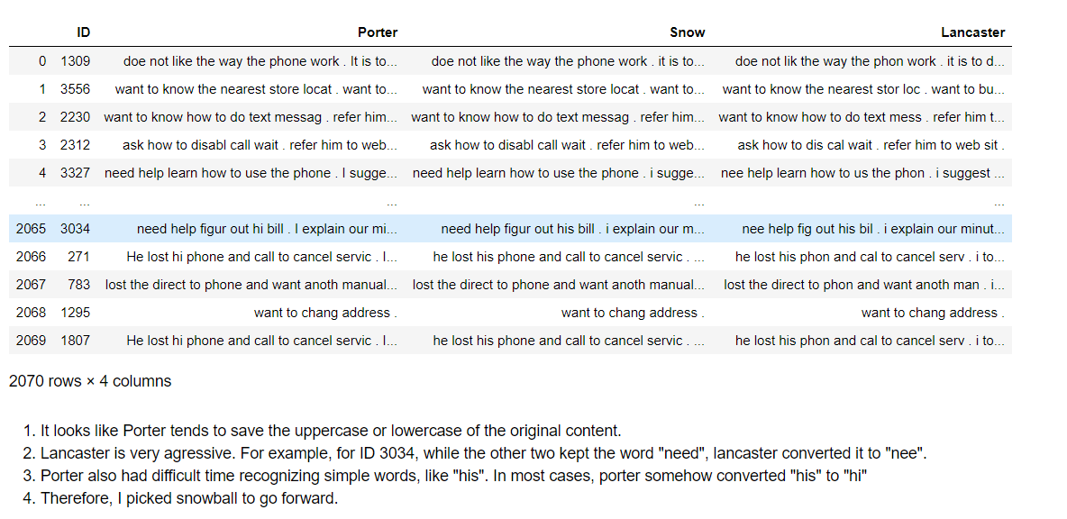
Step 1
2. Apply stemmers

Slide 7
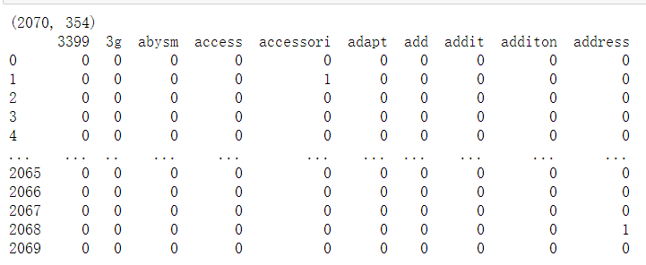
Step 2
Convert the stemmers to term document matrix

Slide 8
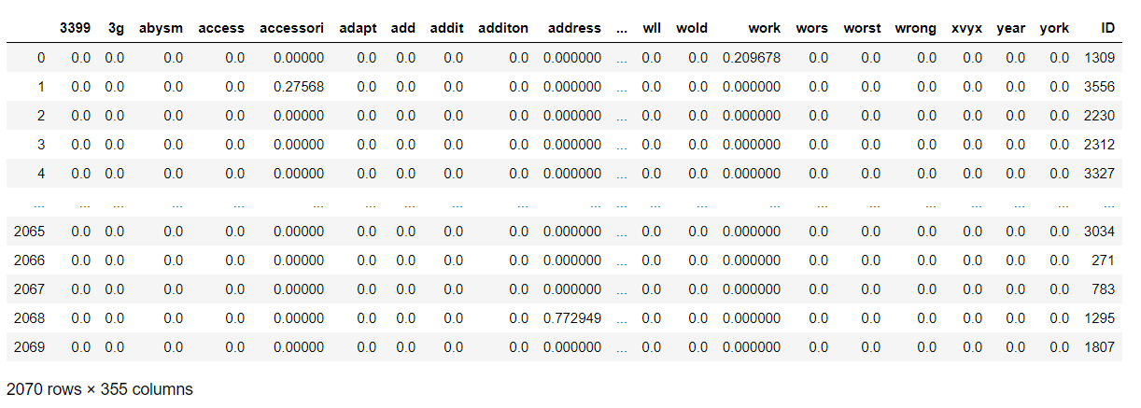
Step 3
Calculate and construct the TF-IDF matrix from the term-document matrix

Slide 9
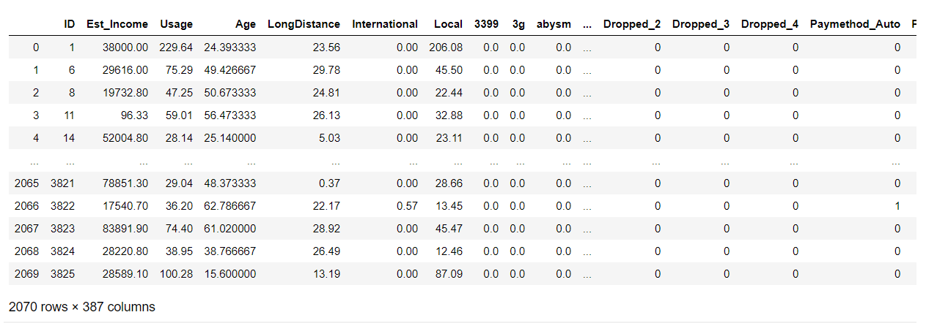
Step 4
Combine the matrix with the original customer data and perform one hot encoding

Slide 10
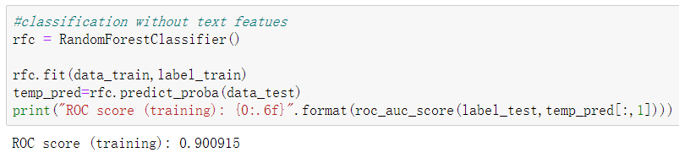
Step 5 & 6
Find the base score with RandomForestClassifier

Slide 11
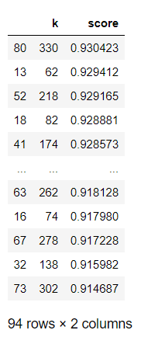
Step 5 & 6
Ran a for loop to find the “best k”

Slide 12
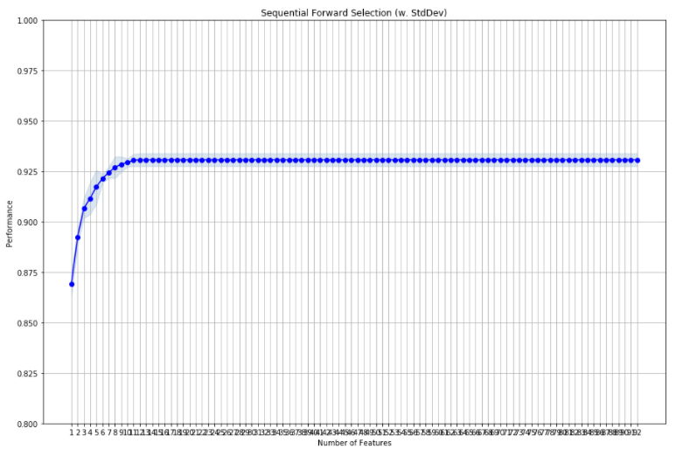
Step 5 & 6
Sequential Feature Selection
Forward = True

Slide 13
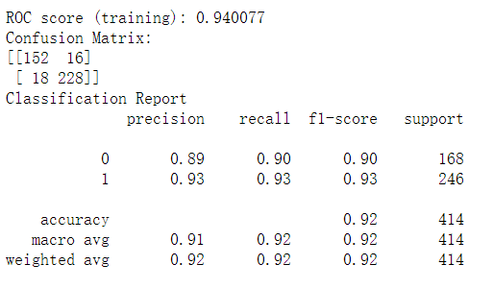
Step 5 & 6
Catboost with 331 features

Slide 14
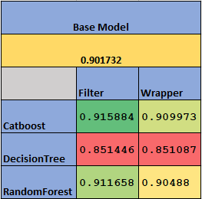
Score Table

