Slide 1
DisERGM
July 20, 2021

Slide 2
ERGMs for three different time periods
STERGMs did not work as it requires all the networks to have same size

Slide 3
ERGM
model
<- ergm(graph ~ edges
+nodefactor(~Category, levels=NULL)
+nodematch(~Category, levels=NULL, diff=TRUE))
edges: it’s like a minimal model/interception
nodefactor: study the importance of the factor in the formation of the network
nodematch: study the homophily of the factors

Slide 4
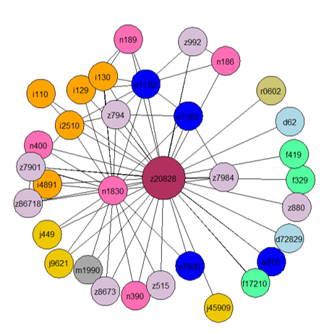
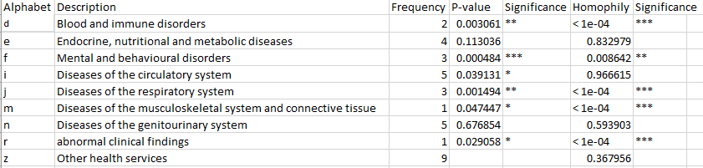
ego network for ‘z20828’ with weight bar 0.2

Slide 5
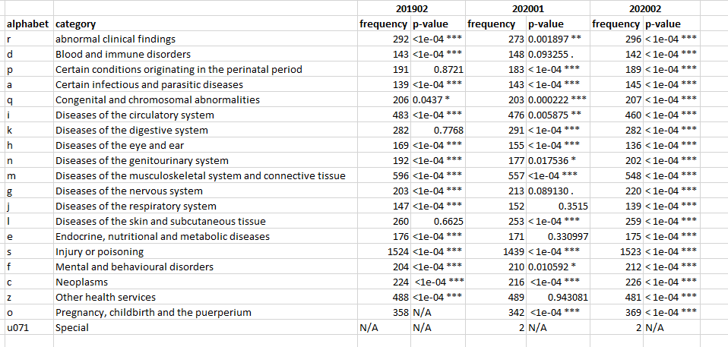
Results

