Slide 1
Final Presentation: Tissue Segmentation
Group 4
Ryan Gifford, Kyeong Joo Jung, Jinhee Lee

Slide 2
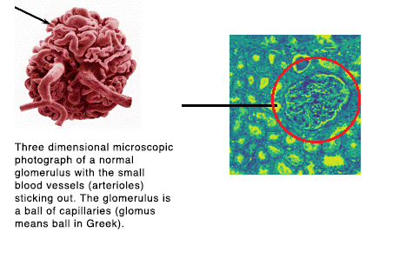
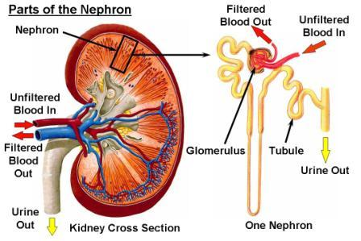
Introduction
Develop a model to identify ‘Glomerulus’ (GL) in the kidney.
Notes:
This is a Glomerulus

Slide 3
Introduction
To identify ‘Glomerulus’ in the kidney → Semantic Segmentation
What is Semantic Segmentation?
Link each pixel in an input image to a class label.
In our case, a 1 for Glomerulus and a 0 for everything else

Slide 4
Introduction
Train a segmentation model that takes PAS kidney image input and identify the segments of glomeruli FTU in the PAS-stained microscopy data.
Historical images of kidney and Annotation information representing the glomerular segmentation are given
Our dataset from the Kaggle: HuBMAP - Hacking the Kidney
https://www.kaggle.com/c/hubmap-kidney-segmentation/
Notes:
FTU is defined as a “three-dimensional block of cells centered around a capillary, such that each cell in this block is within diffusion distance from any other cell in the same block” (de Bono, 2013).
FTU: Functional Tissue Units
HuBMaP: Human BioMolecular Atlas Program
PAS: Periodic-acid Schiff

Slide 5
Project Goals
Predicting segmentation masks for a withheld test set and comparing it with the ground truth.
Achieving better segmentation performance than the model found on kaggle.
Learn about Convolutional Networks for Biomedical Image Segmentation

Slide 6
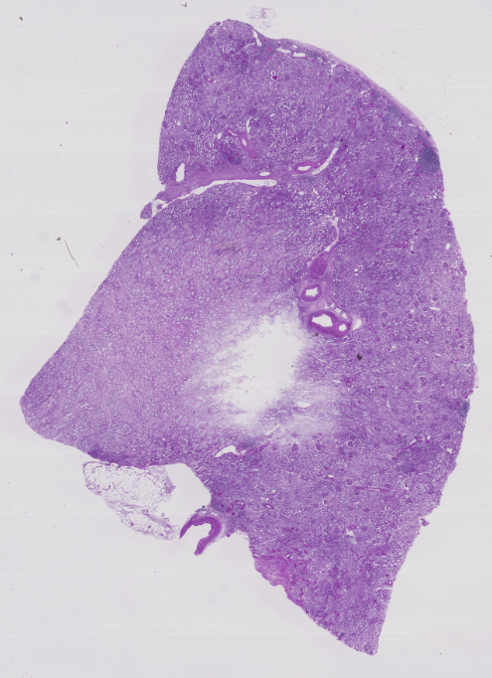
Data Description
HubMap has 20 tissue samples
11 fresh frozen and 9 Formalin Fixed Paraffin Embedded PAS kidney images.
Kaggle provides...
8 train and 5 test TIFF files for tissue images.
Json files for explaining about the masks
Too large and heavy dataset
Notes:
we need to tell them that we focused only at the image segmentation rather than the preprocessing

Slide 7
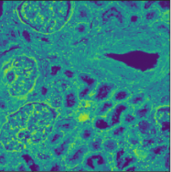
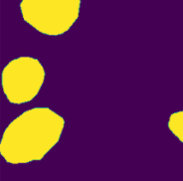
Data Description
We used 256X256 image patches of the original data
original size 18484 X 13013
Data Statistics
Data
Train : 7664 patches and corresponding masks
Test: 1916 patches and corresponding masks
Notes:
Why we use adjusted images rather than original tiff images
discuss more about preprocess

Slide 8
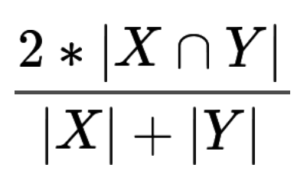
Evaluation
Every predicted segmentation will be compared with the ground truth masks using the mean of Dice Coefficient.
The Dice Coefficient - pixel-wise agreement (From the competition)
X: predicted set of pixels
Y: ground truth
The value would be 1 when X and Y are the same.

Slide 9
Methods
Compared other models for the image segmentation prediction.
Compared method(from Kaggle):
Efficientnet Unet
Compared method(we implemented):
Unet (dropout 0.1)
Unet model with dense block
Our method(Best result):
Unet model with the residual block

Slide 10
Compared method from Kaggle Competition
EfficientnetUnet model
A unet which scales and initializes itself to the dataset in an optimal way
Dice Coefficient: training - 0.8886, validation - 0.9001
Notes:
need to ask if we need more information

Slide 11
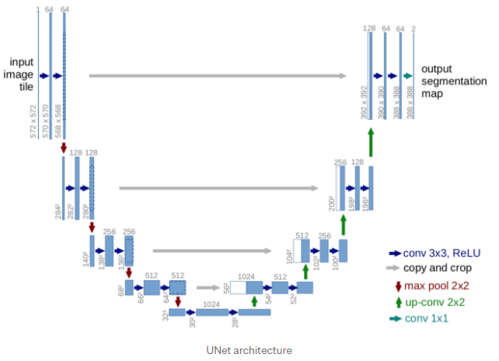
Compared method 1: UNet
Unet
First used in biomedical images for the segmentation
The architecture contains two paths
Contraction path (encoder) : capture the context in the image
Symmetric expanding path(decoder): Localization
Encoder: traditional convolutional and max pooling layer
Decoder: end-to-end Fully Convolutional Network(FCN)
Keeps the location information in the downsampling and combine them with the image feature during the upsampling

Slide 12
Unet
We Implemented Unet with dropout 0.1
Each layer used Relu Activation function
Encoder (256x256x1 → 16x16x256)
5 convolution layers, each layer is two consecutive layers
4 max-pooling layers and dropout
Decoder (16x16x256 → 256x256x1)
Up-sampling 4 times (Transposed convolutions)
Concatenating transposed convolutions with Encoder layers at the same depth
After Concatenating, apply two consecutive convolutions
Use sigmoid function at last after fully connected network
Train with 100 epochs and 10 batch size / Used GPU and Tensorflow-Keras

Slide 13
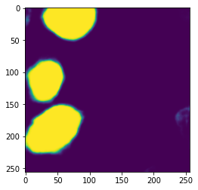
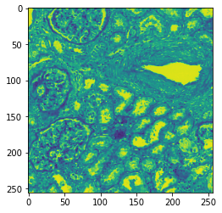
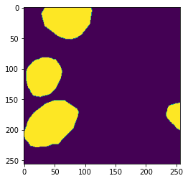
Results of Unet
This model achieved a dice coefficient as 0.8804 and validation dice coefficient 0.7943
Unet Mask
True Mask
Notes:
It does not truely converged yet, at 100 epochs. Almost converged
we can get better result, if we used super computer : time

Slide 14
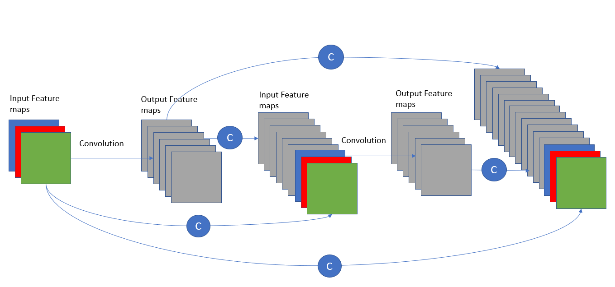
Compared method 2: Unet with dense block

Slide 15
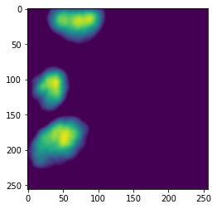
Results of Unet with dense block
This model got a dice coefficient as 0.8188 and valid dice coefficient 0.7692
Model Mask
True Mask
Notes:
It was converged at 21/100 epochs…. however, not better than other models. why it converged so fast?

Slide 16
Our model with best result
Unet with residual block
input: 256 * 256 *1
6 Encoder layers
Each Encoder layers:
2 residual block : relu(relu(1conv) + 1conv)
1 maxpooling
Based on the Unet architecture, changed the conv part to residual
block only for the downsampling
-> To keep the image features better
Each layer used Relu Activation function
Encoder (256x256x1 → 16x16x512)
6 convolution layers, each layer is two residual blocks
5 max-pooling layers
Decoder (16x16x512 → 256x256x1)
Up-sampling 5 times
Concatenated convolutions with Encoder layers at the same depth
After Concatenating, apply two consecutive convolutions
Use sigmoid function at last after fully connected network
Train with 100 epochs and 10 batch size / Used GPU and Tensorflow-Keras
6 Decoder layers
Each decoder layers:
2 conv
1 upsampling
concatanate with corresponding encoding layer
Fully connected layer
sigmoid activation function
output: 256 * 256 * 1
Notes:
What is residual block? compare to vanilla Unet

Slide 17
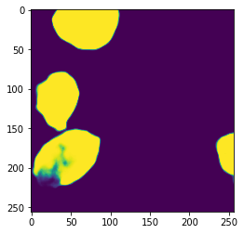
Results of Unet with residual blocks
This model got a dice coefficient as 0.9675 and valid dice coefficient 0.8070
Model Mask
True Mask
Notes:
need to discuss if this is enough
It is not truely converged yet, at 100 epochs. Almost converged
we can get better result, if we used super computer : time takes 2~3 hours for 100 epochs

Slide 18
Scores of each method
Method | Dice Coefficient
EfficientnetUnet from Kaggle | 0.8886, 0.9001(valid)
Unet (Dropout 0.1) | 0.8804, 0.7943(valid)
Unet with dense blocks | 0.8188, 0.7692(valid)
Unet with residual blocks | 0.9675, 0.8070(valid)
Our Model
Notes:
Our models have large gaps between Dice coefficient and Valid Dice coefficient. But Not kaggle’s
Why?

Slide 19
Why we weren’t good as others on kaggle
Some members were first time to explore the image segmentation, learned new networks: Unet, ResNet, DenseNet
Advantages of the Efficient net
uses the batch normalization which we didn’t use
swish activations
lots of optimization of hyperparameters going on in the network
depth, weight initialization, etc
uses pretrained models
Notes:
Need to discuss whether we need more or not
learned, insight….

Slide 20
Conclusion and issues
Conclusion
It is possible to reach a decent performance but achieving higher performance needs lots of optimization and fine tuning
Issues
Hard to improve the performance
Images require a load of computation resources → Lack of computational resource (failure to access gpu in the OSC) → time (needs some time and days to try different models)
Better machines could have allowed us to run the models on original image resolutions, and not patch based.

Slide 21
References
HuBMAP - Hacking the Kidney: https://www.kaggle.com/c/hubmap-kidney-segmentation/overview
Glomerulus: https://unckidneycenter.org/kidneyhealthlibrary/glomerular-disease/
Reducing data: https://www.kaggle.com/iafoss/hubmap-256x256
Unet: Ronneberger, O., Fischer, P., & Brox, T. (2015). U-Net: Convolutional Networks for Biomedical Image Segmentation. ArXiv, abs/1505.04597.
Resnet: K. He, X. Zhang, S. Ren and J. Sun, "Deep Residual Learning for Image Recognition," 2016 IEEE Conference on Computer Vision and Pattern Recognition (CVPR), 2016, pp. 770-778, doi: 10.1109/CVPR.2016.90.
Densenet: G. Huang, Z. Liu, L. Van Der Maaten and K. Q. Weinberger, "Densely Connected Convolutional Networks," 2017 IEEE Conference on Computer Vision and Pattern Recognition (CVPR), 2017, pp. 2261-2269, doi: 10.1109/CVPR.2017.243.
EffieientUNet from Kaggle: https://www.kaggle.com/polomarco/hubmap-eda-efficientnetunet-training-baseline/output?select=masks

Slide 22
Thank you!

