Slide 1
Homework for Chapter3

Slide 2
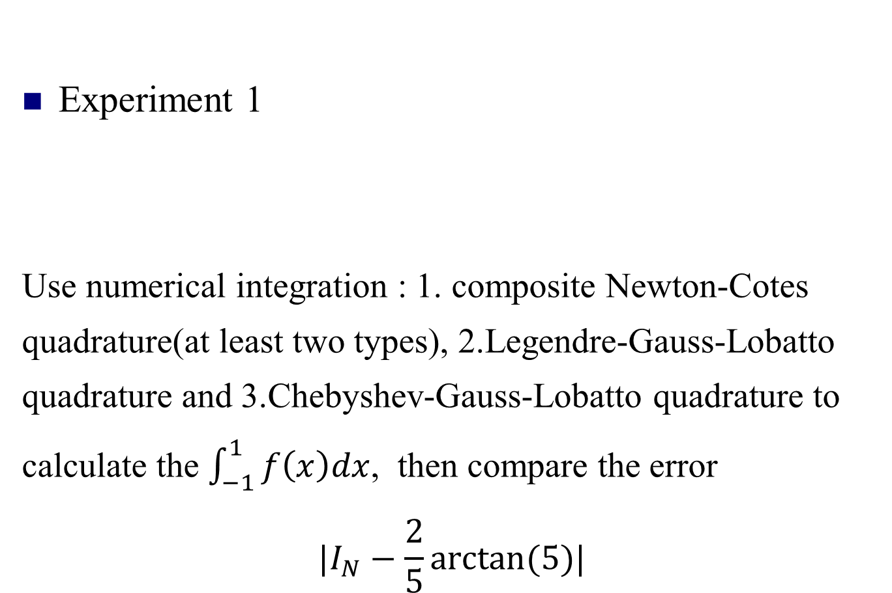
Homework
Experiment 1
Use numerical integration : 1. composite Newton-Cotes quadrature(at least two types), 2.Legendre-Gauss-Lobatto quadrature and 3.Chebyshev-Gauss-Lobatto quadrature to calculate the $\int_{−1}^{1}{f\left(x\right)dx}$, then compare the error
$$|I_{N}−\frac{2}{5}arctan⁡(5)|$$

Slide 3


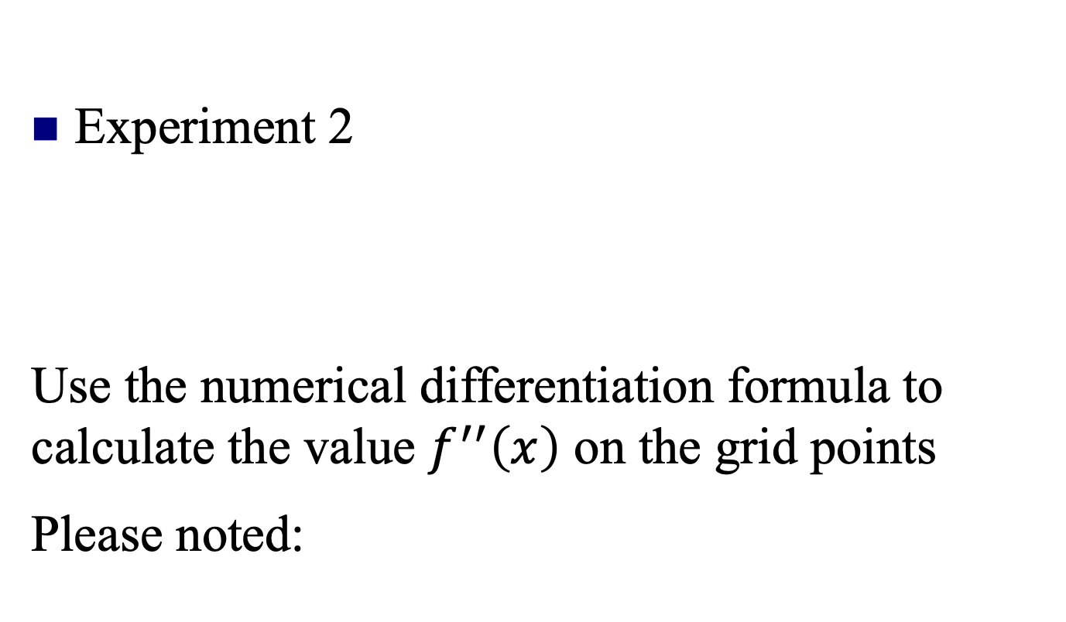
Homework
Experiment 2
Use the numerical differentiation formula to calculate the value $f^{′′}\left(x\right)$ on the grid points
Please noted:
Just write the simplest algorithm

