Slide 1
Homework for Chapter2

Slide 2
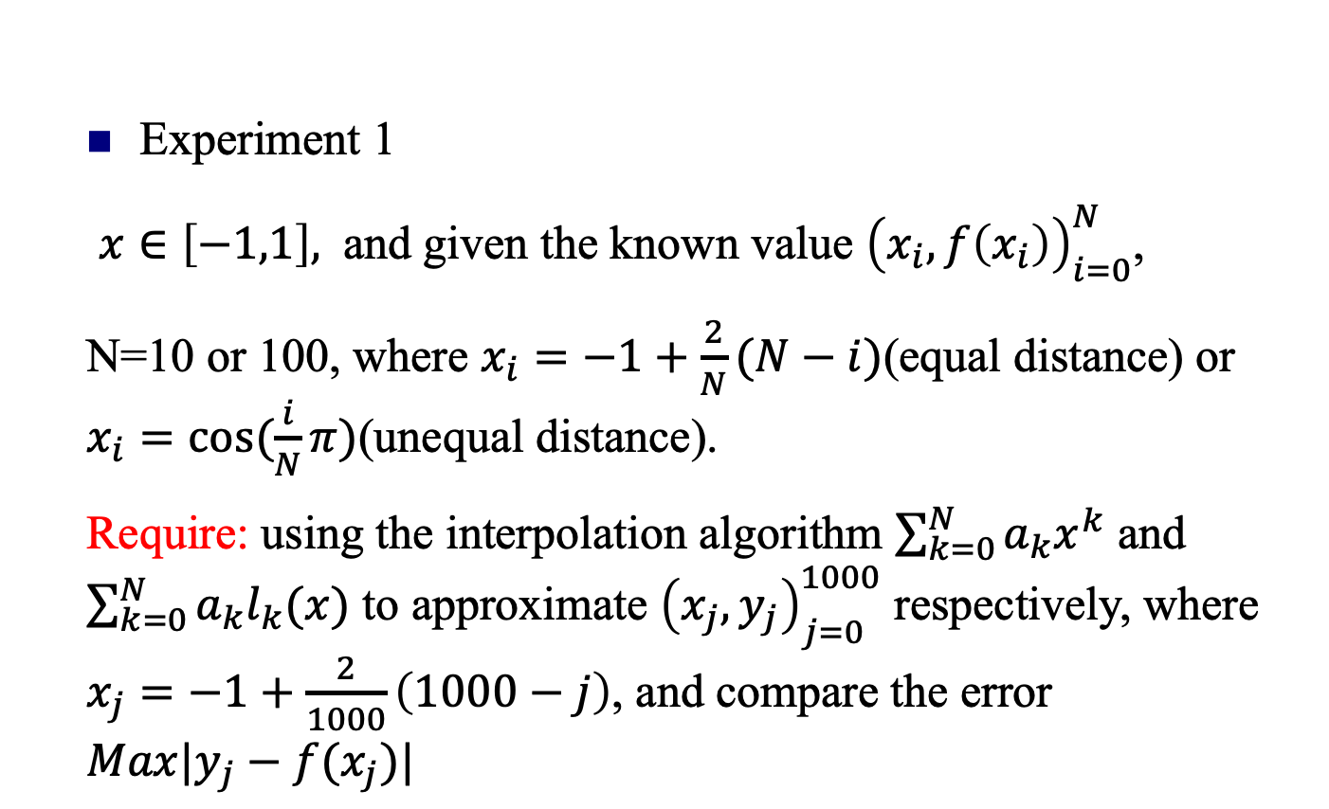
Computer experiment
Experiment 1
$x∈\left[−1,1\right],$ and given the known value ${\left(x_{i}, f\left(x_{i}\right)\right)}_{i=0}^{N}$,
N=10 or 100, where $x_{i}=−1+\frac{2}{N}(N−i)$(equal distance) or $x_{i}=cos⁡(\frac{i}{N}π)$(unequal distance).
Require: using the interpolation algorithm $\sum_{k=0}^{N}{a_{k}x^{k}}$ and $\sum_{k=0}^{N}{a_{k}l_{k}(x)}$ to approximate ${\left(x_{j}, y_{j}\right)}_{j=0}^{1000}$ respectively, where $x_{j}=−1+\frac{2}{1000}\left(1000−j\right)$, and compare the error
$$Max|y_{j}−f(x_{j})|$$

Slide 3
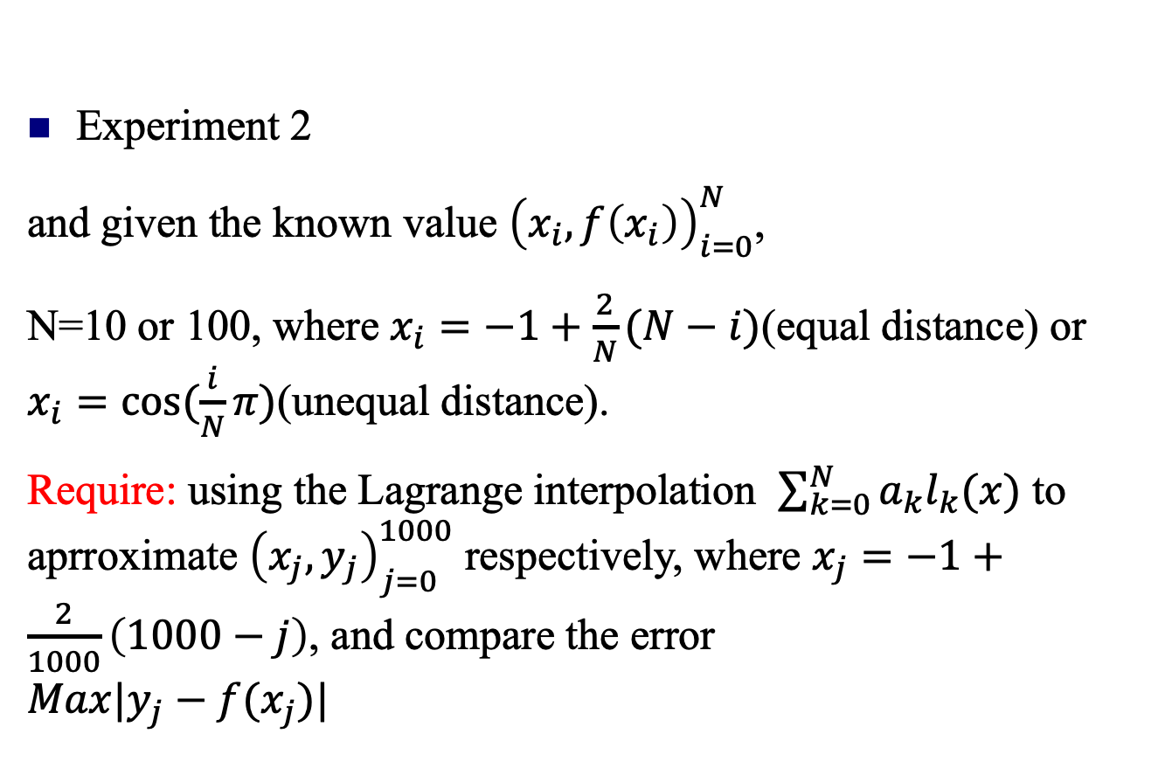
Computer experiment
Experiment 2
and given the known value ${\left(x_{i}, f\left(x_{i}\right)\right)}_{i=0}^{N}$,
N=10 or 100, where $x_{i}=−1+\frac{2}{N}(N−i)$(equal distance) or $x_{i}=cos⁡(\frac{i}{N}π)$(unequal distance).
Require: using the Lagrange interpolation $\sum_{k=0}^{N}{a_{k}l_{k}(x)}$ to aprroximate ${\left(x_{j}, y_{j}\right)}_{j=0}^{1000}$ respectively, where $x_{j}=−1+\frac{2}{1000}\left(1000−j\right)$, and compare the error
$$Max|y_{j}−f(x_{j})|$$

Slide 4
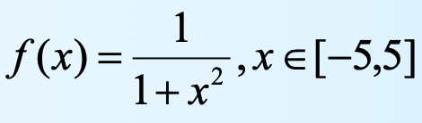
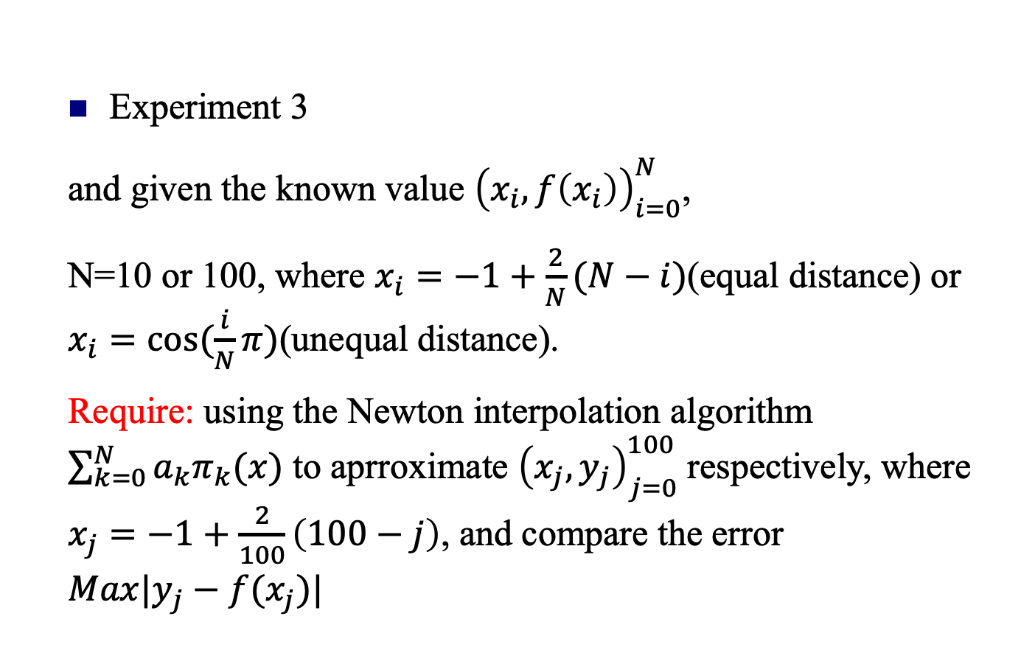
Computer experiment
Experiment 3
and given the known value ${\left(x_{i}, f\left(x_{i}\right)\right)}_{i=0}^{N}$,
N=10 or 100, where $x_{i}=−1+\frac{2}{N}(N−i)$(equal distance) or $x_{i}=cos⁡(\frac{i}{N}π)$(unequal distance).
Require: using the Newton interpolation algorithm $\sum_{k=0}^{N}{a_{k}π_{k}(x)}$ to aprroximate ${\left(x_{j}, y_{j}\right)}_{j=0}^{100}$ respectively, where $x_{j}=−1+\frac{2}{100}\left(100−j\right)$, and compare the error
$$Max|y_{j}−f(x_{j})|$$

Slide 5

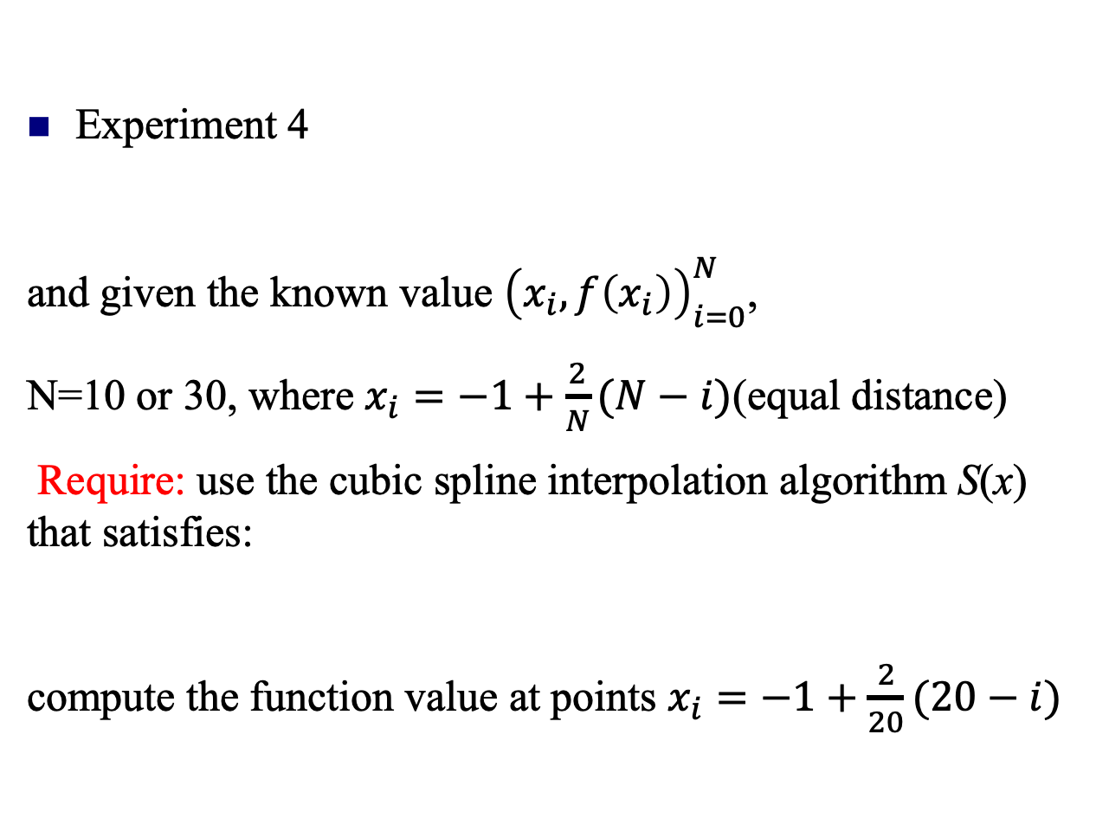
Computer experiment
Experiment 4
and given the known value ${\left(x_{i}, f\left(x_{i}\right)\right)}_{i=0}^{N}$,
N=10 or 30, where $x_{i}=−1+\frac{2}{N}(N−i)$(equal distance)
Require: use the cubic spline interpolation algorithm S(x) that satisfies:
compute the function value at points $x_{i}=−1+\frac{2}{20}(20−i)$

Slide 6
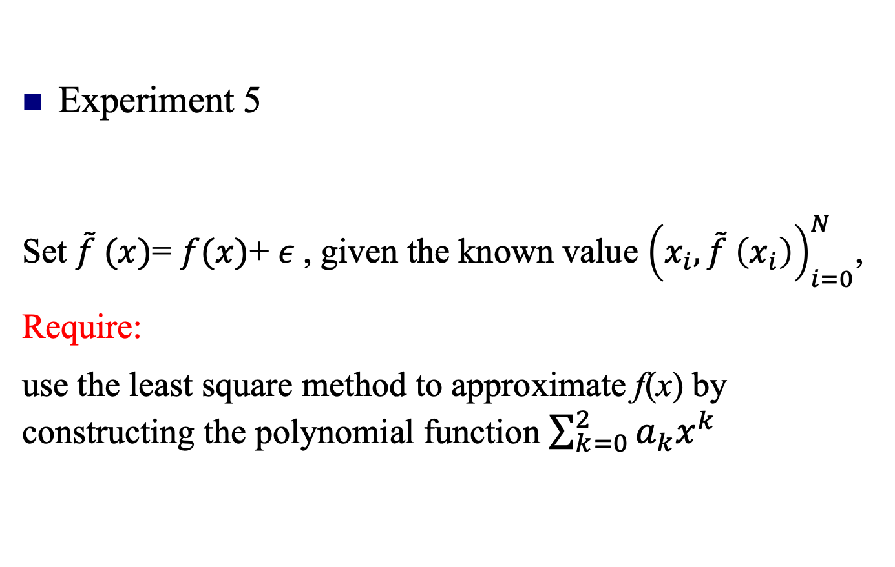
Computer experiment
Experiment 5
Set $\tilde{f} (x)$= $f(x)$+ $ε$, given the known value ${\left(x_{i},\tilde{f} \left(x_{i}\right)\right)}_{i=0}^{N}$,
Require:
use the least square method to approximate f(x) by constructing the polynomial function $\sum_{k=0}^{2}{a_{k}x^{k}}$

Slide 7
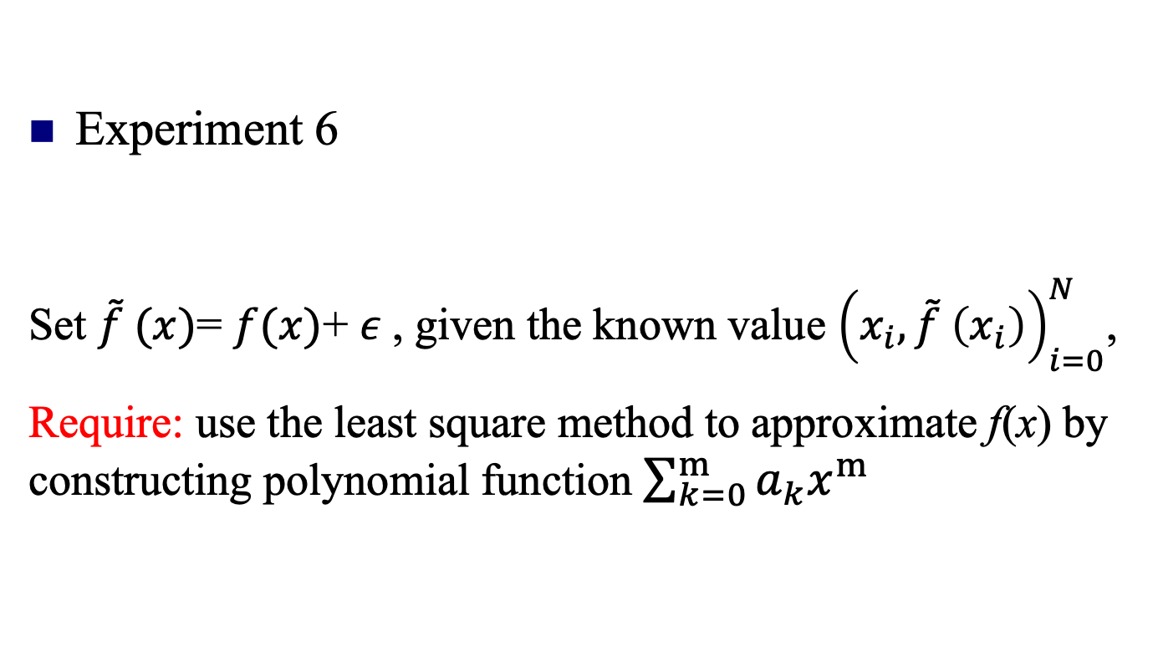
Computer experiment
Experiment 6
Set $\tilde{f} (x)$= $f(x)$+ $ε$, given the known value ${\left(x_{i},\tilde{f} \left(x_{i}\right)\right)}_{i=0}^{N}$,
Require: use the least square method to approximate f(x) by constructing polynomial function $\sum_{k=0}^{m}{a_{k}x^{m}}$

