Slide 1

iMeeting project
Great meeting or seminar appliance.

Slide 2
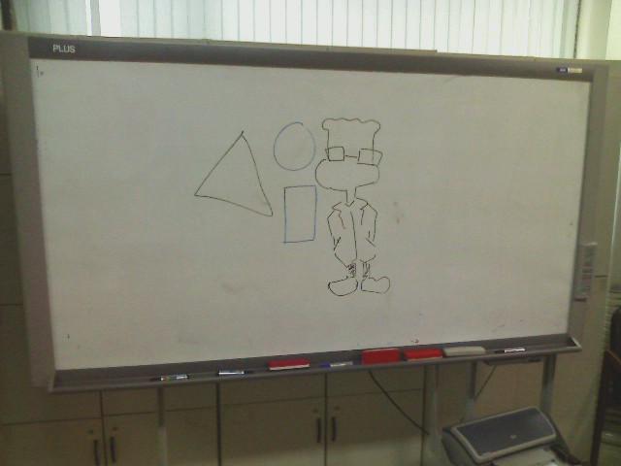

Slide 3
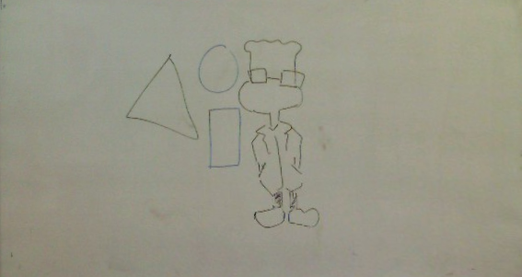
Rectification
By calculation of homography and perspective warping..
  Can detect white board area. ( Not reliable)
  Need to estimate aspect ratio.

Slide 4
What’s more?
Enhancing color is not enough…

Slide 5
Processing
Adjust contrast and brightness.
  Need to increase contrast of image.
  Or histogram equalization.
Adjust white balance.
Extract lines
  Commonly, the intensity of lines is smaller than empty white board.

Slide 6
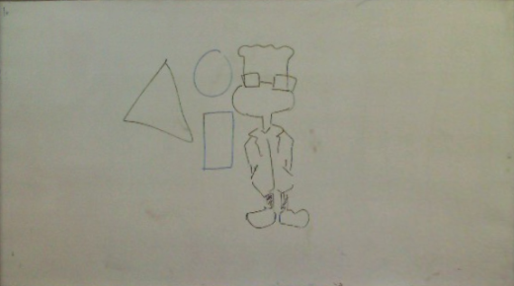
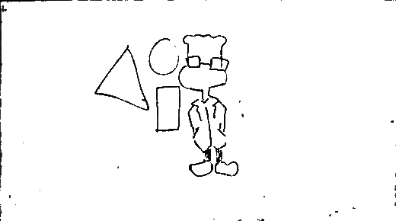
Source
Extracted
sketch

Slide 7
4
1
입력 영상
추출된 영역을 일반 문서 크기로 변환
문서 , 도면영역
추출
2
추출된 영역을 일반 문서 크기로 변환
3

Slide 8


Working flow
Capture image
Extract drawing contents.
Estimate the position of whiteboard.
Post processing to enhance image.
Rectify white board area on image.

Slide 9
Case 1.

Slide 10
Anti-aliasing processing
Extracted sketch has aliasing error.
  Because chromatic filtering erase

Slide 11
Case 2.

Slide 12
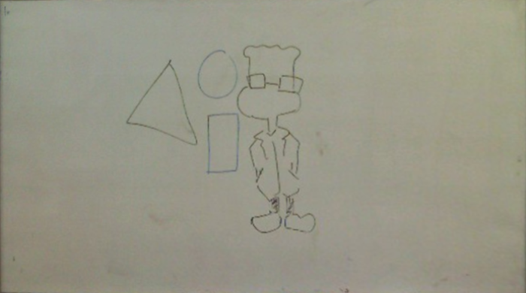
White board image has many white area and small lines.
Lines are meaningful information, not white are.
What is white?

Slide 17
Segment board and drawing
We don’t need drawing ‘image’ but
drawing itself.
Remove specula reflection.
Segment background and drawing.

Slide 19
Video conference

Slide 20
Remove hand or object except drawing.

Slide 21
Example

Slide 22
w₁
w₂
……
w₁₀₀
Pseudo code
………………….
……………
w_{N}
CELL_WIDTH #User define
CELL_HEIGHT #User define
AREA_RATIO = 70% #User define
CELL_AREA = CELL_WIDTH*CELL_HEIGHT
InitFrame = GetInitFrame()
MergedFrame = InitFrame
While( 1 ):
for( each cell w ):
BiArea = GetSub(InitFrame, W) – GetSub(Frame[ i], W)
if( GetArea(BiArea) < CELL_AREA* AREA_RATIO ):
GetSub(MergedFrame,W) = GetSub(Frame[ i], W)
#end if
#end for
i++
tempImage = EnhanceImage( MergedFrame)
ShowImage( tempImage )
#end while

Slide 23
Pseudo code-2
Function EnhanceImage( MergedFrame):
RemoveSpecularReflection( MergedFrame )
AutoWhiteBalance( MergedFrame )
………
Need to add the new functionality for image
Enhancement.

Slide 24
Result
Fail.
  Need the algorithm to divide background and foreground.

Slide 25
Reference research

Slide 26
Eigenbackgrounds
Eigenbackgrounds( N.M Oliver, B.Rosario, and A.P. Pentland, 2000)

Slide 27
Gaussian mixture model
Grimson and Stauffer, Adaptive background mixture models for real-time tracking.

Slide 28
Novel Idea -2

Slide 29
Pseudo code
Const int nAverageFrame
InitFrame = GetInitFrame()
MergedFrame = InitFrame
Int nFrame = 0;
While( 1 ):
if( nFrame < nAverageFrame )
MergedFrame = AverageFrame( InitFrame, Frame)
FgBinaryFrame = CalFGFrame( MergedFrame, Frame)
MergedFrame = MergedFrame + ( FgBinaryFrame && MergedFrame )
ShowImage( MergedFrame )
nFrame++;
#end while

Slide 30
Pseudo code-2
Function EnhanceImage( MergedFrame):
RemoveSpecularReflection( MergedFrame )
AutoWhiteBalance( MergedFrame )
………
Need to add the new functionality for image
Enhancement.

Slide 31
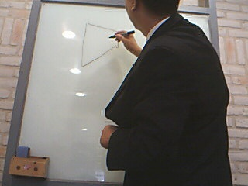
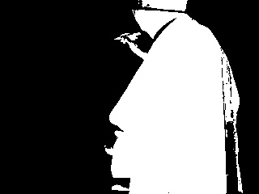
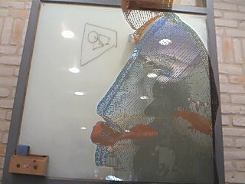
Current frame
Foreground mask

Slide 32
Marketing issue

Slide 33
PC software
Not acceptable
  Nothing survived except middle ware or OS.
  Smart packages were almost open source or free software.
    Because company know that S/W package market is ‘red-ocean’.
    Even google.. Advertisement is the only way to make money.

Slide 34
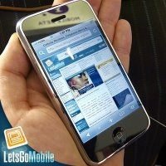
But smart phone
Currently smart phone market is growing 16% in 2008.
In north america, smart phone posessed 10% of mobile phone market in 2008.
Smart phone market will grow TWO TIMES more in every year.

Slide 35
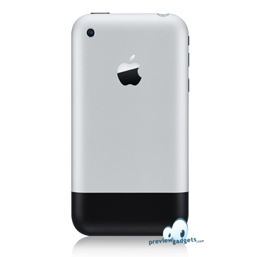
Need to killer app for smart phone.
Many makers support the environment to develop SW for their phone.
  Google, Android.
  Apple, iPhone SDK .
But no practical software to use its camera.

Slide 36
Entry barrier is lower! But..
Apple
  AppStore
Google
  Anroid Market
Almost applications are simple and small ware. NOT SMART ONE!

