Slide 1
Introduction

Slide 2
Figure 1 Block diagram representation of nervous system.

Slide 3
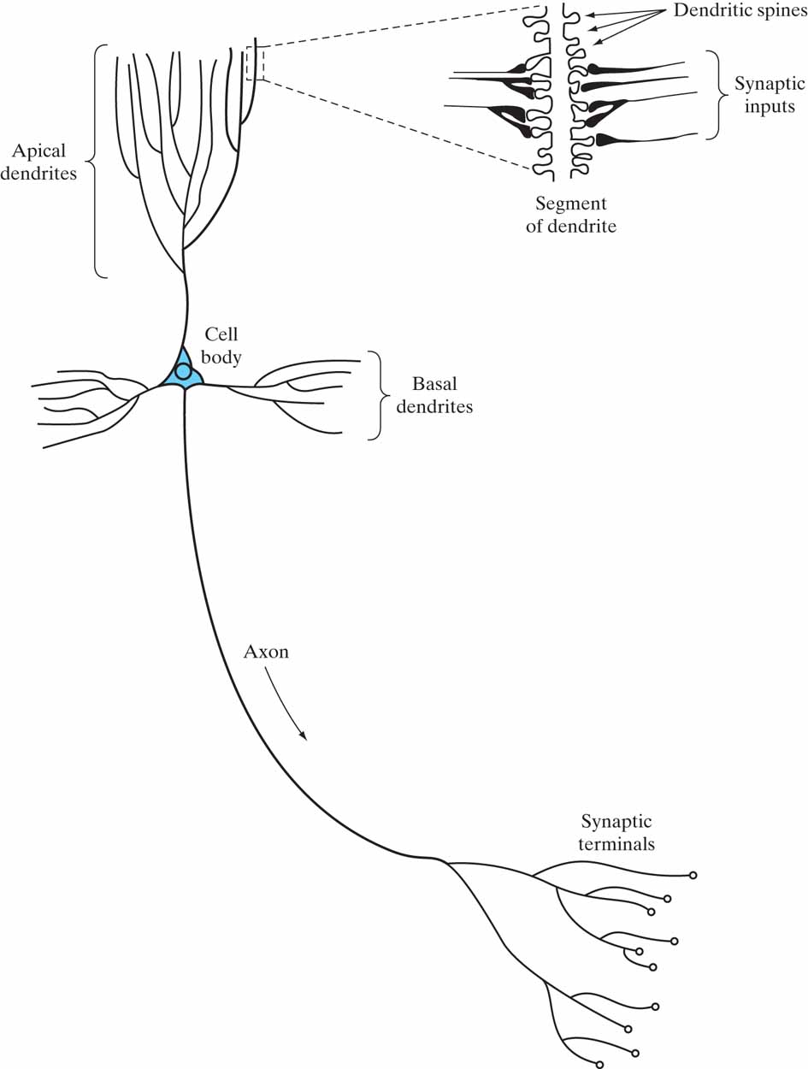
Figure 2 The pyramidal cell.

Slide 4
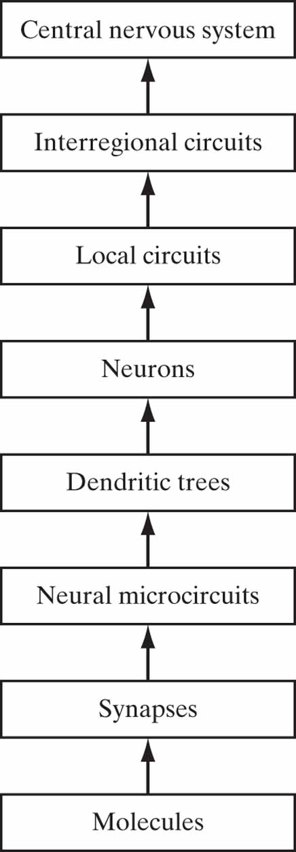
Figure 3 Structural organization of levels in the brain.

Slide 5
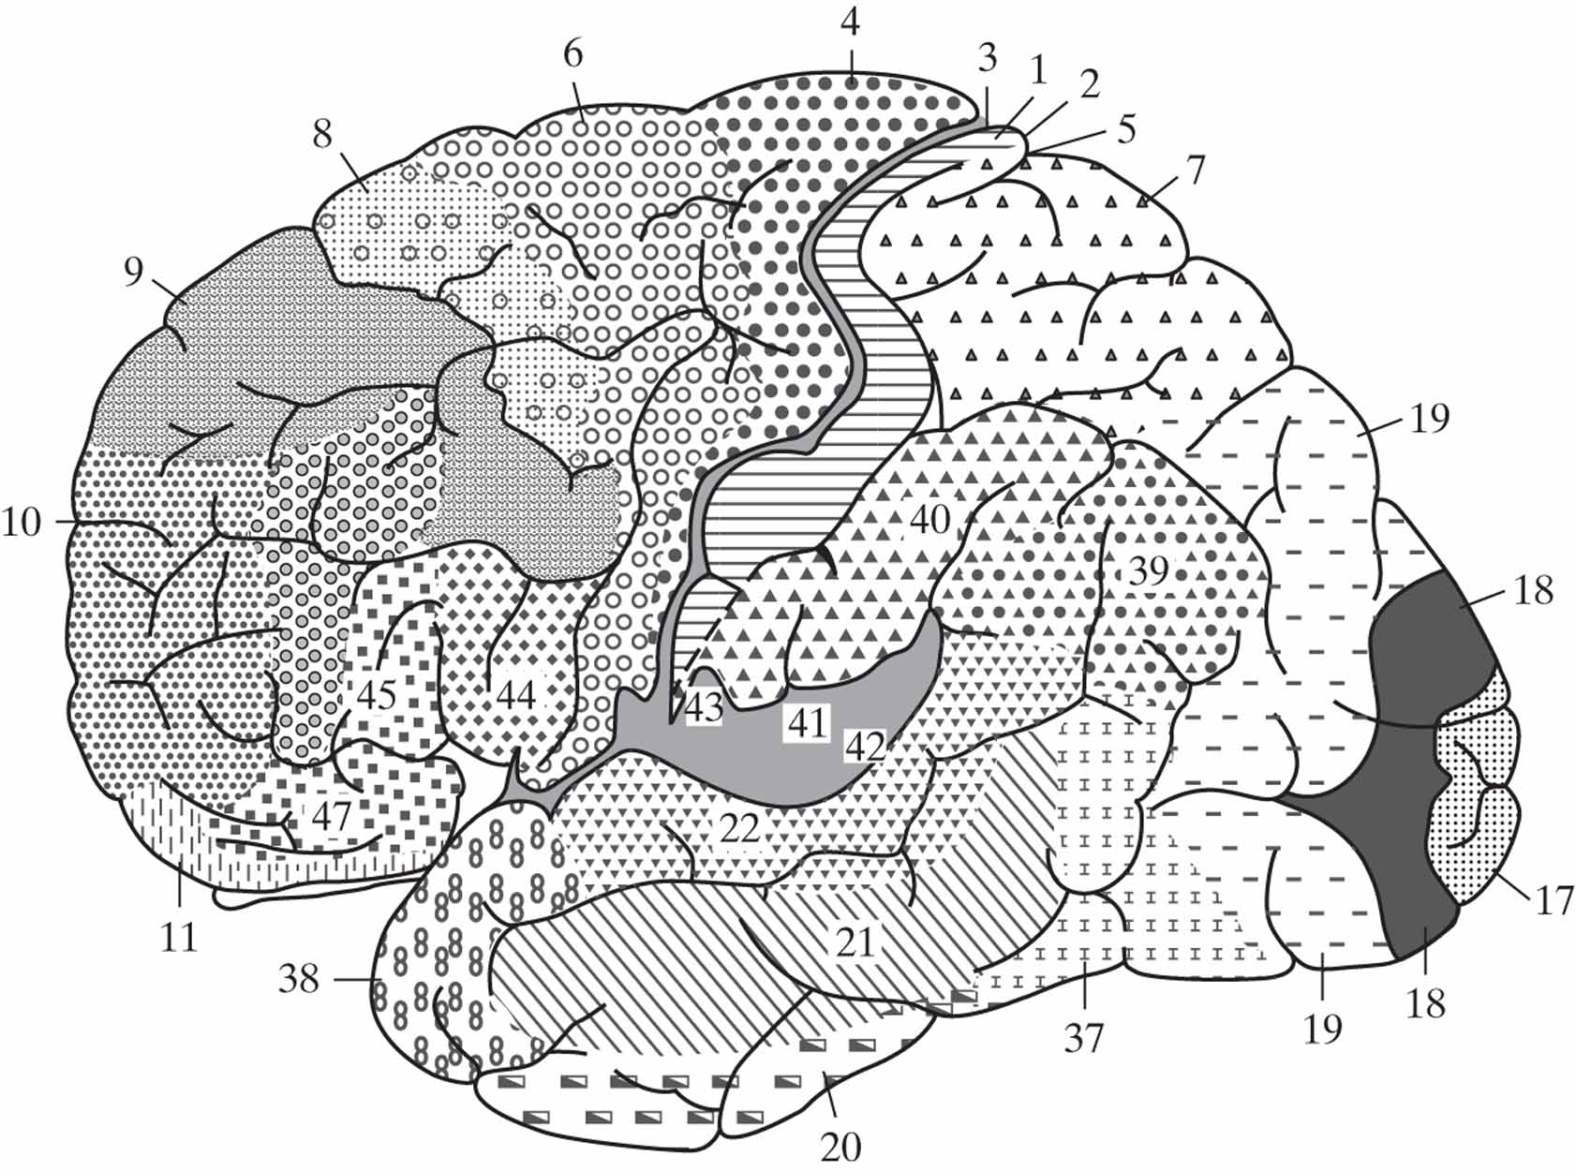
Figure 4 Cytoarchitectural map of the cerebral cortex. The different areas are identified by the thickness of their layers and types of cells within them. Some of the key sensory areas are as follows: Motor cortex: motor strip, area 4; premotor area, area 6; frontal eye fields, area 8. Somatosensory cortex: areas 3, 1, and 2. Visual cortex: areas 17, 18, and 19. Auditory cortex: areas 41 and 42. (From A. Brodal, 1981; with permission of Oxford University Press.)

Slide 6
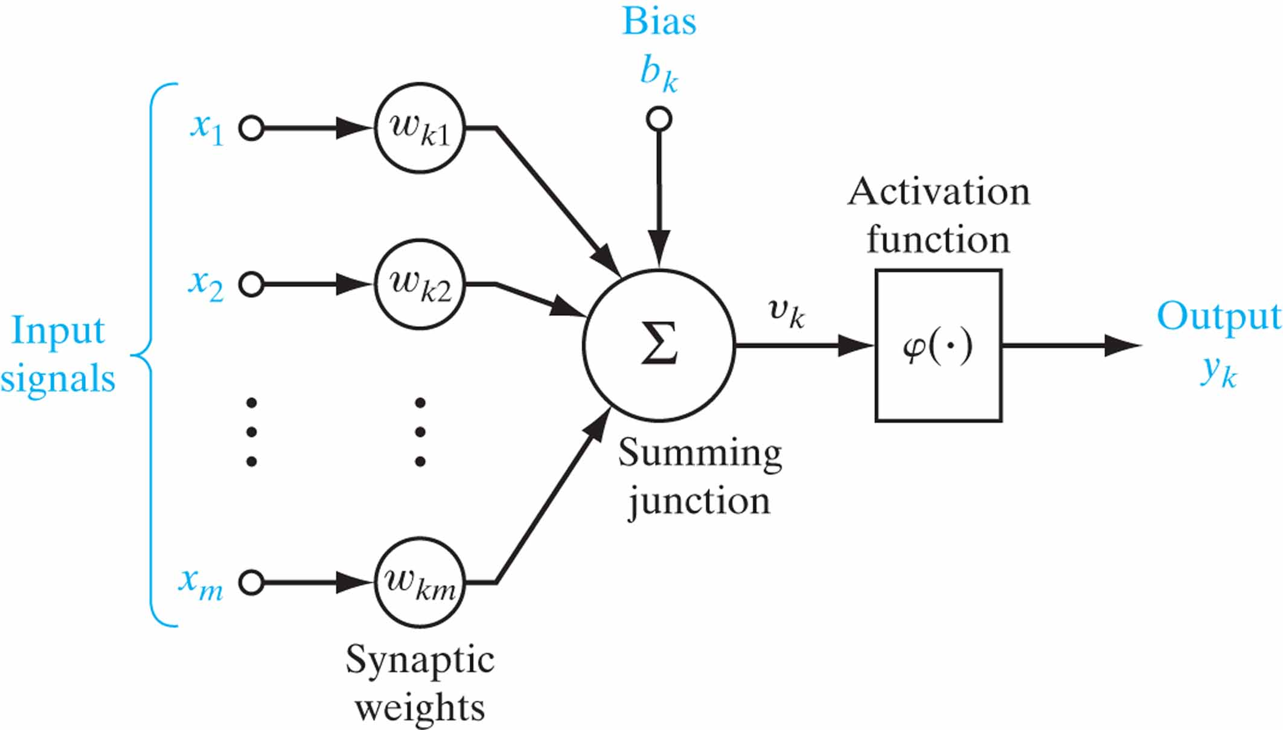
Figure 5 Nonlinear model of a neuron, labeled k.

Slide 7
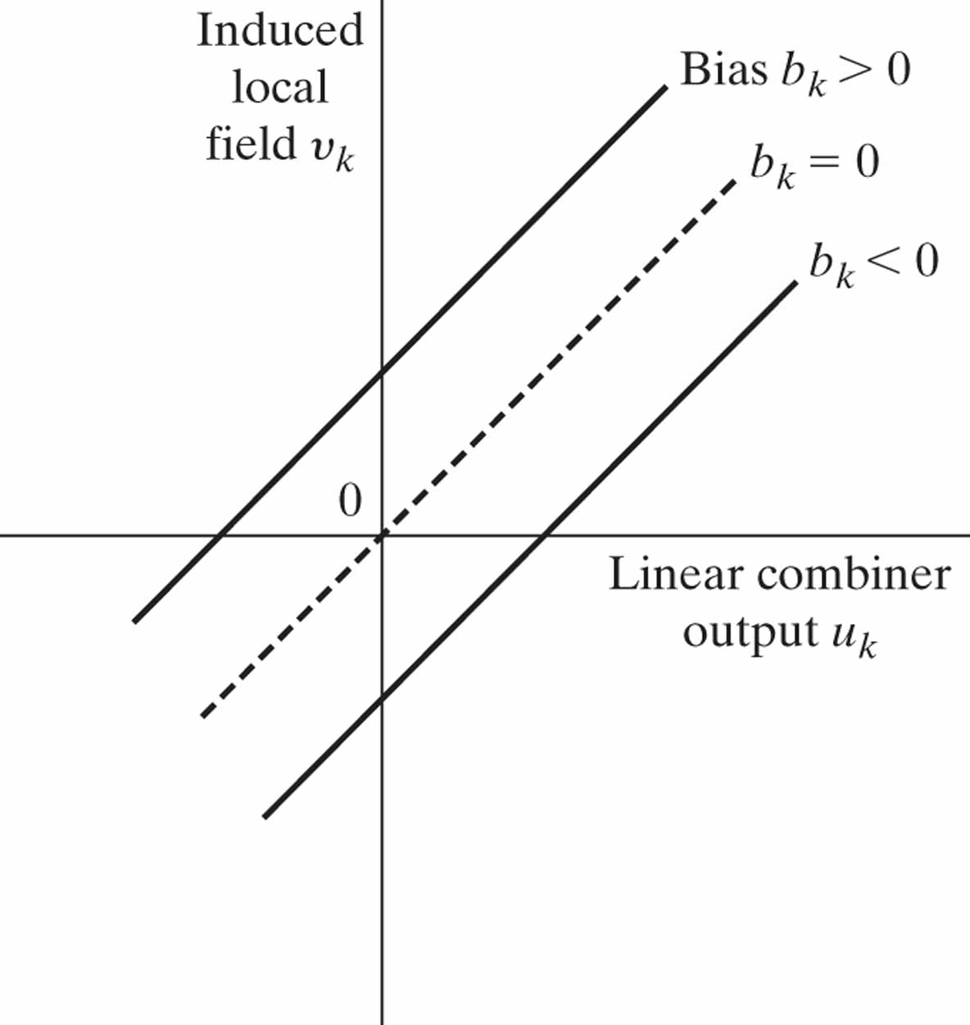
Figure 6 Affine transformation produced by the presence of a bias; note that v_{k} = b_{k} at u_{k} = 0.

Slide 8
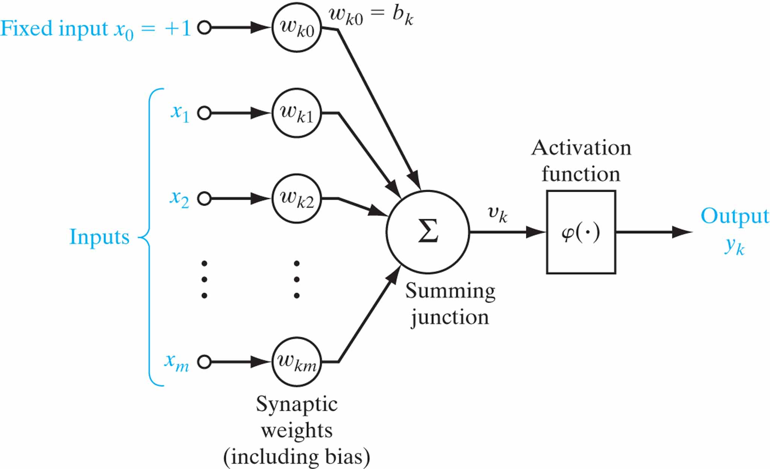
Figure 7 Another nonlinear model of a neuron; w_{k0} accounts for the bias b_{k}.

Slide 9
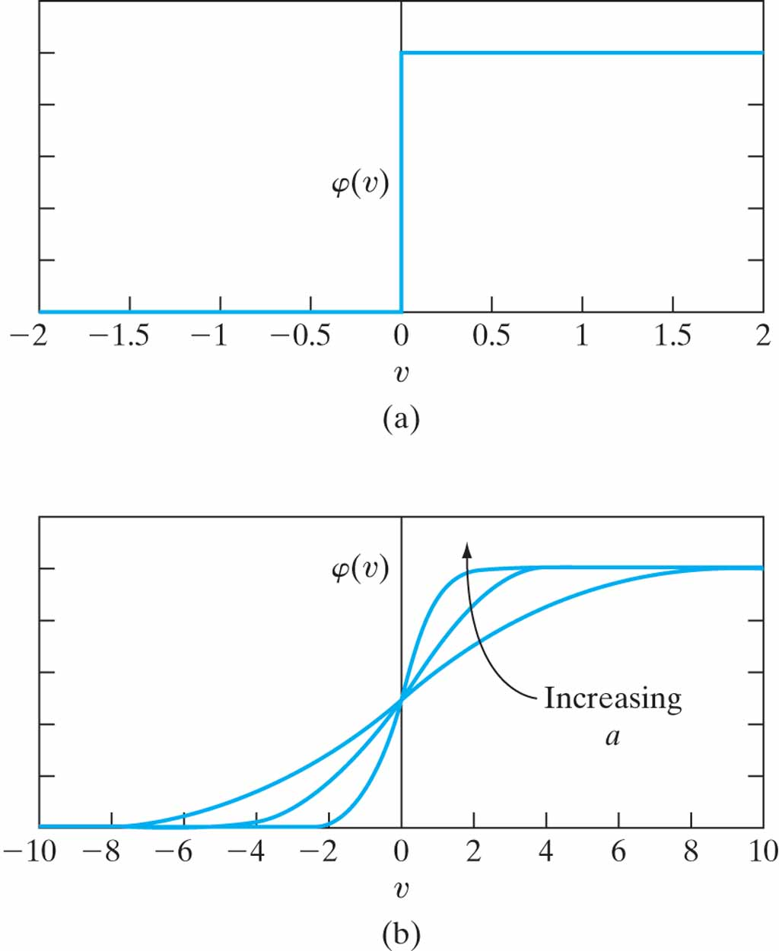
Figure 8 (a) Threshold function. (b) Sigmoid function for varying slope parameter a.

Slide 10
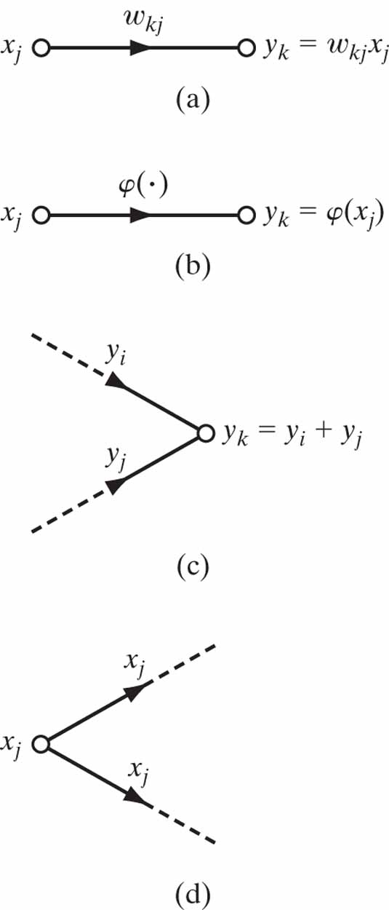
Figure 9 lllustrating basic rules for the construction of signal-flow graphs.

Slide 11
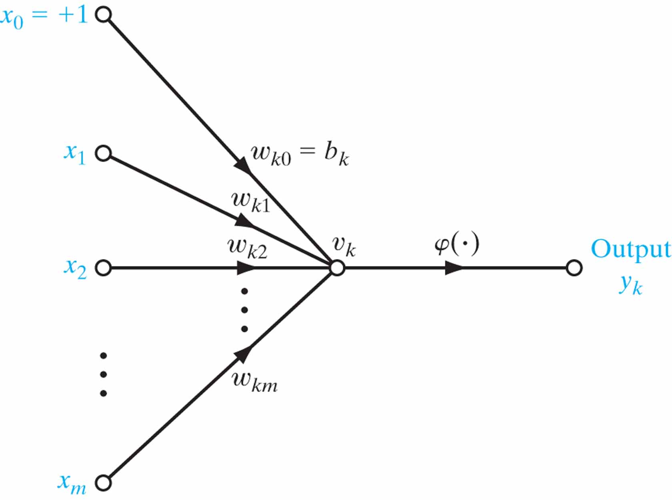
Figure 10 Signal-flow graph of a neuron.

Slide 12
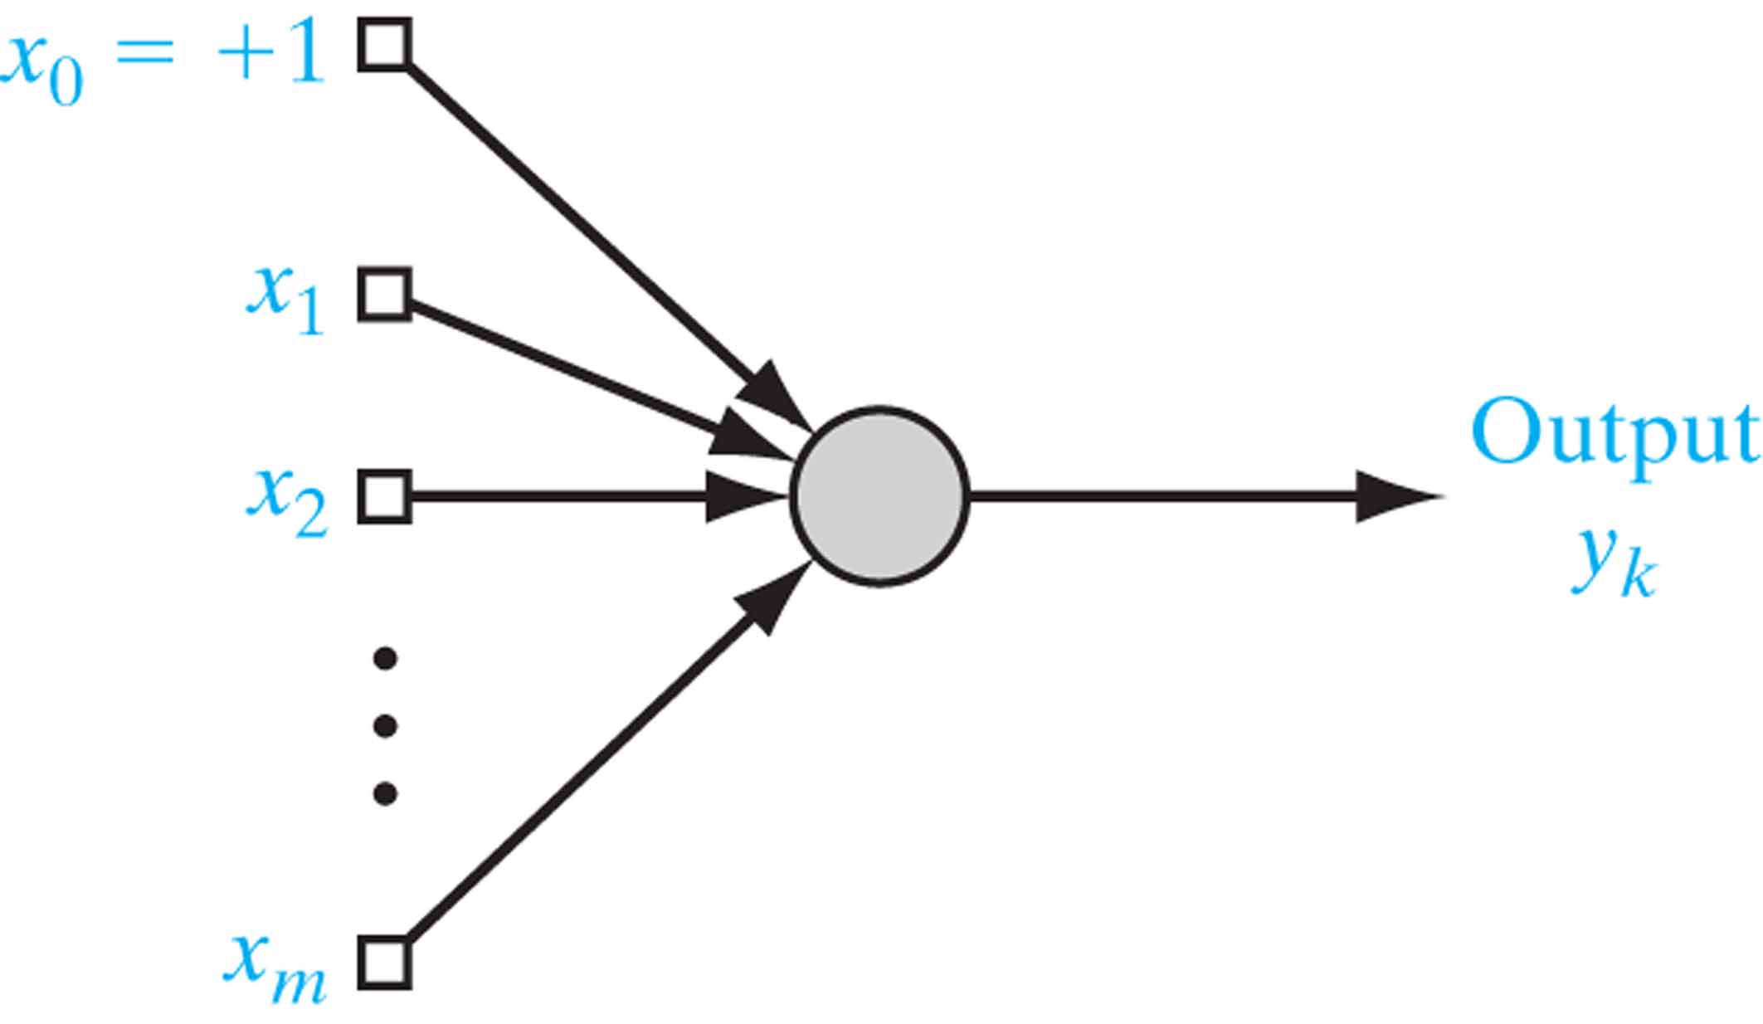
Figure 11 Architectural graph of a neuron.

Slide 13
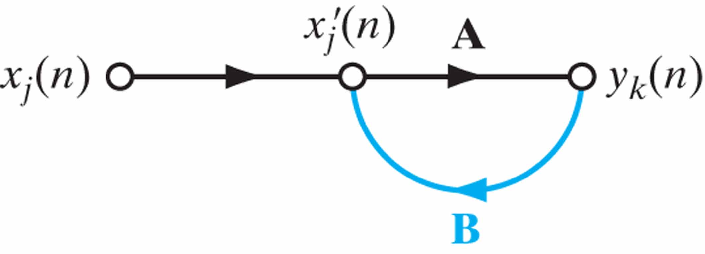
Figure 12 Signal-flow graph of a single-loop feedback system.

Slide 14
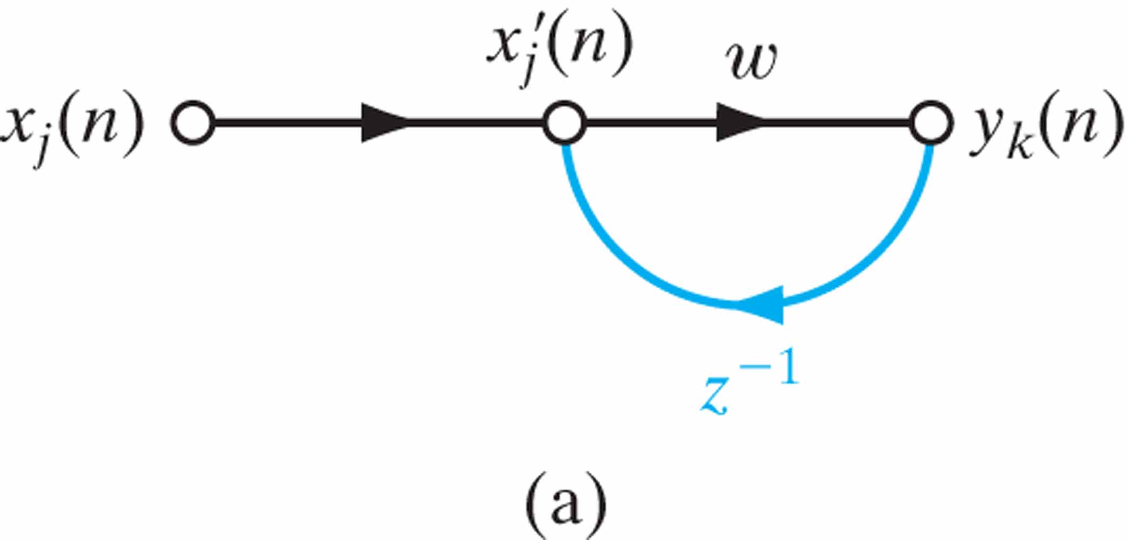
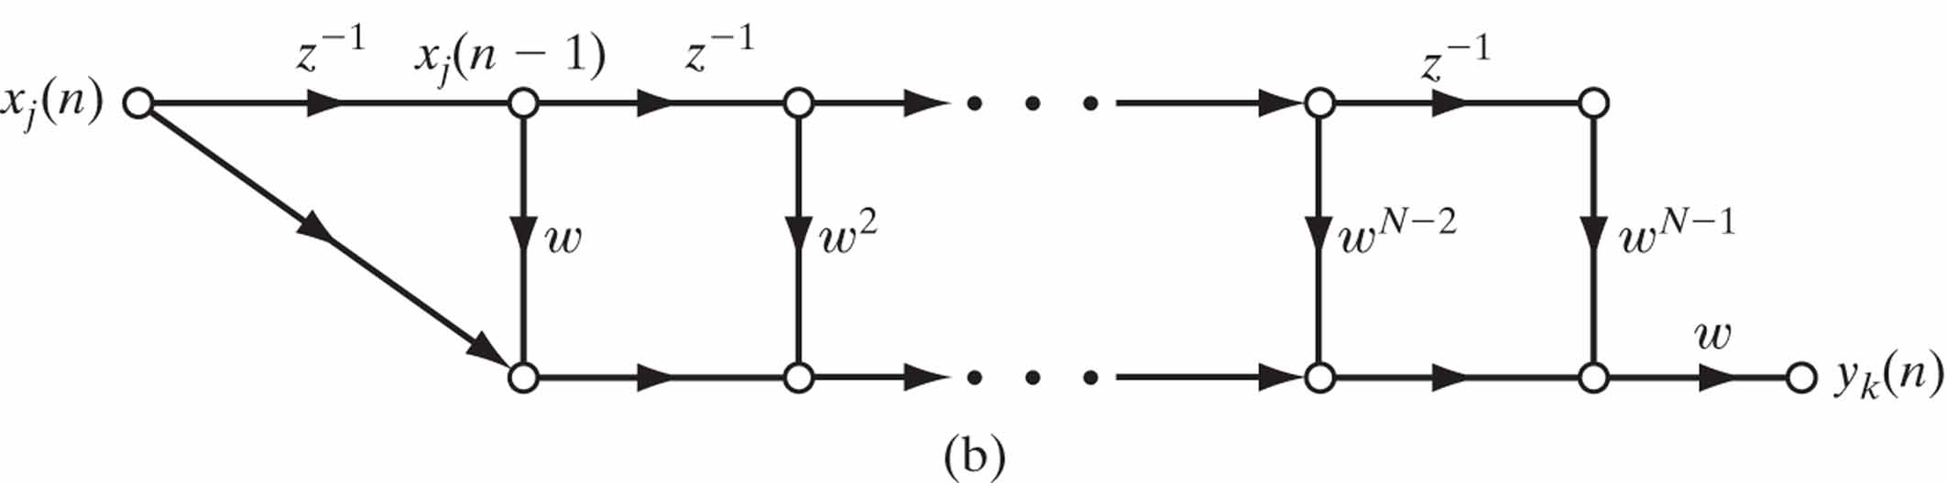
Figure 13 (a) Signal-flow graph of a first-order, infinite-duration impulse response (IIR) filter. (b) Feedforward approximation of part (a) of the figure, obtained by truncating Eq. (20).

Slide 15
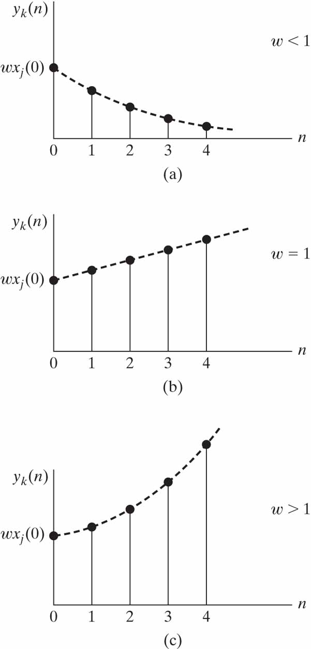
Figure 14 Time response of Fig. 13 for three different values of feedforward weight w. (a) Stable. (b) Linear divergence. (c) Exponential divergence.

Slide 16
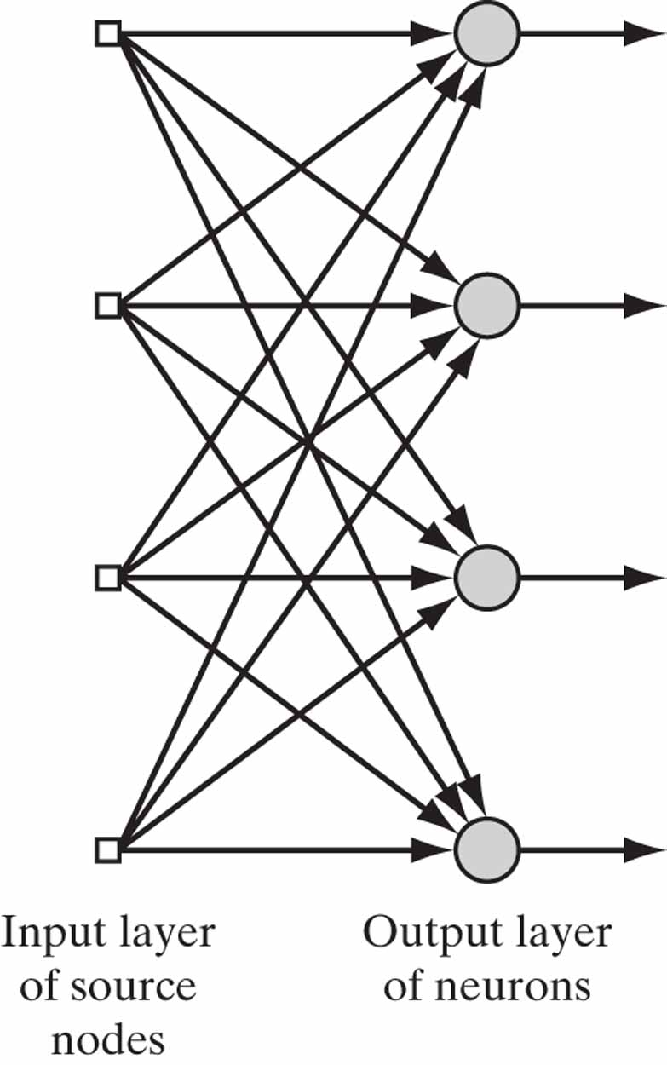
Figure 15 Feedforward network with a single layer of neurons.

Slide 17
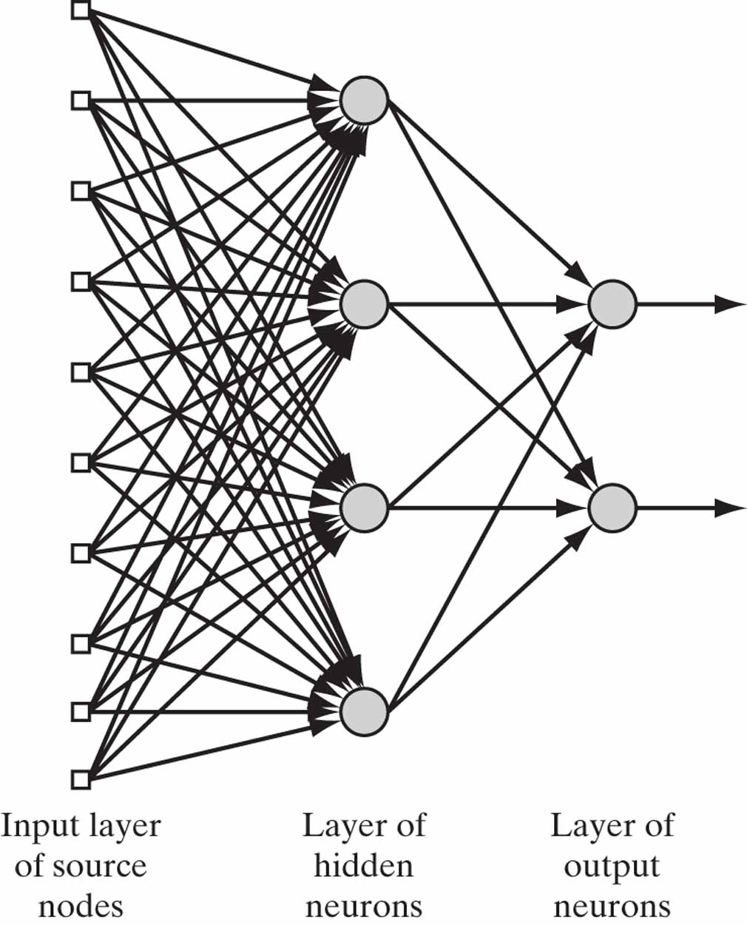
Figure 16 Fully connected feedforward network with one hidden layer and one output layer.

Slide 18
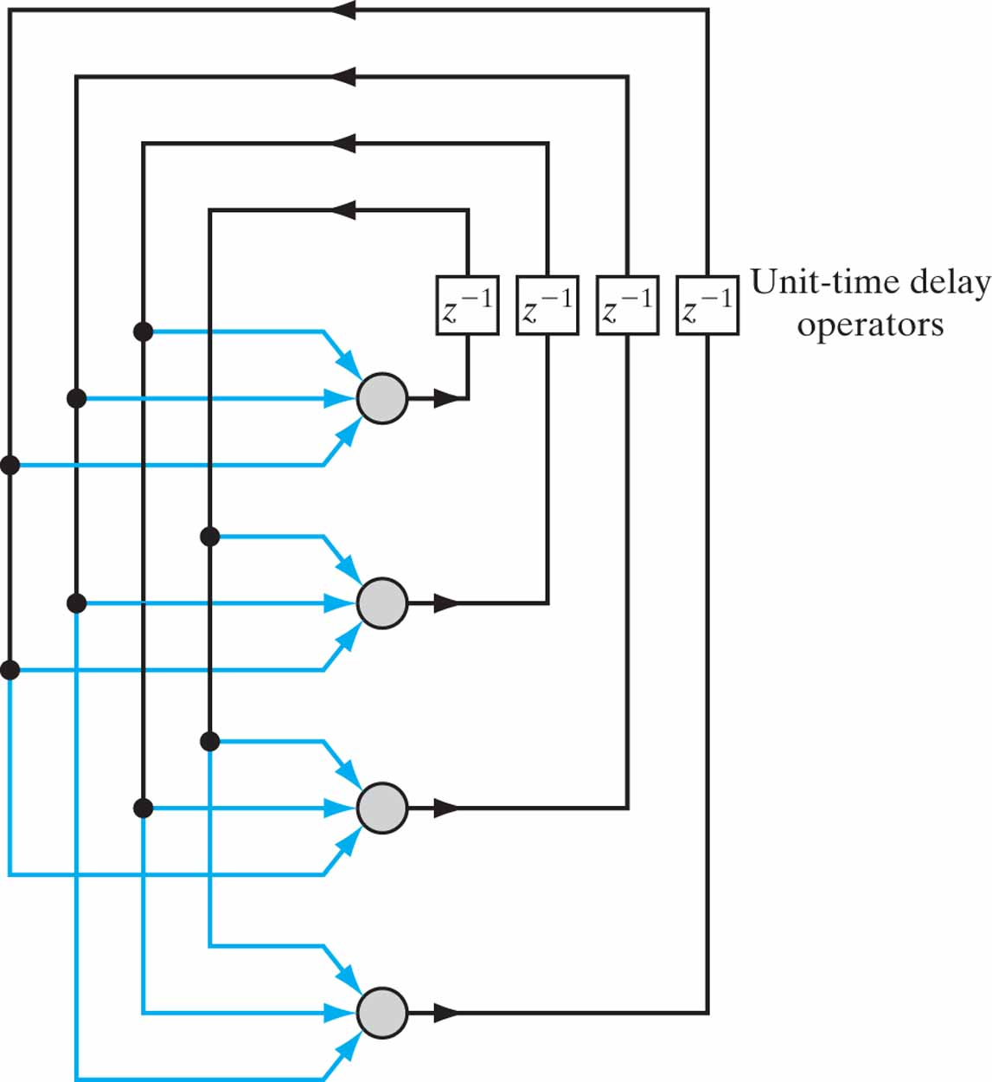
Figure 17 Recurrent network with no self-feedback loops and no hidden neurons.

Slide 19
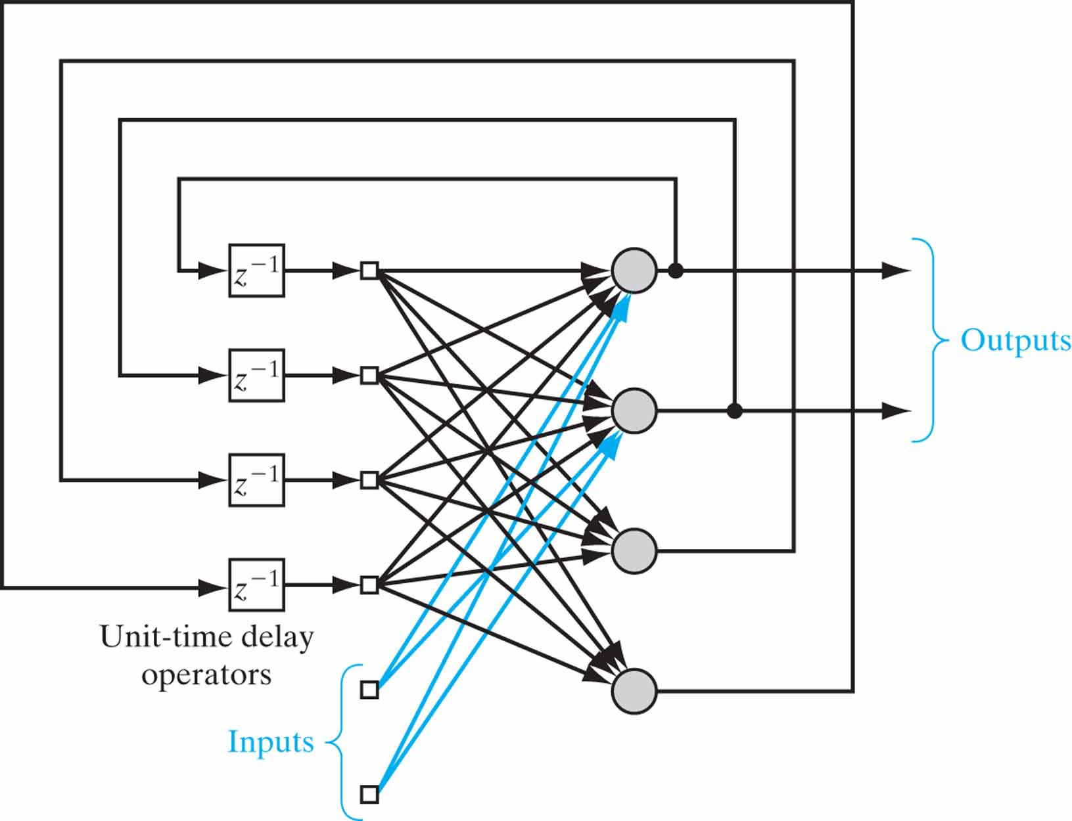
Figure 18 Recurrent network with hidden neurons.

Slide 20
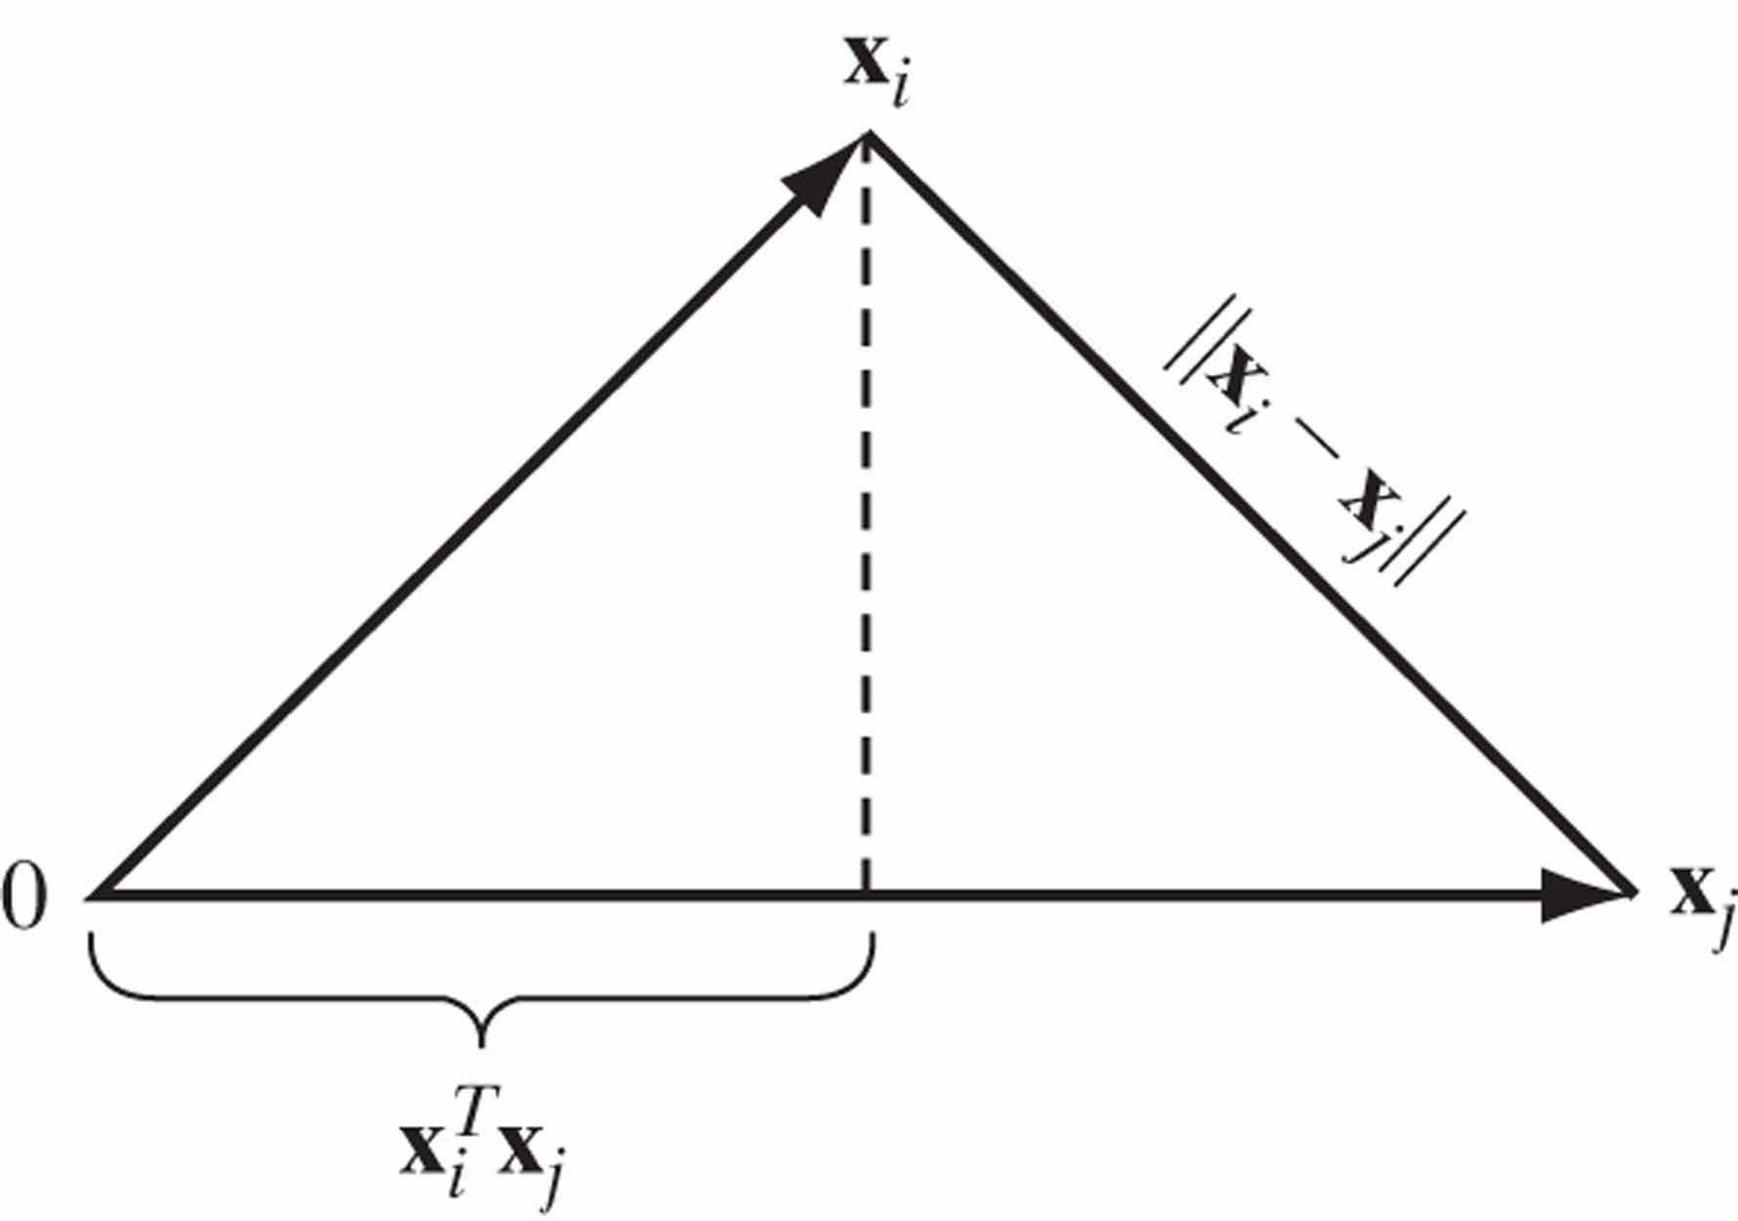
Figure 19 Illustrating the relationship between inner product and Euclidean distance as measures of similarity between patterns.

Slide 21
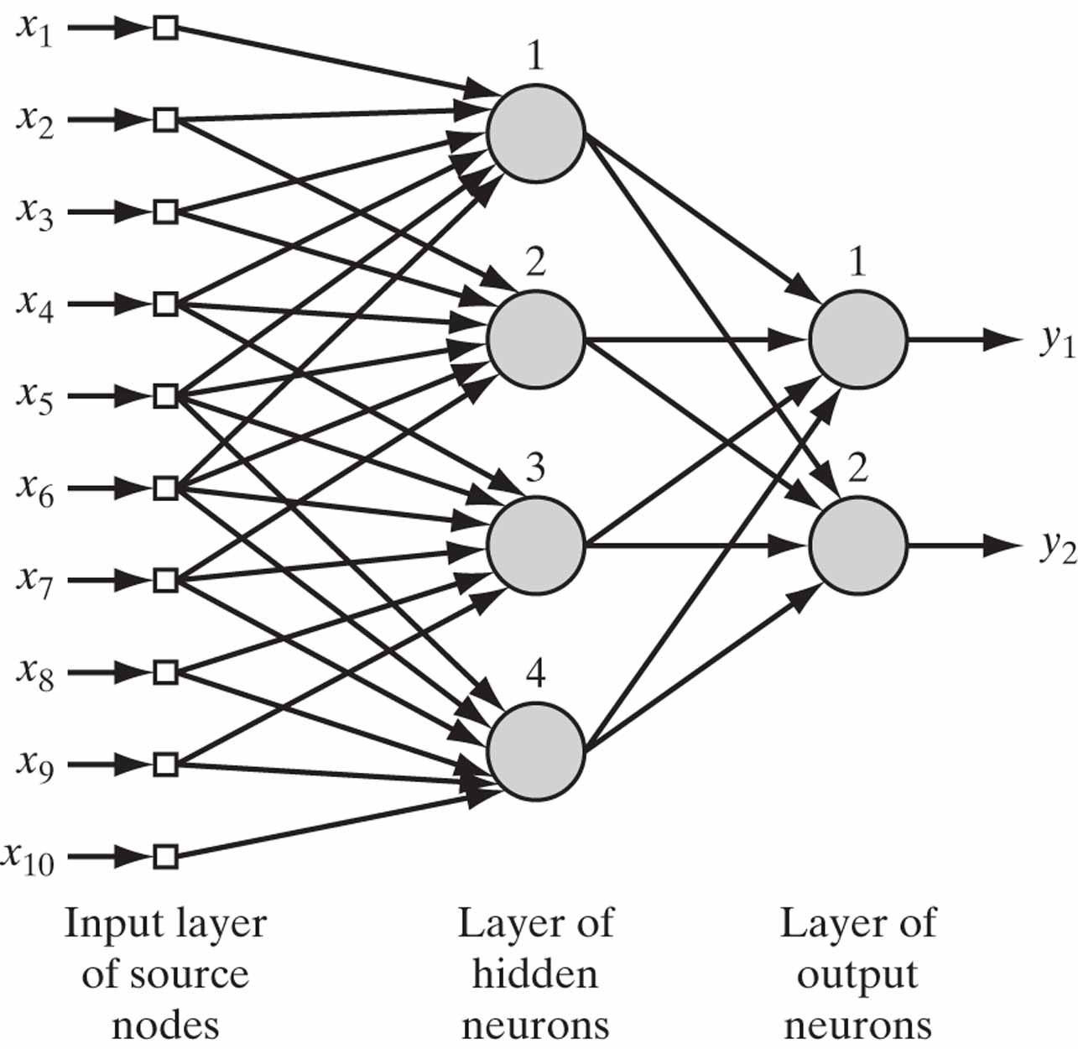
Figure 20 Illustrating the combined use of a receptive field and weight sharing. All four hidden neurons share the same set of weights exactly for their six synaptic connections.

Slide 22
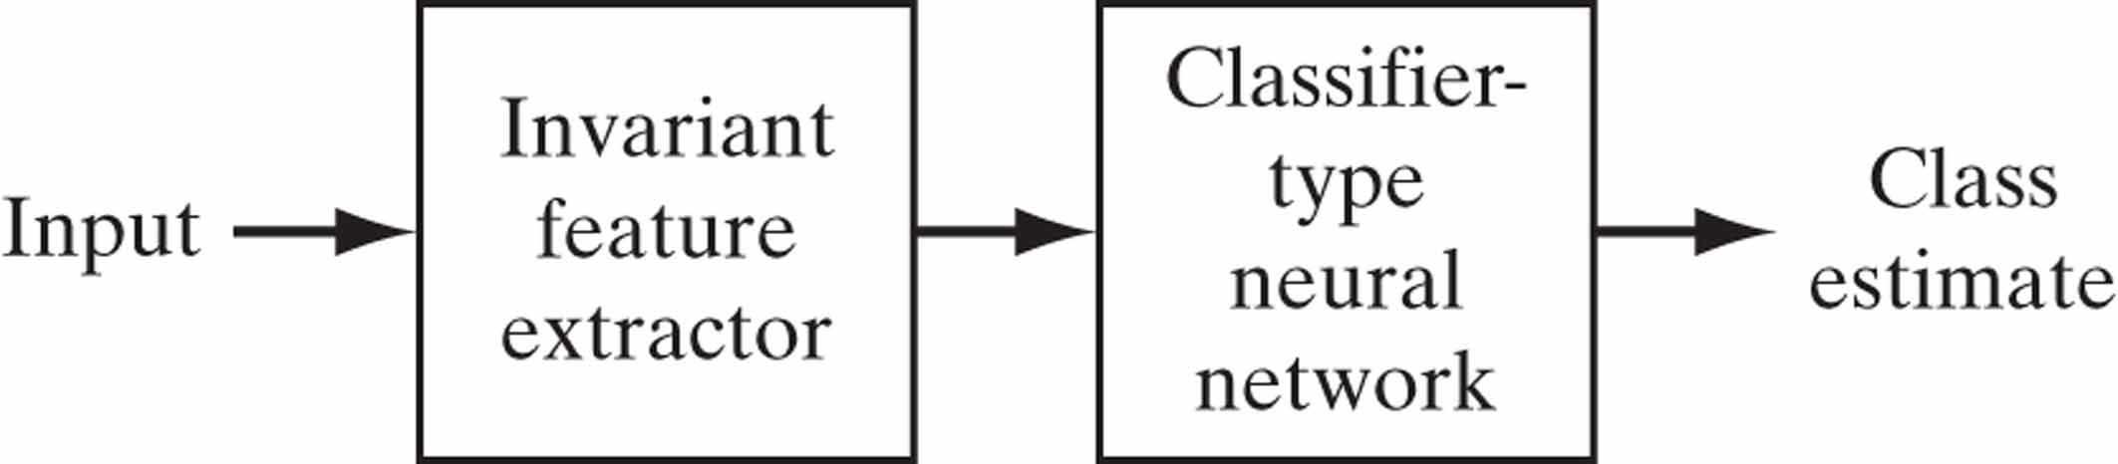
Figure 21 Block diagram of an invariant-feature-space type of system.

Slide 23
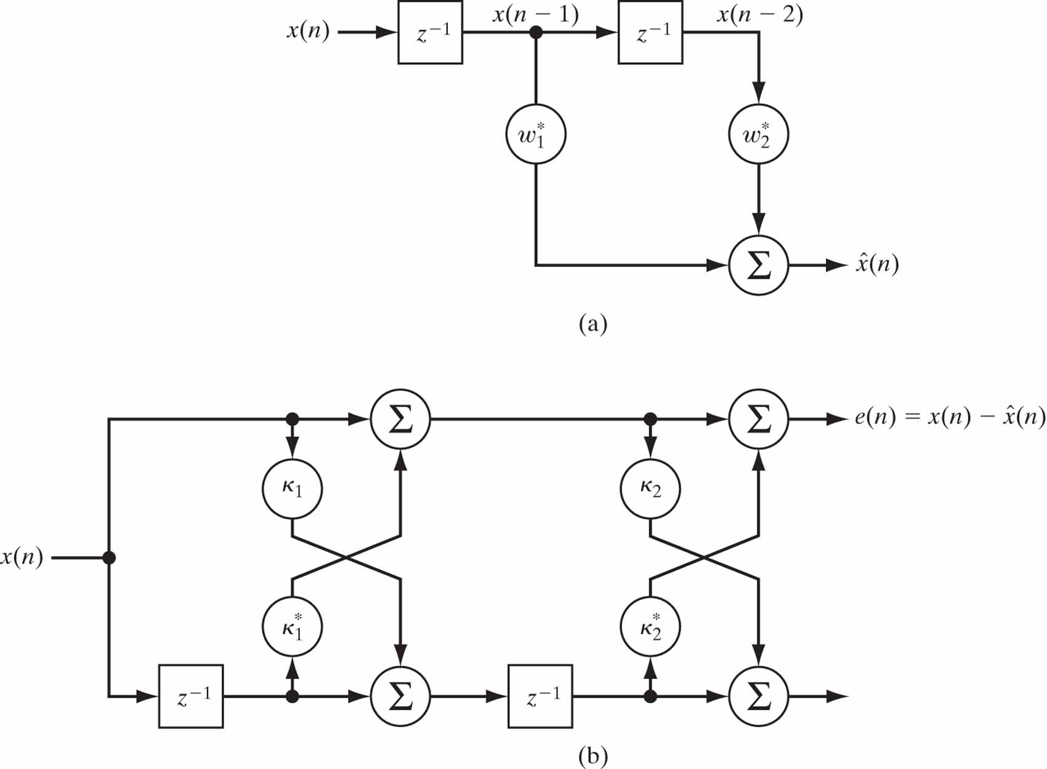
Figure 22 Autoregressive model of order 2: (a) tapped-delay-line model; (b) lattice-filter model. (The asterisk denotes complex conjugation.)

Slide 24
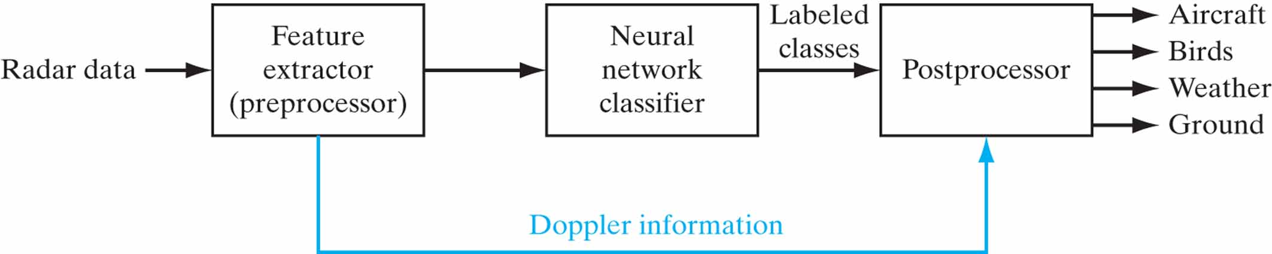
Figure 23 Doppler-shift-invariant classifier of radar signals.

Slide 25
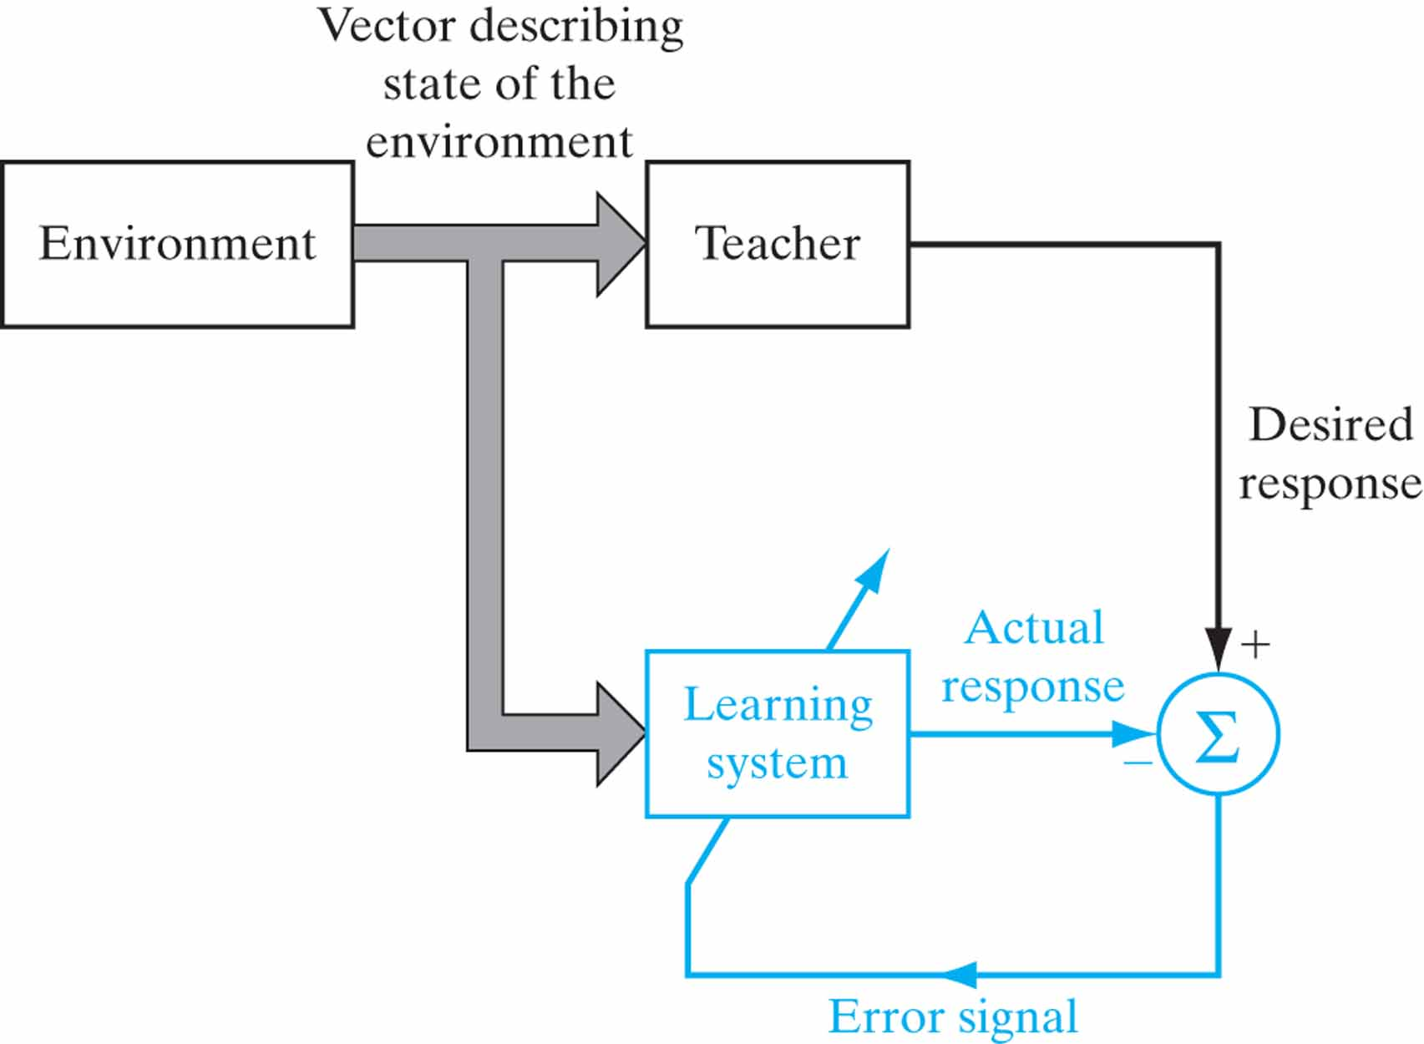
Figure 24 Block diagram of learning with a teacher; the part of the figure printed in red constitutes a feedback loop.

Slide 26
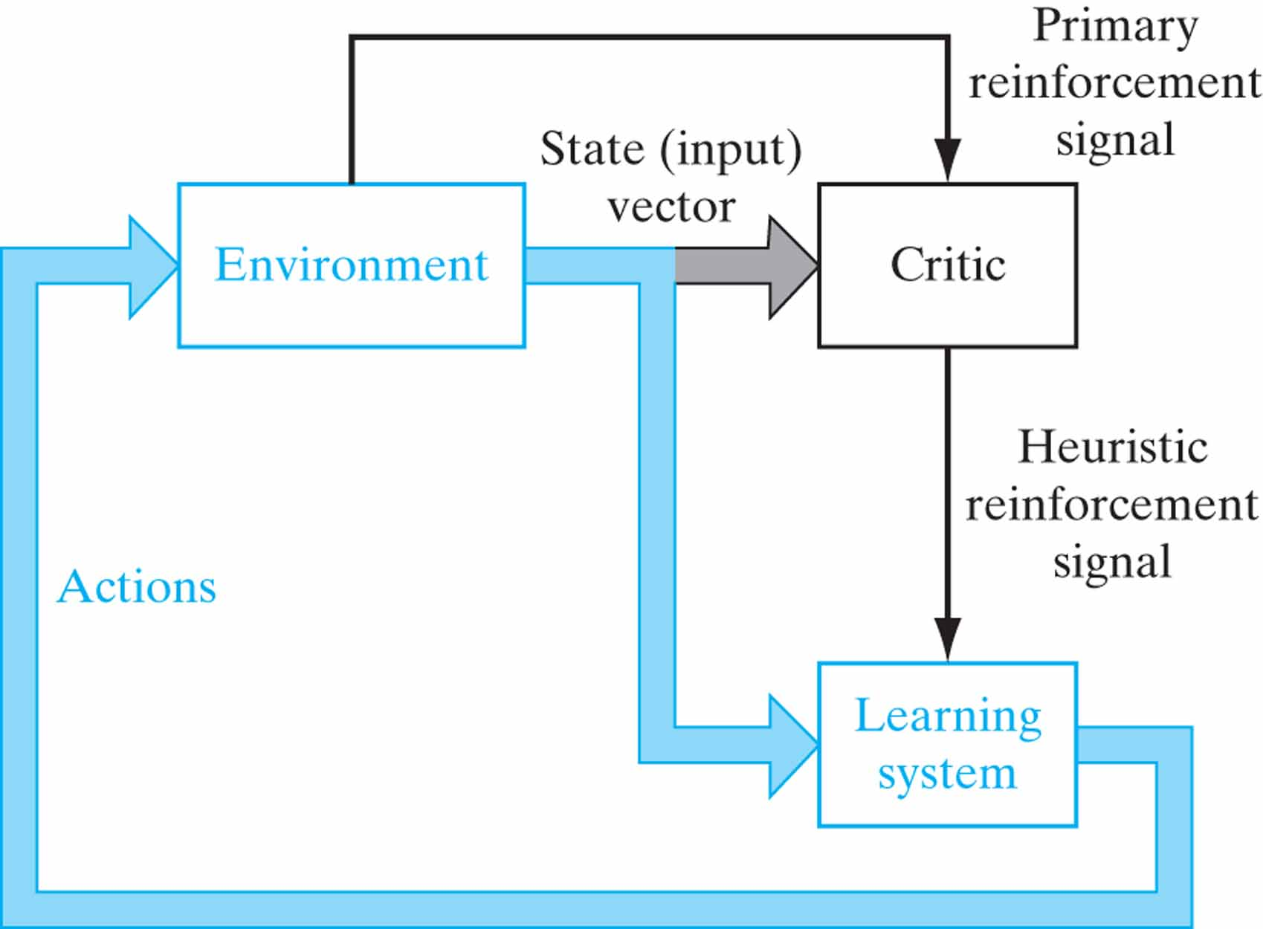
Figure 25 Block diagram of reinforcement learning; the learning system and the environment are both inside the feedback loop.

Slide 27
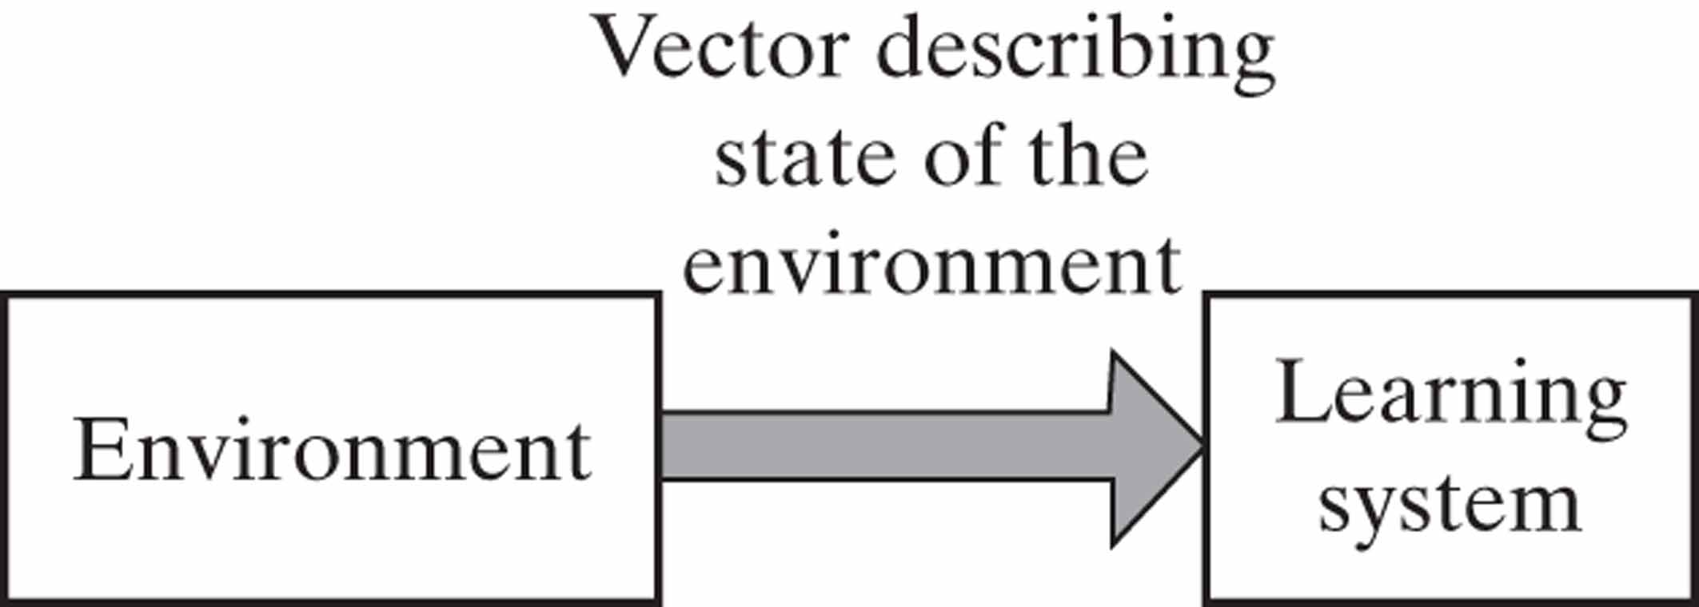
Figure 26 Block diagram of unsupervised learning.

Slide 28
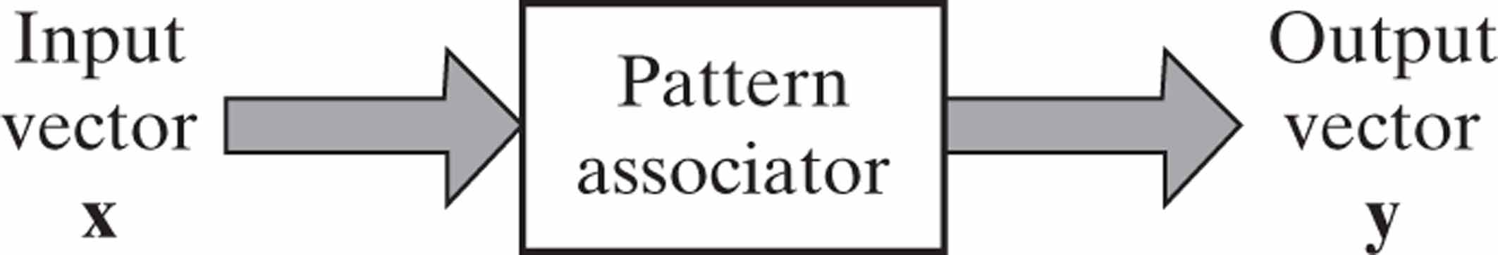
Figure 27 Input–output relation of pattern associator.

Slide 29
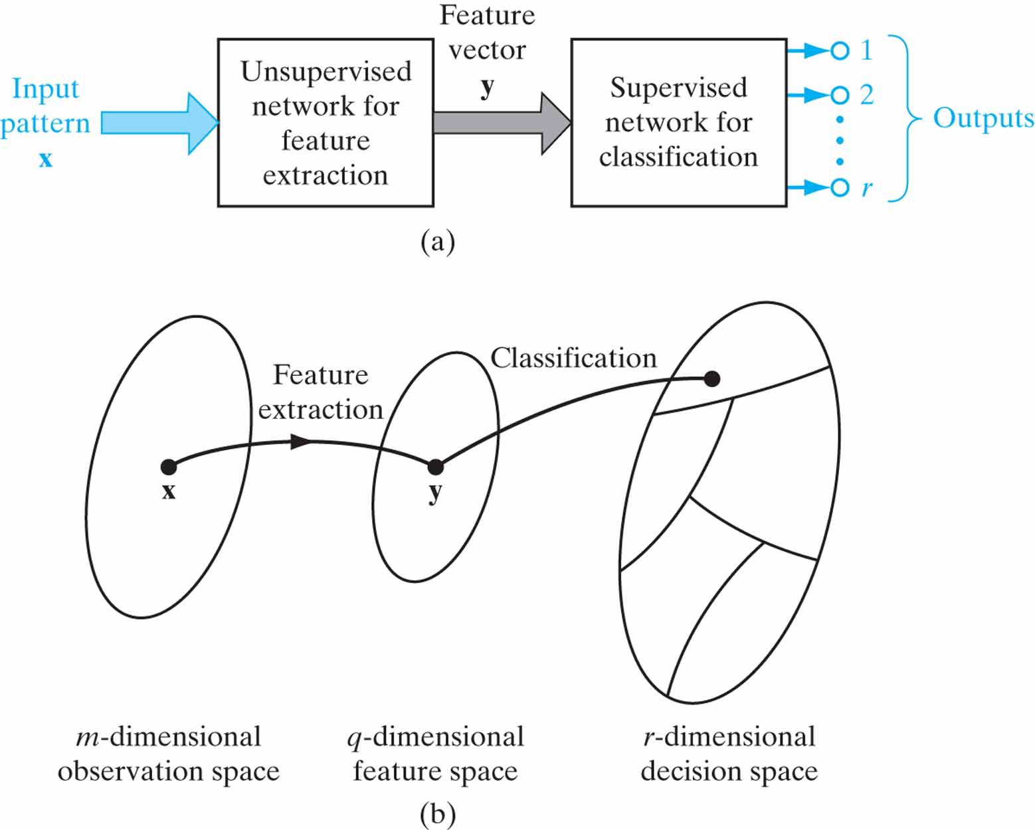
Figure 28 Illustration of the classical approach to pattern classification.

Slide 30
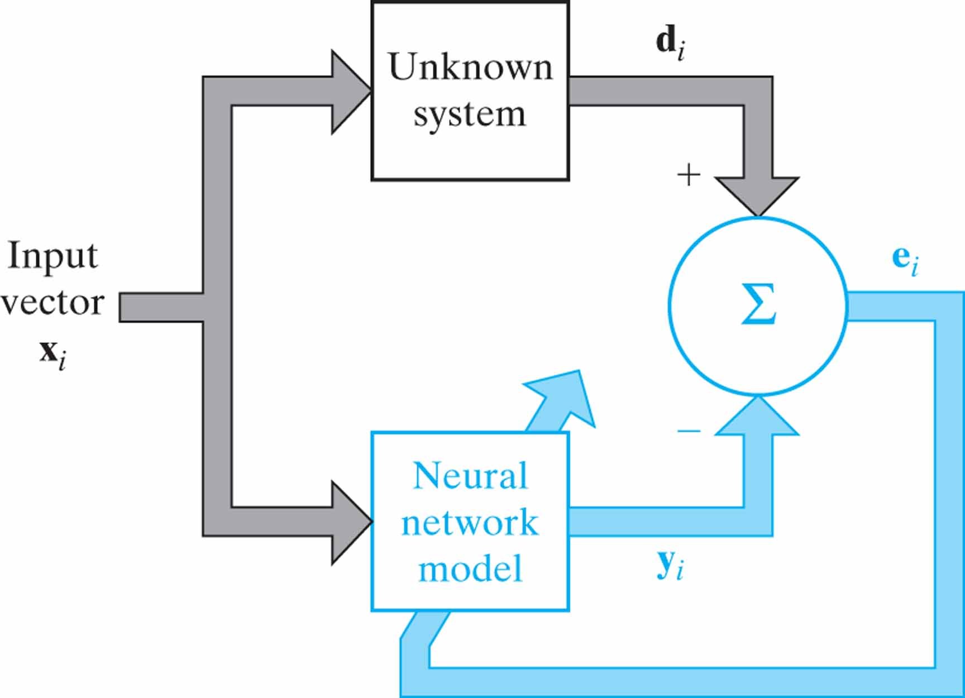
Figure 29 Block diagram of system identification: The neural network, doing the identification, is part of the feedback loop.

Slide 31
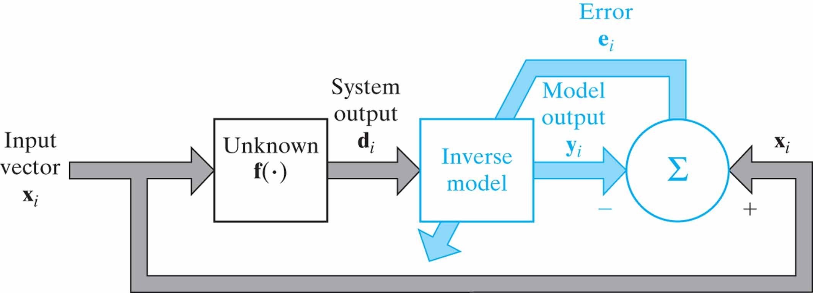
Figure 30 Block diagram of inverse system modeling. The neural network, acting as the inverse model, is part of the feedback loop.

Slide 32
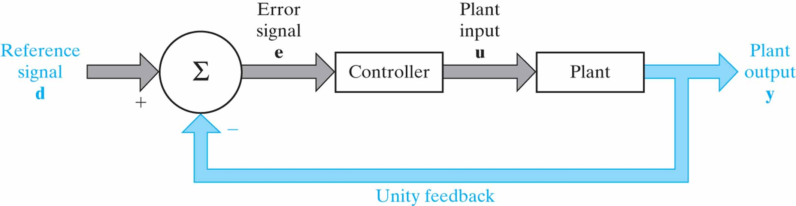
Figure 31 Block diagram of feedback control system.

Slide 33
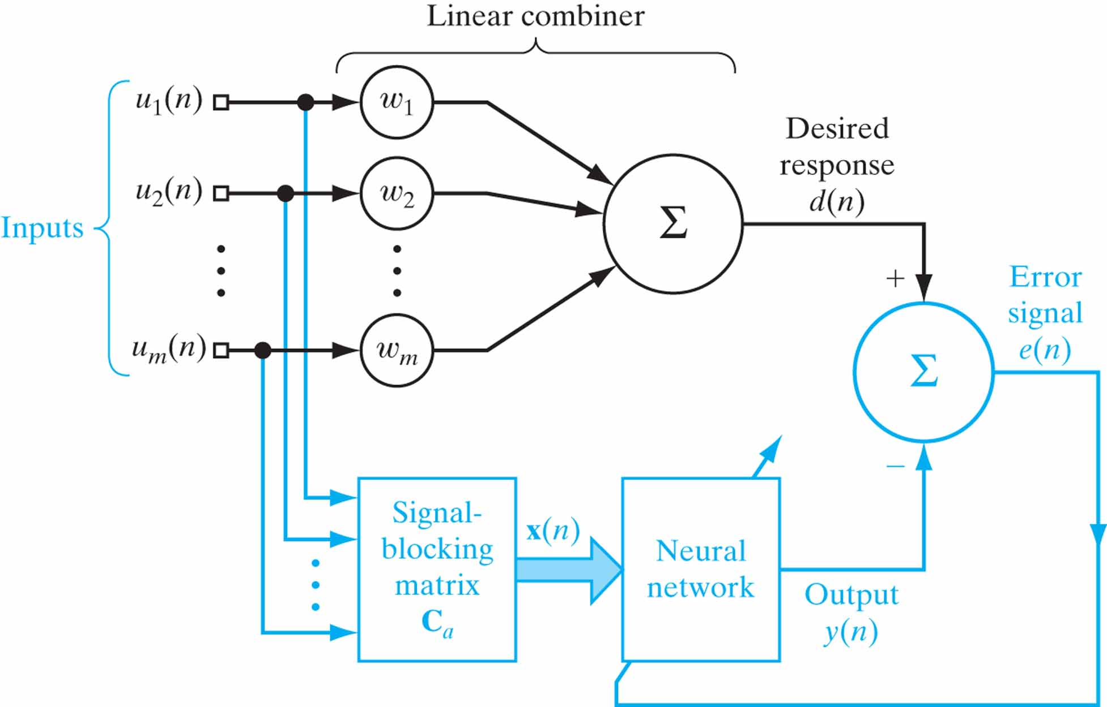
Figure 32 Block diagram of generalized sidelobe canceller.

