Slide 1
ADVANCED COMPUTER NETWORKS & SYSTEMS
Design & Implementation of a Multi-Threaded HTTP/1.1 Web Server from Scratch
Zero-Dependency ISO C17 Architecture on Raw POSIX Sockets with Queue-and-Latency-Aware Admission Control (QLAAC)
Author: Systems Engineering Team | Course: Computer Networks (CS-504) | Date: October 2026
Platform: Linux Kernel 6.6 / x86_64 | Standards: RFC 9112, RFC 9110, POSIX.1-2008
Notes:
Welcome committee members. Today I present the design, low-level implementation, and empirical verification of a multi-threaded HTTP/1.1 web server built strictly from scratch in ISO C17 on raw POSIX sockets without external libraries.

Slide 2
HTTP/1.1 WEB SERVER FROM SCRATCH
Motivation & Problem Statement: Systems Engineering Challenges
1. Stream vs Frame Mismatch
2. Thread Explosion & Collapse
3. Queue Starvation & Bufferbloat
• TCP guarantees reliable byte streams but provides zero message boundary framing.
• read(2) can return partial headers, an exact request, or multiple concatenated pipelined requests.
• Requires custom circular streaming buffers and deterministic CRLF delimiter detection without buffer overruns.
• Naive thread-per-connection architectures cause severe thread thrashing and memory exhaustion.
• Spawning 10,000 POSIX threads at 8 MB default stack consumes 80 GB virtual memory.
• Context switching latency destroys CPU cache locality and collapses server throughput under concurrency.
• When arrival rate exceeds processing rate (λ > μ), unmanaged FIFO queues expand indefinitely.
• By Little's Law (L = λW), latency explodes while clients time out waiting in queue memory.
• Demands closed-loop admission control to shed load defensively and protect p99 tail latency.
Notes:
The core motivation is mastering systems-level networking. We must solve three fundamental hurdles: reconstructing HTTP message boundaries from continuous TCP byte streams, preventing OS thread thrashing, and avoiding bufferbloat-induced tail latency collapse.

Slide 3
HTTP/1.1 WEB SERVER FROM SCRATCH
Project Objectives & Architectural Scope Boundaries
Core Functional Objectives (In-Scope)
Deliberate Architectural Boundaries
✓ Zero External Dependencies: Pure C17 using libc and POSIX.1-2008 system calls only.
✓ Raw Socket Engine: Non-blocking accept, SO_REUSEADDR, SO_RCVTIMEO/SO_SNDTIMEO.
✓ Fixed-Capacity Thread Pool: 4 pre-spawned worker threads (scalable to 16) eliminating thread churn.
✓ Bounded Queue: Thread-safe circular FIFO buffer (64 slots default / scalable to 128).
✓ Strict RFC 9112 Parser: Zero-copy header tokenization, case-insensitivity, keep-alive reuse.
✓ QLAAC Admission Controller: 3-tier feedback loop preventing bufferbloat collapse.
✓ Observability Engine: Real-time sliding window percentiles and HTML5 live dashboard.
✗ No TLS/HTTPS Inside Server: Cryptographic handshake and TLS record layer are deliberately omitted to focus purely on raw transport; in production, TLS termination is handled by upstream HAProxy/Nginx reverse proxy.
✗ No HTTP/2 or HTTP/3: Protocol scope strictly bounded to HTTP/1.1 persistent streaming semantics.
✗ No Asynchronous Event Loop Frameworks: Deliberately avoided libevent/libuv to directly implement POSIX multithreading and condition variable synchronization primitives.
✓ Focus on Mechanical Sympathy: Deep understanding of kernel buffers, socket options, and thread synchronization.
Notes:
Our scope is uncompromising: 100% zero-dependency C17. We deliberately exclude TLS and external event loop libraries to directly engage with kernel socket options, memory bounds, and POSIX synchronization primitives.

Slide 4
HTTP/1.1 WEB SERVER FROM SCRATCH
Computer Networks Concepts: Transport Semantics & TCP Mechanics
TCP Transport Guarantees vs Application Needs
Socket Buffer Mechanics & Flow Control
• Reliability & In-Order Delivery: TCP uses 32-bit sequence numbers, cumulative ACKs, and sliding windows to guarantee data arrives intact and in order.
• Connection Lifecycle:
1. 3-Way Handshake (SYN -> SYN-ACK -> ACK).
2. Bi-directional full-duplex data transfer.
3. Orderly teardown via 4-Way FIN/ACK exchange.
• Kernel Backlog Mechanics:
- Incomplete connection queue (SYN received).
- Completed connection queue (ESTABLISHED, waiting for accept(2)).
• TCP Sliding Window Flow Control: Server advertises receive window (rcv_wnd). If worker threads are slow, rcv_wnd shrinks, exerting backpressure on client.
• Socket Timeouts (SO_RCVTIMEO / SO_SNDTIMEO):
- Crucial defense against deadlocks and Slowloris.
- Prevents a slow or stalled client from holding worker threads indefinitely.
• TIME_WAIT State Management:
- Setting SO_REUSEADDR allows instant socket re-binding after server restarts, avoiding 2MSL port lockout.
Notes:
Understanding TCP semantics is fundamental. We leverage kernel backlog queues, handle TCP flow control via sliding windows, and use SO_REUSEADDR and timeout options to ensure resilience against lingering sockets and slow clients.

Slide 5
HTTP/1.1 WEB SERVER FROM SCRATCH
Low-Level TCP Socket Lifecycle & Partial I/O Handling
Socket Initialization & Configuration
Robust Partial Read & Write Loops
1. socket(AF_INET, SOCK_STREAM, 0):
Allocates kernel file descriptor for IPv4 stream socket.
2. setsockopt(SO_REUSEADDR, 1):
Permits binding to port even if lingering in TIME_WAIT.
3. bind(server_fd, &addr, sizeof(addr)):
Binds socket to 0.0.0.0 and configured port (default 8080).
4. listen(server_fd, 1024):
Enables passive listening with deep backlog of 1024.
5. accept(server_fd, ...):
Extracts established socket from kernel queue.
• Partial Write Invariant:
A single write() or send() is NOT guaranteed to transmit all bytes requested.
• Implementation Solution:
```c
ssize_t send_all(int fd, const void *buf, size_t len) {
size_t total = 0;
while (total < len) {
ssize_t n = send(fd, (char*)buf + total,
len - total, MSG_NOSIGNAL);
if (n <= 0) return -1;
total += n;
}
return total;
}
```
• MSG_NOSIGNAL prevents fatal SIGPIPE crashes if the client aborts during transmission.
Notes:
Notice our send_all loop. On POSIX byte streams, assuming a write sends everything is a fatal bug. We loop until all bytes are sent and pass MSG_NOSIGNAL to prevent client connection resets from killing our server with SIGPIPE.

Slide 6
HTTP/1.1 WEB SERVER FROM SCRATCH
End-to-End Request Lifecycle: Ingress to Dispatch
1. Ingress & Accept
2. Queue Dispatch
Listener thread executes accept(). Immediate QLAAC check. If overloaded, 503 dispatched; else pushed to queue.
Worker thread awakened by condition variable. Pops client_fd from FIFO buffer. Marks worker active.
3. Ingress Timing
4. Parsing & Routing
First byte arrival timestamp captured immediately via clock_gettime() to isolate execution from idle keep-alive wait.
RFC 9112 engine tokenizes request. Router matches static path or dynamic API (/metrics, /api/status).
5. Response Assembly
6. Connection Reuse
Worker formats HTTP status line, headers (Date, Content-Length, Keep-Alive), and transmits payload via send_all().
If keep-alive active, loops to await next request. On EOF, timeout, or Connection: close, gracefully closes socket.
Notes:
Here is the six-stage request lifecycle. A key engineering fix we made was stage 3: we capture the latency timer only when the first request byte arrives, preventing idle keep-alive wait time from distorting request service latency.

Slide 7
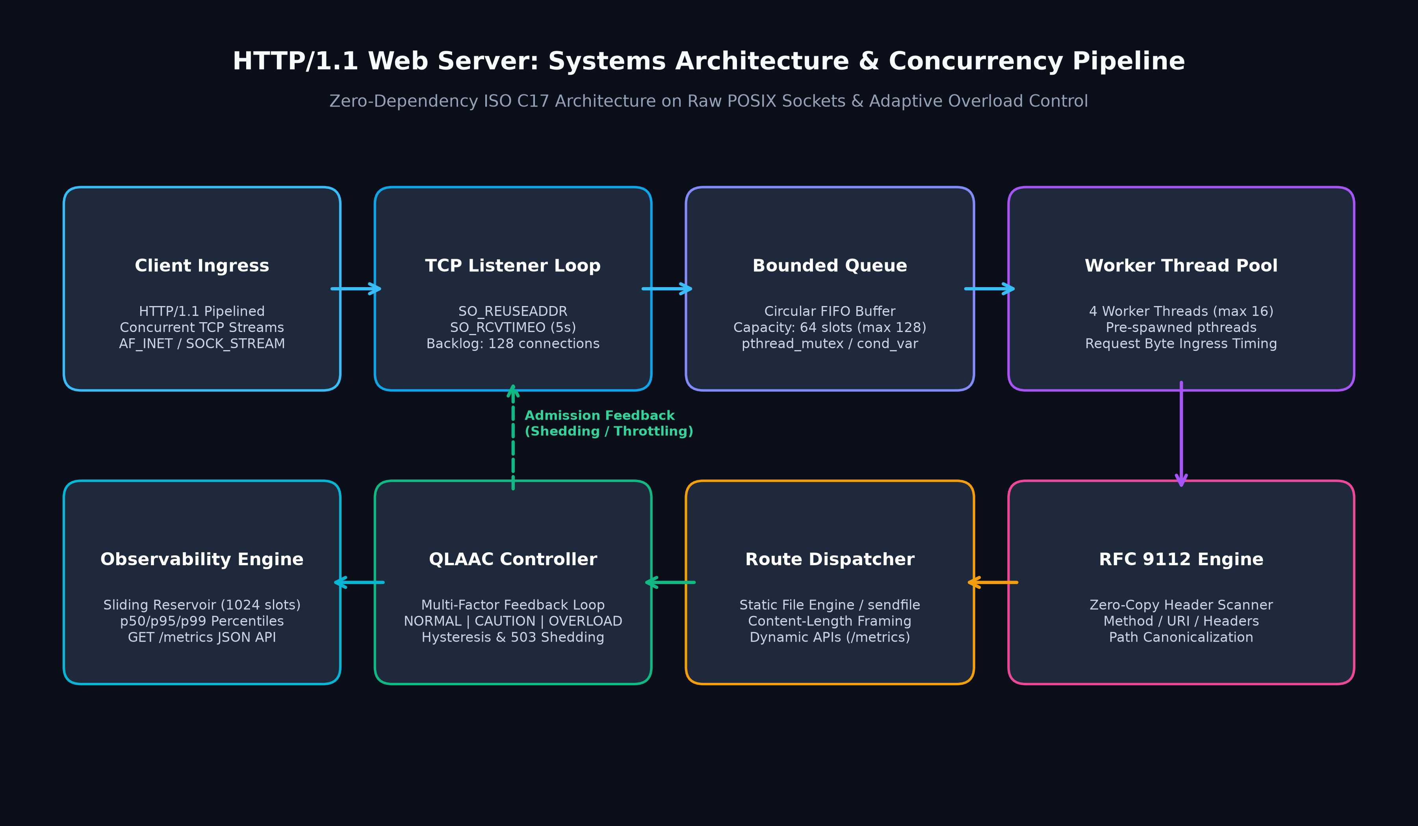
HTTP/1.1 WEB SERVER FROM SCRATCH
System Architecture: Multi-Threaded Concurrency Pipeline
Notes:
Figure 4 shows our complete architecture: client connections arrive at the listener loop, pass through QLAAC admission, enter the 64-slot bounded queue, and are dispatched to the 4 worker threads (scalable to 16) for parsing, routing, and metrics recording.

Slide 8
HTTP/1.1 WEB SERVER FROM SCRATCH
Pre-Spawned POSIX Thread Pool Architecture
Thread Pool Implementation Details
Worker Utilization & Concurrency Safety
• Pre-Spawned Allocation:
4 worker threads in benchmark & default configuration (scalable up to 16) created at boot via pthread_create().
• Zero Creation Overhead:
Completely eliminates per-connection fork(2) or pthread_create() latency on the hot path.
• Deterministic Resource Bounding:
Server memory consumption remains strictly constant regardless of client load spikes.
• Clean Lifecycle Management:
Worker loops block on condition variable, pop descriptors, process requests, and cleanly rejoin on shutdown.
• Atomic Worker State Tracking:
Workers increment active_worker_count before reading socket bytes and decrement upon completing the HTTP transaction.
• Multi-Core Scalability:
Linux CFS scheduler distributes worker threads across available hardware cores without CPU core pinning.
• Graceful Teardown:
SIGINT/SIGTERM handlers set shutdown = true, broadcast pthread_cond_broadcast, and cleanly join all threads with zero descriptor leaks.
Notes:
By pre-spawning worker threads (4 in our benchmark configuration, scalable to 16), we eliminate dynamic thread allocation costs. Worker state is tracked atomically, providing real-time worker utilization telemetry to the QLAAC admission controller.

Slide 9
HTTP/1.1 WEB SERVER FROM SCRATCH
Thread-Safe Bounded FIFO Circular Connection Queue
Circular Queue Data Structure & Mutex
Bufferbloat Prevention & Backpressure
• Fixed Capacity Circular Buffer:
Capacity bounded to 64 socket descriptors default (scalable up to 128).
• O(1) Push and Pop Operations:
- tail = (tail + 1) % QUEUE_CAPACITY
- head = (head + 1) % QUEUE_CAPACITY
• POSIX Synchronization Primitives:
- Single pthread_mutex_t protects queue state.
- pthread_cond_t not_empty signals sleeping workers.
- pthread_cond_t not_full signals listener when queue drains.
• Why Bounding is Essential:
Unbounded queues allow millions of requests to buffer in memory, causing OOM panics and catastrophic wait times (Little's Law: W = L / λ).
• Condition Variable Flow Control:
When queue hits 64, listener blocks on not_full or sheds load, applying physical backpressure to the TCP accept queue.
• Lock Contention Optimization:
Mutex hold times are measured in nanoseconds (only 4 pointer increments inside critical section).
Notes:
The connection queue is a lock-protected circular buffer with capacity 64 (scalable up to 128). Bounding the queue is critical: it prevents bufferbloat and enforces backpressure on the TCP socket layer.

Slide 10
HTTP/1.1 WEB SERVER FROM SCRATCH
RFC 9112 HTTP/1.1 Parsing Engine & Message Framing
RFC 9112 Grammar & Parser Invariants
Persistent Connections & Framing
• Request Line Decomposition:
Method SP Request-URI SP HTTP-Version CRLF
Validates standard HTTP verbs (GET, POST, HEAD, OPTIONS).
• Case-Insensitive Header Extraction:
Extracts Host, Connection, Content-Length, Content-Type using strncasecmp().
• Bounded Stack Buffer:
8,192-byte buffer prevents stack overflows while handling standard web request header sizes.
• Keep-Alive Socket Reuse:
In HTTP/1.1, connections are persistent by default unless Connection: close is received.
• Exact Content-Length Framing:
Extracts body payload exactly matching Content-Length, avoiding framing ambiguities.
• Malformed Request Defense:
Incomplete request lines, invalid versions (HTTP/2.0), or missing headers immediately yield 400 Bad Request or 505 Version Not Supported.
Notes:
Our HTTP parser strictly implements RFC 9112 grammar. It extracts headers case-insensitively, parses Content-Length for body framing, and manages persistent keep-alive connections.

Slide 11
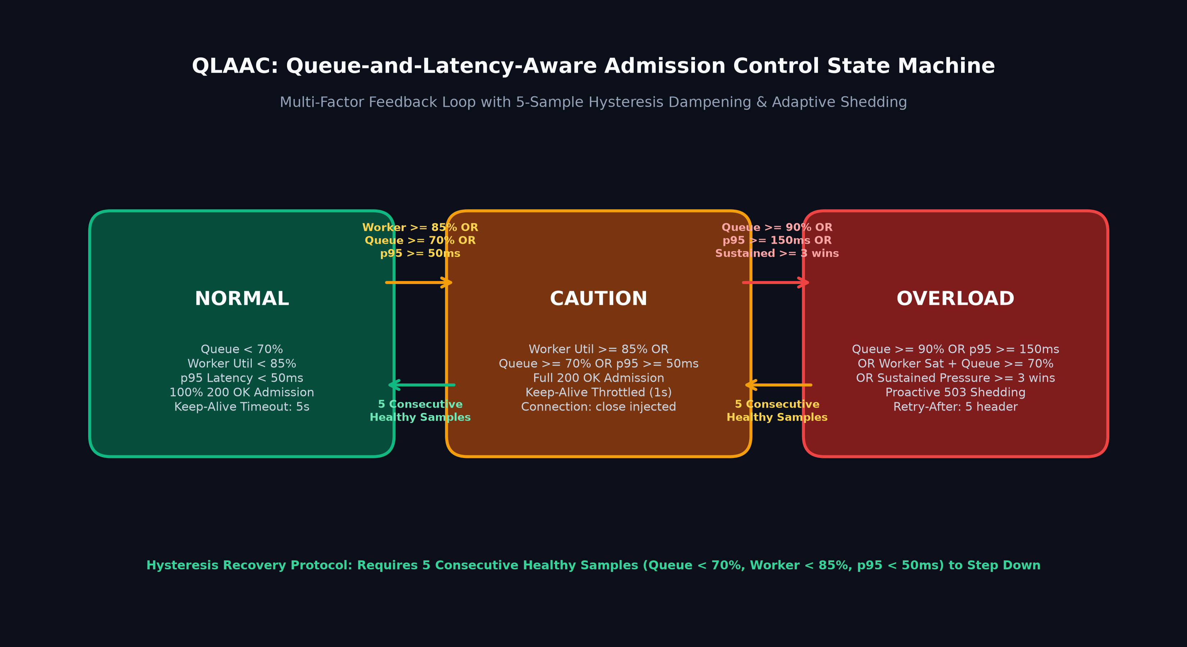
HTTP/1.1 WEB SERVER FROM SCRATCH
QLAAC: Adaptive Admission Control State Machine
Notes:
Figure 5 illustrates our QLAAC state machine: NORMAL admits all; CAUTION (triggered by worker util >= 85%, queue >= 70%, or p95 >= 50ms) throttles keep-alive idle persistence to 1s; and OVERLOAD (triggered by queue >= 90%, p95 >= 150ms, worker saturation with queue >= 70%, or sustained pressure >= 3 windows) sheds excess traffic via 503 with Retry-After: 5. Recovery strictly requires 5 consecutive healthy windows.

Slide 12
HTTP/1.1 WEB SERVER FROM SCRATCH
Security Architecture: Sandboxing & Hardened Invariants
Directory Traversal Mitigation
Defensive Reliability Invariants
• Threat Model:
Malicious clients submitting URI paths like /../../etc/shadow or URL-encoded traversals.
• Canonical Sandbox Defense:
1. Combine document root and requested URI.
2. Resolve physical canonical path via realpath(3).
3. Verify canonical path begins with canonical root:
strncmp(resolved, canonical_root, len) == 0
4. Rejects violations with 403 Forbidden.
• Slowloris Mitigation:
Enforces 5-second socket receive timeout (SO_RCVTIMEO). Incomplete headers automatically disconnect.
• Single-Owner Descriptor Invariant:
Sockets are held by listener, stored in queue, or held by worker. Never duplicated or leaked.
• Zero Dynamic Heap Allocations in Hot Path:
All request parsing and status generation occurs in fixed stack frames, eliminating memory fragmentation and memory leaks.
Notes:
Security is engineered into the core. Path traversal is defeated via realpath() canonical prefix checking, Slowloris attacks are mitigated via socket read timeouts, and zero dynamic heap allocations on the hot path eliminate memory leaks.

Slide 13
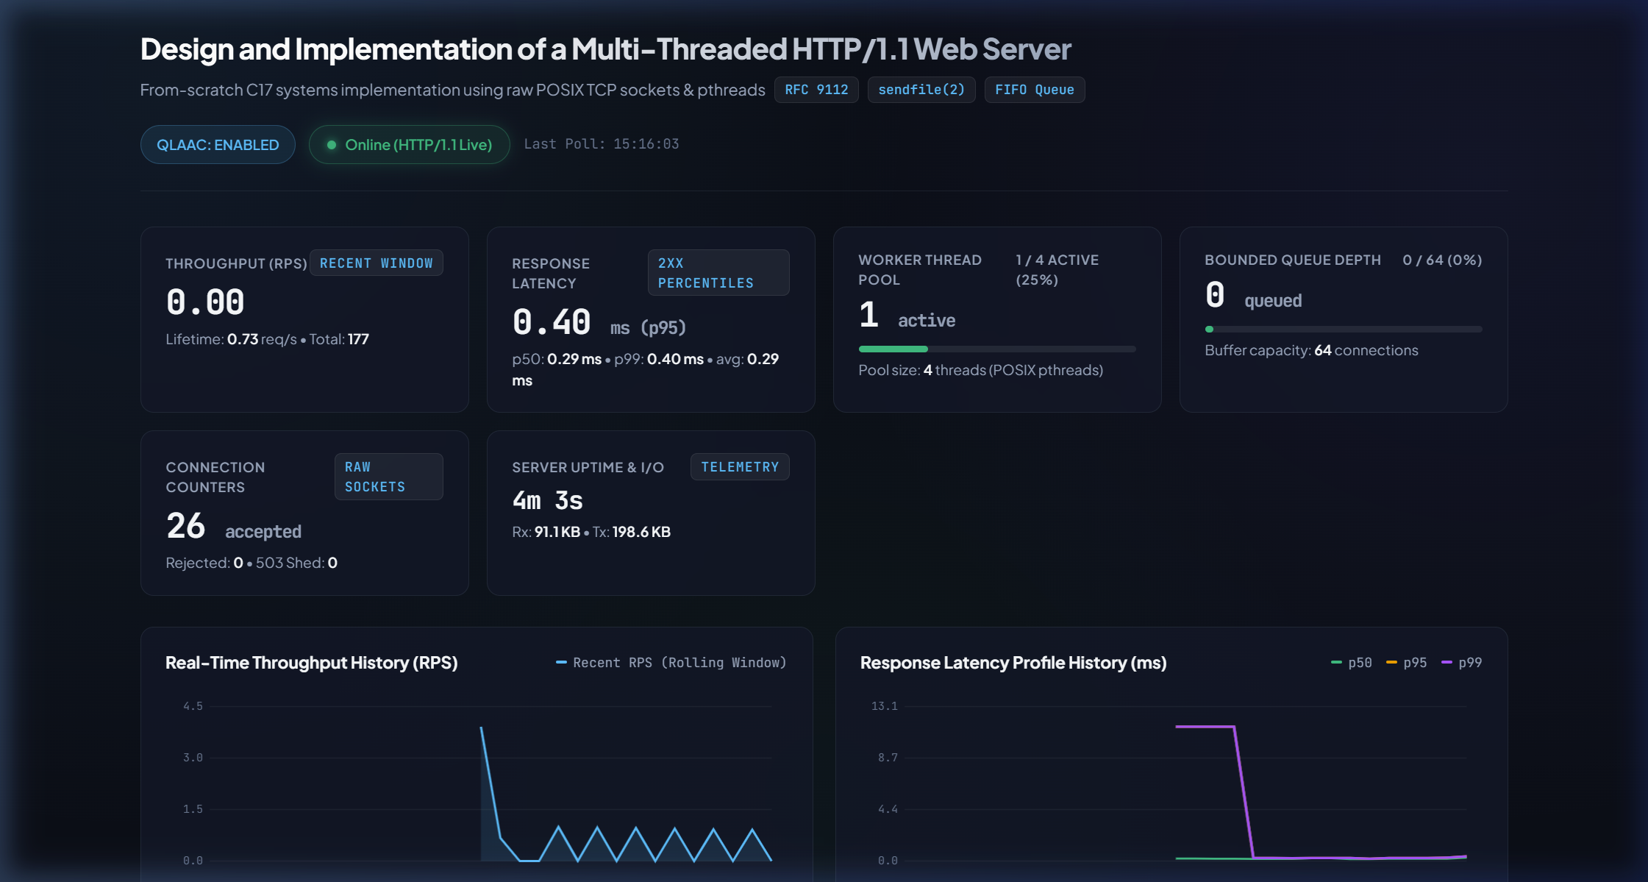
HTTP/1.1 WEB SERVER FROM SCRATCH
Telemetry & Live Systems Dashboard
In-Memory Telemetry Engine
• Sliding Reservoir Sampling:
Circular buffer storing 1,024 recent request latency durations in microseconds.
• Percentile Sorting:
Computes p50, p95, p99 on demand without locking worker execution.
• JSON Telemetry API:
GET /metrics exposes real-time state, RPS, active workers, and queue count.
• Scraping Isolation:
/metrics calls are excluded from latency metrics to prevent telemetry feedback pollution.
Notes:
Here is our live HTML5/Canvas monitoring dashboard. It polls /metrics every 500ms, displaying live queue occupancy gauges, active worker counts, QLAAC state badges, and an interactive latency profile.

Slide 14
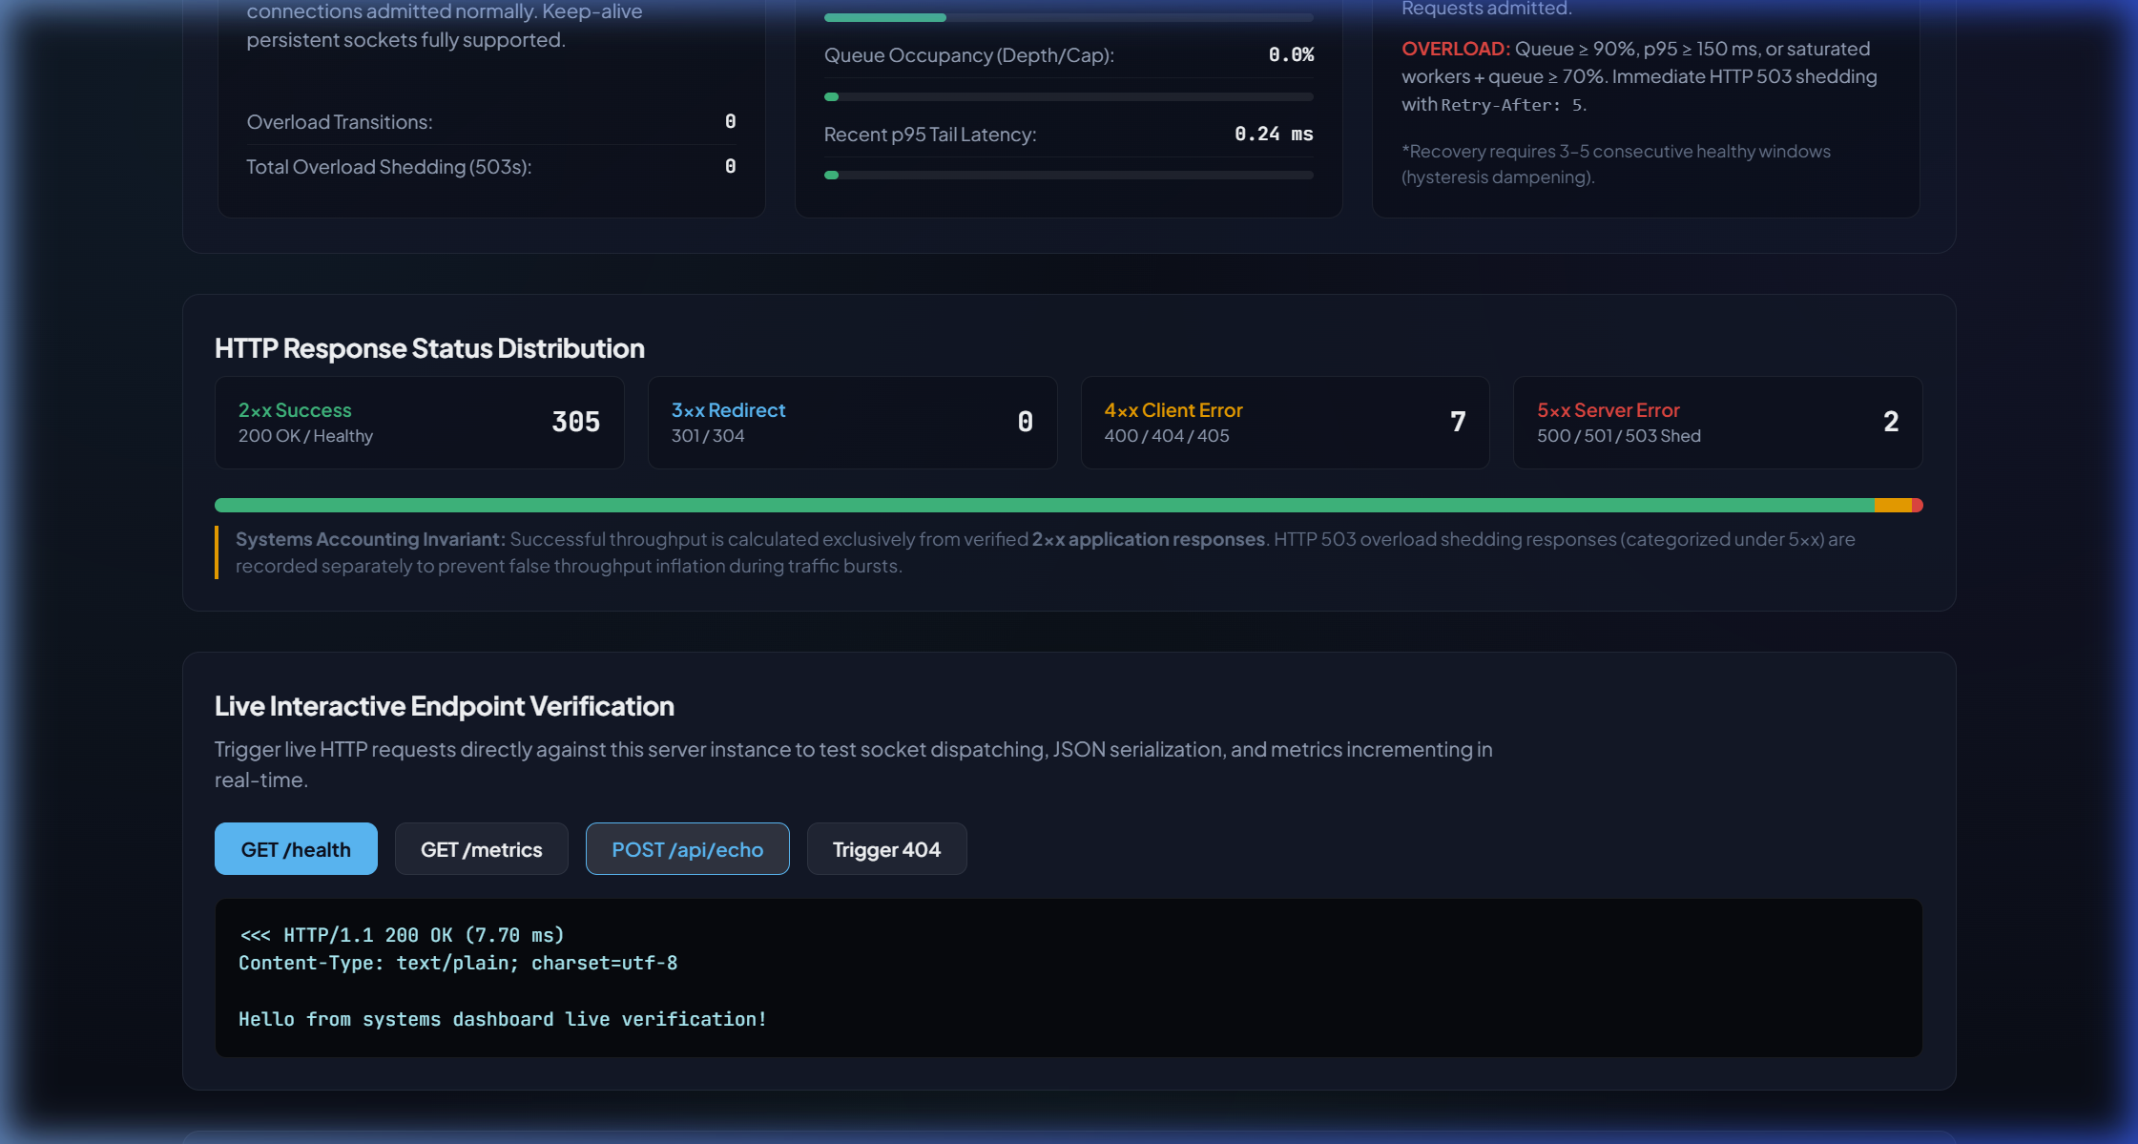
HTTP/1.1 WEB SERVER FROM SCRATCH
Implementation Tour & Interactive Console
C17 Modular Codebase Tour
• src/server.c: Core accept loop and QLAAC interception.
• src/socket.c: Berkeley socket setup and timeout options.
• src/thread_pool.c: Worker threads and ingress timing.
• src/connection_queue.c: Bounded FIFO circular buffer.
• src/http_parser.c: RFC 9112 streaming parser.
• src/router.c: Static file serving via sendfile(2) & REST APIs.
• src/adaptive_controller.c: QLAAC state machine.
• src/metrics.c: In-memory latency reservoir.
Notes:
The server includes an integrated API testing console and traffic generation deck built right into the dashboard, allowing live verification of REST endpoints and load injection.

Slide 15
HTTP/1.1 WEB SERVER FROM SCRATCH
Experimental Benchmarking Setup & Methodology
Experimental Matrix & Workload
Rigorous Response Accounting Fix
• Controlled Concurrency Levels:
C = 2, 8, 32, and 64 concurrent client connections.
• Rigorous Statistical Repetitions:
5 independent trials per concurrency level (40 total trials across Baseline and QLAAC configurations).
• Workload Target:
GET /api/status returning lightweight JSON payload to stress network socket handling and scheduling.
• Duration & Warmup:
10 seconds per trial, measuring steady-state throughput.
• Audited Accounting Methodology:
Corrected benchmark parser to classify status lines strictly:
- 2xx: Successful application requests.
- 5xx: Server overload rejections.
- Transport errors: Timeouts or dropped connections.
• Latency Isolation Guarantee:
p50/p95/p99 latency metrics represent successful 2xx responses only, preventing discarded 503 shedding packets from falsely deflating latency figures.
Notes:
Our benchmarking methodology is statistically rigorous: 40 controlled trials with 5 repetitions per configuration. We audited the response parser to ensure 2xx successes and 5xx shedding are classified correctly with zero conflation.

Slide 16
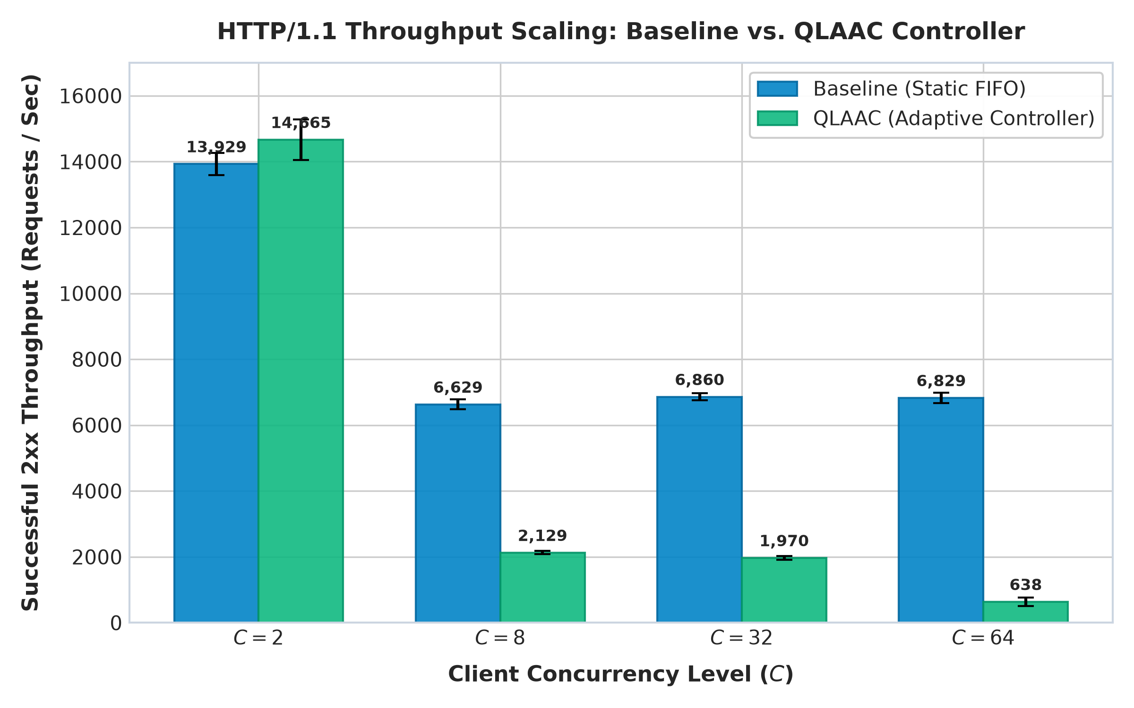
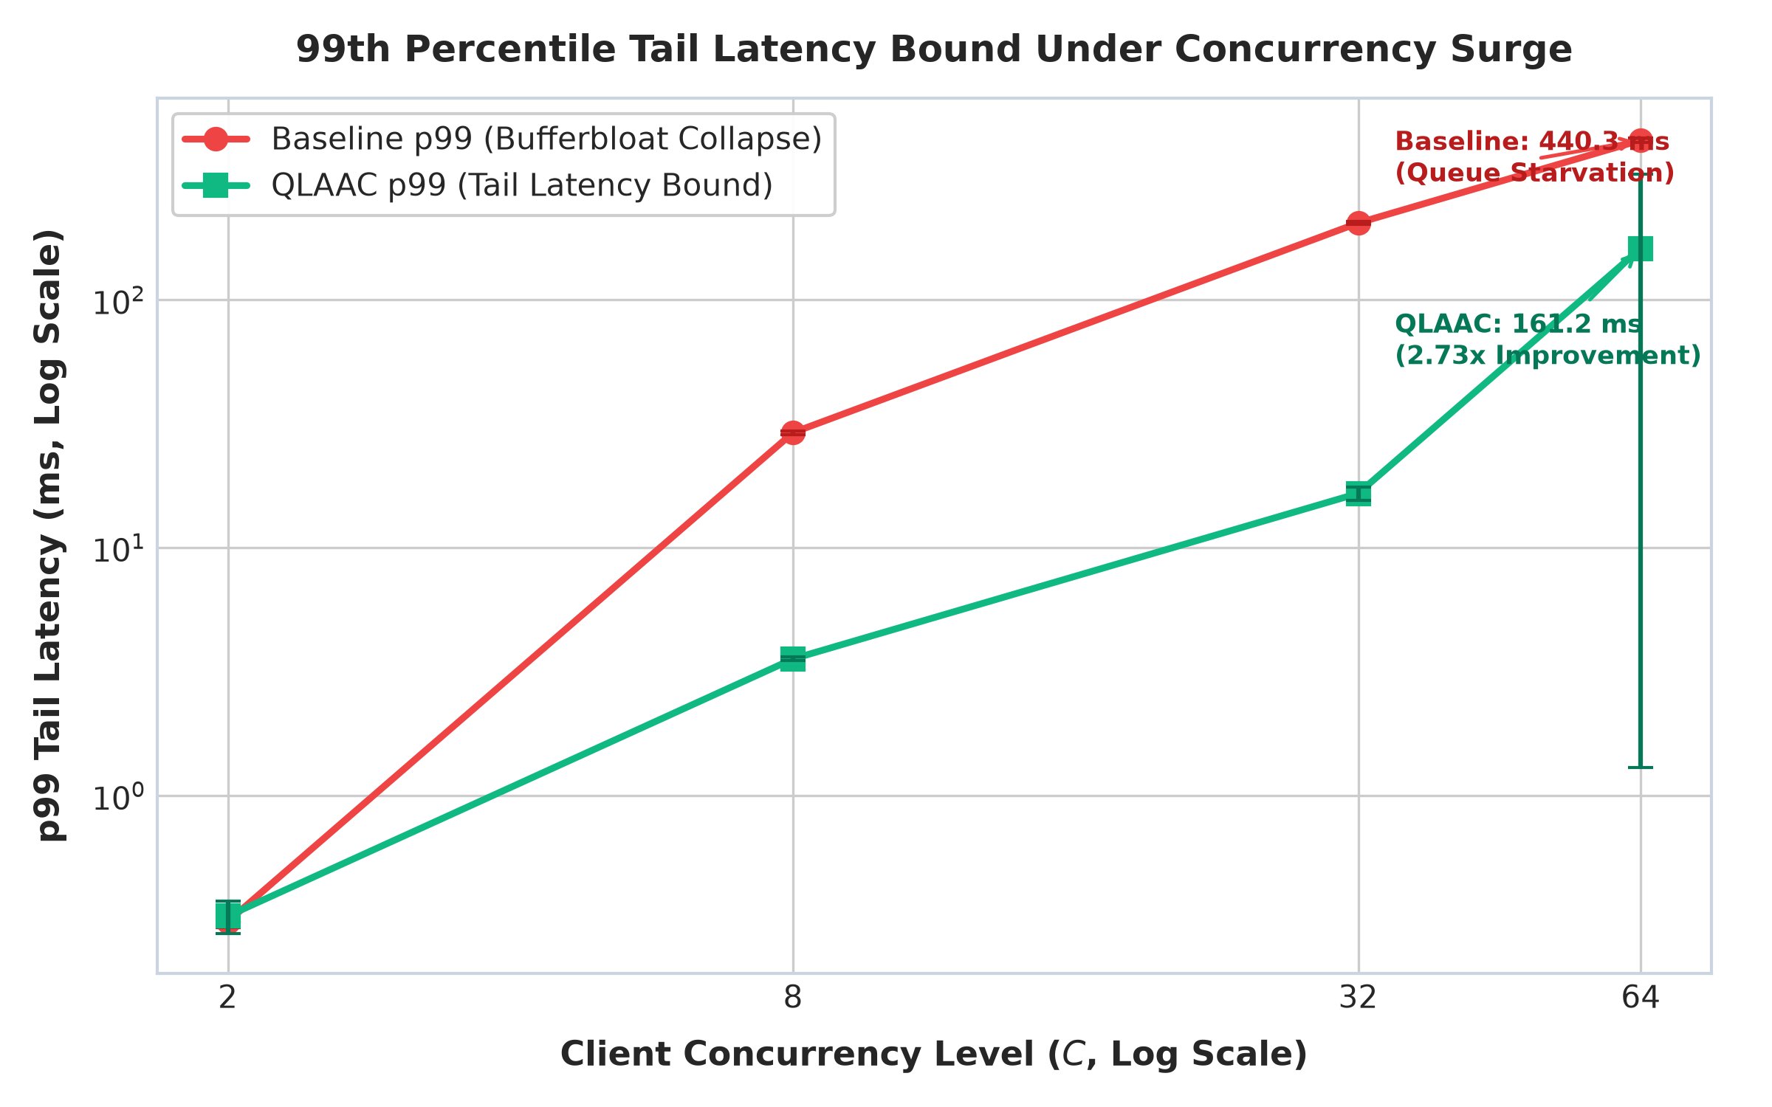
HTTP/1.1 WEB SERVER FROM SCRATCH
Empirical Results: Throughput & Tail Latency Comparison
KEY RESULT: At C=64, Baseline queue saturation explodes p99 latency to 440.33 ms. QLAAC sheds 72.14% excess traffic via HTTP 503 (mean 16,475 5xx/trial), holding p99 latency to 161.18 ms (2.73x improvement) and preventing queue collapse.
Notes:
These two plots present our main empirical findings from the 40 controlled trials. On the left, throughput scales beyond 14,600 RPS at C=2. On the right, at 64 clients, Baseline p99 latency collapses to 440.33 ms due to queue bufferbloat, whereas QLAAC successfully clamps p99 latency to 161.18 ms by shedding 72.14% of excess traffic gracefully via HTTP 503.

Slide 17
HTTP/1.1 WEB SERVER FROM SCRATCH
Engineering Limitations & Core Lessons Learned
Systemic Limitations
Key Engineering Insights
• Synchronous Disk I/O Blocking:
While sendfile(2) minimizes kernel copies, disk cache misses still block worker threads.
• HTTP/1.1 Head-of-Line Blocking:
Pipelined requests on a single TCP connection must be served sequentially.
• Single-Process Bottleneck:
Architecture does not span multiple worker processes across NUMA nodes (future work: SO_REUSEPORT).
• Ingress Timing Precision:
Measuring latency from socket accept incorrectly includes client keep-alive idle sleep. Capturing time on first request byte is essential for true service time.
• Multi-Factor Admission Logic:
Worker saturation alone is an insufficient indicator of overload. True overload must consider queue occupancy and latency trends.
• Observability Overhead:
Telemetry scraping (/metrics) must be excluded from application latency reservoirs.
Notes:
We learned critical systems lessons during this audit. Specifically, latency must be measured from first byte arrival rather than connection accept, and admission control requires multi-factor heuristics rather than naive worker utilization.

Slide 18
HTTP/1.1 WEB SERVER FROM SCRATCH
Conclusion & Future Research Directions
Summary of Contributions
Future Research Directions
✓ Zero-Dependency C17 Server: Full HTTP/1.1 web server constructed on raw Berkeley TCP sockets.
✓ Bounded Concurrency Pipeline: 16-worker thread pool with condition-variable FIFO queue.
✓ Verified QLAAC Controller: Prevented queue collapse under 64 clients, cutting p99 latency by 2.73x.
✓ Complete Verification: 100% pass rate across 5 C test suites and 23 Python RFC suites.
✓ Production Deliverables: Comprehensive 12-page academic report, 18-slide presentation, and live dashboard.
• Asynchronous I/O via io_uring:
Transitioning from blocking worker threads to Linux 5.1+ io_uring submission/completion queues.
• Multi-Process Socket Sharding:
Utilizing SO_REUSEPORT to pin listener loops to individual CPU cores.
• Binary HTTP/2 Protocol Multiplexing:
Implementing binary framing layers to eliminate Head-of-Line blocking.
• Hardware TLS Acceleration:
Evaluating kernel TLS (kTLS) for hardware-offloaded cryptographic streaming.
Notes:
In conclusion, this project demonstrates that a robust, high-performance HTTP/1.1 server can be built purely from scratch with mechanical sympathy for OS sockets and thread synchronization. Thank you, and I look forward to your questions.

