Slide 1
TASK 1
SOLVING PORTSWIGGER LABS

Slide 2
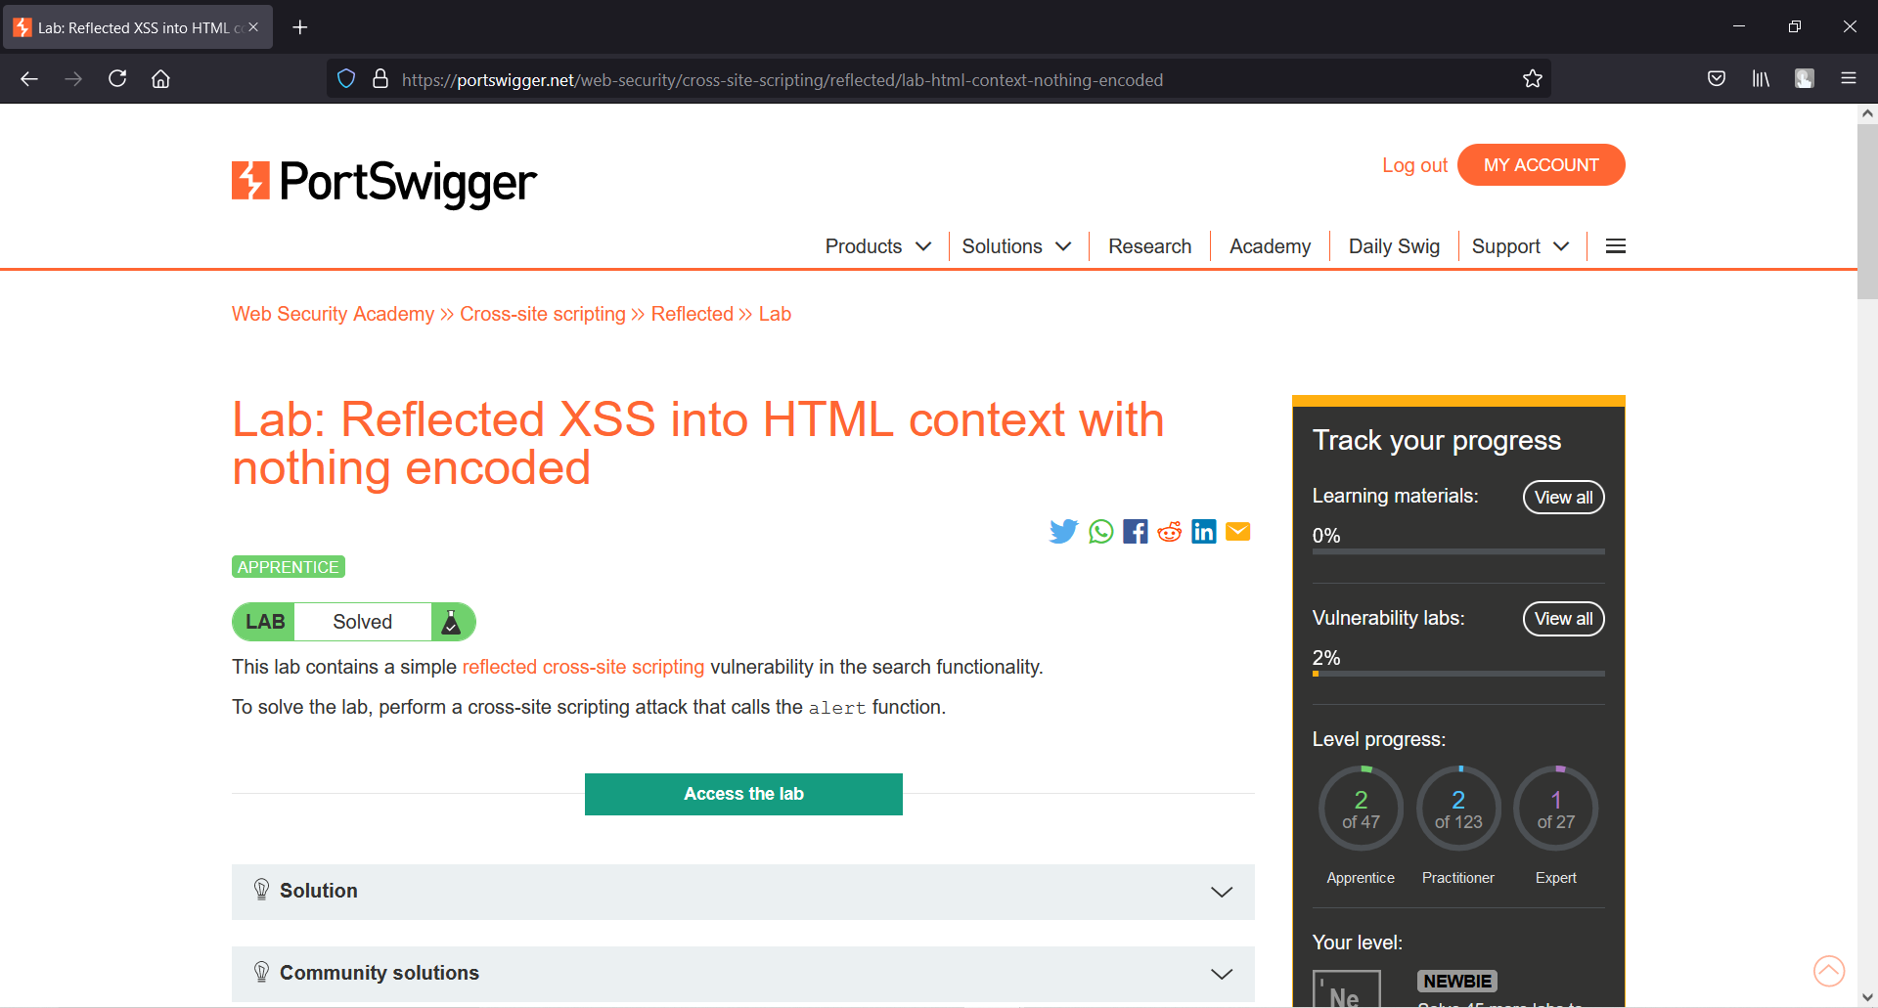
Lab 1:Reflected XSS into HTML context with nothing encoded.

Slide 3
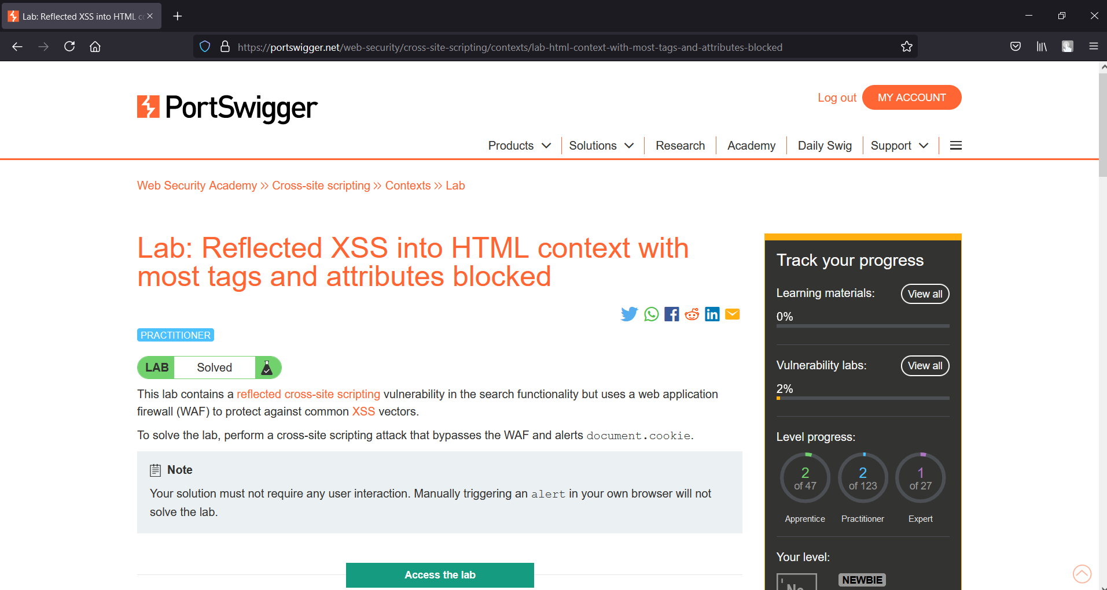
Lab 2: Reflected XSS into HTML context with most tags and attributes blocked.

Slide 4
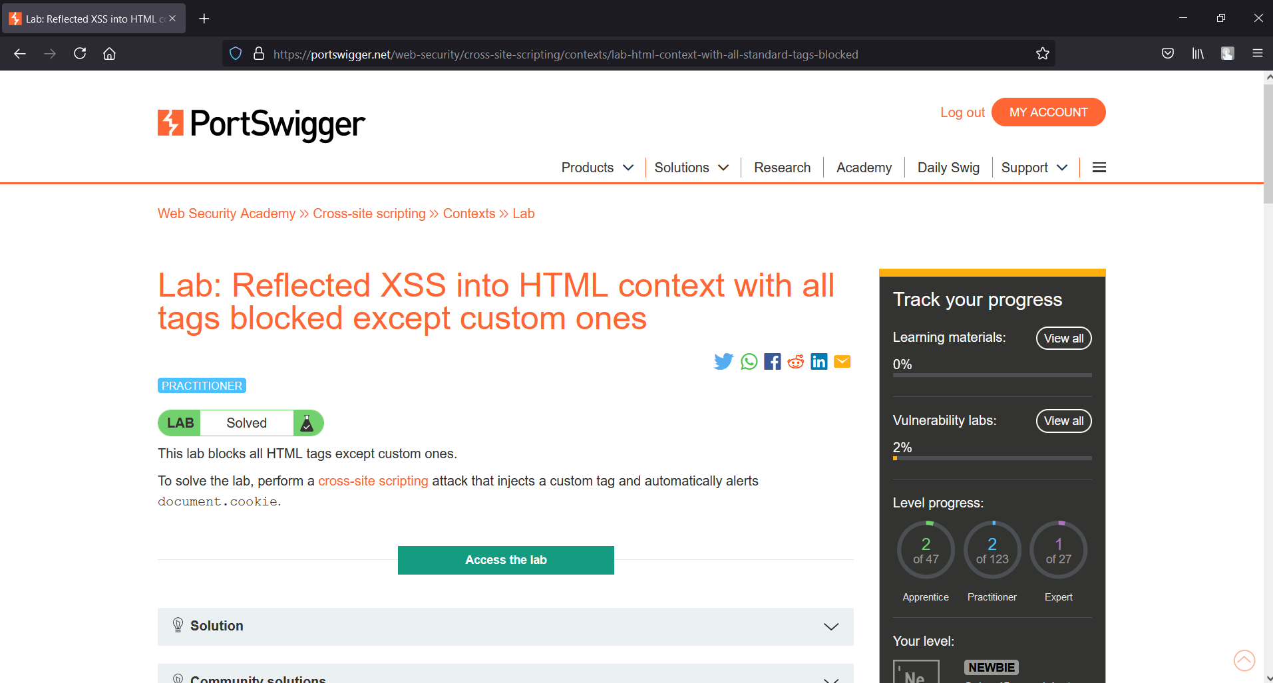
Lab 3: Reflected XSS into HTML context with all tags blocked except custom ones.

Slide 5
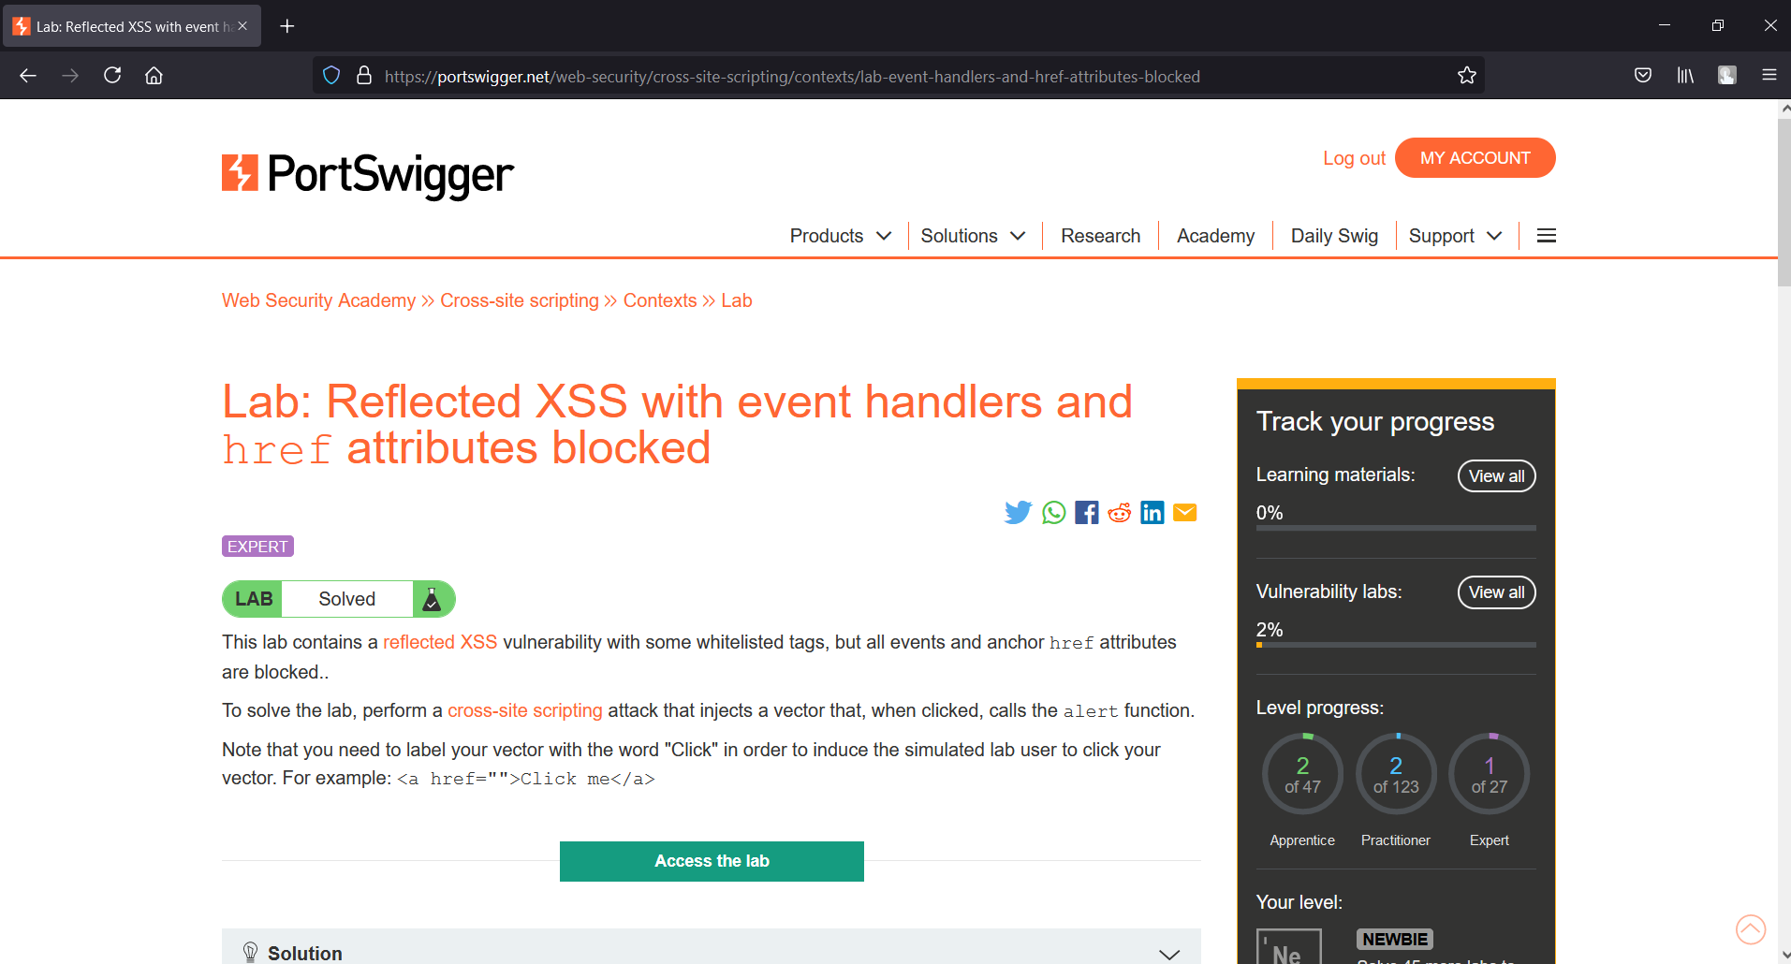
Lab 4: Reflected XSS with event handlers and href attributes blocked.

Slide 6
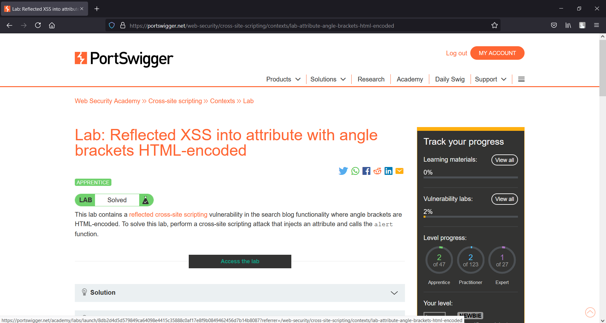
Lab 5: Reflected XSS into attribute with angle brackets HTML-encoded.

Slide 7
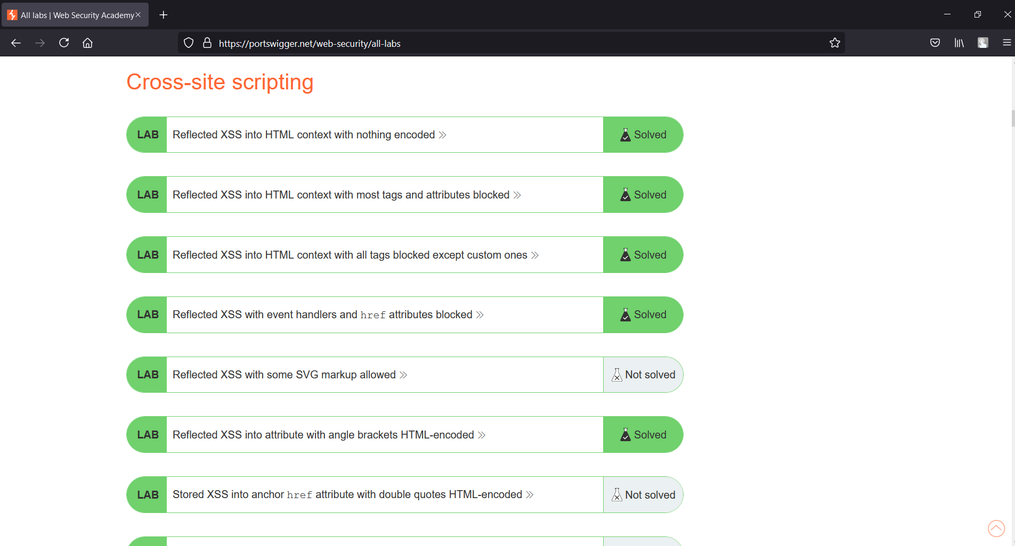
TASK 1 COMPLETED

