Slide 1
TASK 2
FINDING VULNERABILITIES USING
NETSPARKER

Slide 2
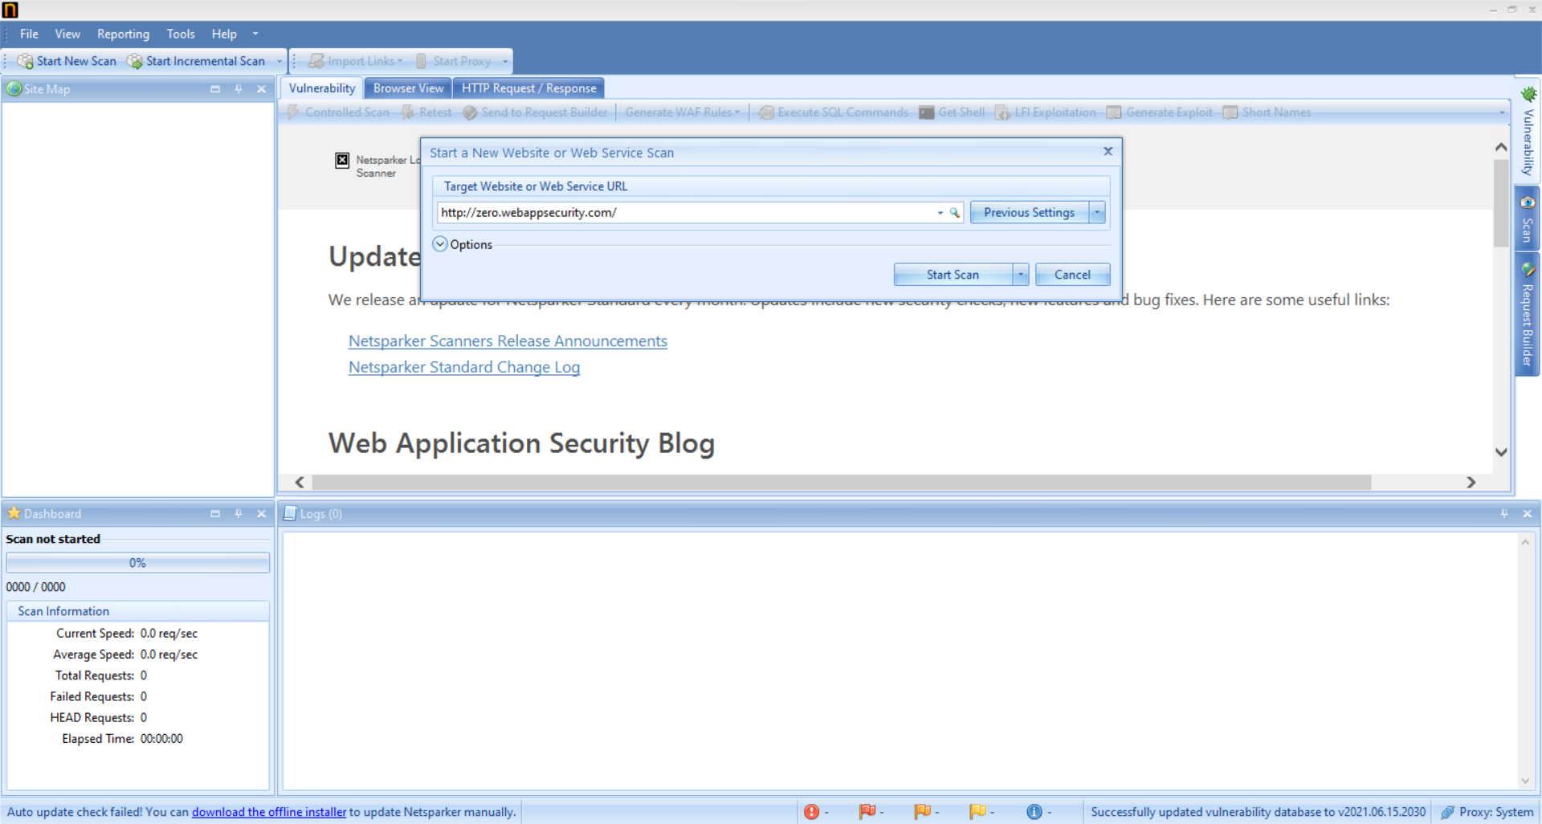
Before Scan

Slide 3
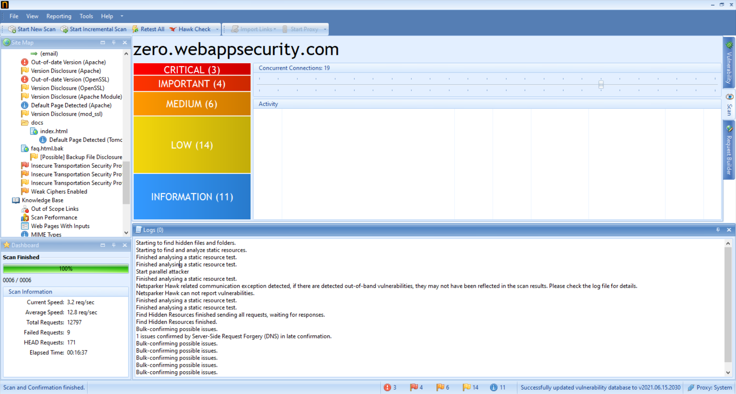
Scan completed

Slide 4
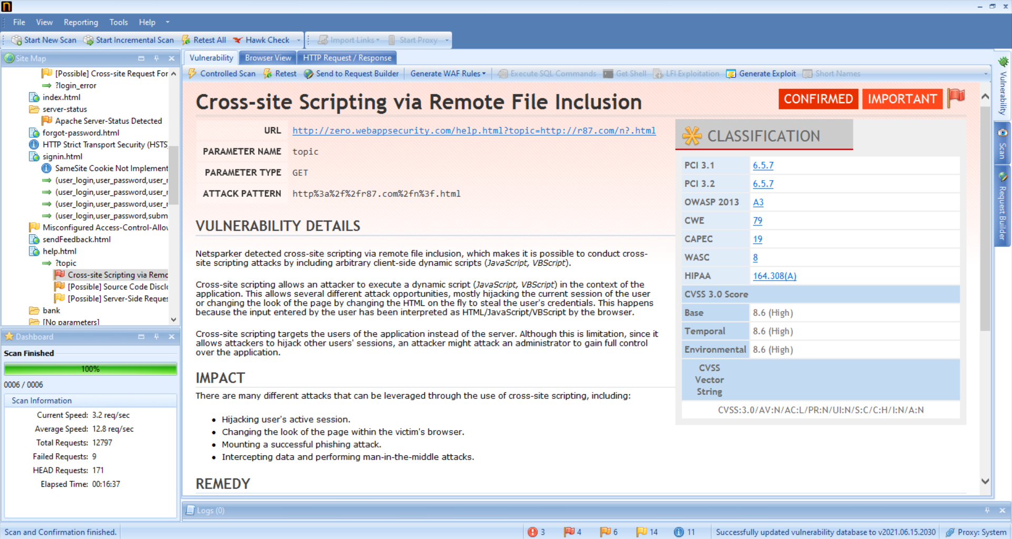
Netsparker generated report for one of the critical vulnerability

Slide 5
Writing a Report for a critical vulnerability found in http://zero.webappsecurity.com/ using Netsparker.
Step 1: Launch Netsparker.
Step 2: Start scanning for vulnerabilities in Netsparker for the domain http://zero.webappsecurity.com/
One of the critical vulnerability found is Cross-site scripting via remote file inclusion.
Vulnerability Details:
Netsparker detected cross-site scripting as a critical vulnerability which makes it possible to perform cross-site scripting attacks.
This allows several different attacking opportunities like changing the look of the page by altering HTML to steal user details and passwords.
Cross-site scripting targets users of the application instead of servers.
Since it allows attackers to attack user’s sessions, he might also attack an administrator to gain full access of the application.

Slide 6
Impact:
An attacker can Intercept data and perform Man-in-the-middle attack.
An attacker can Modify the look of the page within victim’s browser.
Can Perform a successful Phishing attack.
Solution:
To avoid this, all input and output from the application must be filtered. Output should be filtered according to the format and location.
Where the output is HTML, ensure all active content is removed prior to its presentation to the server.
Solution reference: https://owasp.org/www-project-antisamy/

Slide 7
TASK 2 COMPLETED

