Slide 1
TASK 3
Finding vulnerabilities in testasp.vulnweb.com

Slide 2
REPORT
Cross-site Scripting(XSS) in testasp.vulnweb.com
Reported to : InternshipStudio
Reported at : 3rd November 2021
Domain : Vulnweb.com
Subdomain : testasp.vulnweb.com
Weakness : Cross-site Scripting(XSS)
Summary:
The website testasp.vulnweb.com is found to be vulnerable to Cross-site scripting(XSS). As per OWASP's definition: "Cross-Site Scripting (XSS) attacks are a type of injection, in which malicious scripts are injected into otherwise benign and trusted websites. “
This happens because one of the GET parameters "p" does not properly sanitize/escape user input, allowing an injection to occur.

Slide 3
Steps to reproduce :
Visit http://testasp.vulnweb.com/ .
On the menu you will find search option.
By clicking on that you will be prompted by a search box.
In the search box type the XSS payload and press enter.
The payload we used is <script>alert(/NOTPROTECTED/)</script>
Impact :
In an application holding sensitive information like banking details ,credit card details ,E-mail the impact will be serious as the attacker can gain these information.
Attackers often steal session cookies in the browser to hijack user accounts. This allows attackers to take over the victim's session and access any functionality or sensitive information on their behalf.

Slide 4
Mitigation :
In the future ,to prevent the website to be vulnerable to Cross-site scripting they can do the following:
Encoding data on Output.
Using appropriate Response headers.
Implementing Input Validation.
They can also use Content Security Policy (CSP) to reduce the severity of any XSS vulnerabilities that still occur.
Screenshots and POC has been included:

Slide 5
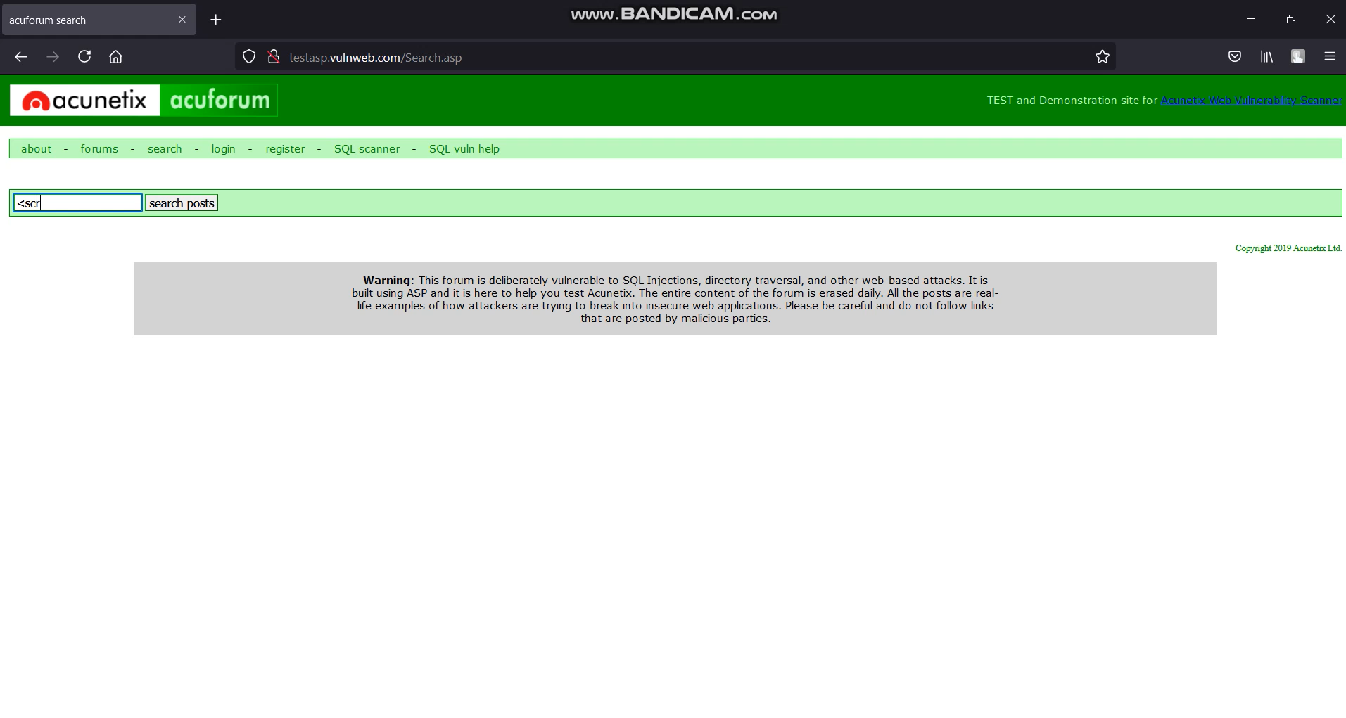
Website:

Slide 6
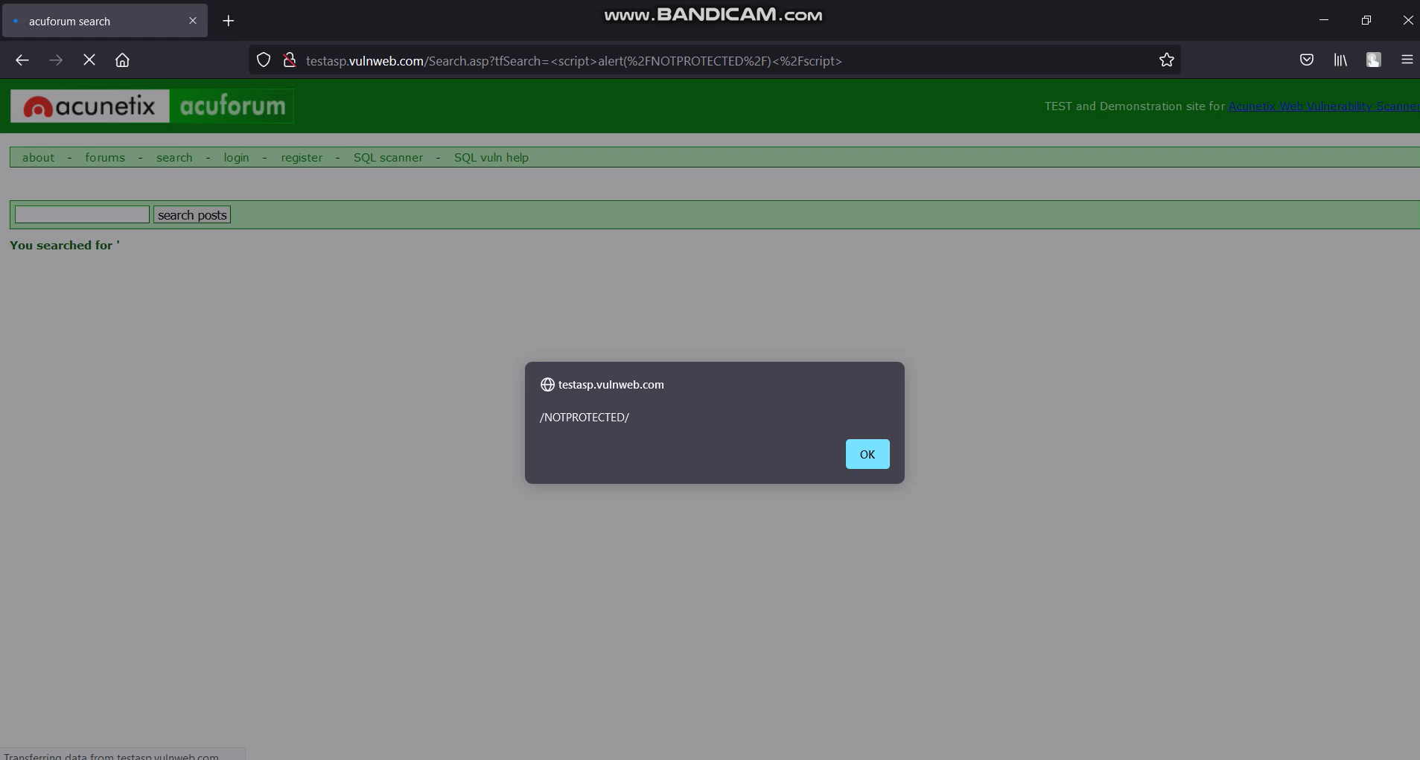
After Cross-site scripting:

Slide 7
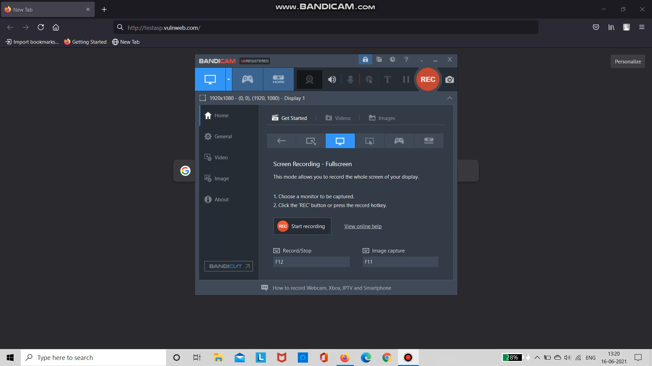
POC video:

Slide 8
TASK 3 COMPLETED

