Slide 1
Chatty
Prompt
Understanding tone
Follow up ticket
Agent callback
Waiting time
Personality bot
“Do you mean”
Language
Auto-complete
Emoji
Keep track of previous case
Predict & suggest
Better recommendation
Proactive

Slide 2
Multiple prompts to narrow down user
problem

Slide 3
Chatty
x
Hi, John
Can I get free shipping where I live ?
May I know this is referring to which product ?
GO Shop Primada Cooker
I see. May I know where is the shipping address ?

Slide 4
Empathizing tone

Slide 5
Chatty
x
Hi, John
What happened AEC is down
Sorry John, we are currently experiencing some difficulty
I paid for this. Such bad service
We truly understand that. We are trying our hardest to fix the issue.

Slide 6
Follow-up ticket

Slide 7
Chatty
x
Hi, John
What happened AEC is down
Sorry we can’t fix that right now. Here is your ticket number 8000011
John, you can keep track of the progress using the ticket

Slide 8
Agent callback

Slide 9
Chatty
x
Hi, John
Can I talk to a live agent ?
All our agents are busy at the moment. Do you want us to call you back ?
YES
NO

Slide 10
Chatty
x
Hi, John
We have fixed the billing issue. You will be refunded next month
Thanks

Slide 11
Display agent waiting
time

Slide 12
Chatty
x
Hi, John
Can I talk to a live agent ?
Yes. Please wait while we route you to our agents
Estimated wait time 1 min

Slide 13
Personality bot

Slide 14
Chatty
x
Hi, John
How’s your day ?
How much do I owe ?
Let me get that for you
It will be great if you can give me you acc no
8000033

Slide 15
“Do you mean”

Slide 16
Chatty
x
Hi, John
Can you get my circle point ?
Are you talking about
Astro Circle
PVR circle button

Slide 17
Chatty
x
Hi, John
Can you get my circle point ?
Are you talking about
Astro Circle
PVR circle button
Astro Circle
1000 pts

Slide 18
Preferred language

Slide 19
Chatty
x
Hi, John
Nak bayar bil saya
Can you provide your acc no ?
Boleh bagi nombor akaun ?
8000033
Terima kasih. Nak bayar sekarang ?

Slide 20
Auto-complete support

Slide 21
Chatty
x
Hi, John
How do I fix b
broken channel
bill problem

Slide 22
Chatty
x
Hi, John
How do I fix b
broken channel
bill problem

Slide 23
Chatty
x
Hi, John
How do I fix broken channel ?
May I know which channel is that ?

Slide 24
Emoji support

Slide 25


Chatty
x
Hi, John
How to pay my bill ?
Sorry I dont understand that

Slide 26
Keep track of previous interaction

Slide 27
Chatty
x
Hi, John
Any progress on my package change ?
John you are refering to Super Pack upgrade right ?
Yes
It will be completed in 2 days time

Slide 28
Predict & suggest

Slide 29
Chatty
x
Hi, John
I see you have a delivery, Primada Cooker that will be arriving in 3 days time
Bill
You have outstanding RM88.00 bill due on 1/2/2018

Slide 30
Better recommendation

Slide 31
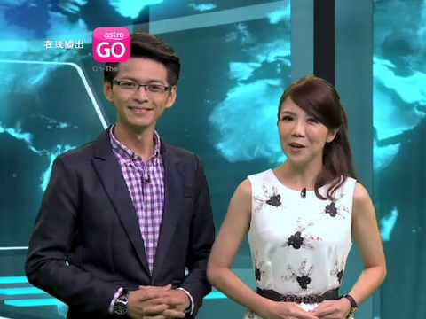

Chatty
x
Hi, John
I am bored. Any shows on right now ?
You might like these shows:

Slide 32
Proactiveness

Slide 33
Chatty
x
Hi, John
How to register Astro ID ?
https://login.astro.com.my/ssowebnx/login.aspx?pid=acm
5 minutes ago
John, did you managed to create your Astro ID ?

