Slide 1
Project Title: Agentic RAG Chatbot with MCP
👤 Author: Jinil Patel
Introduction:
Agentic RAG Chatbot with MCP is an advanced AI-powered question-answering system that allows users to upload and interact with multiple document types like PDFs, DOCX, PPTX, CSVs, and Markdown files. Built on a modular, agent-based architecture, the system employs specialized agents for tasks like ingestion, retrieval, and response generation — all coordinated through a Model Context Protocol (MCP)-like messaging system. This design enables accurate, context-aware answers grounded in retrieved document content, reducing hallucinations and ensuring source traceability. With a FastAPI backend, ChromaDB vector store, and an intuitive Streamlit frontend, the chatbot is both powerful and easy to use.

Slide 2
Modular Agent Architecture
Specialized Agents (each with a dedicated role):
Ingestion Agent: Handles file uploads
Text Extraction: Reads and extracts text from .pdf, .docx, .csv, etc.
Processing: Chunks text for effective embedding
Embedding Agent: Generates vector embeddings from chunks
Retrieval Agent: Searches vector DB for relevant context
LLM Response Agent: Generates answers using retrieved context
Coordinator Agent: Orchestrates workflow & message passing
MCP (Model Context Protocol) Integration:
Structured messaging between agents

Slide 3
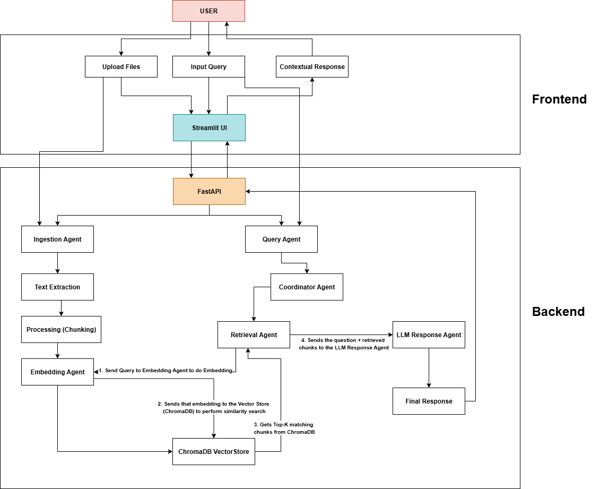
Project Workflow Architecture

Slide 4
How It Works:
Ingestion Flow (Document Understanding)
User uploads documents via the Streamlit UI
IngestionAgent triggers the pipeline
TextExtractor reads content from files (PDF, DOCX, CSV, etc.)
TextProcessor chunks the text into smaller segments
EmbeddingAgent converts chunks into vector embeddings
Vectors are stored in ChromaDB with metadata
Query Flow (Answer Generation)
User submits a question via the chat UI
CoordinatorAgent receives and orchestrates the request
RetrievalAgent is tasked to fetch relevant chunks:
Calls EmbeddingAgent to embed the query
Searches ChromaDB for Top-K matching chunks
Retrieved context is passed to LLMResponseAgent
LLM prompt is crafted and sent to Mistral (via OpenRouter)
Response is generated and sent back through the agents to the UI

Slide 5
Tech Stack
Category | Technology / Tool | Purpose
AI & NLP | Mistral 7B (via OpenRouter) | LLM for final answer generation
 | HuggingFace Transformers (MiniLM) | Sentence embeddings for chunk/query
 | LangChain | Building Agents
Vector Store | ChromaDB | Persistent storage and similarity search
Backend | FastAPI | Backend API for agent orchestration
 | Uvicorn | ASGI server to serve FastAPI
 | Pydantic | Data validation and parsing
 | python-dotenv | Load API keys and env variables
Agent System | Custom Agents (Retrieval, LLMResponse, etc.) | Modular task-specific logic
 | MCP-like Messaging | Structured communication between agents
Frontend (UI) | Streamlit | Web UI for upload, chat, and output
 | Requests (Python) | Communicates with FastAPI backend
File Parsing | PyMuPDF, python-docx, csv, pandas, python-pptx | Extract text from multi-format documents
Storage | data/ directory | Temporarily stores uploaded files
 | vectorstore/ directory | Stores ChromaDB data
Dev & Utilities | Logging (logger.py) | Debugging and event tracking
 | CustomException (exception.py) | Custom error handling
 | venv, requirements.txt | Dependency and environment management

Slide 6
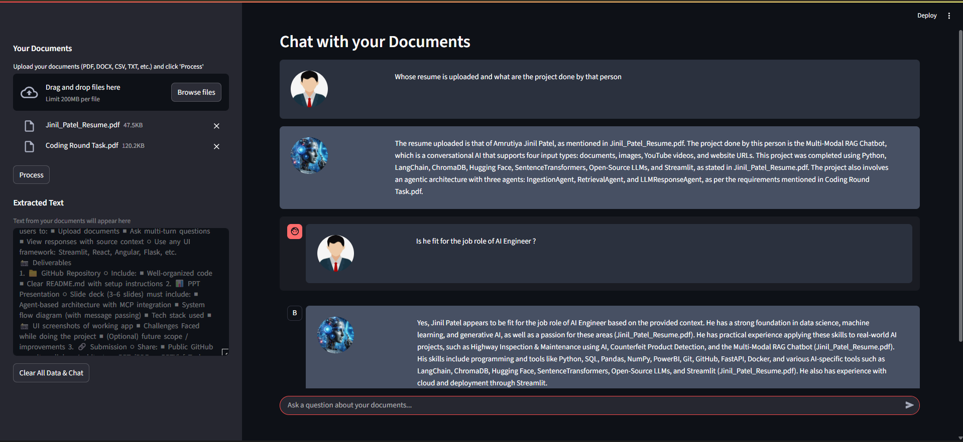
Output

Slide 7
Challenges Faced
ModuleNotFoundError
moments While stitching different agents together, I frequently ran into ModuleNotFoundError especially due to nested directories like src/agents not being recognized. I resolved this by correctly adding __init__.py, setup.py files and ensuring relative imports were clean and consistent.
Mysterious errors during development
At times, things just didn’t work—no clear error, just silence or broken output. I leaned heavily on ChatGPT, LangChain documentation, and small test scripts to debug issues around chunking, prompt formatting, and embedding injection.
Making responses truly contextual
Initially, answers from the LLM were generic—even though retrieval worked. I realized the issue was in how I crafted the prompt. I rewrote the LLMResponseAgent to clearly instruct the LLM to use only the provided context. This led to significantly more grounded and accurate answers.

Slide 8
Learnings from Challenges
These challenges not only tested my technical skills but also taught me the importance of attention to detail, creative problem-solving, and effective collaboration. By overcoming these hurdles, I was able to develop a robust and accurate chatbot that can provide valuable insights to users.

