Slide 1
House Price Prediction
Meenakshi Satpathy

Slide 2
AGENDA
Data Overview
Data Preprocessing
Features Extraction
Training Models
Predictions
Conclusion

Slide 3
Data Overview
Kaggle dataset for prediction sale price of house.
It had two datasets :train and test
It has 79 features and a target present only in train dataset.
There were many missing values and most of the features were actually None to show the absence of particular feature. For ex:-PoolQC had null value indicating absence of Pool.
There were some suspicious outliers which were removed from the dataset.

Slide 4
Data Preprocessing
Analysis of Target Variable
Analysis of Features
Handling NULL values
Handling Skewness

Slide 5
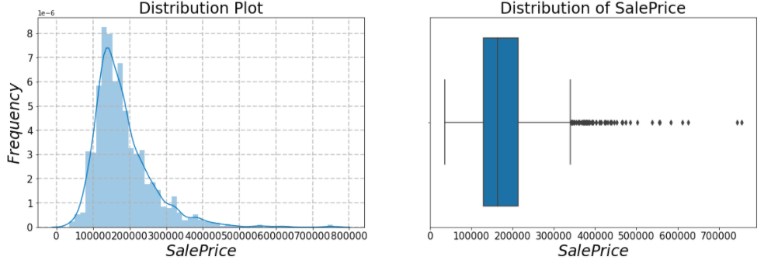
Target Variable
Target variable i.e. SalePrice is rightly skewed indicating presence of outliers. Hence removed outliers with SalePrice>700000.

Slide 6
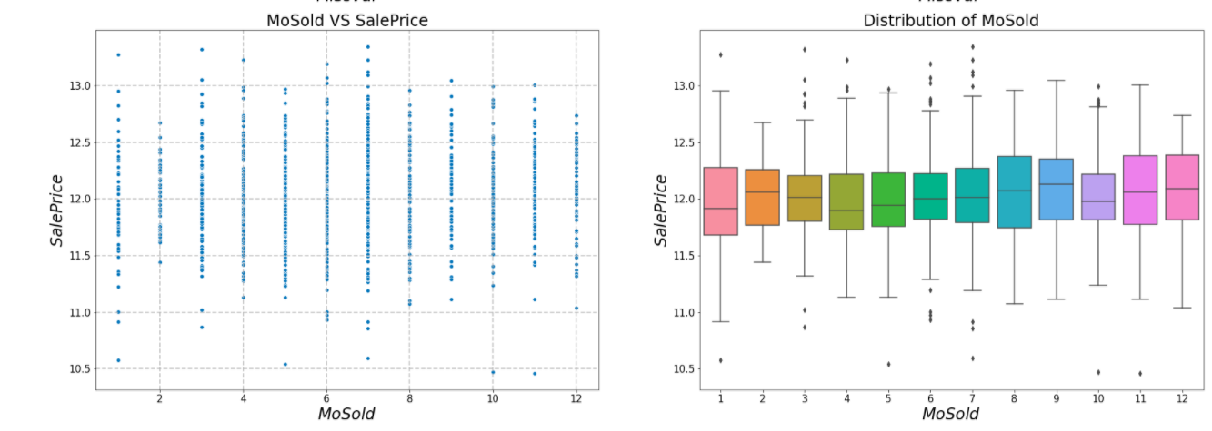
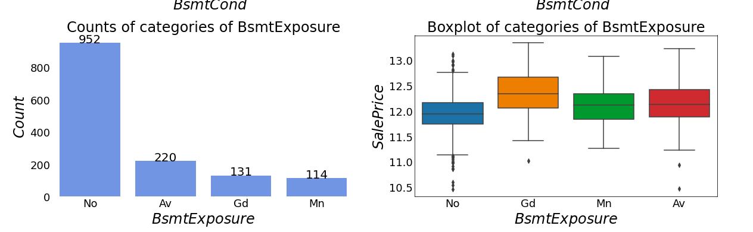
Features
Numerical Columns
Categorical Columns
The above graphs show scatter plot and boxplot of each Numerical columns Vs Target to understand the distribution of data and identifying suspicious outliers.
The above graphs show bar plot(counts of each category) and boxplot of each Categorical columns Vs Target to understand the distribution of data and the counts of each category.

Slide 7
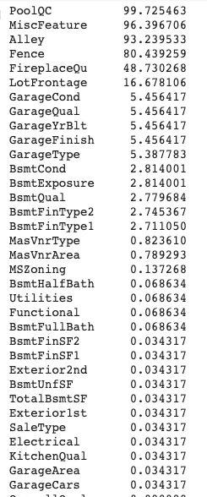
NULL Values
The Null Values in the mentioned columns, PoolQC,MiscFeature, Alley, Fence,FireplaceQu, GarageType, GarageQual, GarageCond, GarageFinish, BsmtExposure, BsmtFinType2 ,BsmtQual, BsmtCond, BsmtFinType1, and MasVnrType, indicates the absence of those features as described in the data description, hence replaced it by None values.
Categorical columns are mostly handled with mode values.
Numerical columns are mostly filled with 0.
LotFrontage columns was filled using Neigboring feature as the former depends on later.

Slide 8
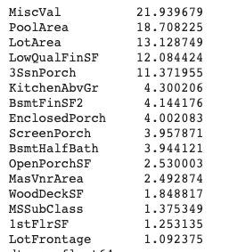
Skewness
Considered skewness more than 1 and less than -1.
There we no negative skewness but had positive skewness in columns
Used Box-Cox transformation because it transform non-normal dependent variables into a normal shape.

Slide 9
Feature Extraction
TotalFloorArea is the combination of all areas i.e TotalBsmtSF and GrLivArea.
HouseQuality is the combination of quality of house i.eOverallQual and OverallCond.
TotalBathrooms is the combination of all full and half bathrooms.
TotalPorchArea is the combination of all porch areas.

Slide 10
Models
Searched hyperparameters using GridSearchCV and implemented LGBMRegressor, XGBoostRegressor, GradientBoostingRegressor, RandomForestRegressor, Ridge Regressor, Support Vector Regressor and StackingCVRegressor.
Evaluated with cross-validation RMSE .
Light GBM: 0.12109867152485046 (0.017484341303571665)
XGBoost: 0.1156612498503222 (0.014304845816744925)
SVR: 0.11110065456632175 (0.01535596280929455)
ridge: 0.11110065456632175 (0.01535596280929455)
Random Forest: 0.1368197439101806 (0.019445978991237907)
GBR: 0.12139228633634447 (0.013056516261514488)

Slide 11
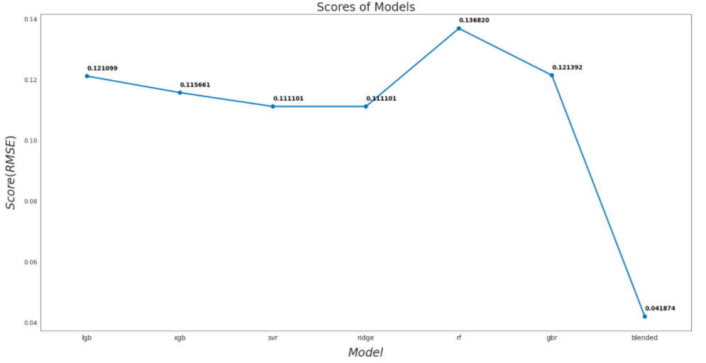
Predictions
Blended predictions from all models to get a better prediction of test dataset and avoid overfitting.
RMSE score on train data: 0.04187
RMSE score on test data: 0.12035

Slide 12
Conclusion
Selecting Hyper parameters using Grid Search CV increased the efficiency of the model.
Using Blending predictions decreased RMSE from 0.15 to 0.12 in test data set.

