Slide 1
NEOSTATS · AI ENGINEER USE CASE ASSIGNMENT
AI-Powered Credit Risk
Intelligence Platform
An end-to-end credit-risk solution on the Home Credit Default Risk dataset — calibrated ML scoring, SHAP explainability, model-derived business rules, and an LLM natural-language → SQL interface, delivered as one interactive application.
307,511
0.763
5
1
APPLICANTS
ROC-AUC
INTEGRATED MODULES
DOCKER COMMAND
Jinisha Leema Rosario AI / ML · Data Science · Generative AI github.com/jinishar/credit_risk

Slide 2
USE CASE & BUSINESS CONTEXT
Credit decisions must be accurate and explainable
Lenders need default-risk assessment that survives credit-committee review, internal audit, and regulatory scrutiny. A single black-box score does not — the decision has to be traceable and usable by non-technical staff.
THE GAP
WHAT THE PLATFORM DELIVERS
— Risk teams need a defensible number and the reasons behind it
— Analysts need readable policy, not model internals
— Business users need to interrogate data without writing SQL
— Calibrated default probability + Low / Medium / High band
— Per-applicant SHAP reason codes
— Human-readable risk rules for analyst review
— Plain-English querying of the applicant data
— One Streamlit app, reproducible via Docker Compose
Credit Risk Intelligence Platform · NeoStats AI Engineer Use Case
02

Slide 3
HOW IT FITS TOGETHER
System architecture
Home Credit dataset · 307K applications · loaded into DuckDB
ML PIPELINE
TALK-TO-DATA PIPELINE
Preprocessing & feature engineering
↓
LightGBM champion + Logistic Regression baseline
↓
Isotonic probability calibration
↓
Risk bands · SHAP explanations · surrogate rules
Schema-grounded prompt context
↓
Gemini NL → SQL generation
↓
Read-only SQL validator (allow-list, row cap)
↓
DuckDB query → business-readable answer
Streamlit UI · packaged with Docker Compose
Credit Risk Intelligence Platform · NeoStats AI Engineer Use Case
03

Slide 4
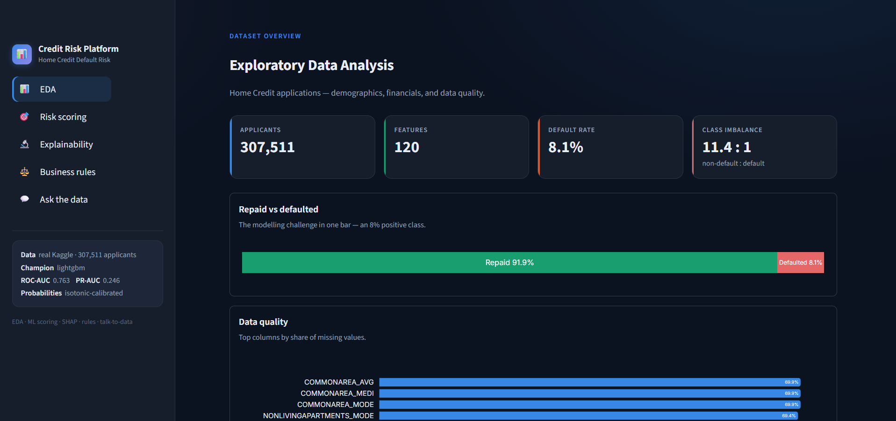
EXPLORATORY DATA ANALYSIS
307K applications, ~8% default — a hard class imbalance
— Imbalance. ~8% positives — ROC-AUC / PR-AUC, not accuracy, drive evaluation
— Missingness. up to ~70% in housing columns; kept as signal, not imputed away
— Anomaly. ~18% of rows carry a ‘not employed’ placeholder → explicit flag
— Every finding is an exploratory association, not a causal claim
Credit Risk Intelligence Platform · NeoStats AI Engineer Use Case
04

Slide 5
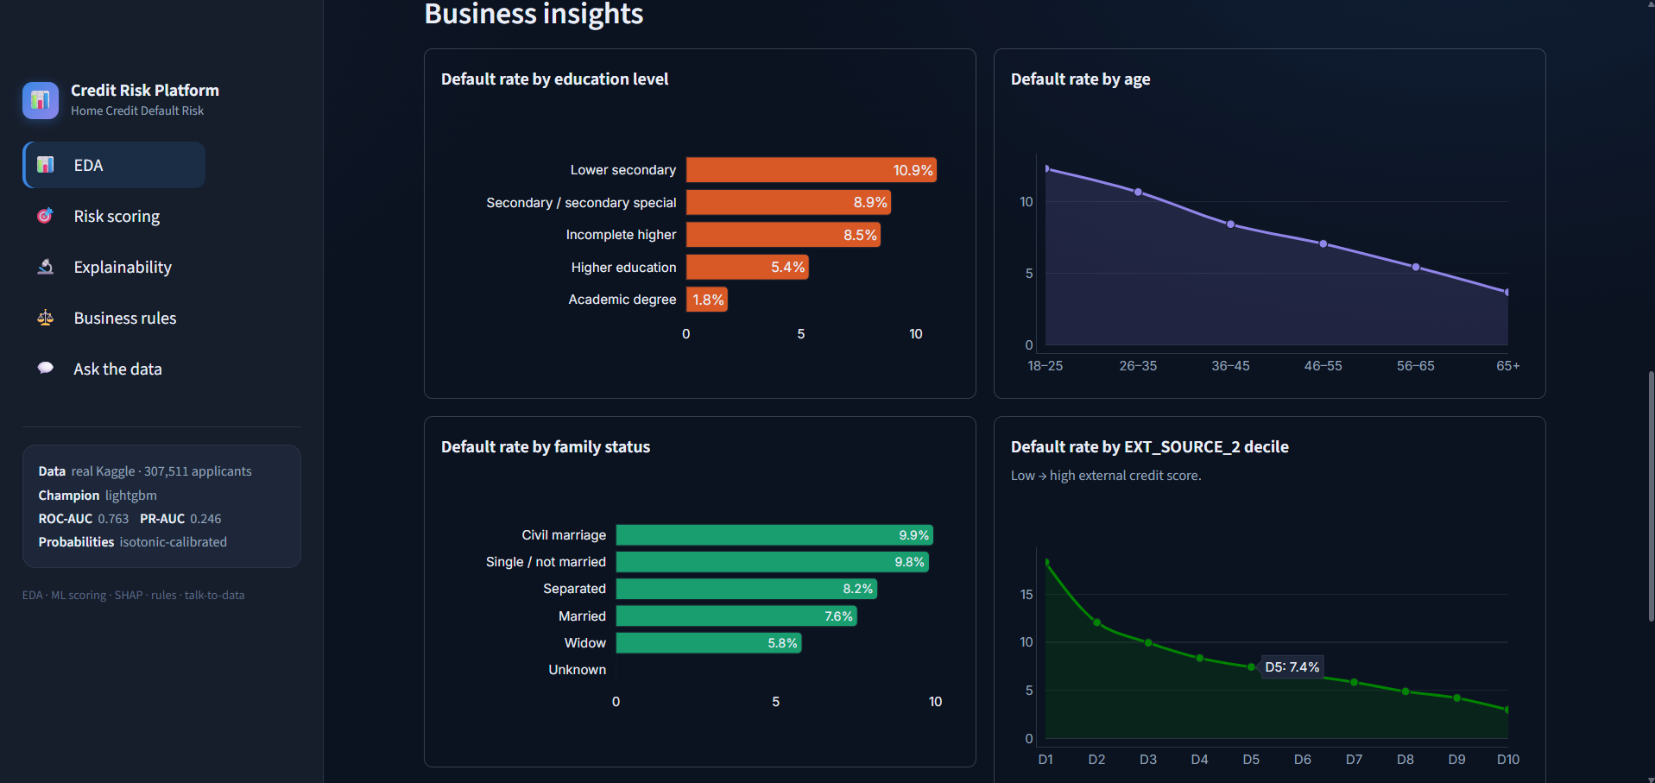
EXPLORATORY DATA ANALYSIS
External credit scores are the strongest default signal
— EXT_SOURCE. 19.9% → 2.6% default across score deciles
— Age. risk falls steadily; 18–25 highest
— Education. 10.9% lower-secondary vs 1.8% academic degree
— Family status and car ownership add smaller, consistent gaps
Credit Risk Intelligence Platform · NeoStats AI Engineer Use Case
05

Slide 6
MACHINE LEARNING
LightGBM champion, calibrated to a real probability
MODEL
ROC-AUC
PR-AUC
Logistic Regression (baseline)
0.750
0.235
LightGBM + isotonic calibration
0.763
0.246
— Class imbalance. at ~8% positives, accuracy misleads — ranking metrics select the model
— Calibration. isotonic regression anchors scores to the true base rate, so a 0.30 reads as ~30%
— Bands. off the calibrated probability — Low < 0.20 · Medium 0.20–0.50 · High ≥ 0.50
— Version-proof scoring. calibrator unwrapped and re-applied explicitly at inference
Validation fold: 61,503 applicants · default prevalence 8.07%
Credit Risk Intelligence Platform · NeoStats AI Engineer Use Case
06

Slide 7
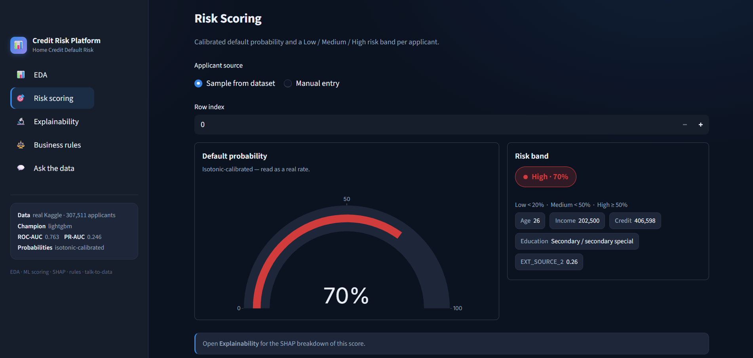
RISK SCORING
A defensible number for every applicant
— Two entry modes. sample a real applicant or enter one manually
— Calibrated gauge. probability shown as a real rate
— Risk band. Low / Medium / High with the driving attributes
— Hand-off. the scored applicant flows into Explainability and Rules
Credit Risk Intelligence Platform · NeoStats AI Engineer Use Case
07

Slide 8
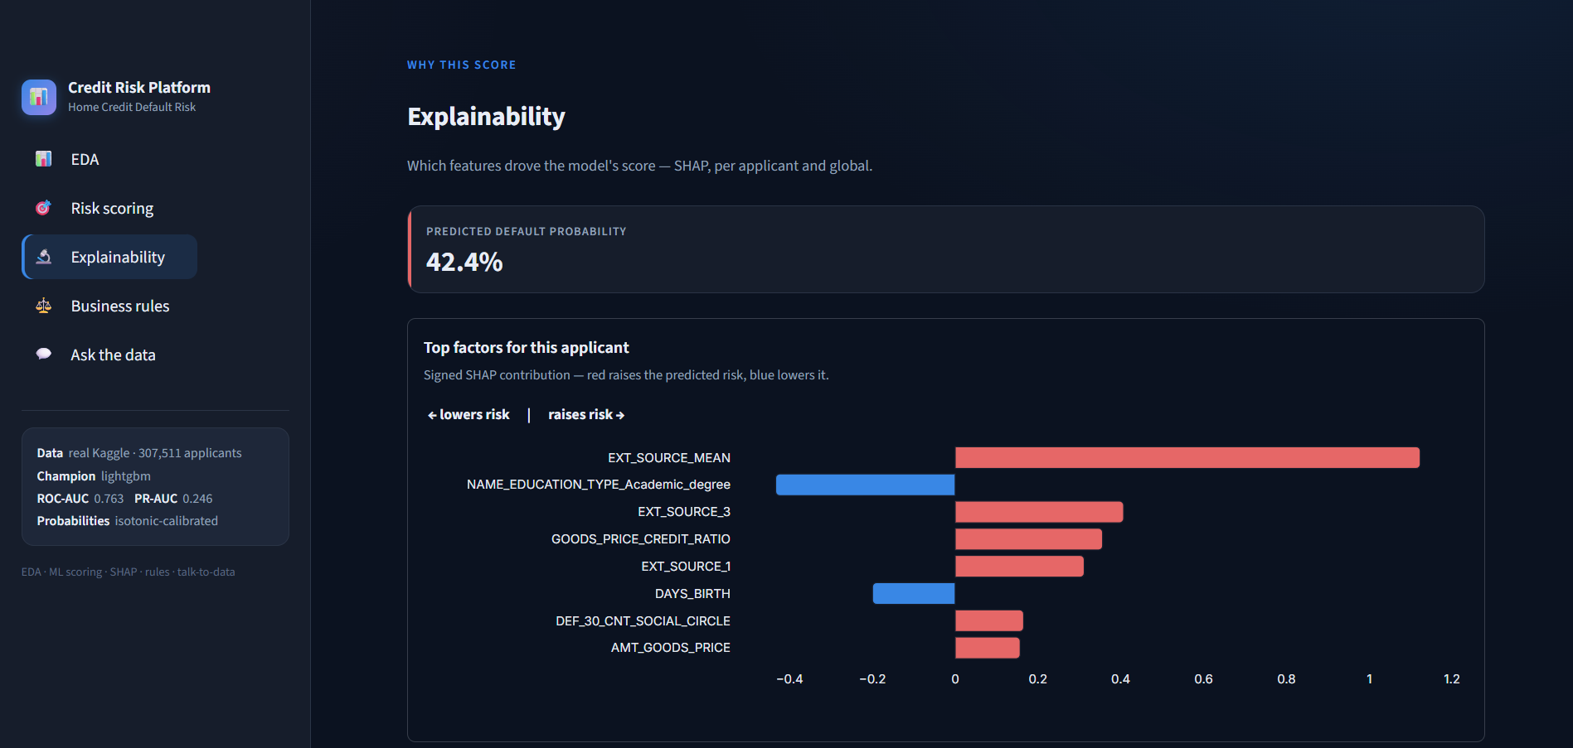
EXPLAINABLE AI
Every score ships with its reasons
— SHAP TreeExplainer on the LightGBM model — exact, fast
— Local view. signed per-applicant contributions; red raises risk, blue lowers it
— Global view. mean-|SHAP| over a 1,000-applicant sample
— EXT_SOURCE features dominate both local and global rankings
Credit Risk Intelligence Platform · NeoStats AI Engineer Use Case
08

Slide 9
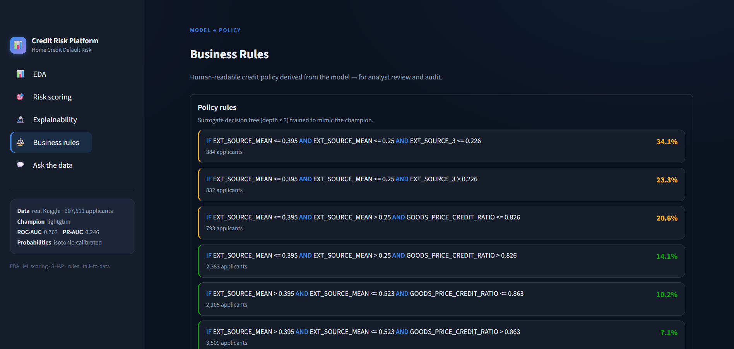
MODEL → POLICY
A human-readable approximation of the model
— Surrogate tree. depth ≤ 3, trained to mimic the champion
— Each leaf is an IF / AND rule with its observed default rate (2.4% → 34.1%)
— Companion table. observed default rate per EXT_SOURCE band vs real labels
— Decision support, explicitly not lending policy
Credit Risk Intelligence Platform · NeoStats AI Engineer Use Case
09

Slide 10
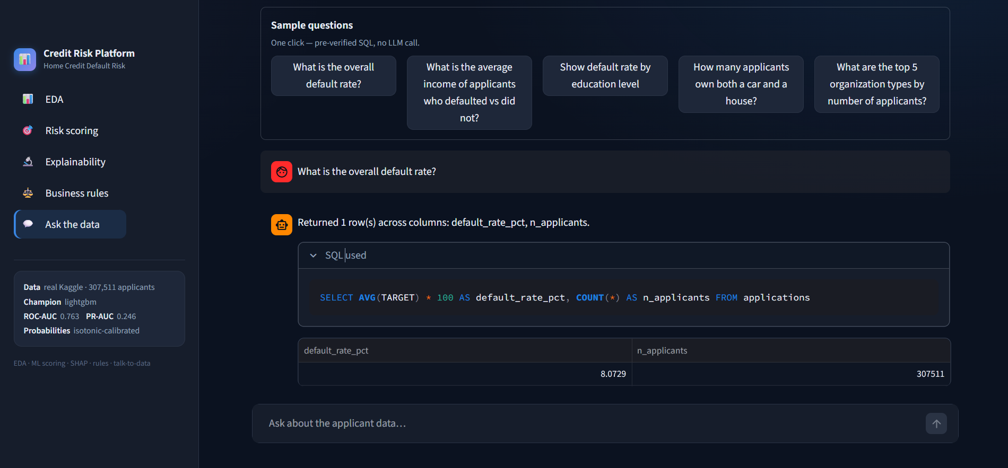
NATURAL LANGUAGE → SQL
Ask the applicant data in plain English
— Schema-grounded prompt → Gemini generates SQL
— Read-only validator. DROP / DELETE / UPDATE / INSERT / ALTER rejected; approved tables only; row cap
— Pre-verified templates answer common questions with no LLM call
— Transparency. generated SQL + result table always shown
Credit Risk Intelligence Platform · NeoStats AI Engineer Use Case
10

Slide 11
HONEST ASSESSMENT
Limitations & what's next
CURRENT LIMITATIONS
NEXT STEPS
— Application table only — no bureau / previous-loan aggregates
— Calibration uses the evaluation fold
— Hyperparameter search intentionally limited
— Free-form NL → SQL needs an external API key
— Rules approximate the model — not formal policy
— No fairness audit or production banking validation
— Aggregate bureau & previous-application history into features
— Automated hyperparameter optimization
— Dedicated train / calibration / test splits
— Model-drift monitoring
— Fairness & bias evaluation
— API inference service with authentication
Credit Risk Intelligence Platform · NeoStats AI Engineer Use Case
11

Slide 12
SUMMARY
Built with a lean, reproducible stack
Data processing
Python · Pandas · NumPy
IN ONE LINE
Analytical database
DuckDB
Data → EDA → feature engineering → calibrated ML → explainability → business rules → NL-to-SQL → UI → Docker.
The full AI-engineering lifecycle in one app.
Machine learning
scikit-learn · LightGBM
Explainability
SHAP
LLM · SQL safety
Google Gemini · sqlparse
UI · visualization
Streamlit · Plotly
Deployment
Docker · Docker Compose · Streamlit Community Cloud
Credit Risk Intelligence Platform · NeoStats AI Engineer Use Case
12

Slide 13
LIVE DEPLOYMENT
Try the platform
https://ai-credit-risk-intelligence-platform.streamlit.app/
Deployed on Streamlit Community Cloud · committed champion model · schema-accurate synthetic fallback dataset
Source code
github.com/jinishar/credit_risk
Jinisha Leema Rosario · NeoStats AI Engineer Use Case Assignment

