Slide 1
COEN 275 Object-Oriented Analysis, Design and Programming
Final Project Presentation

Slide 2
PapApp: Pet Adoption Platform
Connecting pet shelters with adopters seamlessly
  Jinish Shah
  Tishyaketu Deshpande
  Pooja Korani
  Siddhant Tripathi

Slide 3
Introduction
PapApp is a platform that connects pet shelters with potential adopters.
Facilitates online pet adoption through a user-friendly interface.
Objective: Streamline the adoption process for shelters and adopters.

Slide 4
Core Functionalities
User Registration and Authentication: Secure user accounts.
Pet Listings: Detailed pet profiles with pictures and medical history.
Search and Filter: Find pets by breed, age, size, or location.
Adoption Process: Inquire, apply, and schedule visits.
Integrated Chatbot: Real-time messaging with shelter staff.
Pet Care Resources: Training tips and adoption guidelines.

Slide 5
Assumptions
The platform supports two user types: Shelter Admins to manage pet listings and Adopters to search for and adopt pets.
Authentication and security are managed using encrypted passwords with bcrypt and JWT-based tokens for secure login sessions.
Adopters can search for pets using filters like location, breed, age, and size, with real-time updates managed by Shelter Admins.
Adoption requests follow a structured flow, allowing admins to accept, decline, or reschedule requests, with statuses updated dynamically.
The chatbot facilitates real-time communication between adopters and shelter staff, limited to listed pets.
The application is designed for scalability, supporting up to 10,000 concurrent users, with responsive design for seamless use on desktops and mobile devices.

Slide 6
Use cases
Actors:
Shelter Admin: Manages pet listings and adoption requests.
Adopter: Searches for pets, submits adoption requests, communicates with shelters.
Use Cases:
List Pet: Admin uploads details of pets for adoption.
Adopt Pet: Adopter sends a request and schedules visits.
Chat: Direct communication between adopters and shelter staff.

Slide 7
Technical Architecture
Frontend: React.js for dynamic user interface.
Backend: Node.js and Express.js for server-side logic.
Database: MongoDB for storing user and pet data.
Authentication: JSON Web Tokens (JWT) for security.
Chatbot Integration: AI-driven real-time assistance.

Slide 8
Classes
User:
Attributes: name, email, password.
Methods: matchPassword(), save().
Pet:
Attributes: name, breed, age, medicalHistory.
Associations: Linked to Shelter and AdoptionRequest.
AdoptionRequest:
Attributes: status, schedule.
Links: Adopter ↔ Pet.
ChatBot:
Attributes: chatHistory, userQueries.

Slide 9
OO Concepts
Encapsulation:
User password encryption using bcrypt.
JWT-based token management encapsulated in generateToken.js.
Inheritance:
Mongoose schemas (UserSchema) use shared features like timestamps.
Polymorphism:
API supports multiple HTTP methods (GET, POST, PUT).
Abstraction:
Middleware abstracts authentication (authMiddleware.js).

Slide 10
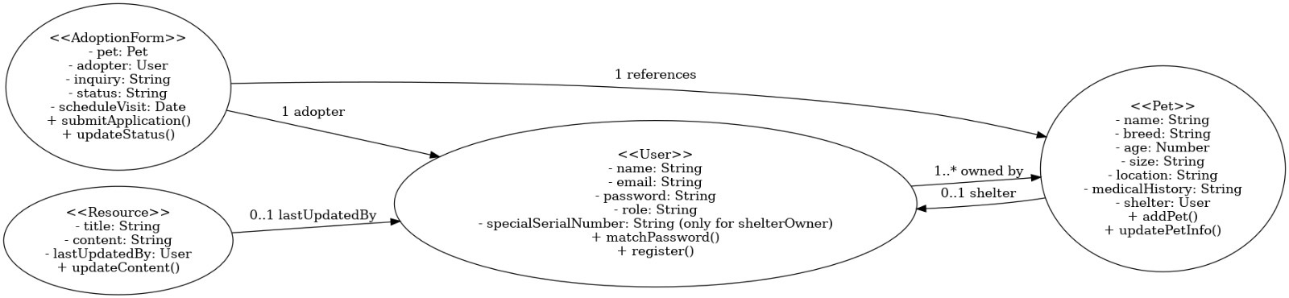
Class diagram

Slide 11
Use case Diagram

Slide 12
Class Implementation

Slide 13
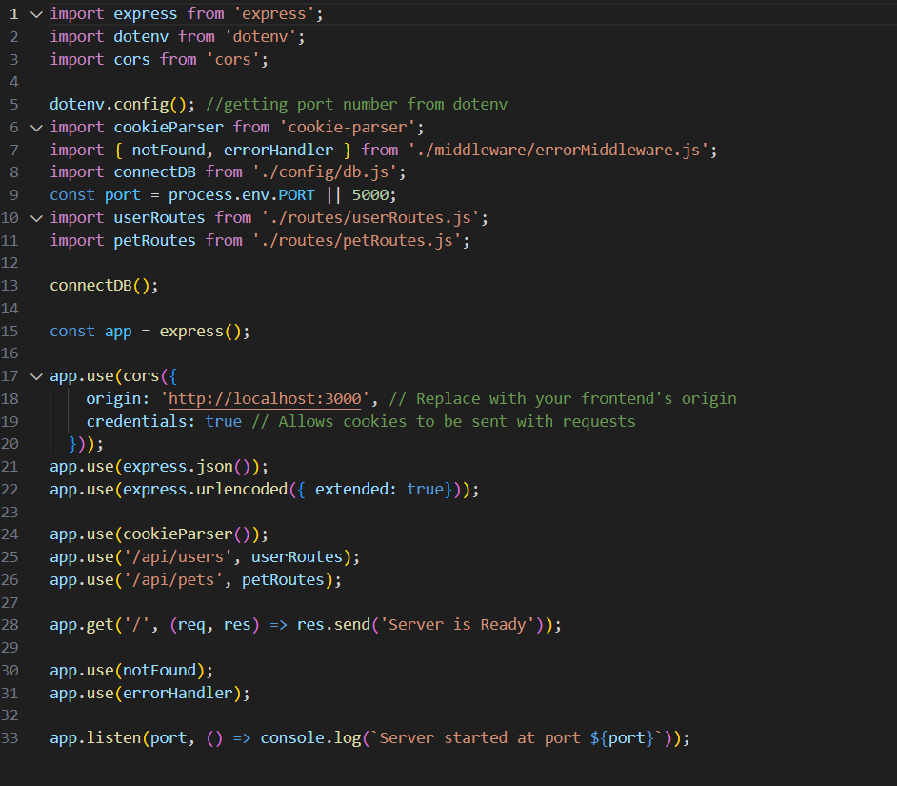
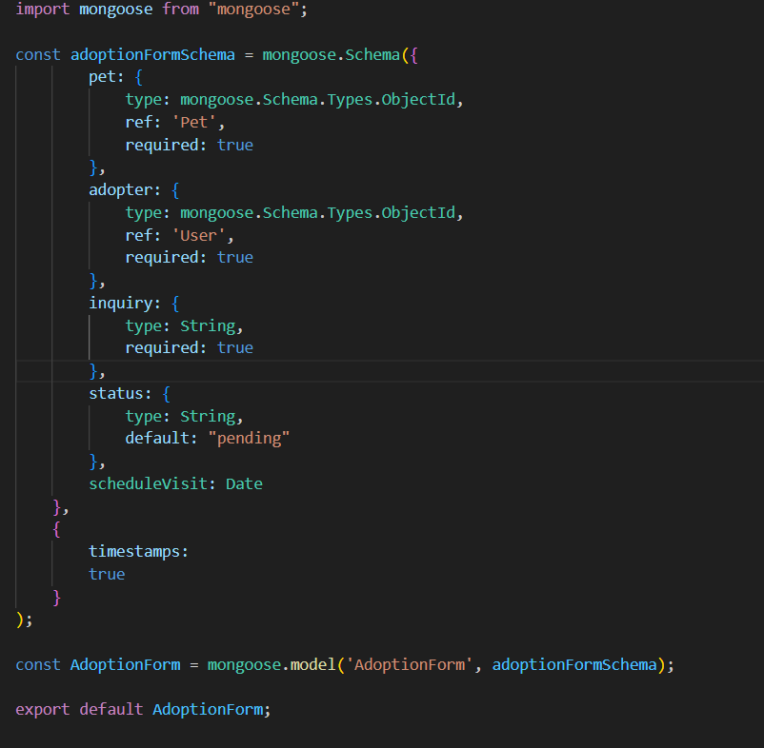

Slide 14
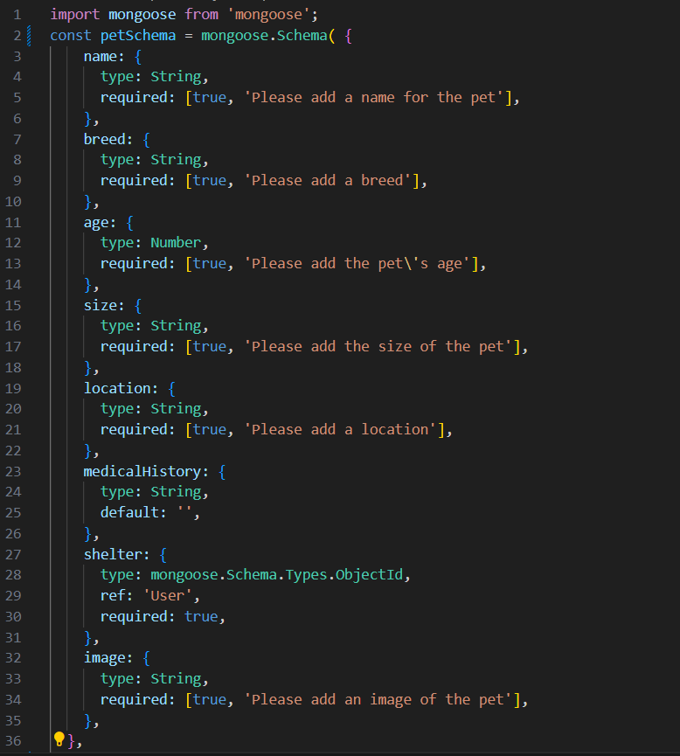
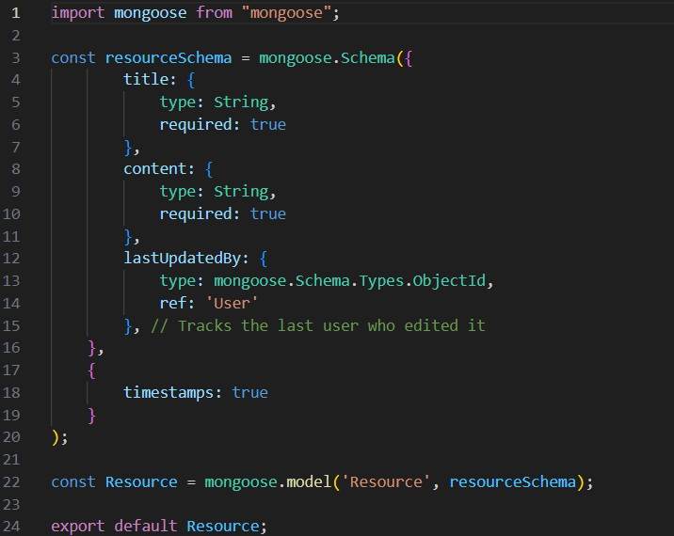

Slide 15
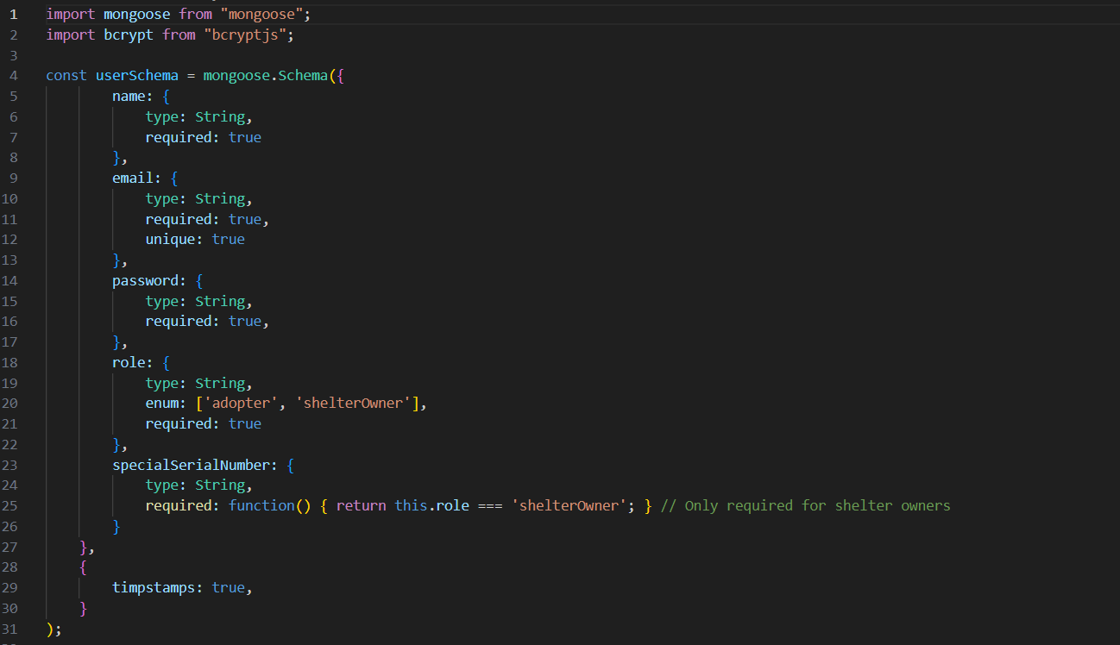

Slide 16
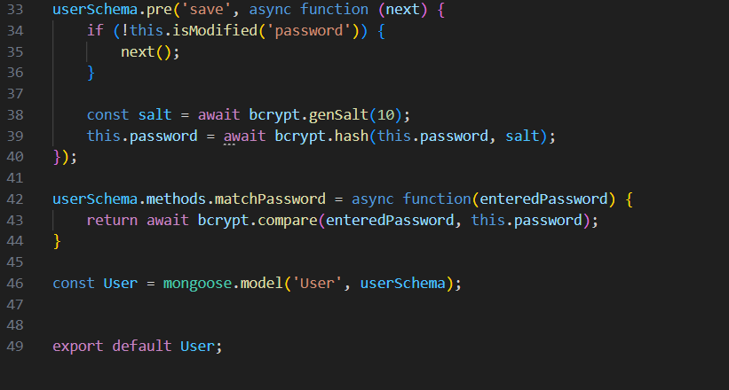

Slide 17
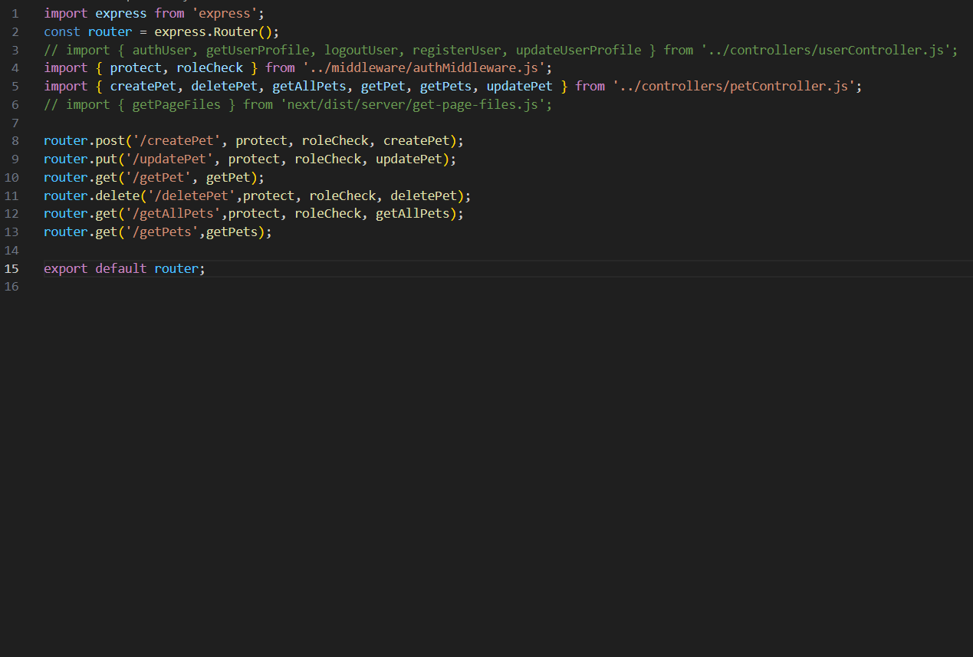
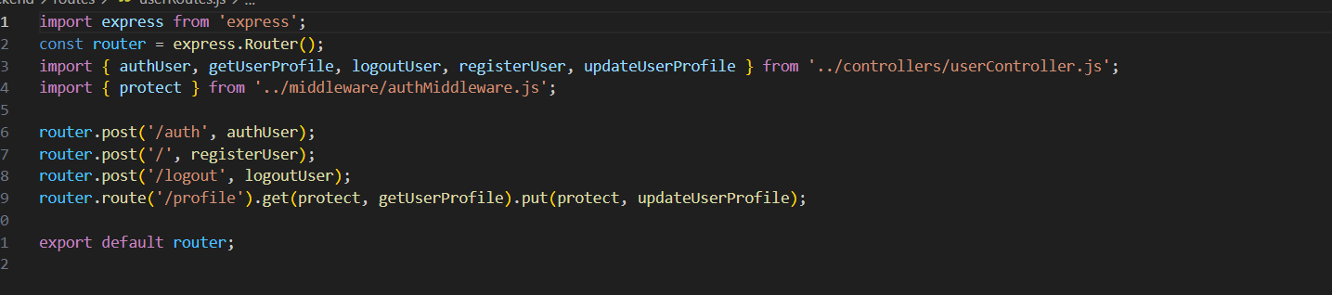

Slide 18
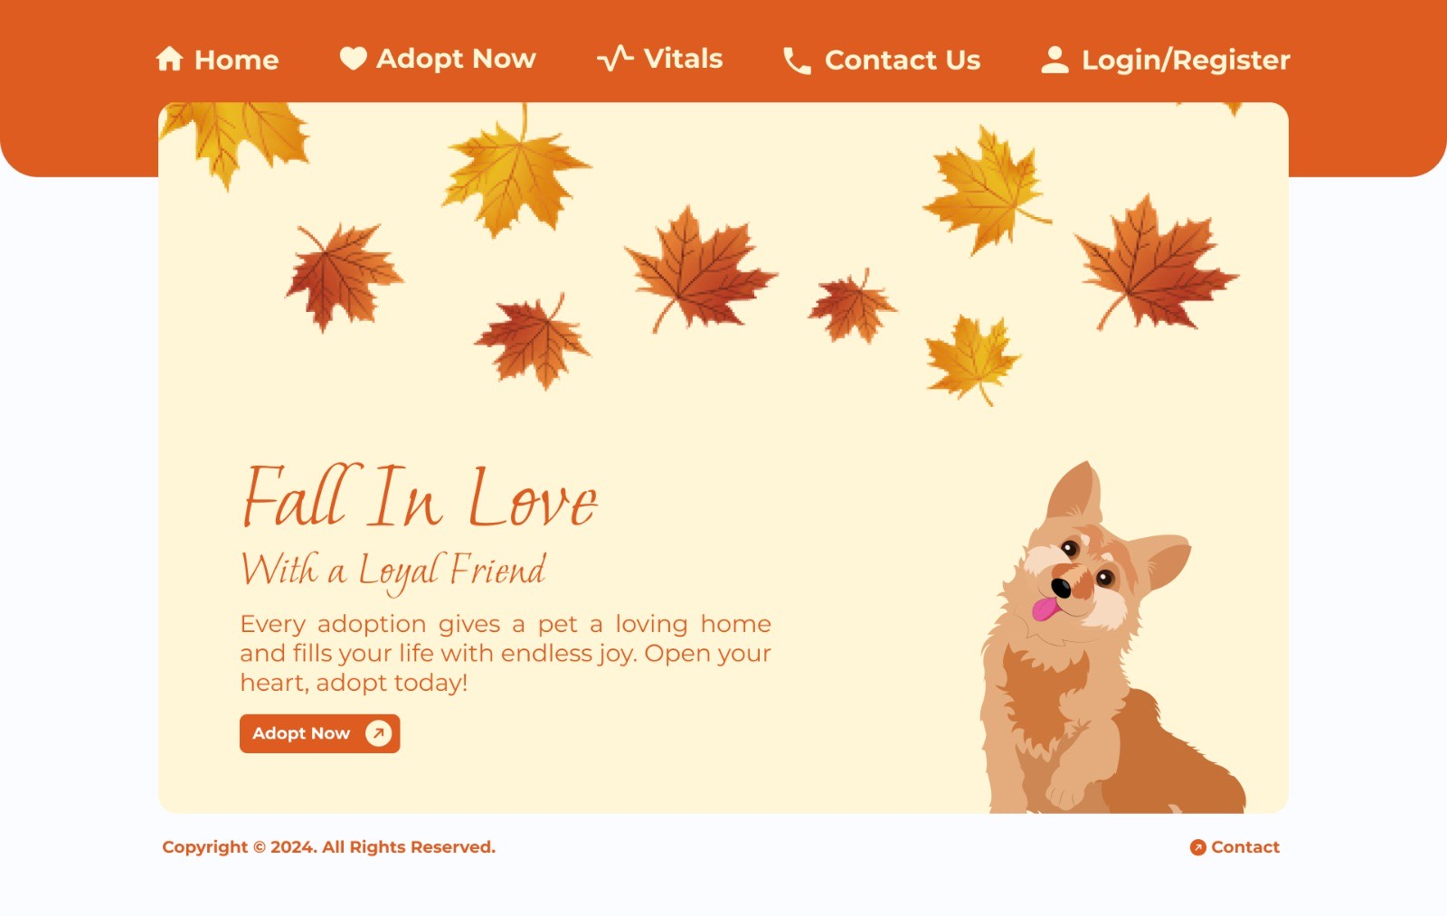
Home Page

Slide 19
Future Enhancements
Mobile Application: Expand accessibility with mobile support.
Advanced Analytics: Track user engagement and improve services.
Community Features: Introduce forums and social interaction.

Slide 20
Thank you

