Slide 1
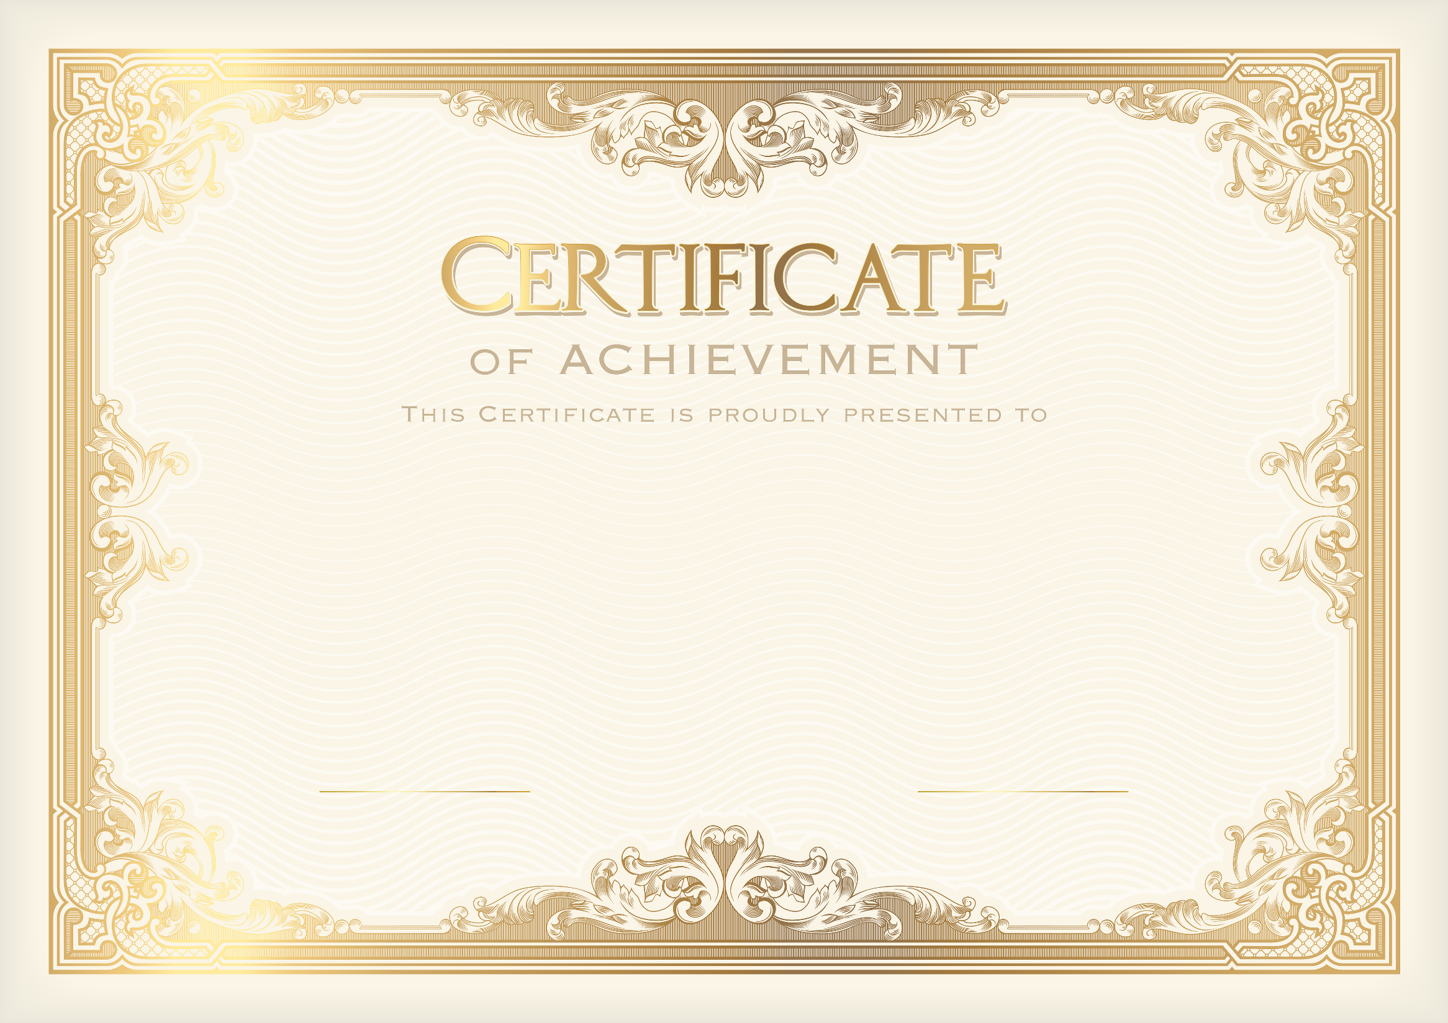

0x6122e34ca2a3369408d157D5fdC3A362A157Ce1A
Certificat delevered by bclc.dz
Baghdade Hamdoud
Digital Marketing
Secured and Saved with blockchain technology
By walid.kheroub@univ-annaba.org
Certificat delevered by bclc.dz
0x6122e34ca2a3369408d157D5fdC3A362A157Ce1A

