Slide 1





Nutrition & Recipe Analytics API
Coursework 1: XJCO3011 Web Services and Web Data
Author: Hengyu Jin
Date: 21 April 2026
GitHub: https://github.com/jinjerry123456/nutrition-recipe-api.git
Render: https://mcdonalds-api-jhd9.onrender.com
Notes:
Good morning, everyone. My name is [Your Name], and I'll be presenting my Coursework 1 project for the XJCO3011 module: the Nutrition & Recipe Analytics API. This project is a comprehensive RESTful API designed to manage and analyze nutritional data, built using modern technologies and following robust software engineering principles. You can find all the source code, documentation, and reports in the GitHub repository linked on the slide.

Slide 2



Problem & Project Goals
PROBLEM STATEMENT
Design a data-driven web API with full database integration, implementing essential CRUD operations while showcasing advanced system architecture features.
CORE PROJECT GOAL
Build a production-ready, scalable API for nutritional analysis and custom meal combo management, adhering to enterprise-level quality standards.
KEY REQUIREMENTS
• Full CRUD for `Combo` resource
• Secure JWT Auth & Permissions • Comprehensive docs & unit testing
• RESTful principles & Clean Code
Notes:
The goal of this coursework was to design and implement a fully functional, data-driven web API. I chose to tackle this by creating a Nutrition and Recipe Analytics API. The core objectives were to not only meet the basic requirements of implementing CRUD operations but also to build a secure, well-documented, and testable system that demonstrates professional software engineering practices.

Slide 3




System Execution Roadmap
This presentation will walk through the core functionality of the API in a logical flow:
1. Authentication:
Obtaining a JWT token to validate user sessions.
2. Core CRUD:
Creating, reading, updating, and deleting a custom meal combo.
3. Data Exploration:
Browsing through available menu items and product categories.
4. Advanced Analytics:
Viewing real-time nutritional efficiency rankings and metrics.
5. Quality Assurance:
Demonstrating automated test results for system reliability.
Notes:
To efficiently demonstrate the API's capabilities within the 5-minute window, I've structured the demo to follow a clear roadmap. We'll start with authentication, then perform the core CRUD operations on a meal combo, explore the available data, check out the advanced analytics features, and finally, show the automated test results to prove the system's reliability.

Slide 4



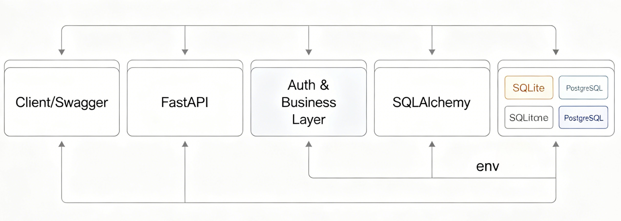







Architecture Overview
Client Layer- Users interact via Swagger UI or HTTP clients for system access.
API Layer- FastAPI framework handles all incoming requests, routing, and data validation.
Business Logic- Core implementation for user authentication, CRUD operations, and data analytics.
Data Access Layer- SQLAlchemy ORM serves as the bridge to interact with the underlying database.
Database- SQLite is used for development environments, with PostgreSQL for production.
Notes:
Here's a high-level overview of the system architecture. It's a layered design. The client interacts with the API layer, which is built using FastAPI. FastAPI handles request validation and routing. The business logic layer contains the core functionality for authentication, CRUD operations, and analytics. Finally, the data access layer, using SQLAlchemy, communicates with the relational database, which can be SQLite for development or PostgreSQL for production.

Slide 5

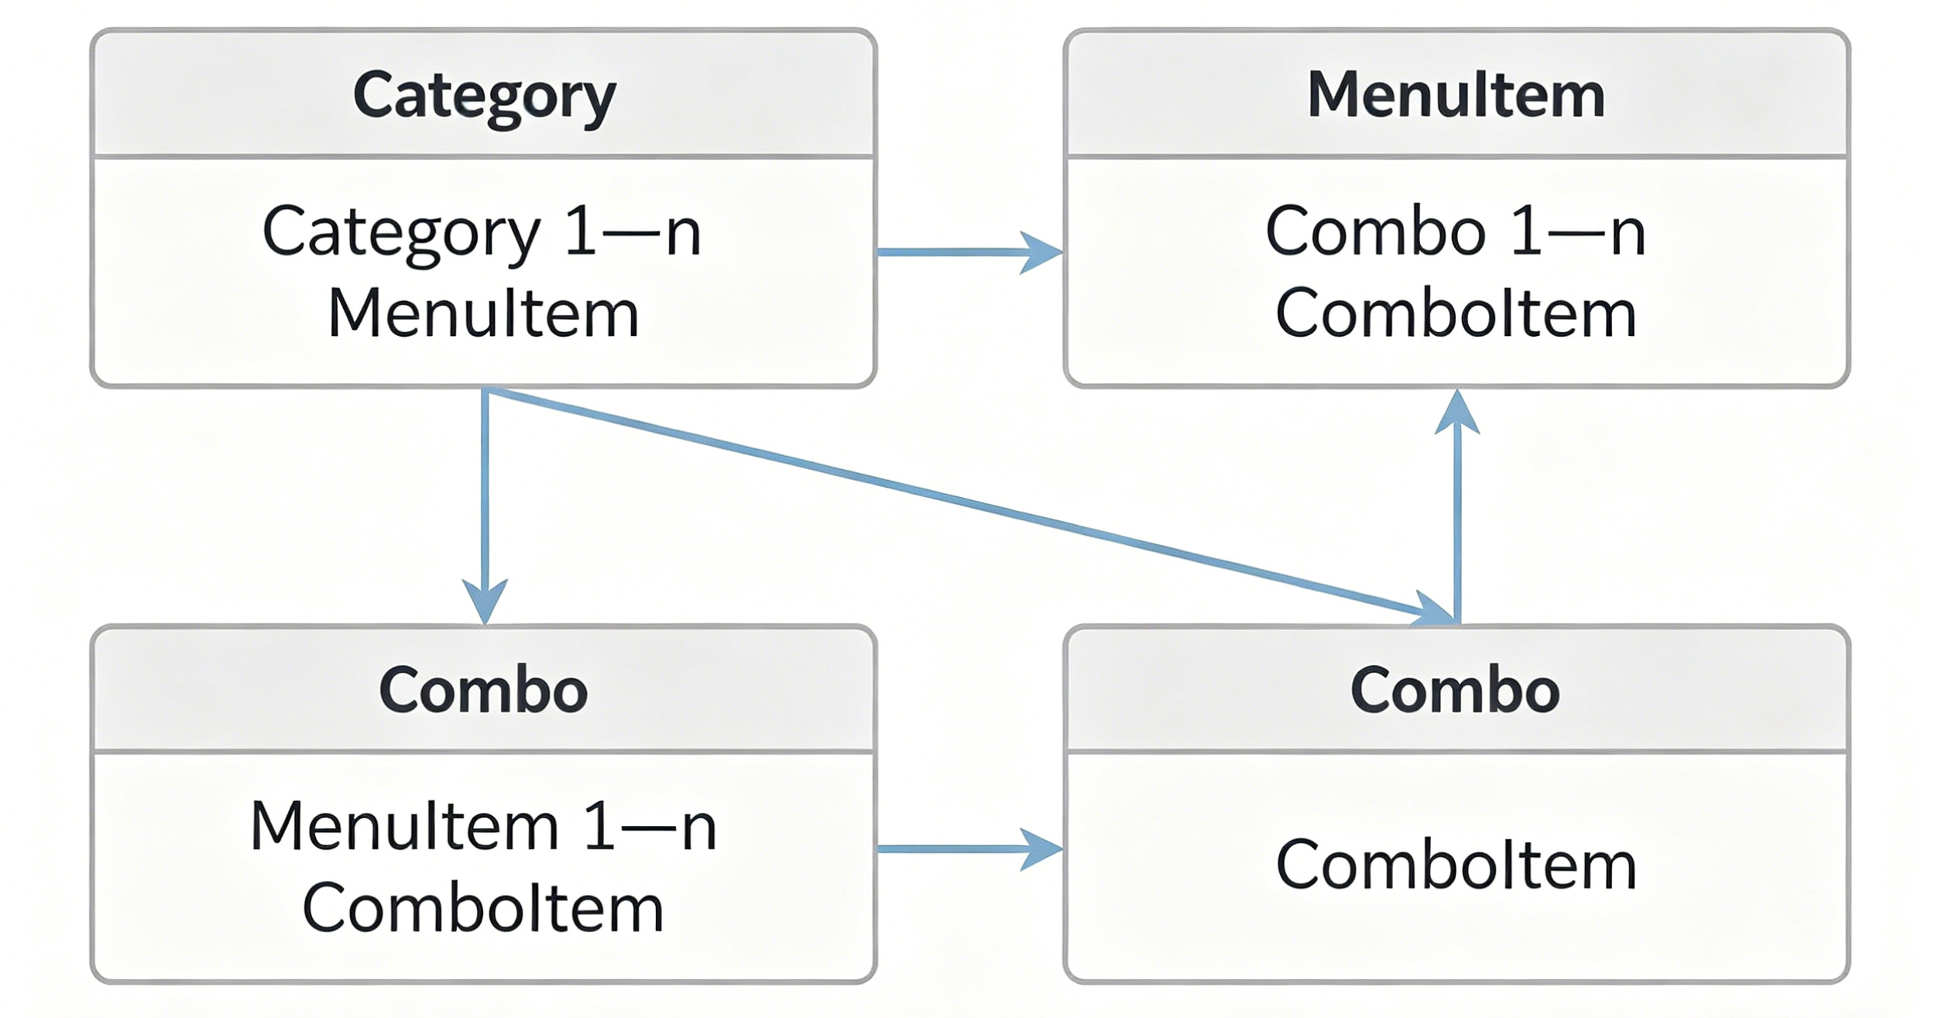


Data Model & Relationships
CORE ENTITIES
The model is built around four fundamental tables:Category,MenuItem,Combo, andComboItem. These form the backbone of all menu operations.
KEY RELATIONSHIPS
•1:N: One Category contains many MenuItems. •M:N: Combos link to many MenuItems via aComboItemjunction table.
ENTITY RELATIONSHIP
Visualizing Core Data Connections
DESIGN RATIONALE
Using a junction table enables precise tracking of ingredient quantities within each combo. This design ensures data integrity and provides the flexibility needed to calculate accurate nutritional values for custom meals.
Notes:
The data model is built around four core entities. The key design choice is the many-to-many relationship between combos and menu items, managed through a junction table called ComboItem. This allows us to track the exact quantity of each ingredient in a custom meal combo, which is essential for calculating accurate nutritional values.

Slide 6
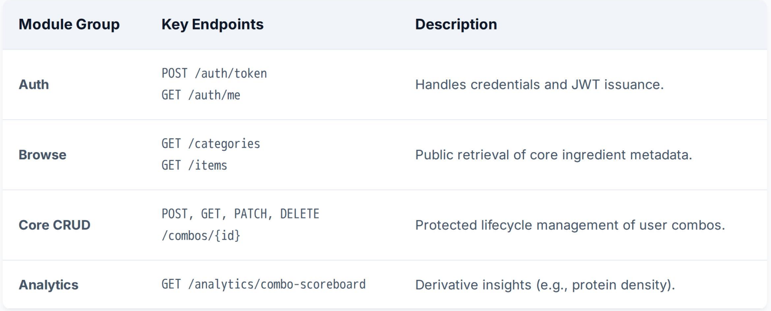
API ENDPOINT OVERVIEW
Notes:
The API surface is well-structured and organized into logical groups. We have endpoints for authentication, browsing public data like categories and menu items, the core CRUD operations for managing combos, and advanced analytics endpoints for data insights. The Swagger UI, which I'll show later, provides a complete interactive overview of all these endpoints.

Slide 7
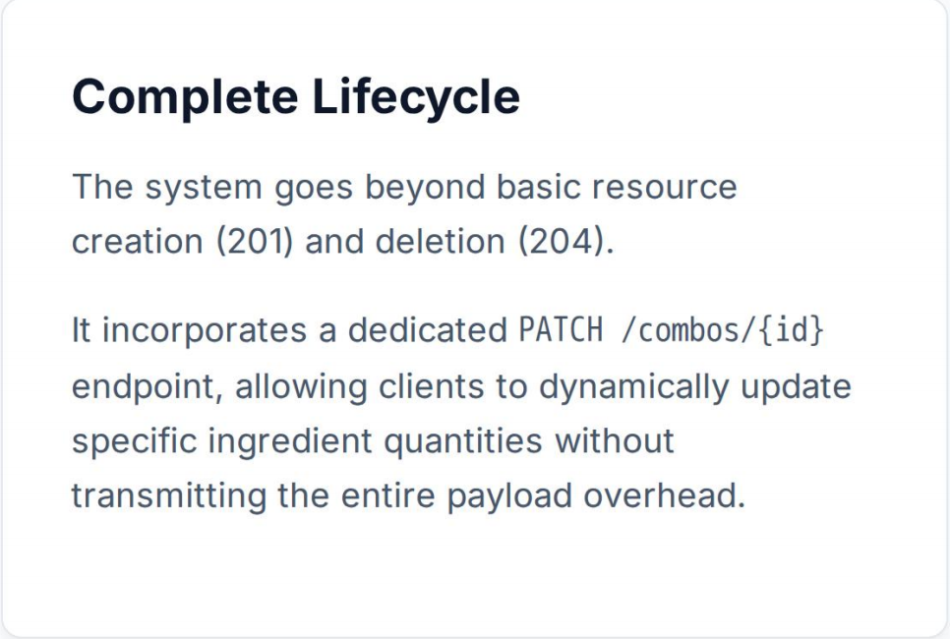
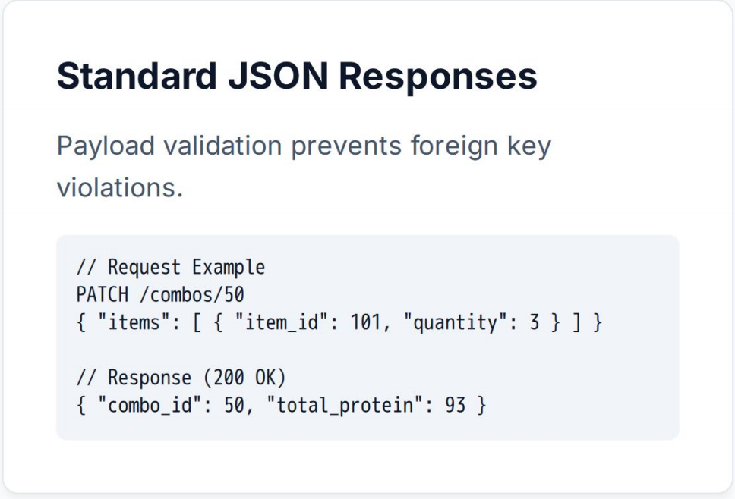
Core CRUD Walkthrough: Meal Combos
Example Request (Create):{ "name": "High Protein Builder", "items": [{ "item_id": 101, "quantity": 2 }] }
The JSON payload defines the combo's identity and composition for persistent storage.
Notes:
Let's walk through the core CRUD operations for meal combos. Creating a combo involves sending a POST request with a JSON body. Reading is done via GET requests. Updates can be full or partial, and deletion is straightforward. This demonstrates a complete lifecycle management for the core business resource.

Slide 8
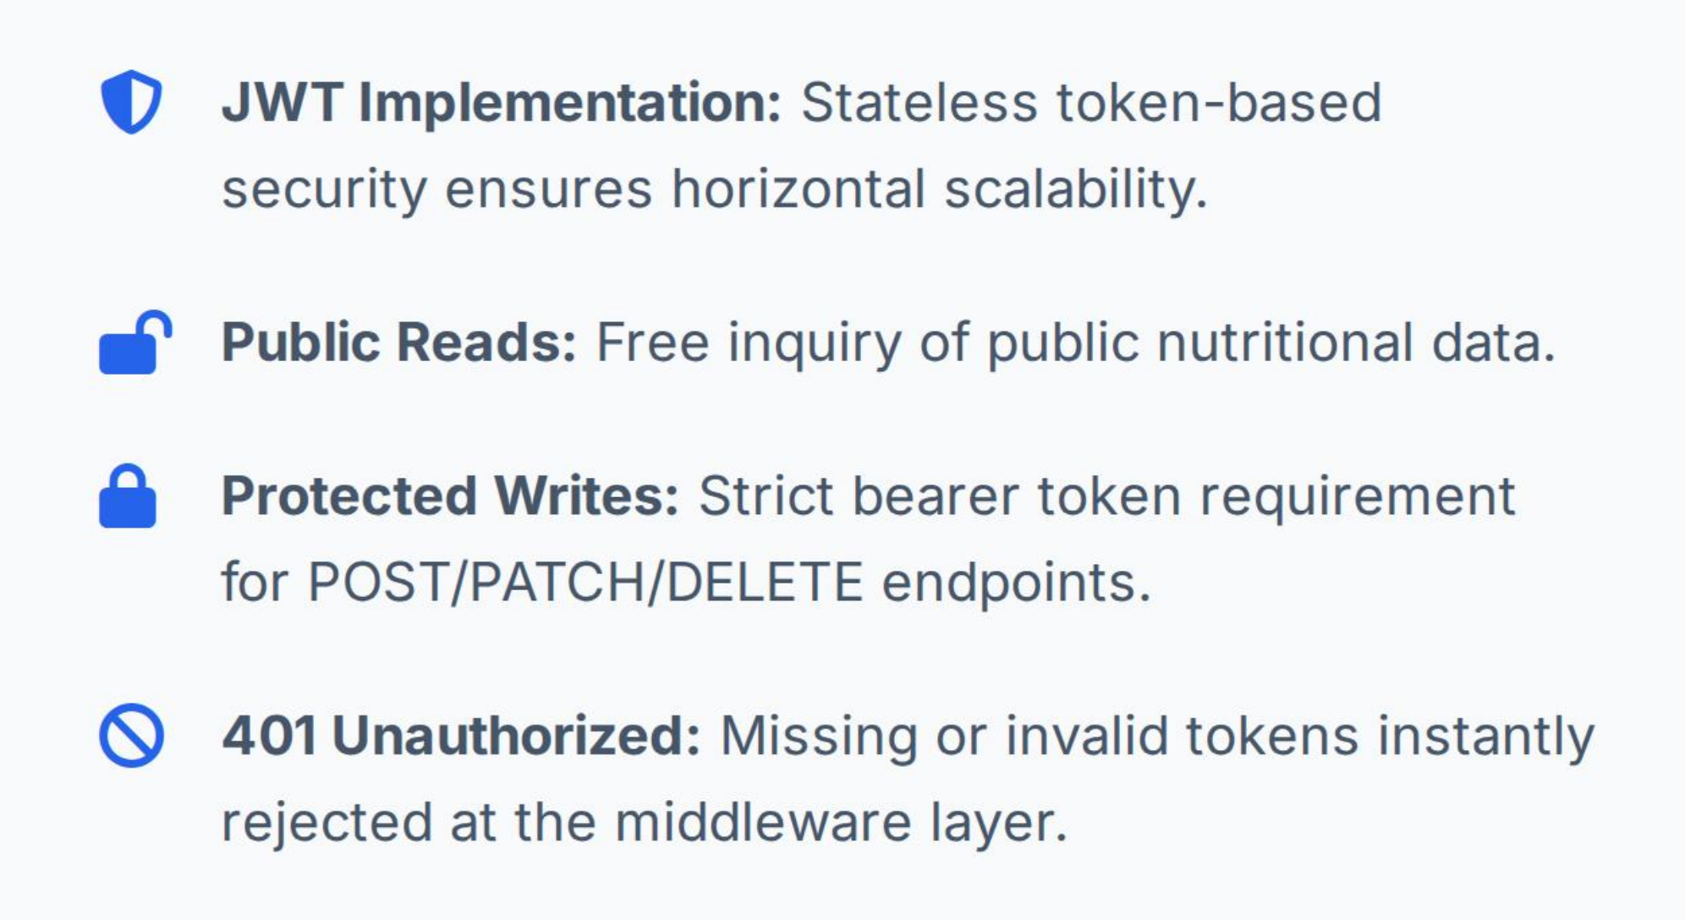
Authentication & Security Boundary
Notes:
Security is a top priority. The API uses JWT for authentication. This is a stateless mechanism, which is ideal for RESTful services. Users log in to get a token, which they then include in the header for any subsequent requests that modify data. This ensures that only authenticated users can create, update, or delete meal combos.

Slide 9
Analytics & Creative Features
Protein Density
A novel metric (protein/calories) to rank combos by nutritional efficiency, highlighting the most value-dense meals.
Example: Combo Scoreboard Response
Category Summary
Aggregates detailed nutritional data by food category (e.g., Burgers, Salads), providing macro-level insights for menu analysis.
[
{ "combo_id": 50,
"name": "High Protein Builder",
"protein_density": 0.144, "rank": 1 }
]
Healthy Search
Advanced filtering allowing users to query menu items by specific nutritional criteria (e.g., max_calories, min_protein).
Notes:
Beyond basic CRUD, the API offers creative analytical features. The most innovative is the 'protein density' metric, which ranks meal combos based on their protein-to-calorie ratio, providing users with a valuable insight into nutritional efficiency. The API also provides category summaries and advanced search capabilities, demonstrating the system's data analysis potential.

Slide 10
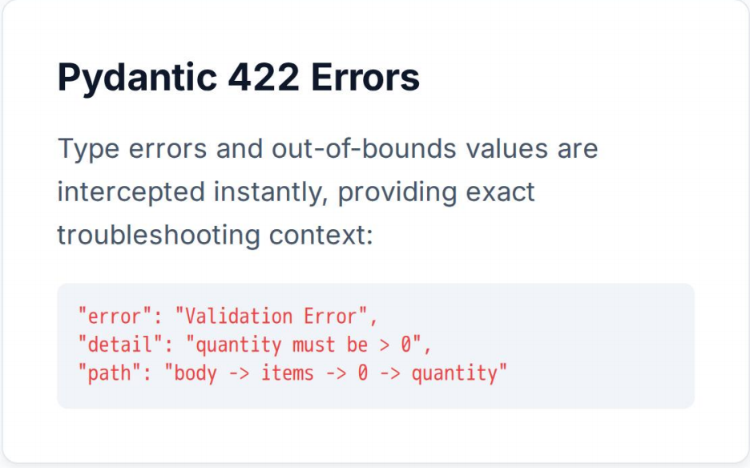
VALIDATION & ERROR HANDLING
HTTP Standard Codes
404Not Found
401Unauthorized
Request lacks valid authentication token or credentials.
The requested resource does not exist on the server.
500 exception
409Conflict
internal server exception
Resource conflict (e.g., duplicate combo name already exists).
Notes:
The API implements robust validation and error handling. Pydantic ensures all incoming data is valid. Errors are returned as structured JSON with standard HTTP status codes, making it easy for developers to understand and handle issues. For example, a 422 error clearly indicates a validation problem, while a 401 error points to an authentication issue.

Slide 11
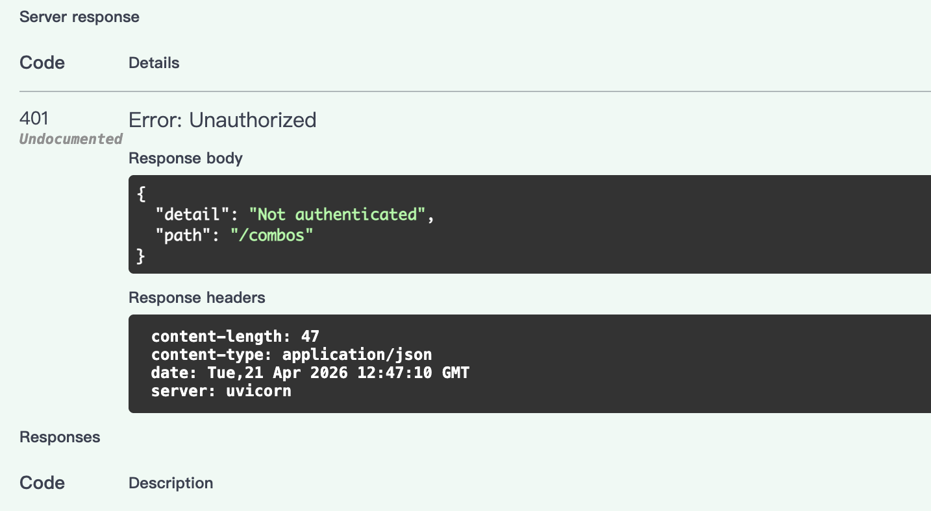
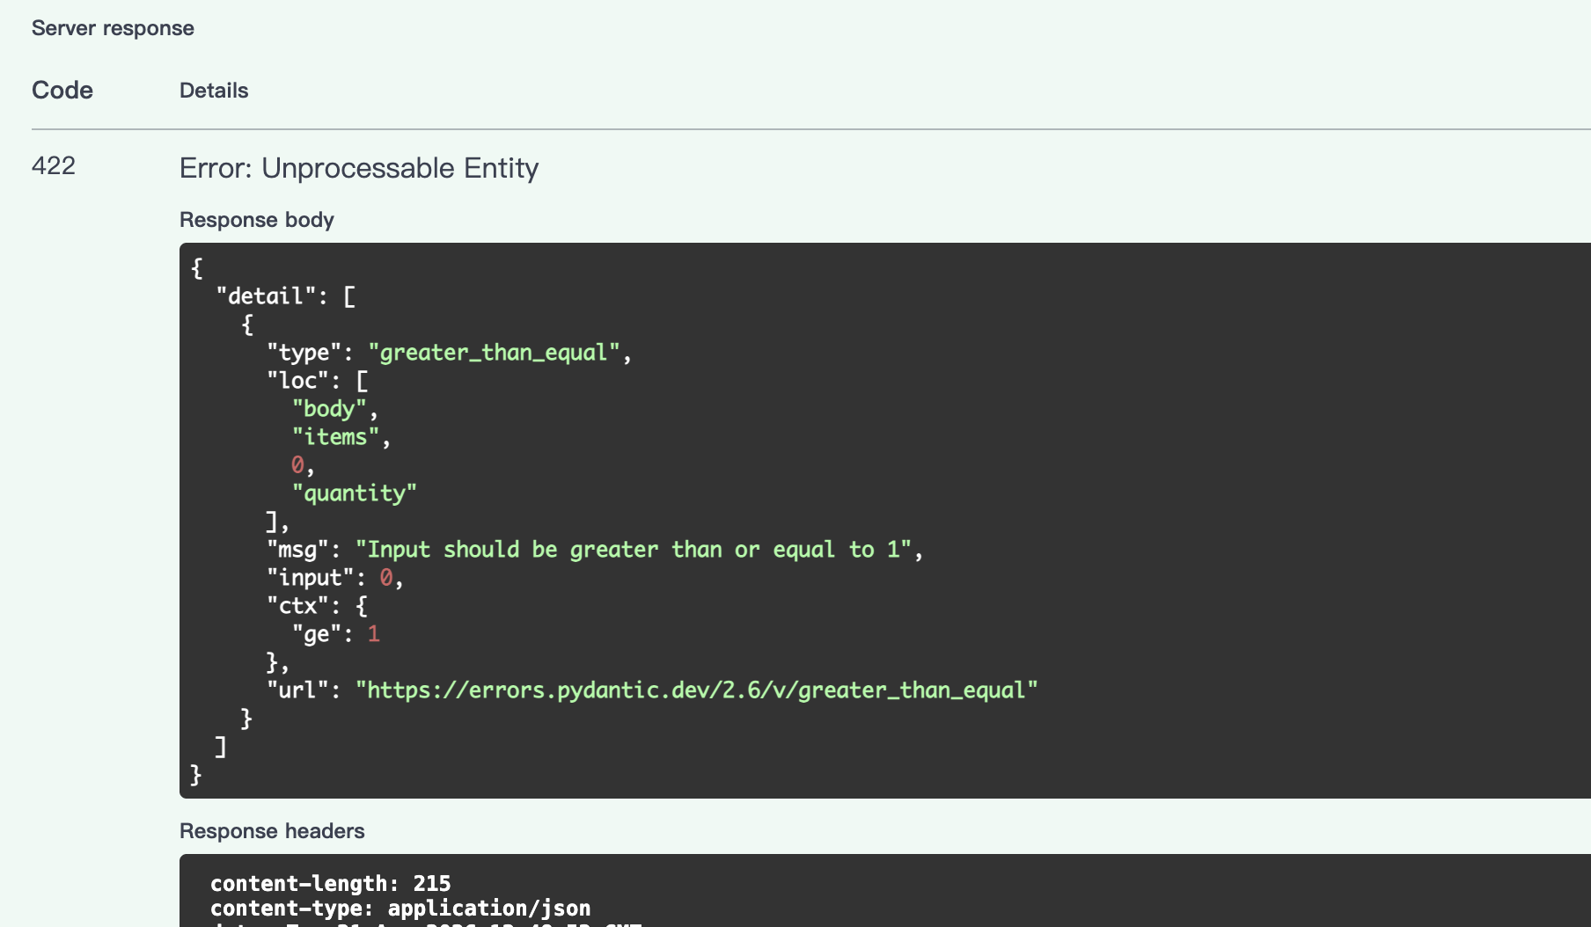
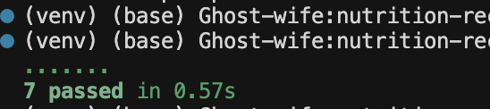
Testing & Engineering Rigor
CORE FRAMEWORK Utilizing Pytest for a scalable and maintainable test suite.
TEST COVERAGE Auth flow, full CRUD lifecycle, input validation & analytical endpoint calculations.
VERIFICATION RESULT All tests pass successfully, ensuring the system behaves as expected with high reliability.
Notes:
To ensure the quality and reliability of the API, I've implemented a comprehensive suite of automated tests using Pytest. These tests cover the entire authentication flow, the complete CRUD lifecycle, input validation, and even the calculations in the analytics endpoints. As you can see from the test results, all tests are passing, providing confidence in the system's stability.

Slide 12
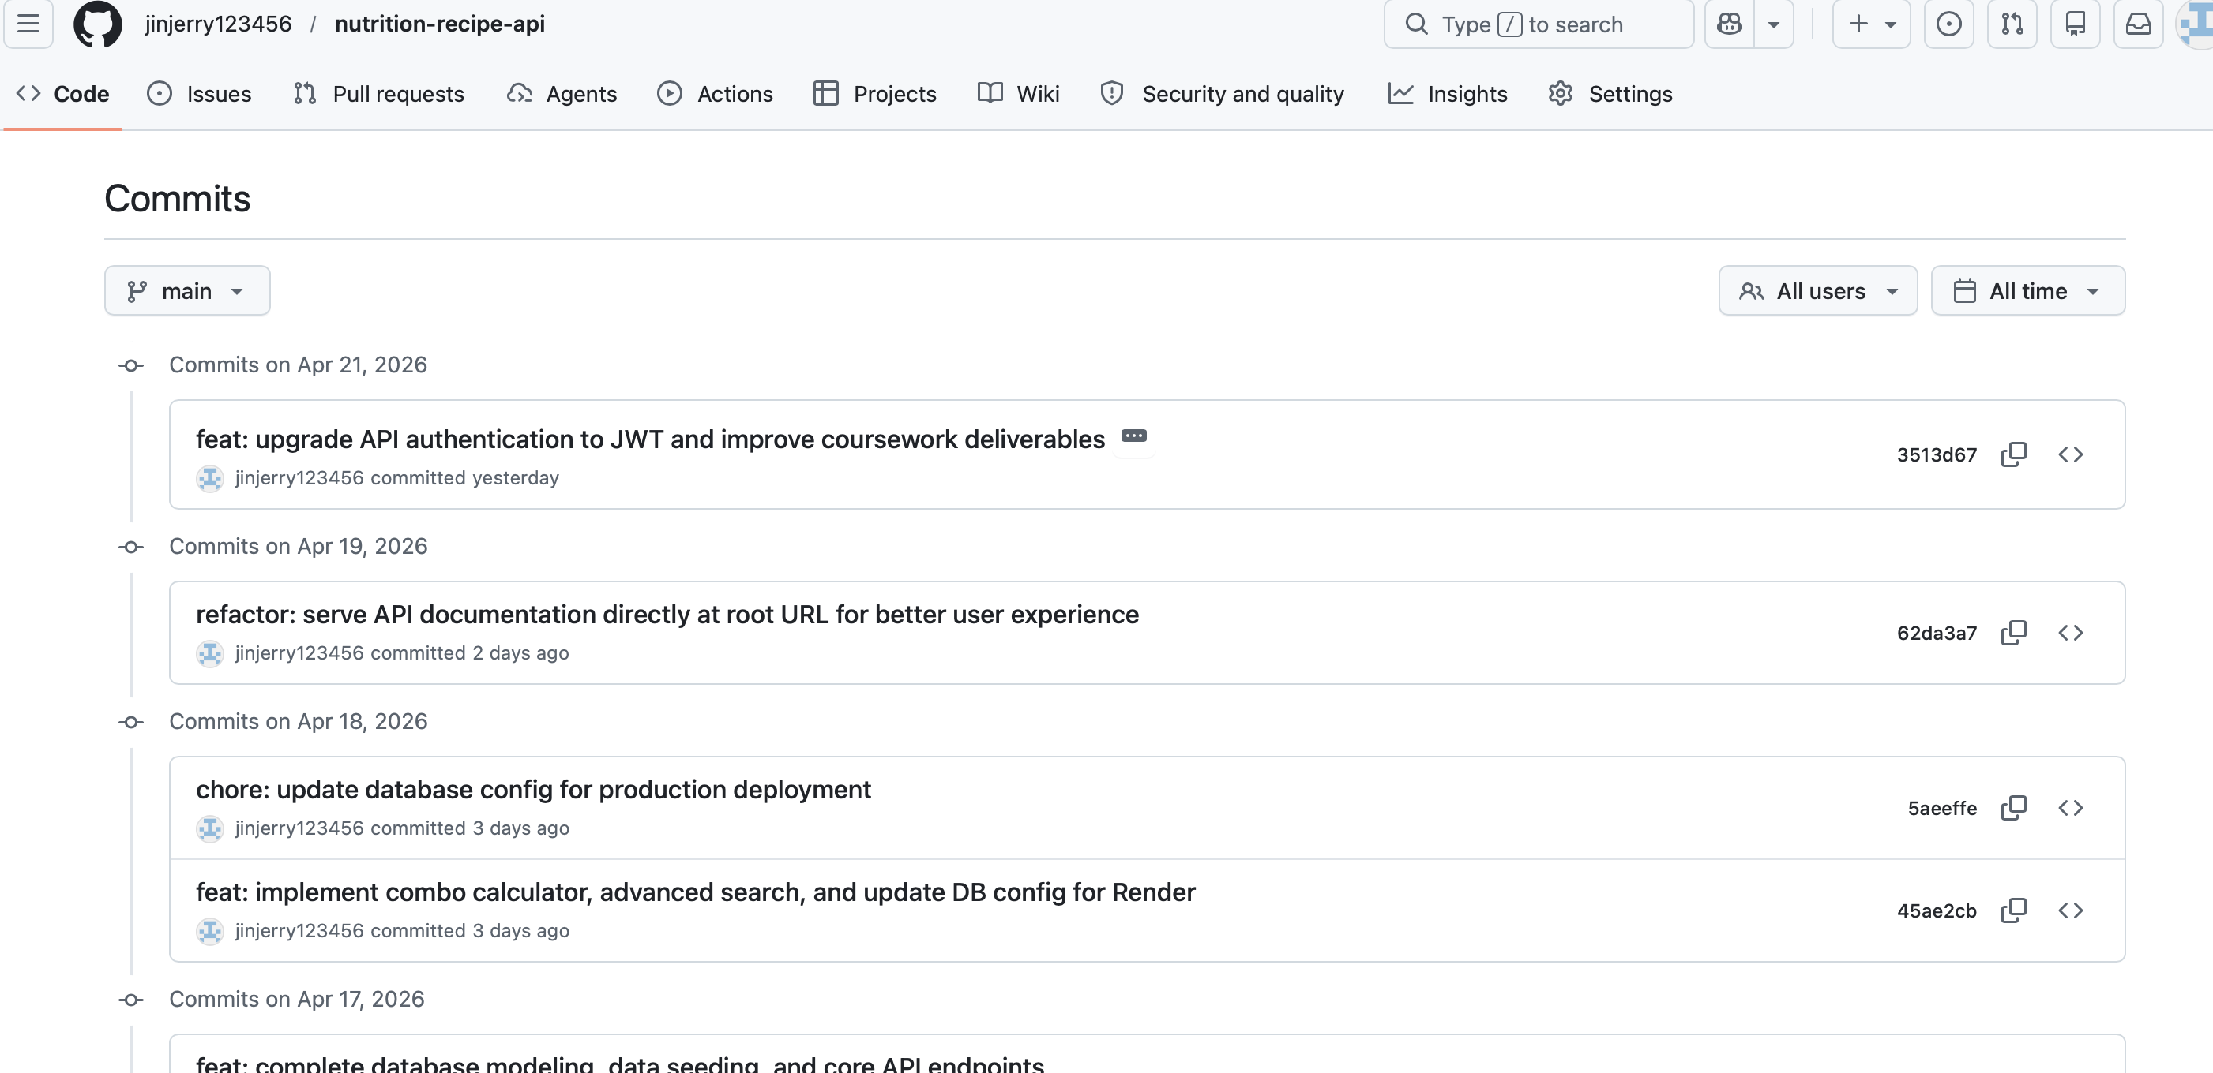
Version Control & Deliverables
Git Version Control
Project Deliverables
Maintained a detailed commit history on GitHub, demonstrating a consistent and iterative development process throughout the project lifecycle.
•Repo:Public GitHub with clear commit logs •API Docs:Interactive Swagger UI + Exported PDF •Report:Detailed technical justification document •Slides:This project portfolio presentation
Notes:
Throughout the project, I maintained a clear commit history on GitHub, demonstrating an iterative development process. All required deliverables are complete and available. This includes the public GitHub repository, comprehensive API documentation in both interactive and PDF formats, a detailed technical report, and these presentation slides.

Slide 13


THANKS
Thank you for your criticism and correction
Notes:
That concludes my presentation. I've demonstrated a fully functional, secure, and well-engineered Nutrition and Recipe Analytics API. I'm now happy to answer any questions you may have about the design, implementation, or any other aspect of the project. Thank you.

