Slide 1
Network Security Project 2 DEMO
Group 10

Slide 2
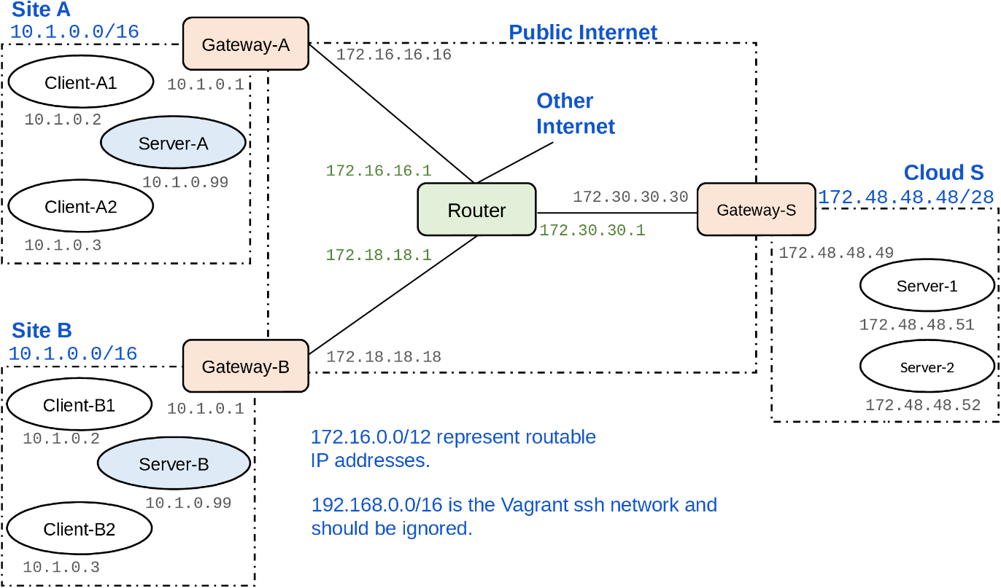
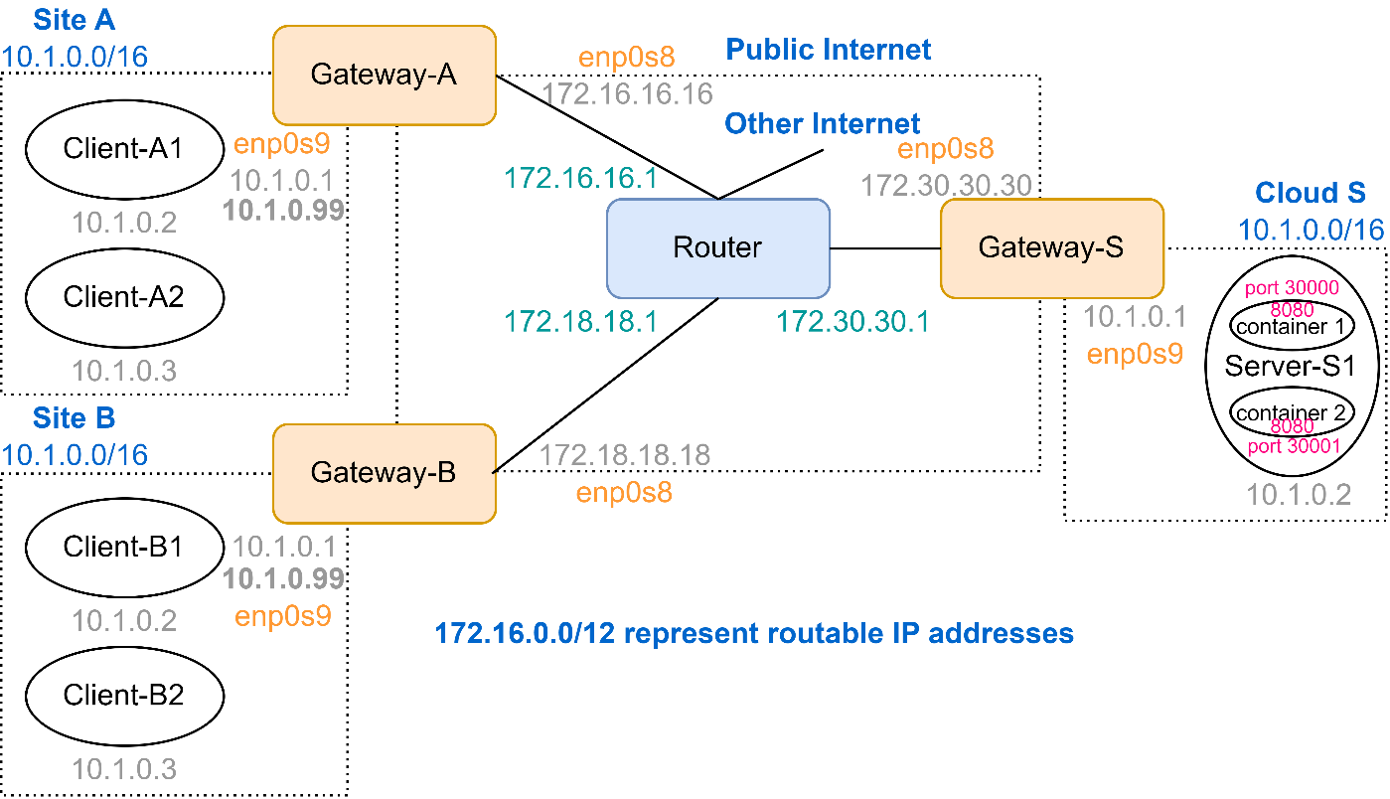
Topology
Before
After

Slide 3
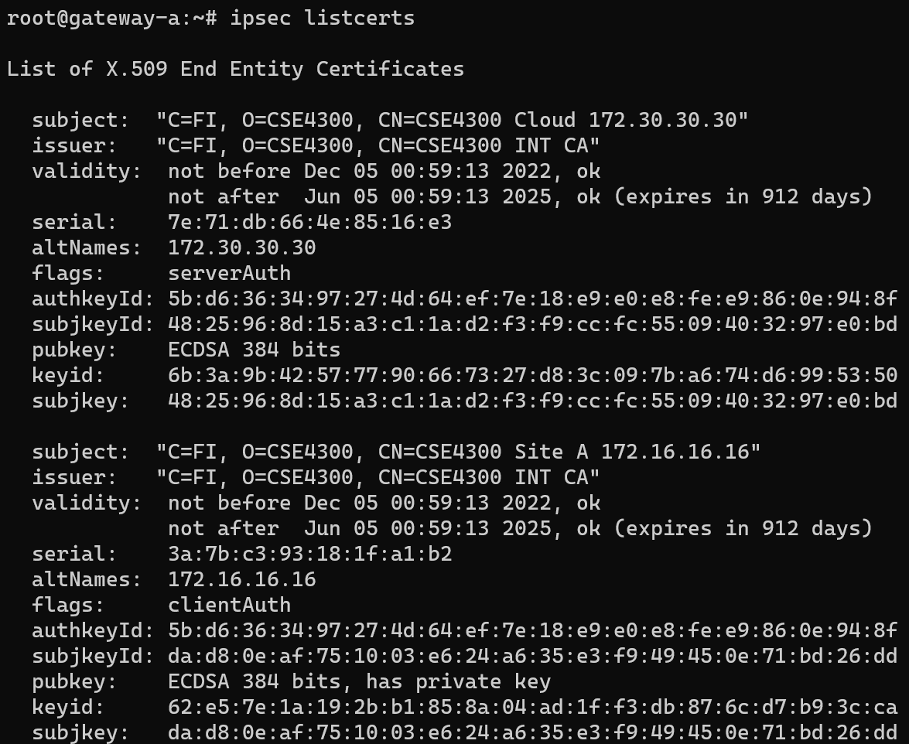
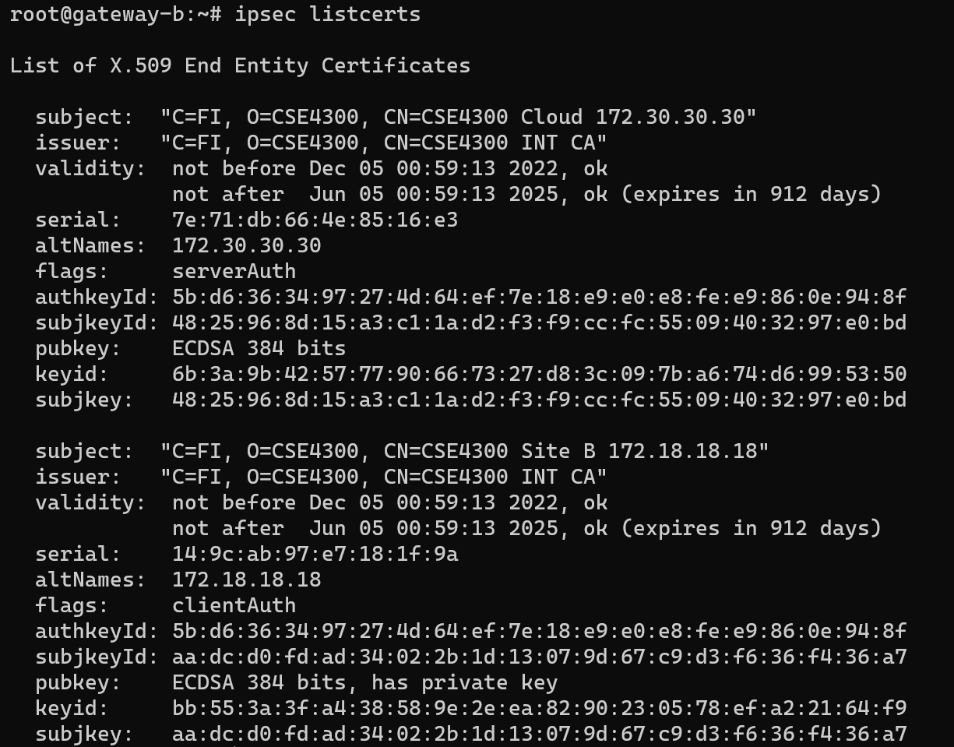
ipsec listcerts （site A and site B）

Slide 4
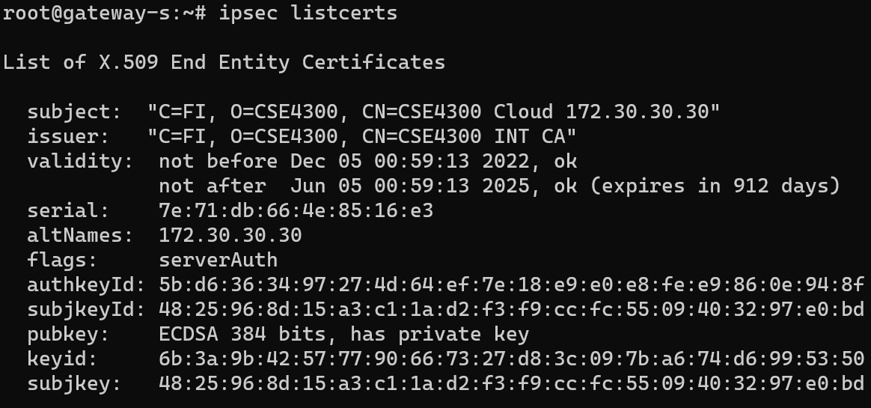
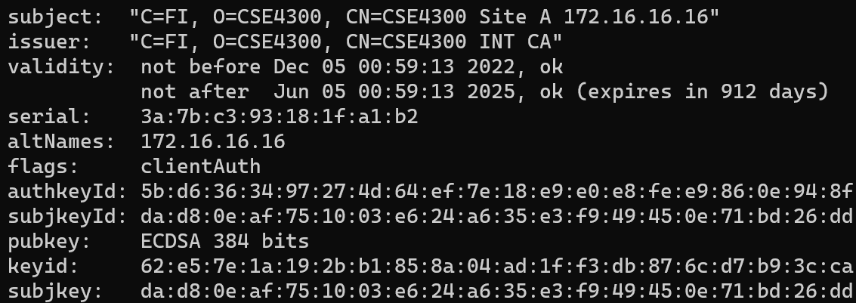
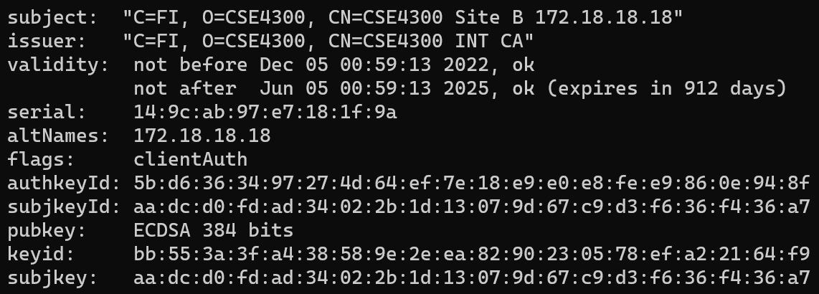
ipsec listcerts （Cloud）

Slide 5

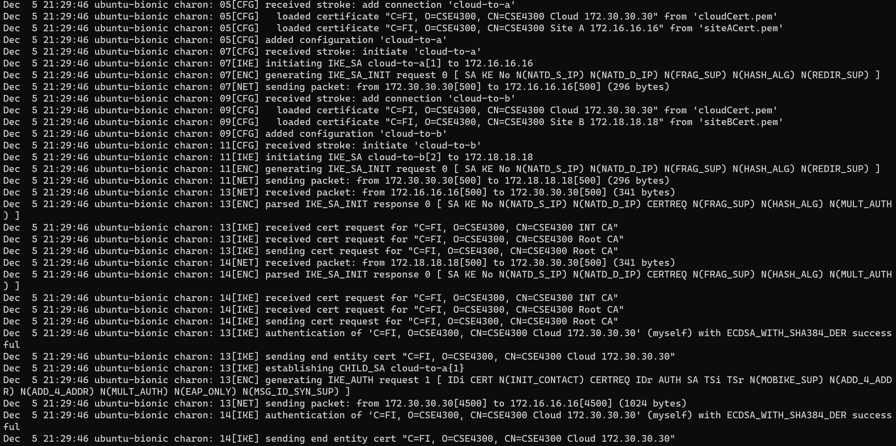
/var/log/syslog that shows the auth process

Slide 6
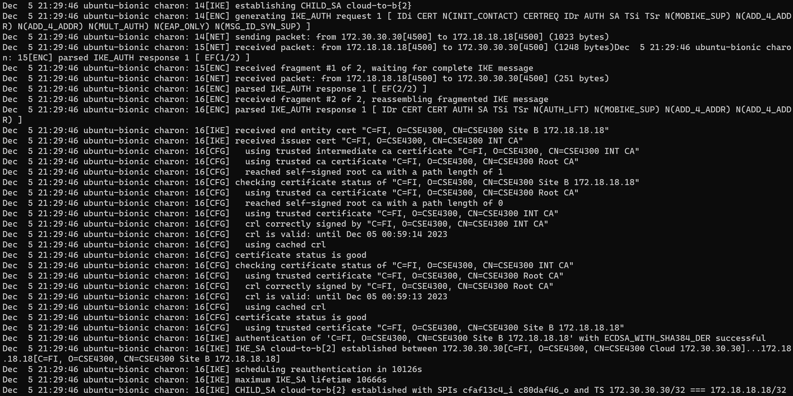
/var/log/syslog that shows the auth process

Slide 7
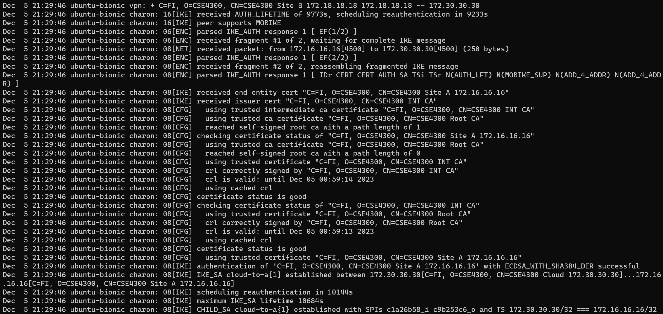
/var/log/syslog that shows the auth process

Slide 8
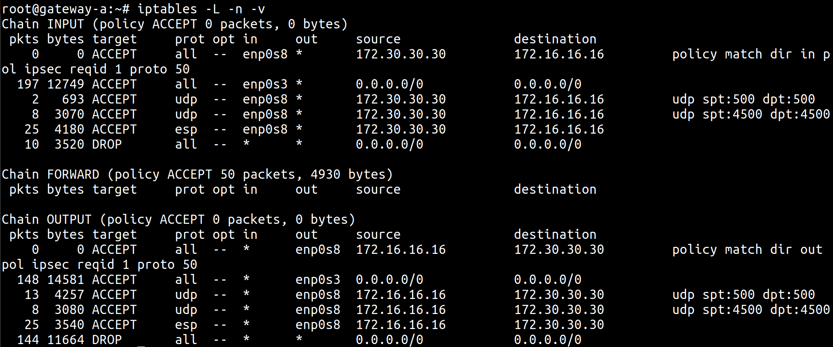

iptables （gateway A）

Slide 9


iptables （gateway B）

Slide 10

iptables （gateway S）

Slide 11


ipsec status

Slide 12





Demo

Slide 13
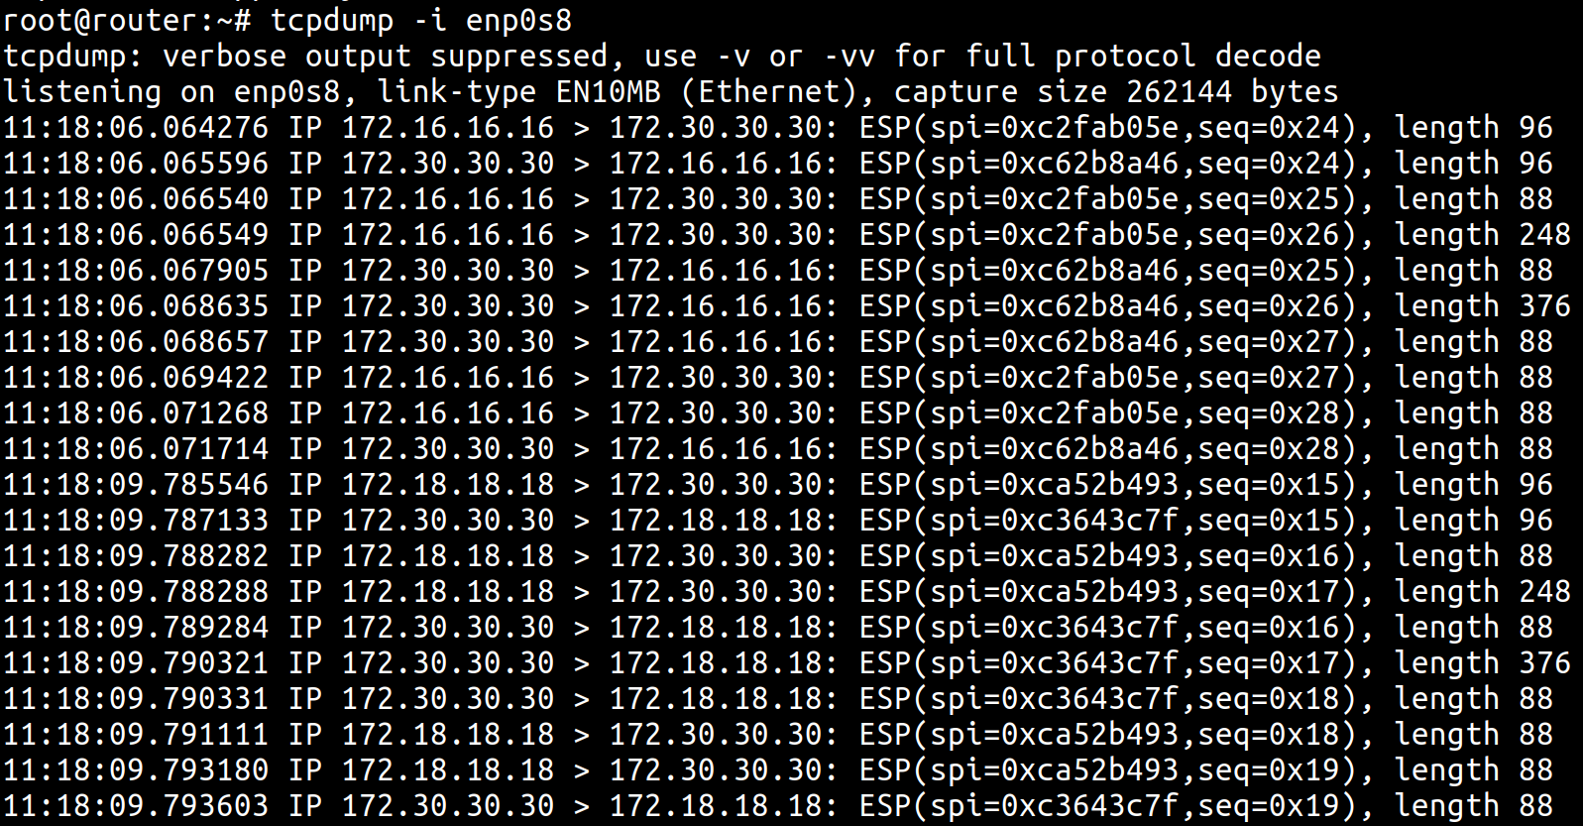
Demo

Slide 14
Questions?

