Slide 1
Network Security Project 2 DEMO
Group 10

Slide 2
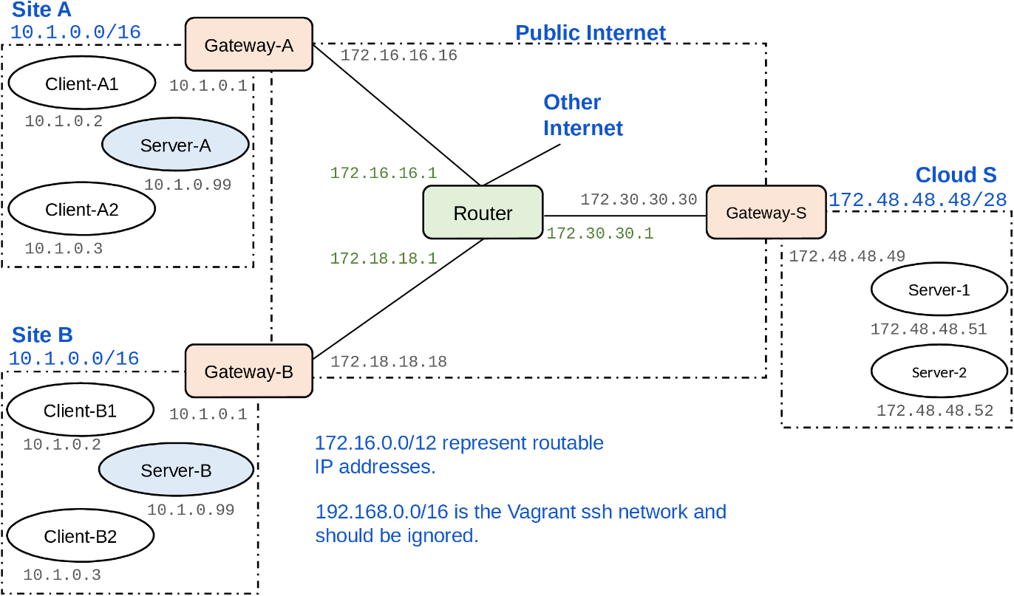
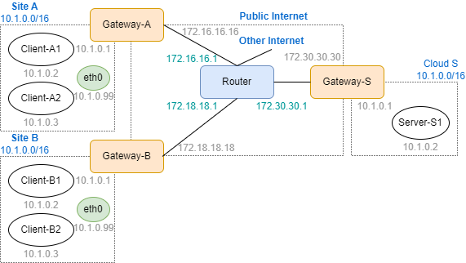
Topology
Before
After

Slide 3
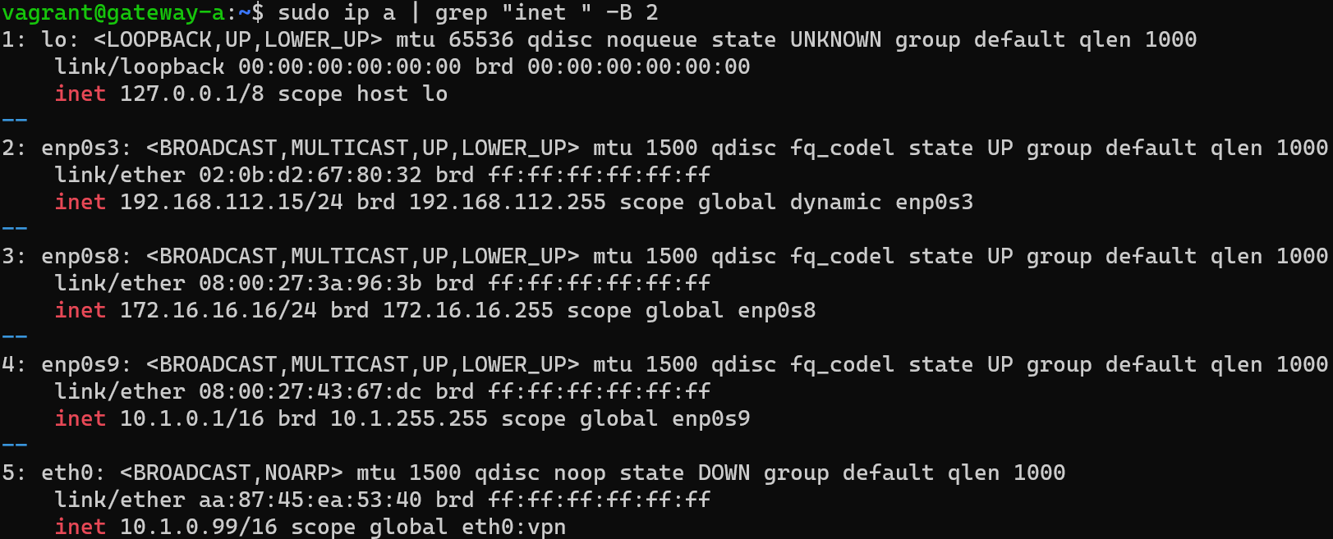


iptables （gateway A）

Slide 4
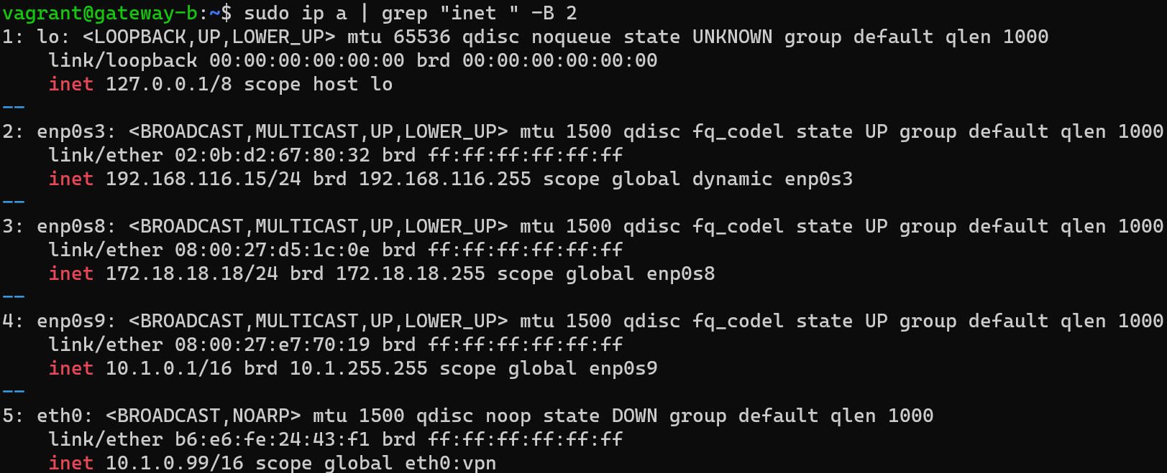


iptables （gateway B）

Slide 5



iptables （gateway S）

Slide 6
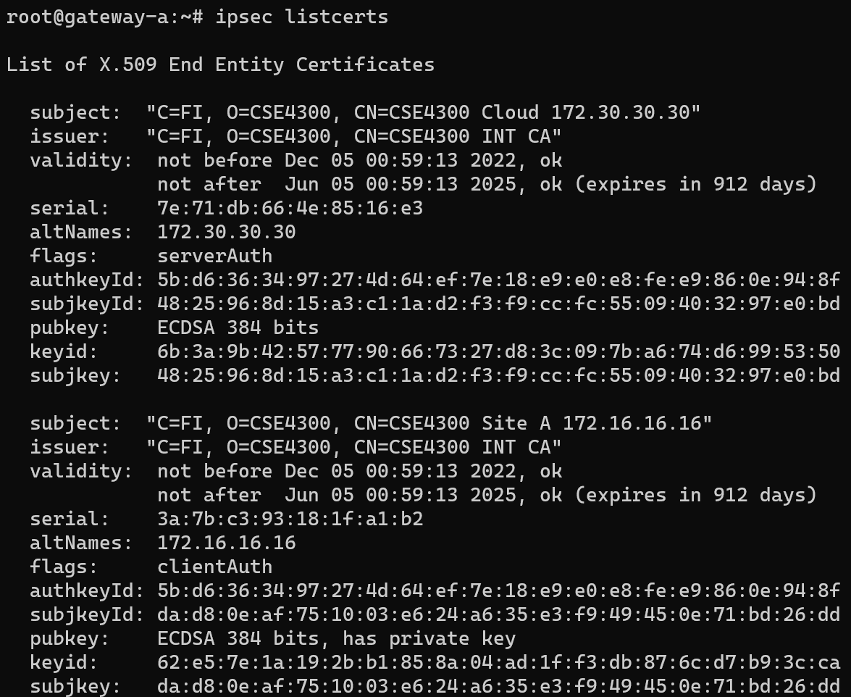
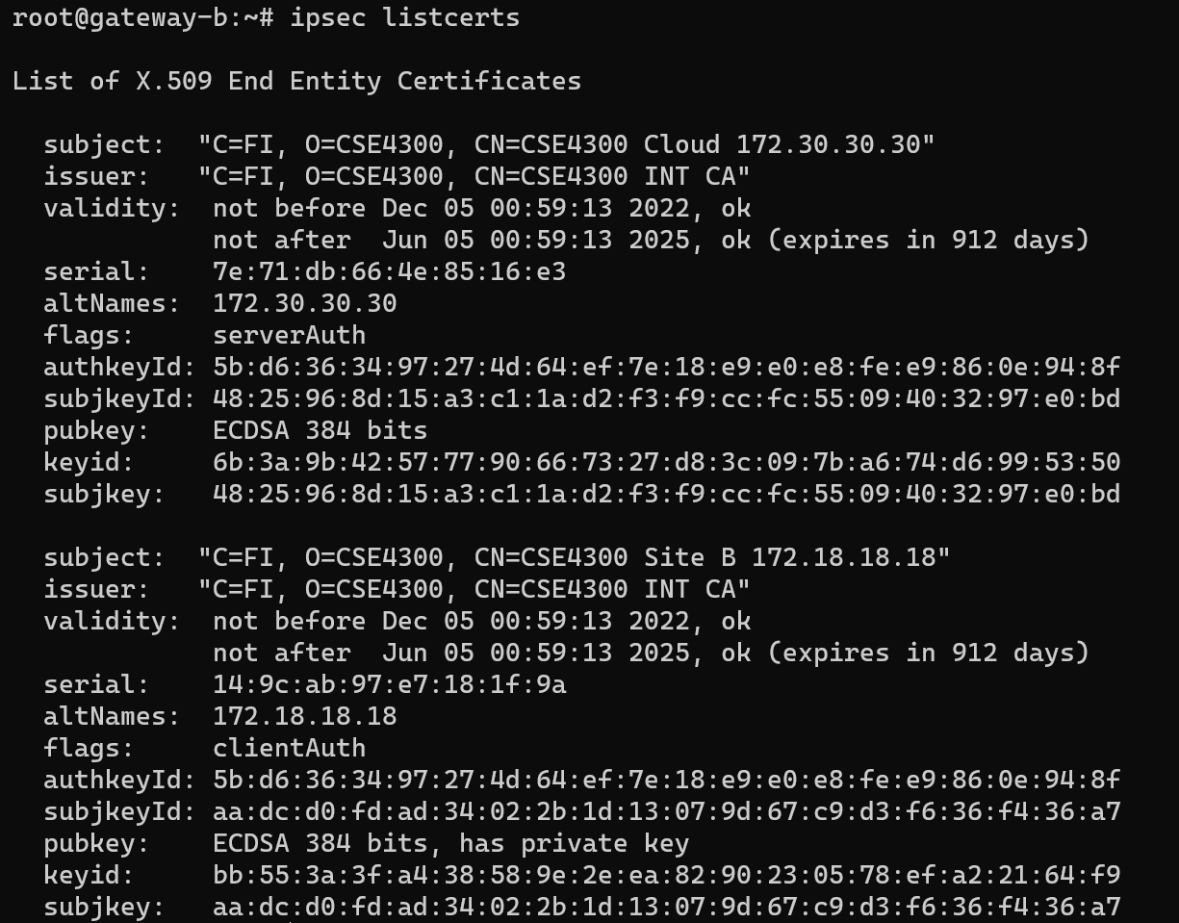
ipsec listcerts （site A and site B）

Slide 7
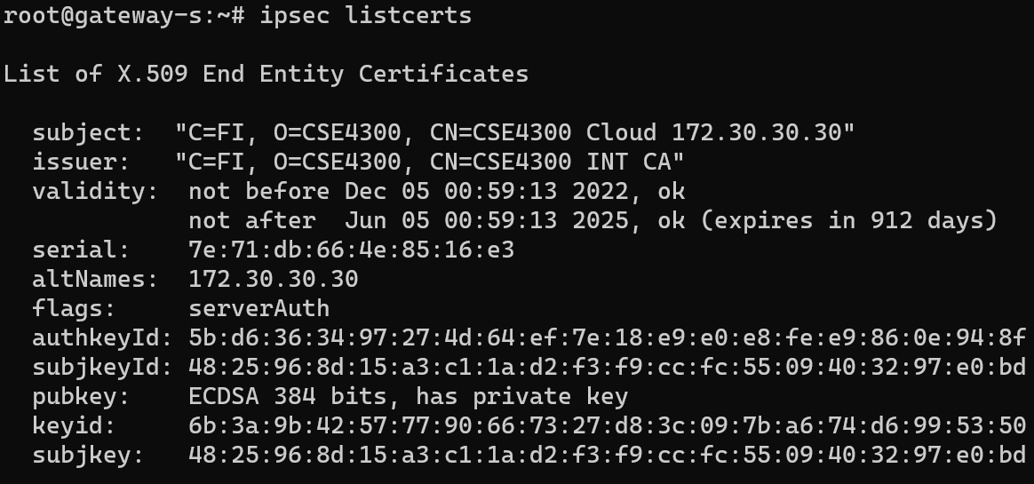
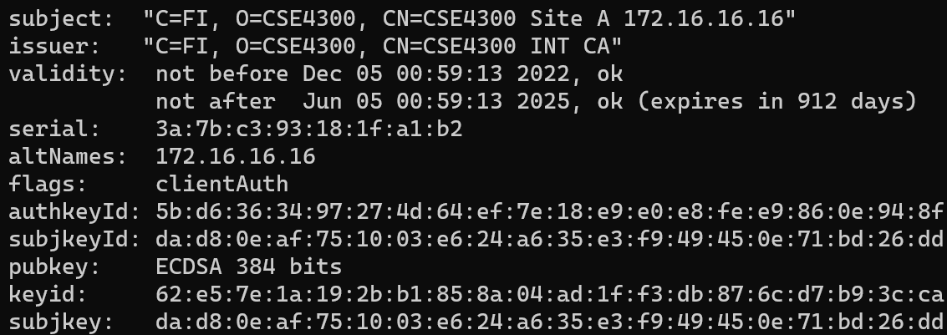
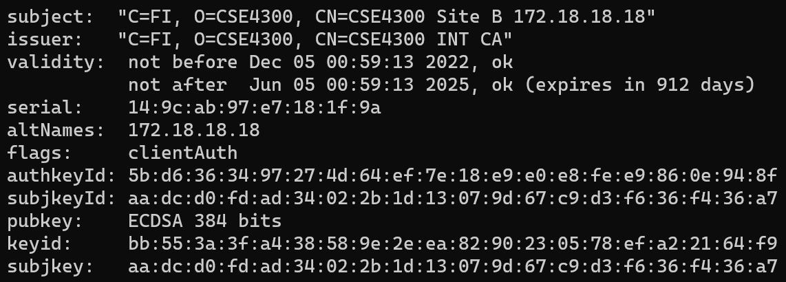
ipsec listcerts （Cloud）

Slide 8

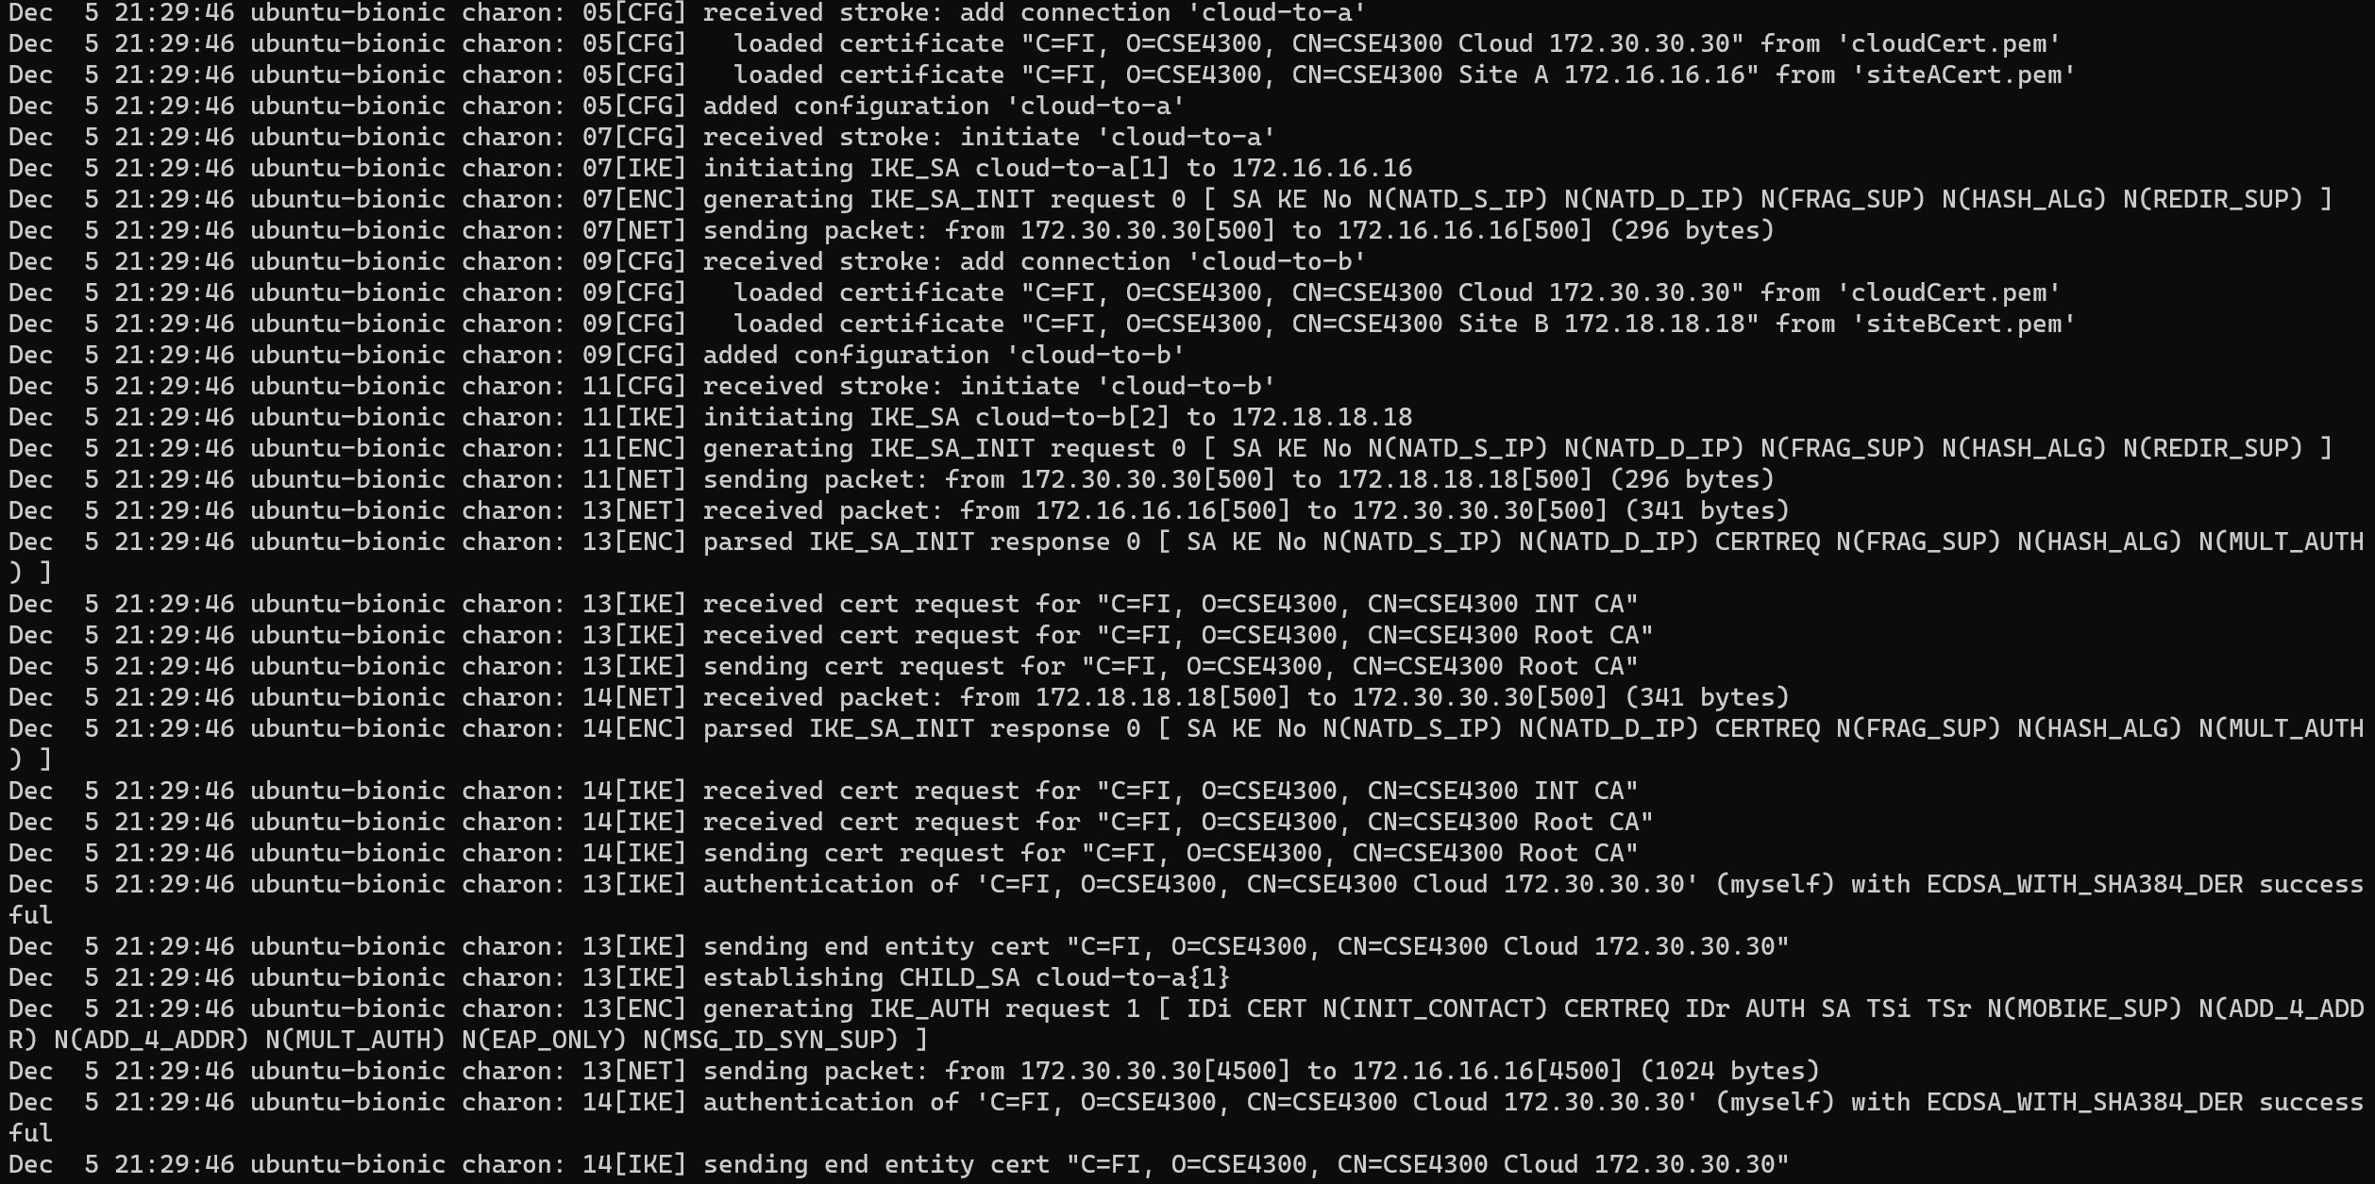
/var/log/syslog that shows the auth process

Slide 9
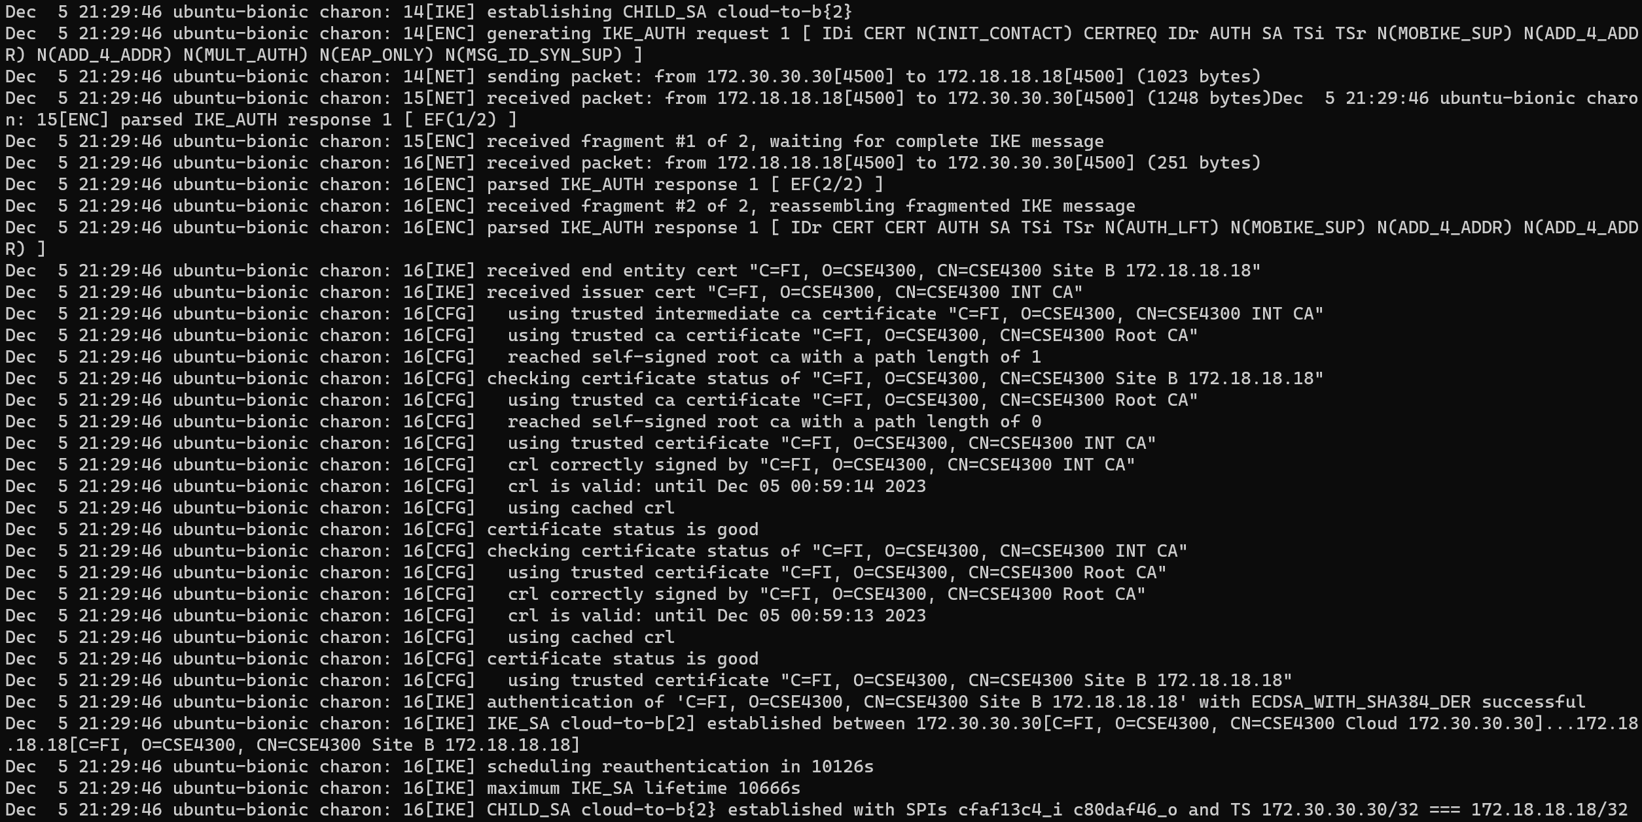
/var/log/syslog that shows the auth process

Slide 10
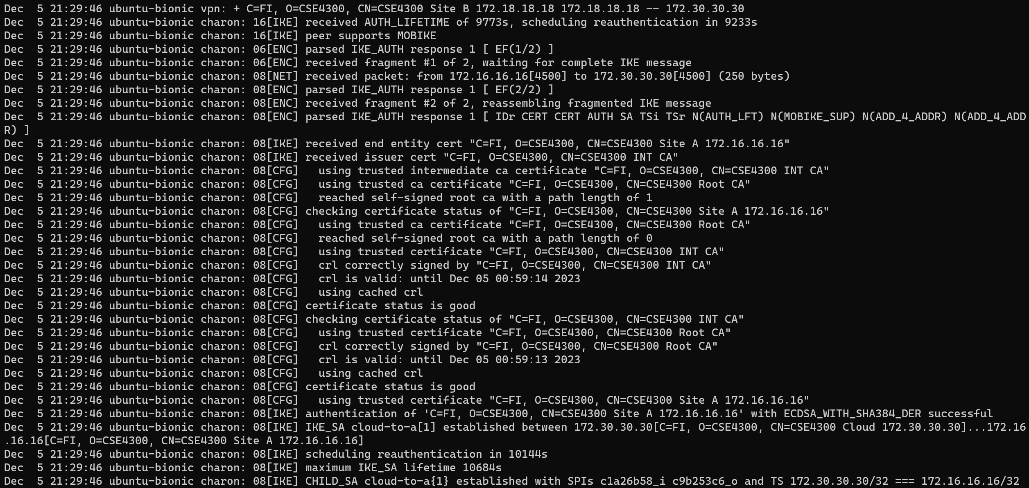
/var/log/syslog that shows the auth process

Slide 11


ipsec status

Slide 12





Demo

Slide 13
Questions?

