Slide 1
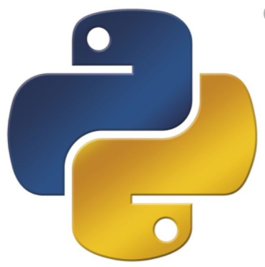
Python Programming
(Business & Analytics)
by Su Lee Seng,
Jan, 2021

Slide 2
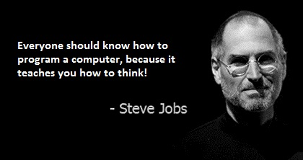
Python Programming
(Business & Analytics)
by Su Lee Seng,
Jan, 2021

Slide 3
Talk is cheap.
show me the code.

Slide 4
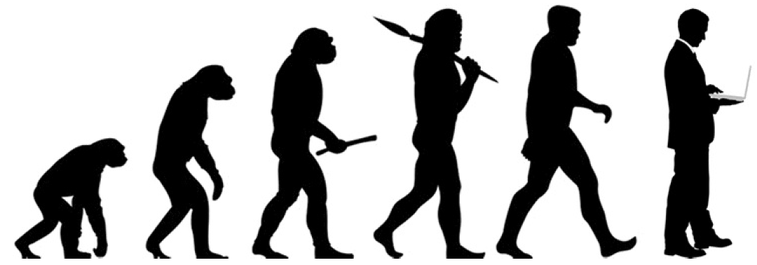
SAP HANA – An Introduction
@ UTAR
by Su Lee Seng,
April, 2014.

Slide 5
Python Basics
Introduction

Slide 6
Python Basics :
Python Execution Model
Python is not a precompiled language in the way that some other languages you may have come across are (such as C++). Instead it is what is known as an interpreted language (although even this is not quite accurate).
An interpreted language is one that does not require a separate compilation phase to convert the human readable format into something that can be executed by a computer. Instead the plain text version is fed into another program (generally referred to as the interpreter) which then executes the program for you.
Python actually uses an intermediate model in that it actually converts the plain text English style Python program into an intermediate 'pseudo' machine code format and it is this intermediate format that is executed.

Slide 7
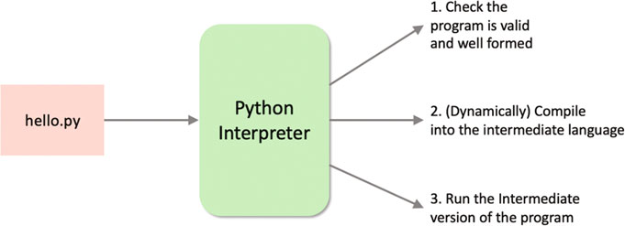
Python Basics :
Python Execution Model
xxxx

Slide 8
Python Basics :
Python Execution Model
The way in which the Python interpreter processes a Python program is broken down into several steps. The steps shown here are illustrative (and simplified) but the general idea is correct.
1. First the program is checked to make sure that it is valid Python. That is a check is made that the program follows all the rules of the language and that each of the commands and operations etc. is understood by the Python environment.

Slide 9
Python Basics :
Python Execution Model
2. It then translates the plain text, English like commands, into a more concise intermediate format that is easier to execute on a computer. Python can store this intermediate version in a file which is named after the original file but with a ‘first.pyc' extension instead of a ‘first.py' extension (the 'c' in the extension indicates it contains the compiled version of the code).
3. The compiled intermediate version is then executed by the interpreter.

Slide 10
Python Basics :
Python Execution Model
When this program is rerun, the Python interpreter checks to see if a '.pyc' file is present. If no changes have been made to the source file since the '.pyc' was created, then the interpreter can skip steps 1 and 2 and immediately run the '.pyc‘ version of the program.
One interesting aspect of Python’s usage is that it can be (and often is) used in an interactive fashion (via Read-Eval-Print-Loop (REPL)), with individual commands being entered and executed one at a time, with context information being built up. This can be useful in debugging situations.

Slide 11
Python Programming
Running Python Program

Slide 12
Python Basics :
Running Python Programs
There are several ways in which you can run a Python program, including
• Interactively using the Python interpreter
• Stored in a file and run using the Python command
• Run as a script file specifying the Python interpreter to use within the script file
• From within a Python IDE (Integrated Development Environment) such as PyCharm.

Slide 13
Python Basics :
1. Interactively Using the Python Interpreter
It is quite common to find that people will use Python in interactive mode. This uses the Python REPL (named after Read Evaluate Print Loop style of operation).
Using the REPL, Python statements and expressions can be typed into the Python prompt and will then be executed directly. The values of variables will be remembered and may be used later in the session.
To run the Python REPL, Python must have been installed onto the computer system you are using. Once installed you can open a Command Prompt window (Windows) or a Terminal window (Mac) and type python into the prompt.
This is shown for a Windows machine below:

Slide 14
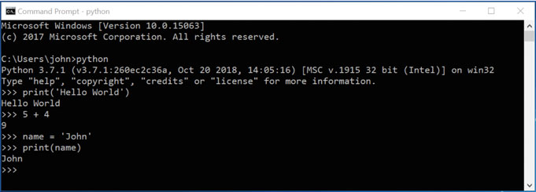
Python Basics :
1. Interactively Using the Python Interpreter
In the above example, we interactively typed in several Python commands and the Python interpreter 'Read' what we have typed in, 'Evaluated' it (worked out what it should do), 'Printed' the result and then 'Looped' back ready for further input.

Slide 15
Python Basics :
1. Interactively Using the Python Interpreter
In this case we …
• Printed out the string 'Hello World'.
• Added 5 and 4 together and got the result 9.
• Stored the string 'John' in a variable called name.
• Printed out the contents of the variable name.
To leave the interactive shell (the REPL) and go back to the console (the system shell), press Ctrl-Z and then Enter on Windows, or Ctrl-D on OS X or Linux.
Alternatively, you could also run the Python command exit() or quit().

Slide 16
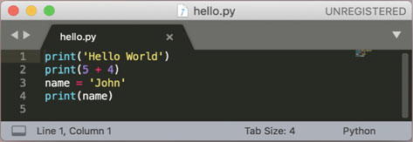
Python Basics :
2. Running a Python File
We can of course store the Python commands into a file. This creates a program file that can then be run as an argument to the python command.
For example, given a file containing the following file (called hello.py) with the 4 commands in it:

Slide 17
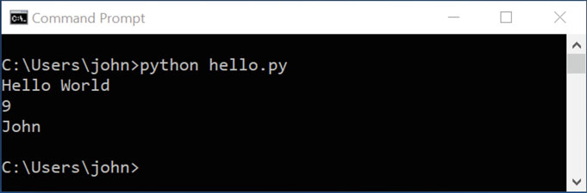
Python Basics :
2. Running a Python File
To run the hello.py program on a PC using Windows we can use the python command followed by the name of the file:
Go to programs, python, python39 and save file with .py extension.
Press F5.

Slide 18
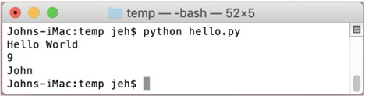
Python Basics :
2. Running a Python File
We can also run the same program on an Apple Mac using MacOS via the python interpreter. For example on a Mac we can do the following:
This makes it very easy to create Python programs that can be stored in files and run when needed on whatever platform is required (Windows, Linux or Mac). This
illustrates the cross platform nature of Python and is just one of the reasons why Python is so popular.

Slide 19
Python Programming – A First Python Program :
3. Using Python in an IDE
We can also use an IDE such as PyCharm to write and execute our Python program. The same program is shown using PyCharm below:

Slide 20
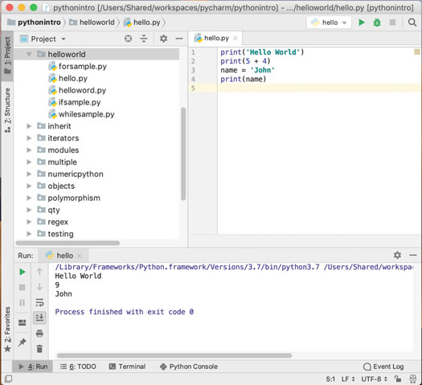
Python Programming – A First Python Program :
Using Python in an IDE
xxx

Slide 21
Python Programming – A First Python Program :
Useful Resources
There are a wide range of resources on the web for Python;
• https://en.wikipedia.org/wiki/Python_Software_Foundation Python Software Foundation.
• https://docs.python.org/3/ The main Python 3 documentation site. It contains tutorials, library references, set up and installation guides as well as Python how-tos.
• https://docs.python.org/3/library/index.html A list of all the builtin features for the Python language—this is where you can find online documentation for the various class and functions that we will be using throughout this book.

Slide 22
Python Programming – A First Python Program :
Useful Resources
• https://pymotw.com/3/ the Python 3 Module of the week site. This site contains many, many Python modules with short examples and explanations of what the modules do. A python module is a library of features that build on and expand the core Python language. For example, if you are interested in building games using Python then pyjama is a module specifically designed to make this easier.
• https://www.fullstackpython.com/email.html is a monthly newsletter that focusses on a single Python topic each month, such as a new library or module.
• http://www.pythonweekly.com/ is a free weekly summary of the latest Python articles, projects, videos and upcoming events.

Slide 23
Python Programming
Setting Up the Python Environment

Slide 24
Setting Up The Python Environment :
Installing Python and IDE
<< PP01aa2 Wkxxpxx - Setting Up the Python Environment .docx >>
<< PP01aa3 Wkxxpxx - IDE - PyCharm .docx >>
<< PP01aa4 Wkxxpxx - IDE - Jupyter .docx >>

Slide 25
Thank you

