Slide 1

Python Programming
(Business & Analytics)
by Su Lee Seng,
June, 2021

Slide 2

Python Programming
(Business & Analytics)
by Su Lee Seng,
Jan, 2021

Slide 3
Talk is cheap.
show me the code.

Slide 4

AI :
An Introduction
Python & Excel :
1. Pandas DataFrames
(( Please, scan QR code for attendance. ))

Slide 5
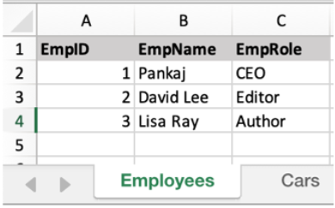
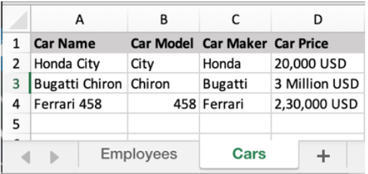
Python and Excel - Using Pandas Dataframes :
1. Panda’s Read_excel()
xxxx

Slide 6
Python and Excel - Using Pandas :
Pandas – An introduction
Pandas package is one of the best ways that you could often use to import your dataset and represent it in a tabular row-column format. The Pandas library is built on top of Numerical Python popularly known as NumPy and provides easy-to-use data structures and data analysis tools for the Python programming language.
Pandas have built-in functions that could be used to analyze and plot your data and make sense of it! Pandas has a set of commands for reading and writing Excel files as well.
Because of the power and flexibility this library provides, it has become the first choice of every data scientist.

Slide 7
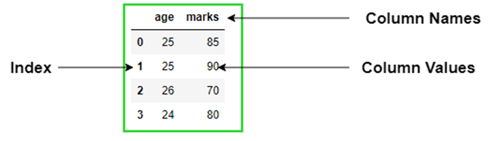
Python and Excel - Using Pandas Dataframes :
1. Panda Dataframes – The Basics
A DataFrame consists of three components: Two-dimensional data values, Row index and Column index. These indices provide meaningful labels for rows and columns. The users can use these indices to select rows and columns. By default, the indices begin with 0.

Slide 8



Python and Excel - Using Pandas Dataframes :
1. Panda Dataframes – Selection
import pandas as pd
data = { “Age": [36.4, 37.7, 35.2], “Income": [123000, 140000, 121000] }
#load data into a DataFrame object:
df = pd.DataFrame(data)
print(df)
print(df[‘Income’])
print(type(df[‘Income’]))
print(df[‘Income’])
Notes:
A Series consists of two components: One-dimensional data values and Index. The index provides meaningful labels for each data value. The users can use this index to select the values. By default, the index begins with 0.

Slide 9

Python and Excel - Using Pandas Dataframes :
1. Panda Dataframes – Selection
print(df[‘Income’,’Age’])

Slide 10



Python and Excel - Using Pandas Dataframes :
1. Selection - Locate Rows
Pandas use the loc attribute to return one or more specified row(s)
#load data into a DataFrame object:
df = pd.DataFrame(data)
print(df)
#refer to the row index:
print(df.loc[1])
print(df.loc[[1]])
#use a list of indexes; return row 0 and 1;
print(df.loc[[0, 1]])
Note: When using [], the result is a Pandas DataFrame.
Notes:
The negative indices count rows from the bottom.
print(df.iloc[[-1, -2, -3, -4, -5]])

Slide 11


Python and Excel - Using Pandas Dataframes :
1. Selection – single column using .loc attribute
Selecting a single column using the .loc attribute
print(df.loc[:, ['Income','Age']])
print(df.loc[[0,2], ['Income','Age']])

Slide 12
Python and Excel - Using Pandas Dataframes :
1. Panda’s Read_excel()
The first parameter is the name of the excel file.
import pandas as pd
cols = [0,1,2,5]
df = pd.read_excel('C:\suleeTest\BankingData.xlsx', sheet_name = 'Sheet11', header = 3, usecols = cols)
## Print whole sheet data
print(df)
print('---The End---')
The sheet_name parameter defines the sheet to be read from the excel file.
When we print the DataFrame object, the output is a two-dimensional table. It looks similar to an excel sheet records.
Notes:
A Pandas DataFrame is a 2 dimensional data structure, like a 2 dimensional array, or a table with rows and columns.

Slide 13
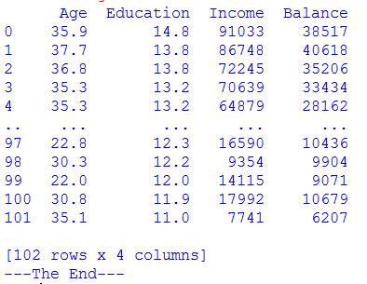
Python and Excel - Using Pandas Dataframes :
1. Panda’s Read_excel()
Specify the columns to be printed.
import pandas as pd
cols = [0,1,2,5]
df = pd.read_excel('C:\suleeTest\BankingData.xlsx', sheet_name = 'Sheet11', header = 3, usecols = cols)
## Print whole sheet data
print(df)
print(df[['Age', 'Income']])
print('---The End---')
Header is on line 4.

Slide 14

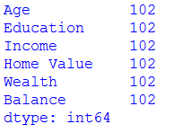
Python and Excel - Using Pandas Dataframes :
1. Panda’s Read_excel() – Total rows
cols = [0,1,2,5]
df = pd.read_excel('C:\suleeTest\BankingData.xlsx', sheet_name = 'Sheet11', header = 3, usecols = cols)
## Print whole sheet data
print(df)
rows = len(df)
print(rows)
print(df.count())
print('---The End---')

Slide 15
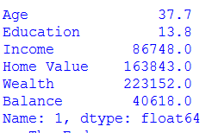

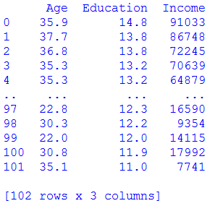
Python and Excel - Using Pandas Dataframes :
1. Selection – single column using .iloc attribute
## Print whole sheet data
print(df[['Age', 'Income']])
rows = len(df)
row = df.iloc[1]
print(row)
row = df.iloc[[1]]
print(row)
row = df.iloc[:, [0,1,2]]
print(row)

Slide 16


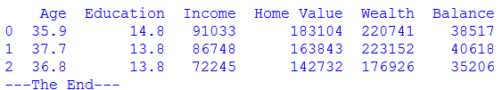
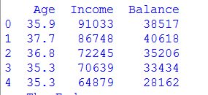
Python and Excel - Using Pandas Dataframes :
1. Selection – single column using .iloc attribute
row = df.iloc[1].Age
print(row)
arow = df.iloc[0:3]
print(arow)
row = df.iloc[0:5,[0,2,3]]
print(row)
print('---The End---')
????

Slide 17
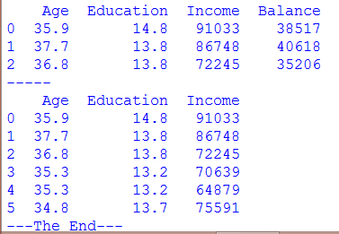
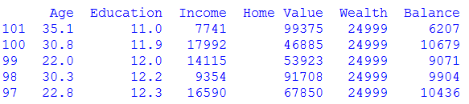
Python and Excel - Using Pandas Dataframes :
1. Selection – rows and columns using .iloc attribute
row = df.iloc[0:3]
print(row)
print('-----')
row = df.iloc[0:6,0:3]
print(row)
print('---The End---')
The negative indices count rows from the bottom.
print(df.iloc[[-1, -2, -3, -4, -5]])
Notes:
print(df.loc[[0,2,4,6,8], [‘Age', ‘Income']])
(can use combination of numbers and/or column labels.

Slide 18

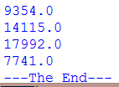
Python and Excel - Using Pandas Dataframes :
1. Selection – using .iloc and values
import pandas as pd
cols = [0,1,2,3,4,5]
df = pd.read_excel('C:\suleeTest\BankingData.xlsx', sheet_name = 'Sheet11', header = 3, usecols = cols)
# determine total rows
rows = len(df)
for xx in range (0, rows):
rowdata = df.iloc[xx].Income
print(rowdata)
print('---The End---')

Slide 19
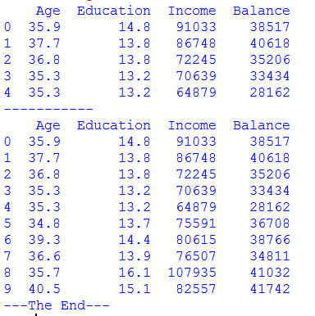
Python and Excel - Using Pandas Dataframes :
1. Panda’s Read_excel() – .head()
import pandas as pd
cols = [0,1,2,5]
df = pd.read_excel('C:\suleeTest\BankingData.xlsx', sheet_name = 'Sheet11', header = 3, usecols = cols)
## Print whole sheet data
print(df.head())
print(‘-----------’)
print(df.head(10))
print('---The End---')

Slide 20
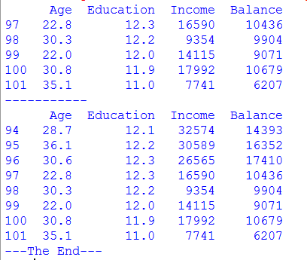
Python and Excel - Using Pandas Dataframes :
1. Panda’s Read_excel() – .tail()
import pandas as pd
cols = [0,1,2,5]
df = pd.read_excel('C:\suleeTest\BankingData.xlsx', sheet_name = 'Sheet11', header = 3, usecols = cols)
## Print whole sheet data
print(df.tail())
print(‘-----------’)
print(df.tail(8))
print('---The End---')

Slide 21
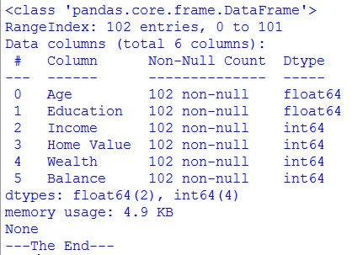

Python and Excel - Using Pandas Dataframes :
1. Panda’s Read_excel() – .info()
import pandas as pd
cols = [0,1,2,3,4,5]
df = pd.read_excel('C:\suleeTest\BankingData.xlsx', sheet_name = 'Sheet11', header = 3, usecols = cols)
## Print whole sheet data
print(df.info())
print(df.shape)
print('---The End---')

Slide 22
Python and Excel - Using Pandas Dataframes :
1. Reading Excel File without Header Row
Reading Excel File without Header Row
If the excel sheet doesn’t have any header row, pass the header parameter value as None.
excel_data_df = pd.read_excel('C:\suleeTest\BankingData.xlsx', sheet_name = 'Sheet11', header=None, usecols = cols)
If you pass the header value as an integer, let’s say 3. Then the third row will be treated as the header row and the values will be read from the next row onwards. Any data before the header row will be discarded.

Slide 23

Python and Excel - Using Pandas Dataframes :
1. Pandas Dataframes - List of Columns Headers of
the Excel Sheet
We can get the list of column headers using the columns property of the dataframe object.
import pandas as pd
cols = [0,1,2,5]
excel_data_df = pd.read_excel('C:\suleeTest\BankingData.xlsx', sheet_name = 'Sheet11', header = 3, usecols = cols)
## Print the name of the column headers
print(excel_data_df.columns.ravel())
print('---The End---')

Slide 24
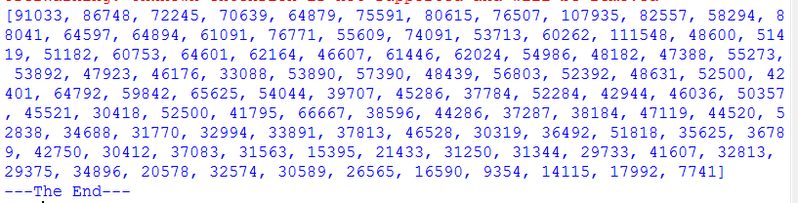
Python and Excel - Using Pandas Dataframes :
1. Pandas Dataframes – Printing a Column data
We can get the column data and convert it into a list of values.
excel_data_df = pd.read_excel('C:\suleeTest\BankingData.xlsx', sheet_name = 'Sheet11', header = 3, usecols = cols)
print(excel_data_df['Income'].tolist())
print('---The End---')
Output :

Slide 25
Python and Excel - Using Pandas Dataframes :
1. Pandas Dataframes – read_excel() usecols
We can specify the column names to be read from the excel file. It’s useful when you are interested in only a few of the columns of the excel sheet.
import pandas as pd
cols = [0,1,2,5]
excel_data_df = pd.read_excel('C:\suleeTest\BankingData.xlsx', sheet_name = 'Sheet11', header = 3, usecols = [‘Age’, ‘Wealth’] )
## Print whole sheet data
print(excel_data_df)
print('---The End---')

Slide 26
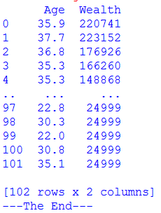
Python and Excel - Using Pandas Dataframes :
1. Pandas Dataframes – read_excel() usecols
import pandas as pd
cols = [0,1,2,5]
excel_data_df = pd.read_excel('C:\suleeTest\BankingData.xlsx', sheet_name = 'Sheet11', header = 3,
usecols = [‘Age’, ‘Wealth’] )
## Print whole sheet data
print(excel_data_df)
print('---The End---')

Slide 27
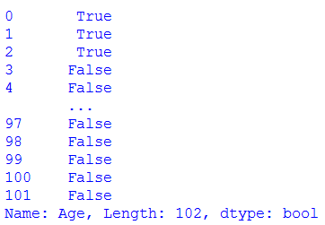
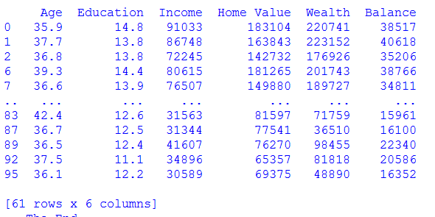
Python and Excel - Using Pandas Dataframes :
1. Filtering – Display rows with certain condition
When we select rows and columns based on specific criteria or conditions, it is referred to as Filtering.
print(df['Age'] > 35.5)
print(df[df['Age'] > 35.5])

Slide 28
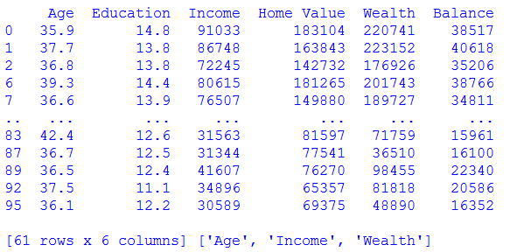
Python and Excel - Using Pandas Dataframes :
1. Filtering – Display rows with certain condition
print(df.loc[df['Age'] > 35.5], ['Age', 'Income', 'Wealth'])

Slide 29
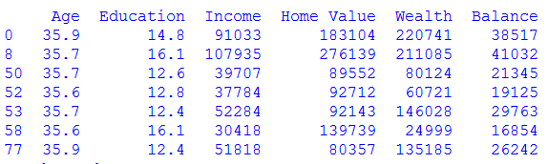
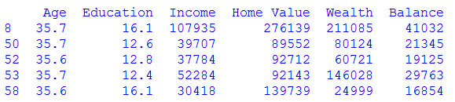
Python and Excel - Using Pandas Dataframes :
1. Filtering – between
print(df.loc[(df['Age'] > 35.5)&(df['Age'] < 36)])
print(df[df['Age'].between(35.5, 35.7)])

Slide 30

Python and Excel - Using Pandas Dataframes :
1. Filtering – inclusive values
print(df[df['Age'].between(35.5, 35.7)])
print(df[df['Age'].between(35.5, 35.7, inclusive=False)])

Slide 31
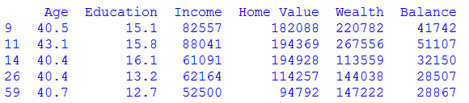
Python and Excel - Using Pandas Dataframes :
1. Filtering – AND operator on different columns
print(df.loc[(df['Age'] > 35.5)&(df['Age'] < 36)])
print(df.loc[(df['Age'] > 40)&(df['Income'] > 50000)])

Slide 32

Python and Excel - Using Pandas Dataframes :
1. Filtering – OR operator
print(df.loc[(df['Age'] > 40)|(df['Income'] > 90000)])
print(df.iloc[[df['Age'].idxmin(), df['Age'].idxmax()]])
(.. subset our data based on the minimum and maximum values of the age variable

Slide 33
AI :
An Introduction
Python & Excel :
Using Pandas
(( Please, scan QR code for attendance. ))

Slide 34
Python and Excel - Using Pandas :
Initial Setting Up
Reading and Writing Excel Files in Python with Pandas
Naturally, to use Pandas, we first have to install it. The easiest method to install it is via pip.
If you're running Windows:
>>> python pip install pandas
If you're using Linux or MacOS:
>>> pip install pandas
Note that you may get a ModuleNotFoundError or ImportError error when running the code in this article.

Slide 35
Python and Excel - Using Pandas :
Initial Setting Up
For example:
ModuleNotFoundError: No module named 'openpyxl'
If this is the case, then you'll need to install the missing module(s):
>>> pip install openpyxl xlsxwriter xlrd
--------------------------------------------------------------------------------
We’ll be using the openpyxl library to access the data in an Excel file. You can install this library with pip:
$ pip install --user openpyxl

Slide 36
AI :
An Introduction
Python & Excel :
1. Using Openpyxl

Slide 37
Python and Excel - Using Pandas (openpyxl) :
Read and Write Excel Files with Openpyxl
The openpyxl package is a Python library offers you high flexibility on how you want to write your data back to Excel files.
It allows you to read , modify Excel spreadsheets and even change cell styles, which makes it one of those packages that you need to know while working with spreadsheets.

Slide 38
Python and Excel - Using Pandas (openpyxl) :
Read and Write Excel Files with Openpyxl
imports the openpyxl module’s load_workbook function so we can use it to read and parse an Excel file and assign the path to the data file to data_file.
The location of the EXCEL datafile to be processed.
from openpyxl import load_workbook
# Load in the workbook
data_file = 'C:\suleeTest\’BankingData.xlsx'
# Load the entire workbook.
wb = load_workbook(data_file)
# Get sheet names
print(wb.sheetnames)
Call load_workbook() with the correct path, and assign the returned object, representing the entire workbook, to wb.

Slide 39
Python and Excel - Using Pandas (openpyxl) :
Read and Write Excel Files with Openpyxl
from openpyxl import load_workbook
# Load in the workbook
data_file = 'C:\suleeTest\BankingData.xlsx'
# Load the entire workbook.
wb = load_workbook(data_file)
# Get sheet names
print(wb.sheetnames)
Output :
['Sheet11', 'Sheet22', 'Sheet3']
You see that the code chunk above returns the sheet names of the workbook that you loaded in Python.
The names of all worksheets in the file are stored in the sheetnames attribute.
Output. Print all the worksheets in the workbook.

Slide 40
Python and Excel - Using Pandas (openpyxl) :
Opening an Excel file (Option 2 ?)
The following code will also open the Excel file and print the names of all worksheets in the file:
from openpyxl import load_workbook
data_file = 'C:\suleeTest\BankingData.xlsx'
# Load the entire workbook.
wb = load_workbook(data_file)
# List all the sheets in the file.
print("Found the following worksheets:")
for shname in wb.sheetnames:
print(shname)
Use variable shname in a for-loop to print Excel sheetname.

Slide 41
Python and Excel - Using Pandas (openpyxl) :
Read and Write Excel Files with Openpyxl
You can also check which sheet is currently active with wb.active. As you can see in the code below, you can also load another sheet from your workbook:
# Get a sheet by name
wsheet = wb[‘Data11']
# Print the sheet title
print('Sheet Title : ',wsheet.title)
# Get currently active sheet
anotherSheet = wb.active
# Check `anotherSheet`
print(anotherSheet)
Specify the attribute..the name of the sheet.
wb.active contains the currently active.
Output :
Sheet Title: Sheet1 <Worksheet "Sheet1">
Notes:
You can also check which sheet is currently active with wb.active.

Slide 42
Python and Excel - Using Pandas (openpyxl) :
Read and Write Excel Files with Openpyxl
This way of extracting values from a cell is quite similar in spirit to selecting and extracting values from NumPy arrays and Pandas data frame via index positions. But with Openpyxl, you need to specify the attribute .value apart from just specifying the index from where you want to extract the value as shown below:

Slide 43
Python and Excel - Using Pandas (openpyxl) :
Accessing cells with Openpyxl
Accessing one cell
>>> varc = wsheet['A5']
>>> print(varc)
>>> print(varc.value)
>>> wsheet['A5'] = 911
>>> vard = wsheet.cell(row=7, column=1)
>>> print(vard)
>>> vard = wsheet.cell(row=7, column=1, value=355)
>>> print(vard)
This will return the cell at A4, or create one if it does not exist yet.
Values can be directly assigned.
Notes:
Note
When a worksheet is created in memory, it contains no cells. They are created when first accessed.

Slide 44
Python and Excel - Using Pandas (openpyxl) :
Accessing cells with Openpyxl
Accessing many cell
>>> cell_range = ws['A1':'C2']
>>> colC = ws['C']
>>> col_range = ws['C:D']
>>> row10 = ws[10]
>>> row_range = ws[5:10]
Ranges of cells can be accessed using slicing.
Ranges of rows or columns can be obtained similarly.
Notes:
Note
When a worksheet is created in memory, it contains no cells. They are created when first accessed.

Slide 45
Python and Excel - Using Pandas (openpyxl) :
Using worksheet.iter.rows()
for row in ws.iter_rows(min_row=5, max_col=3, max_row=10):
for cell in row:
print(cell)
print(cell, ‘---’, cell.value)
Output :
<Cell Sheet1.A1> xx xx
<Cell Sheet1.B1>
<Cell Sheet1.C1>
<Cell Sheet1.A2>
<Cell Sheet1.B2>
……
Display 3 columns only
Notice the difference in the output.
Notes:
Note
When a worksheet is created in memory, it contains no cells. They are created when first accessed.

Slide 46
Python and Excel - Using Pandas (openpyxl) :
Using worksheet.iter.cols()
for col in ws.iter_cols(min_row=5, max_col=4, max_row=10):
for cell in col:
print(cell)
Output :
<Cell Sheet1.A1>
<Cell Sheet1.A2>
<Cell Sheet1.B1>
<Cell Sheet1.B2>
<Cell Sheet1.C1>
….
Display 4 columns only
xx
Notes:
xx

Slide 47
Python and Excel - Using Pandas (openpyxl) :
Using worksheet.rows
>>> ws = wb.active
>>> ws['C9'] = 'hello world'
>>> tuple(ws.rows)
((<Cell Sheet.A1>, <Cell Sheet.B1>, <Cell Sheet.C1>), (<Cell Sheet.A2>, <Cell Sheet.B2>, <Cell Sheet.C2>),
(<Cell Sheet.A3>, <Cell Sheet.B3>, <Cell Sheet.C3>),
(<Cell Sheet.A4>, <Cell Sheet.B4>, <Cell Sheet.C4>),
(<Cell Sheet.A5>, <Cell Sheet.B5>, <Cell Sheet.C5>),
(<Cell Sheet.A6>, <Cell Sheet.B6>, <Cell Sheet.C6>),
(<Cell Sheet.A7>, <Cell Sheet.B7>, <Cell Sheet.C7>),
(<Cell Sheet.A8>, <Cell Sheet.B8>, <Cell Sheet.C8>),
(<Cell Sheet.A9>, <Cell Sheet.B9>, <Cell Sheet.C9>))
Output :
Notes:
If you need to iterate through all the rows or columns of a file, you can instead use the Worksheet.rows property:

Slide 48
Python and Excel - Using Pandas (openpyxl) :
Using worksheet.cols()
>>> tuple(ws.columns)
((<Cell Sheet.A1>,
<Cell Sheet.A2>,
<Cell Sheet.A3>,
<Cell Sheet.A4>,
<Cell Sheet.A5>,
<Cell Sheet.A6>, ...
<Cell Sheet.B7>,
‘<Cell Sheet.B8>,
<Cell Sheet.B9>),
(<Cell Sheet.C1>,
<Cell Sheet.C2>,
<Cell Sheet.C3>,
<Cell Sheet.C4>,
<Cell Sheet.C5>,
<Cell Sheet.C6>,
<Cell Sheet.C7>,
<Cell Sheet.C8>,
<Cell Sheet.C9>)
Notes:
xx

Slide 49
Python and Excel - Using Pandas (openpyxl) :
Values only
If you just want the values from a worksheet you can use the Worksheet.values property. This iterates over all the rows in a worksheet but returns just the cell values:
for row in ws.values:
for value in row:
print(value)
-------------------------------------------------------------------------------
for row in ws.iter_rows(min_row=1, max_col=3, max_row=2, values_only=True):
print(row)
(None, None, None)
(None, None, None)
Notes:
xx

Slide 50
Python and Excel - Using Pandas (openpyxl) :
Read and Write Excel Files with Openpyxl
# Retrieve the value of a certain cell
print(ws['A1'].value)
# Select element 'B3' of your sheet
c = ws['B3']
# Retrieve the row number of your element
print('Row No.:', c.row)
# Retrieve the column number of your element
print('Column Letter:', c.column)
# Retrieve the coordinates of the cell
print('Coordinates of cell:', c.coordinate)
Output :
ID Row No.: 3
Column Letter: 2 Coordinates of cell: B3
Notes:
As you can see, besides the value attribute, there are other attributes that you can use to inspect your cell like row, column, and coordinate.
From the above code cell output when selecting the B3 element from sheet1:
The row attribute gives 3;
Adding the column attribute gives 2, and
The coordinate of the cell gives B3.

Slide 51
Python and Excel - Using Pandas (openpyxl) :
Read and Write Excel Files with Openpyxl
As you can see, besides the value attribute, there are other attributes that you can use to inspect your cell like row, column, and coordinate. From the above code cell output when selecting the B3 element from sheet1:
The row attribute gives 3;
Adding the column attribute gives 2,
The coordinate of the cell gives B3.
Output :
ID Row No.: 3
Column Letter: 2 Coordinates of cell: B3

Slide 52
Python and Excel - Using Pandas (openpyxl) :
Read and Write Excel Files with Openpyxl
You can retrieve cell values by using the sheet.cell() function. All you need to do is pass the row and the column arguments and add the attribute .value in the end, as shown below:
# Retrieve cell value
print(sheet.cell(row=1, column=2).value)
Output :
AGE
Notes:
You can retrieve cell values by using the sheet.cell() function. All you need to do is pass the row and the column arguments and add the attribute .value in the end, as shown above:

Slide 53
Python and Excel - Using Pandas (openpyxl) :
Read and Write Excel Files with Openpyxl
Let's print out the values of the rows that have values in column 2. If those particular cells are empty, you’ll just get back None.
# Print out values in column 2
for i in range(1, 4):
print(i, sheet.cell(row=i, column=2).value)
Output :
1 AGE
2 22
3 15
Notes:
You can retrieve cell values by using the sheet.cell() function. All you need to do is pass the row and the column arguments and add the attribute .value in the end, as shown above:

Slide 54
Python and Excel - Using Pandas (openpyxl) :
Read and Write Excel Files with Openpyxl
The openpyxl has a utility class that has two methods get_column_letter and column_index_from_string. As the name suggests, the former returns the letter given the number/integer and the latter returns the number provided a letter as a string.
# Import relevant modules from `openpyxl.utils`
from openpyxl.utils import get_column_letter, column_index_from_string
# Return 'A‘
print('Column Letter:', get_column_letter(1))
# Return '1'
print('Column Index:', column_index_from_string('A'))
Output :
Column Letter: A
Column Index: 1

Slide 55
Python and Excel - Using Pandas (openpyxl) :
Read and Write Excel Files with Openpyxl
If you want to print out the rows of your file without just focusing on one column → use another for loop.
For example, if you want to focus on the area between A1 and C3, where the first specifies the left upper corner and the second in the right bottom corner of the area on which you want to focus.
Output :
Column Letter: A
Column Index: 1

Slide 56
Python and Excel - Using Pandas (openpyxl) :
Read and Write Excel Files with Openpyxl
# Print row per row
for cellObj in sheet['A1':'C3']:
for cell in cellObj:
print(cell.coordinate, cell.value)
print('--- END ---')
Output :
A1 ID
B1 AGE
C1 SCORE
--- END ---
A2 1
B2 22
C2 5
--- END ---
A3 2
B3 15
C3 6
--- END ---

Slide 57
Python and Excel - Using Pandas (openpyxl) :
Read and Write Excel Files with Openpyxl
You can use max_row and max_column to check up on the result of your import. These attributes are, of course, general ways of making sure that you loaded in the data correctly.
# Retrieve the maximum amount of rows
print('Max Rows:', sheet.max_row)
# Retrieve the maximum amount of columns
print('Max Columns:', sheet.max_column)
Output :
Max Rows: 4
Max Columns: 3

Slide 58
Python and Excel - Using Pandas (openpyxl) ::
Accessing Data from Cells
Now we can access the actual data in the cells. :
from openpyxl import load_workbook
data_file = 'C:\suleeTest\BankingData.xlsx'
# Load the entire workbook.
wb = load_workbook(data_file)
# Load one worksheet.
ws = wb[‘Sheet11']
all_rows = list(ws.rows)
for cell in all_rows[0]:
print(cell.value)
We loop through all cells in the row, and print the value of each cell. This is accessed through the value attribute of the cell object.

Slide 59
Python and Excel - Using Pandas (openpyxl) :
Accessing Data in a Worksheet
To access the actual data in a specific worksheet.→ grab the worksheet, and then extract the data from all rows in the worksheet
from openpyxl import load_workbook
data_file = 'C:\suleeTest\BankingData.xlsx'
# Load the entire workbook.
wb = load_workbook(data_file)
# Load one worksheet.
ws = wb[‘Sheet11']
all_rows = list(ws.rows)
print(f"Found {len(all_rows)} rows of data.")
print("\nFirst rows of data:")
for row in all_rows[:5]:
print(row)

Slide 60
Python and Excel - Using Pandas (openpyxl) :
Accessing Data in a Worksheet
Worksheets are accessed by name through the workbook object. Here we assign a worksheet to ws.
Once you have a worksheet object, you can access all the rows through the ws.rows attribute.
This attribute is a generator, a Python object that efficiently returns one item at a time from a collection.
We can convert this to the more familar list using the list() function.
Here we create a list of all the rows in the workbook.
We then print a message about how many rows were found, and print the first few rows of data:

Slide 61
Python and Excel - Using Pandas (openpyxl) :
Extracting Data from Specific Cells
…...
all_rows = list(ws.rows)
# Pull information from specific cells.
for row in all_rows[1:52]:
state = row[0].value
percent_aa = row[3].value
percent_aa_victims = row[4].value
print(f"{state}")
print(f" {percent_aa}% of residents are African American")
print(f" {percent_aa_victims}% killed by police were African American")
The following example pulls data from three specific columns in each row in the file containing the data.

Slide 62
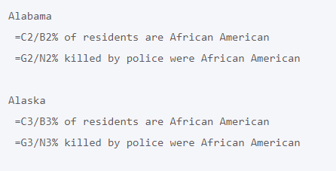
Python and Excel - Using Pandas (openpyxl) :
Extracting Data from Specific Cells
Here we loop through the all of the rows that contain the states’ data. For each row, we pull the values at index 0, 3, and 4, and assign each of these to an appropriate variable name. We then print a statement summarizing what these values mean.
The output isn’t quite what we expect:

Slide 63
Python and Excel - Using Pandas (openpyxl) :
Extracting Data from Specific Cells
The values in these cells are actually formulas. If we want the values computed from these formulas, we need to pass the data_only=True flag when we load the workbook:
from openpyxl import load_workbook
data_file = 'C:\suleeTest\BankingData.xlsx'
# Load the entire workbook.
wb = load_workbook(data_file, data_only=True)
# Load one worksheet.
ws = wb['2013-2019 Killings by State']
all_rows = list(ws.rows)
# Pull information from specific cells.

Slide 64
Python and Excel - Using Pandas (openpyxl) :
Extracting Data from Specific Cells
# Pull information from specific cells.
for row in all_rows[1:52]:
state = row[0].value
percent_aa = row[3].value
percent_aa_victims = row[4].value
print(f"\n{state}")
print(f" {percent_aa}% of residents are African American")
print(f" {percent_aa_victims}% killed by police were African American")

Slide 65
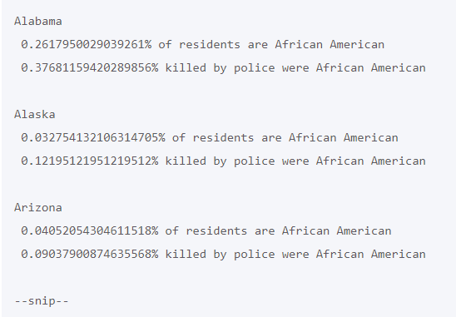
Python and Excel - Using Pandas (openpyxl) :
Extracting Data from Specific Cells
Now we see output that’s much more like what we were expecting:

Slide 66
Python and Excel - Using Pandas (openpyxl) :
Extracting Data from Specific Cells
Data analysis almost always involves some degree of reformatting. For this output, we’ll round the percentages to two decimal places, and turn them into neatly-formatted integers for display:
# Pull information from specific cells.
for row in all_rows[1:52]:
state = row[0].value
percent_aa = int(round(row[3].value, 2) * 100)
percent_aa_victims = int(round(row[4].value, 2) * 100)
Notes:
Be careful about rounding data during the processing phase. If you were going to pass this data to a plotting library, you probably want to do the rounding in the plotting code. This can affect your visualization. For example if two percentages round to the same value in two decimal places but they’re different in the third decimal place, you’ll lose the ability to sort items precisely. In this situation, it’s important to ask whether the third decimal place is meaningful or not.
Also, note that you will often need to identify the specific rows that need to be looped over. Spreadsheets are nice and structured, but people are also free to write anything they want in any cell. Many spreadsheets have some notes in a few cells after all the rows of data. These can be notes about sources of the raw data, dates of data collection, authors, and more. You will probably need to exclude these rows, either by looping over a slice as shown here, or using a try/except block to only extract data if the operation for each row is successful.
Finally, you should be aware that people can modify the hard-coded values in a spreadsheet without updating the values derived from formulas that use those values. If you have any doubt about whether the spreadhseet you’re working from has been updated, you should re-run the formulas yourself before using the data_only=True flag when loading a workbook.

Slide 67
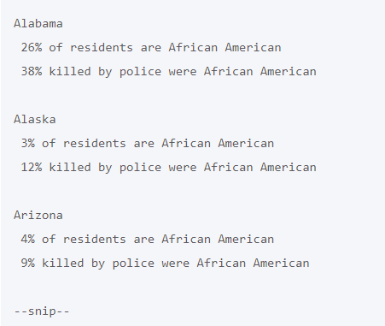
Python and Excel - Using Pandas (openpyxl) :
Extracting Data from Specific Cells
xxxx

Slide 68
Python and Excel - Using Pandas (openpyxl) :
Saving to a file
The simplest and safest way to save a workbook is by using the Workbook.save() method of the Workbook object:
wb = Workbook()
ws1 = wb.active
ws1.title = ‘zzzHeading for Balances’
ws1[‘A3’] = 55
ws1.append([1, 2, 3])
ws1.cell(row=rowid, column=3, value=newpin)
wb.save(‘C:\\suleeTest\\BankingData.xlsx')
Rows can be appended.
Warning :
This operation will overwrite existing files without warning.
Notes:
Warning
This operation will overwrite existing files without warning.

Slide 69
Python and Excel - Using Pandas (openpyxl) :
Summary 1:
from openpyxl import load_workbook
data_file = 'data/mapping_police_violence_snapshot_061920.xlsx'
# Load the entire workbook.
wb = load_workbook(data_file, data_only=True)
# Load one worksheet.
ws = wb['2013-2019 Killings by State']
all_rows = list(ws.rows)
# Pull information from specific cells.
for row in all_rows[1:5]:
state = row[0].value
percent_aa = int(round(row[3].value, 2) * 100)
percent_aa_victims = int(round(row[4].value, 2) * 100)

Slide 70
Python and Excel - Using Pandas (openpyxl) :
Summary 1:
print(f"\n{state}")
print(f" {percent_aa}% of residents are African American")
print(f" {percent_aa_victims}% killed by police were African American")

Slide 71
Python and Excel - Using Pandas (openpyxl) :
Summary 2 (using functions) :
from openpyxl import load_workbook
def get_all_rows(data_file, worksheet_name):
"""Get all rows from the given workbook and worksheet."""
# Load the entire workbook.
wb = load_workbook(data_file, data_only=True)
# Load one worksheet.
ws = wb[worksheet_name]
all_rows = list(ws.rows)
return all_rows

Slide 72
Python and Excel - Using Pandas (openpyxl) :
Summary 2 (using functions) :
def summarize_data(all_rows):
"""Summarize demographic data for police killings of African Americans, for each state in the dataset. """
  for row in all_rows[1:5]:
  state = row[0].value
  percent_aa = int(round(row[3].value, 2) * 100)
  percent_aa_victims = int(round(row[4].value, 2) * 100)
  print(f"\n{state}")
  print(f" {percent_aa}% of residents are African American")
  print(f" {percent_aa_victims}% killed by police were African American")

Slide 73
Python and Excel - Using Pandas (openpyxl) :
Summary 2 (using functions) :
# Main program
data_file = 'data/mapping_police_violence_snapshot_061920.xlsx'
data = get_all_rows(data_file, '2013-2019 Killings by State')
summarize_data(data)

Slide 74
Python and Excel - Using Pandas (openpyxl) :
Iterate through Excel rows in Python
Approach #1:
We will create an object of openpyxl, and then we’ll iterate through all rows from top to bottom.

Slide 75
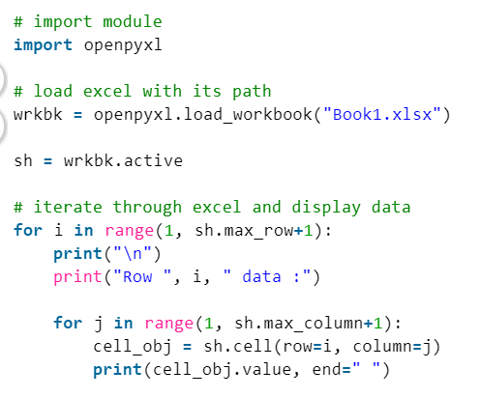
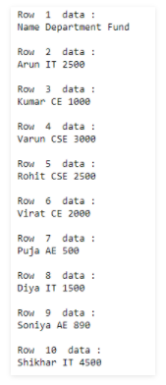
Python and Excel - Using Pandas (openpyxl) :
Iterate through Excel rows in Python
Output :
xx

Slide 76
Python and Excel - Using Pandas (openpyxl) :
Iterate through Excel rows in Python
Approach #2
We will create an object of openpyxl, and then we’ll iterate through all rows using iter_rows() method.

Slide 77
Python and Excel - Using Pandas (openpyxl) :
Iterate through Excel rows in Python
# import module
import openpyxl
# load excel with its path
wrkbk = openpyxl.load_workbook("Book1.xlsx")
sh = wrkbk.active
# iterate through excel and display data
for row in sh.iter_rows(min_row=1, min_col=1, max_row=12, max_col=3):
for cell in row:
print(cell.value, end=" ")
print()

Slide 78
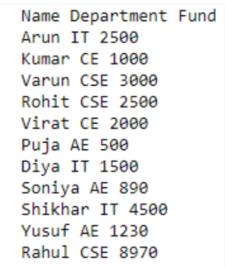
Python and Excel - Using Pandas (openpyxl) :
Iterate through Excel rows in Python
Output

Slide 79

Thank you

