Slide 1

Python Programming
(Business & Analytics)
by Su Lee Seng,
Jan, 2021

Slide 2

Python Programming
(Business & Analytics)
by Su Lee Seng,
Jan, 2021

Slide 3
Talk is cheap.
show me the code.

Slide 4

SAP HANA – An Introduction
@ UTAR
by Su Lee Seng,
April, 2014.

Slide 5

AI :
An Introduction
Python :
Inputs and Outputs Redirection
(( Please, scan QR code for attendance. ))

Slide 6
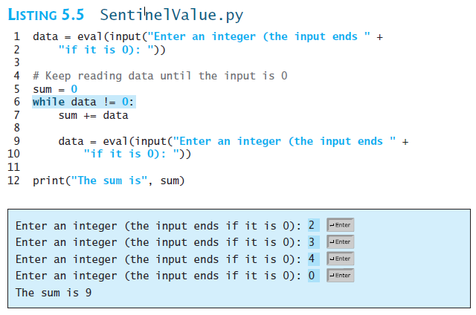
New slide.
Python Programming – Iteration / Looping :
Input and Output Redirections
xx

Slide 7
File Inputs and Outputs :
Input and Output Redirections
If you have a lot of data to enter, it would be cumbersome to type all the entries from the keyboard. You can store the data in a text file (named input.txt, for example) and run the program by using the following command:
python SentinelValue.py < input.txt
This command is called input redirection. Instead of having the user type the data from the keyboard at runtime, the program takes the input from the file input.txt. Suppose the file contains the following numbers, one number per line:
2
3
4
0 → The program should get sum to be 9.

Slide 8
File Inputs and Outputs :
Input and Output Redirections
Similarly, output redirection can send the output to a file instead of displaying it on the screen. The command for output redirection is:
python Script.py > output.txt
Input and output redirection can be used in the same command. For example, the following command gets input from input.txt and sends output to output.txt:
python SentinelValue.py < input.txt > output.txt

Slide 9
File inputs and outputs
Writing Texts & Numbers

Slide 10
File Inputs and Outputs :
Writing Text to a File
If you need to write data to a file, there are three steps to remember:
    Open
    Write
    Close
f = open('example.txt', 'w')
f.write('hello world')
f.close()
There are different modes in which you can open a file:
w to write
r+ to read and write
a to append only

Slide 11
File Inputs and Outputs :
Writing Text to a File
The mode string is 'r' for input files and 'w' for output files. Thus, the following code opens a file object on a file named myfile.txt for output:
>>> f = open("myfile.txt", 'w')
If the file does not exist, it is created with the given filename.
If the file already exists, Python opens it. When an existing file is opened for output, any data already in it are erased.

Slide 12
File Inputs and Outputs :
Writing Text to a File
Writing data using the 'with' syntax
There's a shorter way to write data into a file, and this method can be useful for quick file interactions. It doesn't leave the file open, so you don't have to remember to call the close() function. Instead, it uses the with syntax:
with open('example.txt', 'a') as f:
f.write('hello open source')

Slide 13
File Inputs and Outputs :
Writing Text to a File
String data are written (or output) to a file using the method write with the file object. The write method expects a single string argument. If you want the output text to end with a newline, you must include the escape character '\n' in the string.
The next statement writes two lines of text to the file:
>>> f.write("First line.\nSecond line.\n")

Slide 14
File Inputs and Outputs :
Writing Text to a File (f.close)
When all of the outputs are finished, the file should be closed using the method close, as follows:
>>> f.close()
Failure to close an output file can result in data being lost. The reason for this is that many systems accumulate data values in a buffer before writing them out as large chunks; the close operation guarantees that data in the final chunk are output successfully.

Slide 15
File Inputs and Outputs :
Writing Numbers to a File
The file method write expects a string as an argument. Therefore, other types of data, such as integers or floating-point numbers, must first be converted to strings before being written to an output file. In Python, the values of most data types can be converted to strings by using the str function. The resulting strings are then written to a file with a space or a newline as a separator character.
Five hundred random integers between 1 and 500 are generated and written to a text file named integers.txt.
f = open("integers.txt", 'w')
for count in range(500):
number = random.randint(1, 500)
f.write(str(number) + '\n')
f.close()

Slide 16
File inputs and outputs
Reading Texts & Numbers

Slide 17
File Inputs and Outputs :
Reading Text to a File
f = open('example.tmp', 'r')
for line in f:
print(line)
------------------------------------------------------------------------------
f.close() Reading data using the 'with' syntax
There's a shorter way to read data into a file, and this method can be useful for quick file interactions. It doesn't leave the file open, so you don't have to remember to call the close() function. Instead, it uses the with syntax:
with open('example.txt', ‘r') as f:
f.write('hello open source')

Slide 18
File Inputs and Outputs :
Reading Text from a File
You open a file for input in a similar manner to opening a file for output. The only thing that changes is the mode string, which, in the case of opening a file for input, is 'r'. However, if a file with that name is not accessible, Python raises an error. Here is the code for opening myfile.txt for input:
>>> f = open("myfile.txt", 'r')

Slide 19
File Inputs and Outputs :
Reading Text from a File
There are several ways to read data from an input file. The simplest way is to use the file method read to input the entire contents of the file as a single string. If the file contains multiple lines of text, the newline characters will be embedded in this string. The next session shows how to use the method read:
>>> text = f.read()
>>> text
'First line.\nSecond line.\n‘
>>> print(text)
First line.
Second line.

Slide 20
File Inputs and Outputs :
Reading Text from a File
After input is finished, another call to read would return an empty string, to indicate that the end of the file has been reached. To repeat an input, the file must be reopened, in order to “rewind” it for another input process. (For reading…) It is not necessary to close the file.
Alternatively, an application might read and process the text one line at a time. A for-loop accomplishes this nicely. The for-loop views a file object as a sequence of lines of text. On each pass through the loop, the loop variable is bound to the next line of text in the sequence.

Slide 21
File Inputs and Outputs :
Reading Text from a File
Here is a session that reopens our example file and visits the lines of text in it:
>>> f = open("myfile.txt", 'r')
>>> for line in f:
.. print(line)
First line.
Second line.
Note that print appears to output an extra newline. This is because each line of text input from the file retains its newline character.

Slide 22
File Inputs and Outputs :
Text Files
In cases where you might want to read a specified number of lines from a file (say, the first line only), you can use the file method readline. The readline method consumes a line of input and returns this string, including the newline. If readline encounters the end of the file, it returns the empty string. The next code segment uses our old friend, the while-True-loop, to input all of the lines of text with readline:
f = open("myfile.txt", 'r')
while True:
line = f.readline()
if line == "":
break
print(line)
Output :
First line.
Second line.

Slide 23
File Inputs and Outputs :
Reading Numbers from a File
All of the file input operations return data to the program as strings. If these strings represent other types of data, such as integers or floating-point numbers, the programmer must convert them to the appropriate types before manipulating them further.
In Python, the string representations of integers and floating-point numbers can be converted to the numbers themselves by using the functions int and float, respectively.
When reading data from a file, another important consideration is the format of the data items in the file. During input, these data can be read with a simple for loop.

Slide 24
File Inputs and Outputs :
Reading Numbers from a File
This loop accesses a line of text on each pass. To convert this line to the integer contained in it, the programmer runs the string method strip to remove the newline and then runs the int function to obtain the integer value.
The next code segment → opens the file of random integers written earlier, reads them, and prints their sum.
f = open("integers.txt", 'r')
theSum = 0
for line in f:
line = line.strip()
number = int(line)
theSum += number
print("The sum is", theSum)

Slide 25
File Inputs and Outputs :
Reading Numbers from a File
Obtaining numbers from a text file in which they are separated by spaces is a bit trickier. One method proceeds by reading lines in a for loop, as before. But each line now can contain several integers separated by spaces. You can use the string method split to obtain a list of the strings representing these integers, and then process each string in this list with another for loop.

Slide 26
File Inputs and Outputs :
Reading Numbers from a File
The next code segment modifies the previous one to handle integers separated by spaces and/or newlines.
f = open("integers.txt", 'r')
theSum = 0
for line in f:
wordlist = line.split()
for word in wordlist:
number = int(word)
theSum += number
print("The sum is", theSum)
Note that the line does not have to be stripped of the newline, because split takes care of that automatically.

Slide 27
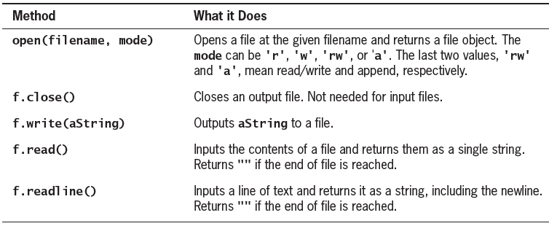
File Inputs and Outputs :
File Inputs and Outputs
xxx

Slide 28
File Inputs and Outputs :
Opening Files
The built-in function open returns a file object. The file object has various methods to allow for reading and writing. We will discuss the most commonly used methods. To read the full documentation on a file object just pass it to the help function. It will list all the methods and describe what they do:
>>> a_file = open (’/ tmp/a.txt ’, ’w ’)
>>> help ( a_file )
Help on file object :
class file ( object )
| file ( name [, mode [, buffering ]]) -> file object
|
| Open a file . The mode can be ’r’, ’w’ or ’a’
...

Slide 29
File inputs and outputs xxxx

Slide 30
File Inputs and Outputs :
Example C7.1
Illustration 7.1: Open a file called “Textfile.txt” in the read mode. Check the name of the file, its mode, and find whether it is closed using the file attributes.
f=open('Textfile.txt','r')
print('Name of the file\t:',f.name)
print('Mode\t:',f.mode)
print('File closed?\t:',f.closed)
f.close()
print('Mode\t:',f.mode)
print('File cloased?\t:',f.closed)
Output :
Name of the file : Textfile.txt
Mode : r
File closed? : False
Mode : r
File closed? : True

Slide 31
File Inputs and Outputs :
Writing files
>>> f = open('TextFile.txt','w')
>>> f.write('Hi there\nHow are you?')
21
>>> f.close()
>>> text=f.read()
>>> text
'Hi there\nHow are you?'
>>> f.close()
Notes:
We will begin with the most basic tasks and then use the functions to write something to a file (say
“TextFile.txt”), and open the file in the write mode. The open function, in this case, will have two parameters: name of the file (“TextFile.txt”) and the mode (“w”). Also, the file needs to be closed. Note that the write function returns the number of bytes written in the file.
----------------------
The read function reads the bytes of the given file. The open function, as stated earlier, may not take any argument. This implies reading a file until the end. The read text can be stored in a string (“text”).
----------------------
A file can be renamed using the rename function of OS. The rename function takes two arguments: the first being the name of the original file and the second being the new name of the file. In the following snippet, a file called
“TextFile.txt” is renamed to “TextFile1.txt” and read into “str” using the open function.
------------------

Slide 32
File Inputs and Outputs :
Writing files
>>> import os
>>> os.rename('TextFile.txt','TextFile1.txt')
>>> f=open('TextFile1.txt','r')
>>> str=f.read()
>>> str
'Hi thereHow are you'
Notes:
We will begin with the most basic tasks and then use the functions to write something to a file (say
“TextFile.txt”), and open the file in the write mode. The open function, in this case, will have two parameters: name of the file (“TextFile.txt”) and the mode (“w”). Also, the file needs to be closed. Note that the write function returns the number of bytes written in the file.
----------------------
The read function reads the bytes of the given file. The open function, as stated earlier, may not take any argument. This implies reading a file until the end. The read text can be stored in a string (“text”).
----------------------
A file can be renamed using the rename function of OS. The rename function takes two arguments: the first being the name of the original file and the second being the new name of the file. In the following snippet, a file called
“TextFile.txt” is renamed to “TextFile1.txt” and read into “str” using the open function.
------------------

Slide 33
File Inputs and Outputs :
Reading n characters and the seek() function
Reading n characters and the seek() function
The use of the read(n) function, which reads the first “n” characters of the file. Note that the tell function tells the position of the cursor, which is why the value of pos changes as and when we move forward.
The seek() function takes two parameters, the first being the offset and the second the position. Note that seek(0, 0) positions the cursor at the first position from the beginning.

Slide 34

Thank you

