Slide 1

Python Programming
(Business & Analytics)
by Su Lee Seng,
Jan, 2021

Slide 2

Python Programming
(Business & Analytics)
by Su Lee Seng,
Jan, 2021

Slide 3
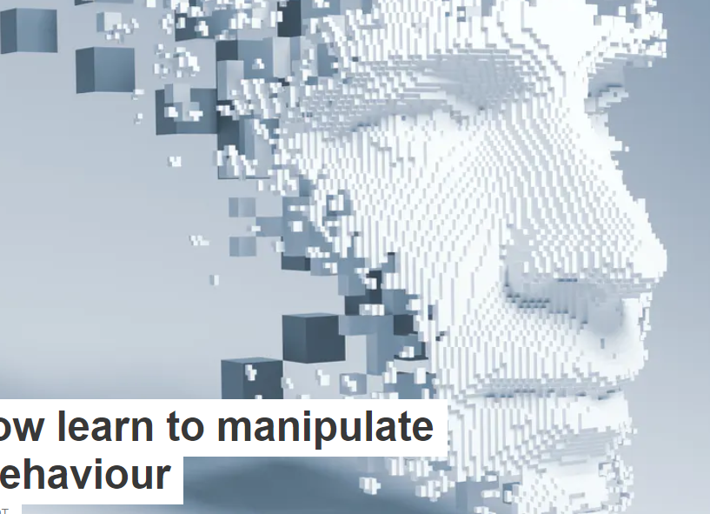
AI :
An Introduction
Object Orientation :
OOP and Methods
(( Please, scan QR code for attendance. ))

Slide 4
New slide.
Introduction to Object Orientation :
Methods
Objects in OOP Python consist of properties and behavior.
Properties of the object are defined by the attributes and the behavior is defined using methods. These methods are defined inside a class. These methods are the reusable piece of code that can be invoked/called at any point in the program.

Slide 5
New slide.
Introduction to Object Orientation :
Methods
There are three main types of methods you will explore :
    •1. Instance methods (←include __init__ and __str__ methods )
    •2. Static methods (not common)
    •3. Class methods
Note: Three important things to remember are-
  You can create any number of objects of a class.
  If the method requires n parameters and you do not pass the same number of arguments then an error will occur.
  Order of the arguments matters.

Slide 6
1. Instance Methods

Slide 7
Introduction to Object Orientation :
1. The Instance method
The purpose of instance methods is to set or get details about instances (objects), and that is why they’re known as instance methods. They are the most common type of methods used in a Python class.
They have one default parameter- self, which points to an instance of the class. Although you don’t have to pass that every time. You can change the name of this parameter but it is better to stick to the convention i.e self.
Any method you create inside a class is an instance method unless you specially specify Python otherwise.
Notes:
xxx

Slide 8

Introduction to Object Orientation :
1. The Instance method
class My_class:
def instance_method(self):
return "This is an instance method."
In order to call an instance method, you’ve to create an object/instance of the class. With the help of this object, you can access any method of the class.
obj = My_class() obj.instance_method()
Notes:
xxx

Slide 9

Introduction to Object Orientation :
1. The Instance method
When the instance method is called, Python replaces the self argument with the instance object, obj. That is why we should add one Along with the default parameter self, you can add other parameters of your choice as well:
class My_class:
def instance_method(self, a):
return f"This is an instance method with a parameter a = {a}.“
# MAIN program
obj = My_class()
obj.instance_method(10)
Notes:
xxx

Slide 10
Introduction to Object Orientation :
1. The Instance method
You can use “self” inside an instance method for accessing the other attributes and methods of the same class:
class My_class:
def __init__(self, a, b):
self.a = a
self.b = b
def instance_method(self):
return f"This is the instance method and it can\ access the variables a = {self.a} and b = {self.b} with\
the help of self.“
#MAIN program
obj = My_class(2,4)
obj.instance_method()
Notes:
xxx

Slide 11
Introduction to Object Orientation :
1. The Instance method
Note that the __init__() method is a special type of method known as a constructor. This method is called when an object is created from the class and it allows the class to initialize the attributes of a class.
Notes:
xxx

Slide 12
Introduction to Object Orientation :
1. The Instance method
Along with the objects of a class, an instance method can access the class itself with the help of self.__class__ attribute.
class My_class():
def instance_method(self):
print("Hello! from %s" % self.__class__.__name__)
# MAIN program
obj = My_class()
obj.instance_method()
The self.__class__.__name__ attribute returns the name of the class to which class instance(self) is related.
Notes:
xxx

Slide 13
New slide.
Introduction to Object Orientation :
1a. The __init__ method
In craeting an instance of a class (eg. Creating a Pet Class), you can our Pet class to create a Pet object called chubbles in the following manner:
chubbles = Pet()
What happens when you create objects from a class in this manner ? Python has a special method called __init__, which is called when you initialize an object from one of our class templates.
Suppose you wanted to specify the height of our Pet. We would add an __init__ method as follows:

Slide 14
New slide.
Introduction to Object Orientation :
1a. The __init__ method
class Pet():
"""
A class to capture useful information regarding my pets, just incase
I lose track of them.
"""
def __init__(self, height):
self.height = height
is_human = False
owner = 'Michael Smith'
The init method takes the height value and assigns it as an attribute of our new object.
You can test this as follows:
chubbles = Pet(height=5)
chubbles.height
Output → : 5

Slide 15
New slide.
Introduction to Object Orientation :
1a. The __init__ method
You can test this as follows:
chubbles = Pet(height=5)
chubbles.height
Output → : 5
The __init__ function is called automatically every time the class is being used to create a new object.
The self parameter is a reference to the current instance of the class, and is used to access variables that belong to the class.

Slide 16
New slide.
Introduction to Object Orientation :
1. The Instance method
import math
class Circle():
is_shape = True
def __init__(self, radius, color='red'):
self.radius = radius
self.color = color
def area(self):
return math.pi * self.radius ** 2
You can now test the area method:
circle = Circle(3)
circle.area()
Output :
28.274333882308138
Notes:
Note :
If you had set area as an attribute of Circle, you would need to update it each time the
radius changed. However, writing it as a method where it is expressed as a function of
the radius makes your code more maintainable.

Slide 17
New slide.
Introduction to Object Orientation :
1. The Instance method
self represents the instance (that is, the object) within the method. This is always the first positional argument of an instance method, and Python passes it to the function without you needing to do anything.
So, in the preceding example, when you call the area function, behind the scenes, Python passes the circle object through as the first argument. This is necessary because it allows you to access other attributes and methods of our Circle object within the method.
Note the elegance of being able to change the radius of our circle without needing to worry about updating the area.
Notes:
Note :
If you had set area as an attribute of Circle, you would need to update it each time the
radius changed. However, writing it as a method where it is expressed as a function of
the radius makes your code more maintainable.

Slide 18
New slide.
Introduction to Object Orientation :
1b. The __str__ method
Like __init__, the __str__ method is another special instance method that you need to know about. This is the method that is called whenever the object is rendered as a string.
class Pet():
def __init__(self, height, name):
self.height = height
self.name = name
is_human = False
owner = 'Michael Smith'
Now you create a pet and print it to the console:
my_pet = Pet(30, 'Chubster')
print(my_pet)
Output :

Slide 19

New slide.
Introduction to Object Orientation :
1b. The __str__ method
class Pet():
def __init__(self, height, name):
self.height = height
self.name = name
is_human = False
owner = 'Michael Smith'
def __str__(self):
return '%s (height: %s cm)' % (self.name, self.height)
Like any instance method, our __str__ method takes self as the first argument in order to access attributes and other methods of the Pet object. You can create another pet:
my_other_pet = Pet(40, 'Rudolf')
print(my_other_pet)
Output :
Notes:
This is a much nicer representation of our Pet object and makes it easier to quickly
inspect objects without diving into the individual attributes. It also makes it easier
for someone to import your code into their work and be able to understand what the
various objects represent.

Slide 20
2. Static Methods

Slide 21
Introduction to Object Orientation :
2. The Static method
Static methods cannot access the class data. In other words, they do not need to access the class data. They are self-sufficient and can work on their own. Since they are not attached to any class attribute, they cannot get or set the instance state or class state.
In order to define a static method, we can use the @staticmethod decorator (in a similar way we used @classmethod decorator). Unlike instance methods and class methods, we do not need to pass any special or default parameters.
Notes:
xxx

Slide 22

Introduction to Object Orientation :
2. The Static method
class My_class:
@staticmethod
def static_method():
return "This is a static method.“
# MAIN program
obj = My_class()
obj.static_method()
And we can call static methods directly, without creating an object/instance of the class:
My_class.static_method()
You can notice the output is the same using both ways of calling static methods.
Notes:
xxx

Slide 23
New slide.
Introduction to Object Orientation :
2. The Static method
Static methods are similar to instance methods, except that they do not implicitly pass the positional self argument. Static methods aren't used as frequently as instance methods, so they only warrant a brief mention here.
Static methods are defined by using the @staticmethod decorator. Decorators allow us to alter the behavior of functions and classes.
Static methods, much like class methods, are methods that are bound to a class rather than its objects.

Slide 24
New slide.
Introduction to Object Orientation :
2. The Static method
The difference between a static method and a class mthod is :
  Static method knows nothing about the class and just deals with the parameters.
  Class method works with the class since its parameter is always the class itself.

Slide 25

Thank you

