Slide 1

Python - Inheritance
by Su Lee Seng,
Jan, 2021

Slide 2


Python Programming
(Business & Analytics)
by Su Lee Seng,
Jan, 2021

Slide 3
Talk is cheap.
show me the code.

Slide 4
Inheritance
Introduction
(( Please, scan QR code for attendance. ))

Slide 5
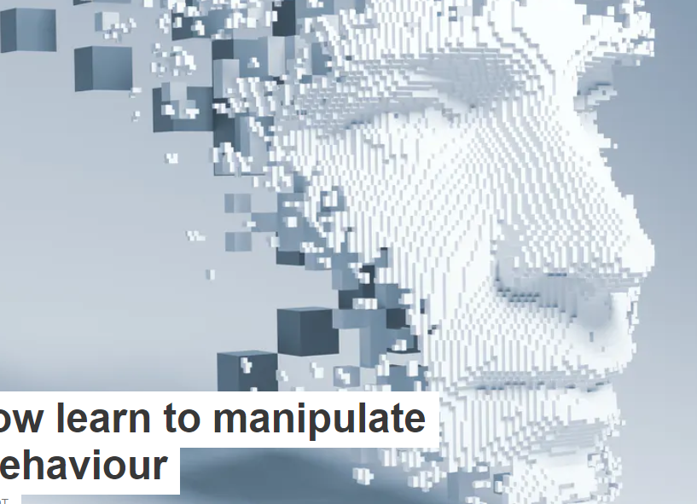
AI :
An Introduction
Python :
Class Inheritance
(( Please, scan QR code for attendance. ))

Slide 6
Python - Inheritance :
Inheritance
Inheritance is a core feature of Object-Oriented Programming. It allows one class to inherit data or behaviour from another class and is one of the key ways in which reuse is enabled within classes.
Class inheritance allows attributes and methods to be passed from one class to another. For example, suppose there is already a class available in a Python package that does almost everything you want.
However, you just wish it had one extra method or attribute that would make it right for your purpose. Instead of rewriting the entire class, you could inherit the class and add additional properties, or change existing properties.

Slide 7
Python - Inheritance :
What is Inheritance ?
Inheritance allows features defined in one class to be inherited and reused in the definition of another class. For example, a Person class might have the attributes name and age. It might also have behaviour associated with a Person such as birthday().
We might then decide that we want to have another class Employee and that employees also have a name and an age and will have birthdays. However, in addition an Employee may have an employee Id attribute and a calculate_pay() behaviour.

Slide 8
Python - Inheritance :
What is Inheritance ?
At this point we could duplicate the definition of the name and age attributes and the birthday() behaviour in the class Employee (for example by cutting and pasting the code between the two classes). However, this is not only inefficient; it may also cause problems in the future.
For example we may realise that there is a problem or bug in the implementation of birthday() and may correct it in the class Person; however, we may forget to apply the same fix to the class Employee.
In general, in software design and development it is considered best practice to define something once and to reuse that something when required.

Slide 9
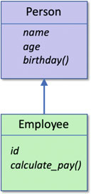
Python - Inheritance :
What is Inheritance ?
In an object-oriented system we can achieve the reuse of data or behaviour via inheritance. That is one class (in this case the Employee class) can inherit features from another class (in this case Person). This is as shown :
In this diagram the Employee class is shown as inheriting from the Person class.
This means that the Employee class obtains all the data and behaviour of the Person class. It is therefore as though the Employee class has defined three attributes name, age and id and two methods birthday() and calculate_pay().

Slide 10
Python - Inheritance :
Inheritance
Class inheritance allows attributes and methods to be passed from one class to another. For example, suppose there is already a class available in a Python package that does almost everything you want.
However, you just wish it had one extra method or attribute that would make it right for your purpose. Instead of rewriting the entire class, you could inherit the class and add additional properties, or change existing properties.

Slide 11
New slide.
Python - Inheritance :
Inheritance
Suppose we wanted to create two classes, one representing cats and the other, dogs.
Our Cat class may look like this:
class Cat():
is_feline = True
def __init__(self, name, weight):
self.name = name
self.weight = weight

Slide 12
Python - Inheritance :
Inheritance
Similarly, our Dog class would look the same, except that it would have a different value for the is_feline class attribute:
class Dog():
is_feline = False
def __init__(self, name, weight):
self.name = name
self.weight = weight
A lot of the preceding code is identical in the two classes. Suppose that, in our program, cats and dogs are sufficiently different to require separate class definitions. You need a way to capture the common information about cats and dogs, without repeating it in both class definitions — enter inheritance.

Slide 13
Python - Inheritance :
Terminology Around Inheritance
Class. A class defines a combination of data and procedures that operate on that data.
Subclass. A subclass is a class that inherits from another class. For example, an Employee might inherit from a class Person. Subclasses are, of course, classes in their own right. Any class can have any number of subclasses.
Superclass. A superclass is the parent of a class. It is the class from which the current class inherits. For example, Person might be the superclass of Employee. In Python, a class can have any number of superclasses.

Slide 14
Python - Inheritance :
Terminology Around Inheritance
Single or multiple inheritance. Single and multiple inheritance refer to the number of super classes from which a class can inherit. For example, Java is a single inheritance system, in which a class can only inherit from one class. Python by contrast is a multiple inheritance system in which a class can inherit from one or more classes.

Slide 15
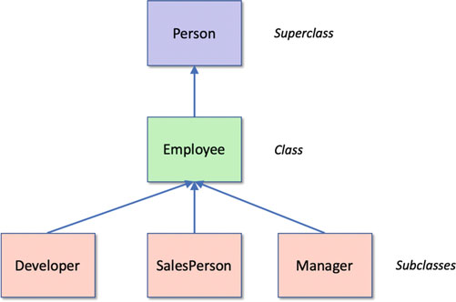
Python - Inheritance :
Terminology Around Inheritance
xxx

Slide 16
Python - Inheritance :
Terminology Around Inheritance
Note that a set of classes, involved in an inheritance hierarchy, such as those shown above, are often named after the class at the root (top) of the hierarchy; in this case it would make these classes part of the Person class hierarchy.

Slide 17
Python - Inheritance :
Types of Hierarchy
In most object-oriented systems there are two types of hierarchy; one refers to inheritance (whether single or multiple) and the other refers to instantiation. The inheritance hierarchy has already been described. It is the way in which one class inherits features from a superclass.
The instantiation hierarchy relates to instances or objects rather than classes and is important during the execution of the object.
There are two types of instance relationships: one indicates a part-of relationship, while the other relates to a using relationship (it is referred to as an is-a relationship). This is illustrated below:

Slide 18
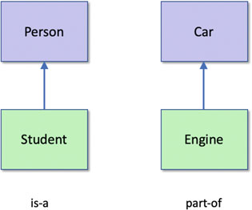
Python - Inheritance :
Types of Inheritance
xxx

Slide 19
Python - Inheritance :
Types of Inheritance
The difference between an is-a relationship and a part-of relationship is often confusing for new programmers (and sometimes for those who are experienced in non object oriented languages). The above figure illustrates that a Student is-a type of Person whereas an Engine is part-of a Car. It does not make sense to say that a student is part-of a person or that an engine is-a type of car!
In Python, inheritance relationships are implemented by the sub-classing mechanism. In contrast, part-of relationships are implemented using instance attributes in Python.

Slide 20
Python - Inheritance :
Types of Inheritance
The problem with classes, inheritance and is-a relationships is that on the surface they appear to capture a similar concept. In the following figure the hierarchies all capture some aspect of the use of the phrase is-a. However, they are all intended to capture a different relationship.
However, in Python, classes such as Employee and Person and an object such as Andrew are different things. We can distinguish between the different types of relationship by being more precise about our definitions in terms of a programming language, such as Python.

Slide 21
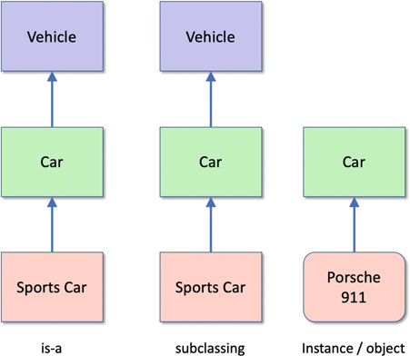
Python - Inheritance :
Types of Inheritance
xxx

Slide 22
Python - Inheritance :
The Class Object and Inheritance
Every class in Python extends one or more superclasses (ie parent classes). Superclass is parent class; subclass is child class. This is true even of the class Person shown below:
class Person:
def __init__(self, name, age):
self.name = name
self.age = age
This is because if you do not specify a superclass explicitly Python automatically adds in the class object as a parent class. Thus the above is exactly the same as the following listing which explicitly lists the class object as the superclass of Person:

Slide 23
Python - Inheritance :
The Class Object and Inheritance
class Person(object):
def __init__(self, name, age):
self.name = name
self.age = age
Both listings above define a class called Person that extends the class object.
Notes:
- It is common to find that Python developers still use the long hand (explicit) form when defining classes
that directly extend object. The fact that all class eventually inherit from the class object means that
behaviour defined in object is available for all classes everywhere.

Slide 24
Python - Inheritance :
The Built-in Object Class
The class object is the base (root) class for all classes in Python. It has methods that are therefore available in all Python objects. It defines a common set of special methods and intrinsic attributes. The methods include the special methods
    __str__(),
    __init__(),
    __eq__() (equals)
    __hash__() (hash method).
It also defines attributes such as __class__, __dict__, __doc__ and __module__.

Slide 25
Python - Inheritance :
Extending Superclass (Parent class) Methods
However, in the previous section we had to duplicated the code in Person down in Employee so that we could convert the name and age attributes into strings.
However we can avoid this duplication by invoking the parent class’s method from within the child class version (as we in fact did for the __init__() initialiser/ constructor. ).
For example:

Slide 26
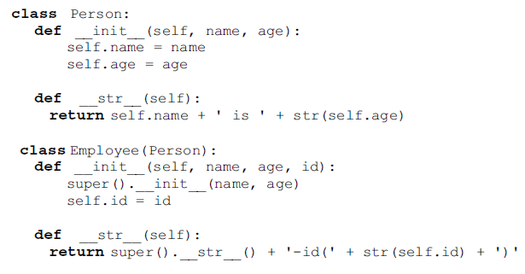
Python - Inheritance :
Extending Superclass (Parent class) Methods
xxx

Slide 27
Python - Inheritance :
Extending Superclass (Parent class) Methods
In this version of the code the Employee classes version of the __str__() method first calls the parent classes version of this method and then adds the location information to the string returned from that. This means that we only have one location that converts name and age into a string.
p = Person('John', 54)
print(p)
e = Employee('Denise', 51, 1234)
print(e)
Output :
John is 54
Denise is 51 - id(1234)

Slide 28
Python - Inheritance :
Inheritance Oriented Naming Conventions
There are two naming conventions to be aware of with respect to Python classes and inheritance. These are that
• Single underbar convention. Methods or instance variables/attributes (those accessed via self) whose names start with a single under bar are considered to be protected that is they are private to the class but can be accessed from any subclass. Their scope is thus the class and any subclasses (either direct subclasses or any level of sub subclass).
• Double underbar convention. Method or instance variables/attributes (those accessed via self) whose names start with a double under bar should be considered private to that class and should not be called from outside of the class. This includes any subclasses; private means private to the class and only to that class.

Slide 29
Types of Inheritance
(i). Single Inheritance

Slide 30
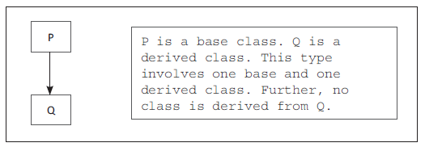
Python - Inheritance :
Types of Inheritance – Single Inheritance
(i) Single inheritance: Only one base class is used for deriving a new class. The derived class is not used as the base class.

Slide 31
Python - Inheritance :
Single Inheritance - Example
The ‘A’ inside the brackets indicates that class B inherits the properties of its base class A.
class A:
print(‘Hello I am in Base Class’)
class B(A):
print(‘Wow!! Great ! I am Derived class’)
ob2 = B() #Instance of class B
Output :
Hello I am in Base Class
Wow!! Great! I am Derived class
Notes:
In the above program, we have created the parent class, i.e. (base class) class A and child class class B(A): (also called the derived class). The ‘A’ inside the brackets indicates that class B inherits the properties of its base class A. The instance of the derived class, i.e. the instance ob2 is invoked to execute the functionality of the derived class.

Slide 32
Python - Inheritance :
Single Inheritance
Single inheritance, also known as sub-classing, involves creating a child class that inherits the attributes and methods of a single parent class. Taking the preceding example of cats and dogs, we can instead create a Pet class that represents all the common parts of the Cat and Dog classes:
class Pet():
def __init__(self, name, weight):
self.name = name
self.weight = weight

Slide 33
Python - Inheritance :
Single Inheritance
The Cat and Dog classes can now be created by sub-classing the parent class, Pet:
class Cat(Pet):
is_feline = True
class Dog(Pet):
is_feline = False
You can check whether this is working as expected:
my_cat = Cat('Kibbles', 8)
my_cat.name
Output :
'Kibbles'

Slide 34
Python - Inheritance :
Single Inheritance
Now the logic in the init method is specified only once, and our Cat and Dog classes simply inherit it from the parent class, Pet. Now, if you decide to change the logic in the init method, you don't need to change it in two places, making our code easier to maintain.
Likewise, it will be easier in the future to create different types of Pet classes. Additionally, you could create further subclasses of the Dog class if you wanted to create different types of Dog classes depending on breed. You can show the structure of our classes as a hierarchy, much like a family tree:

Slide 35
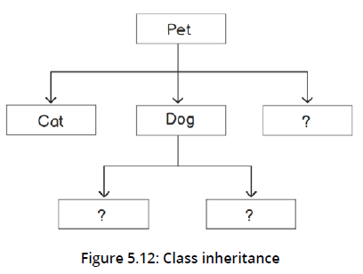
Python - Inheritance :
Single Inheritance
xxx
<< Exercise A81 >>

Slide 36

Python - Inheritance :
Single Inheritance (Example)
class Parent:
def f1(self):
print("Function of parent class.")
class Child(Parent):
def f2(self):
print("Function of child class.")
object1 = Child() #MAIN program
object1.f1()
object1.f2()
Here the class Child is inheriting only one class Parent, hence this is an example of Single inheritance.

Slide 37
Types of Inheritance
(ii). MultiLevel Inheritance

Slide 38
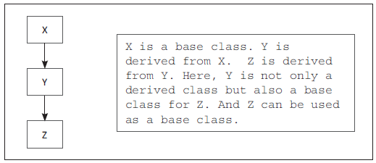
Python - Inheritance :
Types of Inheritance – Multilevel Inheritance
(ii) Multilevel inheritance: When a class is derived from another derived class, the derived class acts as the base class. This is known as multilevel inheritance.

Slide 39
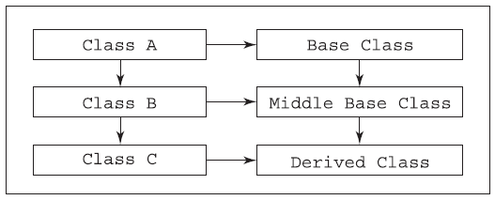
Python - Inheritance :
Types of Inheritance – Multilevel Inheritance
xxx

Slide 40
Python - Inheritance :
Types of Inheritance – Multilevel Inheritance
See example i Practical Lab exercise

Slide 41
Types of Inheritance
(iii). Mutiple Inheritance

Slide 42
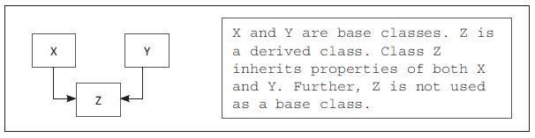
Python – Multiple Inheritance :
Types of Inheritance – Multiple Inheritance
(iii) Multiple inheritance: When two or more base classes are used for deriving a new class, it is called multiple Inheritance.

Slide 43
Python - Multiple Inheritance :
Terminology Around Inheritance
The syntax to define inheritance (i.e. to inherit a single base class) in Python is:
Class Derived_Class_Name(Single_Base_Class_Name):
Body_of_Derived_Class
The syntax to inherit multiple base classes is:
Class Derived_Class_Name(Comma_Seperated_Base_Class_Names):
Body_of_Derived_Class

Slide 44
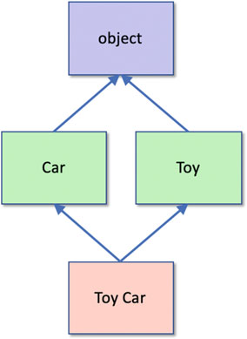
Python - Multiple Inheritance :
Python and Multiple Inheritance
Python supports the idea of multiple inheritance; that is a class can inherit from one or more other classes (many object-oriented languages limit inheritance to a single class such as Java and C#).
This idea is illustrated by the following diagram. In this case the class ToyCar inherits from the class Car and the class Toy. In turn the Car and Toy classes inherit from the (default) base class object.

Slide 45
Python - Multiple Inheritance :
Python and Multiple Inheritance
The syntax for defining multiple inheritance in Python allows multiple superclasses to be listed in the parent class list (defined by the brackets following the class name). Each parent class is separated by a comma. The syntax is thus:
class SubClassName(BaseClassName1, BaseClassName2, … BaseClassNameN):
class-body
For example :
class Car:
""" Car """
class Toy:
""" Toy """
class ToyCar(Car, Toy):
""" A Toy Car """

Slide 46
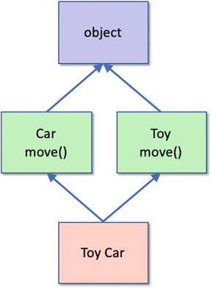
Python - Multiple Inheritance :
Python and Multiple Inheritance
We can say that the class ToyCar inherits all the attributes (data) and methods (behaviour) defined in classes Car, Toy and object.
One of the fundamental questions that this raises is how is inheritance of behaviour managed within a multiple inheritance hierarchy. The challenge that multiple inheritance possesses is illustrated by adding a couple of methods to the class hierarchy we are looking at. In this example we have added the method move() to both the class Car and the class Toy:

Slide 47
Python - Multiple Inheritance :
Python and Multiple Inheritance
The question here is which version of the method move() will be run when an instance of the ToyCar class is instantiated and we call toy_car.move()?
This illustrates (a simple version of) the so-called “diamond inheritance” problem.
The issue is that with multiple base classes from which attributes or methods may be inherited, there is often ambiguity that must be resolved. Here, when we create an instance of the class ToyCar, and call the move() method, does this invoke the one inherited from the Car base class or from the Toy base class?

Slide 48
Python - Multiple Inheritance :
Python and Multiple Inheritance
The answer is that in Python 3, a breadth first search is used to find methods defined in parent classes; this means that when the method move() is called on ToyCar, it would first look in Car; it would then only look in Toy if it could not find a method move() in Car. If it cannot find the method in either Car or Toy it would then look in the class object.
As a result, it will find the version in Car first and use that version.

Slide 49
Python - Multiple Inheritance :
Python and Multiple Inheritance
class Car:
def move(self):
print('Car - move()')
class Toy:
def move(self):
print('Toy - move()')
class ToyCar(Car, Toy):
""" A Toy Car """
tc = ToyCar()
tc.move()
Output :
Car - move()

Slide 50
Python - Multiple Inheritance :
Python and Multiple Inheritance
However, if we alter the order in which the ToyCar inherits from the parent classes such that we swap Toy and Car around:
class ToyCar(Toy, Car):
""" A Toy Car """
This shows that the order in which a class inherits from multiple classes is significant In Python.
Output :
Toy - move()

Slide 51
Python - Multiple Inheritance :
Python and Multiple Inheritance
At first sight multiple inheritance in Python might appear to be particularly useful; after all it allows you to mix together multiple concepts into a single class very easily and quickly. This is certainly true and it can be a very flexible feature if used with care. However, the word care is used here and should be noted.
Multiple inheritance can also be very dangerous and is quiet a contentious topic for programmers and for those designing programming languages. Few things in programming are inherently bad but multiple inheritance can result in a level of complexity (and unexpected behaviour) that can tie developers in knots.

Slide 52
Python - Multiple Inheritance :
Python and Multiple Inheritance
Part of the problem highlighted by those protesting against multiple inheritance is down to the increased complexity and ambiguity that can occur with multiple inheritance trees that may interconnect between the different classes. One way to think of this is that if a class inherits from multiple classes, then that class may have the same classes in the class hierarchy multiple times, this can make it hard to determine which version of a method may execute and this may allow bugs to go untouched or indeed introduce expected issues due to different interactions between methods. This is exacerbated when inherited methods call super() using the same method name such as:
def get_data(self):
return super().get_data() + 'FData'

Slide 53
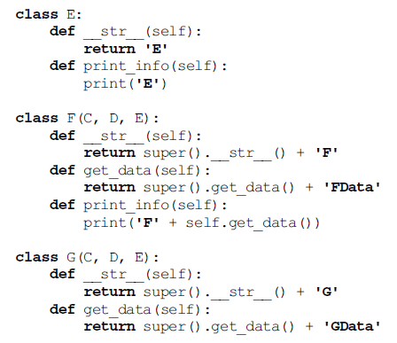
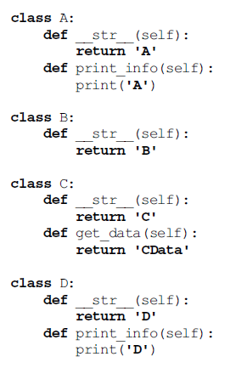
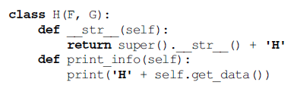
( An Example) :
Multiple Inheritance
xxx

Slide 54
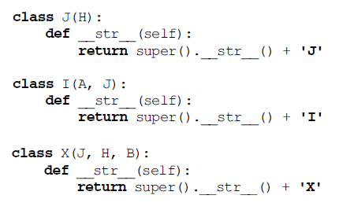
Multiple Inheritance ( An Example) :
Multiple Inheritance (An Example)
xxx

Slide 55
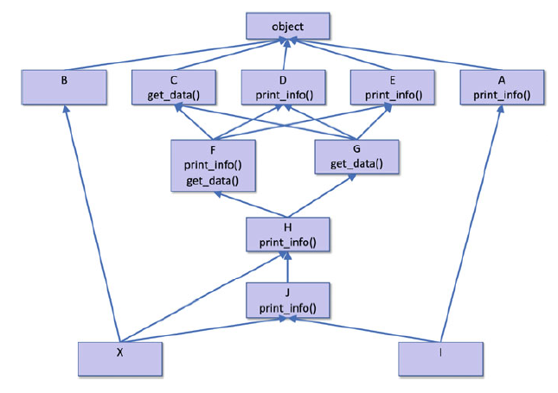
Python - Multiple Inheritance :
Python and Multiple Inheritance (An Example)
xxx
Notes:
The following diagram presents a somewhat convoluted multiple inheritance example where the class names A-X have been used so that there is no semantic meaning attributable to the inherited classes. Different classes define several common methods (print_info() and get_data()).
All the classes in the hierarchy define a __str__() method that returns the class name; if the class extends a class other than object, then the super version of __str__() is also invoked:

Slide 56
Python - Multiple Inheritance :
Python and Multiple Inheritance (An Example)
We can now use the X class in a simple Python program:
x = X()
print('print(x):', x)
print('-' * 25)
x.print_info()
The question now is what is the output from this program?
What is the string printed to represent X? What is printed out as a result of calling the method print_info()? The output from this simple code is:
Output :
print(x): CGFHJX
-------------------------
HCDataGDataFData

Slide 57
Python - Multiple Inheritance :
Python and Multiple Inheritance (An Example)
However, if we change the order of inheritance for the class ‘H’ from (F, G) to (G, F) then the output changes:
This is of course because the search order, back up through the class hierarchy, is now different.
Output :
print(x): CFGHJX
-------------------------
HCDataFDataGData
Note that this change came about not because of a modification we made to the class we instantiated (that is the class X), but from the order of the classes that one of its parents inherited from. This can be one of the unintended consequences of multiple inheritance; changing something in the multiple class hierarchy at one level can break some behaviour further down the hierarchy in a class that is unknown to the developer.

Slide 58
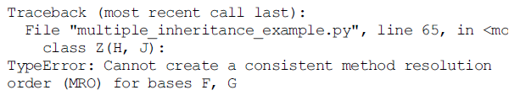
Python - Multiple Inheritance :
Python and Multiple Inheritance (An Example)
Also note that the class inheritance diagram we presented earlier did not state what order the parent classes were listed in for any specific class (this was left to the discretion of the programmer).
Of course Python is not ambiguous nor does it get confused; it is the human developer that can get confused and be surprised with the behaviour that is then presented.
Indeed, if you try and define a class hierarchy which Python cannot resolve into a consistent structure it will tell you so, for example:

Slide 59
Python - Multiple Inheritance :
Python and Multiple Inheritance (An Example)
What can be confusing is that Python’s ability to produce a consistent structure can also be dependent on the order of inheritance. For example, if we modify the classes that ‘X’ inherits from such that the order is I and J:
class X(I, J):
def __str__(self):
return super().__str__() + 'X‘
Output :
print(x): AIX
-------------------------
A

Slide 60
Python - Multiple Inheritance :
Python and Multiple Inheritance (An Example)
However, if we change the order of the parent classes such that we swap I and J:
class X(J, I):
def __str__(self):
return super().__str__() + 'X‘
We now get a TypeError exception raised:
Output :
Traceback (most recent call last):
File "multiple_inheritance_example.py", line 73, in <module>
class X(J, I):
TypeError: Cannot create a consistent method resolution
order (MRO) for bases J, I

Slide 61
Python - Multiple Inheritance :
Python and Multiple Inheritance (An Example)
Therefore, in general care needs to be taken when utilising multiple inheritance; but that is not to say that such situations are not useful.
In some cases you want a class to inherit from parents that have complete different hierarchies and are completely separate from each other; in such situations multiple inheritance can be very useful—these so called orthogonal behaviours are one of the best uses of multiple inheritance and should not be ignored merely due to concerns of increased complexity.

Slide 62
Python - Multiple Inheritance :
Types of Inheritance - Example
Class Point: #Base Class
def Set_Cordinates(self,X, Y):
self.X = X
self.Y = Y
class New_Point(Point): #Derived Class
def draw(self):
print(‘ Locate Point X = ‘,self.X,’ On X axis’)
print(‘ Locate Point Y = ‘,self.Y,’ On Y axis’)
P = New_Point() #Instance of Derived Class
P.Set_Cordinates(10,20)
P.draw()
Output :
Locate Point X = 10 On X axis
Locate Point Y = 20 On Y axis
Notes:
The instance of the derived class P is created. It is used to initialise the two member variables, X and Y. Set_Cordinates() method is used to initialise the values of X and Y. The instance, P can access this method since it has been inherited from the parent class. Finally, the draw() method is called to draw the point. Thus, the child class New_Point has access to all the attributes and methods defined in its parent class.

Slide 63
Python - Multiple Inheritance :
Types of Inheritance – Example 2
class Parent_1:
def f1(self):
print("Function of parent_1 class.")
class Parent_2:
def f2(self):
print("Function of parent_2 class.")
class Parent_3:
def f3(self):
print("function of parent_3 class.")

Slide 64
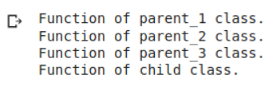
Python - Multiple Inheritance :
Types of Inheritance – Example 2
class Child(Parent_1, Parent_2, Parent_3):
def f4(self):
print("Function of child class.")
object_1 = Child()
object_1.f1()
object_1.f2()
object_1.f3()
object_1.f4()

Slide 65
Python - Multiple Inheritance :
Types of Inheritance – Example 2
Here we have one Child class which is inheriting properties of three-parent classes Parent_1, Parent_2, and Parent_3. All the classes have different functions and all of the functions are called using the object of the Child class.

Slide 66
Python - Multiple Inheritance :
Types of Inheritance – Example 2
But suppose a child class inherits two classes having the same function:
class Parent_1:
def f1(self):
print("Function of parent_1 class.")
class Parent_2:
def f1(self):
print("Function of parent_2 class.")
class Child(Parent_1, Parent_2):
def f2(self):
print("Function of child class.")
obj = Child() #MAIN program
obj.f1()

Slide 67

Python - Multiple Inheritance :
Types of Inheritance – Example 2
Here, the classes Parent_1 and Parent_2 have the same function f1(). Now, when the object of Child class calls f1(), since Child class is inheriting both the parent classes, what do you think should happen?
But why not the function f1() of the class Parent_2 was inherited?

Slide 68
Python - Multiple Inheritance :
Types of Inheritance – Example 2
In multiple inheritance, the child class first searches the method in its own class. If not found, then it searches in the parent classes depth_first and left-right order. Since this was an easy example with just two parent classes, we can clearly see that class Parent_1 was inherited first so the child class will search the method in Parent_1 class before searching in class Parent_2.
But for complicated inheritance problems, it gets tough to identify the order. So the actual way of doing this is called Method Resolution Order (MRO) in Python. We can find the MRO of any class using the attribute __mro__
Child.__mro__

Slide 69
Python - Multiple Inheritance :
Types of Inheritance – Example 2
We can find the MRO of any class using the attribute __mro__
Child.__mro__
This tells that the Child class first visited the class Parent_1 and then Parent_2, so the f1() method of Parent_1 will be called.

Slide 70
Python - Multiple Inheritance :
Types of Inheritance – Example 3
Let’s take a bit complicated example in Python:
class Parent_1: pass class Parent_2: pass class Parent_3: pass class Child_1(Parent_1,Parent_2): pass class Child_2(Parent_2,Parent_3): pass class Child_3(Child_1,Child_2,Parent_3): pass
Here, the class Child_1 is inheriting two classes – Parent_1 and Parent_2. The class Child_2 is also inheriting two classes – Parent_2 and Parent_3. Another class Child_3 is inheriting three classes – Child_1, Child_2 and Parent_3.

Slide 71
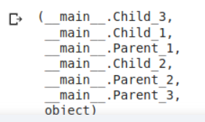
Python - Multiple Inheritance :
Types of Inheritance – Example 3
Now, just by looking at this inheritance, it is quite hard to determine the Method Resolution Order for class Child_3. So here is the actual use of __mro__-
Child_3.__mro__
We can see that first, the interpreter searches Child_3, then Child_1 followed by Parent_1, Child_2, Parent_2, and Parent_3 respectively.

Slide 72
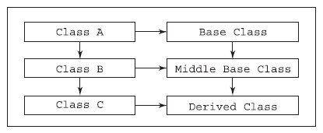
Python - Inheritance :
MultiLeveL Inheritance in Detail
The procedure of deriving a class from a derived class is called multilevel inheritance.

Slide 73
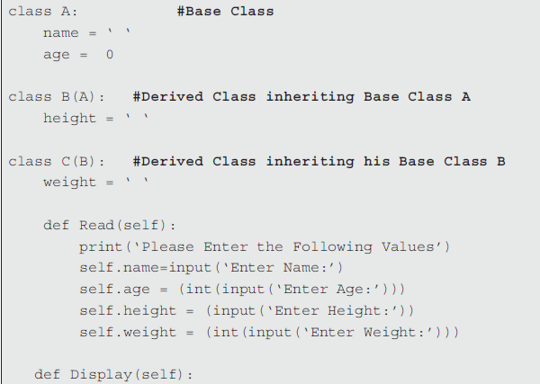
Python - Inheritance :
MultiLeveL Inheritance in Detail - Example
xxx

Slide 74
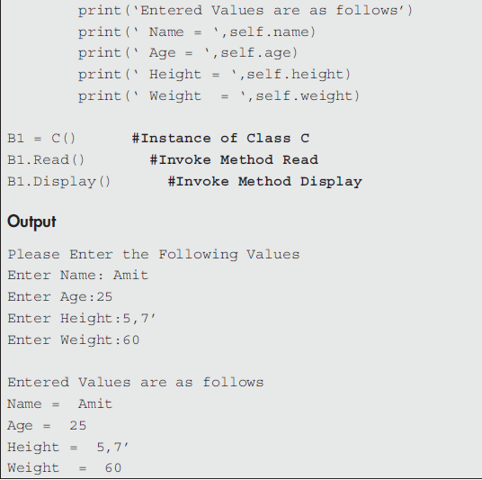
Python - Inheritance :
MultiLeveL Inheritance in Detail - Example
xxx
Notes:
In the above program class A, B and C are declared. The member variables of all these classes are initialised with the default value as zero. Class B is derived from class A. Class C is derived from class B. Thus, class B acts as the derived class as well as the base class for class C. The method read() reads data through the keyboard and the method Display() displays data on the screen. Both the functions are invoked using the object B1 of class C.

Slide 75
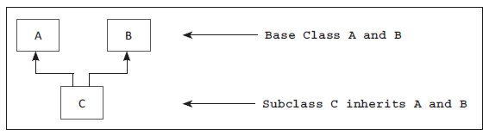
Python - Inheritance :
Multiple Inheritance in Detail
When two or more base classes are used for derivation of a new class, it is called multiple inheritance. Let us create a two base classes A, B and one child class C. The child class C inherits the classes A and B.

Slide 76
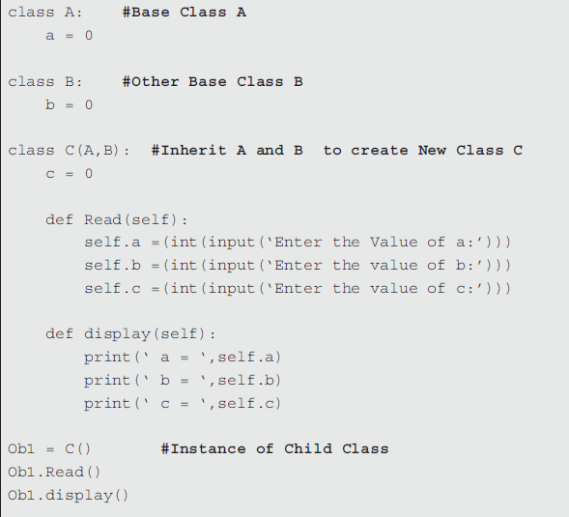
Python - Inheritance :
MultiLeveL Inheritance in Detail
xxx
Output :
Enter the Value of a:10
Enter the value of b:20
Enter the value of c:30
a = 10
b = 20
c = 30
Notes:
In the above program we have created two base classes A and B. Class C is created, which inherits the properties of classes A and B. The statement class C(A, B) is used to inherit the properties of classes A and B. Finally, the instance of subclass C is used to call method read and display.

Slide 77
Python - Inheritance :
More Examples on Inheritance – Example 1
We have created the parent class Box. The constructor __init__ is used to initialise all the attributes of the class Box. Similarly, the subclass named ChildBox is created. The extra attribute named weight is added to the child class, i.e. weight. Thus, all the attributes of the base class along with the attributes of the child class are initialised in the constructor of the child class by making use of the __init__ method.
Write a program to calculate the volume of Box using the init() method. :

Slide 78
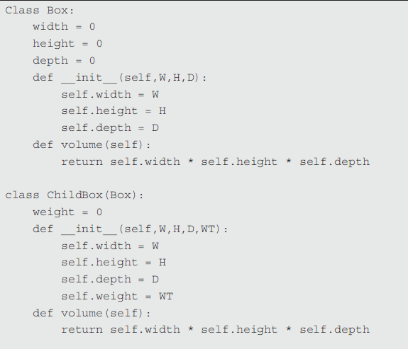
Python - Inheritance :
More Examples on Inheritance
xxx

Slide 79
Inheritance
Overriding Methods and the super()

Slide 80
Python - Inheritance :
Overriding Methods
In class hierarchy, when a method in a sub class has the same name and same header as that of a super class then the method in the sub class is said to override the method in the super class.
When an overridden method is called, it always invokes the method defined by its subclass. The same method defined by the super class is hidden.

Slide 81
Python - Inheritance :
Overriding Methods
class A: #Base Class
i = 0
def display(self):
print(‘ I am in Super Class’)
class B(A): #Derived Class
i = 0
def display(self): #Overridden Method
print(‘ I am in Sub Class’)
D1 = B()
D1.display()
Explanation :
In the above program when display() method is invoked on an instance of B, the
method display() defined within B is invoked.
Therefore, the method display() overrides the
method display() defined in the base class A.
Output :
I am in Sub Class

Slide 82
Python - Inheritance :
Overriding Methods
Programmer can make use of super to access the overridden methods. The syntax to call the overridden method that is defined in super class is
super().method_name
The above same program above is given below except, the overridden method defined in super class is accessed by using super().

Slide 83
Python - Inheritance :
Overriding Methods
class A: #Base Class
i = 0
def display(self):
print(‘ I am in Super Class’)
class B(A): #Super Class
i = 0
def display(self): #Overriden Method
print(‘ I am in Sub Class’)
super().display() #Call Display method of Base class
D1 = B() #Instance of sub class
D1.display()
Output :
I am in Sub Class
I am in Super Class

Slide 84
Python - Inheritance :
Overriding Methods
When inheriting classes, you often do so in order to change the behavior of the class, not just to extend the behavior. The custom methods or attributes you create on a child class can be used to override the method or attribute that was inherited from the parent.

Slide 85
Python - Inheritance :
Method Overriding
The concept of overriding is very important in inheritance. It gives the special ability to the child/subclasses to provide specific implementation to a method that is already present in their parent classes.
class Parent:
def f1(self):
print("Function of Parent class.")
class Child(Parent):
def f1(self):
print("Function of Child class.")
#MAIN program
obj = Child()
obj.f1()

Slide 86
Python - Inheritance :
Method Overriding
Here the function f1() of the Child class has overridden the function f1() of the Parent class. Whenever the object of Child class will invoke f1(), the function of Child class gets executed.
However, the object of the Parent class can invoke the function f1() of the parent class.
obj_2 = Parent()
obj_2.f1()

Slide 87
Python - Inheritance :
Method Overriding and the super()
Note that the parent class is specified by providing the name of that class in round brackets after the name of the new (child) class. We can define the class Person in Python as before:
class Person:
def __init__(self, name, age):
self.name = name
self.age = age
def birthday(self):
print('Happy birthday you were', self.age)
self.age += 1
print('You are now', self.age)

Slide 88
Python - Inheritance :
Method Overriding and the super()
We could now define the class Employee as being a class whose definition builds on (or inherits from) the class Person:
class Employee(Person):
def __init__(self, name, age, id):
super().__init__(name, age)
self.id = id
def calculate_pay(self, hours_worked):
rate_of_pay = 7.50
if self.age >= 21:
rate_of_pay += 2.50
return hours_worked * rate_of_pay
The super is used to call the constructor, i.e. the __init__ method of the super class.
Calls the __init__ method in the parent class, Person.

Slide 89
Python - Inheritance :
Method Overriding and the super()
Here we do several things:
1. The class is called Employee but it extends Person. This is indicated by including the name of the class being inherited in parentheses after the name of the class being defined (e.g. Employee(Person)) in the class declaration.
2. Inside the __init__ method we reference the __init__() method defined in the class Person and used to initialise instances of that class (via the super().__init__() reference. This allows whatever initialisation is required for Person to happen. This is called from within the Employee class’s __init__() which then allows any initialisation required by the Employee to occur.

Slide 90
Python - Inheritance :
Method Overriding and the super()
Note that the call to the super().__init__() initialiser can come anywhere within the Employee.__init__() method; but by convention it comes first to ensure that whatever the Person class does during initialisation does not over write what happens in the Employee class.
3. All instances of the class Person have a name, and age and have the behaviour birthday().
4. All instances of the class Employee have a name, and age and an id and have the behaviours birthday() and calculate_pay(house_worked).

Slide 91
Python - Inheritance :
Method Overriding and the super()
5. The method calculate_pay() defined in the Employee class can access the attributes name and age just as it can access the attribute id. In fact, it uses the employee’s age to determine the rate of pay to apply.
We can go further, and we can subclass Employee, for example with the class SalesPerson:
class SalesPerson(Employee):
def __init__(self, name, age, id, region, sales):
super().__init__(name, age, id)
self.region = region
self.sales = sales
def bonus(self):
return self.sales * 0.5

Slide 92
Python - Inheritance :
Method Overriding and the super()
Now we can say that the class SalesPerson has a name, an age and an id as well as a region and a sales total. It also has the methods birthday(), calculate_pay(hourse_worked) and bonus().
In this case the SalesPerson.__init__() method calls the Employee. __init__() method as that is the next class up the hierarchy and thus we want to run that classes initialisation behaviour before we set up the SalesPerson class (which of course in turn runs the Person classes initialisation behaviour).

Slide 93
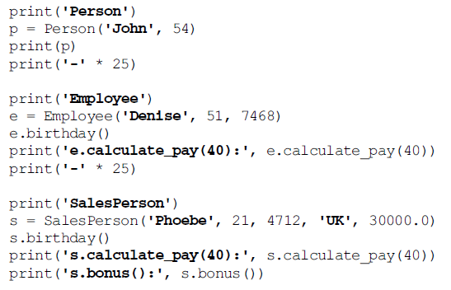
Python - Inheritance :
Method Overriding and the super()
We can now write code such as:
With the output being:

Slide 94
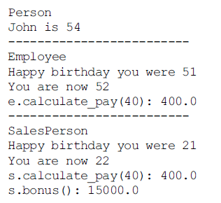
Python - Inheritance :
Method Overriding and the super()
Output :

Slide 95
Python - Inheritance :
Method Overriding and the super()
It is important to note that we have not done anything to the class Person by defining Employee and SalesPerson; that is it is not affected by those class definitions. Thus, a Person does not have an employee id. Similarly, neither an Employee nor a Person have a region or a sales total.
In terms of behaviour, instances of all three classes can run the method birthday(), but
• only Employee and SalesPerson objects can run the method calculcate_pay() and
• only SalesPerson objects can run the method bonus().

Slide 96
Methods Overriding :
Using super()

Slide 97
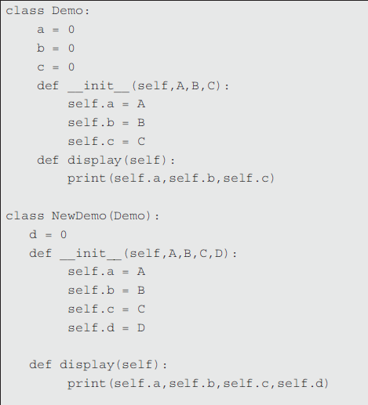
Python - Inheritance :
More Examples on Inheritance – Ex 2
Example 2

Slide 98
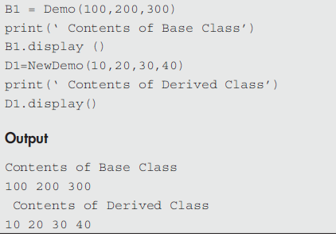
Methods Overriding and using super() :
More Examples on Inheritance – Example 2
Example 2
Notes:
In the above program, the classes derived from the base class Demo were not implemented efficiently or robustly. For example, the derived class NewDemo explicitly initialises the value of A, B and C, fields of the Base class. The same duplication of code is found while initialising the same fields in the base class Demo, which is inefficient. This implies that a subclass must be granted access to the members of a super class.
Therefore, whenever a subclass needs to refer to its immediate super class, a programmer can do so by using super. The super is used to call the constructor, i.e. the __init__ method of the super class.

Slide 99
Methods Overriding and using super() :
More Examples on Inheritance – Example 2
In the above program, the classes derived from the base class Demo were not implemented efficiently or robustly. For example, the derived class NewDemo explicitly initialises the value of A, B and C, fields of the Base class. The same duplication of code is found while initialising the same fields in the base class Demo, which is inefficient. This implies that a subclass must be granted access to the members of a super class.
Therefore, whenever a subclass needs to refer to its immediate super class, a programmer can do so by using super. The super is used to call the constructor, i.e. the __init__ method of the super class.

Slide 100

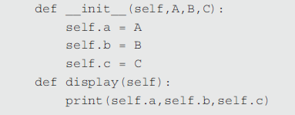
Methods Overriding and using super() :
More Examples on Inheritance – Example 2
Use super() and call the constructor of the base class.

Slide 101
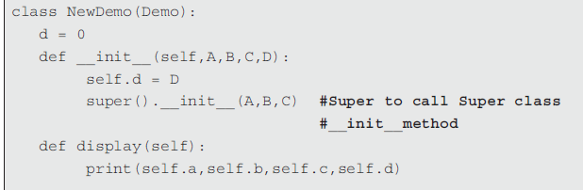
Methods Overriding and using super() :
More Examples on Inheritance – Example 2
xxx

Slide 102
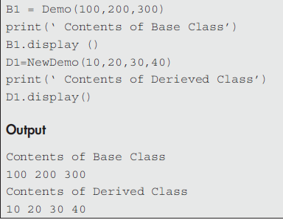
Methods Overriding and using super() :
More Examples on Inheritance – Example 2
xx.
Notes:
The derived class NewDemo() calls the super()with arguments a, b and c. This causes the constructor __init__ of the base class, i.e. Demo to be called. This initialises the values of a, b and c. The NewDemo() class no longer initialises these values itself.

Slide 103
Methods Overriding and using super() :
Calling the Parent Method with super() – Example 3
Suppose the parent class has a method that is almost what you want it to be, but you need to make a small alteration to the logic. If you override the method as you did previously, you'll need to specify the entire logic of the method again, which may become a violation of the DRY principle.
When building an application, you often require code from third-party libraries, and some of this code can be quite complex. If a certain method has 100 lines of code, you wouldn't want to include all that code in your repository in order to simply change one of those lines.

Slide 104
Methods Overriding and Using super() :
Calling the Parent Method with super() – Example 3
For example, suppose you have the following Person class:
class Person():
def __init__(self, first_name, last_name):
self.first_name = first_name
self.last_name = last_name
def speak(self):
print(‘Hello, my name is %s' % self.first_name)

Slide 105

Methods Overriding and Using super() :
Calling the Parent Method with super() – Example 3
Now, suppose you want to create a sub-class to make the person say more things in the speak method. One option would be to do so as follows:
class TalkativePerson(Person):
def speak(self):
print(‘Hello, my name is %s' % self.first_name)
print('It is a pleasure to meet you!')
john = TalkativePerson('John', 'Tomic')
john.speak()
Output:

Slide 106
Methods Overriding and Using super() :
Calling the Parent Method with super() – Example 3
This implementation is okay, though it isn't ideal that you've copied the "Hello, my name is John" line from the Person class. All you wanted to do was add additional things for TalkativePerson to say; you didn't need to change the way they say their name.
Perhaps the Person class will be updated in the future to say something slightly different, and you want our TalkativePerson class to also reflect those changes. This is where the super() method comes in handy. super() allows you to access the parent class without explicitly referring to it by name. In the preceding example, you can use super() as follows:

Slide 107

Methods Overriding and Using super() :
Calling the Parent Method with super() – Example 3
class TalkativePerson(Person):
def speak(self):
super().speak()
print('It is a pleasure to meet you!')
john = TalkativePerson('John', 'Tomic')
john.speak()
You should get the following output:
Figure 5.17: Using the super() method to write cleaner code

Slide 108
Methods Overriding and Using super() :
Calling the Parent Method with super() – Example 3
The super() method allows you to access the parent class, Person, and call the corresponding speak method. Now, if any updates were made to the Person class's speak method, it would be reflected in what our TalkativePerson says as well.
<< Exercise A83 >>

Slide 109
Methods Overriding and Using super() :
Overriding Methods & the super() function
The super() function
The super() function in Python returns a proxy object that references the parent class using the super keyword. This super() keyword is basically useful in accessing the overridden methods of the parent class.
The official documentation of the super() function sites two main uses of super():
1. In a class hierarchy with single inheritance, super helps to refer to the parent classes without naming them explicitly, thus making the code more maintainable.

Slide 110
Methods Overriding and Using super() :
Overriding Methods & the super() function
– Use Case 1
class Parent:
def f1(self):
print("Function of Parent class.")
class Child(Parent):
def f1(self):
super().f1()
print("Function of Child class.")
#MAIN program
obj = Child()
obj.f1()

Slide 111
Methods Overriding and Using super() :
Overriding Methods & the super() function
- Use Case 1
Here, with the help of super().f1(), the f1() method of the super class of Child class i.e Parent class has been called without explicitly naming it.
One thing to note here is that super() class can accept two parameters- first is the name of the subclass and second is an object that is an instance of that subclass. Let’s see how-

Slide 112
Methods Overriding and Using super() :
Overriding Methods & the super() function
- Use Case 1
class Parent:
def f1(self):
print("Function of Parent class.")
class Child(Parent):
def f1(self):
super( Child, self ).f1()
print("Function of Child class.")
# MAIN program
obj = Child()
obj.f1()
The first parameter refers to the subclass Child, while the second parameter refers to the object of Child which, in this case, is self. You can see the output after using super() and super( Child, self) is the same because, in Python 3, super( Child, self) is equivalent to self().

Slide 113
Methods Overriding and Using super() :
Overriding Methods & the super() function
- Use Case 1
Now let’s see one more example using the __init__ function.
class Parent(object):
def__init__(self, ParentName):
print(ParentName, 'is derived from another class.')
class Child(Parent):
def__init__(self, ChildName):
print(ChildName,'is a sub-class.')
super().__init__(ChildName)
# MAIN program
obj = Child('Child')

Slide 114
Methods Overriding and Using super() :
Overriding Methods & the super() function
- Use Case 1
What we have done here is that we called the __init__ function of Parent class (inside the Child class) using super().__init__( ChildName ).
And as the __init__ method of the Parent class requires one argument, it has been passed as “ChildName”.
So after creating the object of the Child class, first the __init__ function of Child class got executed, and after that the __init__ function of Parent class.

Slide 115
Methods Overriding and Using super() :
Overriding Methods & the super() function
- Use Case 2
2. The second use case is to support cooperative multiple inheritances in a dynamic execution environment.
class First():
def __init__(self):
print("first")
super().__init__()
class Second():
def __init__(self):
print("second")
super().__init__()

Slide 116
Methods Overriding and Using super() :
Overriding Methods & the super() function
- Use Case 2
class Third(Second, First):
def __init__(self):
print("third")
super().__init__()
# MAIN program
obj = Third()
The super() call finds the next method in the MRO at each step, which is why First and Second have to have it too, otherwise, execution stops at the end of first().__init__.
Note that the super-class of both First and Second is Object.

Slide 117
Methods Overriding and Using super() :
Overriding Methods & the super() function
- Use Case 2
Let’s find the MRO of Third() as well-
Third.__mro__
The order is Third > Second > First and the same is the order of our output.

Slide 118
Methods Overriding and Using super() :
Overriding Methods & the super() function
- Use Case 3
Overriding occurs when a method is defined in a class (for example, Person) and also in one of its subclasses (for example, Employee). It means that instances of Person and Employee both respond to requests for this method to be run but each has their own implementation of the method.
For example, let us assume that we define the method __str__() in these classes (so that we have a string representation of these objects to use with the print function). The pseudo code definition of this in Person might be:
def __str__(self):
return 'Person ' + self.name + ' is ' + str(self.age)

Slide 119
Methods Overriding and Using super() :
Overriding Methods & the super() function
- Use Case 3
In Employee, it might be defined as:
def __str__(self):
return 'Employee(' + str(self.id) + ')'
The method in Employee replaces the version in Person for all instances of Employee. If we ask an instance of Employee for the result of __str__(), we get the string ‘Employee(<some_id>)’.

Slide 120
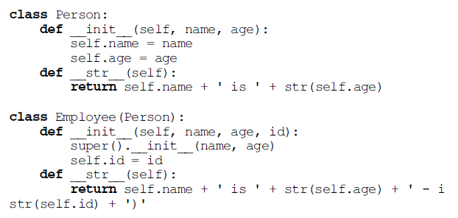
Methods Overriding and Using super() :
Overriding Methods & the super() function
- Use Case 3
As a concrete example, see the classes Person and Employee below; in which the __str__() method in Person is overridden in Employee.

Slide 121
Methods Overriding and Using super() :
Overriding Methods & the super() function
- Use Case 3
Instances of these classes will both be convertible to a string using __str__() but the version used by instances of Employee will differ from that used with instances of Person, for example:
p = Person('John', 54)
print(p)
e = Employee('Denise', 51, 1234)
print(e)
As can be seen from this the Employee class prints the name, age and id of the Employee while the Person class only prints the name and age.
Output :
John is 54
Denise is 51 - id(1234)

Slide 122
Inheritance
Method Resolution Order

Slide 123
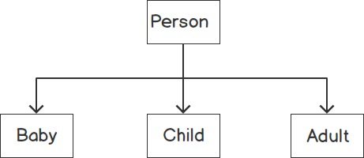
Python - Inheritance :
Multiple Inheritance
You often think of inheritance as allowing us to reuse common methods and attributes between related child classes. For example, a typical class structure could look like this:
Figure 5.19: Single inheritance

Slide 124
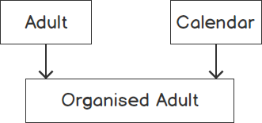
Python - Inheritance :
Multiple Inheritance
Each child class is inheriting from a single parent class, Person. However, it's also possible to inherit from more than one parent class. Often, there are elements of multiple classes that you want to combine to create a new class.
For example, you might combine an Adult class with a Calendar class to make an OrganizedAdult class:
Figure 5.20: Multiple inheritance
<< Exercise A84 >>

Slide 125
Python - Inheritance :
Method Resolution Order
Suppose you were inheriting from two parent classes, both of which have a method of the same name. Which would be used when calling the method on the child class?
Which would be used when calling it via super()? You should find this out through an example.

Slide 126
Python - Inheritance :
Method Resolution Order
Suppose you have Dog and Cat classes, and you combine them to make a monstrosity, DogCat:
class Dog():
def make_sound(self):
print('Woof!')
class Cat():
def make_sound(self):
print('Miaw!')
class DogCat(Dog, Cat):
Pass

Slide 127
Python - Inheritance :
Method Resolution Order
What sort of sounds would such a creature make?
my_pet = DogCat()
my_pet.make_sound()
You should get the following output:
Woof!
So, you can see that Python first checks for the existence of the make_sound method on the Dog class, and since it is implemented, you don't end up calling the make_sound method of the Cat class. Simply, Python reads from left to right in the list of classes.

Slide 128
Python - Inheritance :
Method Resolution Order
If you switched the order of Dog and Cat, our DogCat would miow:
class DogCat(Cat, Dog):
pass
my_pet = DogCat()
my_pet.make_sound()
You should get the following output:
Miaw!

Slide 129
Python - Inheritance :
Method Resolution Order
Suppose you wanted to override the method on DogCat and use the super() method. The same method resolution order would apply:
class DogCat(Dog, Cat):
def make_sound(self):
for i in range(3):
super().make_sound()
my_pet = DogCat()
my_pet.make_sound()
You should get the following output:
    Woof!
    Woof!
    Woof!
<< Exercise A14 >>

Slide 130
Python - Inheritance :
Summary
Inheritance is supported between classes in Python. For example, a class can extend (subclass) another class or a set of classes. A subclass inherits all the methods and attributes defined for the parent class(es) but may override these in the subclass.
In terms of the inheritance we say:
• A subclass inherits from a super class.
• A subclass obtains all code and attributes from the super class.
• A subclass can add new code and attributes.
• A subclass can override inherited code and attributes.
• A subclass can invoke inherited behaviour or access inherited attributes.
<< Exercise B20 >>

Slide 131
Python - Inheritance :
Online Resources
There are many resources available online relating to class inheritance including:
• https://docs.python.org/3/tutorial/classes.html#inheritance The Python software foundation tutorial on class inheritance.
• https://en.wikipedia.org/wiki/Multiple_inheritance which provides a discussion on multiple inheritance and the potential challenges it can introduce.

Slide 132

Thank you

