Slide 1

Python –
The Standard Library
by Su Lee Seng,
Jan, 2021

Slide 2
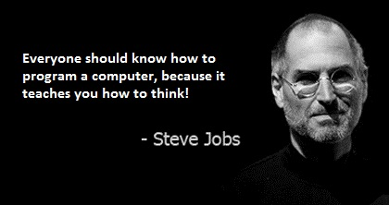
Python Programming
(Business & Analytics)
by Su Lee Seng,
Jan, 2021

Slide 3
Talk is cheap.
show me the code.

Slide 4
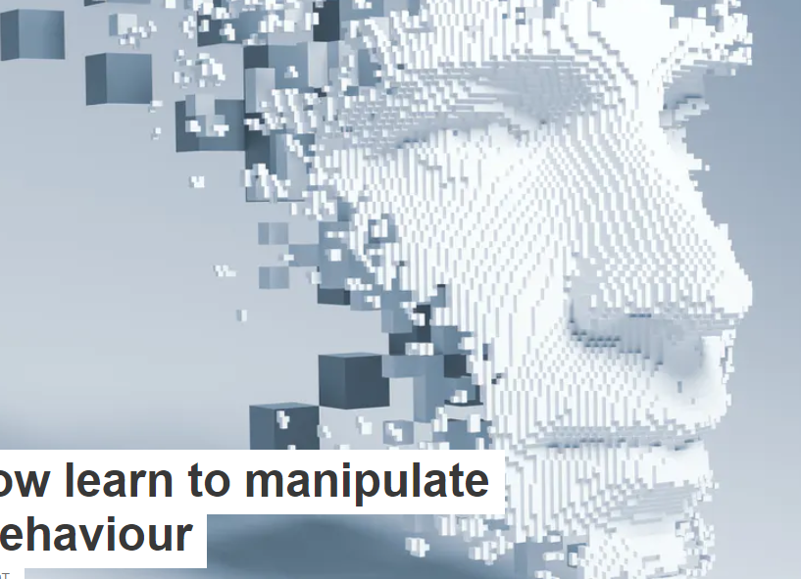
AI :
An Introduction
Python :
The Standard Library
(( Please, scan QR code for attendance. ))

Slide 5
Python - The Standard Library :
The Standard Library
Standard libraries are useful and perform tasks such as unzipping files, speaking with other processes and the OS on your computer, processing HTML, and even printing graphics on the screen.
Many languages have the concept of libraries or reusable chunks of code. Python comes with “batteries included”, which really means that the standard libraries that come included with Python should allow you to do a lot without having to look elsewhere.

Slide 6
Python - The Standard Library :
The Standard Library
Python standard library contains a large number of useful modules. It is always good for the developers to become familiar with the Python standard library, since many problems can be solved quickly. At the same time, the Python libraries can cut your development time and reduce your frustration with respect to the coding.
To use libraries you have to load the code into your namespace. The namespace holds the functions, classes, and variables (ie “names”) your module has access to.

Slide 7
Python - The Standard Library :
The Standard Library
For example the built-in math library has a sin function that calculates the sine of an angle expressed in radians:
>>> from math import sin
>>> sin (0)
0.0

Slide 8
Python - The Standard Library :
The Importance of the Standard Library
The Python standard library is vast. The Python standard library includes modules to connect to a socket; that is, one to send emails, one to connect to SQLite, one to work with the locale module, or one to encode and decode JSON and XML.
It is also renowned for including such modules as turtle and tkinter, graphical interfaces that most users probably don't use anymore, but they have proven useful when Python is taught at schools and universities.
It even includes IDLE, a Python-integrated development environment, it is not widely used as there are either other packages within the standard library that are used more often or external tools to substitute them.

Slide 9
Python - The Standard Library :
Python Libraries
As well as the core language, there are very many libraries available for Python. These libraries extend the functionality of the language and make it much easier to develop applications.
These libraries cover
• web frameworks such as Django/Flask,
• email clients such as smtplib (a SMTP email client) and imaplib (an IMAP4 email client),
• content management operations such as the Zope library,
• lightweight concurrency (running multiple operations at the same time) using the Stackless library,

Slide 10
Python - The Standard Library :
Python Libraries
• the Generation of Microsoft Excel files using the Python Excel library,
• graphics libraries such as Matplotlib and PyOpenGL,
• machine learning using libraries such as SKLearn and TensorFlow.
A very useful resource to look at, which introduces many of these libraries (also known as modules), is the ‘Python 3 module of the Week’ web site which can be found at https://pymotw.com/3. This lists many of the libraries/modules available and provides a short introduction to what they do and how to use them.

Slide 11
Python - Importing Libraries :
Multiple ways to import
>>> import math
>>> math .tan (0)
0.0
In the above we imported the math library and invoked its tan function.
>>> from math import sin , cos , tan
>>> cos (0)
1.0
If you need access to most of the library, it is less typing to just import the library. It also serves as a hint to you as a programmer, where the function (or class or variable) is defined.

Slide 12
Python - Importing Libraries :
Multiple ways to import
>>> from math import sin as other_sin
>>> other_sin (0)
0.0
Now other_sin is a reference to the sin found in math and you may continue using your sin without having to refactor your code.
>>> import math as other_math
>>> other_math .sin (0)
0.0

Slide 13
Python - Importing Libraries :
Multiple ways to import
Users of the Numpy library have adopted the standard of reducing keystrokes by using a two letter acronym:
>>> import numpy as np
The Panda library has adopted a similar standard:
>>> import pandas as pd

Slide 14
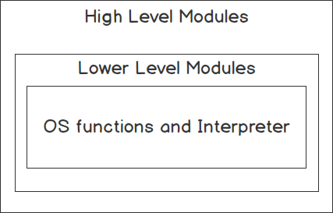
Python - The Standard Library :
The Importance of the Standard Library
These libraries are divided into high-level modules and lower-level modules:
Figure 6.1: Graphical representation of the types of standard libraries

Slide 15
Python - The Standard Library :
The Standard Library : Lower-Level Modules
The standard library also contains multiple lower-level modules that users rarelycinteract with. These lower-level modules are outside that of the standard library. Good examples are the different internet protocol modules, text formatting and templating, interacting with C code, testing, serving HTTP sites, and so on.

Slide 16
Python - The Standard Library :
The Standard Library : Lower-Level Modules
The standard library comes with low-level modules to satisfy the needs of users in many of those scenarios, but you will usually see Python developers relying on libraries such as jinja2, requests, flask, cython, and cffi that are built on top of the low-level standard library module as they provide a nicer, simpler, more powerful interface. It is not that you cannot create an extension with the C API or ctypes, but cython allows you to remove a lot of the boilerplate, whereas the standard library requires you to write and optimize the most common scenarios.

Slide 17
Python - The Standard Library :
The Standard Library : Lower-Level Modules
Finally, there is another type of low-level module, which extends or simplifies the language. Notable examples of these are the following:
• Asyncio: To write asynchronous code
• Typing: To type hinting
• Contextvar: To save state based on the context
• Contextlib: To help with the creation of context managers
• Doctest: To verify code examples in documentation and docstrings
• Pdb and bdb: To access debugging tools

Slide 18
Python - The Standard Library :
The Standard Library : Lower-Level Modules
There are also modules such as dis, ast, and code that allow the developer to inspect, interact, and manipulate the Python interpreter and the runtime environment, but those aren't required by most beginner and intermediate developers.

Slide 19
Python - The Standard Library :
Knowing How to Navigate in the Standard Library
Getting to know the standard library is key for any intermediate/advanced developer, even if you don't know how to use all the modules. Knowing what the library contains and when modules can be used provides any developer with a boost in speed and quality when developing Python applications.
Note
Python beginners are usually encouraged to take the standard library tour in the Python documentation (link: https://docs.python.org/3/tutorial/stdlib.html) once they master the basic syntax of the language.

Slide 20
The Standard Library
Date and Time Module

Slide 21
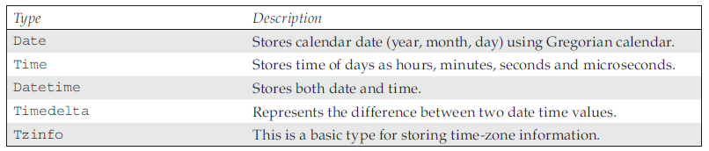
Python - The Standard Library :
Date and Time Module
Python provides rich functionalities to deal with date and time data. The standard libraries contain the modules datetime which provides number of functions to deal with dates, time and time intervals. Python datetime module supplies classes for manipulating date and times in both simple and complex ways.
Types in datetime module :

Slide 22
Python - The Standard Library :
Date and Time Module
Program 12.2 Write Program to store date in variable Current_date.
import datetime
current_date= datetime.date.today()
print(current_date)
2018-12-22

Slide 23
Python - The Standard Library :
Date and Time Module
Program 12.3 Write a program to access different parts of date.
import datetime
current_date= datetime.date.today()
print(‘Current Month = ‘,current_date.month)
print(‘Date = ‘,current_date.day)
print(‘Year = ‘,current_date.year)
(‘Current Month = ‘, 4)
(‘Date = ‘, 22)
(‘Year = ‘, 2018)

Slide 24
Python - The Standard Library :
Date and Time Module
Program 12.4 Write Program to store current time in variable Current_time.
import datetime
current_time = datetime.datetime.now()
print(current_time)
2018-04-22 20:48:05.324000

Slide 25
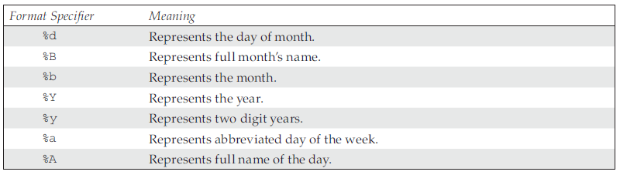
Python - The Standard Library :
Date Formats
Different users and different countries make use of different date formats. So, there is always scope to handle different date formats by the same time. The default date format is “YYYY-MM-DD”.
Python makes the use of strftime() to format dates

Slide 26
Python - The Standard Library :
Date and Time Module
Program 12.5 Demonstrate the uses of strftime() function to format date.
import datetime
current_date = datetime.date.today()
print(current_date.strftime(‘Date Formatting: %d %b %y’))
Date Formatting: 22 Apr 18

Slide 27
Time Module
The time module provides the number of functions that deals with date and time within a day. When the command dir(time) is executed on interactive mode, it gives the list of functions available under time module.
>>> dir(time)
[‘__doc__’, ‘__name__’, ‘__package__’, ‘accept2dyear’, ‘altzone’, ‘asctime’,‘clock’, ‘ctime’, ‘daylight’, ‘gmtime’, ‘localtime’, ‘mktime’, ‘sleep’,‘strftime’, ‘strptime’, ‘struct_time’, ‘time’, ‘timezone’, ‘tzname’]

Slide 28
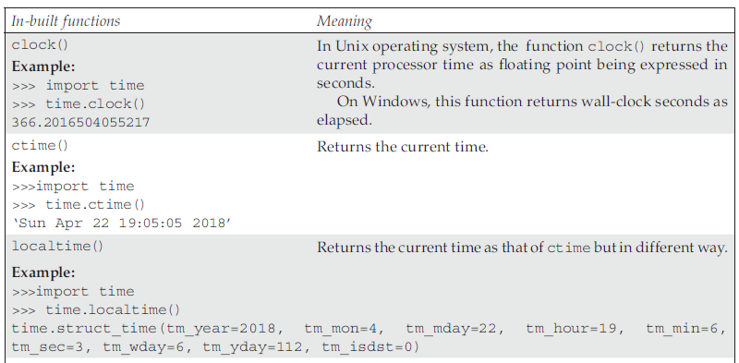
Python - The Standard Library :
Date and Time Module
xxxx

Slide 29
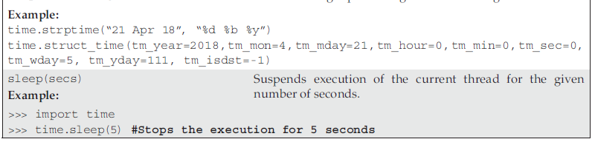
Python - The Standard Library :
Date and Time Module
xxxx

Slide 30
The Standard Library - Dates & Times :
Dates and Times
Many programs will need to deal with dates and times, and Python comes with multiple modules to help you handle those effectively. The most common module is the datetime module. The datetime module comes with three types that can be used to represent dates, times, and timestamps. There are also other modules, such as the time module, or the calendar module, which can be used for some other use cases.
datetime.date can be used to represent any date between the years 1 and 9999. For any date/time outside of this range, you would need to use more specialized libraries, such as the astropy library.

Slide 31

The Standard Library - Dates & Times :
Dates and Times
You can create a datetime.date by passing the year, month, and day, or get today by just calling datetime.date.today():
import datetime
datetime.date.today()
The output is as follows:
Figure 6.6: Representation of a date object

Slide 32
The Standard Library - Dates & Times :
Dates and Times
The output format for time is similar; it takes hour, minute, second, and microsecond.
All of them are optional and are initialized at 0 if not provided. This can also be created with tzinfo, but you will see more about that attribute in the datetime.datetime section.
Within the datetime module, you have what is probably the most frequently used class, the datetime.datetime class. It can represent a combination of a date and a time, and it actually inherits from datetime.date. But before you start to explore the datetime class within the datetime module, you need to better understand the concept of time and how you represent it.

Slide 33
The Standard Library - Dates & Times :
Dates and Times
There are usually two kinds of time that you need to represent. They are commonly referred to as timestamps and wall time.
The first, timestamps, can be seen as a unique point in time independent from any human interpretation of it. It is an absolute point in the line of time that is not relative to any geographical location or country. This is used for astronomical events, log records, and the synchronization of machines, among other things.

Slide 34
The Standard Library - Dates & Times :
Dates and Times
The second, wall time, refers to the time on the wall at a specific location. This is the time humans use, and you synchronize your time using it. This time is the "legal" time as it is dictated by the country and is related to a time zone. This is used for meetings, flight schedules, working hours, and so on. The interval of time can change at any point due to legislation. As an example, think of countries that observe daylight saving time (DST) and change their standard clock accordingly.

Slide 35
The Standard Library - Dates & Times :
Dates and Times
When you are working with wall time, you just need to treat datetime.datetime objects as a mere combination of a date and a time at a location. But you should usually attach a time zone to it to be more precise and get proper semantics for time comparison and basic arithmetic. The two most commonly used libraries to handle time zones are pytz and dateutil.

Slide 36
The Standard Library - Dates & Times :
Comparing datetime
You must use dateutil when using wall times; pytz has a time model that will lead the inexperienced user to make mistakes more often than not. To create a datetime with a time zone, you just need to pass it through the tzinfo argument:
import datetime
from dateutil import tz
datetime.datetime(1989, 4, 24, 10, 11,
tzinfo=tz.gettz("Europe/Madrid"))
This creates a datetime with that time zone information attached.
<< Exercise A87 >>

Slide 37
The Standard Library - Dates & Times :
Calculating Time delta
To create a datetime with an offset of 0, also known as a datetime in UTC, you can use datetime.timezone.utc as the tzinfo argument. This will then represent an absolute point in the line of time. You can safely add, subtract, and compare datetimes without any issue when using UTC.
On the other hand, if you use any specific time zone, you should be aware that nations might change the time at any point, which could make any of your calculations invalid.
<< Exercise A88 >>

Slide 38
The Standard Library - Dates & Times :
Handling leap seconds
Another module that you use when dealing with time is the time module. In the time module, you can get the Unix time through time.time. This will return the number of seconds since the Unix epoch is without leap seconds. This is known as Unix time or POXIS time.
You are encouraged to read about leap seconds if you need to develop highly timesensitive applications, but Python offers no time support for them. The time and datetime modules just use the system clock, which will not count leap seconds.

Slide 39
The Standard Library - Dates & Times :
Handling leap seconds
But what happens in an instance where a leap second occurs is up to the OS admin.
Some companies slow down time around leap seconds, while others just skip them by making a second take two seconds in the real world.
If you need to figure this out in your workplace, you will need to check with your OS admin how the NTP servers are configured to act in leap seconds. Luckily, you know well in advance when the next leap second will happen, as the International Earth Rotation and Reference Systems Service (https://packt.live/2oKYtUR) publishes leap seconds at least 8 weeks in advance.

Slide 40
The Standard Library - Dates & Times :
Unix Epoch Time
What is epoch time?
The Unix epoch (or Unix time or POSIX time or Unix timestamp) is the number of seconds that have elapsed since January 1, 1970 (midnight UTC/GMT), not counting leap seconds (in ISO 8601: 1970-01-01T00:00:00Z).
Literally speaking the epoch is Unix time 0 (midnight 1/1/1970), but 'epoch' is often used as a synonym for Unix time.
Some systems store epoch dates as a signed 32-bit integer, which might cause problems on January 19, 2038 (known as the Year 2038 problem or Y2038).
<< Exercise A89 >>

Slide 41
Python - The Standard Library :
Example
Program 12.1 Write program to count “.txt” files.
import os
count = 0
Dir1 = os.chdir(‘C:\Python27\Python Programs’)
for (dirname, dirs, files) in os.walk(‘.’):
for filename in files:
if filename.endswith(‘.txt’):
print(filename)
count = count + 1
print(‘Text Files:’,count)
Output :
text1.txt
text2.txt
(‘Text Files:’, 2

Slide 42
Python - Importing Libraries :
Naming Convention / Import organization
According to PEP 8, place import statements at the top of file following the module docstring. There should be one import per line and imports should be grouped by:
• Standard library imports
• 3rd party imports
• Local package imports

Slide 43
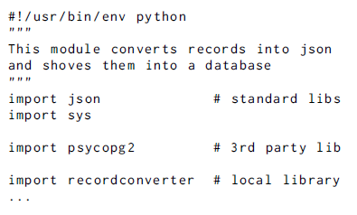
Python - Importing Libraries :
Naming Convention / Import organization
An example module might have the following at the start:

Slide 44
The Standard Library
The re Module

Slide 45
Python - The Standard Library :
The re Module (re.match)
The re module provides various methods to perform operation on input string. The most commonly used methods of re module are as follows.
re.match(pattern, string)
The match() method returns zero or more characters which match the pattern at the beginning of string. The match() function returns none if the string does not matches the pattern.

Slide 46
Python - The Standard Library :
The re Module
>>> import re
>>> match_obj = re.match(“Python”, “Python Programming Language”)
>>> match_obj
<_sre.SRE_Match object at 0x05CAA6E8>
>>> match_obj.group(0) #group() method on match
‘Python’
we have string “Python Programming Language” and from the given string, we are going to search string pattern, i.e. “Python”. Thus, the match() function returns the matched pattern.

Slide 47
Python - The Standard Library :
The re Module
What if developer is interested to know the index position of match string from where it starts and ends? Thus, in such cases, we use of the methods, such as, start() and end().
>>> match_obj = re.match(“Python”, “Python Programming Language”)
>>> match_obj.start()
0
>>> match_obj.end()
6

Slide 48
Python - The Standard Library :
The re Module
Note: The match() method returns none if pattern to be matched from the given string is not present at the beginning of the string.
>>> import re
>>>match_obj = re.match(“Programming”, “Python Programming Language”)
>>> print(match_obj)
None

Slide 49
Python - The Standard Library :
The re Module (re.search)
re.search(pattern, string)
The main advantage of search() method is that it does not restrict us to find matches at the beginning of the string only.
>>> search_obj = re.search(r”Programming”, “Python Programming Language”)
>>> print(search_obj)
<_sre.SRE_Match object at 0x053BEAA0>
>>> search_obj.group(0)
‘Programming’
>>> search_obj.start()
7
>>> search_obj.end()
18

Slide 50
Python - The Standard Library :
The re Module (re.search)
Note: The search() method is able to find a pattern from any position of the string. But it returns only first occurrence of matched string.
>>> search_obj = re.search(r”Good”, “If Good Programmer then you can be
Good Developer”)
>>> search_obj.group(0)
‘Good’
>>> search_obj.start()
3
>>> search_obj.end()
7

Slide 51
Python - The Standard Library :
The re Module (re.findall)
re.findall(pattern,string)
The string is scanned from left to right and the pattern is to be searched if matched ones are returned in the order they are found. Finally, it returns the list of all matching patterns from the string.
>>> import re
>>> re.findall(“Python”,”Programming in Python.I like Python”)
[‘Python’, ‘Python’]

Slide 52
Python - The Standard Library :
The re Module (re.split)
re.split(pattern, string,[maxsplit=0]):
Let us split the string by the occurrences of pattern.
>>> re.split(“y”,”Python”)
[‘P’, ‘thon’]
In example above, we have split the string “Python” by ‘y’. The split() method has another argument, i.e. maxsplit. The default value of maxsplit is ’0’. If maxsplit is ‘0’, then split() method does the maximum split. But if we give value to maxsplit, then the maxsplit will split the string up to the given number of splits.

Slide 53
Python - The Standard Library :
The re Module (re.split)
Example
>>> re.split(“-”,”978-92-95055-02-5”) #maxsplit = 0
[‘978’, ‘92’, ‘95055’, ‘02’, ‘5’]
>>> re.split(“-”,”978-92-95055-02-5”, maxsplit=3)
[‘978’, ‘92’, ‘95055’, ‘02-5’]

Slide 54
Python - The Standard Library :
The re Module (re.sub)
re.sub(pattern, repl, string)
The sub() method helps us to search a pattern and replace with new sub-strings. If the pattern to be searched is not found, then the original string will remain unchanged.
>>> re.sub(“Python”, “Japan”,“I Love Python”)
‘I Love Japan’

Slide 55
Python - The Standard Library :
The re Module (re.sub)
re.compile(pattern)
Let us compile the regular expression pattern into a regular expression object which later can be used for matching by utilizing its match(), search() and findall() methods.
The sequence of using compile() and findall() is ..:
Comp_obj = re.compile(pattern)
result = Comp_obj.findall(string)
Example 9
>>>Comp_obj = re.compile(“Python”)
>>>result = Comp_obj.findall(“I Love Python”)
>>> result
[‘Python’]

Slide 56
The Standard Library
Basic example of regular expressions

Slide 57
Python - The Standard Library :
Basic example of regular expressions
PROBLEM 1: Extract each character from the given string, i.e. “Python Programming” Solution
>>> ans = re.findall(‘.’,’Python Programming’)
>>> ans
[‘P’, ‘y’, ‘t’, ‘h’, ‘o’, ‘n’, ‘ ‘, ‘P’, ‘r’, ‘o’, ‘g’, ‘r’, ‘a’, ‘m’, ‘m’, ‘i’, ‘n’, ‘g’]
Note In Problem 1 above, space is also extracted as a character. To avoid it \w is used instead of “.”.
>>> ans = re.findall(‘\w’,’Python Programming’)
>>> ans
[‘P’, ‘y’, ‘t’, ‘h’, ‘o’, ‘n’, ‘P’, ‘r’, ‘o’, ‘g’, ‘r’, ‘a’, ‘m’, ‘m’, ‘i’, ‘n’, ‘g’]

Slide 58
Python - The Standard Library :
Basic example of regular expressions
PROBLEM 2: Extract words from given string, i.e. “I Love Python”
>>> ans = re.findall(‘\w*’,’I Love Python’)
>>> ans
[‘I’, ‘’, ‘Love’, ‘’, ‘Python’, ‘’]
In Problem 2 above, it returns the space as word because “*” returns zero or more different matches. In order to remove space, we will go with ‘+’.
>>> ans = re.findall(‘\w+’,’I Love Python’)
>>> ans
[‘I’, ‘Love’, ‘Python’]

Slide 59
Python - The Standard Library :
Basic example of regular expressions
PROBLEM 3: Extract only first word from the sentence, i.e. “Incredible India”
>>> ans = re.findall(‘^\w+’,’Incredible Japan’)
>>> ans
[‘Incredible’]
PROBLEM 4: Extract last word from the sentence, i.e. “Incredible Korea”
Solution
>>> ans = re.findall(‘\w+$’,’Incredible Korea’)
>>> ans
[‘Korea’]

Slide 60
Python - The Standard Library :
Basic example of regular expressions
PROBLEM 5: Extract date from the string, i.e. ‘India 15-08-1947’
>>> ans = re.findall(‘\d{2}-\d{2}-\d{4}’,’India 15-08-1947’)
>>> ans
[‘15-08-1947’]
PROBLEM 6: Extract domain names from the given e-mail ids, abc@gmail.com and “mit@standford.edu”
>>>re.findall(“@\w+.(\w+)”,”abc@gmail.com”, “mit@standford.edu”)
[‘com’, ‘edu’]

Slide 61
The Standard Library
Mathematic
The math Module

Slide 62
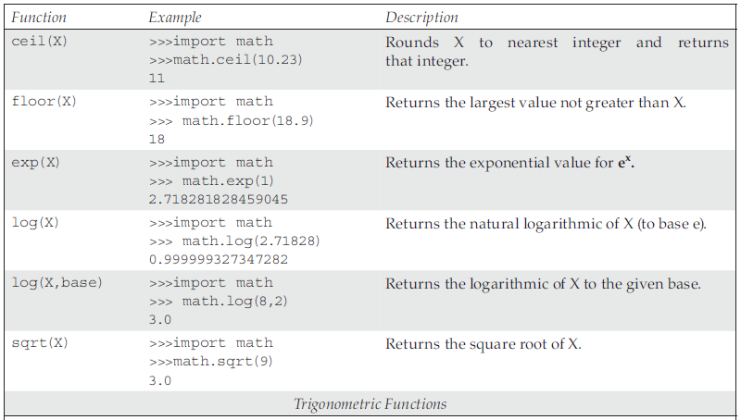
Python - The Standard Library :
The math Module
xxxx

Slide 63
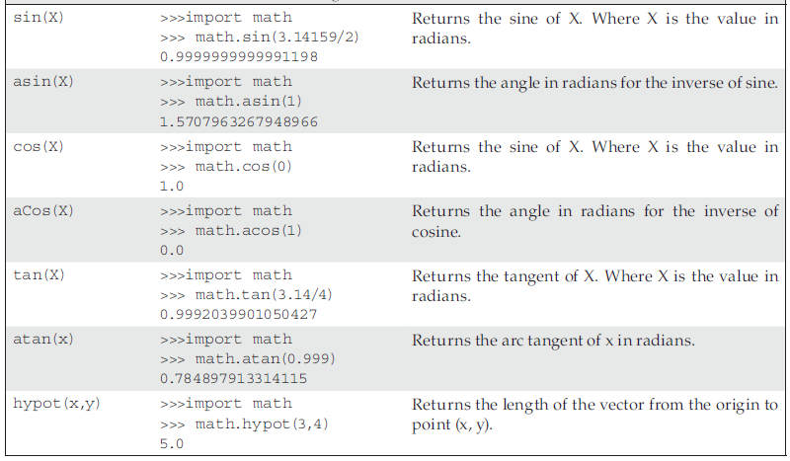
Python - The Standard Library :
The math Module
xxxx

Slide 64
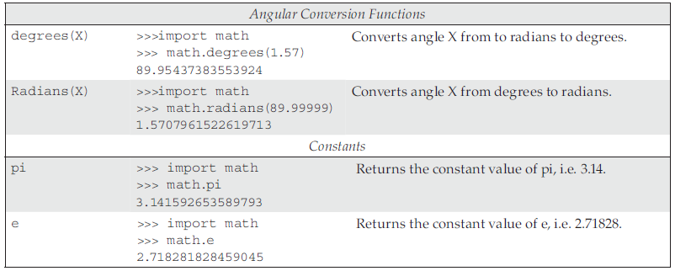
Python - The Standard Library :
The math Module
xxxx

Slide 65

Thank you

