Slide 1

Python Programming
(Business & Analytics)
by Su Lee Seng,
Jan, 2021

Slide 2
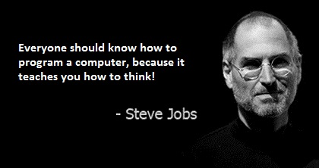
Python Programming
(Business & Analytics)
by Su Lee Seng,
Jan, 2021

Slide 3

Python Programming
(Business & Analytics)
by Su Lee Seng,
Jan, 2021

Slide 4
Talk is cheap.
show me the code.

Slide 5

SAP HANA – An Introduction
@ UTAR
by Su Lee Seng,
April, 2014.

Slide 6
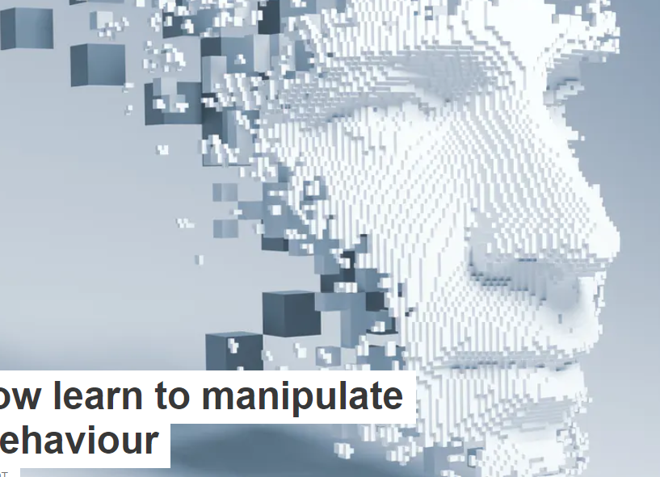
AI :
An Introduction
Python :
Recursion
(( Please, scan QR code for attendance. ))

Slide 7
Python Programming – Recursion :
Recursive Behavior
The key here is that an overall problem can be solved by breaking it down into smaller examples of the same problem.
Functions that solve problems by calling themselves are referred to as recursive functions.
However, if such a function does not have a termination point then the function will go on calling itself to infinity (at least in theory). In most languages such a situation will (eventually) result in an error being generated.

Slide 8
Python Programming – Recursion :
Infinite Loop
You can imagine that a function that calls itself might end up in an infinite loop; it is true that you can write a recursive function that will keep running indefinitely:
def print_the_next_number(start):
print(start + 1)
return print_the_next_number(start + 1)
# MAIN program
print_the_next_number(5)
Note
The output mentioned above is truncated.
Output :
6
7
8
9
10
11
..
..
..

Slide 9
Python Algorithms - Recursion :
Infinite Loop
If you run this code in a Python shell, it will continue printing integers until you interrupt the interpreter (Ctrl + C). Take a look at the preceding code and ensure you understand why it behaves in this manner. The function executes the following steps:
• The function is called with start = 5.
• It prints 6 to the console, that is (5 + 1 = 6).
• It then calls itself, this time passing in the argument start = 6.
• The function starts again, this time printing 7, that is (6 + 1 = 7).

Slide 10

Python Algorithms - Recursion :
A Terminating Case
To avoid being stuck in an infinite loop, a recursive function will typically have a Terminating Case, such as a point where the chain of recursion is broken. In our previous example, you could make it stop once the start parameter is greater than or equal to 7:
def print_the_next_number(start):
print(start + 1)
if start >= 7:
return "I'm bored"
return print_the_next_number(start + 1)
print_the_next_number(5)
Output :
xx
<< Exercise A50 >>
<< Activity A11 >>
<< Exercise A51 >>

Slide 11
Python Programming – Recursion :
Recursive Behavior
For a recursive function to the useful it must therefore have a termination condition. That is a condition under which they do not call themselves and instead just return (often with some result). The termination condition may be because:
• A solution has been found (some data of interest in a tree structure).
• The problem has become so small that it can be solved without further recursion. This is often referred to as a base case. That is, a base case is a problem that can be solved without further recursion.
• Some maximum level of recursion has been reached, possibly without a result being found/generated.

Slide 12
Python Programming – Recursion :
Recursive Behavior
All recursive functions thus share a common format; they have a recursive part and a termination point which represents the base case part.

Slide 13
Python Programming – Recursion :
Benefits of a Recursion
The key benefit of recursion is that some algorithms (solutions to computer problems) are expressed far more elegantly and with a great deal less code when implemented recursively than when using an iterative approach.
This means that the resulting code can be easier to write and easier to read. These twin ideas are important both for the developers who initially create the software but also for those developers who must maintain that software (potentially a significant amount of time later).
Code that is easier to write tends to be less error prone. Similarly code that is easier to read tends to be easier to maintain, debug, modify and extend.

Slide 14
Python Programming – Recursion :
Recursively Searching a Tree
A binary tree is a tree data structure made up of nodes in which each node has a value, a left pointer and a right pointer.
The root node is the top most node in the tree. This root node then references a left and right subtree. This structure is repeated until a leaf node.
A leaf node is a node in which both the right and left pointers are empty (that is they have the value None).

Slide 15
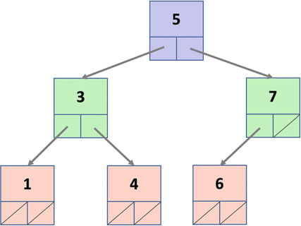
Python Programming – Recursion :
Recursively Searching a Tree
This is shown below for a simple binary tree:
Thus a binary tree is either empty (represented by a null pointer), or is made of a single node, where the left and right pointers each point to a binary tree.

Slide 16
Python Programming – Recursion :
Recursively Searching a Tree
If we now want to find out if a particular value is in the tree then we can start at the root node.
If the root node holds the value we print it; otherwise we can call the search function on the child nodes of the current node. If the current node has no children we just return without a result. The pseudo code for this might look like:
search(value_to_find, current_node):
If current_node.value == value_to_find:
print(‘value found:’, current_node.value)
Else If current.node.has_children:
search(value, current_node.left)
search(current_node.right)
Notes:
This illustrates how easy it is to write a recursive function that can solve what might at first appear to be a complex problem.

Slide 17
Python Programming
Recursion in Python

Slide 18
Python Programming – Recursion :
Recursion in Python
In Python it is perfectly legal to have a function that calls itself (that is within the body of the function a call is made to the same function). When the function is executed it will therefore call itself.
In Python we can write a recursive function such as:
def recursive_function():
print('calling recursive_function')
recursive_function()
Here the function recursive_function() is defined such that it prints out a message and then calls itself. Note that no special syntax is required for this as a function does not need to have been completely defined before it is used.

Slide 19

Python Programming – Recursion :
Recursion in Python
Of course in the case of recursive_function() this will result in infinite recursion as there is no termination condition. However, this will only become apparent at runtime when Python will eventually generate an error:
However, as already mentioned a recursive function should have a recursive part and a termination or base case part. The termination condition is used to identify when the base case applies. We should therefore add a condition to identify the termination scenario and what the base case behaviour is.

Slide 20
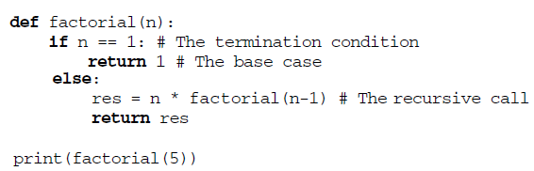
Python Programming – Recursion :
Calculating Factorial Recursively
Recall that 5! = 5 * 4 * 3 * 2 * 1
We can create a recursive solution to the Factorial problem by defining a function that takes an integer to generate the factorial number for. This function will return the value 1 if the number passed in is 1—this is the base case.
Otherwise it will multiple the value passed into it with the result of calling itself (the factorial() function) with n − 1 which is the recursive part.

Slide 21
Python Programming – Recursion :
Calculating Factorial Recursively
The key to understanding this function is that it has:
1. A termination condition that is guaranteed to execute when the value of n is 1. This is the base case; we cannot reduce the problem down any further as the factorial of 1 is 1!
2. The function recursively calls itself but with n − 1 as the argument; this means each time it calls itself the value of n is smaller. Thus the value returned from this call is the result of a smaller computation.

Slide 22
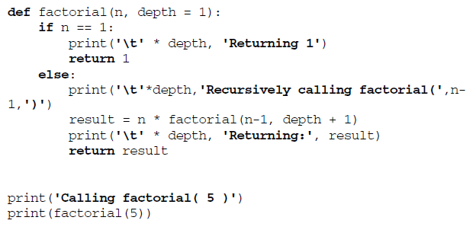
Python Programming – Recursion :
Calculating Factorial Recursively
To clarify how this works we can add some print statements (and a depth indicator) to the function to indicate its behaviour:
Notes:
Note that the depth parameter is used merely to provide some indentation to the print statements.

Slide 23
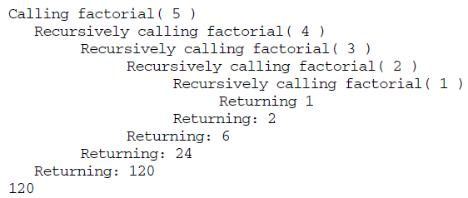
Python Programming – Recursion :
Calculating Factorial Recursively
xxxx
Output :
Notes:
From the output we can see that each call to the factorial program results in a simpler calculation until the point where we are asking for the value of 1! which is 1. This is returned as the result of calling factorial(1). This result is multiplied with the value of n prior to that; which was 2. The causes factorial(2) to return the value 2 and so on.

Slide 24
Python Programming – Recursion :
Disadvantages of Recursion
Although Recursion can be a very expressive way to define how a problem can be solved, it is not as efficient as iteration.
This is because a function call is more expensive for Python to process that a for loop. In part this is because of the infrastructure that goes along with a function call; that is the need to set up the stack for each separate function invocation so that all local variables are independent of any other call to that function. It is also related to associated unwinding the stack when a function returns.
However, it is also affected by the increasing amount of memory each recursive call must use to store all the data on the stack.
<< Exercise B09 >>

Slide 25
Python Programming – Recursion :
Online Resources
The following provides some references on recursion available on line:
• https://en.wikipedia.org/wiki/Recursion_(computer_science) Provides wikipedias introduction to recursion.
• https://www.sparknotes.com/cs/recursion/whatisrecursion/section1/ provides an introduction to the concept of recursion.

Slide 26

Thank you

