Slide 1
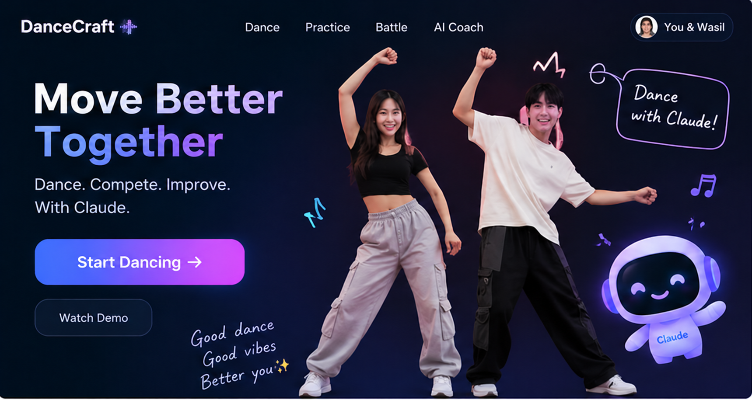
DanceCraft
AI Motion Arena
Follow a short dance, get a Claude practice plan, then return to beat the score.
Dance. Practice. Rematch.
Concept illustration
Move better. Together.
A dance challenge with a coach that shapes your next attempt.
Anthropic Creator Summit / Wasil and Jin
Notes:
0:00-0:20
DanceCraft turns a short dance into a challenge with a useful next step. Follow the host, see your score, and practice the section Claude recommends before trying again. We want the rematch to feel fun and help the player improve.
Visual: concept artwork adapted from the user-supplied Groovy_Plus_AI_Motion_Arena.pptx. The illustration does not depict an actual recorded session.

Slide 2
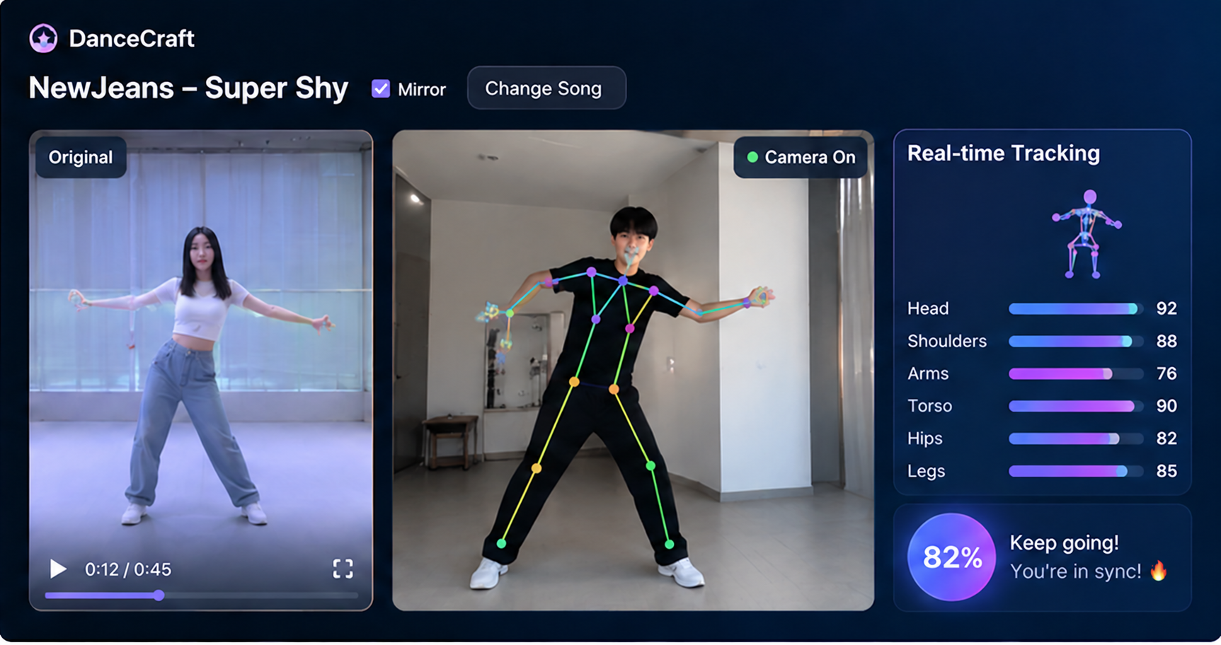
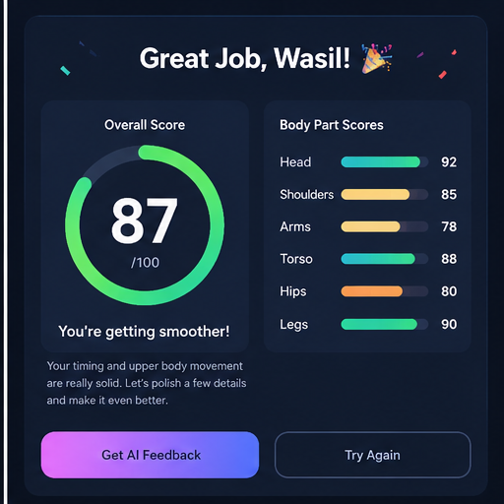
A dance challenge the room can follow
One short routine becomes a score to beat and a clear next step.
One routine.
A score for every challenger.
1
Watch
Choose a routine and its Mirror setting.
2
Move
The webcam tracks one dancer against the reference video.
3
Review
Compare scores and replay a move at its video timestamp.
Every attempt leads to a specific next step.
Section and body-part scores feed the Claude coach.
Concept screens with illustrative scores
Notes:
0:20-0:45
Choose a reference routine and its Mirror setting. A webcam tracks one dancer while the motion engine calculates the score. The player can replay a move at its timestamp and see the evidence behind the result. The current challenge supports players taking turns with a shared leaderboard.
Visuals: supplied concept screens and illustrative scores. Feature sources: C:/Users/jink/dancecraft/groovy/src/App.tsx and src/components/ReplayMode.tsx. We do not claim simultaneous online party rooms.

Slide 3
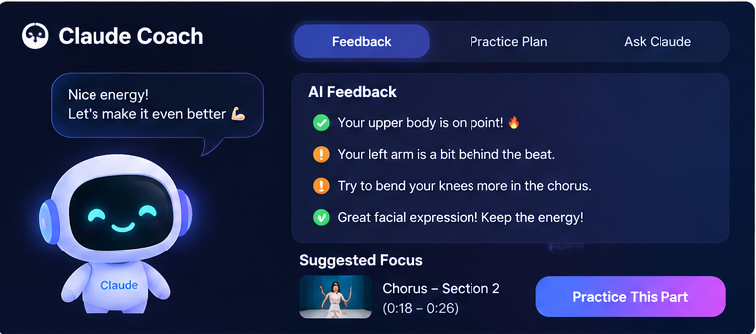
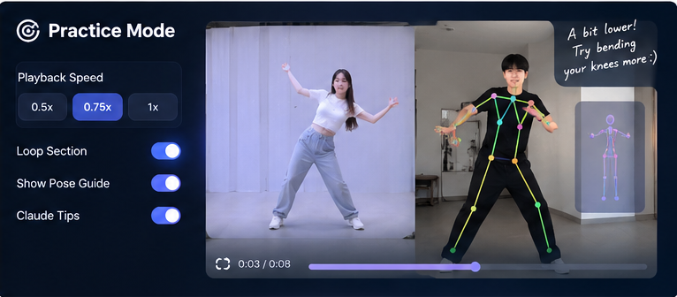
Claude chooses what to practice next
Performance data becomes a practice section, speed, repeat count and concrete cue.
Concept screens with an example coaching plan
1 Diagnose
2 Adapt
3 Practice + retry
Use tracking coverage and movement evidence before technique tips.
Claude selects the loop, speed, repetitions and one coaching cue.
PracticeMode runs the plan. Retry the dance and compare the result.
Built-in coach available. Live Claude needs API credits.
Notes:
0:45-1:25
The Anthropic API turns measured performance into a practical intervention. Claude receives section scores, body-part scores and tracking evidence. It selects a section to loop, a slower playback speed, a repeat count and a concrete cue. The app applies that structured plan in PracticeMode. Tracking evidence comes first, so the coach should recognize missing visibility or very little movement before giving technique advice. The integration is implemented, but today's account has exhausted its API credits. The app labels its built-in coach fallback.
Visuals: supplied concepts with an example plan, not a live API response. Sources: server/coach/claude.ts, src/coach/types.ts, src/components/PracticeMode.tsx. A direct local API test returned insufficient credit balance.

Slide 4
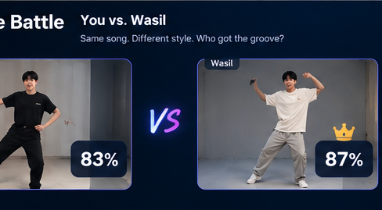
DanceCraft: the coached rematch
Built on Groovy’s dance engine, with Claude guiding the next attempt.
Groovy foundation
DanceCraft adds
✓ Video import and webcam tracking
✓ Joint-angle scoring and breakdown
✓ Reference timestamps and replay
✓ Slow playback and section loops
01 Claude practice plans
02 Executable loops and repeat counts
03 Motion-aware scores and replay
04 Host challenge and leaderboard
Live demo flow
1 Dance
2 Score
3 Practice with Claude
4 Rematch
Built on Groovy by JoeyWangTW (MIT). Concept screens show the Claude version.
Notes:
1:25-1:50
Groovy provides the video import, pose tracking, replay and practice foundation under the MIT license. DanceCraft adds the Claude practice plan, executable drills, a host challenge and evidence-aware review. A separate motion scorer calculates the numeric result. Claude explains the evidence and selects what to practice.
Attribution: Groovy by JoeyWangTW, https://github.com/JoeyWangTW/groovy, MIT. Concept screens contain illustrative numbers. The scoring lab checks synthetic perturbations and still recordings, not validated human dance accuracy.

Slide 5
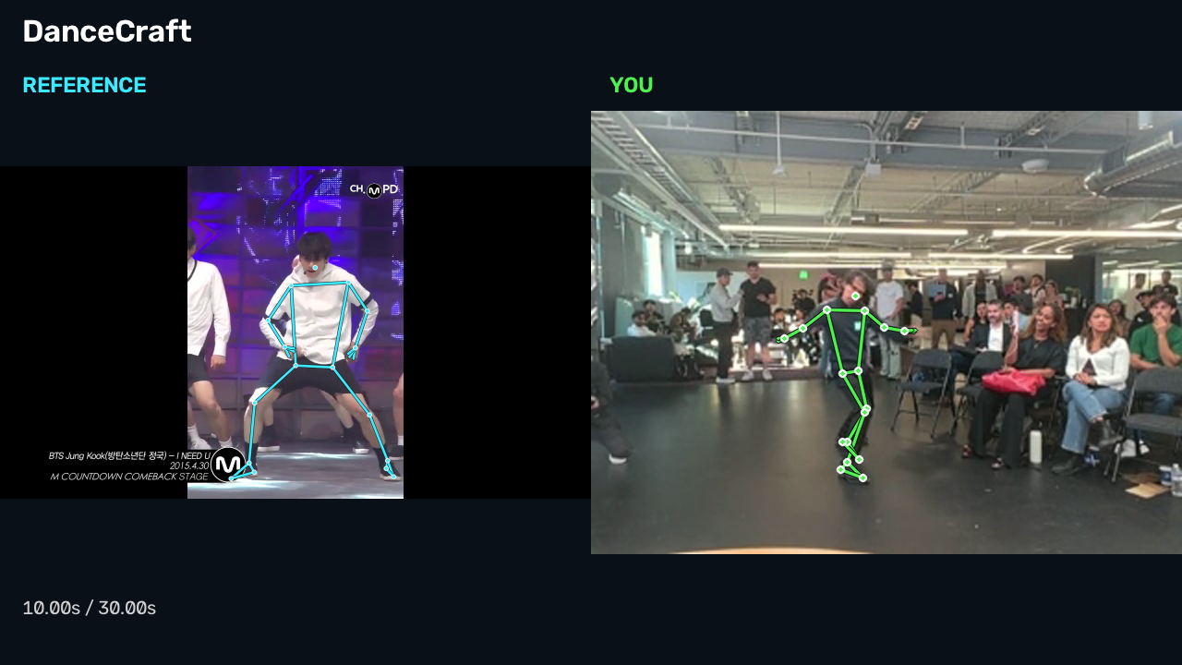
Demonstration
The latest saved attempt, with synchronized reference video and audio
Saved replay
Reference and player on one video timeline.
Separate skeleton exports reveal how each pose compares.
Dance. Practice. Rematch.
Video: DanceCraft_04_Synced_With_Audio.mp4
Notes:
1:50-2:45
Open DanceCraft_04_Synced_With_Audio.mp4 from the delivered video folder. Play approximately 25-30 seconds, then return to the app's saved result. Show the timestamped replay and the separate player and reference skeleton exports. Explain how the player can inspect a difficult move, practice the selected section, then retry against the host score. If the live app is unavailable, the saved video is the demo backup.
The poster is a frame from the user's latest saved history and synchronized video export. The export matches the song timeline using the recorded start marker, without changing the player's movement timing. The reference clip originates from the video registered by the user. Separate files: DanceCraft_01_Camera.mp4, DanceCraft_02_Camera_Skeleton.mp4, DanceCraft_03_Reference.mp4, DanceCraft_04_Synced_With_Audio.mp4, DanceCraft_05_Reference_Skeleton.mp4.

Slide 6
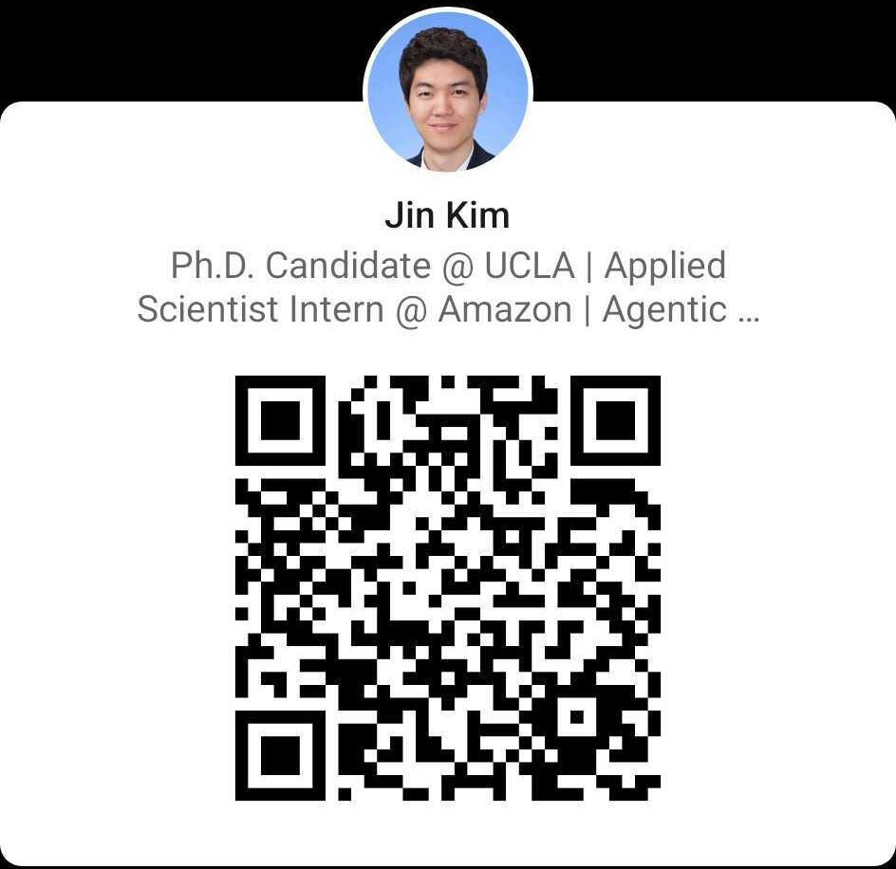
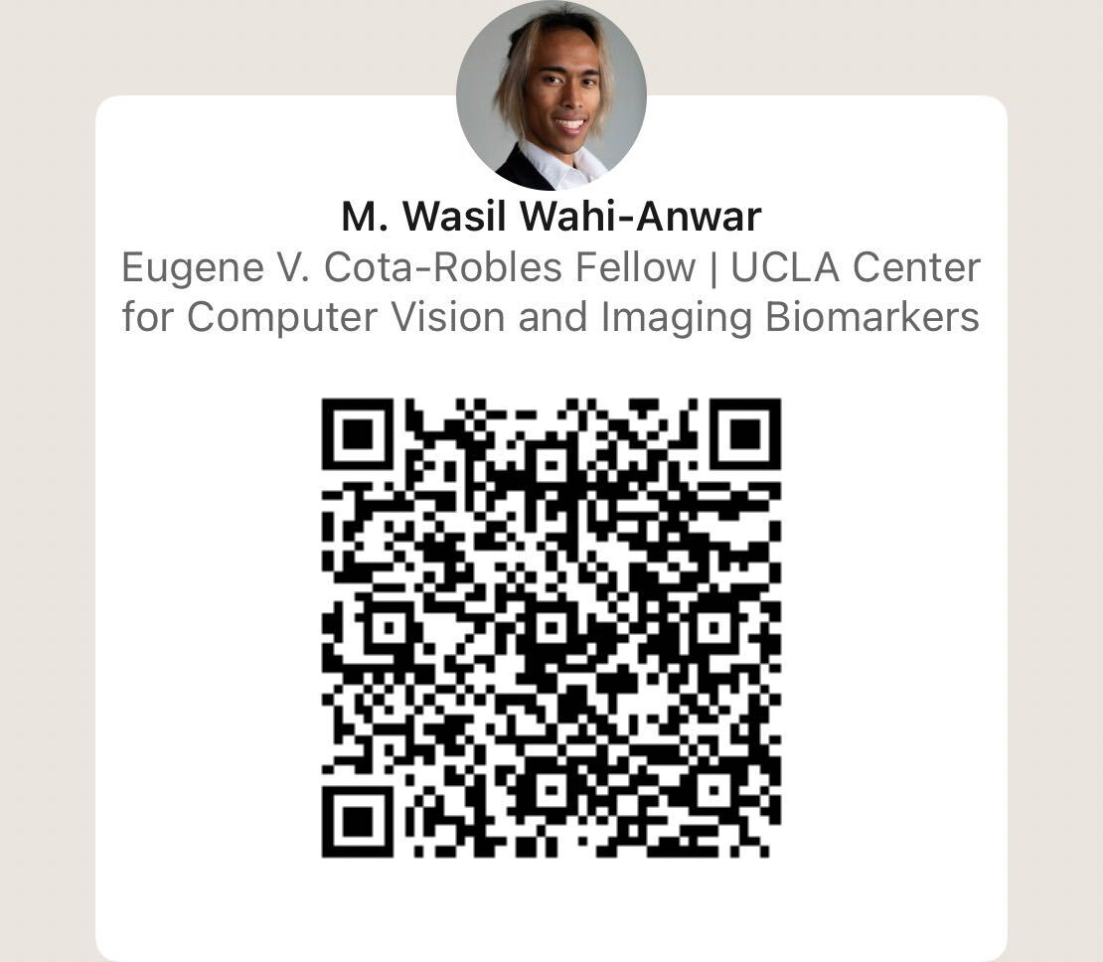
Notes:
2:45-3:00
We are Jin Kim and M. Wasil Wahi-Anwar. DanceCraft makes a dance challenge replayable and gives each attempt a specific next step. Thank you.
The user supplied both team identity and QR images. Preserve their original appearance and proportions. Repository: https://github.com/jink-ucla/DanceCraft. The repository is private for now and will require a separate public-release decision.

